Slide 2
Scientist Activity
Close your eyes for a moment and picture a scientist. What comes to mind when you do this?
Take out a piece of paper and a pencil and spend the next five minutes drawing the image in your head.
Notes:
Facilitator Notes:
Welcome to our session, Breaking Barriers: Dispelling Career Misconceptions. As we start today’s session, we want to open with a brief activity. Please grab a piece of paper and a pen or pencil to help you complete this task. The instructions are here on the first slide (Read instructions)
You can work on this task as we discuss our session goals and objectives for today!
Hello everyone! Welcome to our session, Breaking Barriers: Dispelling Career Misconceptions. As we start today’s session, we want to open with a brief activity. Please grab a piece of paper and a pen or pencil to help you complete this task. The instructions are here on the first slide: Close your eyes for a moment and picture a scientist. What comes to mind when you do this?
Take out a piece of paper and a pencil and spend the next few minutes drawing that image in your head.).
You can work on this task as we discuss our session goals and objectives for today!

Slide 3
Breaking Barriers
Dispelling Career Misconceptions
Notes:
Facilitator Notes:
We are so happy to have you all join us for our session: Breaking Barriers: Dispelling Career Misconceptions. In the next few slides, we will cover our essential question for today’s session, our objectives and session norms, and then revisit our opening activity.

Slide 4
Essential Question
How do you overcome career misconceptions in a virtual world?
Notes:
Facilitator Notes:
If you are just joining us, we are glad you are here! We have an opening activity to work on as we review our EQ and objectives today. Those instructions will be posted again with a few minutes of work time in just a moment. Our Essential Question to keep in mind throughout this presentation today is “How do you overcome career misconceptions in a virtual world?”

Slide 5
Session Objectives
Explore personal and professional career misconceptions.
Design a virtual career exploration program that breaks career stereotypes.
Implement new career exploration strategies in your program or school that help break down the barriers and misconceptions of career clusters.
Notes:
Facilitator Notes:
To support our essential question, here are our session objectives: READ OBJECTIVES.
Explore personal and professional career misconceptions.
Design a virtual career exploration program that breaks career stereotypes.
Implement new career exploration strategies in your program or school that help break down the barriers and misconceptions of career clusters.

Slide 6
Session Norms
Share your ideas with the group.
Your participation is desired and valued.
If you’re able, we encourage you to turn your camera on during this session.
Notes:
Facilitator Notes:
For our session norms - We encourage discussion and dialogue in this session! Feel free to unmute and share verbally when we have opportunities for feedback. You can also use the chat to contribute feedback. Your participation is greatly appreciated, and will help navigate our discussions and learning for today. There will be several opportunities for your feedback and thoughts - we look forward to learning from each other during this session.

Slide 7
Scientist Activity
Close your eyes for a moment and picture a scientist. What comes to mind when you do this?
Take out a piece of paper and a pencil and spend the next five minutes drawing that image in your head.
Notes:
Facilitator Notes:
Here are the instructions again for the activity you are working on (review). We want to make sure everyone has a couple of minutes to complete these quick drawings or sketches. GIVE 1-2 additional minutes of drawing time.

Slide 8
Show Us Your Scientists!
Access the Padlet to share your scientist with the group!
  Scan the QR code with your phone, or click the link in the chat.
  Click the plus sign (+) at the bottom right of the Padlet.
  Select the camera icon.
  Take a photo of your drawing!
As others are adding their drawings, take some time to view them.
  Are there similarities?
INSERT QR CODE HERE
Notes:
Facilitator Notes:
Alright! As we get into our session information, we want to see your scientists! It’s okay if you’re still finishing these up - go ahead and make your last detail on your image and start adding them on our padlet as soon as you get to a stopping point - they don’t have to be complete, just enough to show your idea that you have to the best of your ability within the time we have had to work on them this morning. Please access the padlet by using the link in the chat, or the QR code on your phone. If a password is needed, please type NCCEP (all caps). You will click the + sign in the bottom right hand corner of the padlet screen. This will open a sticky note. You will click the camera icon and take a picture of your drawing. Click off of the sticky note on to the background of the padlet for it to be submitted. We encourage as many participants to share their drawings as possible. As others are adding their drawings, take some time to view them. Do you notice any similarities? Drop your thoughts in the chat.
Drop the Padlet link into the chat for participants
INSERT PADLET HYPERLINK HERE
Stop sharing the presentation and share the Padlet screen with the participants
As you are putting your thoughts in the chat, we are going to share the Padlet on the screen with everyone so we can all see the scientists you shared with us. If you would like to share your thoughts or any details about how you created your scientist, please add your comments to the chat or unmute yourself to share. (Mentoring team, share some observations) 2-3 minutes.

Slide 9
Research
Scientists are human—they’re as biased as any other group. But they do have one great advantage in that science is a self-correcting process.
-Cyril Ponnamperuma
Notes:
Facilitator Notes:
Thank you all for your feedback and ideas. We wanted to share some research with you that supported our activity today and helps frame our discussion for this session: (SHARE RESEARCH)
“Adults in many nations associate science with men much more than with women (e.g., Miller, Eagly, & Linn, 2015; Smyth & Nosek, 2015). To investigate the origins of these associations, researchers have studied children's perceptions of scientists over several decades. For instance, children were asked to draw a scientist in a landmark study of nearly 5,000 elementary school students who were mostly from the United States and Canada (Chambers, 1983). The drawings, collected from 1966 to 1977, almost exclusively depicted male scientists, often with lab coats, eyeglasses, and facial hair, working indoors with laboratory equipment. Only 28 children drew a female scientist (0.6% of the sample), suggesting strong gender‐science stereotypes linking science with men. This limited view of scientists might have restricted children's science‐related educational and career aspirations, to the extent that children did not identify with such depictions.” The full article can be found in your Files tab on Pathable labeled as HANDOUT 1 if you would like to learn more about this after our session today.

Slide 10
What do real scientists look like?
Notes:
Facilitator Notes:
So, what do real scientists look like? Let’s take a look at some examples.

Slide 11
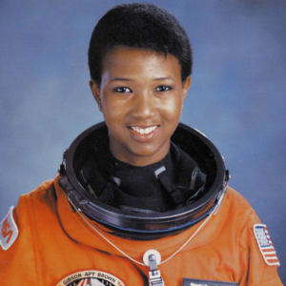
Mae C.
Jemison
Notes:
Facilitator Notes:
They look like Dr. Mae C. Jemison, the first African American female astronaut and the first African American woman in space in 1992.
NASA. (2017). Mae C. Jemison [Photograph]. https://www.biography.com/astronaut/mae-c-jemison

Slide 12
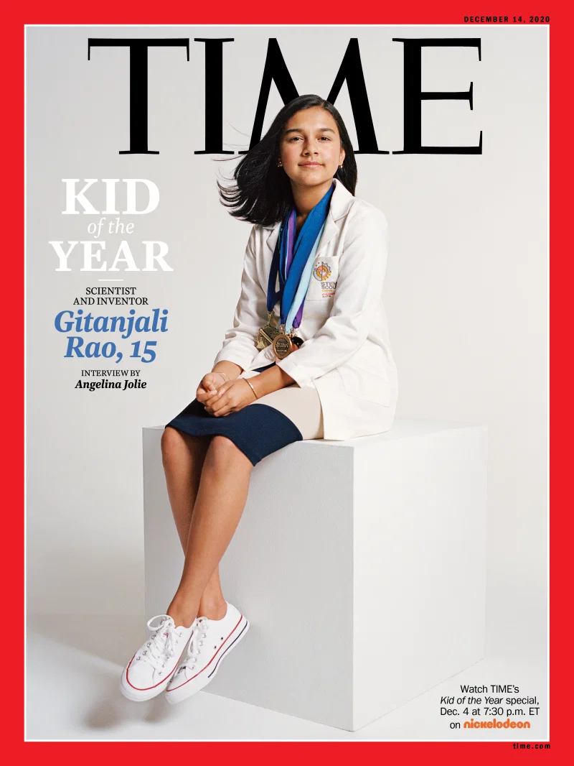
Gitanjali
Rao
Notes:
Facilitator Notes:
They look like (Ge-TAN-geli Row)Gitanjali Rao , the first ever Time’s Kid of the Year at 15, who, with her work using technology tackles issues ranging from contaminated drinking water to opioid addiction and cyberbullying, AND about her mission to create a global community of young innovators to solve problems the world over.
Hamza, S. (2020). Kid of the year [Photograph]. Time. https://time.com/5916772/kid-of-the-year-2020/

Slide 13
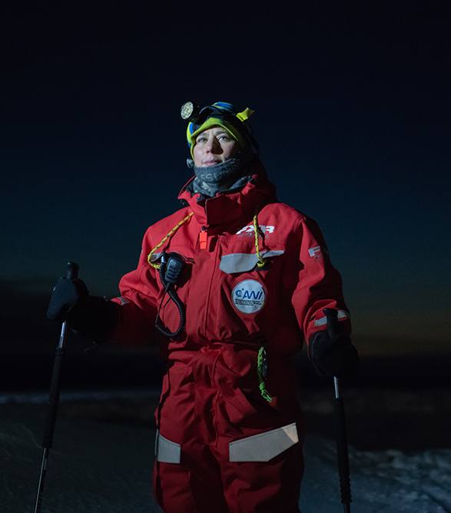
Verena Mohaupt
Notes:
Facilitator Notes:
They look like Verena Mohaupt, the logistics coordinator for a year-long mission known as the Multidisciplinary drifting Observatory for the Study of Arctic Climate (MOSAiC) — the largest Arctic research expedition in history.
Horvath, E. (2020). Nature’s 10: Ten people who helped shape science in 2020 [Photograph]. Nature. https://www.nature.com/immersive/d41586-020-03435-6/index.html

Slide 14
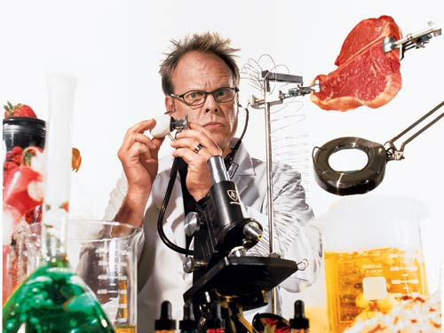
Alton Brown
Notes:
Facilitator Notes:
They look like Alton Brown, a chef, and sometimes called a “food scientist,” who has revolutionized the way we learn to cook our food! Another example of a scientist in this industry would be someone like Wylie Dufresne, a chef and leading proponent of molecular gastronomy. Molecular gastronomy is the scientific approach of nutrition from the perspective of physics and chemistry.
Lewis, M. (2004). The thermochemical joy of cooking [Photograph]. Wired. https://www.wired.com/2004/06/cooking/

Slide 15
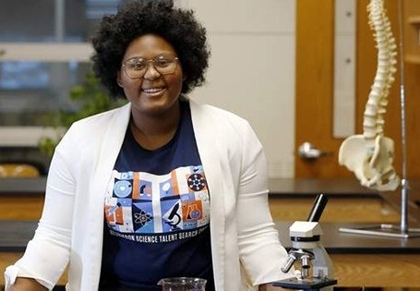
Daisa Taylor
Notes:
Facilitator Notes:
They also look like Daisa Taylor, a high school senior from Iowa who recently won $25,000 at the prestigious Regeneron Science Talent Search for her invention of cost-effective surgical sutures that change color to detect if a patient’s wound is infected.
Daisa Taylor (2021). Black teen invents cost effective method to detect surgical infections [Photograph]. The Florida Star. https://www.thefloridastar.com/articles/black-teen-invents-cost-effective-method-to-detect-surgical-infections/

Slide 16
Billy
Malan
Notes:
Facilitator Notes:
Billy Malan - a pediatric nurse in Oklahoma City
Malan, B. (2021). Pediatric nurse.

Slide 17
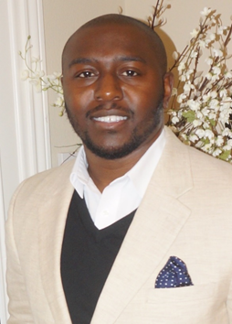
Robbie
Ferguson
Notes:
Facilitator Notes:
Robbie Ferguson - Engineering specialist
Ferguson, R. (2021). Engineering specialist.

Slide 18
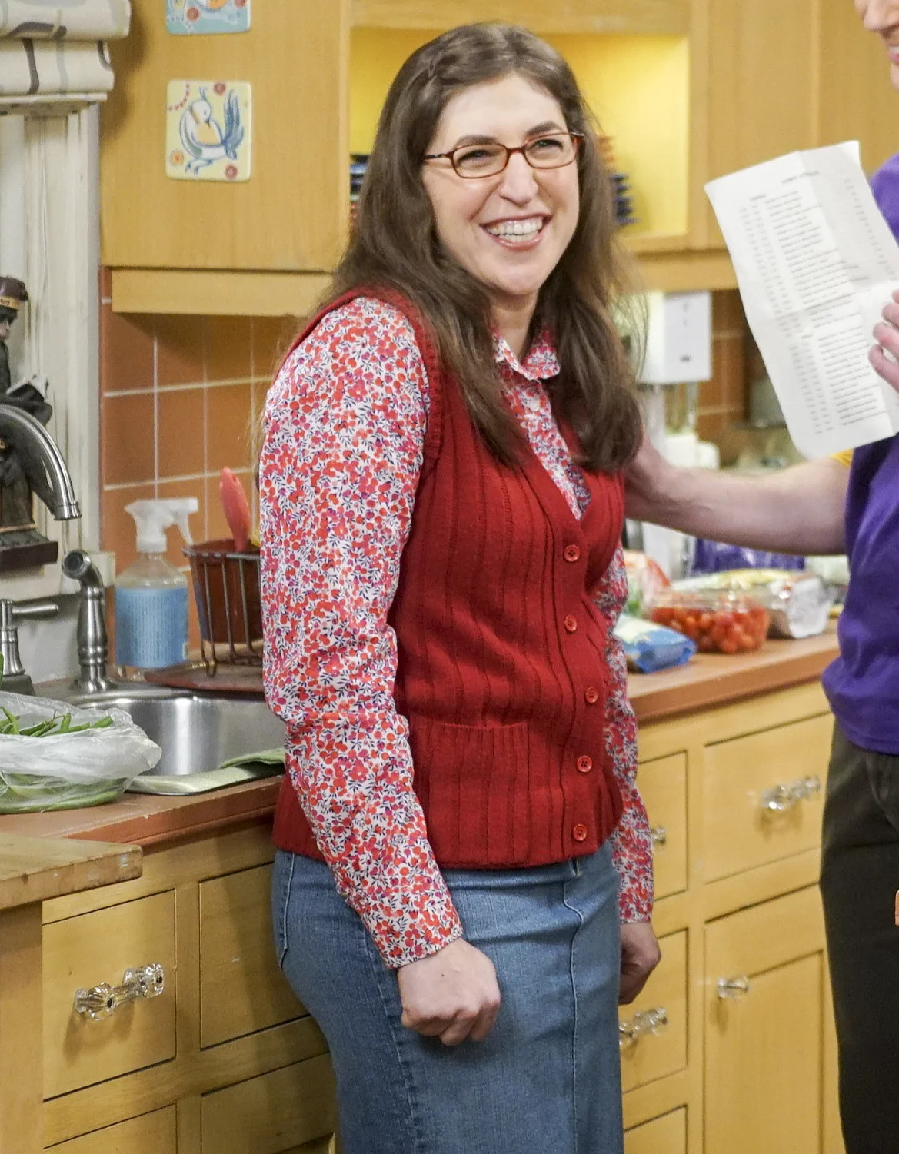
Mayim
Bialik
Notes:
Facilitator Notes:
(MYim BEEalik) - Mayim Bialik - you might recognize her from her role as neuroscientist Amy Farrah Fowler on The Big Bang Theory. She isn’t just an actress on well-known tv show - she earned her Ph.D. in neuroscience from UCLA.
Guglielmi, J. (2018). Mayim Bialik on The Big Bang Theory ending: 'Am I happy? Of course not' [Photograph]. People. https://people.com/tv/mayim-bialik-not-happy-big-bang-theory-ending/

Slide 19
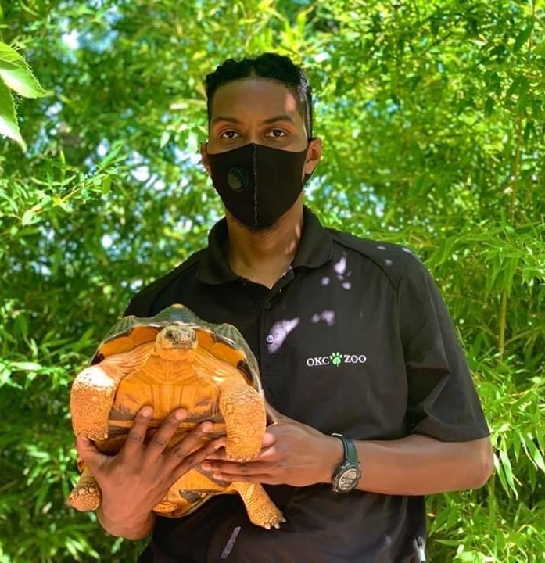
Renaldo
Woodson
Notes:
Facilitator Notes:
Renaldo Woodson - Senior herpetologist at the OKC Zoo
Woodson, R. (2021). Senior herpetologist.

Slide 20
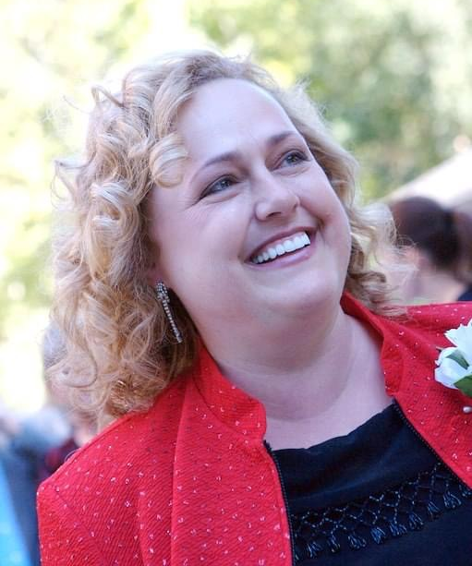
Beth
Golnick
Notes:
Facilitator Notes:
Beth Golnick - Is a nurse with certification as an assisted living director
Golnick, B. (2021). Assisted living director.

Slide 21
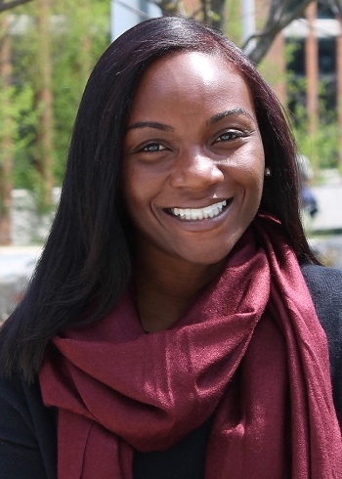
Kizzmekia S. Corbett
Notes:
Facilitator Notes:
Dr. Kizzmekia S. Corbett - is immunologist at the US National Institutes of Health and helped develop an mRNA-based vaccine for COVID-19.
These people are all amazing scientists, but are also just a few examples of who is out there in the world as a scientist.
Corbett, K. (2021). Immunologist.

Slide 22
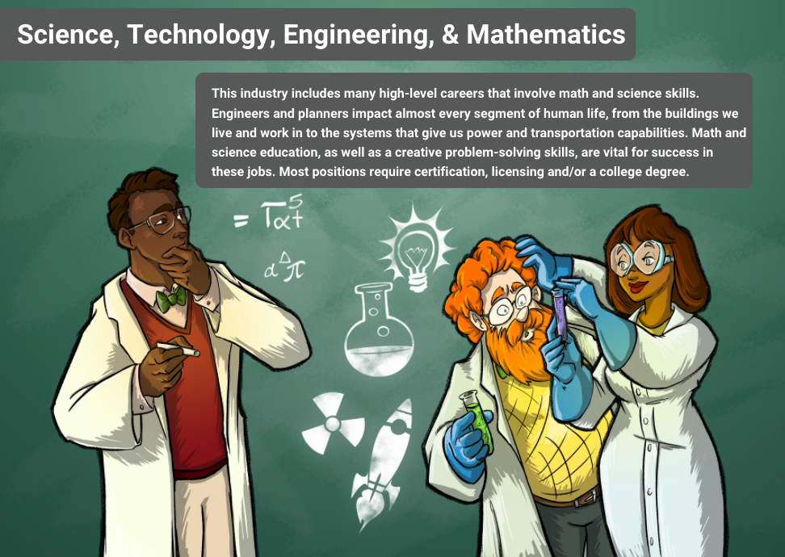
Notes:
Facilitator Notes:
Even with this knowledge and understanding, we still stereotype the fields we’re teaching our students all about. This is an example of a graphic from an infogram that was developed to share career opportunities information with students. As you can see, there are a lot of things about this image that we know are related to scientists, but we still have work to do in order to break our barriers and misconceptions of who scientists are.

Slide 23
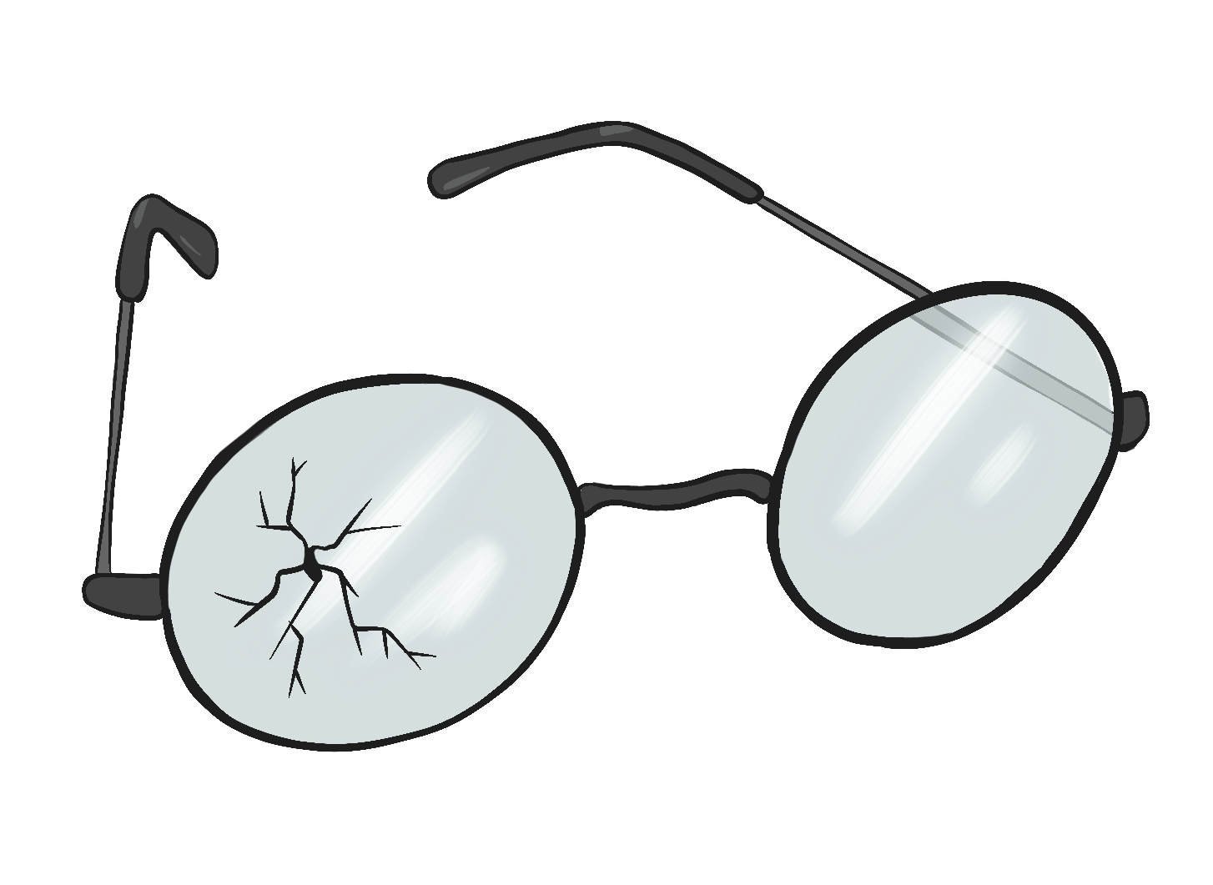
Checking our Lenses for Cracks
Geographic Location
Religion
Gender
Ethnicity
Race
Age
Education
Sexual Orientation
Marital Status
Notes:
Facilitator Notes:
To do this, we need to be Checking our lenses for cracks - in a lot of different areas.
Religion
Race
Marital Status
Geographic Location
Ethnicity
Gender
Age
Education
Sexual Orientation
These are just some of the biases to think about when addressing careers and opportunities with students. As a mentoring team, we have discussions about checking our own lenses and how we can also help share activities and information with schools and students to help break career misconceptions.

Slide 24
Discussion
How has your view of scientists changed over time?
After seeing scientists in different fields, including molecular gastronomy, has your view changed in terms of what a scientist “looks like”?
Thinking back to your drawing, how might you now alter your image of a scientist?
Notes:
Facilitator Notes:
Discussion questions - Let’s have some discussion. As we ask these questions, please feel free to voice your thoughts in the chat - you can also raise your hand using the reactions, or unmute to share. (READ QUESTIONS)
Thank you for your participation - we are just getting started with this very important conversation today.

Slide 25
Collaborative Word Cloud
What are some words that come to mind when you think of the agriculture career field?
INSERT QR CODE HERE
Notes:
Facilitator Notes:
Drop the Mentimeter link into the chat for participants
INSERT HYPERLINK HERE
When we envision and discuss career fields, what we visualize in our minds and what we say doesn’t always align with the reality of that career. Oftentimes, what we believe to be a comprehensive view of a field may in fact be only a small fraction of what exists.
Using the following mentimeter QR code or link we’ve dropped in the chat, share some words that come to mind when you think of the Agriculture Career Cluster.
Feel free to enter more than one keyword. Don’t worry if someone else has already sent in a keyword you like. Words can be repeated.
Stop sharing the presentation and share the Mentimeter screen with the participants
Notice that some words are bigger than others. These are words that might have been mentioned more often. Did the most common words match your responses? This is something you can do with your students that will help open their eyes to a more global view of the clusters. There is more in these areas/fields then what is just in your area.

Slide 26
Discussion
Why are these the words that come to mind when you think of the agriculture field?
What past experiences might have affected the words you used to describe the agriculture career field?
Notes:
Facilitator Notes:
Let’s discuss this a little more in depth together. Drop your thoughts in the chat - you can also unmute yourself and share aloud.
(READ QUESTIONS)

Slide 27
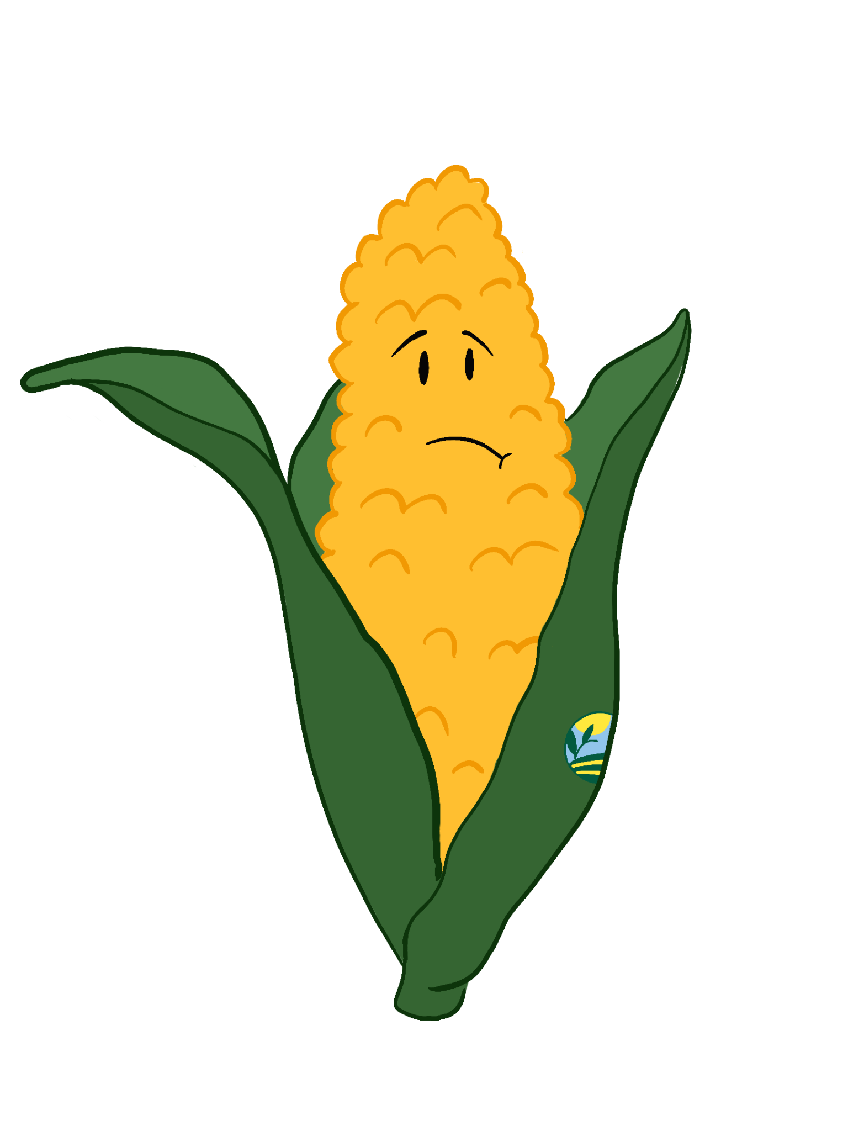
Biases and Misconceptions Reflection
We’ve had to overcome our own misconceptions through:
Consistent assessment of our career services.
Conversations with speakers.
Writing career activities.
Notes:
Facilitator Notes:
We had to ask ourselves these questions as well to help us grow. We have accomplished this through consistent assessment of some of our career services, such as our virtual career expos and student-led career activities. One example of our team having to address career misconceptions took place while listening to one of our Career Expo speakers share about her experiences working in agriculture and how misunderstood she believed this cluster to be. We as a team had to adjust our mindsets, address misconceptions, and continue to learn and grow.
Another example took place as we developed an education career cluster activity, as we realized that this field also encompassed more than we originally considered. When we think of education, because of our professional backgrounds, we thought of teachers in a classroom setting. But as we worked on this cluster, we realized that this cluster also encompasses individuals who train or teach other people in and outside of the classrooms.

Slide 28
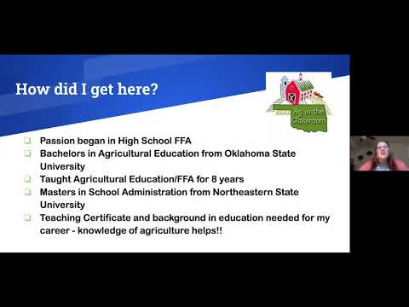
Notes:
K20 Center. (2021, July 28). Oklahoma ag in the classroom state coordinator-Emily Ague-Zoom into your career
[Video]. YouTube. https://youtu.be/eyxd5BDNhmw

Slide 29
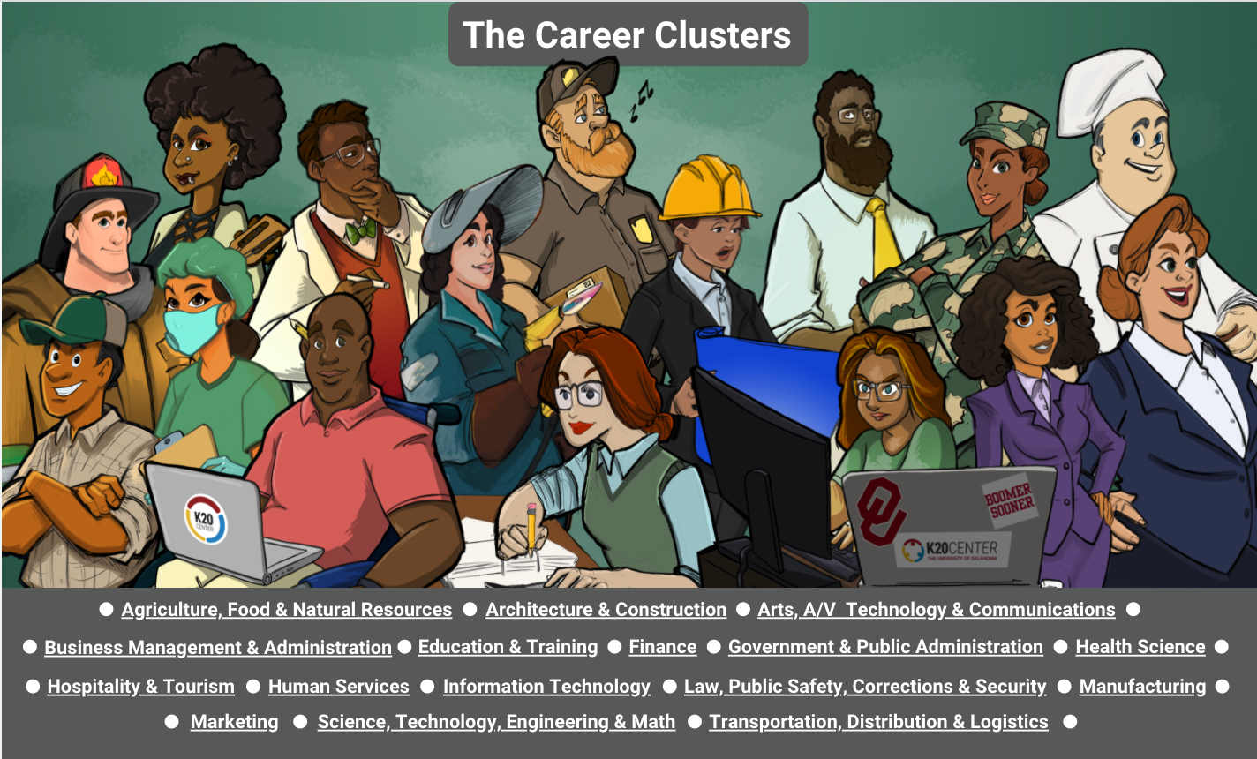
Notes:
Facilitator Notes:
In conversations and work on this project we developed an infographic.
Drop the infogram link in the chat:
https://infogram.com/k20center-careerclusters-1hdw2jp8e9n1x2l?live
Take a few minutes to look over the first iteration of the infogram that we have developed. As you look through the infogram, take some time to consider the visuals that are there, what would you change? How might you make this more global? As you consider these questions, feel free to submit responses in the chat.

Slide 30
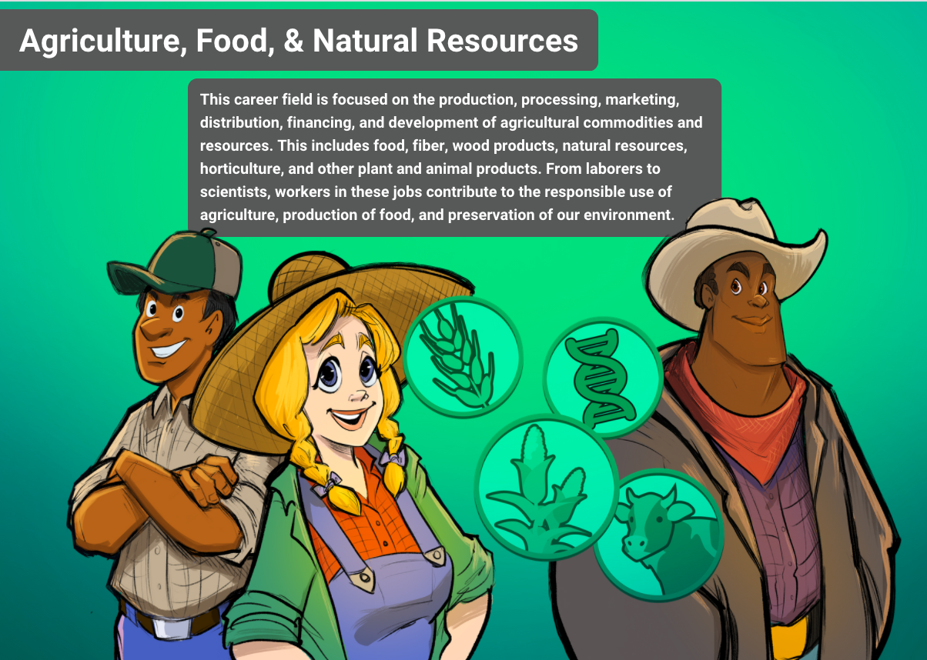
Notes:
Facilitator Notes:
One aspect our team noticed is in the Agriculture cluster. The visual representations embody the belief that this cluster’s main focus is farming, when we learned from our speaker that farming actually makes up a small percentage of this field. We would like to adjust the visual to better represent the career diversity present in this cluster.
While this infogram is an amazing resource that we are grateful to have, there is always room for continual growth as we adjust our mindsets.
We are going to let you look closer at the infographic by moving into breakout rooms for small group discussion of these questions.

Slide 31
Breakout Room
Use the infographic to continue discussing these questions in small groups:
What do you like?
What would you change?
How might you make this more global?
Select one main takeaway and someone to share this takeaway with the whole group.
Notes:
Facilitator Notes:
We are going to let you look closer at the infographic by moving into breakout rooms for small group discussion of these questions.
Only going to have five minutes in the breakout rooms and then you will bring that feedback to the whole group.

Slide 32
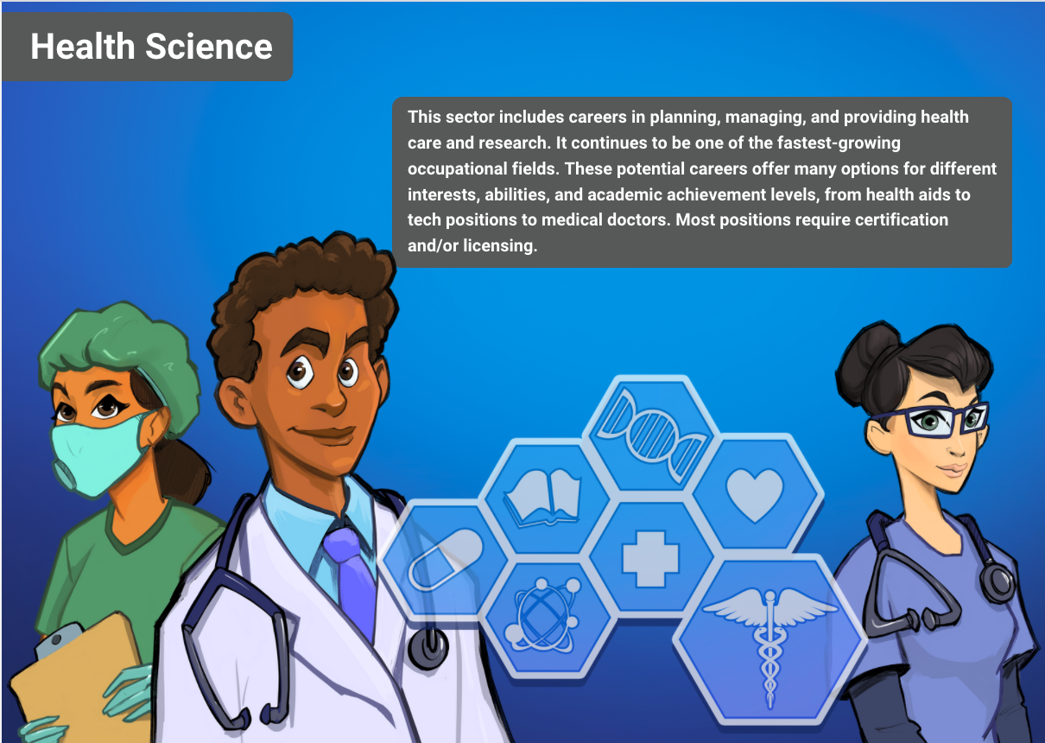
Notes:
Facilitator Notes:

Slide 33
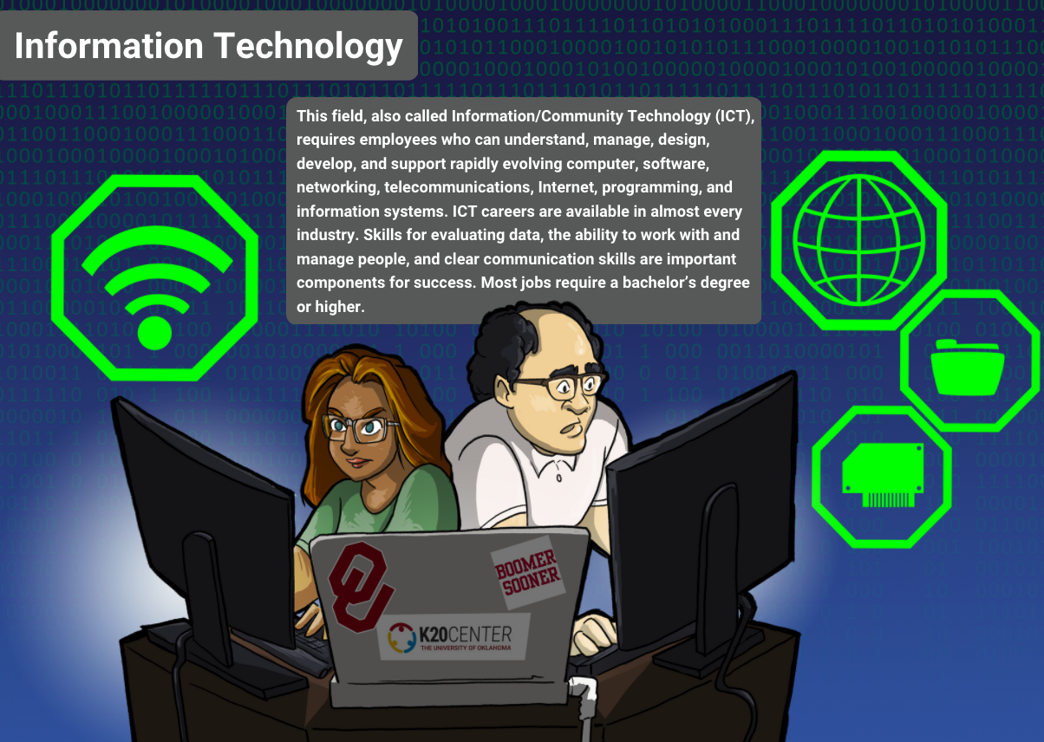
Notes:
Facilitator Notes:

Slide 34
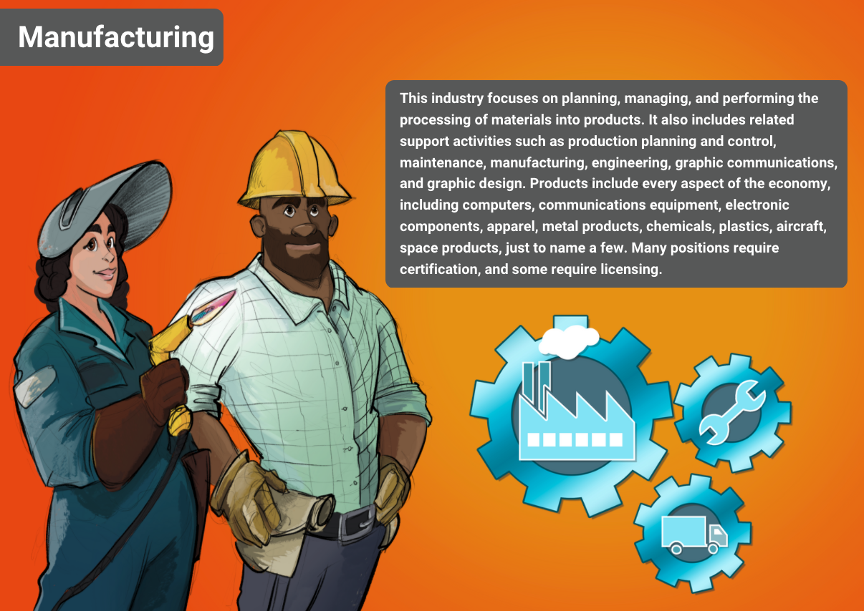
Notes:
Facilitator Notes:

Slide 35
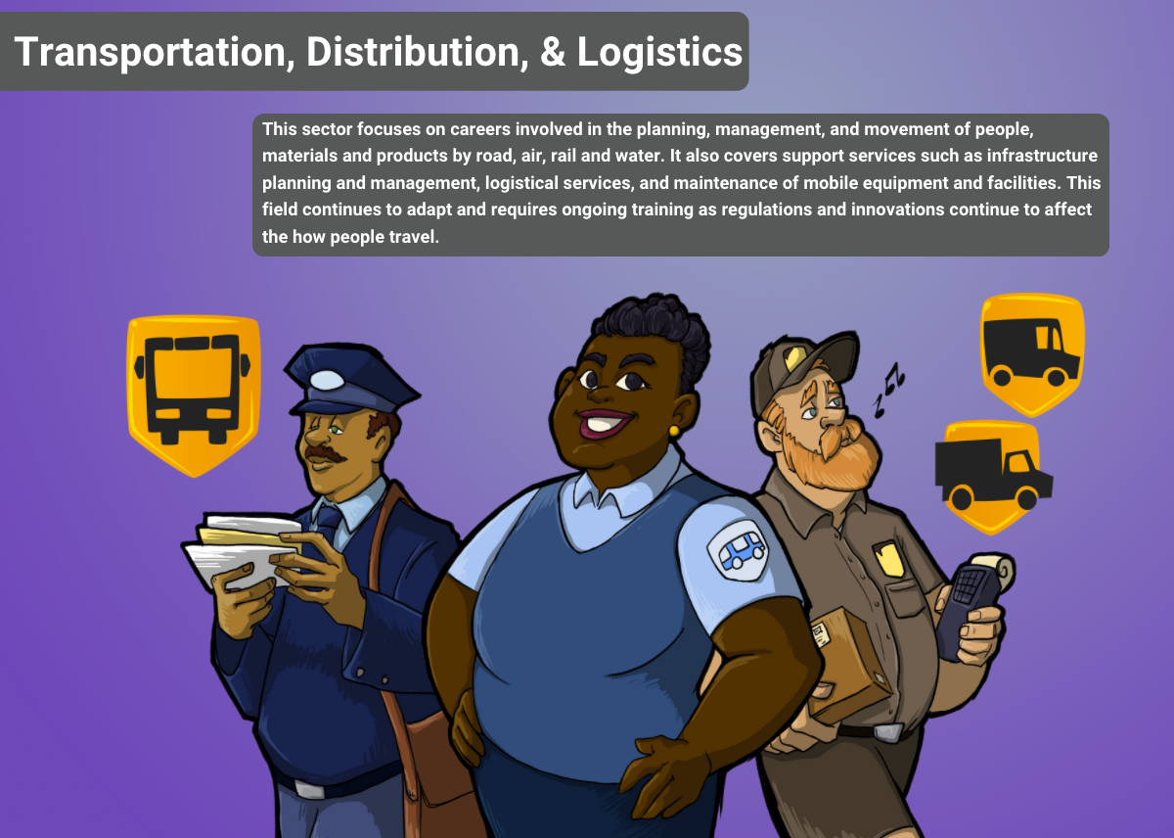
Notes:
Facilitator Notes:

Slide 36
Action Plan
Career field/cluster | What jobs are commonly associated with this field? | What are common beliefs and stereotypes associated with this career field? | What activities or tools can be used to break down the barriers and misconceptions for the field?
Agriculture, Food, & Natural Resources | Farmers, ranchers, food manufacturers | People work outside with animals or nature; commonly associated with men; commonly associated with rural communities; work with your hands; messy work. | We had a speaker from this career field who is not the stereotypical “ag” worker; looked through the career cluster infogram to identify misconceptions after the career talk; reevaluated the range of this cluster.
Notes:
Facilitator Notes:
Here is an action plan template for you to help guide you to start your own action plan. Though our template uses the agricultural field, you can fill in this template with any number of careers to help answer student questions about career misconceptions. These questions can be used to help break the common misconceptions of careers to further increase your students' post-secondary awareness.

Slide 37
Discussion
After hearing about our career exploration program, what ideas do you have for how to help break the barrier for your students?
Why do you think it’s important for students to hear from professionals that, at first glance, don’t seem to fit the standard mold for that career cluster?
Notes:
Facilitator Notes:
Reflection Questions
After hearing about our career exploration program (the short video we watched or our infographics), do you have any ideas on how to help break the barrier for your students?
Why do you think it’s important for students to hear from professionals that, on first glance, do not seem to fit the standard mold for that career cluster?
If anyone has any thoughts that have come to mind about these discussion questions, feel free to share your thoughts in the chat or share out loud. Your input might help others come up with ideas of their own! We will spend just a couple of minutes reflecting on those before we finish up.

Slide 38
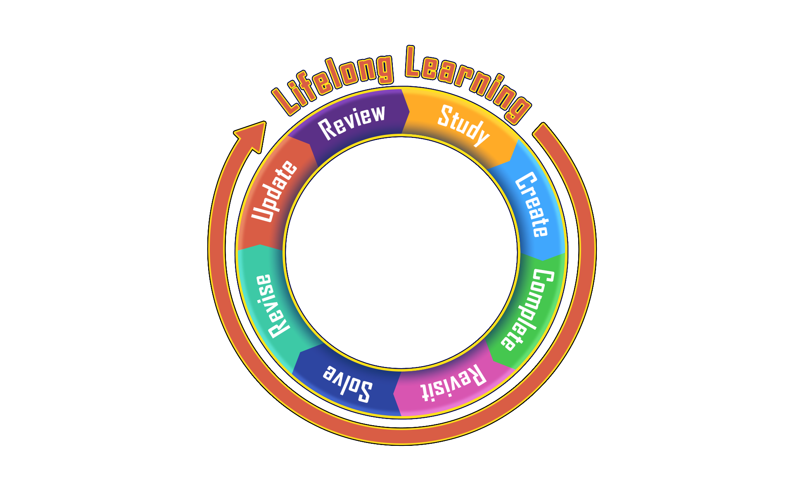
Lifelong
Learning
Notes:
Facilitator Notes:
We are always a lifelong learner so when you think you’re done, you always end up going back to it to revisit/revise how it looks, is it up to date? We might be considered “experts” on this topic but we are never done learning. Everytime we have a new set of speakers we always find someone who transforms the way we see that career cluster.
It’s good to be vulnerable and ask others’ thoughts to make improvements and have meaningful/thoughtful discussions. The best way we can advocate for our students is for us to be open.

Slide 39
Six-Word Memoir
Reflect on today’s session and use six words to describe your reflection.
This can be about something you learned, or it can be about your action plan.
Use the code to access the Menti and add your Six-Word Memoir.
INSERT QR CODE HERE
Notes:
Facilitator Notes:
Now that we are closing out our session we want to finish with a quick reflection strategy called Six Word Memoirs. This is a strategy of brevity. You can say a lot briefly. Six-Word Memoirs does just that. Describe your feelings on this topic or your action plan in six words. Saying less requires identifying essential facts. It means thinking about word choice. It also requires eliminating unimportant information.
We will have you put your six word memoir into a mentimeter and we will share your responses on screen.
Drop the Mentimeter link into the chat for participants
INSERT HYPERLINK HERE
Stop sharing the presentation and share the Mentimeter screen with the participants
Since you are limited in word count, seeing other participants' memoirs might strike a chord you did not think about. We will give you just a couple of minutes to complete your reflection.

Slide 40
Questions?
Email us at
gearupmentor@groups.ou.edu
Notes:
Facilitator Notes:
Thank you all so much for attending today’s session! I wanted to take this time to review a few things before we open up for questions -
We encourage you to use this template to help with any career program planning you might work on. There are several resources on page 2 of that document that you might find helpful including our Zoom Into Your Career video playlist on YouTube, and link to our LEARN website where you can find a variety of career exploration student activities we have developed that are free and available for anyone to access/use.
You can find a general guide for virtual career talks in the attachments. If you’re considering a virtual career program or have any questions about the format of how we go step-by-step to host our ZIYC sessions, that is a great place to look. There is also a volunteer guide for speakers that volunteer to participate.
We have really appreciated this opportunity to learn from each other today. Whatever program you might implement or information you take away from this, remember to keep your students at the forefront of planning - even including them in the discussions and getting their feedback on how to create/implement a virtual career program to help break barriers and dispel career misconceptions, and even the careers/speakers they would like to hear from, will help you keep a student-centered focus.
We will open up the session for any questions - you can use the chat or unmute. We have also included our team email in case you have any additional questions to send us directly, or would like to participate as a volunteer in one of our ZIYC expos. Thank you all again!

