Slide 2
Make an Escape: Career Exploration Using Digital Breakouts
K20 Center - Mentoring Team

Slide 3
Essential Question
How can integrating technology into a learning environment shape students’ career exploration?

Slide 4
Session Objectives
Engage in a digital breakout that integrates career exploration with technology.
Analyze the resources and determine how they can be incorporated into the curriculum.

Slide 5
GEAR UP Goals
GEAR UP for the FUTURE, GEAR UP O+K=C, GEAR UP for MY SUCCESS
Goals include the following:
Increased cohort student engagement in learning and percent who are academically prepared for PSE upon graduation;
Increased high school graduation rate and PSE enrollment rates;
Increased students’ and families’ knowledge of PSE options, preparation, and financing.
Cohort students are currently in 9th & 10th grade

Slide 6
Always, Sometimes, Never True
Read each statement carefully and determine whether it is one of the following:
Always True - Thumbs up
Sometimes True - Thumbs to the side
Never True - Thumbs down
Notes:
https://learn.k20center.ou.edu/strategy/145

Slide 7
Always, Sometimes, Never True
Middle school is a key time period to begin more focused career exploration with students.

Slide 8
Always, Sometimes, Never True
Students should know what career they want before enrolling in a postsecondary education institution.

Slide 9
Always, Sometimes, Never True
Businesses want employees with more than a high school diploma.

Slide 10
Always, Sometimes, Never True
People with a college education generally have more careers to choose from.

Slide 11
Always, Sometimes, Never True
Over the course of a lifetime, a college graduate will earn twice as much as a high school graduate.

Slide 12
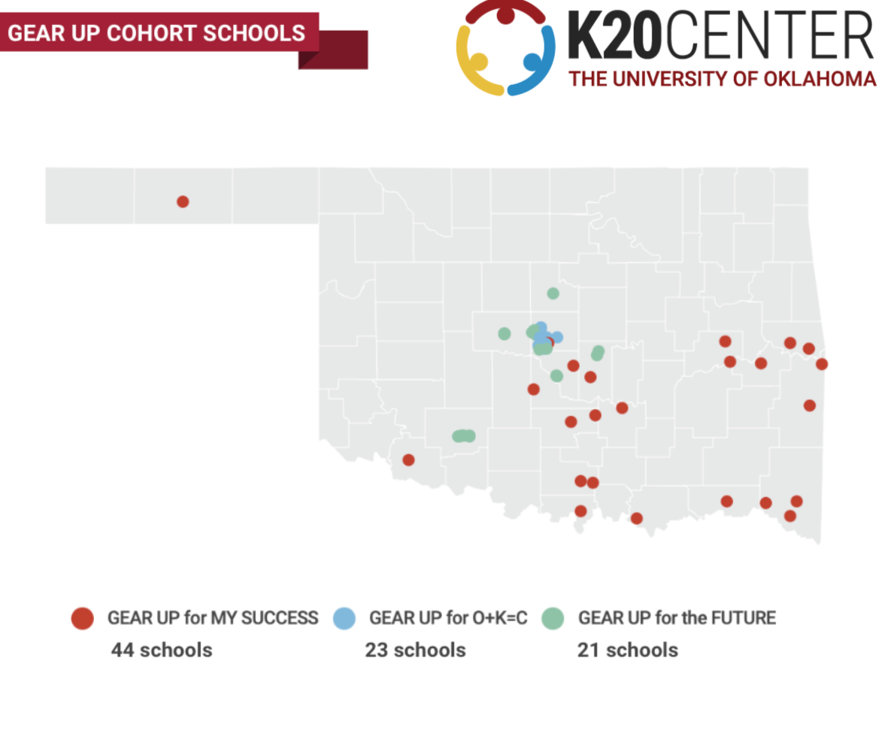

Slide 13
Our Work
Zoom Into Your Career
Career Café Events
College2Career Forum
Career Cluster Student Activities
Career Exploration Resources
Peer Mentoring Programs

Slide 14
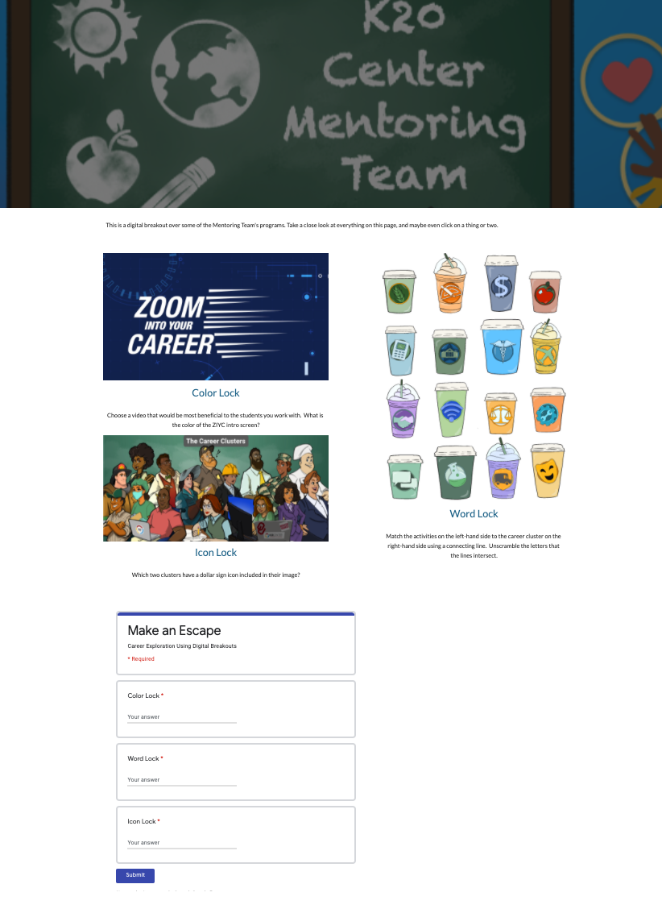
Digital Breakout
Make an Escape: Career Exploration Using Digital Breakouts

Slide 15
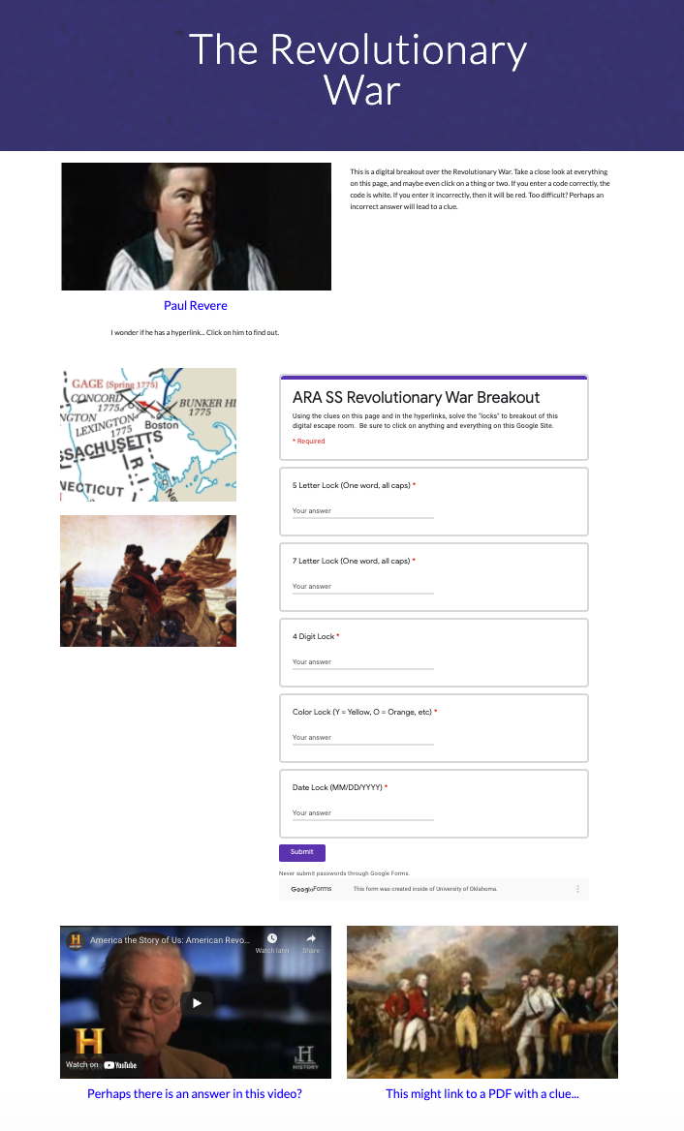
What are Digital Breakouts?
Have you ever participated in an escape room?
Think of this as a digital version.
Purchase kits from Breakout EDU or create them for free using G-Suite.
Locks
Color Locks
Directional Locks
Word Locks
Date Locks

Slide 16
Career Exploration
With your partner, try to “break out!”
tinyurl.com/K20Breakout
Use the Digital Breakout handout to help you keep track of the activity.
Notes:
https://sites.google.com/ou.edu/makeanescape/home

Slide 17
I Notice, I Wonder
What did you...
Notice?
Learn?
Like?
Find helpful?
Wonder?
How can you use any of these resources with your students?
Notes:
https://learn.k20center.ou.edu/strategy/180

Slide 18
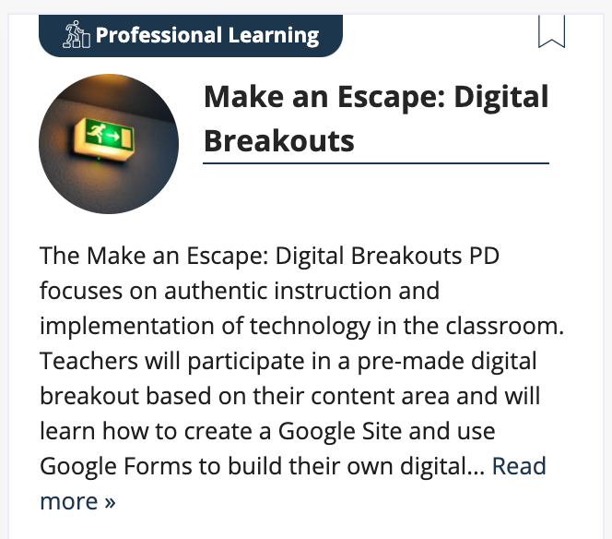
Additional Resources
Notes:
https://learn.k20center.ou.edu/professional-learning/47

Slide 19
How am I Feeling/What am I Thinking?
Draw a diagonal line on your sticky note to make halves.
Side 1: Draw a picture that represents how you feel after the session.
Side 2: Write a sentence that explains what you understand after the session.
Notes:
https://learn.k20center.ou.edu/strategy/187

Slide 20
Session Objectives
Participants engage in a digital breakout that integrates career exploration with technology.
Participants analyze the resources and determine how they can be incorporated into the curriculum.

Slide 21
GEAR UP Schools
If you work with any of the following schools, please come speak to us at the conclusion of this session.
Notes:
Alex-

Slide 22
Questions & Contact
Email us at gearupmentor@groups.ou.edu
Notes:
Alex-

