Slide 2
Interactive Technology for Student-Centered Learning
Name, Title
Name, Title

Slide 3
How can we use technology to create student-centered learning experiences?
Notes:
This is the essential question for the session. Pose it and briefly allow participants to discuss with their table how they have possibly used tech to create student centered learning experiences. Some may summarize what was shared among their table group.

Slide 4
Objectives
Identify components of student-centered learning.
Analyze how the modeled activities and technologies support the identified components.
Explore educational activities and supporting technology that promote student-centered learning.
Apply activities and technologies to specific content areas.

Slide 5


What makes a learning experience student-centered?
In your groups:
Read the provided statements.
Choose 4 to 5 statements that define student-centered learning.
One person from your group shares your selected statements.
Student-Centered Learning Card Sort Google Slide
https://docs.google.com/presentation/d/1NJfN9iZNDQToRyY_mXkcvISBHXy0AhhPtt1g3jQ9l_4/copy
Notes:
Card sort
Divide class into small groups. For this session it would be ideal to have four groups of five or less participants.
Have each group open a copy of the provided Jamboard template and read through the provided statements about student learning.
Select 4 to 5 of the statements about learning on the left and drag them under the question on the right.
After sorting, have each group can share how they sorted to the whole group.

Slide 6

Screen Sharing
Go to www. justcastit.com
Enter your Name
Enter the Session ID
Press Cast My Screen
Choose to share the Chrome Tab
Notes:
Use this slide for touchIT technologies.
For the facilitator watch https://youtu.be/W2nKFu7Jjj0?t=36
After sorting, have each group can cast what they sorted to the larger screen. The screen should be split so that we can see all group maps at the same time and compare them.
TOUCHIT TECH - Just Cast It (https://www.youtube.com/watch?v=W2nKFu7Jjj0) should be the app they use to share their screen.
APP DESCRIPTION:
Just Cast IT Software Cast & Multi-Cast to your TouchIT LED - from TouchIT Technologies
Casting and Multi-Casting is the ability to send a screen from your PC, MAC, Chromebook or Linux machine wirelessly to the Interactive LED.
With Just Cast IT, there is nothing to install on your computers. Simply open the App on the LED, then head over to www.justcastit.com. There is no limit to the number of computers you can cast at the same time.

Slide 7

The Authenticity Framework:
Student-Centered Learning
Read the section titled,
Student-Centered Learning
Highlight the concepts you selected from the Student-Centered Learning Card Sort Google Slide.
Discuss with your group what you highlighted and why.
Notes:
Depending on the time you have and the depth of learning you’d like to go into, provide students with either the “Authenticity Framework and Reflection Tool” or with the “Student-Centered Learning Research-Long version” handout. Allow a few minutes for each person in the group to read and highlight the handout.
If you are using the Authenticity Framework and Reflection Tool, all participants should read the introduction and then skip down to read the section titled “Student-Centered Learning.”
If you are using the Student-Centered Learning-Long Version, consider using the Jigsaw strategy and having each group take a section of the text to read.
When everyone is finished, have the groups take a few minutes to discuss the reading with each other, including which information they highlighted as important and why. When groups are finished discussing, have each group report out what they discussed.

Slide 8
Revise Student-Centered Learning Card Sort Google Slide
After reading, are there any statements you would like to add or remove from your current list?
Notes:
Ask groups to pull up their jamboard again. Have them to take a few moments to consider if they would like to add or remove any statements from their top 4 to 5 they originally chose to best represent student-centered learning.

Slide 9


Represent!
As a group, create a GramIt post for student-centered learning.
Go to Canva.com
(sign-in/create an account using your school’s gmail account)
Select, Classroom Announcement
Create your post using a hashtag (#).
#TwoToThreeWords
Notes:
Next, instruct participants to work within their groups to construct a Tweet Up including a visual representation, and a hashtag summarizing their group’s understanding of student-centered learning based on the reading. Their summary should be no more than one sentence.
Example Response: “Giving choice empowers students to own their learning and construct their own knowledge. #nurturingcriticalthinkers”
Screencast on TouchIt LED: justcastit.com
https://www.google.com/url?sa=i&url=https%3A%2F%2Ficonscout.com%2Ficon%2Fcanva-3823975&psig=AOvVaw037B_Pc9vvH6zX505BwzrP&ust=1640189129079000&source=images&cd=vfe&ved=0CAsQjRxqFwoTCODPoe-i9fQCFQAAAAAdAAAAABAD (canva image)

Slide 10
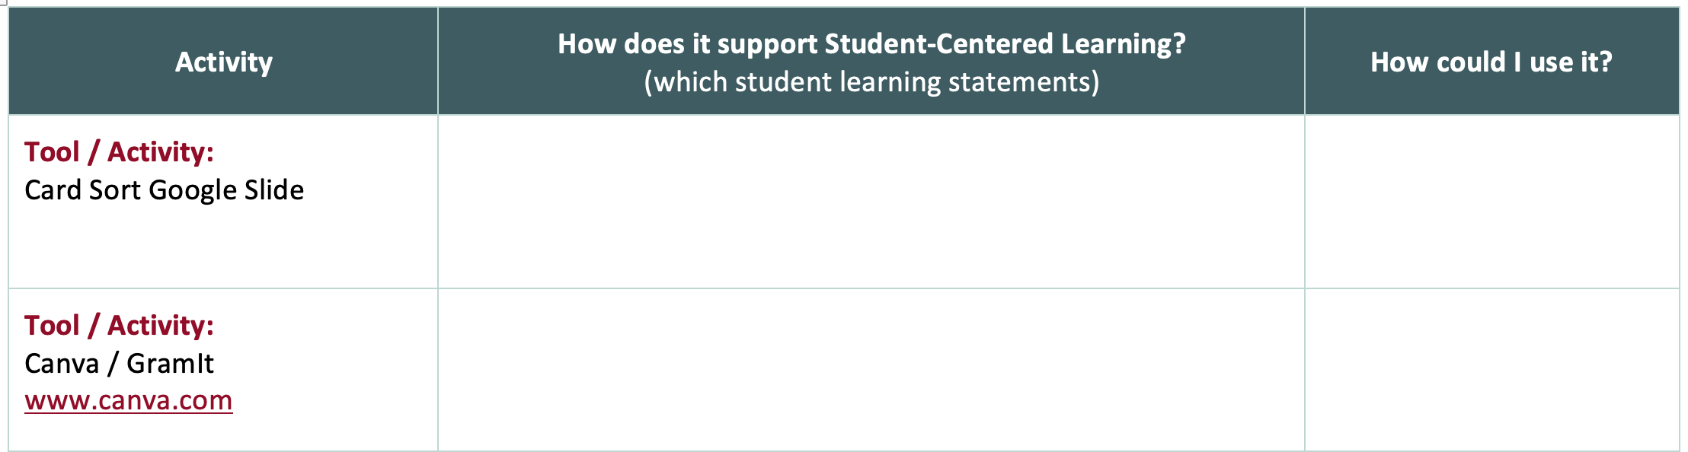
Reflection
How did the tech tool and activities support student-centered learning?
How could they be modified to use in your classroom?
Notes:
Using the provided notes-organizer as a guide, ask participants to take some time to reflect on the Google Slides card sort activity and the Canva GramIt activity. They will specifically note how these activities facilitated student-centered learning and ideas for how they could use these activities in their own classrooms.

Slide 11
Student-Centered Activities and Tech Brainstorm
In your group, brainstorm another activity using an interactive technology that supports the components of student-centered learning.
Add the tech tool and activity to the note sheet.
Record the student-centered learning connection.

Slide 12

Strategy Harvest
Explore Tech Tools from your agenda.
Pair selected tech tools with existing or new activities/lessons.
Record how they support student-centered learning.
Record how you will use the activity and tech tool with students.

Slide 13

Triangle, Square, Circle
Three components of student-
centered learning.
How do the tech and activities square with your curriculum?
What questions are still circling in your head about how the integration of tech supports student-centered learning?

Slide 14
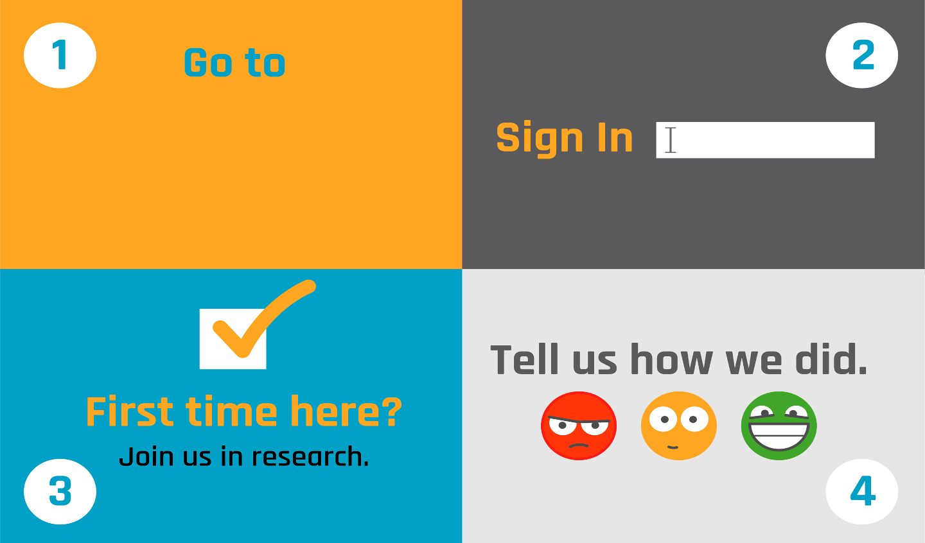
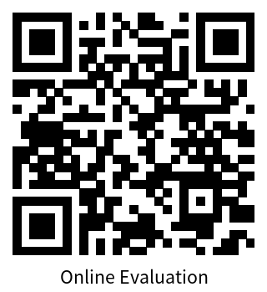
trek.k20center.ou.edu/oe/34061
Google Sign-in (school email)
(No Participant ID is required)

