Slide 2
Study Skills and Self-Regulation

Slide 3
Essential Question
How can students and teachers optimize self-productivity?

Slide 4
Lesson Objectives
foster self-responsibility among students
equip students with strategies to support autonomy
reflect on personal teaching styles and current classroom structures in a place that empowers student responsibility

Slide 5
Justified List
Reasons People Study
Reasons People DO NOT Study
Course/content is difficult/rigourous
Motivated/Interested in the topic
Motivation for a high grade/to do well
The learner has the skills to study
Achieve personal/career goals
Parents compel them
Course/content is too easy
Doesn’t know how to study
Lacks discipline
Lacks skill to study
There’s no motivation to study
Don’t have access to tools/materials to study
Notes:
To begin, invite learners to use the Justified List strategy to determine the top reasons people study and the top reasons people do not study. Explain to leaners that they will be choosing the top 3 reasons why people study and the top 3 reasons why people do not study from a given list of reasons.

Slide 6
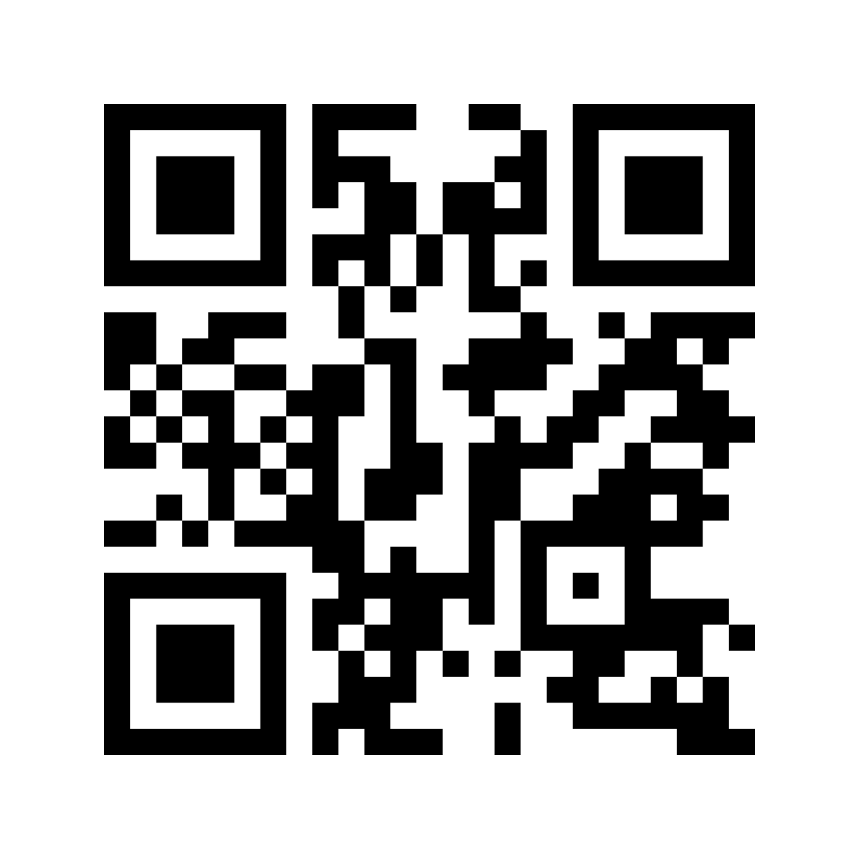
Mentimeter
Go to menti.com and enter this code:
2165 9015
Or scan the QR code with your phone.
Notes:
Then, invite leaners to vote in the Mentimeter poll for what they think the top reason is for both lists.
Allow time for learners to access the Mentimeter and to vote.
Display the Mentimeter results as a ranked list. Encourage a whole group discussion about the results. Invite learners to share why they chose the reasons they did.

Slide 7
Honeycomb Harvest
Move the honeycombs so that the sides touch where you see relationships between the statements provided.
https://bit.ly/2W0W8Gg
Notes:
Distribute a copy of the attached Study Skills Honeycomb Harvest handout to each learner.
Make the following link available to all learners: Study Skills Honeycomb Harvest activity (this link, also on slide 7, provides a separate copy for each learner.)
Be sure learners can access the activity before moving on.
Introduce learners to the Honeycomb Harvest strategy. For this activity, the statements in the “honeycomb” hexagons describe various aspects of self-regulated learning.
Ask learners to look at the statements and consider their relationships to one another. Learners should arrange the hexagons on the page in any combination that makes sense. Hexagons that touch each other should be somehow related to each other.
After individual learners have sorted the hexagons, ask them to pair up with another participant to discuss differences and similarities in how their study skills are arranged. Invite learners to share their reasoning with partners, explaining why the hexagons are arranged as they are.
Have each pair (or volunteers if it’s a very large session) share with the whole group something they sorted differently and summarize their discussion as partners.

Slide 8
Discussion
How would the use of the strategies from the Honeycomb Harvest address the reasons why learners do or do not study?
Notes:
After pairs or groups have shared out how they sorted the hexagons, ask them to consider this question: How would the use of the strategies from the Honeycomb Harvest address the reasons why learners do or do not study? Allow processing time, then ask for volunteers to share their answer to the question.

Slide 9
CUS and Discuss
CIRCLE references to strategies you saw in the Honeycomb Harvest activity
UNDERLINE any concepts you feel you could apply in your classroom
STAR what stands out to you and that you would like to do but struggle envisioning how to implement in your classroom
https://bit.ly/3svN73v
Notes:
Pass out a copy of the Best Practices: Self-Regulated Learning Research Brief to each learner. (Alternatively, you could provide the link to the research brief and learners could complete the activity within Google Docs.} Move to slide 9. Explain to learners that as they read the provided research brief, they will be completing a CUS and Discuss strategy. Briefly review the CUS and Discuss strategy with learners.
Circle references to strategies you saw in the Honeycomb Harvest activity
Underline any concepts you feel you could apply in your classroom
Star what stands out to you and that you would like to do but struggle envisioning how to implement in your classroom
Allow ample time for learners to read the research brief and to complete the CUS and Discuss strategy.

Slide 10
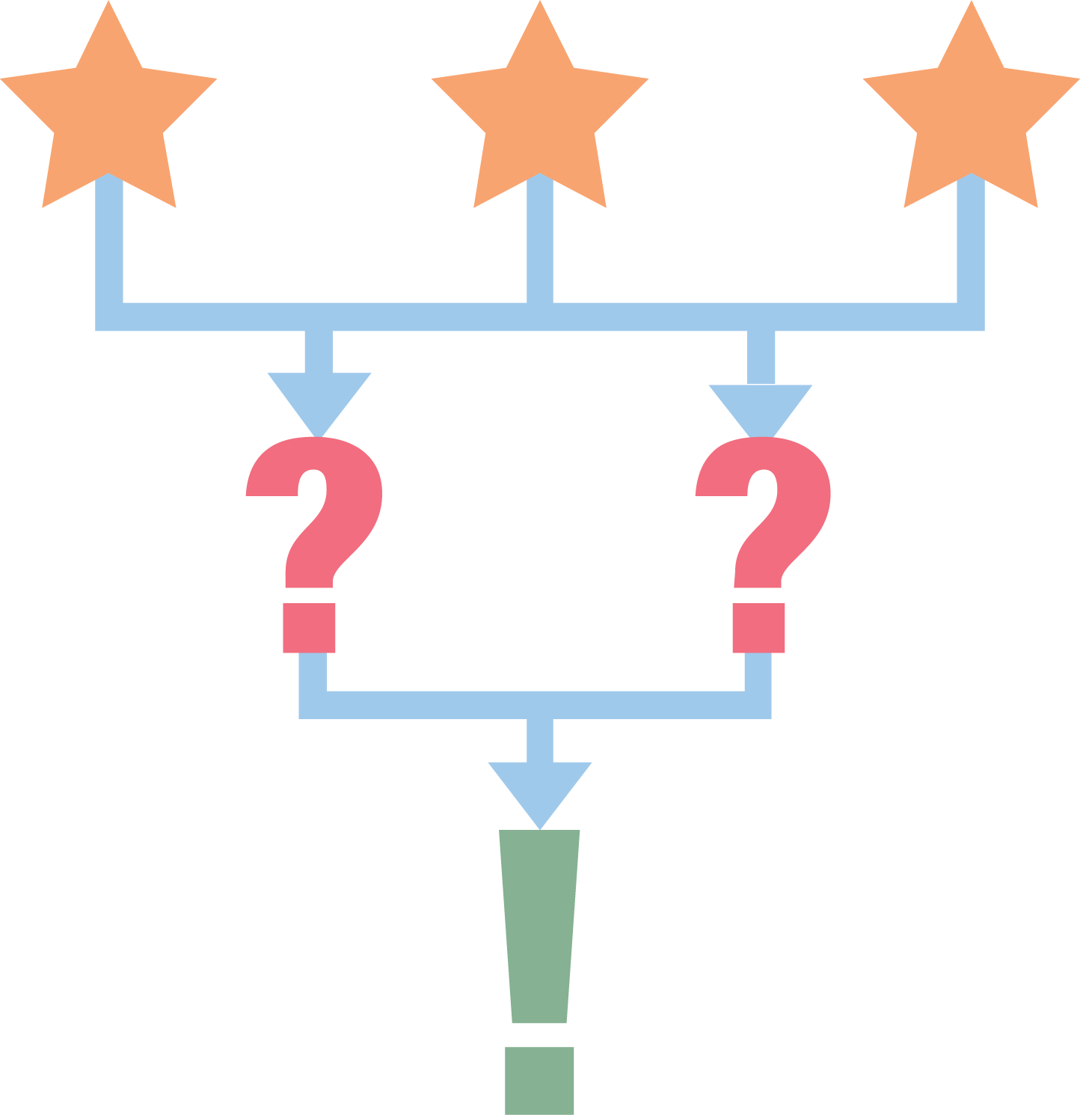
3-2-1
3 - Identify three different Study Skill strategies that you would like to use in your classes
2 - List two ways you could implement one of the strategies
1 - Answer the question “Which strategy will you implement first?”
Notes:
Invite learners to explore the resources in the Study Skills and Strategies for Students in High School book. Allow learners time to identify strategies that they may use in their classrooms.
Link for the Padlet: (link goes here)
This is a sample Padlet. You will need to create your own version.
Using Padlet, learners will complete a 3-2-1 strategy to discuss the study skills they have explored. Share slide 10 and invite learners to go to the Padlet link or scan the QR code. Ask learners to answer the 3-2-1 prompts.
3 - Identify three different Study Skill strategies that you would like to use in your classes
2 - Two ways you could implement one of the strategies
1 - Which strategy will you implement first?
Briefly review responses.

Slide 11
Window Notes
Reflect on all the new information you have learned and explore how you feel about the information learned in the previous activities. Answer each prompt focusing on your main takeaways, feelings, and inspirations for next steps.
Notes:
Pass out the Window Notes for Self-Regulation handout. (Alternatively, you could provide the link to the Window Notes for Self-Regulation handout and learners could complete using Google Docs.) Move to slide 11. Briefly review the Window Notes strategy.
Share with learners that they will now reflect on all the new information they have learned and explore how they feel about the information learned in the previous activities. Invite learners to answer each prompt focusing on their main takeaways, feelings, and inspirations for next steps.

