Slide 2
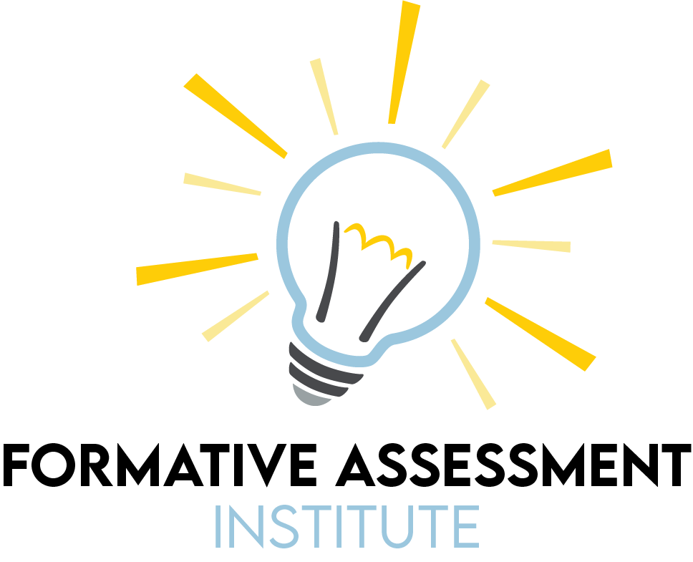

Slide 3
Bransford’s Model and Assessment Types

Slide 4
GEAR UP for the FUTURE Goals
Increase cohort academic performance and preparation for postsecondary education (PSE).
Increase high school graduation and PSE participation.
Increase student educational expectations and increase student and family knowledge of PSE options, preparation, and financing.
Notes:
Instructor/Facilitator Notes:

Slide 5
GEAR UP O+K=C Goals
Increase students’ engagement in learning.
Increase students’ academic preparation for PSE upon graduation.
Increase schools’ high school graduation and PSE enrollment rates.
Increase students’ and their families’ knowledge of PSE options, preparation, and financing.
Notes:
Instructor/Facilitator Notes: Ayanna
Here our are grant specific goals for GEAR UP OKC

Slide 6
GEAR UP for MY SUCCESS Goals
Increase cohort academic performance and preparation for PSE.
Increase High School graduation and PSE participation.
Increase student educational expectations and increase student and family knowledge of PSE options, preparation, and financing.
Notes:
Instructor/Facilitator Notes:

Slide 7
Purposes of Formative Assessment
On your paper write down what you believe are the three (3) most important purposes of formative assessment.
Notes:
The topic of this workshop is formative assessment. We will begin by gathering the group’s current thoughts and ideas about formative assessment using a strategy called Stand Up, Sit Down. During this activity we will generate an anchor chart that will serve as a foundation for us to generate a group definition of formative assessment.

Slide 8
Stand Up, Sit Down
Share out one (1) of your purposes.
If someone shares something you wrote down, cross it off your paper.
Once all three (3) of yours have been crossed out, sit back down.

Slide 9
New developments in the science of learning raise important questions about the design of learning environments - questions that suggest the value of rethinking what is taught, how it is taught, and how it is assessed.
Bransford, 2004
Notes:
In today’s session, we will examine the effective design of classroom learning environments and begin to look at where assessment fits into effective learning environments. We will discuss the definition of assessment in general and then begin to narrow down to the specifics of formative assessment. The remainder of the workshop will focus on formative assessment and how it can be used in the classroom.

Slide 10
Note Catcher
Take a moment to reflect on the assessment strategies that we have participated in and answer the following questions:
How was it used?
How can I use it?
Notes:
Break after taking notes

Slide 11
Essential Question
What is the role of assessment in the design of effective learning environments?

Slide 12
Session Objectives
Identify the elements of an effective learning environment.
Explain how they overlap using Bransford’s model of knowledge-centered, student-centered, and assessment-centered environments.
Define the different types of assessment as they relate to the purpose (diagnostic, formative, and summative).
Construct a definition of assessment that includes the categories of diagnostic, formative, and summative assessment.

Slide 13
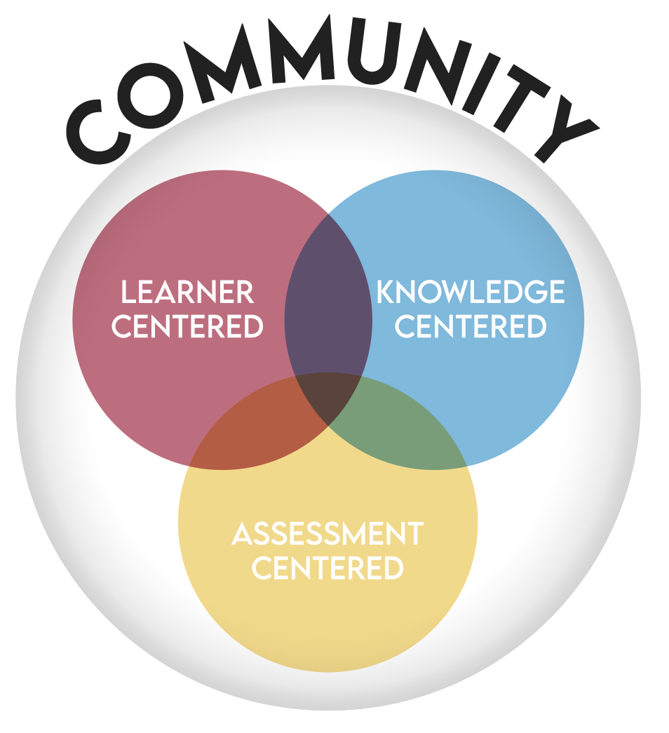
Bransford’s Model
Community-Centered
Learner-Centered
Knowledge-Centered
Assessment-Centered
Notes:
Before we dive into assessment we would like to talk about the environment in which learning occurs for students, and its implication for the design of instruction in the classroom. Bransford, Brown, and Cocking (2000) synthesized previous research on learning in a book called “How People Learn” and developed a model to guide the design of classroom environments. The model describes four interrelated research-based attributes of a learning environment that are necessary for optimizing student learning.

Slide 14
Bransford’s Model
Community-Centered refers to several aspects of the community that surround the classroom, the school as a community, and the degree to which the students, teachers, and administrators feel connected to the larger community around them.

Slide 15
Bransford’s Model
Learner-Centered refers to those environments that pay attention to the knowledge, skills, attitudes, and beliefs that learners bring into the classroom. Knowing where your students come from and begin is important in understanding where they are going and how they are going to get there.

Slide 16
Bransford’s Model
Knowledge-Centered refers to those environments and teachers that take seriously the need to empower students to become knowledgeable by learning in ways that lead to understanding and subsequent transfer of knowledge and skills.

Slide 17
Bransford’s Model
Assessment-Centered refers to those environments that effectively intertwine a variety of assessments which provide opportunities for feedback and revision and what assessment is congruent with the learning goals.

Slide 18
Jigsaw
In your group of four (4) divide up the reading.
There are four (4) sections to choose from:
Community-Centered
Learner-Centered
Knowledge-Centered
Assessment-Centered

Slide 19
Why-Lighting
As you’re reading, highlight any information that helps you to answer the question:
What are the key elements of a _________-centered environment?
Provide an explanation for how it answers the question in the margins.

Slide 20
Jigsaw
Connect with those who read the same article as you and discuss the following:
Takeaways from the article
Questions you still have
Things you wondered about
Key elements of the environment

Slide 21
Jigsaw
In your original group of four (4) each person should share the following:
What you learned from your reading
How does your section help to define the learning environment?
The key elements of the environment

Slide 22
Three-Sticky Notes (Modified)
Using four (4) sticky notes, write a word, phrase, or sentence that summarizes the information you learned about each perspective.
Add your sticky notes to the poster with the correct heading.

Slide 23
Three-Sticky Notes (Modified)
On a final sticky note, answer the question: How do the four types of learning environments interact with one another?

Slide 24
Three-Sticky Notes (Modified)
Add a sticky note to each of the four (4) perspectives with a word, phrase, or sentence that summarizes the information.
On the final slide, consider the question: what is the role of assessment in an effective learning environment?
Notes:
https://jamboard.google.com/d/1Jx_K0X2JGHhIGgi_Kb564YBy50_ACThh3XPYtLgmw8g/viewer?f=0

Slide 25
Note Catcher
Take a moment to reflect on the assessment strategies that we have participated in and answer the following questions:
How was it used?
How can I use it?
Notes:
We have seen that assessment is one of the four most important aspects of a learning environment and that it should be integrated throughout instruction that is both student-centered and knowledge centered within a set of community values and norms.
Break after taking notes

Slide 26
What is Assessment?
In your own words, how would you define assessment?
Notes:
We have seen that assessment is one of the four most important aspects of a learning environment and that it should be integrated throughout instruction that is both student-centered and knowledge centered within a set of community values and norms.

Slide 27
Types of Assessment
Diagnostic Assessment
Formative Assessment
Summative Assessment
Notes:
We want to take some time here to look at the types of assessment that occur in an assessment-centered environment and how assessment fits into effective learning environments.

Slide 28
Purposes of Each Type of Assessment
Diagnostic Assessment - To uncover what students understand and do not understand.
Formative Assessment - to inform instruction and provide feedback to students on their learning.
Summative Assessment - to measure and document the extent to which student have achieved a learning target.

Slide 29
True for Who?
Determine, as a group, which assessment type is being described by the statement.
Diagnostic Assessment
Formative Assessment
Summative Assessment

Slide 30
True for Who?
Occurs before instruction.
Diagnostic Assessment

Slide 31
True for Who?
Aligned to content area state standards.
Summative Assessment

Slide 32
True for Who?
The goal is to understand your student’s current position to inform effective instruction.
Diagnostic Assessment

Slide 33
True for Who?
The data is used to modify instruction.
Formative Assessment

Slide 34
True for Who?
Low-stakes
Diagnostic Assessment

Slide 35
True for Who?
Collects evidence of student knowledge, skill, or proficiency.
Summative Assessment

Slide 36
True for Who?
Assesses students understanding and mastery of skills.
Formative Assessment

Slide 37
True for Who?
Occurs daily.
Formative Assessment

Slide 38
True for Who?
State Assessment
Summative Assessment

Slide 39
True for Who?
Used to identify the current knowledge and/or misconceptions about a topic.
Diagnostic Assessment

Slide 40
True for Who?
Linked to the learning experience.
Formative Assessment

Slide 41
True for Who?
End-of-Year
Summative Assessment

Slide 42
True for Who?
On-going, throughout the course.
Formative Assessment

Slide 43
True for Who?
Identifies gaps, and improves learning.
Formative Assessment

Slide 44
True for Who?
Given at the end of the instructional period.
Summative Assessment

Slide 45
True for Who?
Identify student strengths and areas of improvement.
Diagnostic Assessment

Slide 46
What is Assessment?
Revisit your initial definition and revise it to include the following:
Your new understanding
How your understanding has shifted
Evidence from the resources to show your thought process

Slide 47
Affinity Process
With your table group, discuss your current understanding of assessment.
Create a group definition of assessment that includes the following:
Diagnostic Assessment
Formative Assessment
Summative Assessment

Slide 48
Affinity Process
As a table group, partner up with another table group.
Consolidate your definition into one comprehensive definition to share with the whole group.

Slide 49
Affinity Process
Review all of the definitions as a group and come to a consensus on a final group definition of assessment.

Slide 50
Note Catcher
Take a moment to reflect on the assessment strategies that we have participated in and answer the following questions:
How was it used?
How can I use it?

Slide 51
Trek Evaluation
Notes:
Now that we have established where assessment fits into an effective learning environment, our next three sessions will explore in depth the definition, characteristics, and uses of formative assessment.

