Slide 3
Essential Question
What is formative assessment and what does it look like in the English Language Arts Classroom?

Slide 4
PURPOSES OF FORMATIVE ASSESSMENT
Insert photo of the collaborative list developed in the first session.

Slide 5
Assessment Strategies
Magnetic Statements
Caption This
Fist to Five
Why-Lighting
They Say, I Say
ABC Graffiti

Slide 6
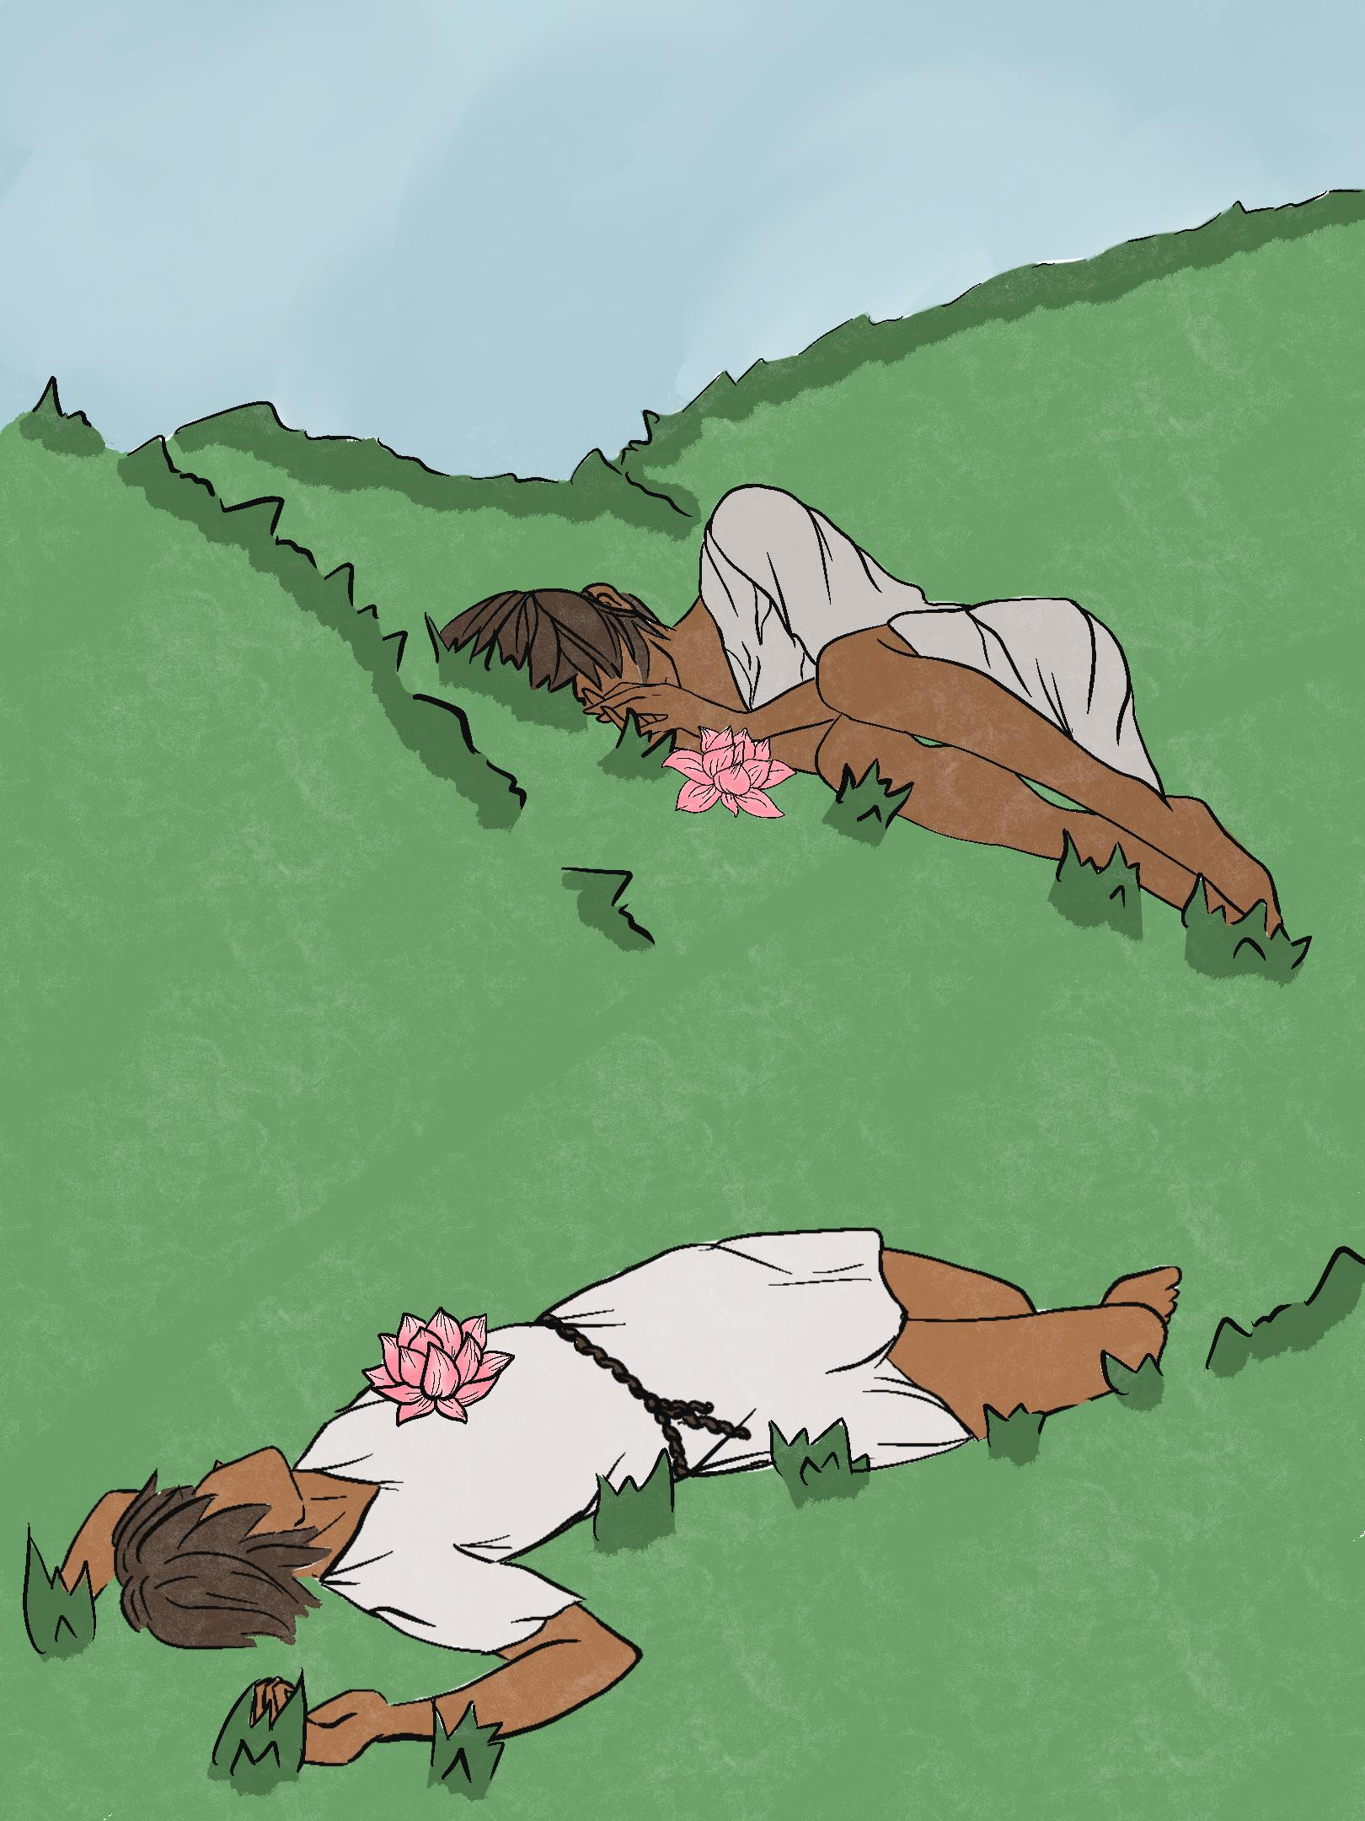
Lesson Showcases: Summary
Caption This
Totally Different Stories
Fist to Five
Ichabod and Brom: Ghostfacers
Why-Lighting
Alienstock
They Say, I Say
Lord of the Flies Unit: Lesson 8 (In the End)
ABC Graffiti
Just Say No! The Lotus Eatersqy

Slide 7
Strategy: [Which strategy did you choose?]
Lesson Objective: | [insert learning goal here] | Course: | [10th ELA]
Describe what you would present to students. Example A: Example B: Example C: Example …
Lesson Placement & Reasoning: I would put this strategy … I selected this strategy because…

Slide 8
Strategy: [Which strategy did you choose?]
Lesson Objective: | [insert learning goal here] | Course: | [10th ELA]
Describe what you would present to students. Example A: Example B: Example C: Example …
Lesson Placement & Reasoning: I would put this strategy … I selected this strategy because…

Slide 9
Strategy: [Which strategy did you choose?]
Lesson Objective: | [insert learning goal here] | Course: | [10th ELA]
Describe what you would present to students. Example A: Example B: Example C: Example …
Lesson Placement & Reasoning: I would put this strategy … I selected this strategy because…

Slide 10
Strategy: [Which strategy did you choose?]
Lesson Objective: | [insert learning goal here] | Course: | [10th ELA]
Describe what you would present to students. Example A: Example B: Example C: Example …
Lesson Placement & Reasoning: I would put this strategy … I selected this strategy because…

