Slide 3
Essential Question
What is formative assessment and what does it look like in the Science Classroom?

Slide 4
PURPOSES OF FORMATIVE ASSESSMENT
Insert photo of the collaborative list developed in the first session.

Slide 5
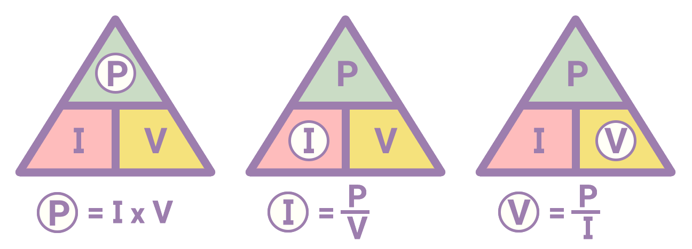
Assessment Strategies
Justified List
Using Phenomena to Drive Science Instruction
Triangle of Power
Sticky Bars
Claim, Evidence, Reasoning
I Notice, I Wonder

Slide 6
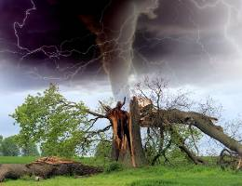
Lesson Showcases: Summary
Justified List
Scientific Reason Not Scientific Treason
Using Phenomena to Drive Science Instruction & Triangle of Power
What is a Wave? Unit: Lesson 2 (Not the Bermuda Triangle)
Sticky Bars
What’s A GMO?
Claim, Evidence, Reasoning
Feelin’ the Phenomena

Slide 7
Strategy: [Which strategy did you choose?]
Lesson Objective: | [insert learning goal here] | Course: | [Science]
Describe what you would present to students. Example A: Example B: Example C: Example …
Lesson Placement & Reasoning: I would put this strategy … I selected this strategy because…

Slide 8
Strategy: [Which strategy did you choose?]
Lesson Objective: | [insert learning goal here] | Course: | [Science]
Describe what you would present to students. Example A: Example B: Example C: Example …
Lesson Placement & Reasoning: I would put this strategy … I selected this strategy because…

Slide 9
Strategy: [Which strategy did you choose?]
Lesson Objective: | [insert learning goal here] | Course: | [Science]
Describe what you would present to students. Example A: Example B: Example C: Example …
Lesson Placement & Reasoning: I would put this strategy … I selected this strategy because…

Slide 10
Strategy: [Which strategy did you choose?]
Lesson Objective: | [insert learning goal here] | Course: | [Science]
Describe what you would present to students. Example A: Example B: Example C: Example …
Lesson Placement & Reasoning: I would put this strategy … I selected this strategy because…

