Slide 2
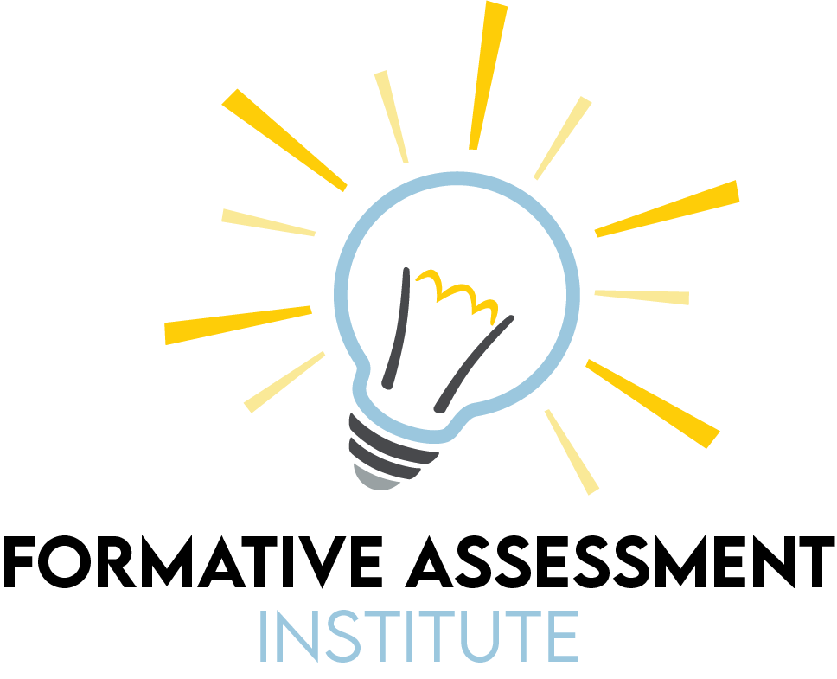

Slide 3


Slide 4
Formative Assessment in the Science Classroom
K20 Center

Slide 5
Essential Question
What is formative assessment, and what does it look like in the science classroom?

Slide 6
Learning Objectives
Explore a variety of strategies that support formative assessment for the science classroom.
Identify the purposes and uses of formative assessment probes in science.

Slide 7
Purposes of Formative Assessment
{Insert a photo of the collaborative list developed in the first session.}

Slide 8
Agenda
Probe: Is it a Theory?
Phenomenon: Polar Bear
Probe: Giant Sequoia Tree
Probe: Ice-Cold Lemonade
Phenomenon: Billion-Dollar Disasters
Phenomenon: Niangua River Darters

Slide 9
What is a Formative Assessment Probe?
“Formative assessment probes can be used to foster productive science discussions in which students make their thinking visible to themselves, their peers, and the teacher. During these discussions, there is an exchange between the teacher and students that:
Encourages exploratory thinking.
Supports careful listening to others' ideas.
Asks for elaboration and evidence-based explanations.
Acknowledges and respects everyone's ideas.
Discussion prompts are among one of our most important formative assessment tools.” — Page Keeley
Notes:
Source: Keeley, P. (2019). GUEST Editorial: Formative Assessment in the Science Classroom: What It Is and What It Is Not. Science and Children, 56(9), 8–11. https://www.jstor.org/stable/26901465
All of the Formative assessments that we have seen could be probes, but the way we are featuring them today is:
Assessment AS learning.
Science is about surfacing thinking.

Slide 10

Justified List
Examine a list of statements.
Check off the ones that apply.
Provide a justification for your selections at the end of the activity. Describe what a theory in science means to you.

Slide 11
Is it a Theory?
Theories include observations.
Theories are “hunches” scientists have.
Theories can include personal beliefs or opinions.
Theories have been tested many times.
Theories are incomplete, temporary ideas.
A theory never changes.
Theories are inferred explanations, strongly supported by evidence.
A scientific law has been proven and a theory has not.
Theories are used to make predictions.
Laws are more important to science than theories.
Examine the statements you selected. Describe what a theory in science means to you.
Notes:
Have participants choose answers, consider the prompt, and then discuss the prompt in groups to come to a consensus.
Justified List probe

Slide 12
Is it a Theory?
Theories include observations.
Theories are “hunches” scientists have.
Theories can include personal beliefs or opinions.
Theories have been tested many times.
Theories are incomplete, temporary ideas.
A theory never changes.
Theories are inferred explanations, strongly supported by evidence.
A scientific law has been proven and a theory has not.
Theories are used to make predictions.
Laws are more important to science than theories.
Examine the statements you selected. Describe what a theory in science means to you.
Notes:
Have participants choose answers, consider the prompt, and then discuss the prompt in groups to come to a consensus.
Justified List probe

Slide 13
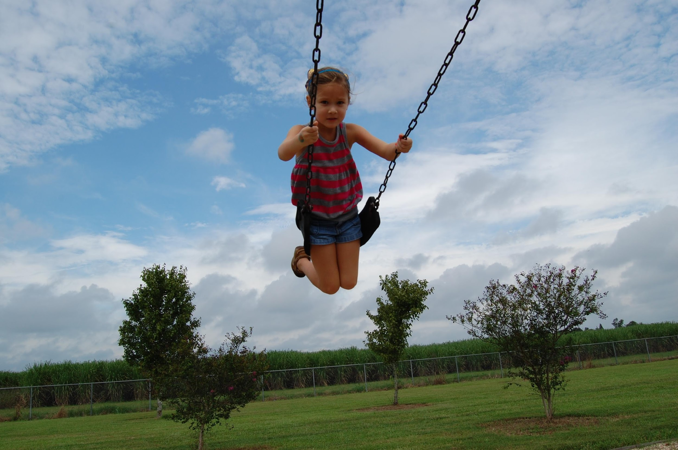
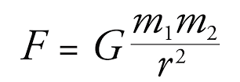
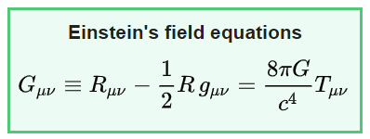
What is Science?
Law of Gravity
Theory of Relativity
The faster your travel, the slower time goes.
Notes:
Example of Law vs. Theory
For most applications, gravity is well approximated by Newton's law of universal gravitation, which describes gravity as a force causing any two bodies to be attracted toward each other, with magnitude proportional to the product of their masses and inversely proportional to the square of the distance between them. (What gravity is.)
However, gravity is most accurately described by the general theory of relativity (proposed by Albert Einstein in 1915), which describes gravity not as a force, but as a consequence of masses moving in a curved space and time (4th dimension) continuum caused by the uneven distribution of mass. (Why gravity works the way it does.)

Slide 14
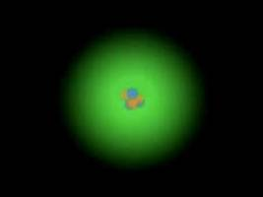
Scientific Reason, Not Scientific Treason
What formative assessments were used in this activity?
How was the phenomenon used for formative assessment?
https://learn.k20center.ou.edu/lesson/346
Notes:
https://learn.k20center.ou.edu/lesson/346

Slide 15
Dimensions of Science Learning
Dimension 1: Scientific and engineering processes
Dimension 2: Cross-cutting concepts
Dimension 3: Disciplinary core ideas
  Life sciences
  Earth and space sciences
  Physical sciences

Slide 16
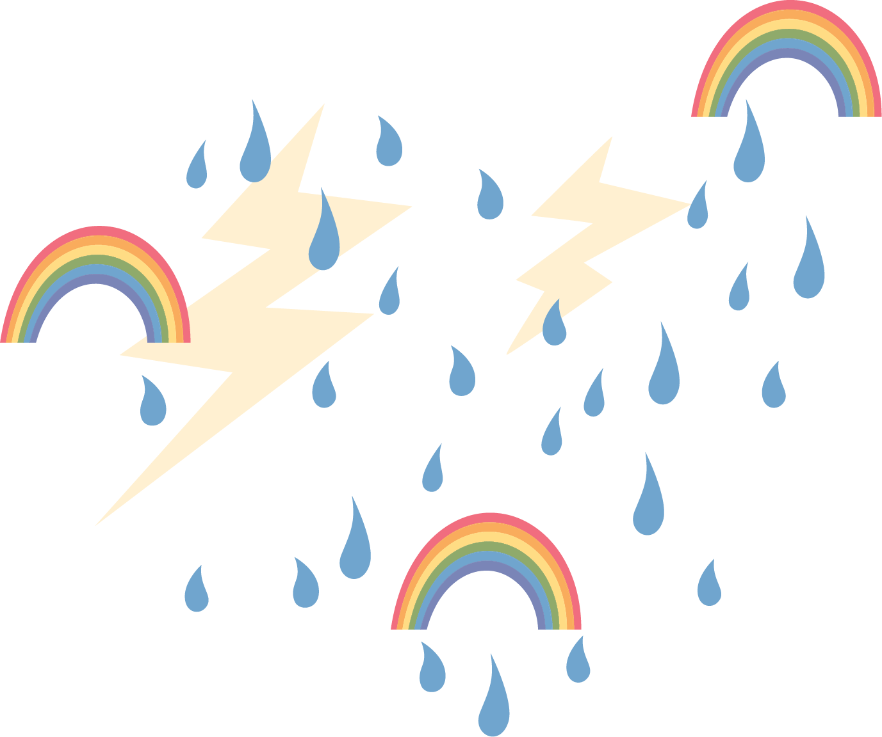
Phenomena
Phenomena for science instruction are observable objects or real events, familiar or unusual, that can be explained using core concepts from the standards.
A phenomenon should capture student interest and provide a focus for learning through cross-cutting concepts and science and engineering practices.

Slide 17
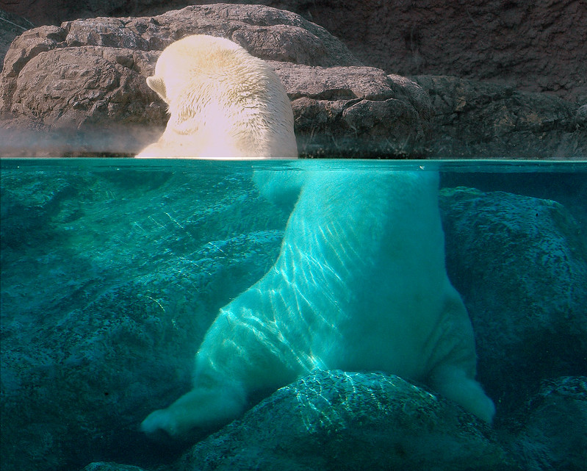
Did someone chop off this bear’s head?
Notes:
Image Source: Valerie (2007, August 20). The old "cut the polar bear in half" trick [Image]. Flickr. https://www.flickr.com/photos/ucumari/1203329752/in/photolist-pYSzn3-2Qko1G-qmJn1/
Phenomenon
Solicit some initial explanations

Slide 18
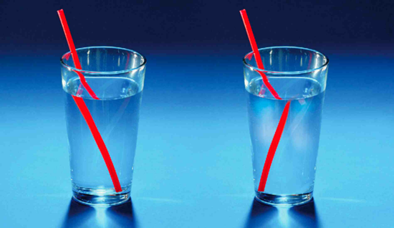
Pencils in Beakers of Different Media
Put a pencil into each of the liquids.
Based on what you know about waves,
explain how light waves interact with the
materials to create the differences among
the beakers.
Hint: think about the relationship between
wavelength, frequency, and speed. What
changes? What stays the same?
Draw a model to help support your explanation.
Notes:
Hands-on activity; assure participants that it’s okay if they don’t know/remember anything about waves. They should just try their best.
Use of models and initial explanations as formative assessment
Image Source: Reeko Science. (2017, Feb. 15). Things aren't always as they appear - light refraction experiment [Image]. Flickr.
https://www.flickr.com/photos/123311815@N06/32769790322/in/photolist-RVKJYS-THdYHB-a7NjLt-2mbqkXr-wRxw-vRhUVj-qTaLrx-ie4ick-26iM1Fq-hLup5y-rD1fsd-qPzxoL-rxpLxy-2kMriCw-DPDsFz-uX6bGr-t2sjh5-rLu5Bs-odb7zd-ru2Mn3-rSV2un-qPLo3Z-2eVzqpG-rSTFzK-rE9LTw-rsCANE-rJzpbt-ruHvBq-2jt4Jek-rMcgcx-uUax49-ruFeD5-axg2Mm-2kMWDWz-2kMSMbd-2kMrMtf-2kMCAC6-2kMriD3-6BxAua-qYNPcv-9bzswQ-6jtGFq-batsxv-2maAKPw-Rk22kQ-63Jn2G-SJoW3C-qLHMU4-8XGzq1-rcg2Bh/

Slide 19
Pencils in Beakers of Different Media
Frequency (f) remains constant.
Speed of light (c) and wavelength (λ) must be the parts that change.
c
f
λ
Notes:
Use of models and initial explanations as formative assessment. Students will likely provide conceptual explanations as they are not expected to be be familiar with the mathematical relationships at this point, but this is discussed here for the participants’ benefit.
The actual explanation for this refraction phenomenon has to do with the interaction of waves of electric fields and is too complex for this session. (Full explanation here: https://www.youtube.com/watch?v=CUjt36SD3h8&t=29s) However, participants need to understand the basic mathematical relationship in different media in order to understand the thorough explanation (PS4.3). This would formatively assess students’ understanding that, if frequency is constant regardless of the medium (the number of waves that enter per second does not spontaneously change upon entering a new medium), then the velocity and wavelength have to change to maintain that.
Conceptually, it makes far more sense to assume that light waves would move slower through a new medium rather than suddenly becoming faster than the speed of light through air. (The “speed of light” through air is very close to the speed of light in a vacuum, so it’s generally treated like the speed through a vacuum in calculations at this level.) If the velocity decreases, the wavelength will also have to decrease (directly proportional relationship).

Slide 20
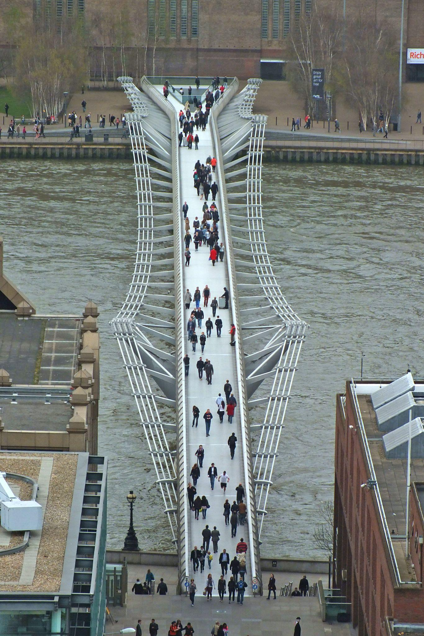
What is a Wave? Unit: Lesson 2
(Not the Bermuda Triangle)
What formative assessments were used in this activity?
How was the phenomenon used for formative assessment?
https://learn.k20center.ou.edu/lesson/1666
Notes:
https://learn.k20center.ou.edu/lesson/1666
Image Source: Kamenícek, J. (2014, March 31). London Millennium Bridge from Saint Paul's [Image]. Wikimedia Commons. https://commons.wikimedia.org/wiki/File:London_Millennium_Bridge_from_Saint_Paul%27s.jpg

Slide 21
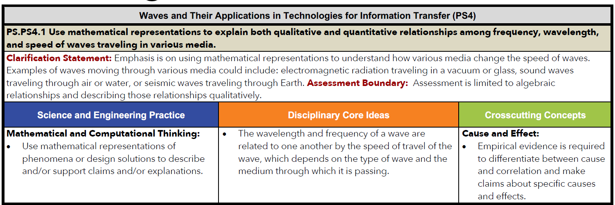
Physical Science, Chemistry, Physics
Notes:
Note: PE - Explain that the standard is the whole top section.

Slide 22
Cross-Cutting Concepts
Patterns
Cause and effect: Mechanism and explanation
Scale, proportion, and quantity
Systems and system models
Energy and matter: Flows, cycles, and conservation
Structure and function
Stability and change
Notes:
Ask participants which CCCs the phenomenon and activity touched upon (particularly patterns; systems and system models; scale, proportion, and quantity)

Slide 23
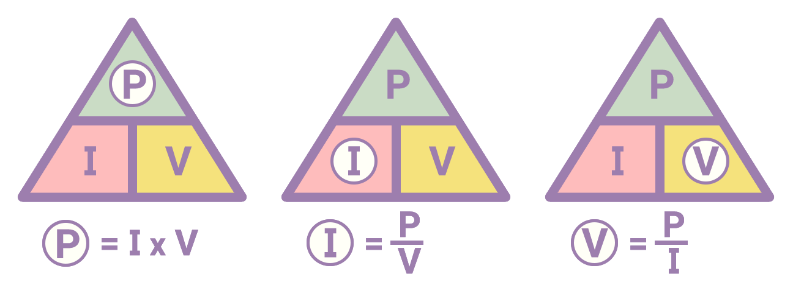
Note Catcher
Take a moment to reflect on each of the assessment strategies that we have engaged with and answer the following questions:
How was it used?
How can I use it?
Notes:
Break after taking notes.

Slide 24
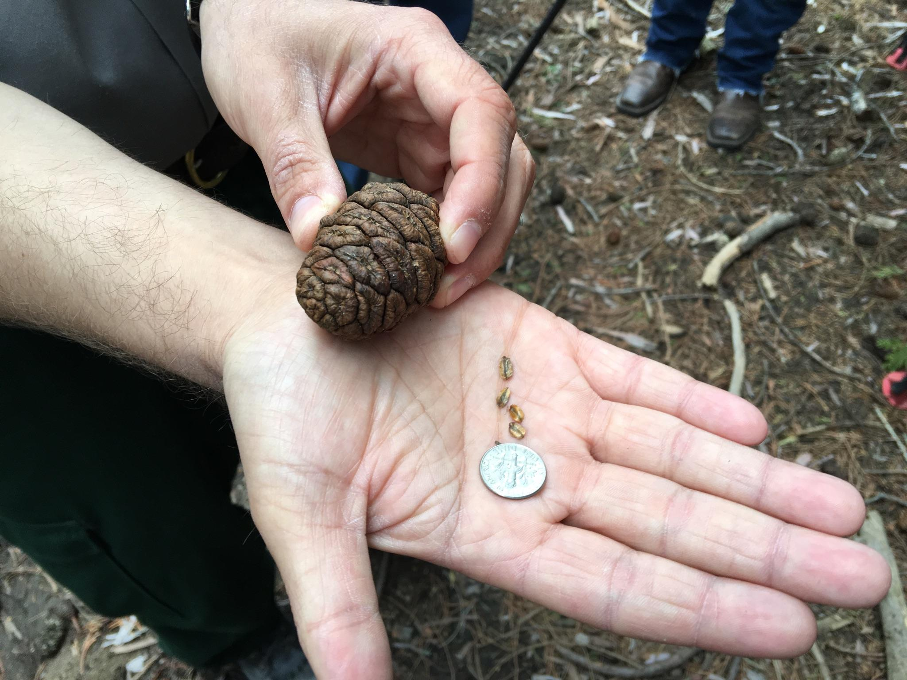
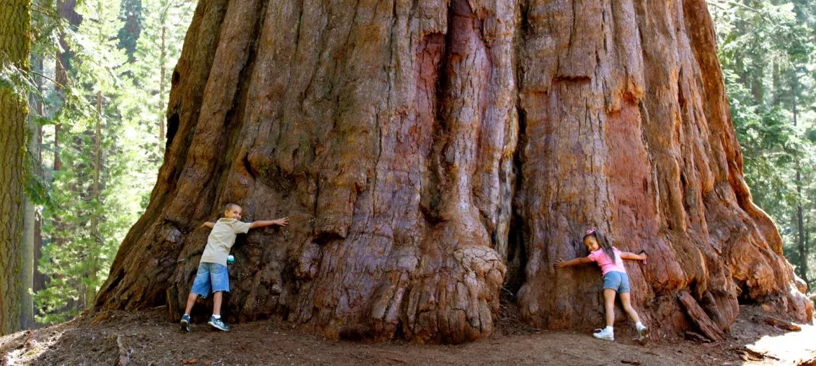
Sticky Bars
Consider the question: Where did most of the matter come from?
Place a sticky note over the answer you think is correct:
  Sunlight
  Water
  Soil
  Carbon Dioxide
  Oxygen
  Minerals
Notes:
Sticky bars (use of a phenomenon, probe, instructional strategy together)
Mention that few teachers actually get the right answer the first time.
Image Source:
Romero, E.D. (2016, May 5). Months after the rough fire millions of giant sequoia seedlings take root. NPR for Central California.
https://www.kvpr.org/post/months-after-rough-fire-millions-giant-sequoia-seedlings-take-root

Slide 25
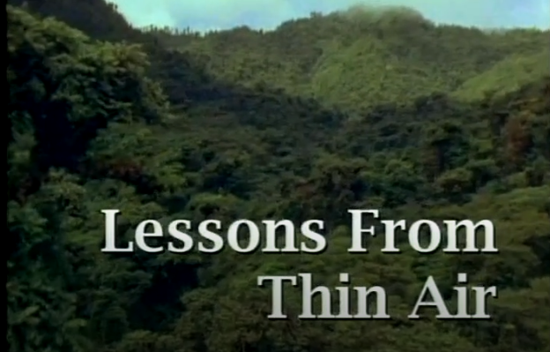
Minds of Our Own: Lessons from Thin Air
Notes:
Video Source: Annenberg Learner. (n.d.). Lessons from thin air. Retrieved October 14, 2021, from https://www.learner.org/series/minds-of-our-own/2-lessons-from-thin-air/
This video has the answer.
Talk about the connection to FA. Teaching science is about uncovering student pre-conceptions and using them to build new knowledge.
Probes are a valuable tool in science.

Slide 26
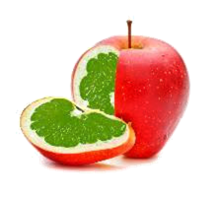
What’s a GMO?
What formative assessments were used in this activity?
How was the phenomenon used for formative assessment?
https://learn.k20center.ou.edu/lesson/458
Notes:
https://learn.k20center.ou.edu/lesson/458

Slide 27
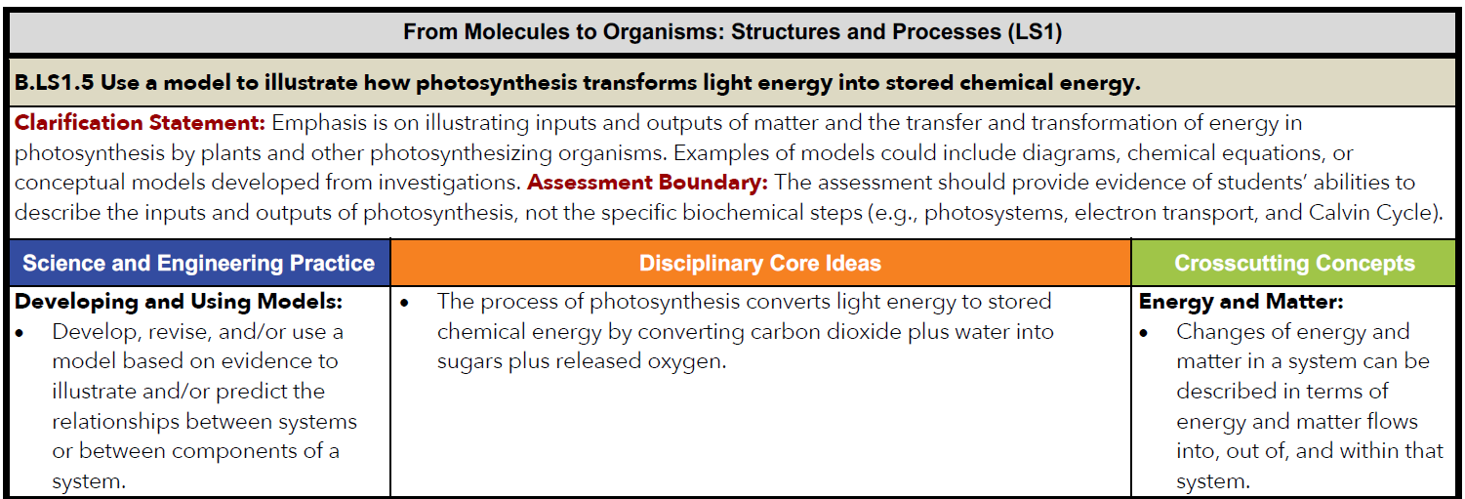
Biology
Notes:
For this standard, the FA tells us what students know about the inputs required

Slide 28
Scientific and Engineering Practices
Asking questions and defining problems
Developing and using models
Planning and carrying out investigations
Analyzing and interpreting data
Using mathematics and computational thinking
Constructing explanations and designing solutions
Engaging in argument from evidence
Obtaining, evaluating, and communicating information

Slide 29
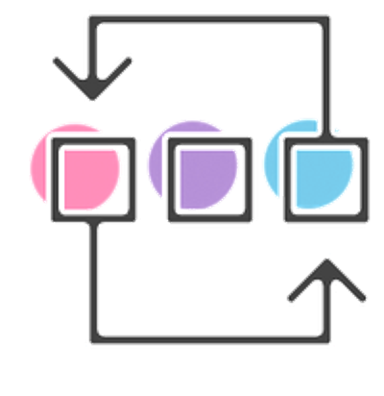
Before-During-After
Read the Ice-Cold Lemonade probe.
Choose the idea that you think best explains why the lemonade got cold.
Draw three (3) pictures that show what happens before, during, and after Mattie adds the ice to help explain your reasoning for the answer you chose.
Notes:
Before-During-After (B-D-A) formative assessment strategy with probe
Ask where in the lesson you could use this probe

Slide 30

Ice-Cold Lemonade Probe
Mattie poured herself a glass of lemonade. Because the lemonade was warm, Mattie put some ice in the glass. After about 10 minutes, she noticed that the ice was melting and the lemonade was cold. Mattie wondered what made the lemonade get cold. She had three different ideas. Which idea do you think best explains why the lemonade got cold?
The coldness from the ice moved into the lemonade.
The heat from the lemonade moved into the ice.
The coldness and the heat moved back and forth until the lemonade cooled off.
Notes:
Image Source: Long, C. B. (2018). Tray of lemonade [Image]. Unsplash. https://unsplash.com/photos/_PaXoN4_2s0
Before-During-After (B-D-A) formative assessment strategy with probe
Ask where in the lesson you could use this probe

Slide 31
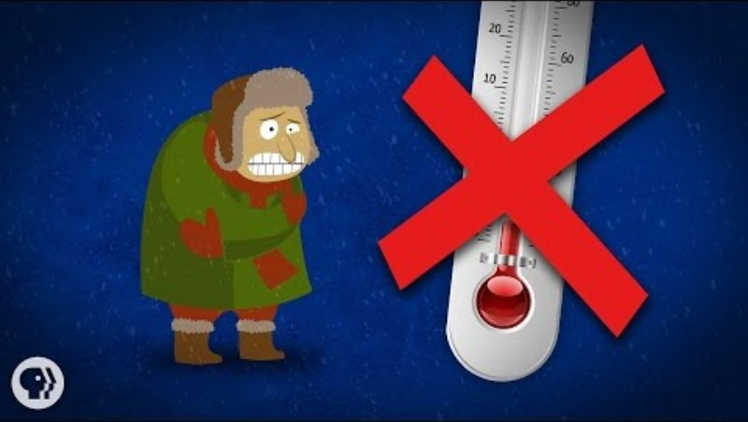
There’s no such thing as cold
Notes:
Video Source: It’s Okay To Be Smart. (2015, January 19). There’s no such thing as cold [Video]. YouTube. https://www.youtube.com/watch?v=Akd7MMRKDwc
(0:38-1:58)
B-D-A strategy allows us to see student understanding of the process of atomic motion/average kinetic energy in thermal energy transfer, which is central to conceptual understanding of the DCI.

Slide 32
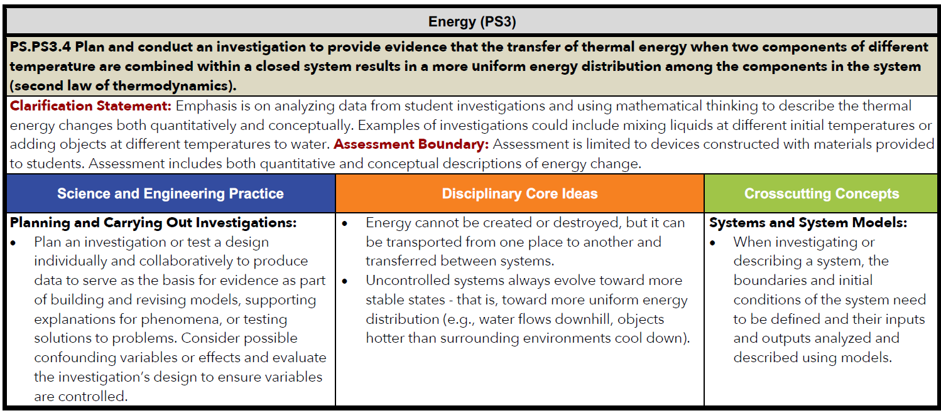
Physical Science, Chemistry, Physics

Slide 33
Placement of Probes in a Science Lesson or Unit
Beginning of instruction
After introduction of a related concept to transition to the next level of that concept
As an introduction to an experiment to give students ownership of the concept
Before a science reading assignment
During the teaching of a topic to see what students are thinking
End of instruction ONLY after students go back and edit their initial answers/explanations
Notes:
Bottom line, these are not summative assessments.

Slide 34

Claim-Evidence-Reasoning
Claim: hypothesis, answer to a question, etc.
Evidence: qualitative, quantitative; empirical, experimential, etc.
Reasoning: connection between claim and evidence, based on scientific principles.
Notes:
Initial explanation likely includes evidence from personal experience only

Slide 35
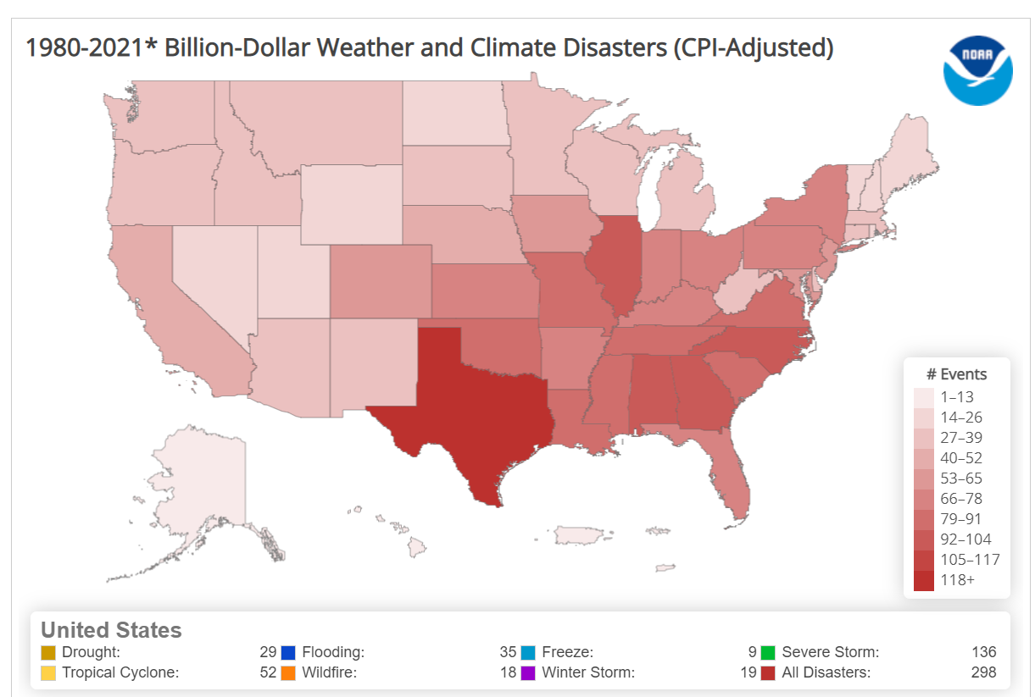
Claim-Evidence-Reasoning
Explore the Billion-Dollar Weather and Climate Disasters data and make a claim about how severe weather events have changed over time.
Support your explanation with evidence from the website.
Notes:
Example of data as a phenomenon
Have participants visit https://www.ncdc.noaa.gov/billions/mapping to collect their own evidence.
The easiest way to explore the data is the Mapping tab, but the Time Series and Events tabs also provide straightforward data.
Source: NOAA National Centers for Environmental Education. (2021). Billion-dollar weather and climate disasters. https://www.ncdc.noaa.gov/billions/

Slide 36
Claim-Evidence-Reasoning
Claim: hypothesis, answer to a question, etc.
Evidence: qualitative, quantitative; empirical, experimential, etc.
Reasoning: connection between claim and evidence, based on scientific principles.
What would your next steps be?
How does the CER structure support formative assessment as learning?
Notes:
An initial explanation, like we’ve seen in previous FAs is valuable for seeing the ideas, misconceptions, and ways of thinking about material, but it also provides a scaffold for the learning to come. CER allows students to continuously revise their thinking and strengthen their explanations as they learn more about the concept

Slide 37
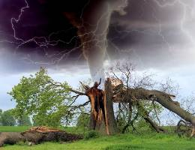
Feelin’ The Phenomena
What formative assessments were used in this activity?
How was the phenomenon used for formative assessment?
https://learn.k20center.ou.edu/lesson/415

Slide 38
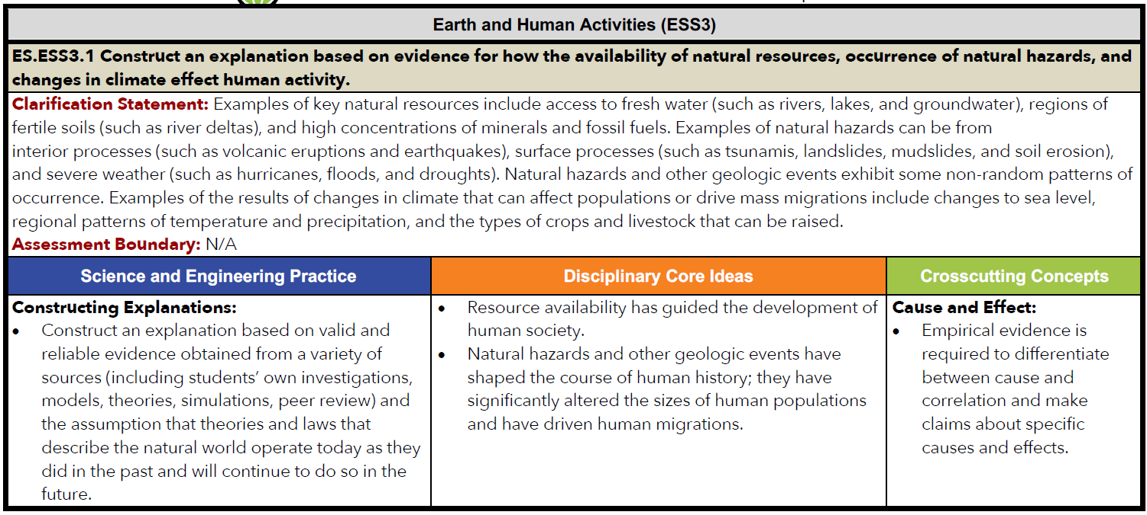
Earth and Environmental Science

Slide 39

I Notice, I Wonder
Take some time to look over the three-dimensional assessment task from the Niangua River Darter Task
What do you notice about what the task is asking the students to do?
What are some things you “wonder?”

Slide 40
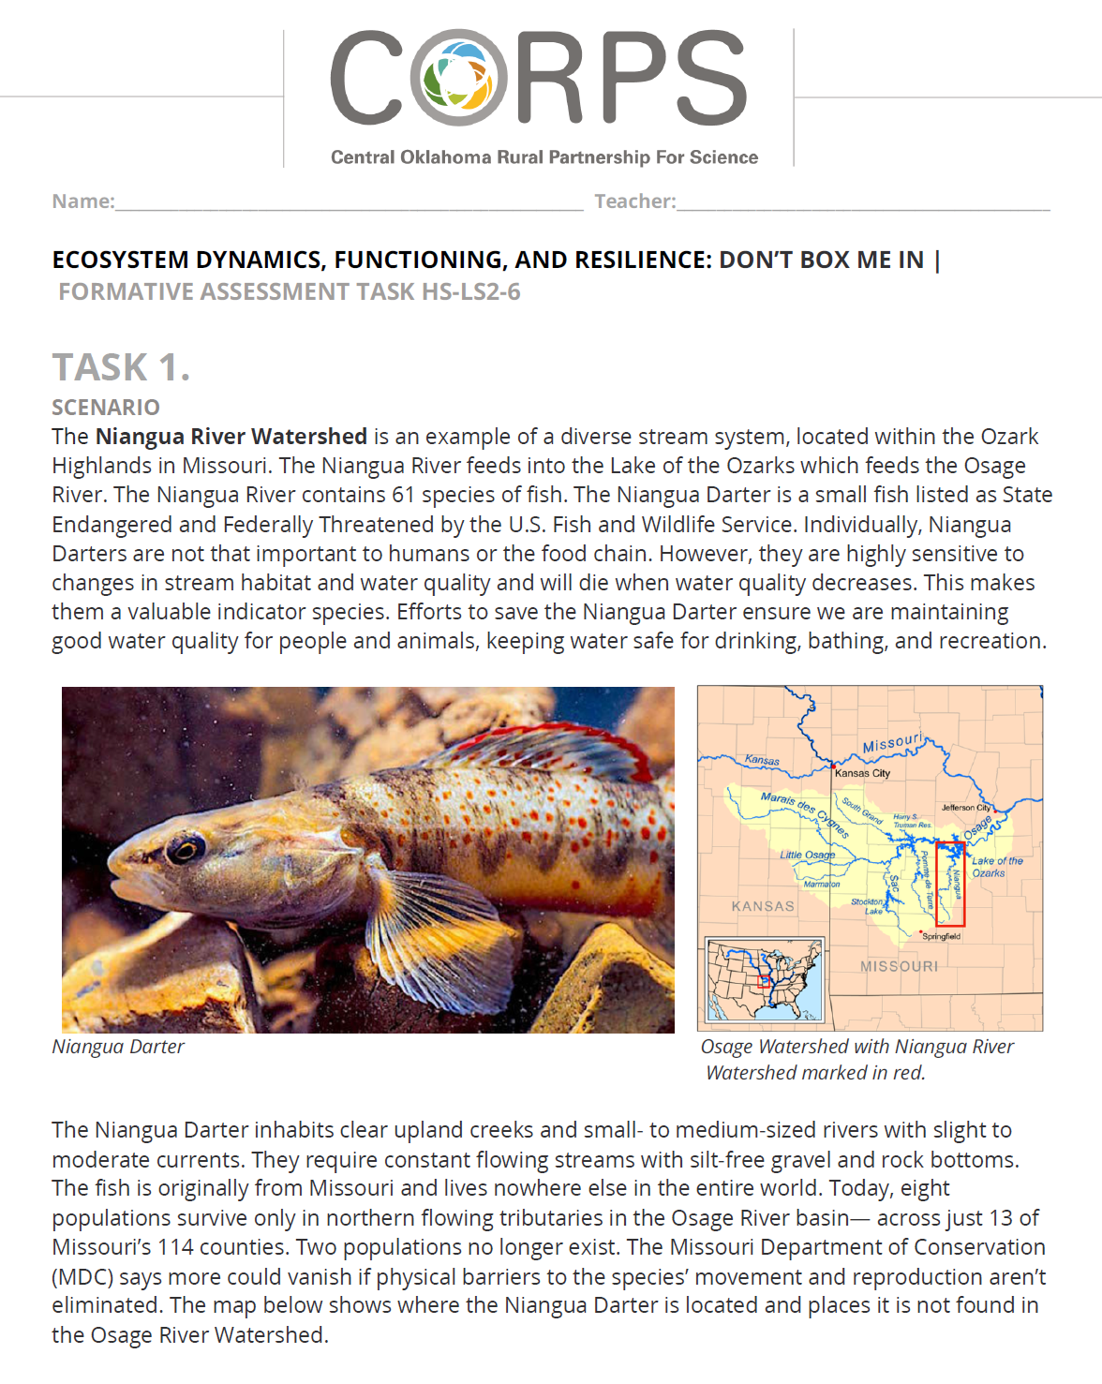
Niangua River Darter Assessment
Structured around a single phenomenon
Multiple tasks that build upon one another or address different facets of understanding that students are acquiring
Could be used as an assessment, as initially designed, or presented like an instructional activity
Notes:
Activity: using student data to assess in a holistic way; assessment task created for assessment as learning
Developed with and vetted by rural OK teachers. Assessments use a central phenomenon and several focused “tasks” that address all three dimensions of a given standard. Give teachers some time to look over the task and several student work examples (4-5 per group is ideal).
River Darter Assessment Task https://learn-legacy.k20center.ou.edu/files/scienceresources/HS-LS2-6/HS-LS2-6-AT-Ecosystem-Dynamics-Functioning-and-Resilience-Niangua-Darter.pdf
Example student data here (12 examples): https://drive.google.com/file/d/1UMVb3kTX6g2-lL3Cn3MRI0iLXiJRu6nL/view?usp=sharing (Heather has the pdf if it isn’t accessible by the link)

Slide 41
I Notice, I Wonder
Take some time to look over the three-dimensional assessment task from the Niangua River Darter Task
Add to your I Notice, I Wonder chart.
Are you able to answer some of your “wonders” from earlier?

Slide 42
Niangua River Darter Assessment
What do you notice about the assessment task overall?
What do you notice about student answers?
How could this assessment be used for learning?

Slide 43
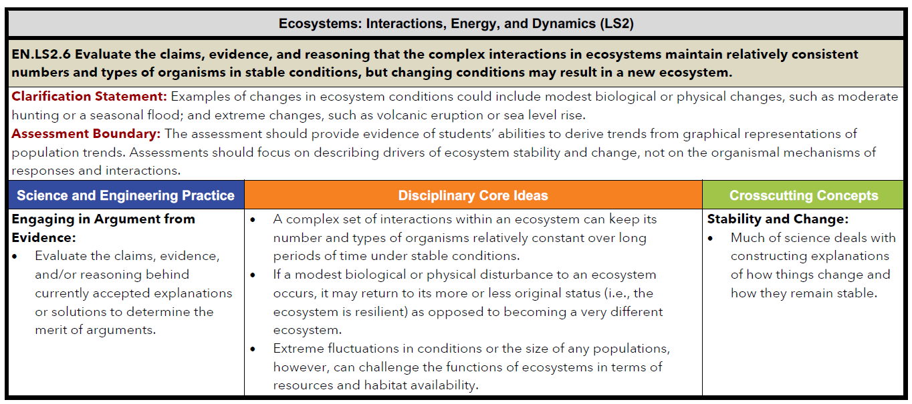
Biology, Environmental Science

Slide 44
Formative Assessment and Grades
Should grades be given for formative assessments?
What kind of documentation is needed for formative assessment?
How do we hold students accountable if we are not grading an assessment?
What questions do you have about formative assessment and grades?
Notes:
Common questions teachers ask.

Slide 45

Note Catcher
Take a moment to reflect on each of the assessment strategies that you have engaged with and answer the following questions:
How was it used?
How can I use it?
Notes:
Break after taking notes

Slide 46
Develop Your Own Probe
Return to your note catchers for the last four days. Choose one strategy and develop your own version for an upcoming lesson or unit in your classroom

Slide 47
Day 4 Evaluation and Reflection
Complete the TREK Rapid Feedback form.
Choose two (2) strategies that you intend to use in the coming month.

