Slide 2
To the Dictionary and BEYOND!
Authentically Engaging Students in Academic Vocabulary
Notes:
(1 minute)
Welcome and briefly highlight the agenda. (Notice that it is in the 5E model.)

Slide 3
Rock, Paper, Scissors, Lizard, Spock
The Definitions:
Rock – smashes scissors and crushes lizard
Scissors – cut paper and decapitate lizard
Paper – covers rock and disproves Spock
Lizard – eats paper and poisons Spock
Spock – vaporizes rock and bends scissors
Notes:
(1 minute)
"Is anyone familiar with 'Rock, Paper, Scissors, Lizard, Spock'?”
Read the definitions aloud or let participants read them on their own. Definitions are also printed on the back of the agenda for participants to refer to.
“These are important definitions and should be known when playing the game 'Rock, Paper, Scissors, Lizard, Spock’.”

Slide 4

Sheldon Explains
Notes:
(1.5 minutes)
Now watch this video from The Big Bang Theory. Sheldon is explaining to Barry how the game works.
Click the image to play the video or use this link: https://youtu.be/fqlDc2VICZ0.

Slide 5
Philosophy of Authentic Teaching
  Ready to play the game or teach someone else?
    What else could have benefited your learning experience?
Notes:
(2 minutes)
Click the slide and pose the question, “Are you ready to play the game without help or teach someone else?” - “NO!”
“Sheldon explained it twice for you. What else might have benefited your learning experience?” (Let participants share out a few quick ideas.)
Could you have used…
*More time/practice?
*More opportunities to use it?
*Interaction/competition?
*Clear context to the game/words?
*A chance to talk about it?
*Visuals or handouts?

Slide 6
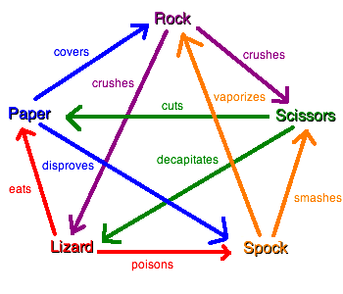

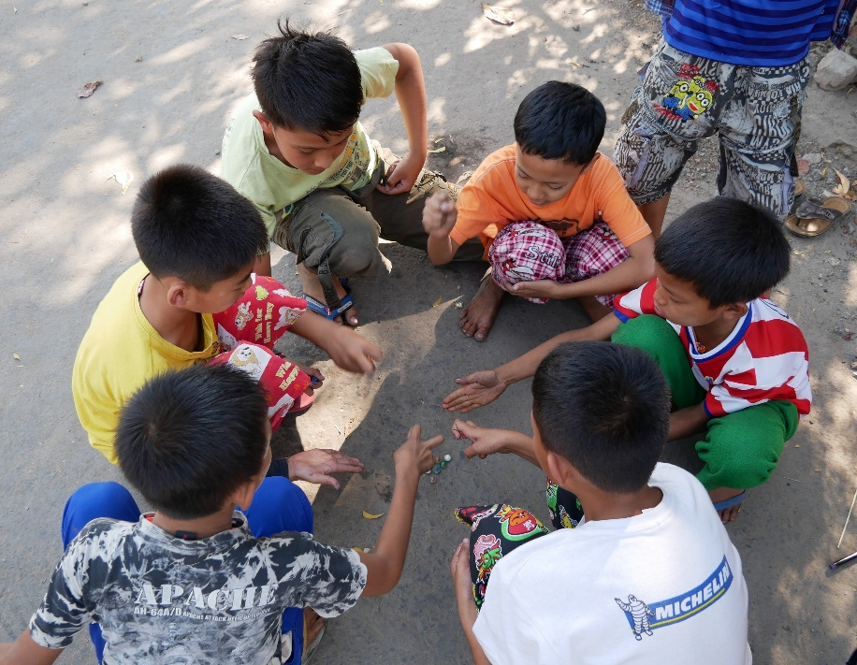

What if you had…
A visual…
A chart…
Time to talk or practice…
Context…
Notes:
(1 minute)
Then click through the slide and ask which of these images might have helped them understand.
“I heard some of you say if you’d had…”
A chart to keep you organized
More context or meaning behind the game
A chance to play the game, talk about it, and ask questions
A visual to see the hand representations.

Slide 7
Objectives
Explore and evaluate new strategies to increase the authentic teaching of academic vocabulary
Explain the benefits of authentic academic vocabulary instruction
Identify one strategy to implement in your own classroom
Notes:
(30 seconds)
“This session will provide protected time to explore new (and maybe old) vocabulary strategies and connect these back to authentic components that benefit student learning.”
Highlight the main goals, but do not read this slide.
Know what the objectives are and mention them to the participants.

Slide 8
Two-Minute Table Talk
At your table, share strategies that you already use to promote authentic vocabulary instruction.
Notes:
(2 minutes)
Participants turn and talk, sharing the strategy or strategies that they have used in their classrooms to teach vocabulary authentically.
(Note: You can use a timer to track this activity, but if participants are done discussing after one minute, then move on. Don't use the whole two minutes if they don't need it.)

Slide 9

Authentic Vocabulary Strategies
Strategy or activity name
1. Brief description or steps of how you used it
2. Reference, if applicable (ex: K20 LEARN Site)
3. Your name and content area
Notes:
(3 minutes)
Click through the slide and tell participants the following:
Using the index cards provided on the tables, write down:
A strategy or activity that you have used in your classroom to build academic vocabulary.
A brief description or the steps of how you use this strategy/activity.
A reference, if applicable.
Your name and content area.
Collect these cards to use during the Explore activity.
LEAD teachers will bring all cards to the follow-up reflection sessions.

Slide 10
Vocabulary Resources
Notes:
(1 minute)
Introduce the “Vocabulary Strategies List” on the table.
This resource will be used to provide more details regarding the strategy you select to explore in just a moment.
You can scan the QR Code to access the digital material now or later to explore more strategies.
(Note: If you email a digital copy to participants, then the links will be active as well.)

Slide 11
Strategies for Building Vocabulary
If possible, partner or group with others in your content area.
Select two academic vocabulary words.
Write the words on the top of your Strategy Harvest Note Sheet.
Notes:
(4 minutes)
“As you pair and chose your words, I will collect your index cards. Please place them at the edge of your table.”
“It is always good to increase the number of tools and resources we have to teach material, and that’s no different for vocabulary introduction and review.”

Slide 12
Strategy Harvest Note Sheet
Notes:
(1 minute)
Introduce the Instructional Strategy Note Sheet (which might be printed on the back of the Vocabulary Strategies List).
Identify where participants record the strategy that they choose to explore and what to record next to each bullet point.
The Heads Up strategy, printed on the paper, provides a clear, concrete example for participants to follow.
Using a graphic organizer to help structure your thoughts:
What is the strategy?
What is it asking students to do?
How are students interacting with the vocabulary or content?
How does this strategy support authentic teaching and learning?

Slide 13
Strategy Harvest
Preview the vocabulary strategies on your table.
You will be modeling one strategy for the whole group using the two words you selected previously.
Notes:
(1 minute)
I am handing out index cards to each working group. The end goal will be to model one of these strategies to the whole group, but first you must learn more. As a group, briefly read these cards and select one strategy to explore further together. The strategy selected will be recorded on the “Strategy Harvest Note Sheet” as we described earlier. (Hold one up and show them again what will be recorded and where.)
*After your group has selected one green or blue card, please turn over all the other cards that you are not using. I will come around and pick those up.*

Slide 14
Strategy Harvest Note Sheet
For the strategy that you will model, record the following:
My Strategy is (strategy name)
What is it asking students to do? Can it be used to introduce or review vocabulary? Which component of authenticity does the strategy address? (See Authenticity rubric.) How is addressing this component beneficial to student learning?
Notes:
(6 minutes)
Tell participants that as they are recording information about their strategy, they need to also plan how they will model for the whole group. For the third bullet point, consult the “Authenticity Learning and Teaching Rubric.”
Remember to use the two academic vocabulary words already selected, which should be recorded on the “Strategy Harvest Note Sheet.”

Slide 15
ACT IT OUT/write it down
While groups model, record the details of their strategies.
_________ is (strategy name)
What is it asking students to do? Can it be used to introduce or review vocabulary? Which component of authenticity does the strategy address? (see Authenticity rubric) How is addressing this component beneficial to student learning?
Notes:
(1 minute)
Groups will use the two vocabulary words they selected to demonstrate the selected strategy to the whole group. For further explanation of this activity give the following example:
“Using the strategy “Heads Up” and two math vocabulary words (inequality and variable), a small group would demonstrate how a class might engage in the activity/strategy. Partner A, selects a card without reading the word and places the word on their forehead. Partner B (or the rest of the small group) describes the word without saying the word until time runs out or until Partner A guesses the correct word. So, Partner B might describe ”Inequality” as, ‘This is similar to an equation, but the unknown number might be a variety of answers within a given range.’ Then the partners switch roles, and Partner B places the next card on their forehead while Partner A describes “Variable” as ‘The unknown value in an equation or something that can change depending on the output.’ The objective for this strategy is that these are the students' words and they are applying ideas, communicating, performing, and connecting situations that may or may not exist within the classroom setting.”
Tell participants to record these details on their “Strategy Harvest Note Sheet” while groups model their strategies.
We will be specifically looking for the third and fourth bullet points connecting back to the benefits of student learning.

Slide 16




Higher-Order Thinking
Disciplined Inquiry
Authentic Teaching
  Authentic component/benefit to student learning?
Value Beyond School
Implicit View of Students
Notes:
(15 minutes)
As groups model, display this slide.
(At least two groups should model, but if time allows have a more groups present.)
*As the facilitator, pay close attention that groups are highlighting each bullet from the note sheet. (Keep a “Strategy Harvest Note Sheet” and an “Authenticity Rubric” visible.)
Ensure that each group explains an authentic component and how that component benefits student learning.

Slide 17
Decide and Share…
Find someone from another group.
Share the one strategy from your sheet that you will try before the reflection session.
Notes:
(2 minutes)
Extend
After the last group models, instruct participants to select one strategy that was explored today that they will try with their students before our next meeting. Have them write that strategy down at the bottom of their “Strategy Harvest Note Sheet.”
Instruct participants to share the one strategy that they will implement in their class before the reflection.

Slide 18
TREK Evaluation
Notes:
(3 minutes)
Tell participants to place the barcode on the top of their evaluation sheet. Remind them that there are questions on the back side.

Slide 19
Point of Most Significance (POMS)
What point was most significant and helped you understand how promoting authentic instruction of academic vocabulary might benefit student learning?
  Take a moment to reflect, write, and share.
Notes:
If you do not have a TREK Evaluation to give participants, use this slide!
Ask participants to think about the most significant point of the session. You can do this by starting with a review of the topic and then posing a question, like, “What point made during today’s session helped you understand the importance of promoting authentic instruction for academic vocabulary.”
Have them either share this point out loud or write it down.
Collect participants’ responses.
Analyze responses and use them as necessary during the follow-up reflection session.

Slide 20
Follow Up

Slide 21
SCORE
What is one Strategy you used to support authentic teaching and learning?
What was successful and needs to be Celebrated?
What Obstacle did you face and overcome?
What might you Refine in the future when using this strategy?
Extra notes or ideas?
Notes:
During a follow-up session, ask participants to reflect on the strategies they used. Participants can use the “SCORE Reflection Note Sheet” for recording thoughts and reflections.

