Slide 2
Manipulating Mathematics
Building a Conceptual Foundation
Notes:
Welcome participants and briefly introduce yourself and the professional development session.

Slide 3
Magnetic Statements
Read the statements
Stand by the statement you feel most - Repelled (disagree) + Attracted (agree)
Discuss with your group why you chose that statement
Summarize and share your group’s discussion
Notes:
Engage activity about 20 minutes
Participants will read the statements on slide four and identify the one that they are either most attracted to or most repelled by, then move to stand next to that statement.
Once participants understand the objective, display the next slide and allow them time to find a statement to stand by.

Slide 4
Statements to Stand By
Everyone can learn math to the highest levels
Mistakes are valuable
Questions are really important
Math is about creativity and making sense
Math is about connections and communicating
Math class is about learning not performing
Depth is more important than speed
Positive Classroom Norms by Jo, Boaler
Notes:
After groups have formed around the statements, instruct participants to share within their group why they chose that particular statement. One person will summarize what was discussed to the whole group.
Within Jo Boaler’s book, Mathematical Mindset: Unleashing Students’ Potential Through Creative Math, Inspiring Messages and Innovative Teaching (pp. 269 – 277), the following statements are discussed and supported throughout the book. However, there are direct connections to these chapters:
#1 – Chapter 1
#2 – Chapter 2
#3 – Throughout the book
#4 – Chapter 3 and 4
#5 – Chapter 5 and 6
#6 – Chapter 6, 7, and 8
#7 – Throughout the book
Use the book as a reference.

Slide 5
Essential Question
How can using manipulatives make mathematics more accessible to students?
Notes:
30 seconds
Participants to return to their seats. Then briefly share the essential question and learning objectives for the session. Participants should keep these in mind as they explore each activity using manipulatives.

Slide 6
Objectives
Experience mathematical concepts using manipulatives to solve non-routine tasks.
Explain how these experiences can make mathematical ideas more accessible to all students and develop their conceptual foundation about mathematics.
Create a lesson or a non-routine task that uses manipulatives to foster students’ conceptual understanding and make it more accessible.
Notes:
30 seconds

Slide 7
“Not all tasks are created equal, and different tasks will provoke different levels and kinds of student thinking.”
Stein, Smith, Henningsen, & Silver (2000)
Notes:
Explain that we will begin exploring different math activities that use manipulatives and not all activities can foster deep thinking about mathematical concepts. It is important to be intentional with the tasks we select. They must open and provoke deep thinking and questioning about mathematical ideas, concepts, and relationships.

Slide 8
Exploring Manipulatives
Each center contains a mathematical activity that uses manipulatives.
Record the name of each manipulative and the experience on the “Math Manipulative Center” note sheet during each rotation.
Notes:
Explore should take about 45 to 60 minutes depending upon the set up of the Activity and Manipulative Centers
Provide 3 to 4 manipulatives centers for participants to rotate between.
Each group will explore each center for about 10 minutes and then use 5 minutes to reflect and answer the two prompts on the "Math Manipulative Centers" note sheet (listed on slide nine).
Groups rotate after 15 minutes (time must be monitored and notify groups when the first 10 minutes has passed, and reflections should begin).

Slide 9
Conceptual Mathematical Thinking and Mindset
How does each manipulative develop and foster students’ conceptual understanding and thinking about mathematical ideas?
How does each activity open mathematics, making it accessible to all students?

Slide 10
3-2-1
Share 3 ways the manipulatives you explored can help develop and foster students’ conceptual understanding and thinking about mathematics.
Share 2 ways the activities make mathematics more accessible to a variety of students.
What is 1 question you still have about using manipulatives to support students’ learning about and accessibility to mathematics?
Notes:
Explain allow approximately 20 minutes
After completing the note sheet and centers, teachers reflect on these three statements using the “3-2-1” handout. The main goal is to see how manipulatives are beneficial to students’ access to and learning of mathematics.
These can be shared out within small groups or as a whole group.

Slide 11
Thinking ahead the next 2 or 3 weeks to… PLAN and CREATE!
What is one topic you could see yourself integrating manipulatives to…
Make it more accessible to more students?
Build students’ mathematical conceptual foundation?
Notes:
Extend could take up to 45 minutes (slides 11 – 14)
Participants will now select a topic they plan to teach in the next two to three weeks and begin to develop a lesson outline/plan or a non-routine task that incorporates manipulatives. The lesson/task should utilize manipulatives to make mathematical ideas and relationships more accessible to all and fosters students’ conceptual foundation. This is protected time to apply new knowledge into their practice.

Slide 12
Work to… PLAN and CREATE!
Brainstorm the following:
Standards and mathematical ideas to address.
Which manipulatives to use?
How does it open mathematical ideas to all students?
How does it build students’ conceptual understanding?
How might you prepare your class (organize room/students) before the lesson/task?
Notes:
If there is extended time to work, participants should also consider the following on this slide

Slide 13
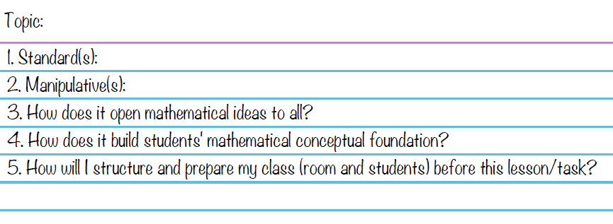
1 Topic & 4 Notecards
Record the details below on 4 notecards… 1 will be kept and 3 will be traded...
Notes:
Structures for organizing for the Mix and Mingle activity:
Notecards could be color coded so participants must find 3 others with either the same color or different colors. They take turns sharing their lesson/task summary. Then they trade cards and continue until they have traded all three of their cards.
Participants could begin creating groups of four. Then they each share their items detailed on the notecard and then trade cards.

Slide 14
Mix and Mingle
Find 3 other people and take turns sharing your note card.
Notes:
Mix and mingle – share your manipulative/lesson/task and how it is going to make mathematics accessible to all students and develop their conceptual understanding of mathematics.
See notes on previous slide for ideas of structures for intentionally mixing participants up using the notecards

Slide 15
Magnetic Statements Remix Which statement(s) is supported by your lesson/task?
Everyone can learn math to the highest levels
Mistakes are valuable
Questions are really important
Math is about creativity and making sense
Math is about connections and communicating
Math class is about learning not performing
Depth is more important than speed
Notes:
Revisit the magnetic statements. Move to the statement that now attracts you the most when considering utilizing manipulatives to increase students’ access to and foster student’s conceptual understanding of mathematics.
Which statement applies to your lesson/task? Why? – If it doesn’t look back at numbers 3 and 4 on your notecard. If still struggling, how might you change it so these statements are supported in the lesson/task?

Slide 16
trek.k20center.ou.edu/oe/#####
School email
(No Participant ID is required.)
Notes:
***This slide MUST be edited with the correct TREK number (trek.k20center.ou.edu/oe/#####).***
Click on the link in the orange box to replace the number signs (#####) at the end of the web address with the provided TREK number from your K20 Center contact.
TREK evaluations will be used at the end of any GEAR UP Professional Development Session. Your Professional Development Coordinator at the K20 Center will provide you with a TREK number once you have notified them of the scheduled PD. The provided TREK number will be added to Slide 16, replacing the five number signs (#####).

Slide 17
Follow-Up Session
Reflecting on using Manipulatives for Mathematics
Notes:
Anywhere from a week to a month after the session, schedule and host an informal reflection with small groups of participants who attended the formal professional development session. This might be one session with all participants or multiple sessions with different participants each time. These follow-up sessions can be held during a PLC or teacher planning period since they are to be short and informal. Use slide 18 and the attached "SCORE Reflection Note Sheet" for this follow-up session.

Slide 18
SCORE
What is one manipulative you used to Support students’ conceptual understanding and make mathematics more accessible?
What was successful and needs to be Celebrated?
What Obstacle did you face and overcome?
What might you Refine in the future when using this manipulative?
Extra notes or ideas from other teachers?
Notes:
Instruct participants to use the "SCORE Reflection Note Sheet" to record reflective notes about their own experience implementing any lessons and tasks that used the manipulatives explored from the professional development session.
After participants have reflected and recorded their thoughts, facilitate a small group share-out/discussion providing each attendee time to highlight the manipulatives they used and their students' overall experience. The questions on slide 18 mirror the "SCORE Reflection Note Sheet" and should be used to guide the discussion.
Encourage attendees to use another manipulative and continue to follow up with each participant, cultivating a safe environment for accountability and growth.

