Slide 2
PocketLab Sensors:
Engage Students with Data
Teresa Randall, Ph.D.
MY SUCCESS Science Curriculum Specialist
terrierteacher@ou.edu

Slide 3
Essential Question
How can teachers get students excited, engaged, and comfortable interacting with data in an authentic way?

Slide 4
Objectives
View classroom examples of PocketLab sensors in use.
Experience hands-on time with three different PocketLab sensors.

Slide 5



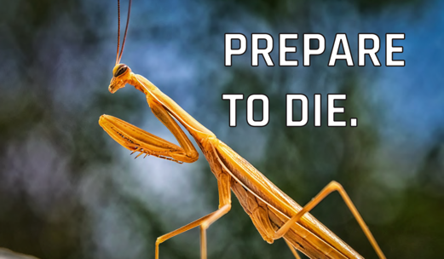
Magnetic Memes
Move to the poster that describes how you feel about using data in the classroom with your students.
With your group, discuss why you chose that poster.
Notes:
ENGAGE

Slide 6
Magnetic Memes
Move to the poster that describes how your students feel about using data in the classroom.
With your group, discuss why you chose that poster.
Notes:
ENGAGE

Slide 7
Stations
With your group, work through the Task Card at each station.
Each card is associated with a PocketLab sensor that can be used in your classroom.
  Voyager
  Air
  Weather
Use the Note Catcher to write down any helpful or pertinent information for your personal use.
Notes:
EXPLORE -- 6-8 MIN/STATION =18-24 MINUTES TOTAL
Have 3 devices (iPads) set up -- 1 at each station. They will already have the PocketLab app downloaded and opened up for use
You could tell them about the app (maybe make a QR code for them to scan if they want to put it on their own device).

Slide 8
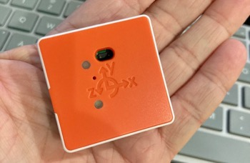
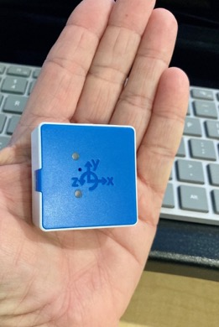
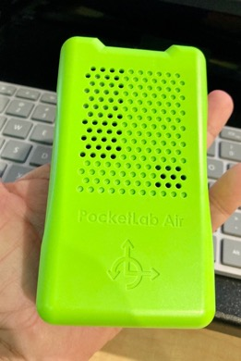
PocketLab Sensors to the Rescue
Collect, visualize, and analyze live experiment data in a way that makes labs come alive.
Use wireless, multi-functional, and remote-ready sensors.
Transmit data instantly to your
free PL Notebook, a full-featured digital lab book, for visualization and analysis.
Notes:
EXPLAIN

Slide 9
Meet Voyager, the Adventure Sensor
The world is made of motion!
Voyager incorporates eight popular science sensors in one small pocket device.
You can measure almost anything—motion, altitude, light, magnetic field, and more.
The Voyager is adaptable. It can be used for F2F, hybrid, and remote learning.
Notes:
EXPLAIN

Slide 10
Meet Air, the Climate Sensor
Air is a compact tool for professional-grade air research.
It enables you to investigate the air in your own communities.
It also enables you to assess climate patterns.
Air empowers citizen scientists to make climate change personal and involves them in gathering real-world data.
Notes:
EXPLAIN

Slide 11
Meet Weather, the Mini-Meteorologist
Weather takes you beyond the daily weather report and shows the stories behind the seasons.
It enables you to explore complex weather factors interacting behind the scenes.
Weather teaches students how to decipher weather forecasts.
Notes:
EXPLAIN

Slide 12
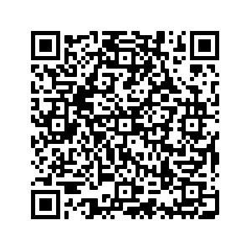
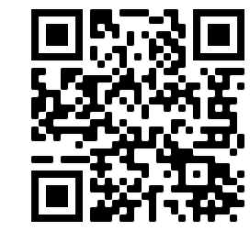
Your Classroom Your Way
Explore this elementary lesson:
“Using Nature as Inspiration
to Design Martian Landers”
Visit the PocketLab Library:
Use your Note Catcher to jot down any lessons or ideas that could be useful in your classroom.
Notes:
EXTEND:
GIVE THEM SOME OF THE LISA PITTS DIRECTED ONES OR STEER THEM TO THE PL RESOURCE LIBRARY
Inside Notebook software are hundreds of lessons written by experts, teachers, and our in-house team, adaptable to any classroom
Elementary Lesson: https://docs.google.com/presentation/d/1e8reJuDDTqUdWbmzHOSbyzhRiZiCFfRb/edit?usp=sharing&ouid=102766245578584010233&rtpof=true&sd=true
Lesson Library: https://www.thepocketlab.com/lesson-library

Slide 13
How can you get students excited, engaged, and comfortable interacting with data?
Six-Word Memoirs: Prepare a short summary of no more than six words about how you can get your students excited about using data with pocket sensors
Notes:
K20 Center. (n.d.). Six-word memoirs. Strategies. https://learn.k20center.ou.edu/strategy/75
Answer the question with a six-word summary of the main idea.

Slide 14
“The art of teaching is the art
of assisting discovery.”
—Mark Van Doren

