Slide 2
The 3-2-1 Instructional Strategy
3 Ways 2 Use 1 Strategy Across Content Areas

Slide 3
Essential Question
How can instructional strategies be modified to fit the needs of students in the classroom?

Slide 4
Lesson Objectives
Apply the 3-2-1 instructional strategy to multiple content areas at different parts of a lesson.
Construct a 3-2-1 for your content area.

Slide 5

Fist to Five
Closed Fist: I haven’t heard of it.
One Finger: I have heard of it but haven’t used it.
Two Fingers: I have used it once or twice.
Three Fingers: I have used it a few times.
Four Fingers: I have used it many times.
Five Fingers: I have used it extensively.
Notes:
K20 Center. (n.d). Fist to Five. Strategies. https://learn.k20center.ou.edu/strategy/68

Slide 6
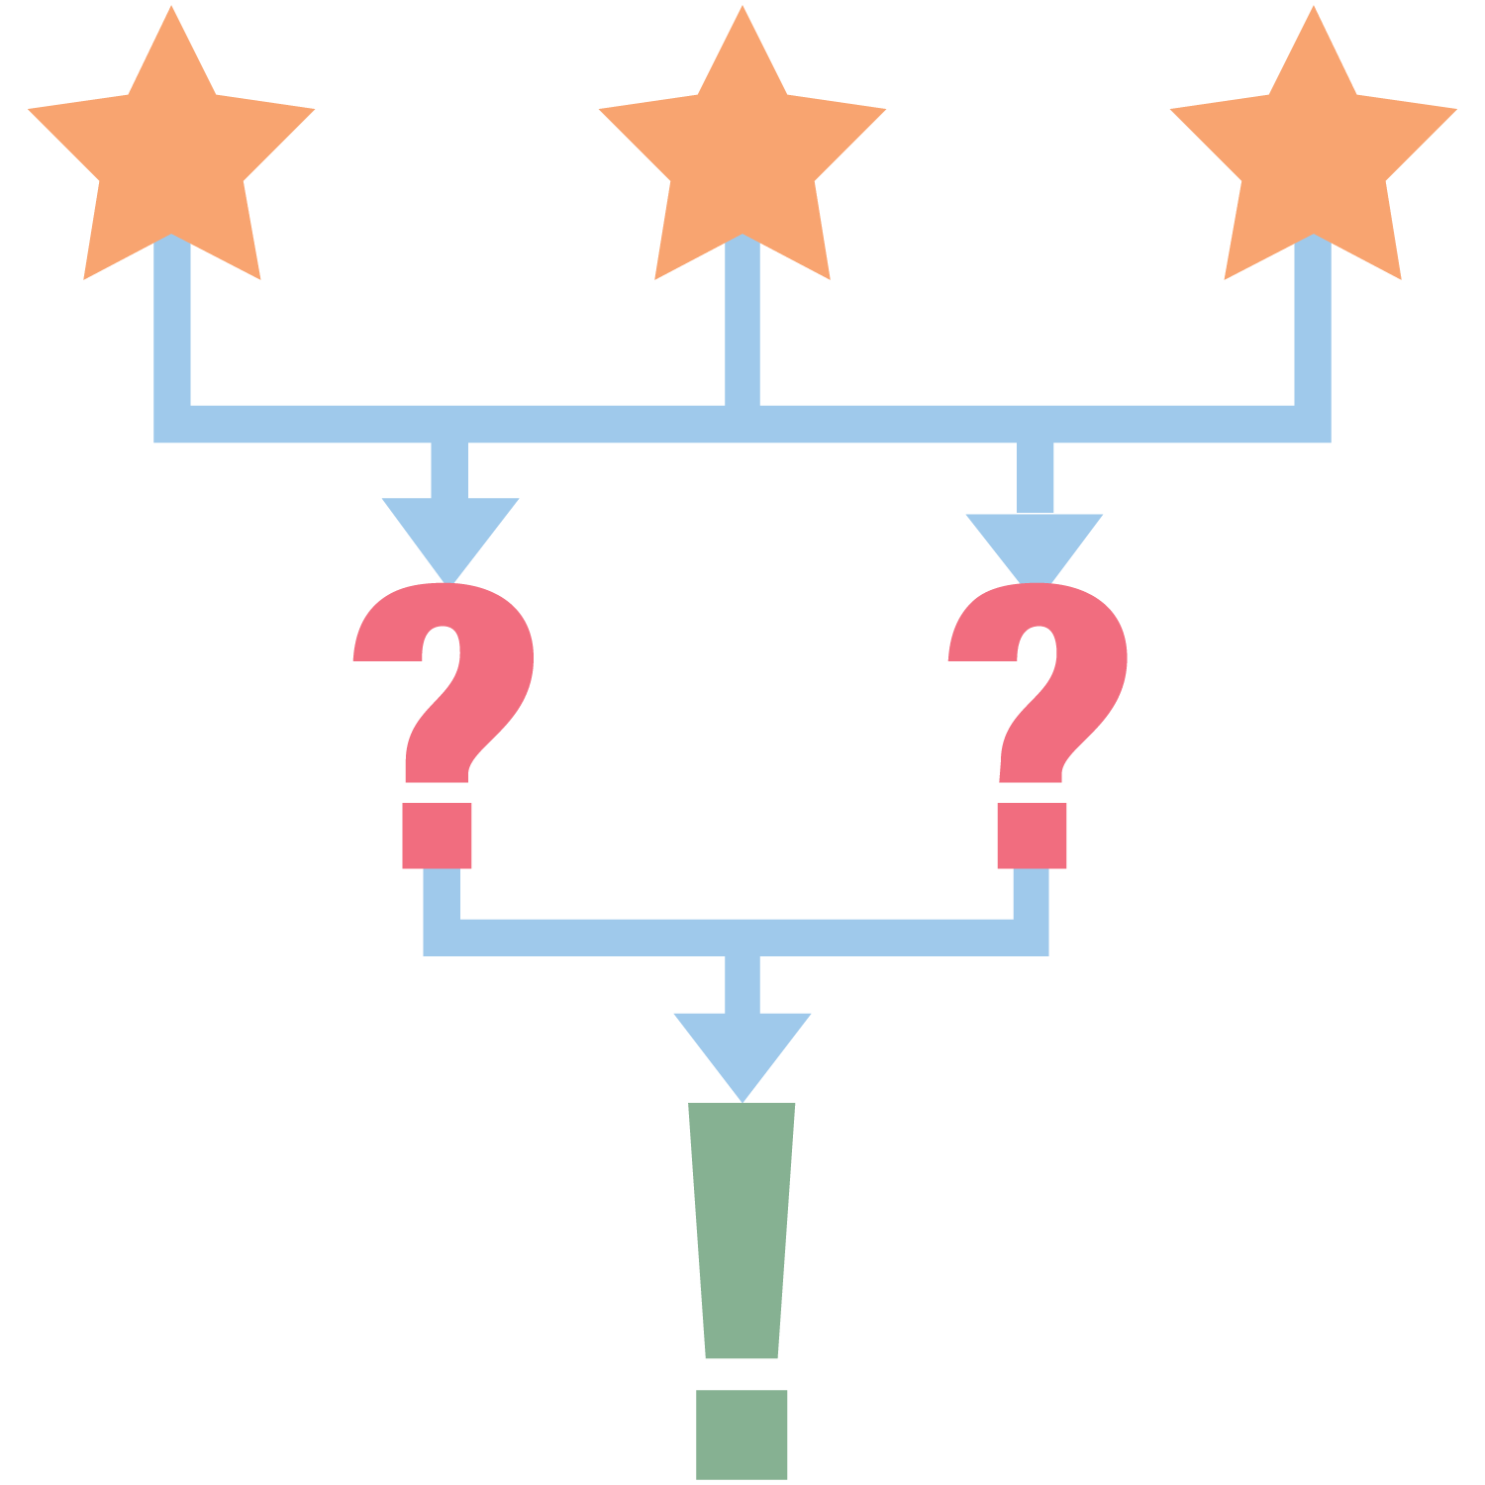
3-2-1 Instructional Strategy
3 - What are three things you learned?
2 - What are two questions you still have?
1 - What is one thing you found interesting?
Notes:
K20 Center. (n.d.). 3-2-1. Strategies. https://learn.k20center.ou.edu/strategy/117

Slide 7
Geometry Example - Prior Knowledge
Name 3 polygons.
Name 2 places polygons are found in the real world.
Name 1 characteristic of polygons.
  Jam Board QR Code here

Slide 8

Social Studies Example - Build Anticipation
3 things you notice in the photo.
2 questions you have about the photo.
1 thing you can infer from the photo.
Notes:
K20 Center. (n.d.). 3-2-1. Strategies. https://learn.k20center.ou.edu/strategy/117

Slide 9
Science Example – Formative Assessment
Walk to each of the eight stations posted around the room.
Read over the activity that is described at each station.
Return to your seat and think about:
  3 things all the stations had in common.
  2 differences you observed among the stations.
  1 question you still have about waves.

Slide 10
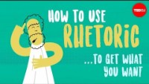
ELA Example – The Use of Rhetoric
Notes:
Langston, Camille A. (n.d.). How to use rhetoric to get what you want. TedEd. https://ed.ted.com/lessons/how-to-use-rhetoric-to-get-what-you-want-camille-a-langstonu want - Camille A. | TED-Ed

Slide 11
3-2-1 Rhetoric
3 things you learned about rhetoric.
2 reasons why rhetoric is important.
1 question you have about rhetoric.

Slide 12
Similar and Different
How were the four examples of 3-2-1 similar?
How were they different?

Slide 13

Make your own 3-2-1
Open a copy of the 3-2-1 Template:
  bit.ly/3n9wsRW
Think of the content you teach. How could you modify the 3-2-1 strategy for your content?
Create a 3-2-1 activity to take back to your classroom.

Slide 14
3-2-1 Reflection
3 – When are three times you can use 3-2-1 during a lesson?
2 – What are two ways to adapt the 3-2-1 strategy?
1 – What is one benefit of using the 3-2-1 strategy?

