Slide 2
Getting Started with Makerspaces

Slide 3
Essential Question
What is the added value of Makerspaces to learning?
What do you need to start up a Makerspace with students?

Slide 4
Lesson Objectives
Understand how to develop a culture of Making.
Develop a plan for using low cost/no cost Maker tools.
Explore the best tools to add to their own spaces.

Slide 5
Making Meaning
Using the materials on your table, create something that showcases the most important point of the last unit you taught.

Slide 6
Exploring Makerspaces
What do you notice about Makerspaces?
Select a color of sticky note that is different from the others at your table to record what stands out to you.

Slide 7
Exploring Makerspaces
Find someone with the same color sticky note as yours and talk about what you noticed.

Slide 8
Making Makerspaces
Think about what materials you already have on hand.

Slide 9
Makerspace Ideas
[Insert forced copy QR Code]

Slide 10
Maker Mindset
Looks like…
Sounds like…
Feels like…

Slide 11
OETT Grants
Notes:
https://www.oett.org/grants/

Slide 12
Four Corners
Move to the corner of the room corresponding to your comfort level concerning each of the following items.

Slide 13
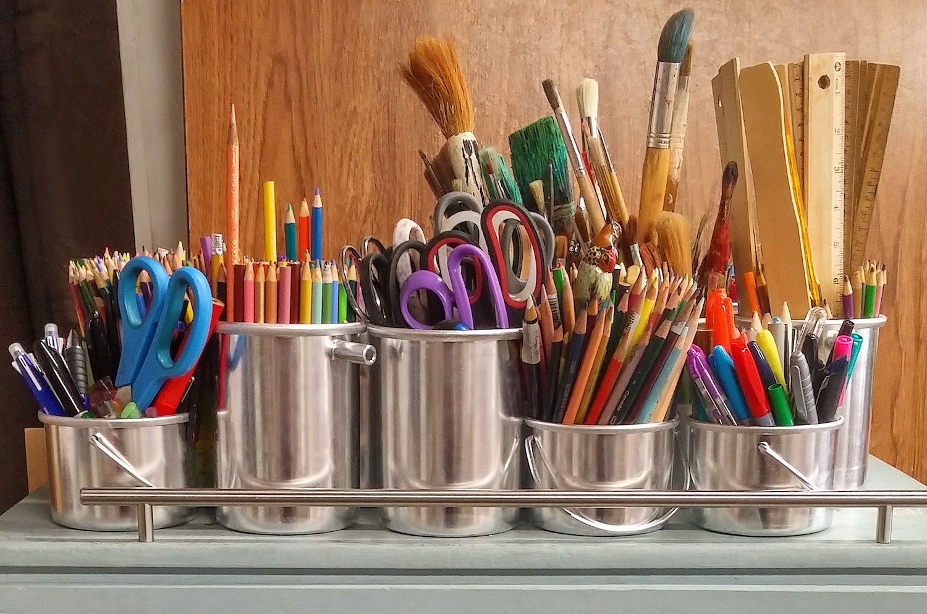
Basic Art Supplies
Notes:
Pixabay. (n.d.). Pencils in Stainless Steel Bucket. Retrieved from Pixabay: https://www.pexels.com/photo/pencils-in-stainless-steel-bucket-159644/

Slide 14
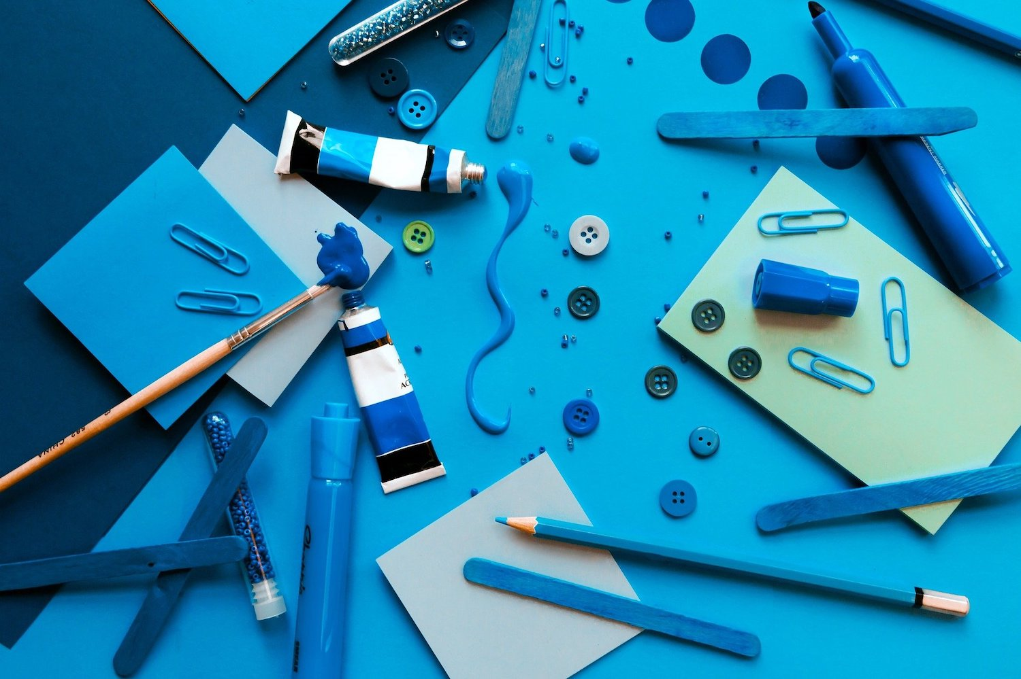
Unconventional Supplies
Notes:
bridgesward. (2017, August 4). Retrieved from Pixabay: https://pixabay.com/photos/art-craft-design-paper-hobby-2578353/

Slide 15
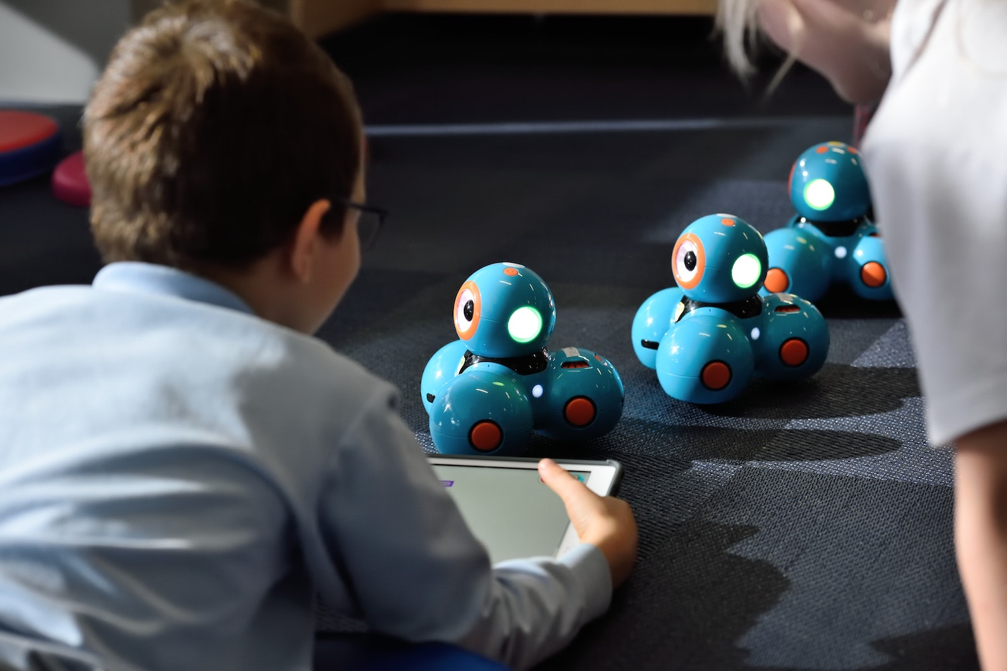
Robots
Notes:
stem.T4L. (2019, September 15). Retrieved from Unsplash: https://unsplash.com/photos/rSdkzkfvqlY

Slide 16
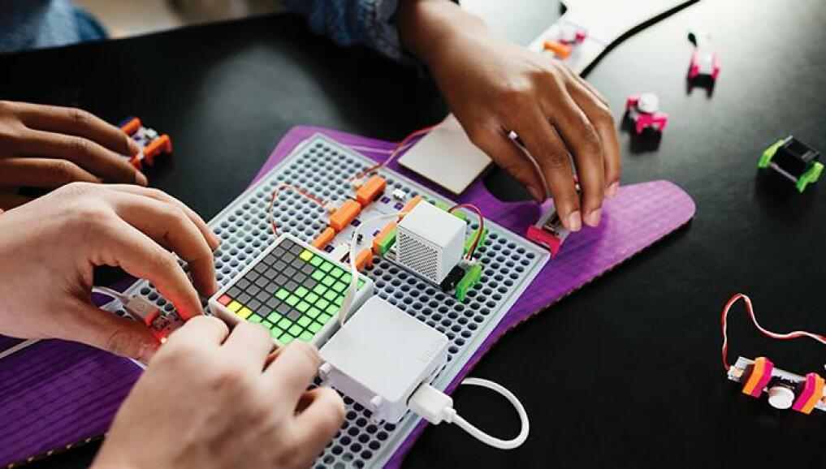
Little Bits
Notes:
PC Magazine. (n.d.). LittleBits Code Kit Review. Retrieved from PC Mag: https://www.pcmag.com/reviews/littlebits-code-kit

Slide 17
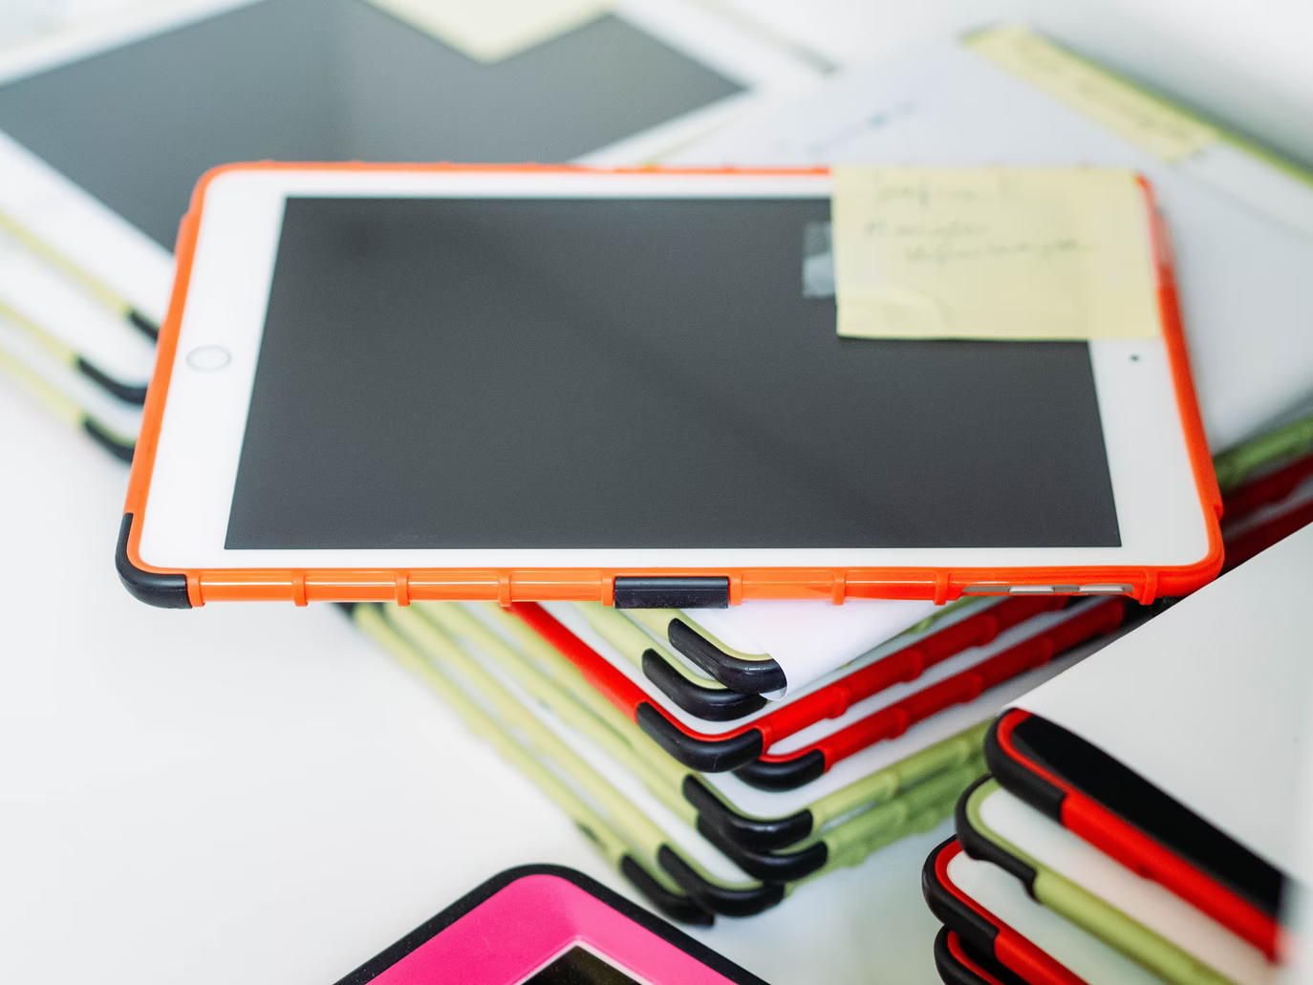
iPads
Notes:
Lambillotte, A. (2020, November 9). iPads used by Students in School Classrooms. Retrieved from Unsplash: https://unsplash.com/photos/1382ByZsCtU

Slide 18
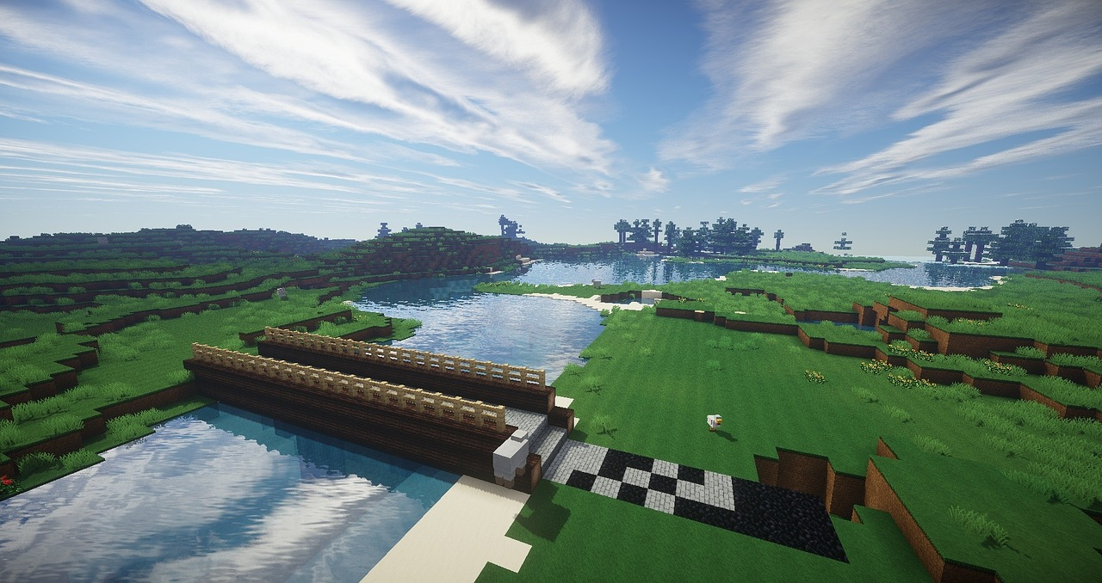
Minecraft
Notes:
Chickenonline. (2015, March 12). Retrieved from Pixabay: https://pixabay.com/illustrations/minecraft-bridge-river-wood-669310/

Slide 19
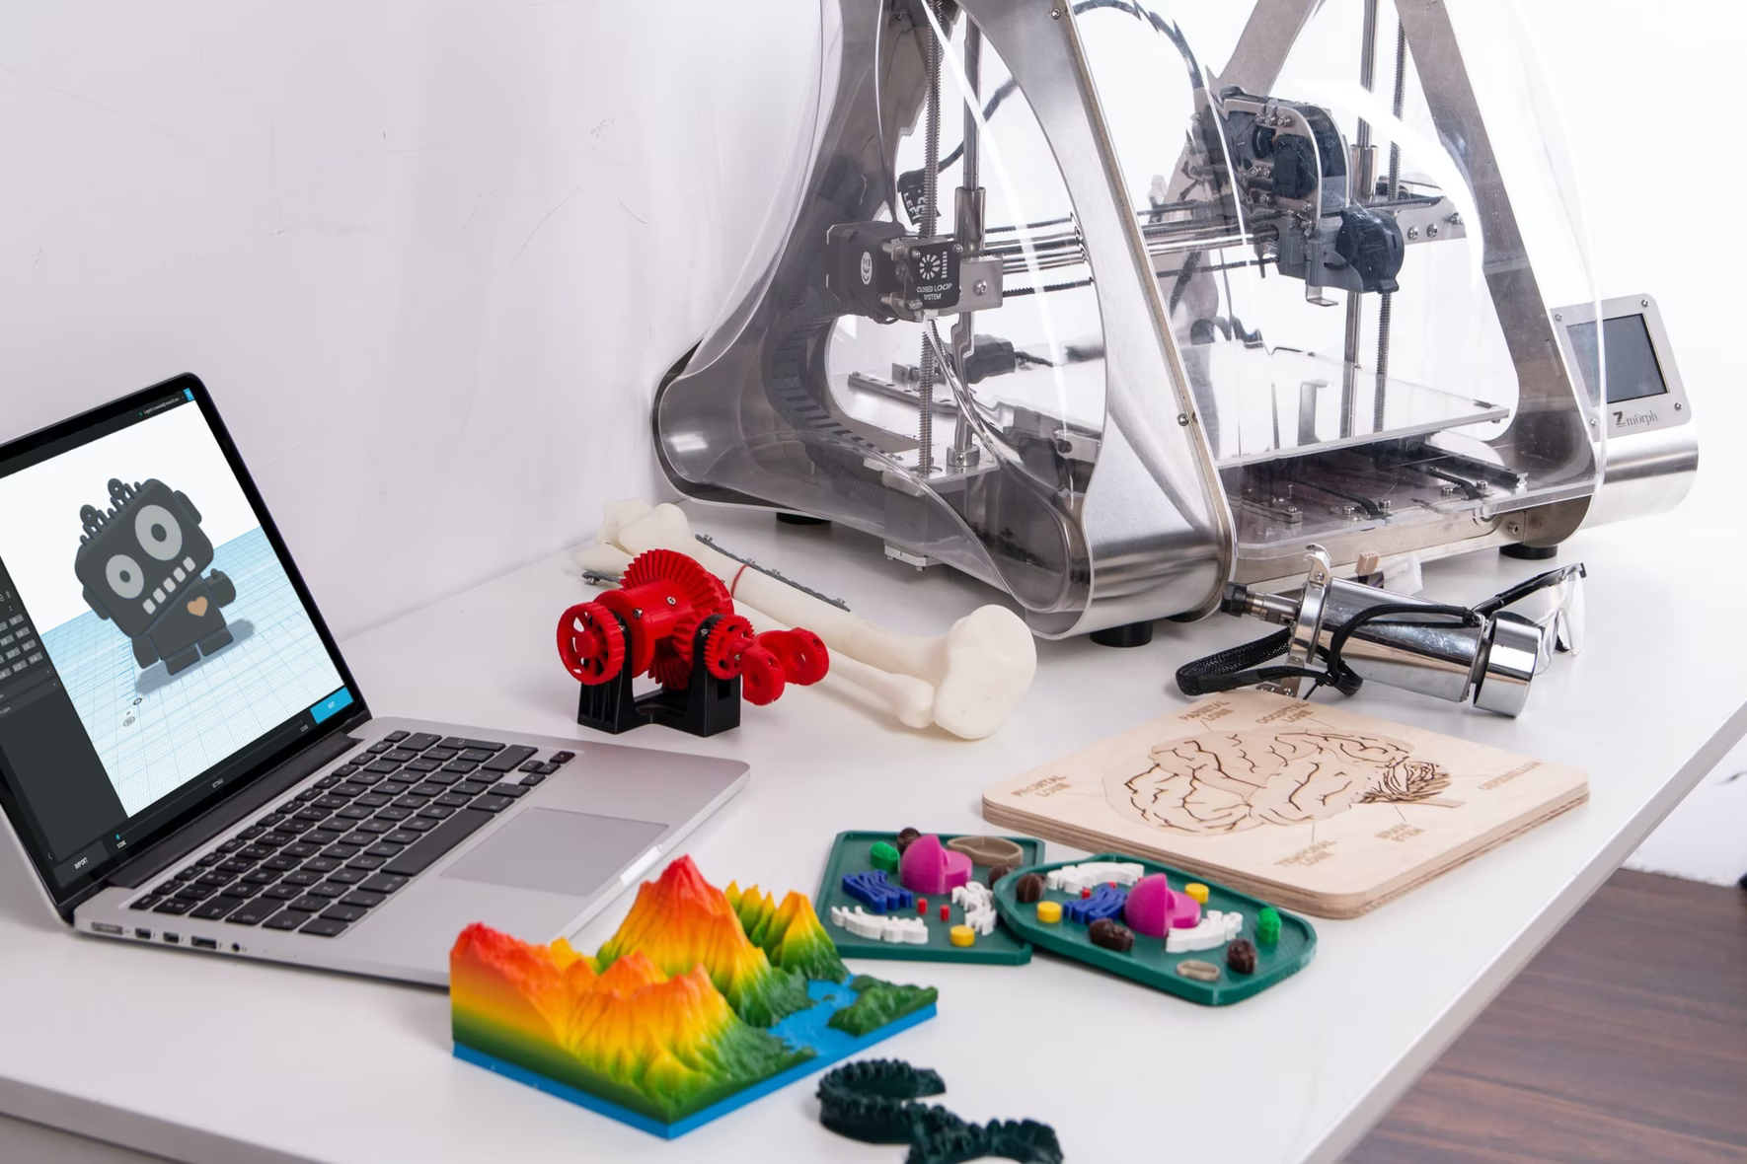
3D Printers
Notes:
Tao, X. (2010, October 22). Retrieved from Unsplash: https://unsplash.com/photos/Fo-HQUlRGkU

