Slide 2
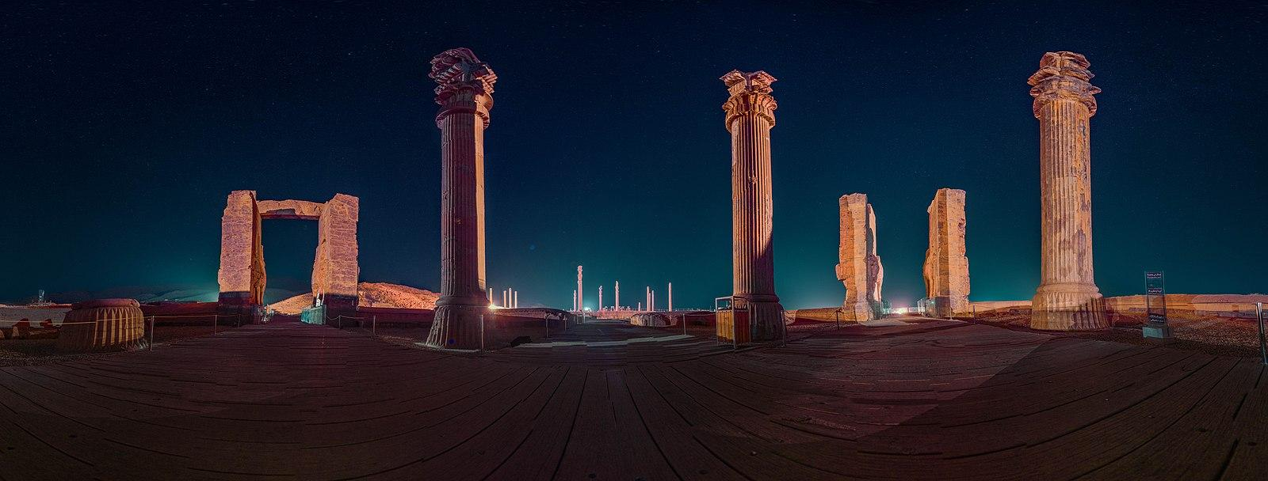
Imagine the Possibilities with Virtual Reality
Lindsay Hawkins, GEAR UP for MY SUCCESS PD Coordinator
Notes:
Before the PD, make sure the teacher/facilitator has downloaded the A First Look At College expedition to the teacher tablet via the school WiFi, then connect the teacher tablet back to the Expeditions router along with the students devices. You will want to follow the quick step by step guide to getting the expedition downloaded on the teacher tablet before the PD starts (and telling teachers to do this before the lesson they’re doing starts) and that way you only have to get the student devices connected for participants when they come in. The directions for getting the student devices hooked up are also on the quick step by step guide.
IN ADDITION TO DOWNLOADING THE COLLEGE TOUR EXPEDITION, ALSO DOWNLOAD THE EGYPT EXPEDITION THAT WILL BE USED LATER IN THE PD. THAT WAY YOU DON’T HAVE TO HOOK THE ROUTER UP TO THE INTERNET TWICE.
Image: https://commons.wikimedia.org/wiki/File:Persepolis_Panorama_360_Virtual_Reality.jpg

Slide 3
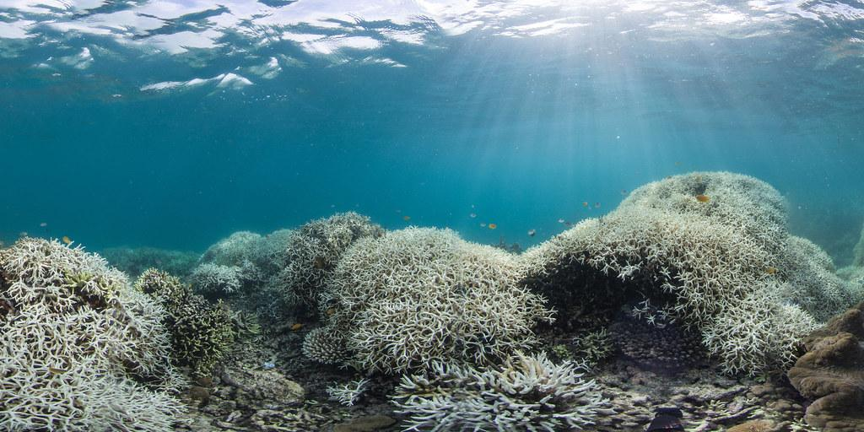
YouTube 360-Degree Videos
Notes:
Facilitator can share this video with the participants OR allow them to watch it on their own devices. Show them that they can manipulate the 360 video.
Image: https://www.flickr.com/photos/stopadani/33764630136
Direct link here to the underwater video: https://youtu.be/pJU626sUUiU (VR 360: Protecting Tanzania's Reefs | WCS)
Participants can also use this video on their own devices - https://www.youtube.com/watch?v=hNAbQYU0wpg (rollercoasters)

Slide 4

Notes:
Image is a screenshot from help videos on the Lenovo website. I can get the direct video links if you need me to for copyright purposes.

Slide 5
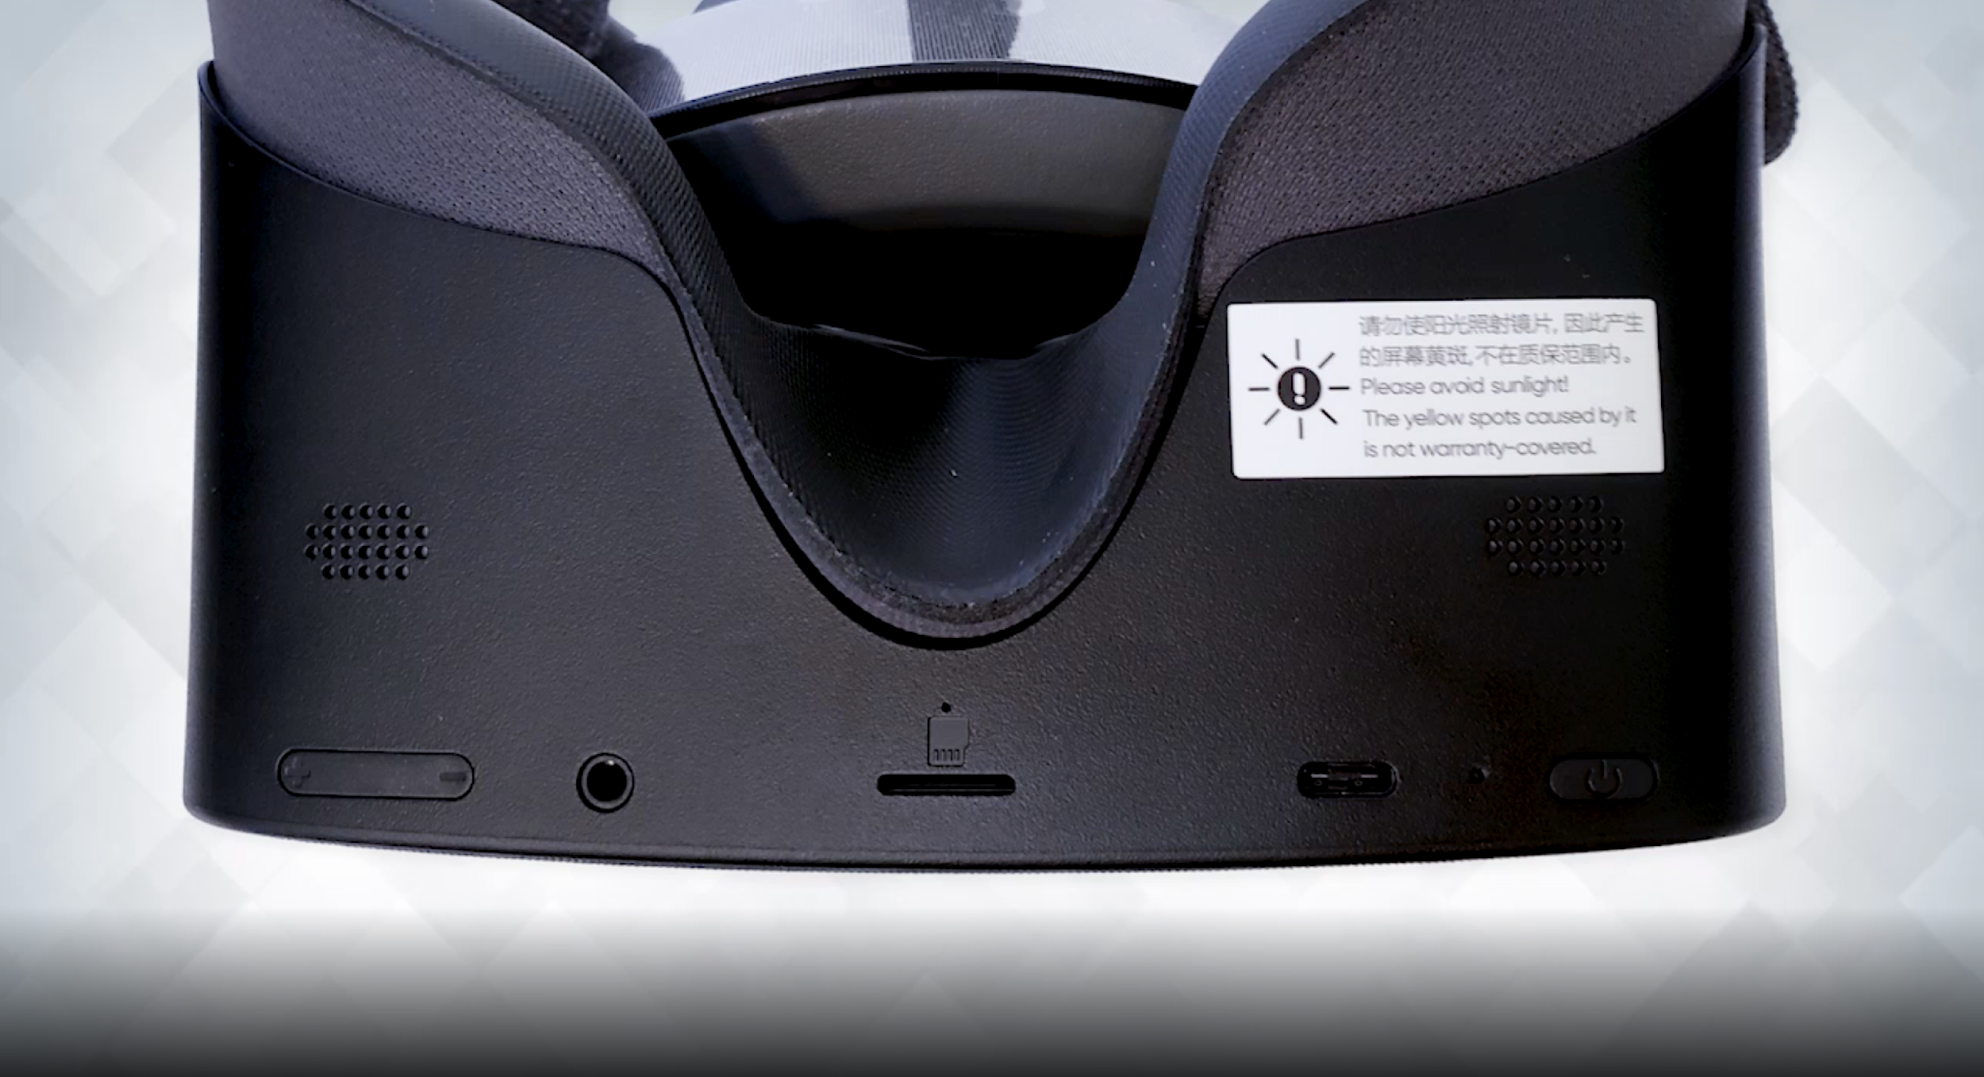
Speakers
Audio Plug
Power Button
Power Plug
Volume
SD Card

Slide 6


Slide 7


Slide 8
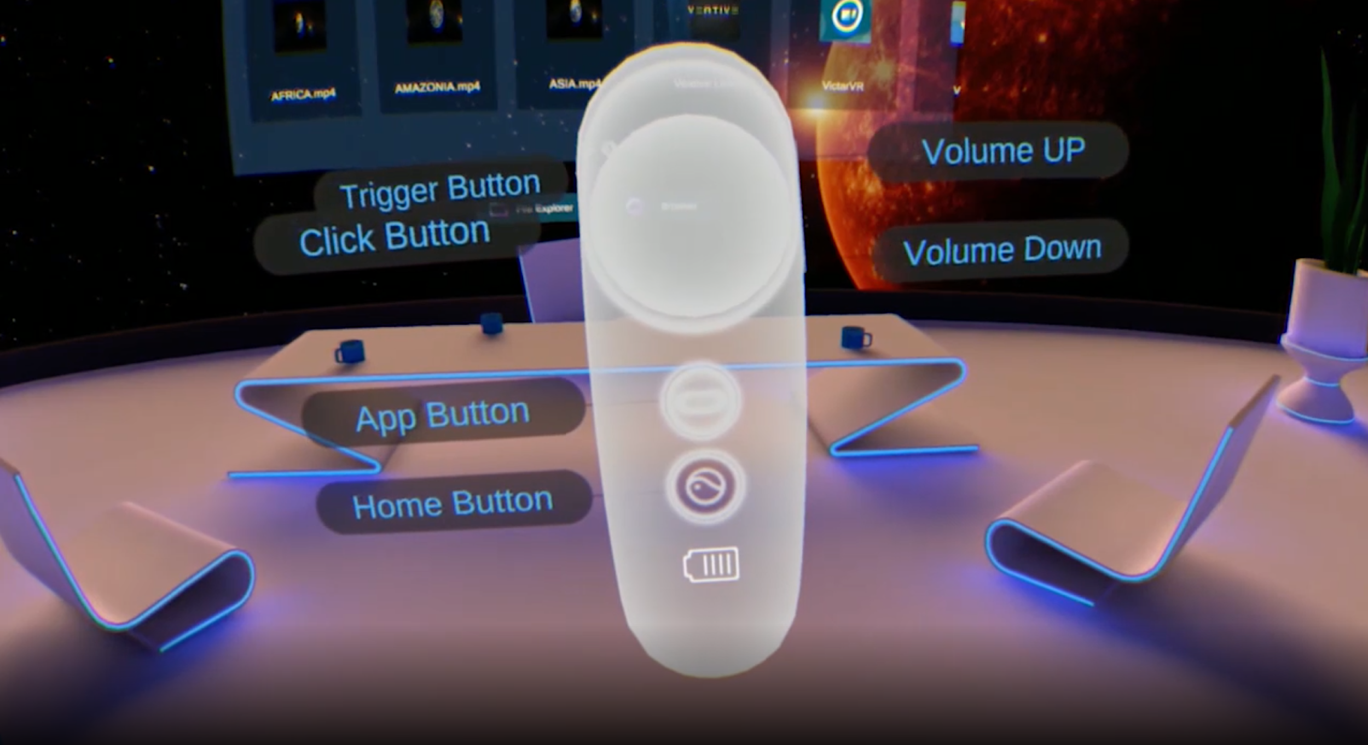

Slide 9
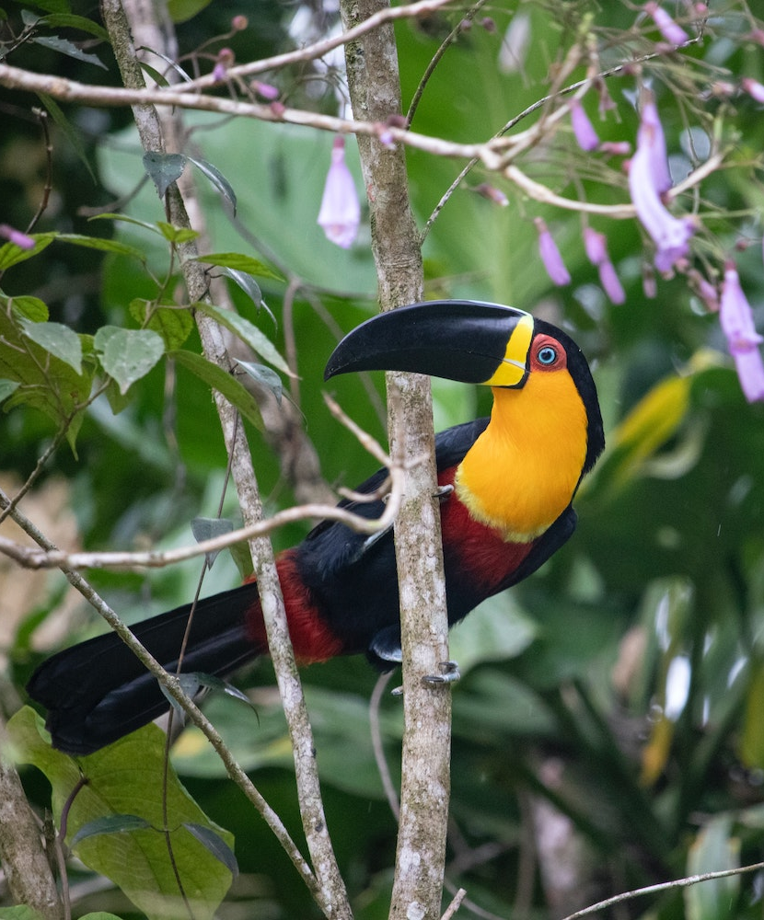
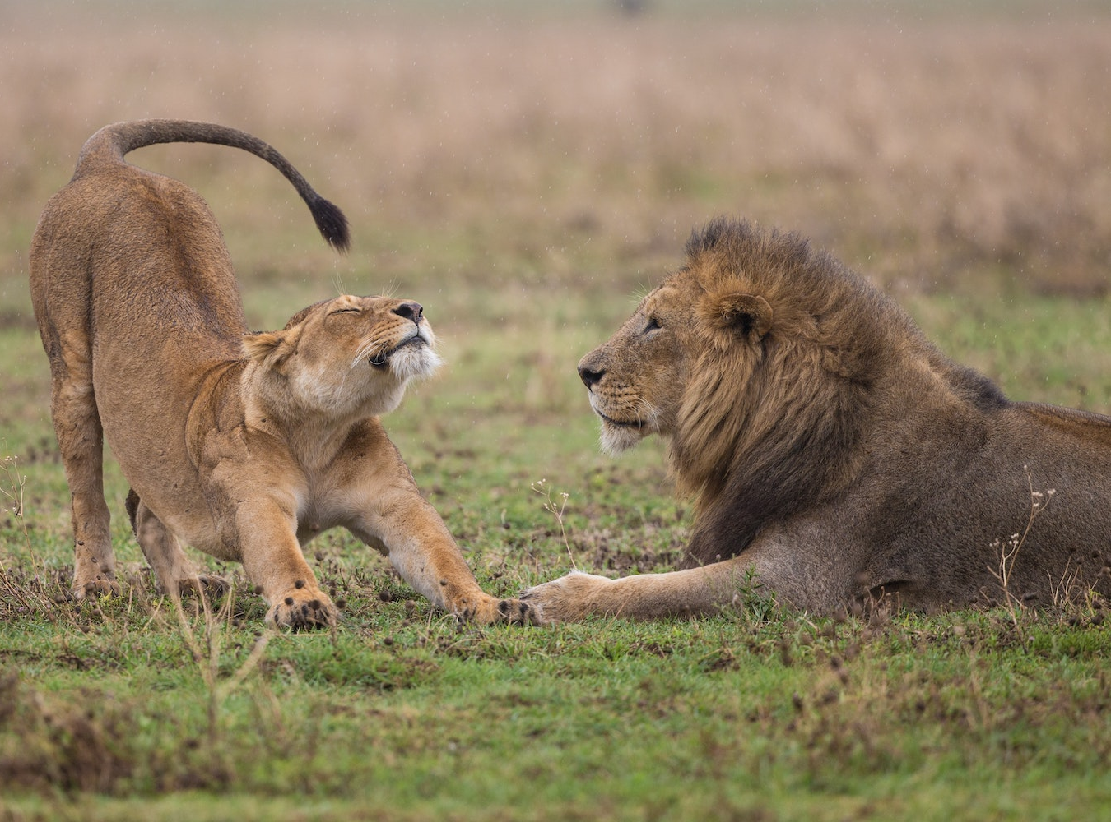

Let’s Dive Right In!
AMAZON
AFRICA
ASIA
Notes:
Then have every participants get a viewer. Teacher/facilitator will then allow the participants to watch a 360 video through the VR headset.

Slide 10
The Experience
What was similar and different between the two experiences?
What are the advantages of using VR in the classroom?
Notes:
Ask the question on the slide. Potential Answers: Active learning, experiential learning, immersive experiences, multi sensory learning, broadens perspective, gives exposure to both past and future

Slide 11
GEAR UP for MY SUCCESS Goals
Increase cohort academic performance and preparation for PSE
Increase High School graduation and PSE participation
Increase student educational expectations and increase student and family knowledge of PSE options, preparation, and financing.

Slide 12
Essential Question
How can an authentic, technology-enriched learning environment increase student engagement and academic performance?

Slide 13
Objectives
Experience VR Expeditions through a career exploration
Explore available expeditions and lessons
Apply understanding of VR expeditions in the creation of a classroom activity
Notes:
Objectives for the session

Slide 14
Why is education beyond high school important to your future?
Notes:
Note to Lindsay: Add think pair share image once downloaded to ppt.
Think top 10 benefit to college

Slide 15
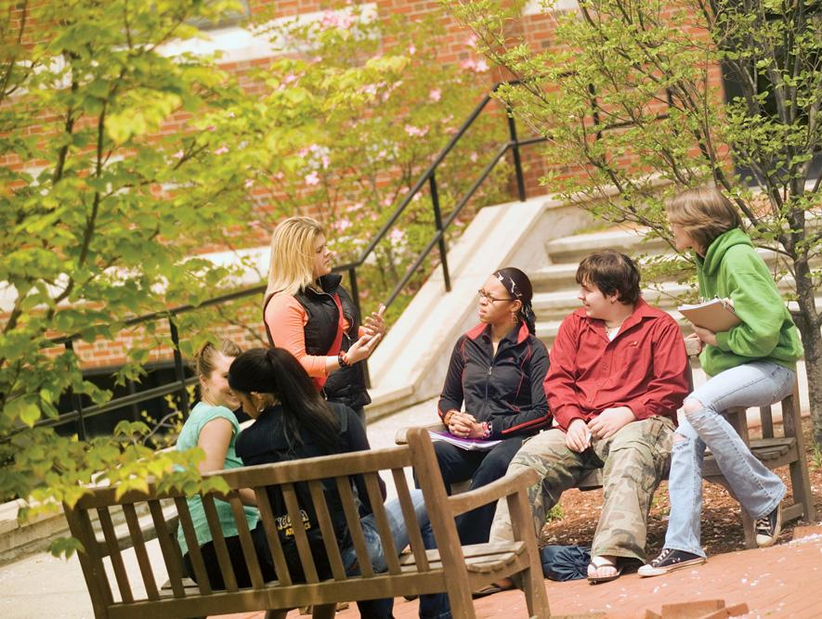
Brainstorming
If you were to explore careers, what might you learn?
What might you want to know or ask?

Slide 16
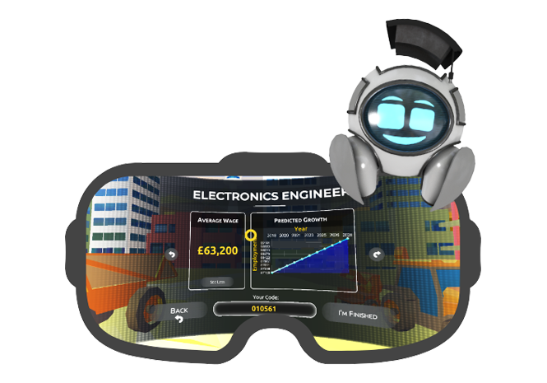
Let’s Go On A
Career Exploration!
Launch Your Career
Take the profile quiz
Explore careers that are connected to your profile
Notes:
ONLINE OPTION: https://launchyourcareer.com/p/quiz (profile quiz - if there are not enough devices)

Slide 17

What did you discover?
Notes:
Think-Pair-Share
After finishing the exploration, have participants get back with their groups to discuss their findings from the career tour.
Then have a whole group share out.

Slide 18
What are the benefits of a virtual career tour?
What might be the challenges of a virtual career tour?
Notes:
Table Talk and then share out what are some benefits and challenges? Transition the conversation to extend to classroom content and career café.
Maybe show the videos on K20’s YouTube channel.
Zoom into your career: https://www.youtube.com/playlist?list=PL-aUhEQeaZXIhi-ivvrQTrrEAlWvFWisR

Slide 19
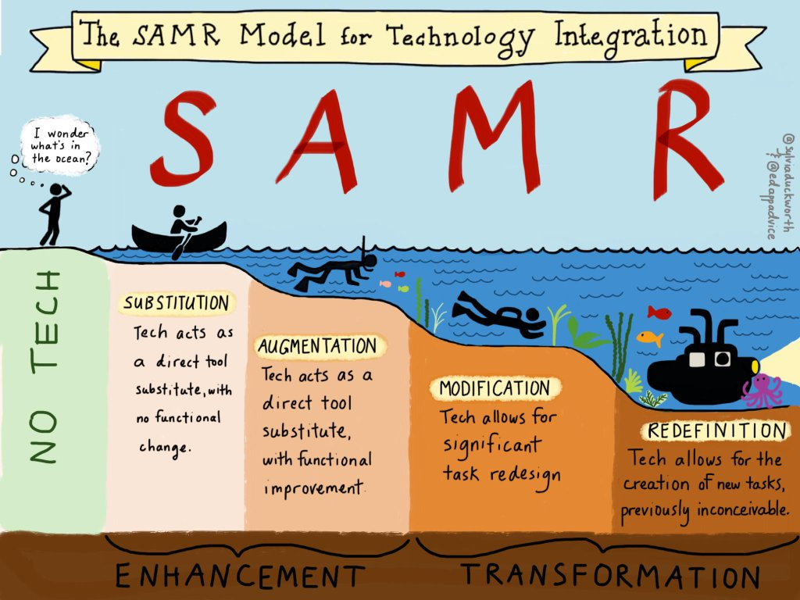
Notes:
SAMR Model Explained by Students:
https://youtu.be/7nSTnwbNM58 (higher resolution - October 18, 2018)
https://youtu.be/OBce25r8vto (SAMR Video - older 2011)
Introduce the SAMR model as a resource to consider how all integrated technology can be used at different levels to provide students with an enhanced learning experience. While watching the video, participants use a modification of the strategy, Window Notes to record only the Facts and Questions. NOTE: Facilitators can add the two additional window notes (feelings and ideas) during the Extend and Evaluate activity.
Already familiar with SAMR?
Remind participants how SAMR is a model to scaffold the integrated technology at different levels. Allow participants to share their understanding and uses of the SAMR model. Participants can watch the video to obtain a common understanding or refresh their understanding of SAMR.
Participants first explain how VR headsets fit within the SAMR model. If additional explanation is needed, explain that virtual reality tools and resources shift integration to the Modification and Redefinition level because they take students places they would never be able to do otherwise. Refer back to the career tour experience and the 360-degree videos, these are examples of modification and redefinition.
Transition by telling the teachers they’re going to now look at how they can incorporate VR programs and experiences into a content lesson.

Slide 20
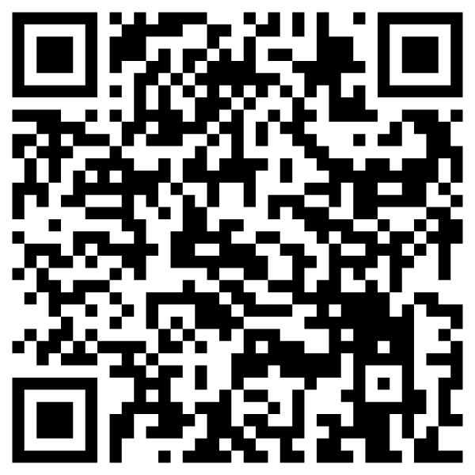
Additional VR Resources
YouTube https://www.youtube.com/360/featured
Google Arts & Culture https://artsandculture.google.com/explore
*Google Expedition Google Sheet tinyurl.com/k20vrtrips
Lessons Integrating Expeditions tinyurl.com/k20tes
Notes:
Add a few non vr resources K20’s Zoom into your career videos, link LEARN activities, because we can’t just stop at the VR… Also link LEARN lessons that could integrate a 360 video.
YouTube – use youtube 360 videos through the VR headsets by searching the embedded Firefox Reality Browser. Make sure to make the video fullscreen to get the full VR experience.
Tell participants now that they have experienced two different Google Expeditions, one of which was embedded in a campus tour experience, take some time to explore the following websites and mine them for expeditions you could potentially use in a lesson. Have participants fill in the graphic organizer as they find expeditions they can use (at least 3). Through this graphic organizer, they are listing the expedition they find, a summary of it, how it meets/addresses the standards they teach, and how they could incorporate it in a lesson. This should take them a good chunk of time. Tell participants that they should be prepared to share out what they found and how they might use it. Tes Website with middle school lessons: https://www.tes.com/en-us/teaching-resources/hub/middle-school

Slide 21
Lesson Planning
Now that you’ve had time to mine through the VR resources, spend the next half hour fleshing out and putting together a lesson plan that incorporates one of the resources you found.
Notes:
PRESENTER’S NOTE: IF THIS IS A 3 HOUR PD, YOU CAN ADD THIS SLIDE AND GO DEEPER INTO THE APPLICATION PROCESS, HAVING TEACHERS ACTUALLY CREATE A LESSON WITH AN EXPEDITION INCORPORATE INTO IT.

Slide 22
Essential Question
How can an authentic, technology-enriched learning environment increase student engagement and academic performance?
Notes:
Revisit the essential question and ask participants how GE specifically can increase student engagement and academic performance

Slide 23
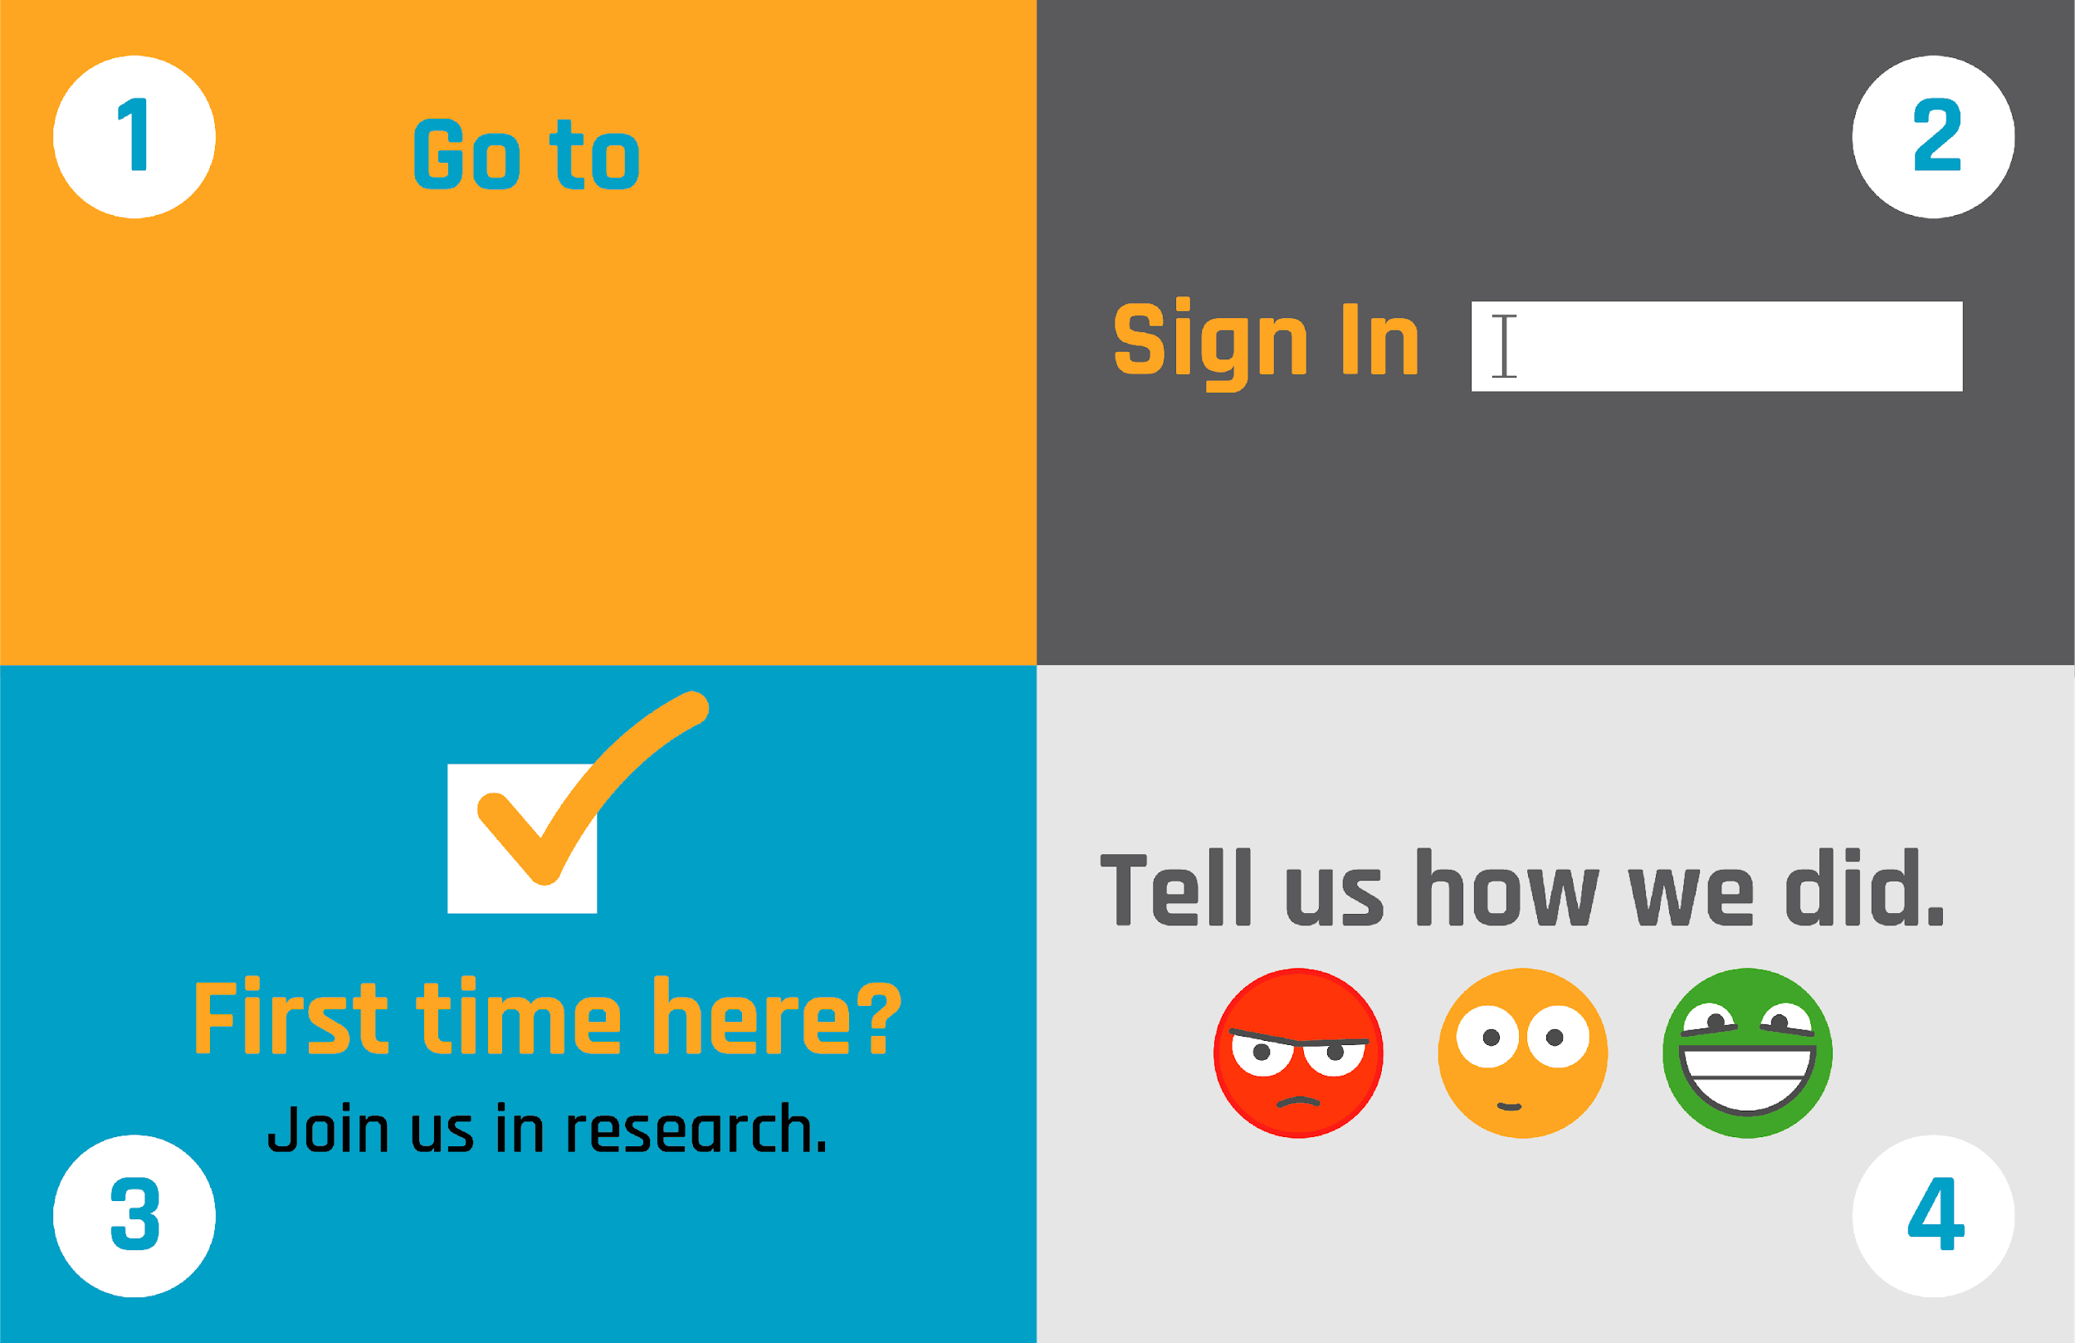
trek.k20center.ou.edu/oe/#####
Google Login
(No Participant ID is required.)
Notes:
***This slide MUST be edited with the correct TREK web address.***
Click on the link in the orange box to edit the numbers at the end and the QR code.

