Slide 2
Name Tent
Please fold your cardstock in half.
Write your name and the school where you teach.
Place it in front of you!

Slide 3
Authenticity in Math:
Digital Breakouts
K20 Center

Slide 4

Traditional Teaching
Notes:
Kholoud.almulla. (2012). Traditional teaching [Video]. YouTube. https://youtu.be/aWYcOR18-x0

Slide 5

Video Reflection
Was there a time in your life that you felt this way in the classroom?
What was happening in the classroom that made you feel that way?
Even though content standards were being addressed, does this environment increase academic performance and engagement?
Notes:
K20 Center. (n.d.). Elbow Partners Strategies. https://learn.k20center.ou.edu/strategy/116

Slide 6
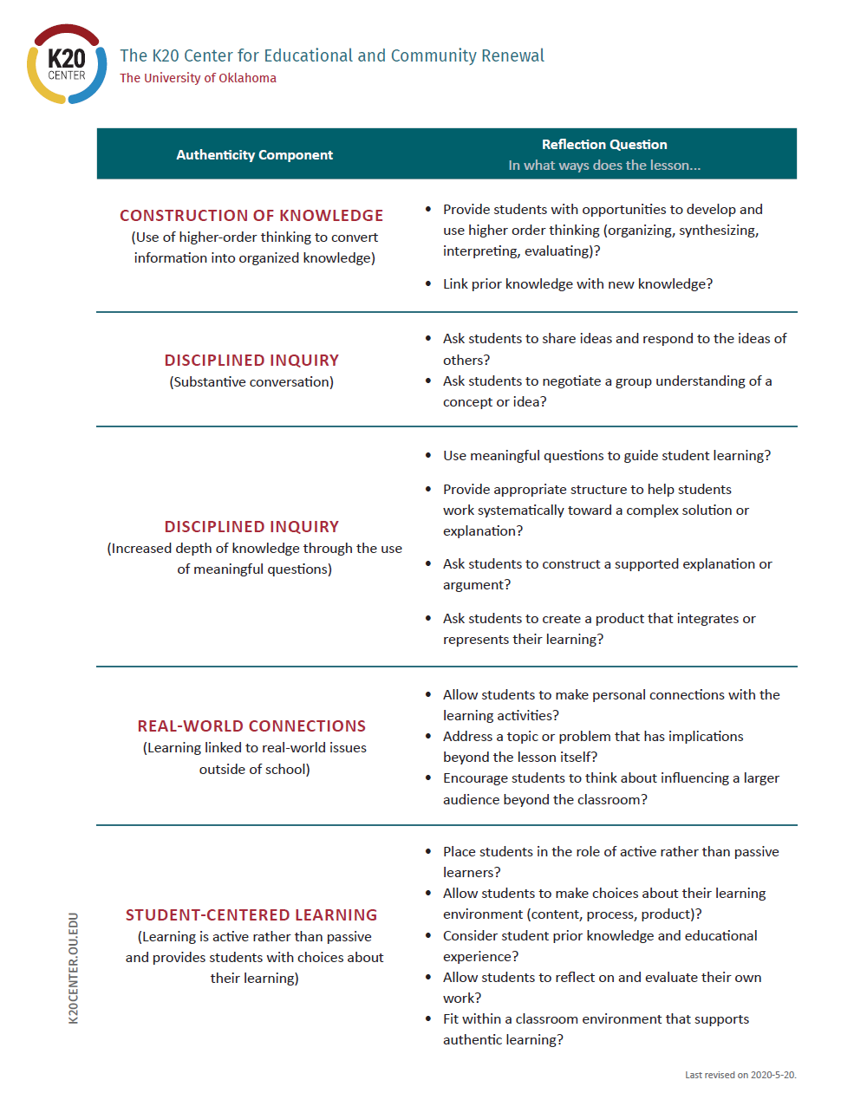
Authentic Lesson Reflection Tool

Slide 7
Essential Question
How can an authentic, technology-enriched learning environment increase student engagement and academic performance?

Slide 8
Learning Objectives
Identify instructional strategies modeled that support authentic instruction and Oklahoma Math State Standards.
Analyze an authentic activity integrating technology and reflect on this experience to determine the relevant components of authenticity.
Create a plan for authentically integrating technology in a lesson.

Slide 9
Give yourself ONE point for each of the following that describes you:
I can create a Google Form.
I can create a simple website using a tool (like blogger, Wiki, or Google Sites).
I am comfortable using spreadsheets to organize data.
I know how to use the main components of Google Suites (Docs, Forms, Drive).
I enjoy solving puzzles.

Slide 10
Find Your Partner
Based on your number, find someone who does not have the same number as you.
Get to know each other! Discuss:
How have you used Google Suites in your classroom so far?
What questions or hopes do you have about Google Suites?
Notes:
Use this pairing for the walkthrough building Google Sites later. There should be some sort of processing question here. Talk to each other about how you have used Google Suite in your classroom so far. Talk about questions you have or hopes if you don’t have much experience yet.

Slide 11
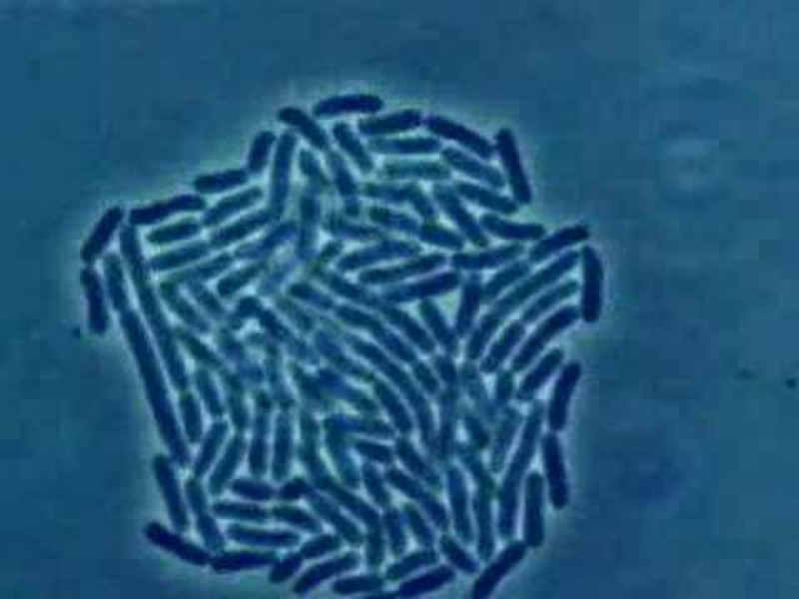
Math Lesson: Epidemic Outbreak
Can you save the world?
Bacteria Growth
Notes:
Daniel Izzo. (2007, July 29). Bacteria growth [Video]. YouTube. https://www.youtube.com/watch?v=gEwzDydciWc

Slide 12
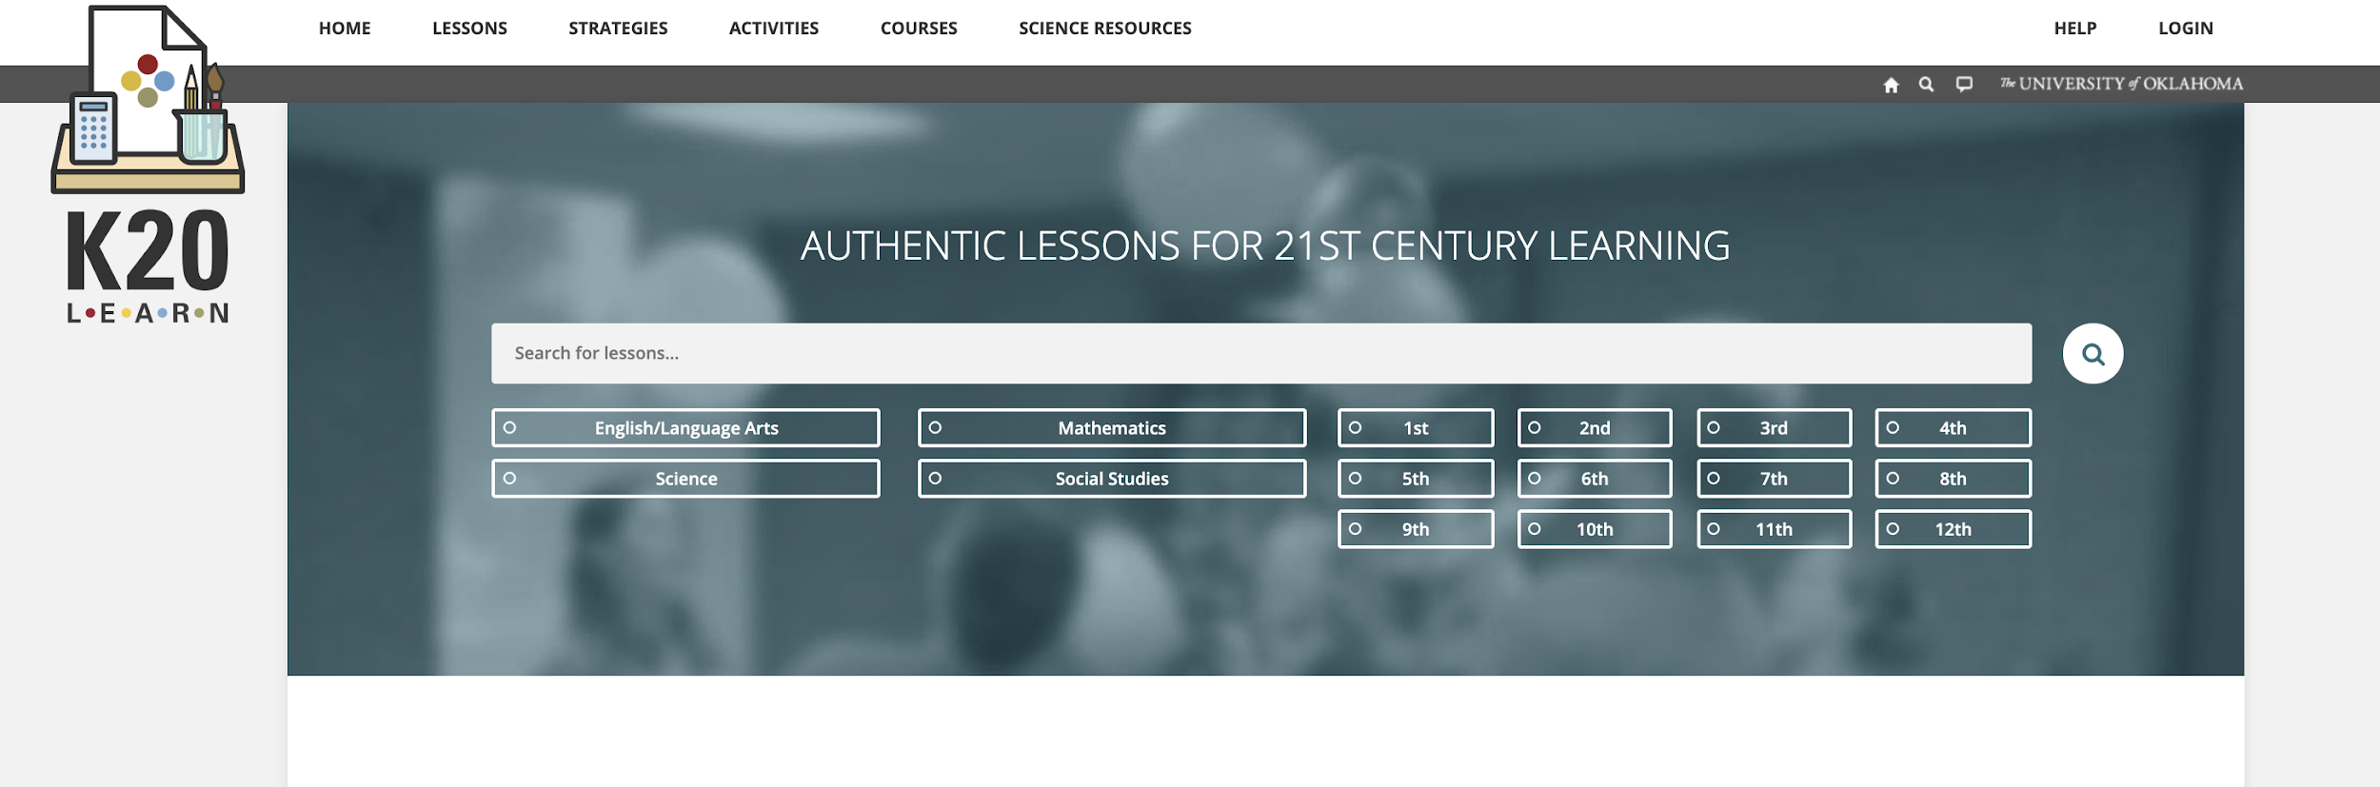
learn.k20center.ou.edu
Lesson Snapshot
Exponent Rules—“Can You Save the World in Time?”
Notes:
https://learn.k20center.ou.edu/lesson/b5aef944bb8300a7bdb6f1a67f02c303

Slide 13
What Are Digital Breakouts?
Have you ever participated in an escape room?
  Think of this as digital version.
You can purchase kits from Breakout EDU or you can create them for free using Gsuite.
Locks
  Color Locks
  Directional Locks
  Word Locks
  Date Locks
  Emoji Locks
Notes:
Get into your pairs from Fold in the Line mention GEAR UP and technology purchases and that they will reflect on the components of Authenticity

Slide 14
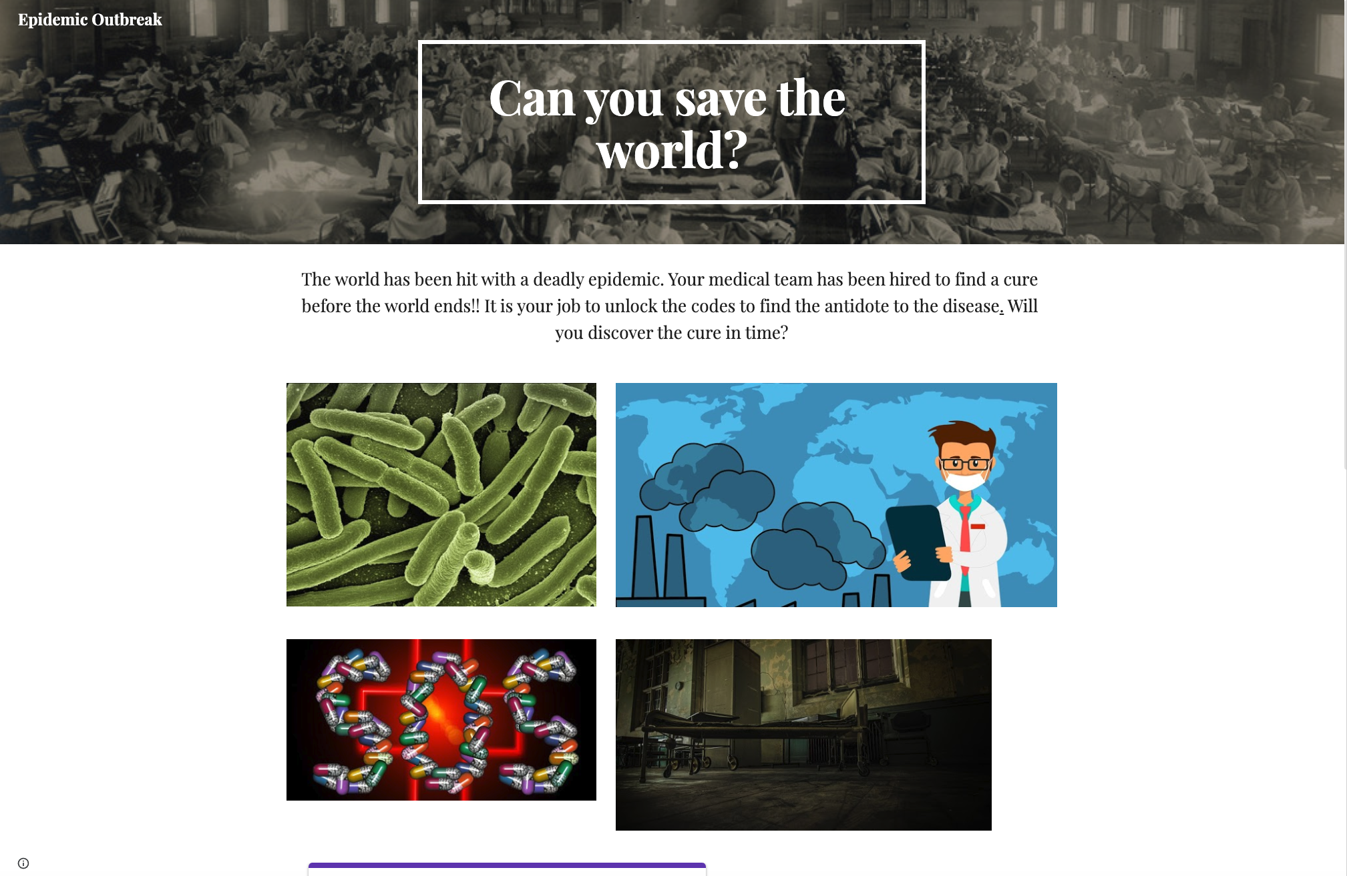
WE NEED YOUR HELP!
The world has been hit with a deadly epidemic. Your medical team has hired to find a cure before the world ends!
Notes:
Hand out the worksheet to fill in the locks.
http://bit.ly/epidemicbreakout

Slide 15
Did You Save the World?
What was your experience with the activity and lesson?
How can you implement a breakout into your classroom that aligns with the standards?

Slide 16
Authentic Lesson Reflection Tool

Slide 17
Authenticity Lesson Reflection Tool
Use the lesson reflection tool to think about the ways in which this activity aligns with the components of authenticity.
How could this activity be modified to make it even more authentic?
How could this activity have been done without the use of technology?

Slide 18
Breakout Brainstorm
Before walking through the components of the breakout, let’s brainstorm what content you would be interested in converting to a breakout format.
Use the standard organizer to help you decide what content you want to incorporate and the math problems associated with it.

Slide 19
How to Build a Breakout
Google Sites
Google Forms
Conditional Formatting = Color Locks

Slide 20
Need more ideas for clues and locks?
Consider these:
Youtube videos
  A keyword can be used as a lock solution.
Brief passages or documents with multiple choice questions
  The correct answers can be used as a lock solution.
Maps
  Information can be used a lock solution or directional lock solution.
Puzzles
  Use Jigsaw Planet and your own images to create puzzles to hyperlink.
Google Draw
  Create a document that, when solved, reveals a word that solves a lock.
Notes:
Jigsaw Planet: https://www.jigsawplanet.com/

Slide 21
How to Hack
Want to use a pre-made digital breakout but don’t know the correct answers?
Right-click on the lock form, but not in an answer blank.
Select “View Frame Source.”
  Scroll to the bottom of the page, past all of the code, until you see separated lines and white space.
  In the parentheses, you will see the lock titles and the corresponding answers.

Slide 22
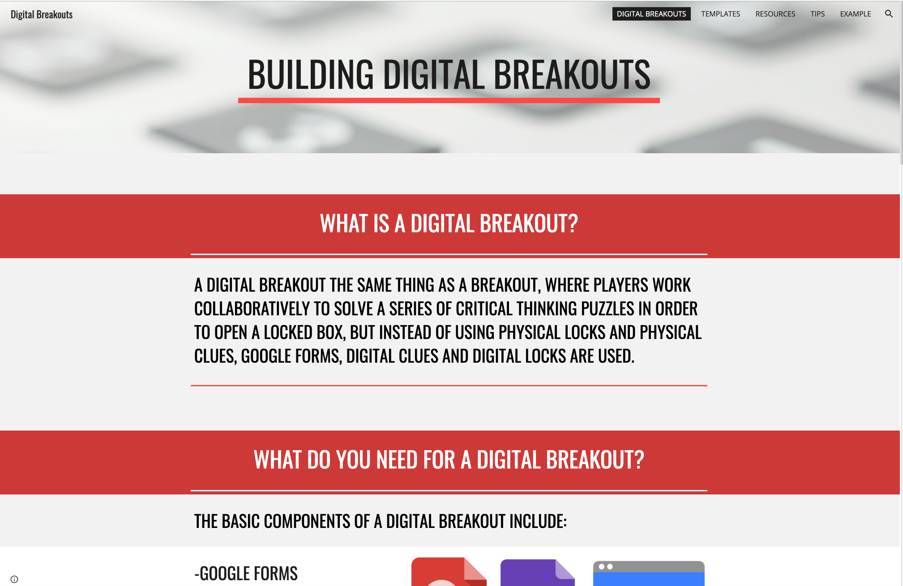
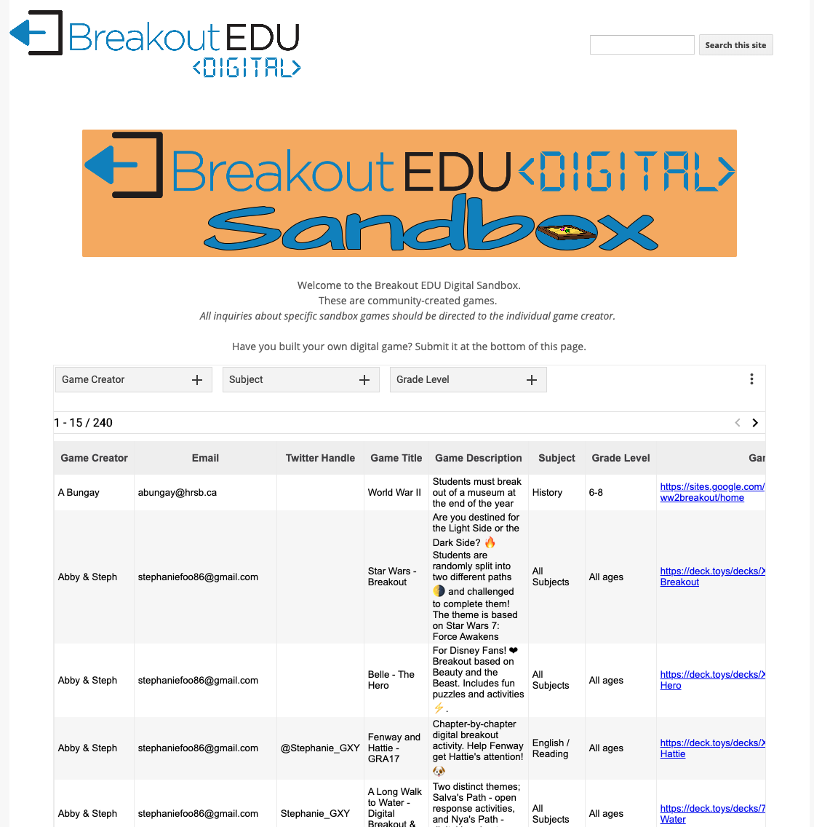
Tutorials and Premade Breakouts
Step-by-step tutorial with videos and templates:
Sandbox with 240 pre-made breakouts constructed by fellow teachers:
Notes:
http://bit.ly/K20breakouts
https://sites.google.com/site/digitalbreakoutjb/sandbox

Slide 23
Create Your Own
Now that we have gone over the basics of digital breakouts, use the organizers to put together your own.
  Follow the plan you created in the Breakout Brainstorm.
  Use the How to Build a Breakout guide (or the tutorial website) for step-by-step instructions.
Need more guidance or help?
  Let us know!

Slide 24
Authentic Lesson Reflection Tool

Slide 25
LEARN Lesson Repository
Notes:
https://learn.k20center.ou.edu/

