Slide 2
Connecting Classmates:
Engage With Scaffolded
Classroom Practices

Slide 3
Name Tents
On your table, you will find a folded piece of cardstock.
Please put your name on one side and answer the following questions on the back:
  Where are you from?
  How long have you been in professional education?
  What has been the most challenging part of this year?
  What has been a highlight for you this year?
  What is most important to you as an educator?

Slide 4




At the Door
Jellyfish
Turkey
Dairy Farmer
Happy Salmon

Slide 5
Instructional Strategy Notes
On your Instructional Strategy Notes sheet, answer the following questions regarding the different types of handshakes:
How was it used? How will I use it?
Repeat the process with each strategy you try.

Slide 6
Brainstorm
How do you use technology in the classroom?
On a sticky note, write about the different ways your students use technology.
Post them around the room.

Slide 7

Gallery Walk
Walk around the room and read about the different ways students use technology in the classroom.
Notes:
K20 Center. (n.d.). Gallery Walk / Carousel. Strategies. https://learn.k20center.ou.edu/strategy/118

Slide 8


Commit and Toss Strategy
On a sticky note, write your biggest TAKEAWAY from the posts you read during your Gallery Walk.
Crumple up your response and throw it on the floor.
Notes:
K20 Center. (n.d.). Commit and Toss. Strategies. https://learn.k20center.ou.edu/strategy/119
https://tenor.com/view/david-wood-throw-paper-gif-18838376

Slide 9
Essential Question
What do you think makes social media so engaging to your students?

Slide 10
Learning Objectives
Understand how video technology can be used for communication inside and outside the classroom.
Engage with instructional strategies you can use in your classroom.

Slide 11
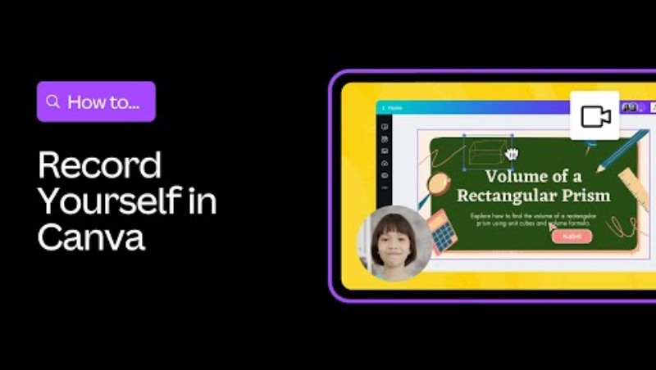
Record Yourself Canva Design Skills for Students
Notes:
https://www.youtube.com/watch?v=52Dhed2QwAo

Slide 12

30-Second Expert Strategy
What did you learn from the Canva video?
Find a partner.
The first person will take 30 seconds to share everything they learned from the video.
Switch places.
The second person will repeat back what they heard and then add anything else they learned from the video.
Questions?
Notes:
K20 Center. (n.d.). 30-Second Expert. Strategies. https://learn.k20center.ou.edu/strategy/1048

Slide 13

Canva Time
Go to Canva.com and login or sign up for a free account.
Follow this link to the “All About Me” template:
  https://tinyurl.com/325csar4
Create your “All About Me” page using the information from your Name Tent.
Add text, pictures, symbols and any other features you like to personalize your page.
Notes:
https://learn.k20center.ou.edu/tech-tool/612

Slide 14
Record Your Video
On the left side of your screen, select “Uploads”.
At the top of the menu, select “Record Yourself”.
A menu should appear in the top left corner of your screen. Select “Camera” and make sure your visual and audio selections are correct.
Select “Record” at the bottom of your screen when you are ready to record your video. Your video should be 60 seconds or less.
You may playback your video or rerecord until you are satisfied with your product.
Move your video to the best spot on your page when you are done.

Slide 15
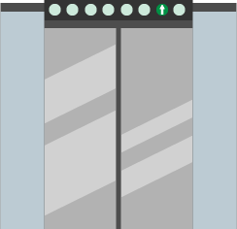
Elevator Speech
🎯 You have 90 seconds to share your Name Tent with your colleagues.
Notes:
K20 Center. (n.d.). Elevator Speech. Strategies. https://learn.k20center.ou.edu/strategy/57

Slide 16

Share Your Video

Slide 17

3-2-1 Strategy
What are three things you learned from the activity today?
What are two things you learned about yourself?
What is one question you have about what you learned today?
Notes:
K20 Center. (n.d.). 3-2-1. Strategies. https://learn.k20center.ou.edu/strategy/117

Slide 18

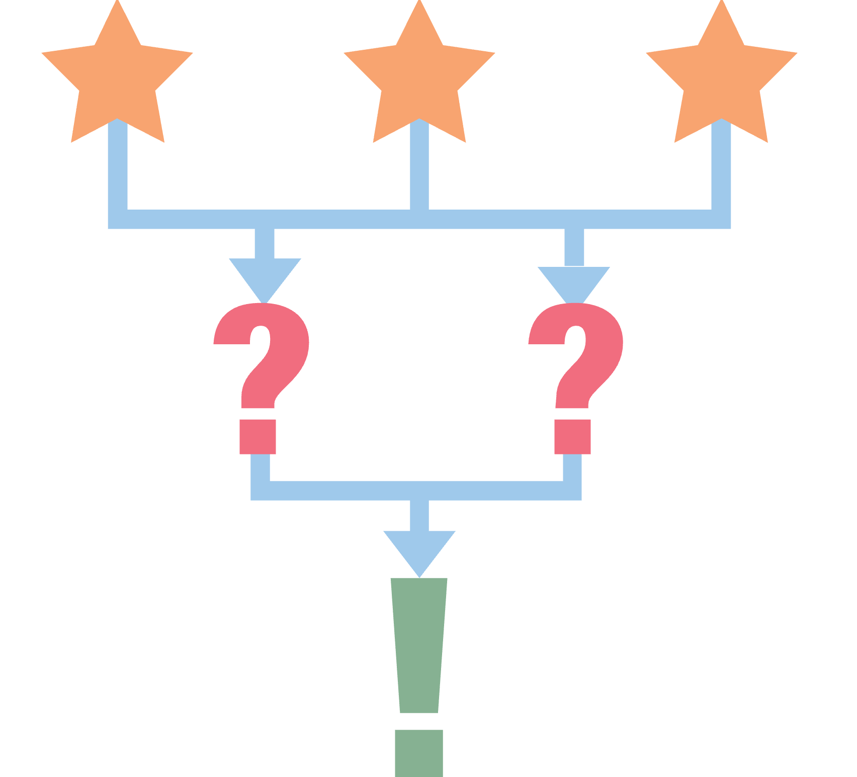
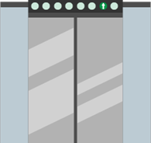
LEARN Strategy Reflection
Handshakes
Name Tents
Gallery Walk
Commit and Toss
30-Second Expert
Flipgrid
Elevator Speech
3-2-1/Exit Ticket
Notes:
K20 Center. (n.d.). Gallery Walk / Carousel. Strategies. https://learn.k20center.ou.edu/strategy/118
K20 Center. (n.d.). Commit and Toss. Strategies. https://learn.k20center.ou.edu/strategy/119
K20 Center. (n.d.). 30-Second Expert. Strategies. https://learn.k20center.ou.edu/strategy/1048
K20 Center. (n.d.). Elevator Speech. Strategies. https://learn.k20center.ou.edu/strategy/57
K20 Center. (n.d.). 3-2-1. Strategies. https://learn.k20center.ou.edu/strategy/117

Slide 19
Revisit the Instructional Strategies Notes
How was it used?
How will I use it?
Repeat the process with each strategy you tried.

Slide 20

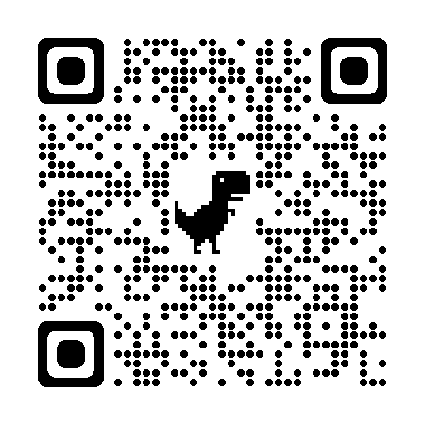
K20 LEARN Website
Virtual Learning
Instructional Strategies
5E Lessons

Slide 21






Follow Us on Social Media!

