Slide 2
Sequencing Authentic Science Lessons

Slide 3
Session Objectives
Experience and reflect upon a non-example of authentic science lesson structure.
Compare and evaluate several authentic lesson models.
Explore LEARN to select a 5E lesson or strategy that supports research-based science instruction to utilize in your own classroom.

Slide 4
Vervim in Pharkles
Creating Plopidectus
Notes:
15 min

Slide 5
A cratusis is used as a source of vervim. If a flam is used to make a pathway connecting opposite ends of a cratusis, a pharkle is created. In a pharkle, vervim burbles from the compendic end of the cratusis to the impendic end of the cratusis. This vervim burble is called plopidectus. A merobite can be added to the pharkle using flams. Plopidectus burbling through the pharkle causes the merobite to turn. When plopidectus is burbling through a pharkle, we say that the pharkle is closed. If the pharkle is broken at any location, this results in an open pharkle. Plopidectus will not burble in an open pharkle.
Notes:
Handout the untranslated pharkles reading with quiz questions. Ask participants to silently read along with you as you read the paragraph on slide 5 out loud. Treat it seriously as if it is any other science reading. Have participants complete the quiz. Review the answers on slide 6 and celebrate that everyone (or nearly everyone) got 100%.
Translation below for presenter reference. Do not share with participants yet.
A battery is used as a source of energy. If a wire is used to make a pathway connecting opposite ends of a battery, a circuit is created. In a circuit, energy flows from the negative end of the battery to the positive end of the battery. This energy flow is called electricity. A motor can be added to the circuit using wires. Electricity flowing through the circuit causes the motor to turn. When electricity is flowing through a circuit we say that the circuit is closed. If the circuit is broken at any location, this results in an open circuit. Electricity will not flow in an open circuit.

Slide 6
Vervim in Pharkles Quiz
A source of vervim.
A pharkle.
From the compendic end of the cratusis to the impendic end of the cratusis.
Vervim burble.
A flam.
False.
Notes:
Go over “quiz.” Everyone should make 100% since the answers come directly from the text without requiring comprehension.
What is a cratusis?
What do you get when you make a pathway connecting opposite ends of a cratusis with a flam?
Which way does vervim burble in a pharkle?
What is plopidectus?
What do you need to use when adding a merobite to a pharkle?
Is this statement true or false? Plopidectus will burble in an open pharkle.

Slide 7
Can You Make the Merobite Turn?
Draw a model and explain what is happening.
Compendic
End
Impendic
End
Cratusis
Vervim
Merobite
Flam
Notes:
Initial model without materials. Participants draw the model, label the parts and show the direction the vervim burbles with arrows
Then give them pharkle kits to play with and revise their models

Slide 8
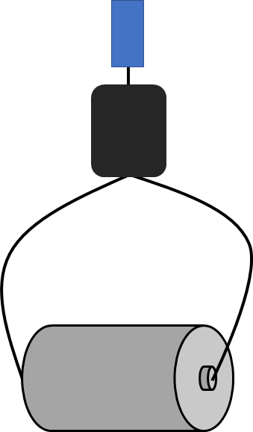
Will the Merobite Turn?
merobite
flam
vervim
flam
cratusis
Notes:
Review model, validating how most if not all will have drawn theirs

Slide 9
Symbols
Cratusis
= Battery
Flam
= Wire
Merobite
= Motor
M
Notes:
Explain that this is the technical model for a circuit and provide the translated words

Slide 10
Vervim in Pharkles
Battery
A source of energy.
A circuit.
From the negative end of the battery to the positive end of the battery.
Energy flow.
A wire.
False. (Electricity won’t flow in an open circuit.)
Wire
Wire
M
Motor
Notes:
Give participants the translation at this time. Skip this slide if time is limited.
What is a battery?
What do you get when you make a pathway connecting opposite ends of a battery with a wire?
Which way does energy flow in a circuit?
What is electricity?
What do you need to use when adding a motor to a circuit?
Is this statement true or false? Electricity will flow in an open circuit.

Slide 11
Pharkles Reflection
How would starting with the activity rather than the reading have changed your learning experience?
“Although vocabulary is important for science learners, we must remember that words are not science. [...] Vocabulary needs to be introduced to students in the midst of their engagement with objects.”
Notes:
Benefit of activity versus starting with vocab
“Although vocabulary is important for science learners, we must remember that words are not science. Zoologists do not study words but use words to communicate their study of animals with others who share the same vocabulary. Vocabulary needs to be introduced to students in the midst of their engagement with objects.” (Teaching for Conceptual Understanding in Science, p.7)

Slide 12
ABC Instructional Models
Activity
Before
Content
This prioritizes student exploration and investigation prior to engaging in technical science content and vocabulary.

Slide 13
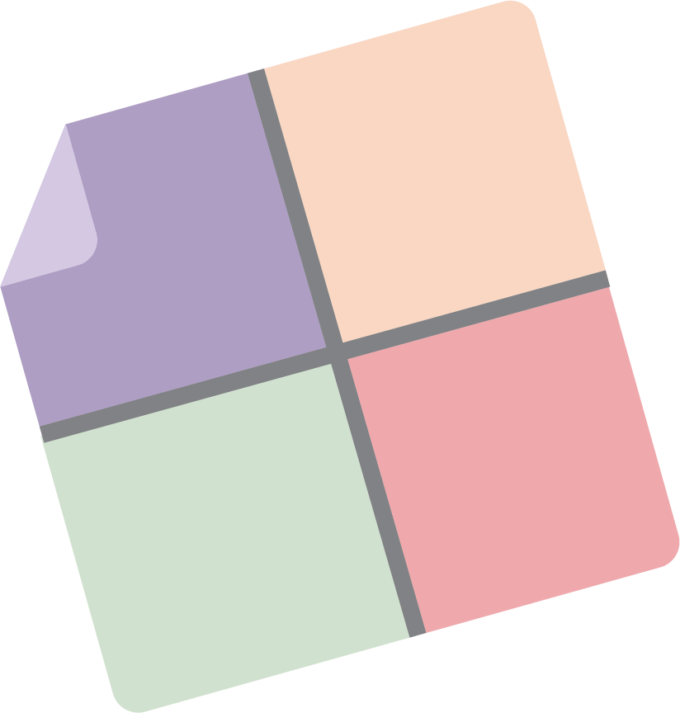
ABC Instructional Model Exploration
Look through the materials at your station.
On your chart paper, record the following information in each “window”:
Characteristics
Teacher/student roles
Benefits
Questions you have
Notes:
10 min
http://stemteachingtools.org/assets/landscapes/brief4_second.gif
Stations w/ example of ABC lesson structures
Project-Based Learning
https://drive.google.com/drive/folders/1uf8jytvpkQy97QQJ4rAQxZ1u2k5G5Y-J
https://www.pblworks.org/what-is-pbl
Tinkering Pedagogy
http://www.museoscienza.it/tinkering-eu/download/Tinkering-A-practitioner-guide.pdf (p.15, 20, 26-27)
https://web.archive.org/web/20170830005016/http://tinkering.exploratorium.edu/sites/default/files/pdfs/PetrichWilkinsonBevan-ItLooksLikeFun.pdf (p.10-12, p.14-16)
http://93.42.126.186/tinkering-eu/download/tinkering-total-Hres.pdf (p.36-39)
Place-Based
How place-based science education strategies can support equity for students, teachers, and communities(resource)
Environmental Impact Studies
Creature Connection
Documenting Biodiversity in Your Schoolyard (p.41)

Slide 14
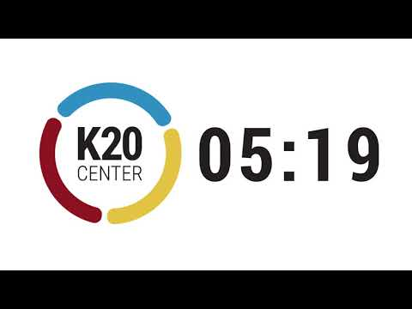
ABC Instructional Model Exploration

Slide 15
Group Share Out
Characteristics
Teacher/student roles
Benefits
Questions you have
After this exploration, how comfortable would you feel teaching in an ABC-structured lesson?
Notes:
Share Out/Debrief
Fist to 5: comfort level with teaching ABC now that we’ve explored some structures

Slide 16
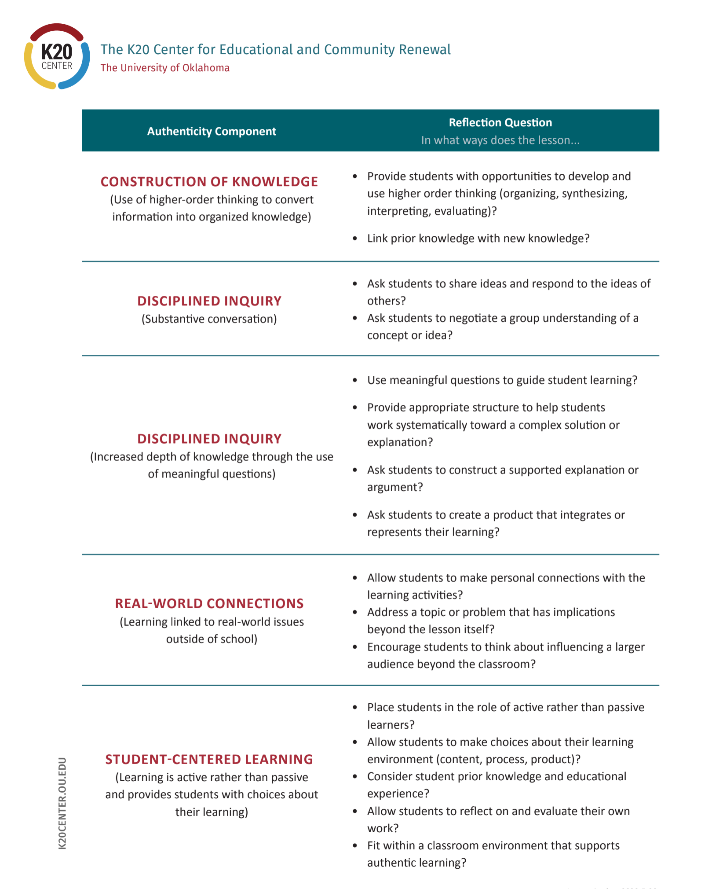
Authenticity in Science Instruction
Look over the Authenticity Reflection Handout.
Where do you see components of Authenticity reflected in the instructional models we explored?
Notes:
5-7 min
Authenticity connections to types of lessons
Have teachers ID where they found characteristics or teacher/student roles that align with the Authenticity Components

Slide 17
What the Research Says
The sequence of a learning experience matters.
Students prefer beginning with experiences over content.
Relevance of content is more apparent with activity first.
Optimal learning takes place when the content is introduced in context.
Place an activity upfront to help students connect prior experiences in ways that make sense to them.
Invest the extra time for students to explore.
Many if not most questions you plan for will come up organically.
Embed formal instruction in discourse.
Provide opportunities for students to be in disequilibrium.
Including phenomena, discrepant events, or open-ended investigation.
Notes:
3-5min
The sequence of a learning experience matters
Students dislike starting with content compared to starting with activities
Even when students understand the content they often don’t see the connection to activities or what they’re expected to actually know/learn
Optimal learning takes place when the content instruction follows an experience (e.g., data gathering, investigation, etc.)
Early experiential learning experiences allow students to organically connect their prior knowledge/experience
Invest the extra time for students to explore
It is worth taking longer to get through a lesson or standard
Consistent reports that when students are given ample “unstructured” time to investigate many if not most questions teachers planned for come up organically
Can design more robust learning experiences that support exploration of multiple related concepts simultaneously
Formal introduction of content should be embedded in discourse
Provide opportunities for students to be in disequilibrium
Phenomena, discrepant events, “unstructured” exploration
Background notes
Herbart (1901) “the best pedagogy allow[s] students to discover the relationship among different, but related, experiences”
Dewey (1916) “in contemporary terms, doing hands-on activities is important but inadequate; those experiences also must be minds-on”
Begin experience with presenting an experience where students sense a problem (“sensing perplexing situations”)
“Messing About in Science” (David Hawkins, 1965)
giving students time to explore freely (with scaffolds, not just chaotic lack of any guidelines) opportunities to gather information on their own leads to more autonomous learning, surfaces many of the teacher’s pre-planned topics organically, may lead to interesting unforeseen phenomena and experience that can be capitalized on for learning; conceptual understanding comes contextually embedded and with discourse among students and teacher
Abraham & Renner, 1986, JRST 23(2), 121-143.
sequence matters; the specific placement of formal instruction depends on learners and content/context and is flexible, except when it precedes experiences

Slide 18
Next Steps
K20 utilizes the 5E instructional model for our lessons.
Take this time to do one of the following:
Find a 5E lesson on LEARN for the upcoming semester.
Find an instructional strategy on LEARN that supports ABC instruction.
Draft a new ABC lesson or begin revising one you already have in mind.
Notes:
12 min
Ask if everyone is familiar with 5E (they probably will be if they’re mostly ARA), if not give very quick description of structure
Send them to LEARN to explore, offer the option to just work on resequencing their own lesson if they’d prefer
Walk around and discuss with them

Slide 19
I Used to Think... But Now I Know...
Before you go, grab a sticky note and respond to the following prompt:
I used to think (about teaching science)... But now I know...
Notes:
3-5 min
“Exit ticket” (on stickies on their way out)

Slide 20
Action Research in Authenticity (ARA)
Requirements
Teach any 10th or 11th graders
Attend a summer workshop
Quarterly goal setting activity and debrief
Benefits
Summer and quarterly stipends (up to $1,200 this year)
Classroom resources
Targeted professional development
Year-long individualized instructional coaching

Slide 21
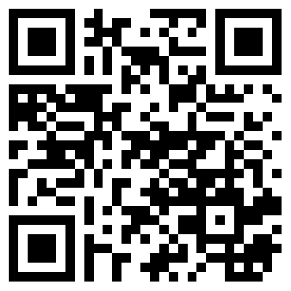
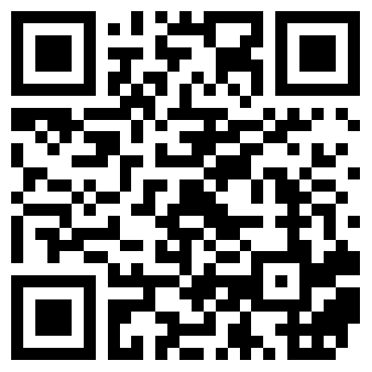
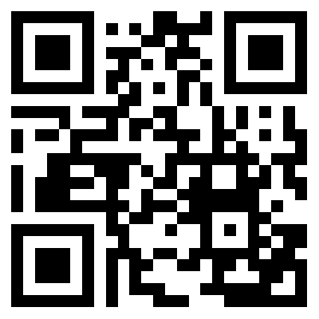
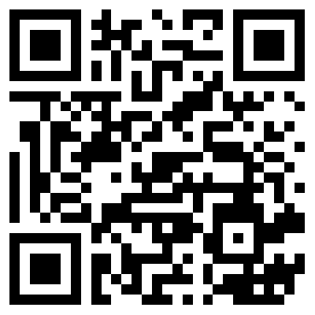
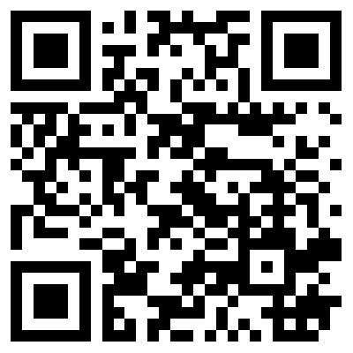
Follow us on Social Media!
Facebook.com/ K20Center | YouTube.com/ K20Center | Twitter.com/ K20Center | LinkedIn.com/ showcase/ K20-Center | Instagram.com/ K20Center

