Slide 2
AUTHENTICITY …
IT’S NOT JUST A FAIRY TALE
K20 Center

Slide 3
Blast from the Past! Or Maybe Last Week…
Think about your most meaningful learning experience.
Fold your paper in half.
Draw this on half of your sheet.

Slide 4
Guiding Question
“How can the components of authenticity help teachers prepare students for pursuing post-secondary educational opportunities?”
Notes:
Connect this to the next slide.

Slide 5
Session Objectives
We will:
Experience a collaborative, authentic lesson with a variety of instructional strategies and examine the components of authentic teaching and learning.
Compare different classroom environments and how they support authentic teaching and learning.
Connect authentic teaching and learning practices with the
goals of the GEAR UP grant.

Slide 6
Fold the Line
How much do you know about the story of Rumpelstiltskin?
Notes:
Engage
Image source: Crane, W. (1886). Illustration of Rumpelstiltskin from Household Stories by the Brothers Grimm. Public Domain.

Slide 7
Paired Verbal Fluency
Partner 1: 60 seconds
Share everything you know about Rumpelstiltskin.
Partner 2: 30 seconds
Add to the story (without repeats) or ask questions if you are not familiar with the story.
Partner 1: 20 seconds
Add anything else.
Partner 2: 15 seconds
Any last thoughts or questions?
Notes:
Engage

Slide 8
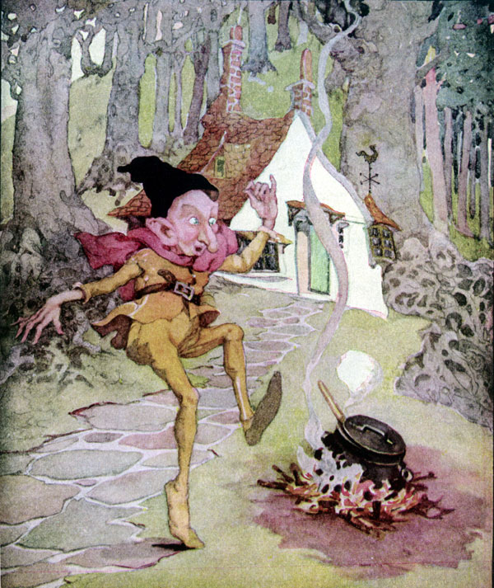
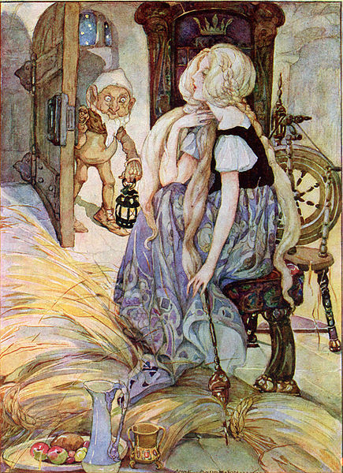
The Story
Happily Ever After
UNTIL…
Notes:
Keep this slide up while participants read the Rumpelstiltkin story.
Left image source: Anderson, A. (n.d.). Rumplestiltskin is my name. Public domain. Retrieved from https://en.m.wikipedia.org/wiki/File:Rumplestiltskin_-_Anne_Anderson.jpg
Right image source: Anderson, A. (n.d.). The Miller’s Daughter. Public domain. Retrieved from https://commons.wikimedia.org/wiki/File:The_Miller%27s_Daughter_by_Anne_Anderson.jpg

Slide 9
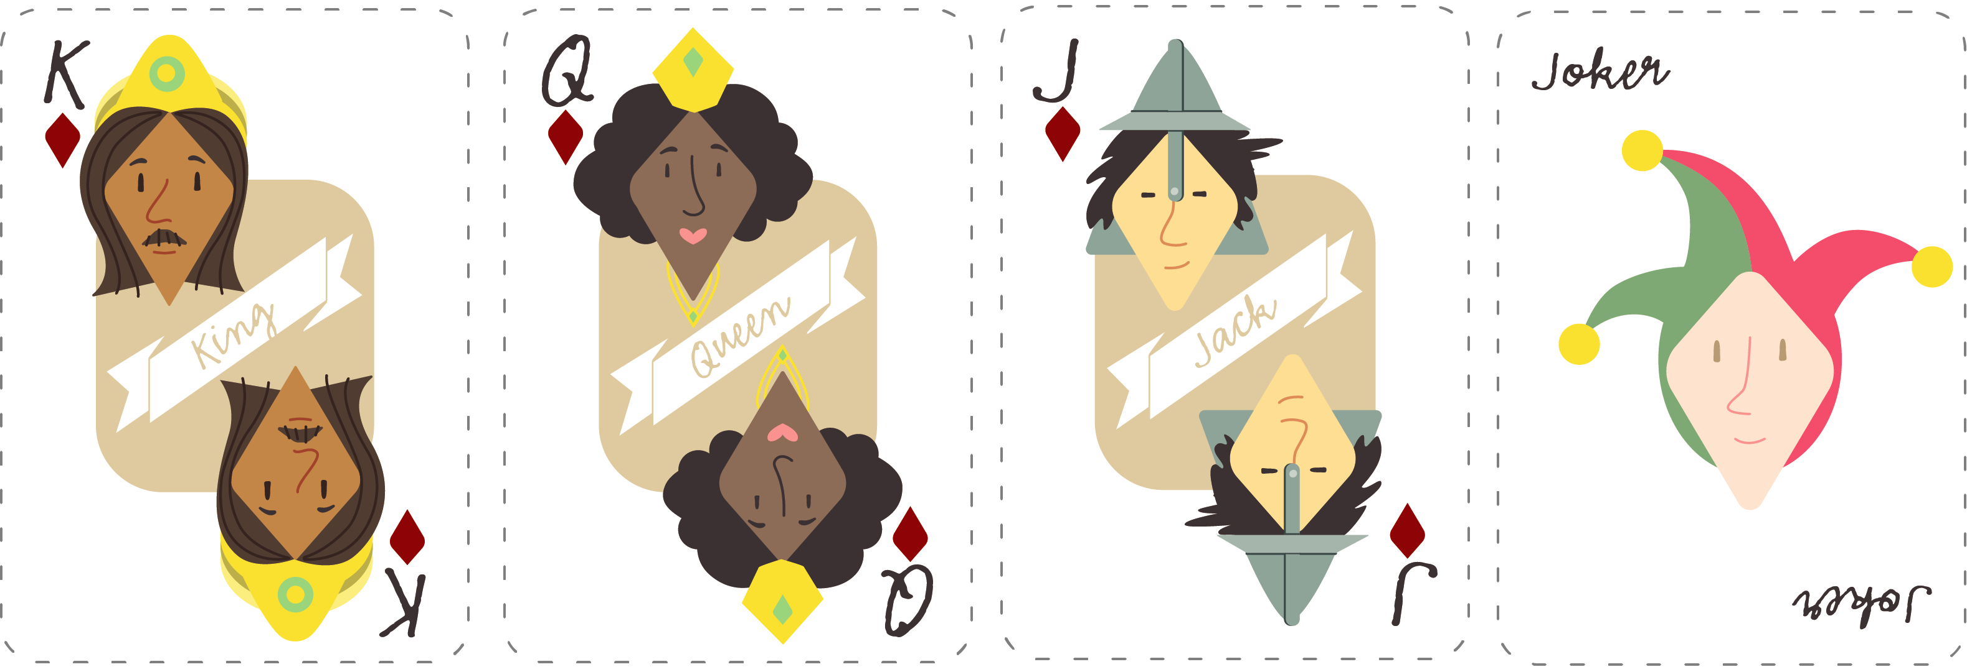
Playing Cards
King
The King
Queen
The Miller’s Daughter/Queen
Jack
The Miller
Joker or 2
Rumpelstiltskin

Slide 10
The Imaginary People’s Court
The justice system caught up with these reprehensible “characters.”
The Miller: Charged with bribery, human trafficking,
and tax fraud.
The King: Being impeached for accepting illegal tax contributions, intimidation, and unlawful detention.
Rumpelstiltskin: Charged with extortion, attempted kidnapping, and coercion.
The Miller’s Daughter/Queen: Charged with child abandonment, child endangerment, and human trafficking.

Slide 11
CUS and Discuss
CIRCLE any mention of your character.
UNDERLINE any actions taken by your character.
STAR any emotions or important adjectives.
Discuss the defense of your character’s innocence.

Slide 12
CER Example
Claim – Chromebooks are better school technology tools than laptops.
Evidence – Most applications on a Chromebook are web-based and store data online.
Reasoning – Because data is stored online, students can use any device to access it. This prevents loss of student work and provides them with the ability to work both from school and home.

Slide 13
Pair Square Legal Team
Get together with your card group (jokers with jokers, queens with queens, etc.).
Share your CER and your defense.
Come to a consensus about the defense of your client.
Choose your spokesperson, known as the lead defense attorney.

Slide 14


HEAR YE! HEAR YE!
ALL RISE!
The Honorable Judge declares that court is in session.
Present your arguments.

Slide 15
Beyond Rumpelstiltskin
This was a lesson on process of instruction for students to think more critically.
The goal was to construct a logical and supported argument based on a guiding question.
Notes:
The content, Rumpelstiltskin, is not what was significant or the point. The goal was the students construction of a logical and supported argument based on evidence from a text. The use of an essential question helps stimulate the higher order thinking.

Slide 16

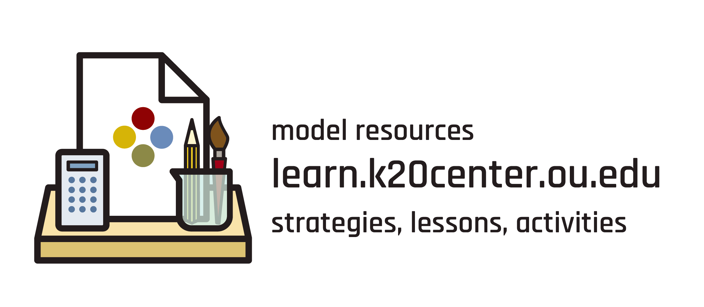
LEARN Strategy Reflection
Fold the Line
Paired Verbal Fluency
CUS and Discuss
Claim, Evidence, Reasoning (CER)
Preflections*
Notes:
Fold the line – Activating prior knowledge and getting students to use that prior knowledge to talk about what they do and don’t know. They are learning from their peers before the teacher provides new information. This is a type of formative assessment.
Paired Verbal Fluency – what happens when you give students 5 mins to talk? They don’t stay on topic, so this is a great strategy to modify the time and partner speaks
CUS and Discuss – This is an annotation strategy that allows for processing of a document before students are expected to share. Each letter can be modified for the purposes or goals of the reading (ex: Circle is concrete such as the name of the character they are looking for; Underline and Star scaffold into deeper elements of the reading)
CER – typically a science strategy but can be used across content areas whenever students need to justify and provide evidence
*Preflections (optional in this lesson) – Allows participants to hypothesize about learning before they engage and later reflect on their learning in light of their hypothesis.

Slide 17
CONSTRUCTION OF KNOWLEDGE
DISCIPLINED INQUIRY
Authentic Teaching
Prior Knowledge
REAL-WORLD CONNECTIONS
STUDENT-CENTERED

Slide 18
Jigsaw and Why-Lighting
Why-Light your section, and then discuss the big ideas with your group.

Slide 19
Represent!
Using large poster paper, represent your component of authenticity in a visual way.
Add a Tweet Up description as a caption.
CHALLENGE: Include a hashtag. #OneToThreeWordSummary

Slide 20
LEARN Strategy Reflection
Jigsaw
Why Lighting
Tweet Up
Notes:
These are all literacy strategies, so if you’re trying to find strategies that help with literacy skills, these are great

Slide 21
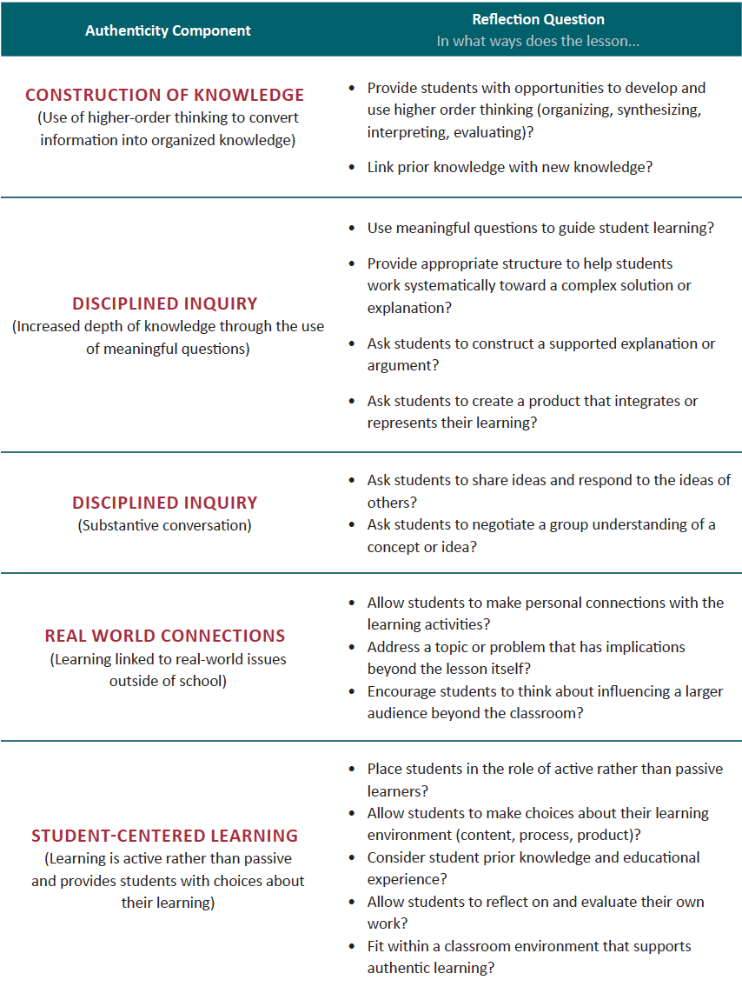
Authentic Lesson Reflection Tool

Slide 22
Cognitive Comics
Draw Your Own Authentic Classroom
Are there commonalities between your two images?
What conclusions can we make about the types of environments that support authentic learning?

Slide 23
Think-Pair-Share
How does teaching authentically lead to deeper learning?

Slide 24
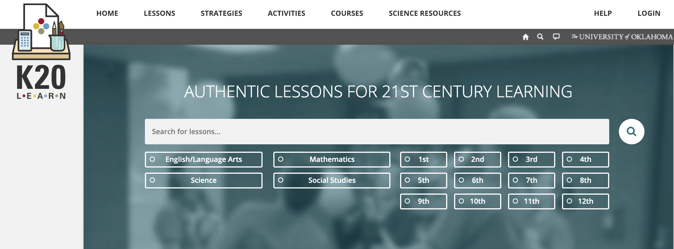
K20 LEARN
https://learn.k20center.ou.edu/
Notes:
Follow-up activity. Direct participants to the K20 Learn lesson repository for more example of authentic learning and teaching.

