Slide 2
Creating a College- and Career-Going Culture
K20 Center, The University of Oklahoma
Notes:
NOTE: Don’t display the following slide until AFTER completing the Engage. The next slide shows answers that will be discovered during the Engage activity.

Slide 3
Top 10 Benefits of a PSE
Earn a million dollars more over your lifetime
Be happier in your job
Connect with peers and mentors
Make a difference in your community
Develop your creativity and problem-solving skills
Feel a sense of accomplishment
No limit on your career choices
Prepare for success in a tech-driven world
Live longer and healthier
Have a more satisfying family life
Notes:
For 20 or fewer participants – Use a Kick Me strategy with Top 10 cutouts
More than 20 participants – Use a Family Feud strategy with Top 10 posters
See lesson instructions for details on how to conduct each activity.

Slide 4

Commit and Toss
On the slip of paper you were provided, jot down your answer to the following question:
  What is a college- and career-going culture?
Notes:
Make sure to pass out color coded paper. Colors should match the colors used during the carousel activity later.

Slide 5
So, What is a College- and Career-Going Culture?
A culture that cultivates aspirations and behaviors conducive to preparing for, applying to, and enrolling in college or leading to a career pathway.

Slide 6
Essential Question
How can school leaders promote a culture of college and career readiness that helps students prepare for and pursue postsecondary educational opportunities in a technology-enriched learning community?

Slide 7
Today’s Objectives
Describe the importance of creating a culture of college and career readiness.
Assess the current college- and career-going culture baseline of your school.
Create a list of strategies that signal a college- and career-going culture.
Identify one strategy your team will address this year to create a college- and career-going culture and connect to the appropriate ICAP indicator.
Notes:
Today’s objectives will provide a roadmap of where you will go together during the session and will let participants know what to expect from this professional development.

Slide 8
Why is a College- and Career-Going Culture Important?
A school’s culture of preparation makes a difference in students’ access to information about college, financial aid and career pathways.
“Students must be able to imagine a future where post- secondary opportunities are possible, so that current behavior has intent.”
– K20 Research Brief Strategies for College Readiness
Notes:
Image: https://commons.wikimedia.org/wiki/File:Future_plate_blue.svg
Quote: K20 Research Brief Strategies for College Readiness

Slide 9
Things To Consider in Building a College- and Career-Going Culture
Start in middle school.
Include ALL students.
Provide systemic support. (Have a stated college/career-going mission.)
Involve all stakeholders, not just the counselor, in supporting the mission.
Expose students to the benefits of post-secondary options and the tools, skills, and information that they need to be ready.
Remember that culture building is a process, not a program.
(Radcliffe & Boss 2013; Stewart, 2016; Corwin & Tierney, 2007)

Slide 10
ICAP (Individual Career Academic Plan)
ICAP is an Oklahoma State Department of Education initiative to provide all OK students with college and career information and readiness skills. Schools will be required to provide a strategic plan for their students by addressing the ICAP initiatives. A college and career-going culture supports these initiatives.
ICAP has a strong, intentional connection with career- and college-readiness.
Notes:
Briefly introduce ICAP at this time and note that more opportunity will be given to discuss it later in the day. Your purpose at this point is simply to foreshadow a later discussion and plant a seed to later show that some of ICAP’s goals will be addressed by creating a college- and career-going culture.

Slide 11
College and Career Culture Rubric
Complete the college and career culture rubric for your classroom or school site.
Notes:
Participants will complete the rubric individually for their school or classroom.

Slide 12
Video: Leading Success
Fostering a culture of expectations and opportunity
Visual
Auditory
Identify examples as you watch the video.
Practices/Rituals
Systems/Structures
Notes:
Handout: CCGC Category Quadrant graphic organizer
Link to video: https://youtu.be/mP_A-tg67bY
Video Site: NASSP National Association of Secondary School Principals, Module 3: Creating a College- Going Culture
Participants will list ideas they see during the video in the appropriate category.

Slide 13

Think–Pair–Share Your Ideas
Did you notice the same things or different things?
Notes:
Think–Pair–Share activity

Slide 14
College and Career Going Culture Carousel
Find your group!
  1. Visual
  2. Auditory
  3. Practices/Rituals
  4. Systems/Structures
Notes:
Use the color of paper participants ended up with during the commit and toss to group. Give each group one marker that matches the color of their group so it is easy to to identify which group wrote/checked during the rotation. Make sure to take your marker as you move.
Take a photo of the finished posters
First Round: 3 minutes
Second Round: 2.5 minutes
Third Round: 2 minutes
Forth Round: 1.5 minutes
Fifth Round: 1 minute – group back at their original poster and will review additions, checkmarks, etc.

Slide 15
College and Career Culture Carousel
Spend three minutes at your first “station” brainstorming ideas that could be used to signal a CCGC.
When the timer goes off rotate to the next station and try to add more ideas!
Add a check mark next to a practice that you currently do in your school.
Draw a star if you want to add a practice at your school.
When you group arrives back where you started, circle one idea to share.

Slide 16
Examples
College posters visible by all grades
Posting information about teachers’ college experience
Conversations with students about college readiness and preparation, including mentoring
College talk among teachers and students
Visual
Auditory
Celebrations for academic achievement
Honors luncheon
National Honor Society inductions
Guidance counselors being required to conduct lessons on college and career in grades 7–12
Practices/Rituals
Systems/Structures
Notes:
Transition to this slide as everyone gets back to their seats.

Slide 17
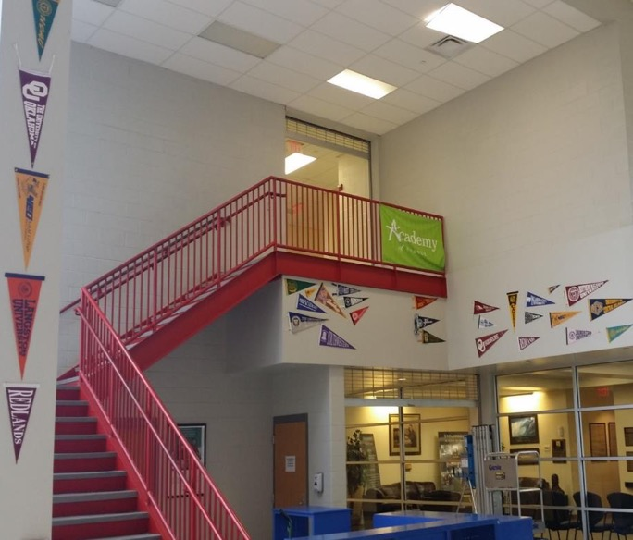
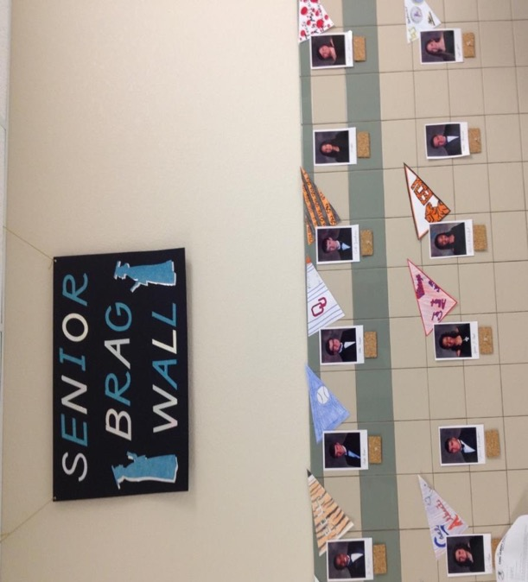
Visual
Notes:
These photos show pennants from various colleges, perhaps ones in the area or where school alumni or teachers have attended. There is also a Senior Brag Wall displaying college choices as seniors get accepted to various schools or maybe just where they are applying or want to attend.

Slide 18
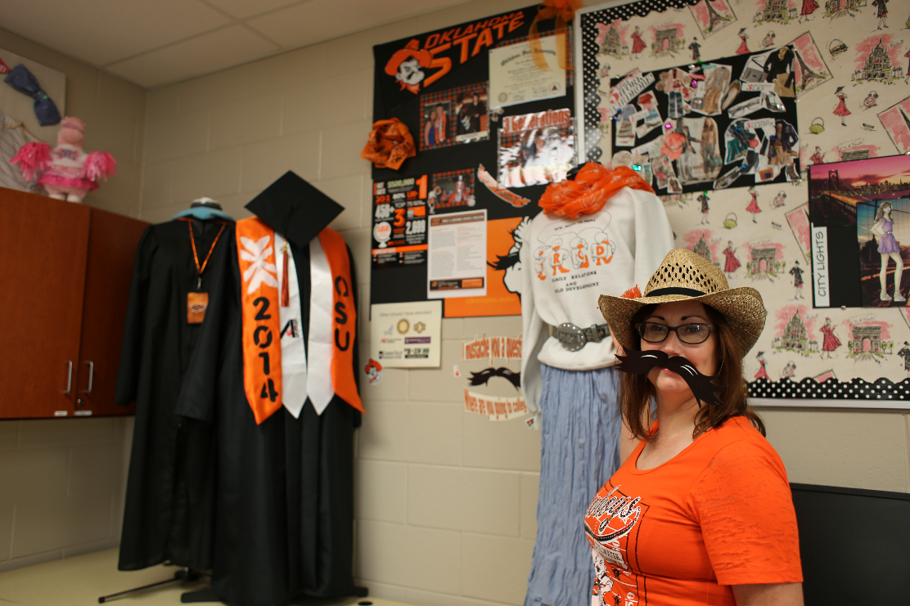
College Swag Board Challenge
Notes:
College Swag Board Challenge: Challenge teachers, counselors, or administrators to create a 'swag board' or "vision board" highlighting their college experience and any challenges they may have faced. Include materials, memorabilia, photos, etc. from their college days. Let students judge and pick a winner.

Slide 19
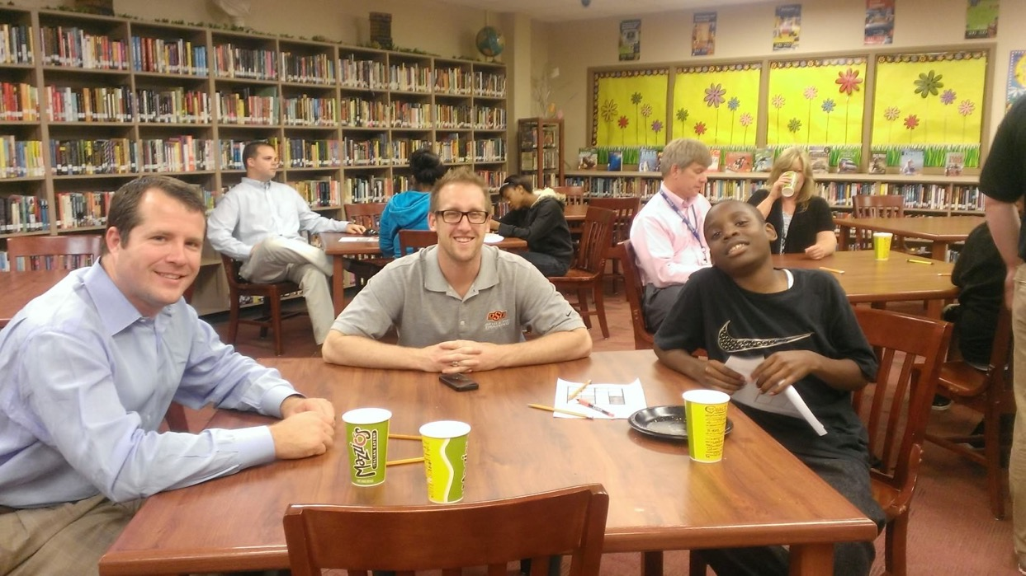
Auditory
College readiness and preparation conversations
Notes:
Auditory: Mentors, community leaders, people in various careers, or teachers and staff might meet with students to have college readiness and preparation conversation.

Slide 20
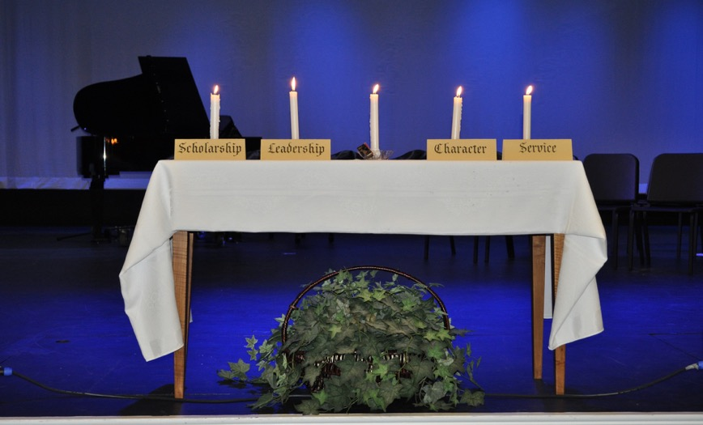

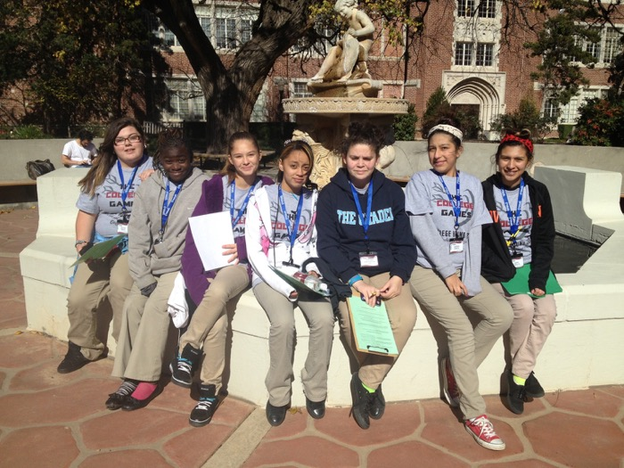
Practice and Rituals
Notes:
Practices and Rituals: Ceremonies to honor academic success, such as National Honor Society induction, or organized visits to college campus promote a culture of college-readiness.

Slide 21
College and Career Culture Strategies and Ideas
Count off 1 through 3.
Find a partner who has the same number.
Notes:
Hand out the 75 Possible Ideas and Strategies document.
Pair participants and divide the reading according to the instructions in the activity.

Slide 22
4-2-1
Individually read your assigned page.
Narrow down your individual top four favorites and write those in the top boxes of your graphic organizer.
Notes:
Hand out the 4-2-1 graphic organizer

Slide 23
4-2-1
Share your top four picks with your partner.
Together, narrow down your four to two and write those in the two middle boxes of your graphic organizer.

Slide 24
4-2-1
Find another group of two and share your two choices.
As a group narrow down to one college and career culture idea or activity that you can accomplish this academic year.

Slide 25
Share your Group’s Goal
List groups’ ideas here….
Notes:
As the groups share their goals of what they would like to accomplish, list them here.

Slide 26
Which Individual Career Academic Plan (ICAP) Indicators Will Your Goal Meet?
Notes:
Hsnd out the ICAP indicators list.
Ask participants to read through their indicators and then match which indicator(s) are being met by their activity.
After giving them a few minutes to read through and match up, then we will ask them to share out which indicators are being met.

Slide 27
Evaluate: College and Career Rubric
Take another look at the College and Career Rubric
Did your score change?
Notes:
Participants will complete the rubric individually for their school or classroom.

Slide 28

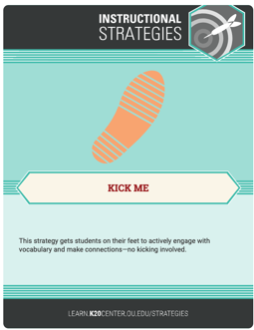
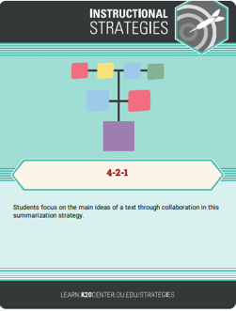
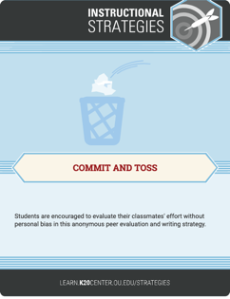
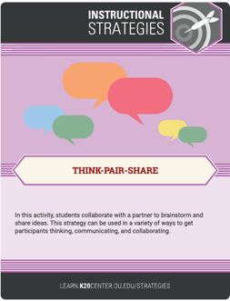
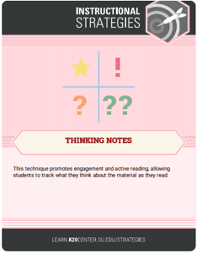
Strategies Used Today
Kick Me/Family Feud
Commit & Toss
Thinking Notes
Think-Pair-Share
4-2-1

