Slide 2
Mobilize Through Strategic Visual Communication

Slide 3
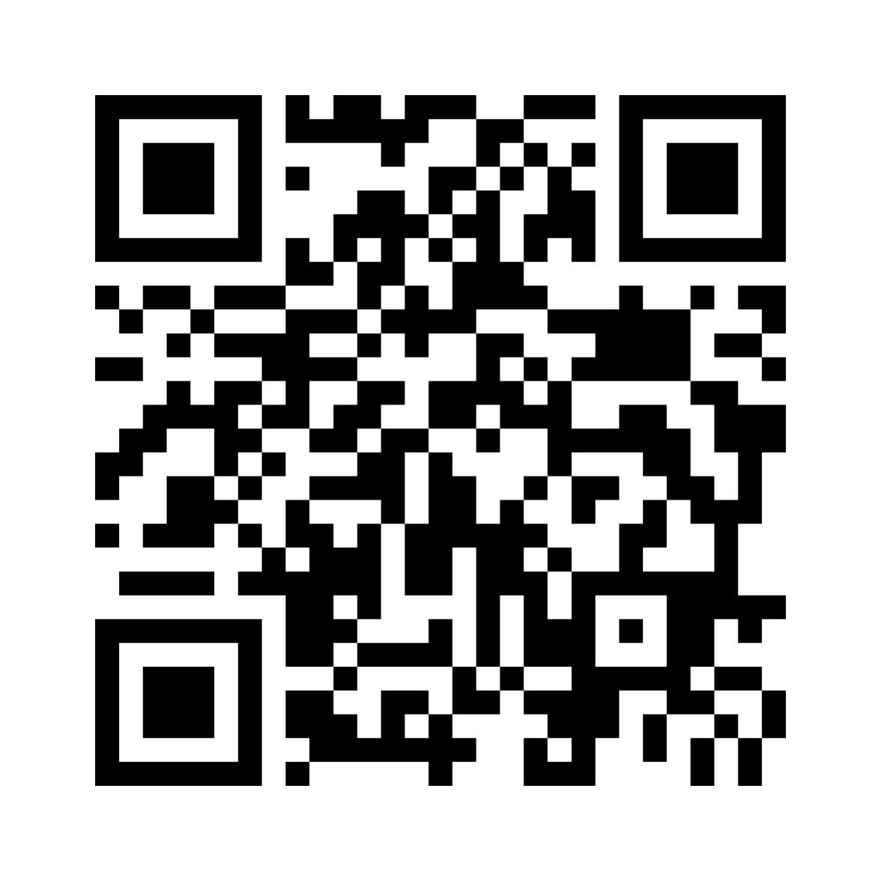
What Is the Purpose of Communication?
Go to Menti.com
Enter Code 7788 8107
Notes:
Ask participants to answer the following question: What’s the purpose of communication? Tell participants that they can answer the question by either using the QR code on the slide or heading to Menti.com and entering the code provided. Give participants a couple of minutes to answer the question.
As the audience answers the question, make sure to display their responses as a flowing grid. Once all the responses have been submitted, convert those responses to a Word Cloud.
Make sure to draw attention to the words that stand out in the Word Cloud.
Facilitation Link:
https://www.mentimeter.com/app/presentation/almeupj3zfatpiohyvfmcfscn7v9b5bx/rc1c87fpb4qt/edit
Direct link for Voting: https://www.menti.com/alqqjgxaaej1

Slide 4
Strategic Communication Goals (McKeever, 2013)
AWARENESS Gain attention Elicit prior knowledge | ATTITUDE Care about the cause Understand the problem | ACTION Feel a sense of urgency Know how to help
Notes:
Introduce participants to the research-based categories of strategic communication: raising awareness, changing attitudes, and motivating action. You can mention how some words on the word cloud resonate with these three purposes.
These are also on the back of the agenda.
Start where your audience is. If they aren’t yet aware of the cause, you can’t expect them to act on it. If they are aware but don’t care or understand, they aren’t ready to act either. If they are both aware and they care, then why haven’t they acted yet? You must find the call to action that will motivate them. Is it urgent? Do they know how to get involved?
McKeever, B. W. (2013). From awareness to advocacy: Understanding nonprofit communication, participation, and support. Journal of Public Relations Research, 25(4), 307–328. https://doi.org/10.1080/1062726x.2013.806868

Slide 5
Objectives
Explore how the purpose of visual representations can serve as a tool for strategic communication.
Identify the tools and features available for creating a strategic visual representation.
Determine ways to apply this approach with your learners or stakeholders.

Slide 6
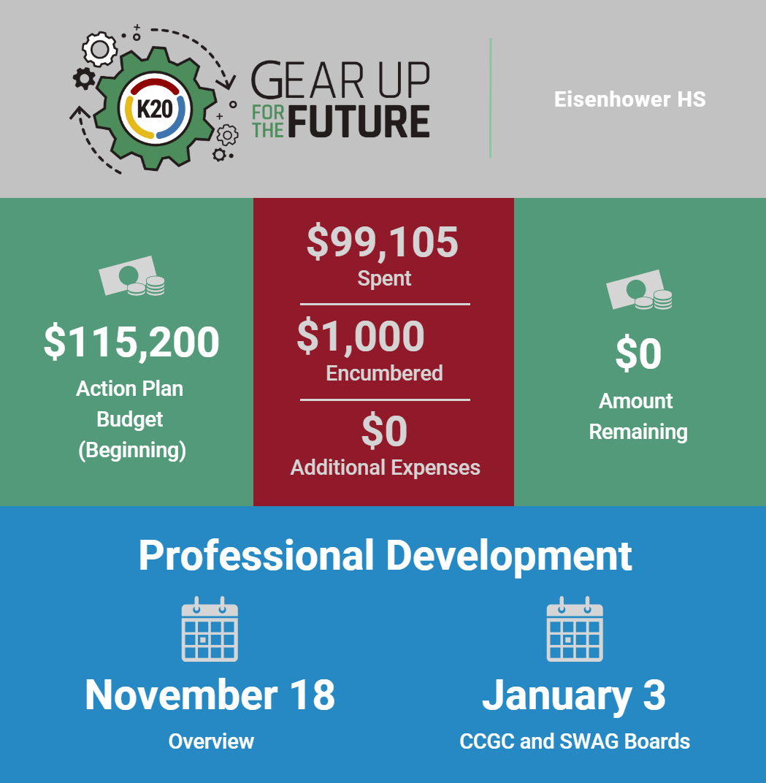
Infogram: School Profile Report
Notes:
Transition to display and scroll through the actual infogram: https://infogram.com/1pkgyrj1r3rrgyc9vpmrr9gdm9c3npj0992?live
An infographic like this one was created for each school in our program to show how they have used our services so far this year. This brings some awareness as they may not realize how much their school has done in the year, this can motivate action if they see what still needs to be done to reach goals for the year.

Slide 7
Infogram:
Career Exploration
Notes:
Transition to display and scroll through the actual infogram:
https://infogram.com/k20center-careerclusters-1hdw2jp8e9n1x2l?live
You may point out that the primary goal of this infogram is to develop an awareness of career options for students. However, it also serves a secondary function of addressing attitudes about what kinds of people can serve in different careers by representing a diversity of identities across the career clusters. For example, a female mechanic. Every career cluster links out to activities that students can do independently to learn more about that career cluster, which could be considered an action.

Slide 8
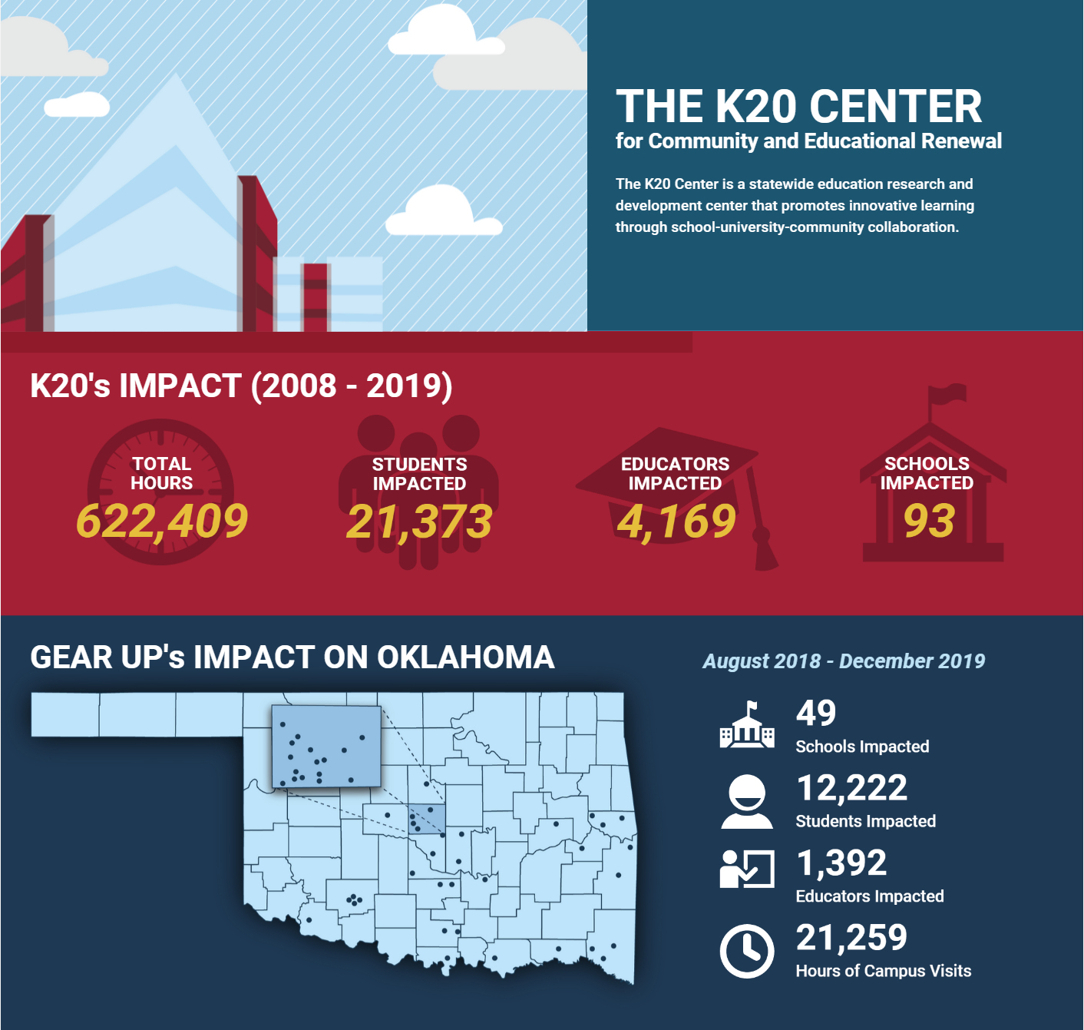
Infogram: Program Overview
Notes:
Show and scroll through the infographics. Same/similar data with different audiences.
Shared with congressman: https://infogram.com/k20-grant-infographics-1h7g6kvpdvog4oy?live
Share with school partners: https://infogram.com/k20-grant-infographics-for-gear-up-hs-overview-1h7z2l95mlxl2ow?live
Our teams created this infogram to share historical data and impact. Mention also that this infogram was created with the goal to inform our congressman of our impact on Oklahoma schools so that he would vote to support our programs in the future. It could also be a call to action with the data-created change. We then created an adaptation of this one to inform new partners when we got new grants of our past successes and to build awareness of the services we’d be providing them going forward.
This infogram was created with the Awareness goal. It could also be a call to action with the data - created change.

Slide 9
Infogram: Lesson Support
Notes:
Here are two lesson examples. One that contains more text and images break up the reading. The second is a math example with some equations and embedded videos for learning.
Si Se Puede: https://infogram.com/si-se-puede-1h8n6m39knm9j4x?live
Explain that the first example from the lesson “Si Se Puede” contains more text, along with images that break up the reading. The intentions behind this example are primarily to inform or provide awareness to students of farm worker conditions during the Delano Grape Strike and present day. You could also make an argument that this infogram within the context of an entire lesson may eventually motivate changes in attitudes about the topic from the students, at least in terms of the essential question which is, “How can political participation effect change?”
Imaginary Numbers: https://infogram.com/1pmqxelljqgkpwu37rkyjzzejdtz3rpqg3g?live

Slide 10
For which of the three purposes do you most see yourself using an infographic?
Go to: Menti.com
Enter Code: 7788 8107
Notes:
After seeing the four examples and their goals, respond to this prompt in menti. “After seeing the four examples and their corresponding goals, for which of the three goals do you most see yourself using an infogram?”

Slide 11
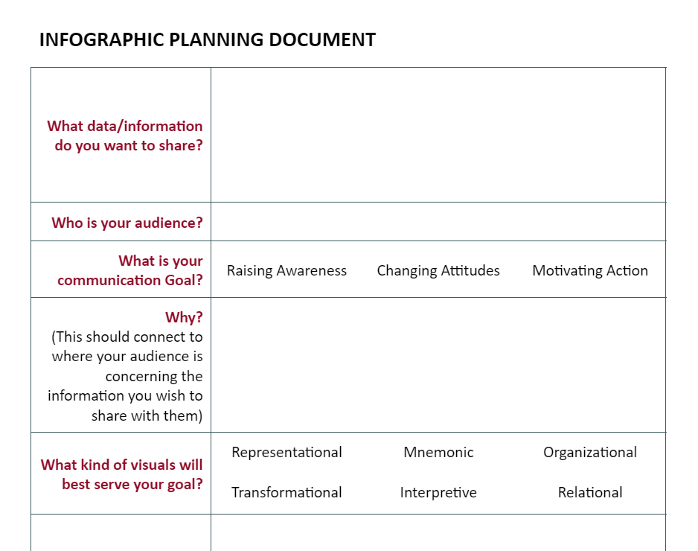
What data or information do you want to share with your learners or stakeholders?
Use the Infographic Planning Document to record your ideas.
Notes:
Lindsay W 4 mins
Extend (2 min)

Slide 12
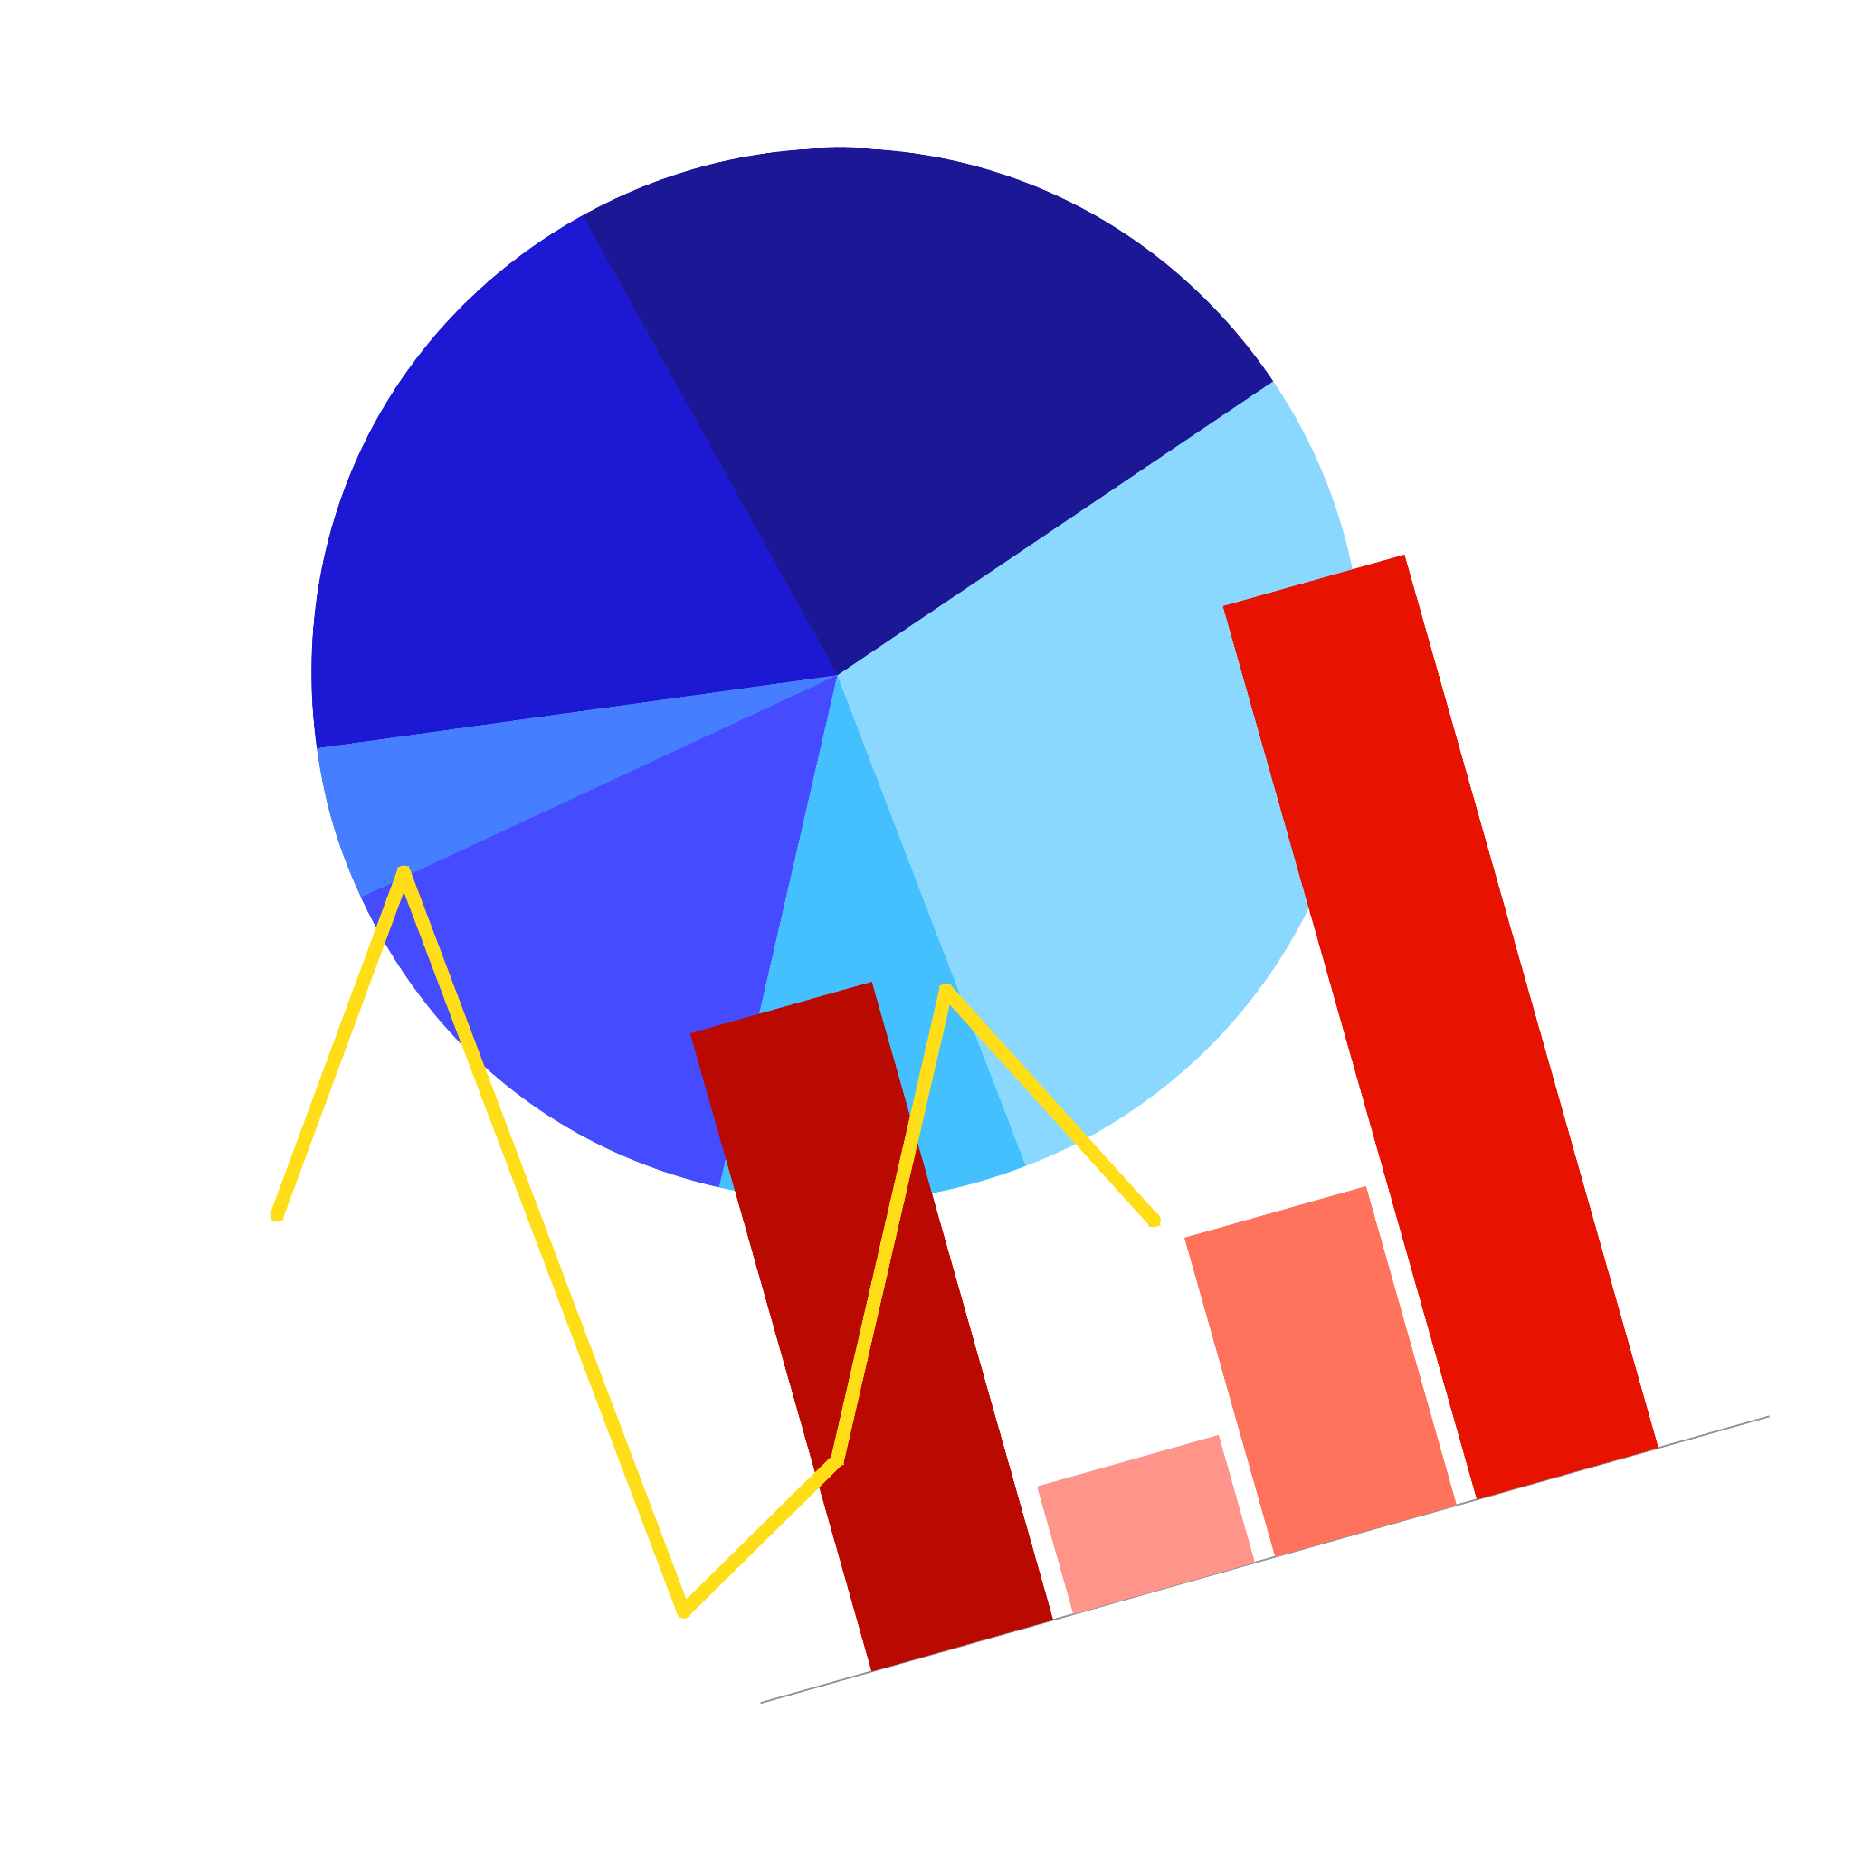
Application
Create an infographic using the cards provided at your table.
Write on each card why you chose to include each graphic and how it supports your communication goal.
Notes:
Tell participants they will use the cards in the center of their table to create the infographic. Let them know that they can include any of the following types of graphic: bar chart, timeline, illustration, org chart, photo, pie chart, line graph, animation, etc. On each card, they should write why they chose to include each graphic and how that graphic supports their communication goal. Give participants about 10 minutes to create their infographic
You may wish to scaffold them in their creations a little through prompting questions. Ask if there is someone from the audience who has an idea they are working on that they’d like to share and model the thinking process of how to develop that idea a little with the following questions.
Ask this volunteer where they are thinking they might go with their infogram in terms of what kinds of information to show and how to show it?
Have they decided if they will focus their strategy on awareness, attitude, or action?
Which piece of information they have to share is the most compelling? How does it relate to their goal
Has anyone in this room had a similar project and something they did that worked for them?
Even if know one has encountered this before, is there anyone that has another idea about where they would start with this kind of project?
It’s okay to keep this conversation fluid and not work through this list of questions like a drill sergeant. Just use the ones that feel natural in the moment to get the participants thinking together about how to approach sharing information in a strategic, goal focused, way.
Provide some time for participants to work independently or in small groups/pairs on their ideas before you move to the next slide and then have some share what they worked out.

Slide 13
Point of Most Significance
How can you apply what you learned about visual communication to your own work?
Notes:
Shayna 4 mins
Evaluate Provide some thinking time.
Have participants use their extra sticky note(s) to answer this question and put it on the door before they leave.
Share with table, then ask tables to share out to whole group
Can share what they learned or something they created?
Extend:
Choice: use your own program knowledge OR use the pseudo information we have provided on the back of the graphic organizer.
Graphic organizer (paper to organize thoughts)
Topic
Stakeholders
Information you would like to communicate
What is the purpose/goal of your communication?
What is the function of visuals?
K20 Center. (2020, September 16). POMS: Point of most significance. Strategies. https://learn.k20center.ou.edu/strategy/101

Slide 14
Available Options
Infogram:
Free version: Beginner-friendly, template features, etc.
Paid version: Additional user access, export options, etc.
Alternatives:
(Free/Paid) | (Free/Paid) | (Free/Paid) | (Free/Paid)
Notes:
Caitlin 1 min
The examples we’ve shared use infogram, but other free options are available. If you dare, go forth and build what you created today digitally in one of these platforms.
Infogram:
Free version: Beginner friendly, Template abilities, etc.
Paid version: Additional user access, Export options, etc.
Alternatives:
Piktochart (Free/Paid)
Venngage (Free/Paid)
Visme (Free/Paid)
Canva (Free/Paid)
K20 Center. (2020, October 20). Canva. Tech Tools. https://learn.k20center.ou.edu/tech-tool/612

