Slide 2
Interactive Story in the Classroom
Choose Your Own Adventure

Slide 3
Fist to Five
What is your experience with using interactive story in your classroom?
Fist - No experience
1 - I used it once or twice, but I didn’t have a good experience.
2 - I have used it a few times, but it was a little shaky, and I need some extra support.
3 - I have used it, but I have a couple of questions to help clean up my approach.
4 - I use it all the time, but I would like some extra tricks or tips.
5 - I use it all the time, but I heard you had some new information and came to see what you have to offer.
Notes:
K20 Center. (n.d.). Fist to five. Strategies. https://learn.k20center.ou.edu/strategy/68

Slide 4
What are some examples of interactive story?
Role-playing games (video games, pen-and-paper games)
Choose-your-own-adventure books
Interactive TV (YouTube, Netflix)

Slide 5
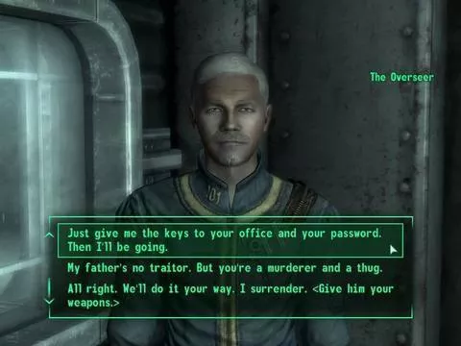
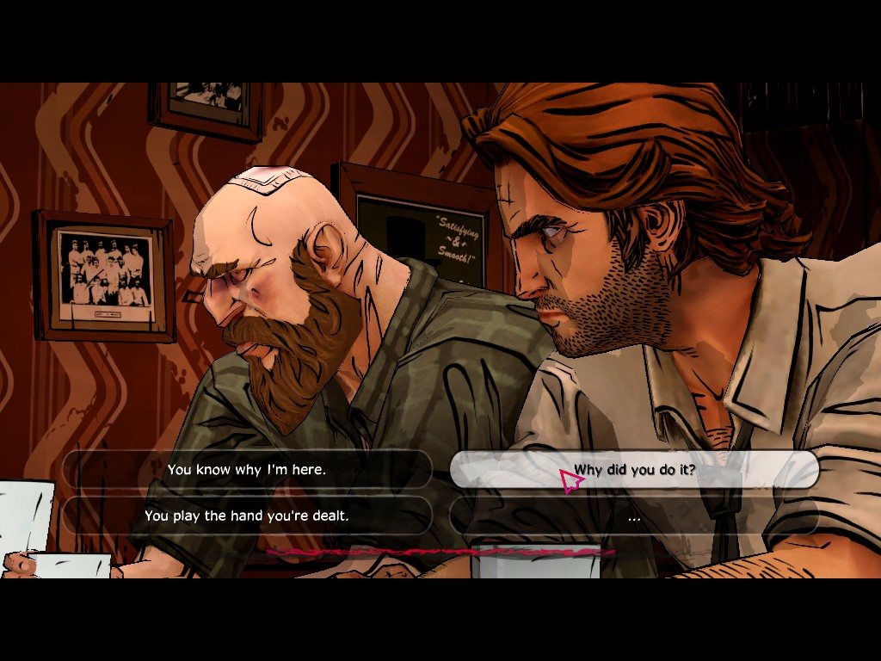
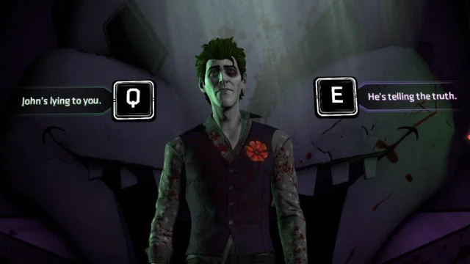
Choosing what the character will do/say next

Slide 6
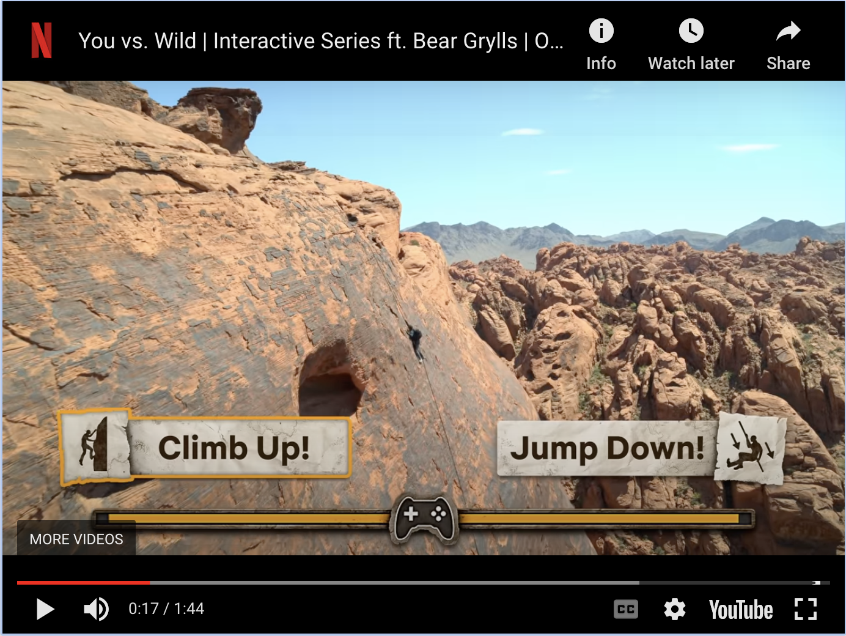
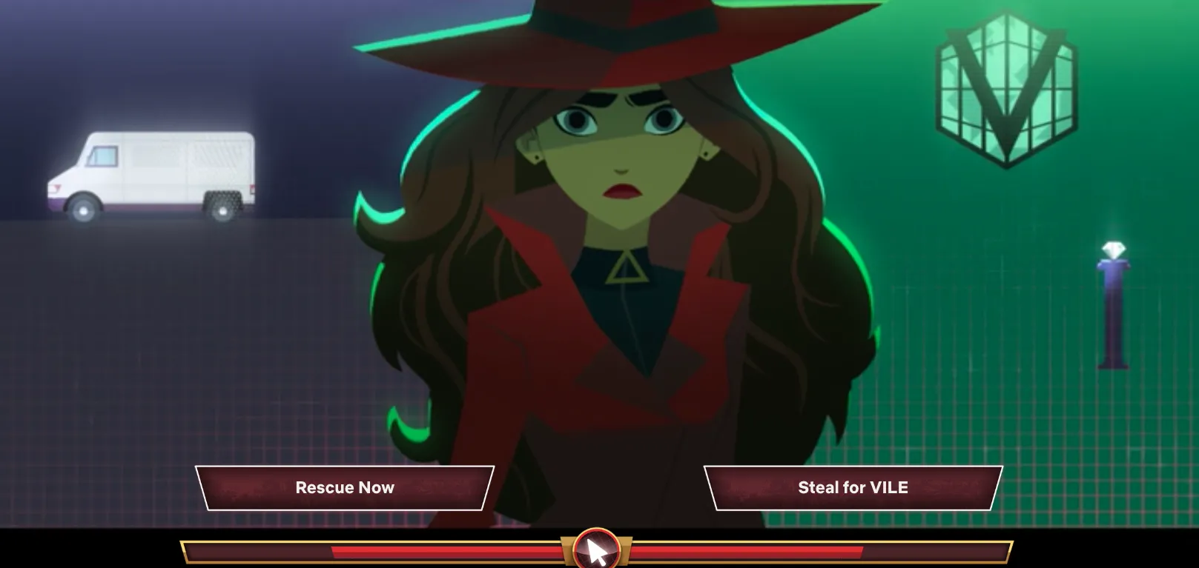
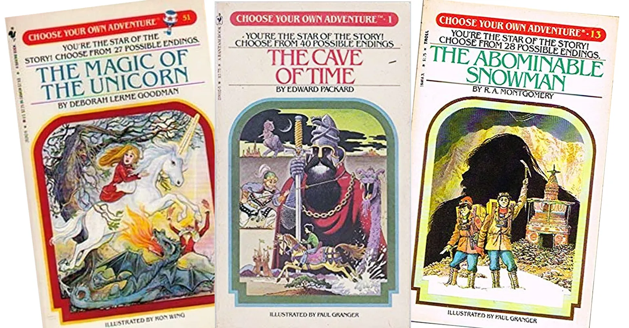
Choosing which path the story takes
Notes:
The second one is Netflix Carmen San Diego

Slide 7
Essential Question
How can teachers use interactive story to create engaging content in their classrooms?

Slide 8
Session Objectives
Reflect on the value of interactive story for learning.
Identify strategies for implementing interactive story into learning.
Explore Twine as a tool for interactive story.

Slide 9
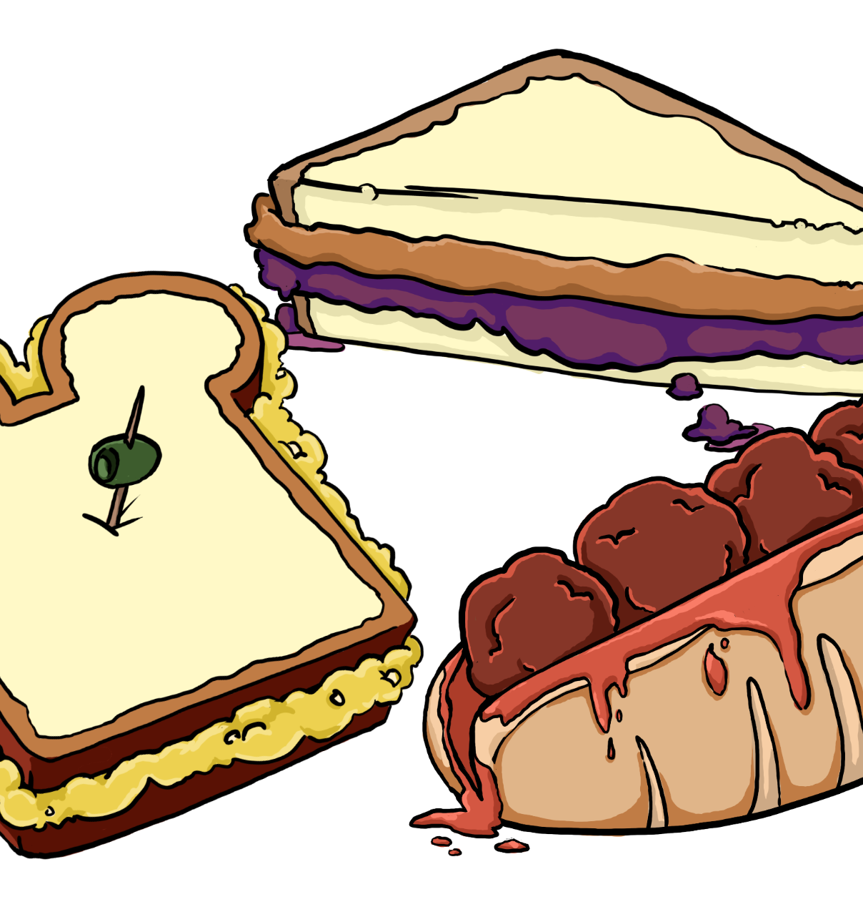
Food Fight:
Difficult Conversations in the Classroom
Classroom participation in difficult conversations gives students a safe place to learn how to express their ideas and opinions without fear. In this lesson, students engage with difficult topics through in-class discussions, use of Twine, the development of class discussion norms, and the creation of their own Twine.
Speaking and Listening
9th and 10th grade
English Language Arts
5-10 minutes
Standards
9.1.L.1
9.1.L.2
9.1.S.1
Notes:
K20 Center. (n.d.). Food fight: difficult conversations in the classroom. Lessons. https://learn.k20center.ou.edu/lesson/1761

Slide 10
Tricks of the Trade
In this lesson, students examine the nature and function of international trade agreements in the world economy. Through using Twine to engage in an interactive story, students learn important concepts regarding world trade.
International Trade Agreements
10th grade
World History
5-10 minutes
Standard: WH.6.1
Notes:
K20 Center. (n.d.). Tricks of the trade. Lessons. https://learn.k20center.ou.edu/lesson/1804

Slide 11
Reflection and Discussion
Access the Padlet to add your reflection on the activities. To do this:
Scan the QR code with your phone, or type the link in your browser.
Click the plus sign (+) under the reflection column in which you are responding.
Post ideas you have while going through the example interactive stories.
Add your text in the space provided.
Click “Publish.”
As others are adding their reflections, take some time to view them.
Insert bit.ly here
Notes:
Have your participants open the Padlet before they access one of the two interactive stories.
Model the instructions on the slide for how to use the Padlet with your participants
K20 Center. (n.d.). Padlet. Tech tools. https://learn.k20center.ou.edu/tech-tool/1077

Slide 12
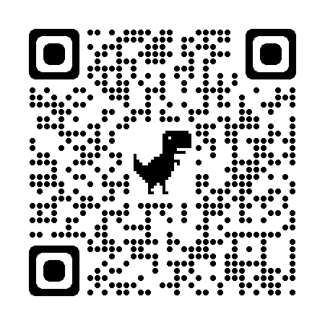
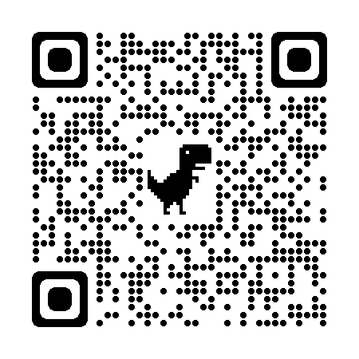
Food Fight!
Tricks of the Trade
https://k20center.ou.edu/ e-learning/food-fight/
https://k20center.ou.edu/ e-learning/tricks-of-the-trade/
Notes:
Instruct your participants to explore one of the two stories (if time permits, have them explore both) and post their reflection in the Padlet.
When you notice they are wrapping up, have them share with their table what they posted in the Padlet. One person from the table will share with whole group.
K20 Center. (2021, September 21). K20 Center 10 minute timer [Video]. YouTube. https://www.youtube.com/watch?v=9gy-1Z2Sa-c

Slide 13
Let’s Write a Story!
Access the Padlet to add to the story we have started for you! To do this:
Scan the QR code with your phone, or type the link in your browser.
Click the plus sign (+) at the bottom right of the Padlet.
Add your text in the space provided.
Click “Publish.”
Select the open circle on the timeline, and drag your text to where it belongs in the story’s sequence of events.
As others are adding their story elements, take some time to view them.
Insert Padlet QR code and bit.ly here
Notes:
Share the new Padlet with your participants.
Model the instructions on the slide for how to use the Padlet. Specifically, show them how to drag their text to the correct location on the timeline in the sequence of events.
K20 Center. (n.d.). Padlet. Tech tools. https://learn.k20center.ou.edu/tech-tool/1077

Slide 14
Let’s Write a Story!
Read the blue plot points provided.
With your group:
Brainstorm events to include in the current story
Add another plot point to the timeline
Between the beginning and middle
Or between the middle and end
Make sure your new event includes an action and an outcome.
Keep in mind that this activity is not meant to write a good story—it’s meant to show you how the mechanics of the technology work.
Notes:
Once your participants have come to a stopping point, open up https://twinery.org/ and walk them through how to make this interactive story a reality!
K20 Center. (n.d.). Twine. Tech tools. https://learn.k20center.ou.edu/tech-tool/1840

Slide 15
I Used to Think… But Now I Know…
Consider what you knew at the beginning of the session compared to where you are now.
Divide your sticky note in half.
Left side - I used to think…
Right side - Now I know…
Notes:
K20 Center. (n.d.). I used to think… but now I know. Strategies. https://learn.k20center.ou.edu/strategy/137

Slide 16
Resources
Twine website and building app: https://twinery.org/
How to Twine: Quick-start guide created by K20
How to do the really cool stuff in Twine: https://twinery.org/cookbook/
Lesson plans for teaching students how to Twine: https://teachingwithtwine.wordpress.com/resources/
Student-created Twine projects: https://keeganslw.com/student-twine-games-research/
MissionUS immerses middle school students in transformational moments in U.S. history. Each interactive narrative game is research-based and empowers students to make choices illuminating how people experienced the past. https://www.mission-us.org/play/
Notes:
Easter, B. (2015, March 20). Lesson plans. Teaching with Twine. Retrieved February 6, 2023, from https://teachingwithtwine.wordpress.com/resources/
Long-Wheeler, K. (2017, August 23). Student Twine games collection & resources. KeeganSLW.com. Retrieved February 6, 2023, from https://keeganslw.com/student-twine-games-research/
Thirteen Productions LLC. (2022, November 15). Play - Mission US. WNET/Thirteen. Retrieved February 6, 2023, from https://www.mission-us.org/play/
Twine contributors. (n.d.). Twine is an open-source tool for telling interactive, nonlinear stories. Twine. Retrieved February 6, 2023, from https://twinery.org/
Twine contributors. (n.d.). Welcome to the Twine cookbook. Twine. Retrieved February 6, 2023, from https://twinery.org/cookbook/

