Slide 2
Across the Hall
Multidisciplinary Lessons

Slide 3
Essential Question
What are the key elements needed to create an effective and engaging multidisciplinary lesson?

Slide 4
Learning Objectives
Participants will:
Explore the functions, challenges, and benefits of multidisciplinary lessons.
Identify potential partners, as well as possible roadblocks in developing multidisciplinary lessons in their own schools.
Locate areas of their own curriculum where such lessons could be used and brainstorm an idea.

Slide 5

Collective Brain Dump
With your table group, list as many qualities as you can about multidisciplinary learning.
How would you define multidisciplinary learning using those qualities?
Notes:
K20 Center. (n.d.). Collective brain dump. Strategies. https://learn.k20center.ou.edu/strategy/111

Slide 6

Patriot’s Pen
Student Work Samples
Notes:
Veterans of Foreign Wars of the United States. (n.d.). Patriot's Pen. VFW | Veterans of Foreign Wars. Retrieved January 20, 2023, from https://vfwauxiliary.org/scholarships-voice-of-democracy-and-patriots-pen/.

Slide 7
Patriot’s Pen
Students work with social studies teachers to learn the context behind the prompt for the VFW Patriot’s Pen scholarship contest.
Notes:
This year’s topic - “"Why is the Veteran Important?"

Slide 8
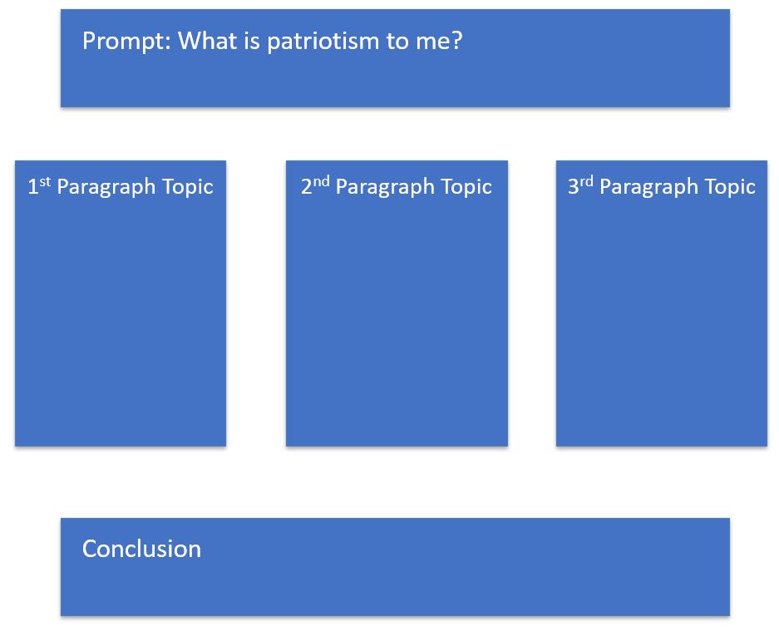
Patriot’s Pen
Students take their ideas to ELA courses where they are constructed into a full length essay to submit in the contest.

Slide 9
Clue Week
Student Work Samples

Slide 10

Clue Week
CLUES NEWS: Case Brief
Notes:
YouTube. (2022). Clue News : Case Brief. YouTube. Retrieved November 28, 2022, from https://www.youtube.com/watch?v=U5N-AvRz150.

Slide 11
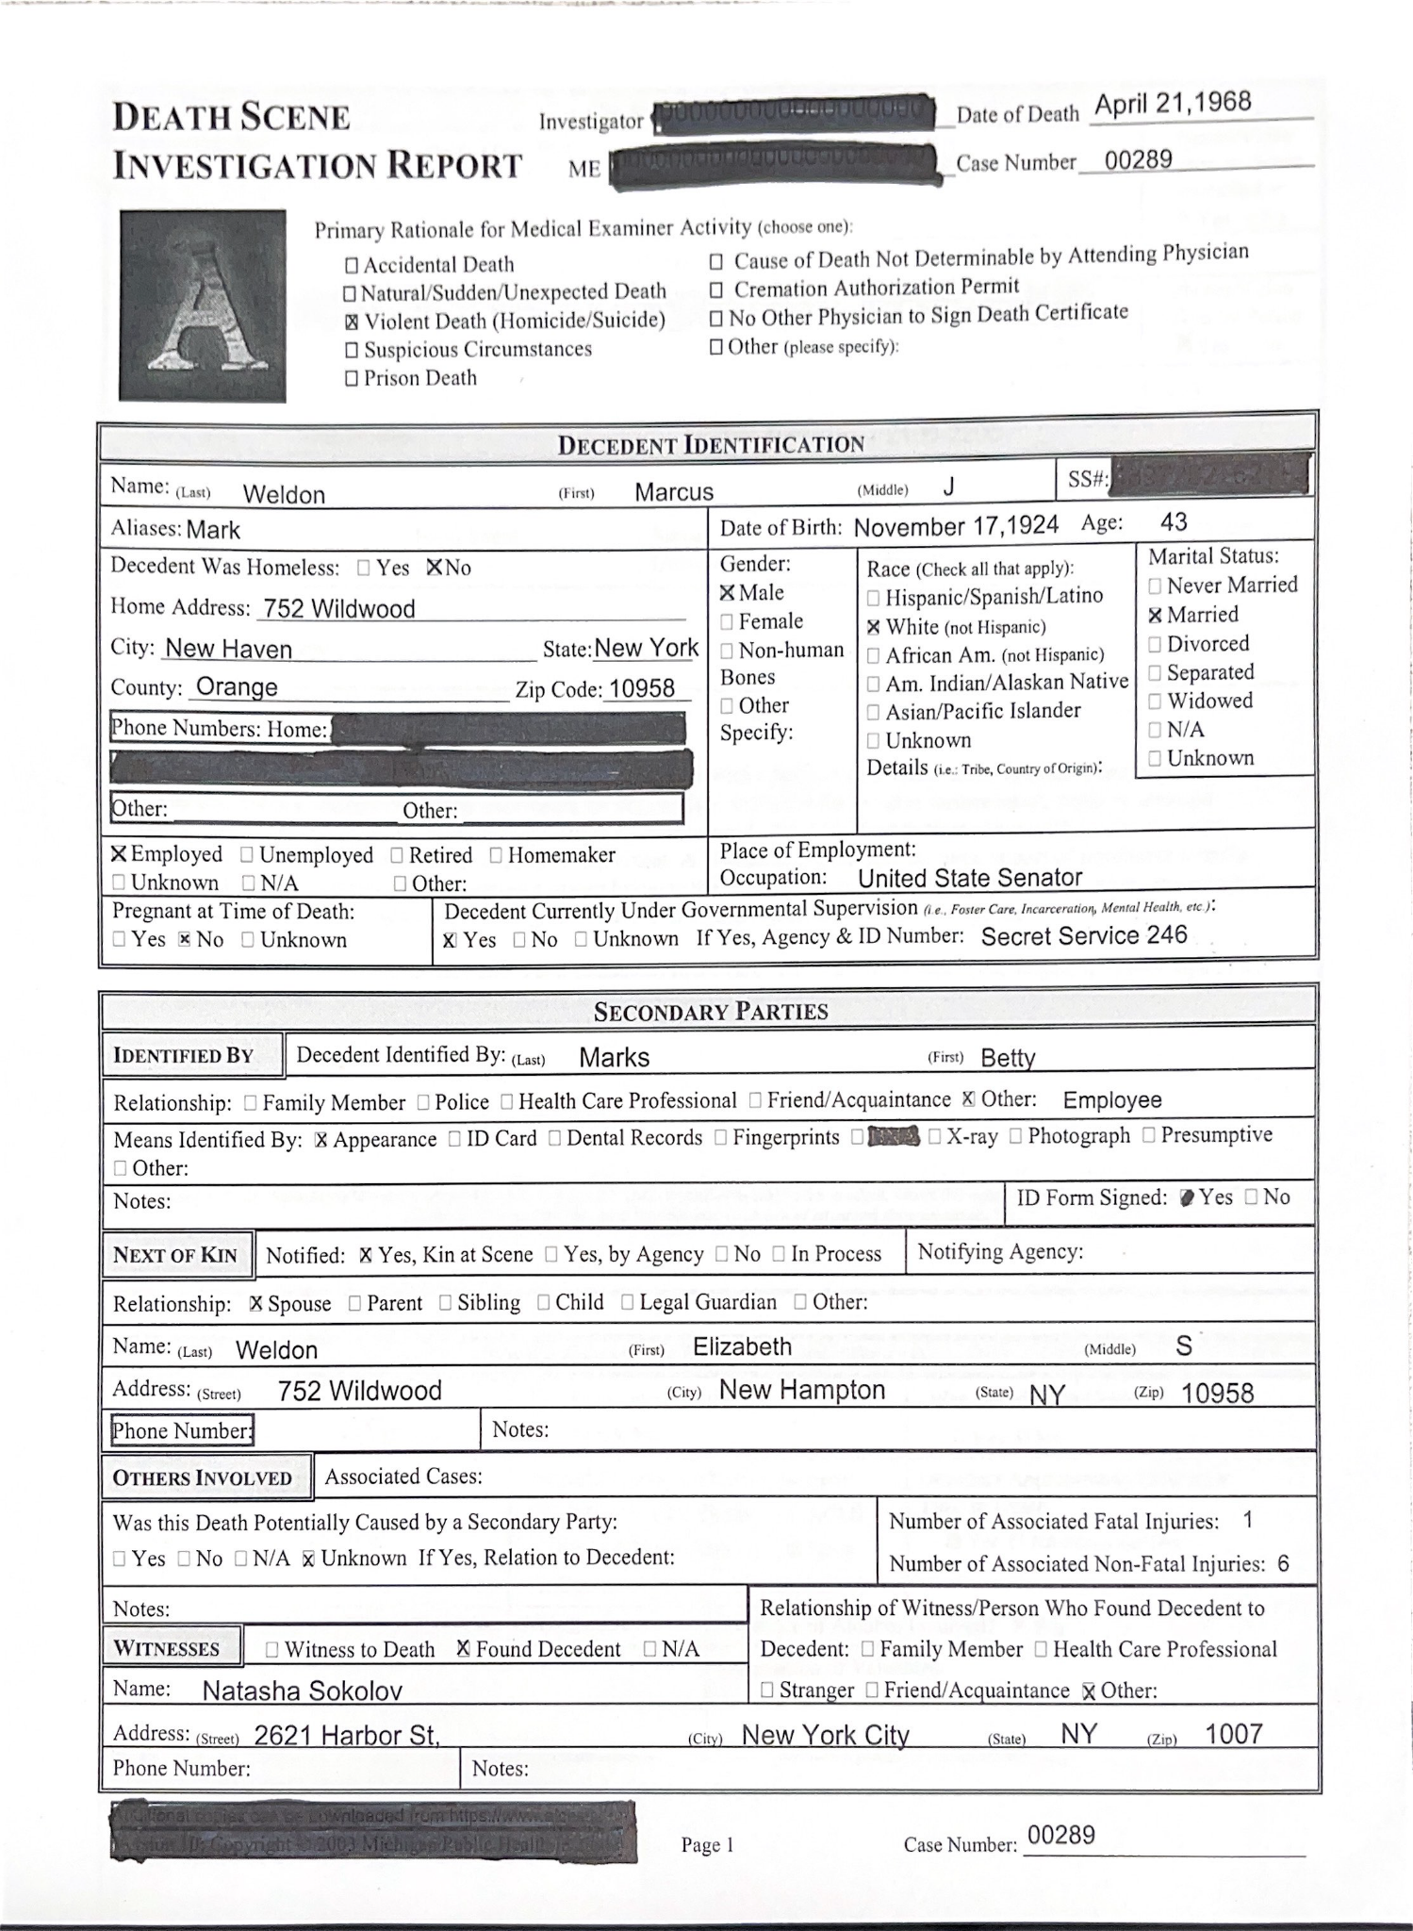
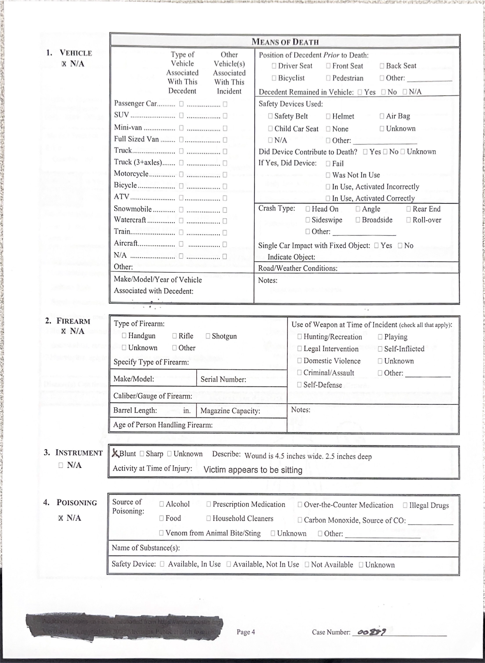
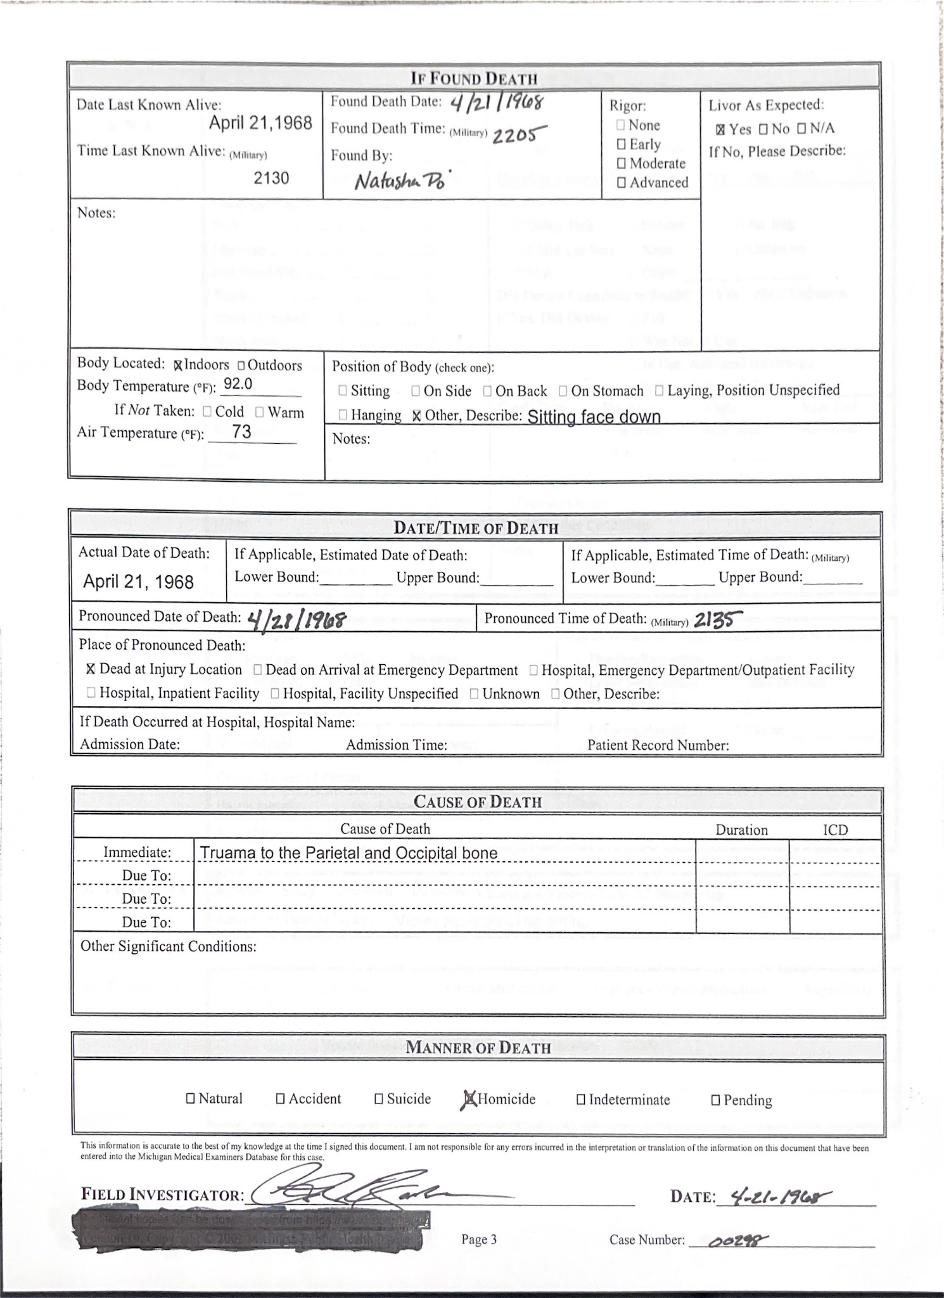
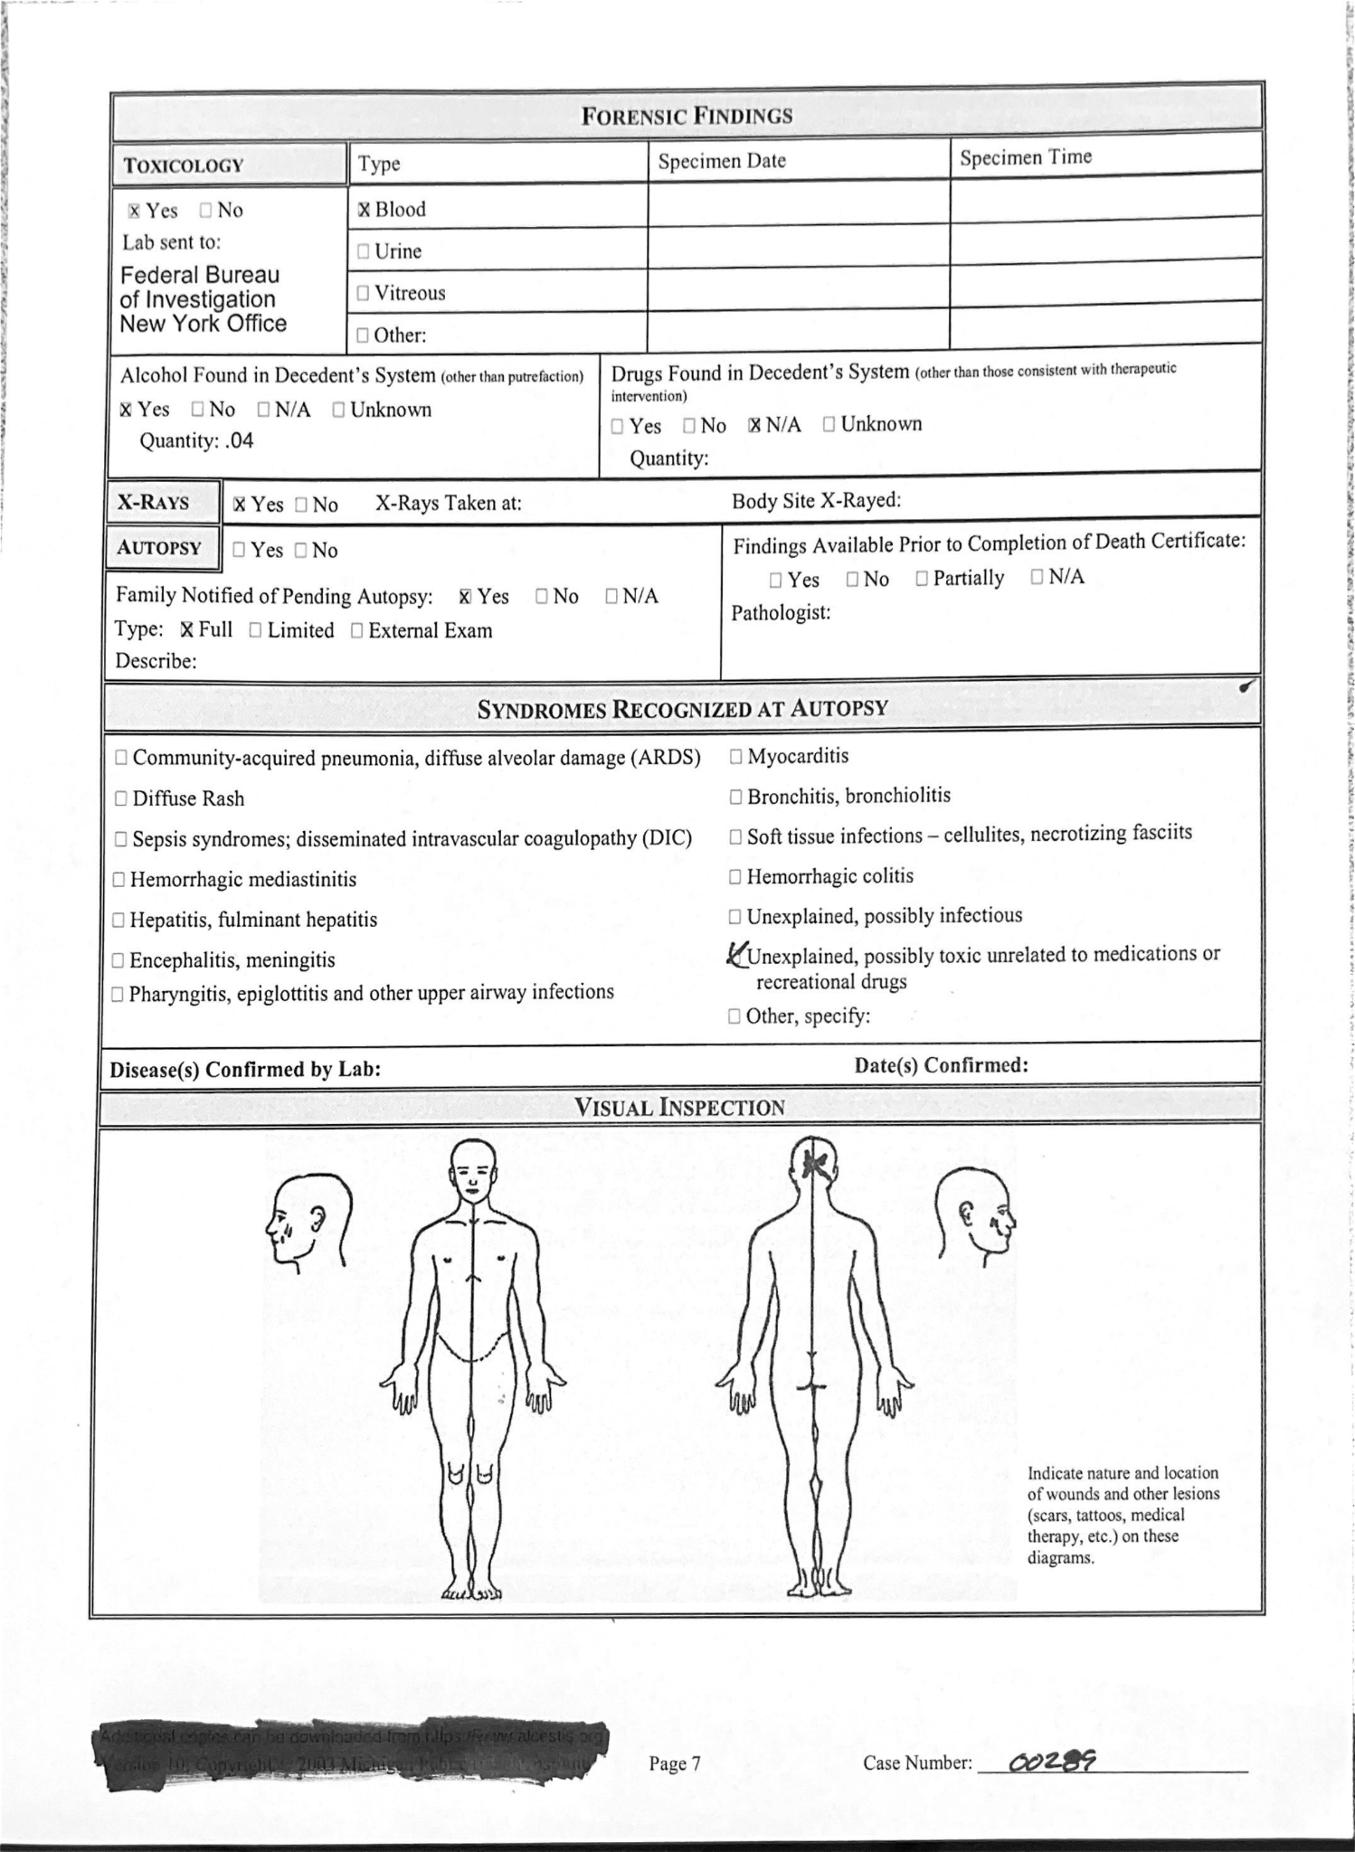
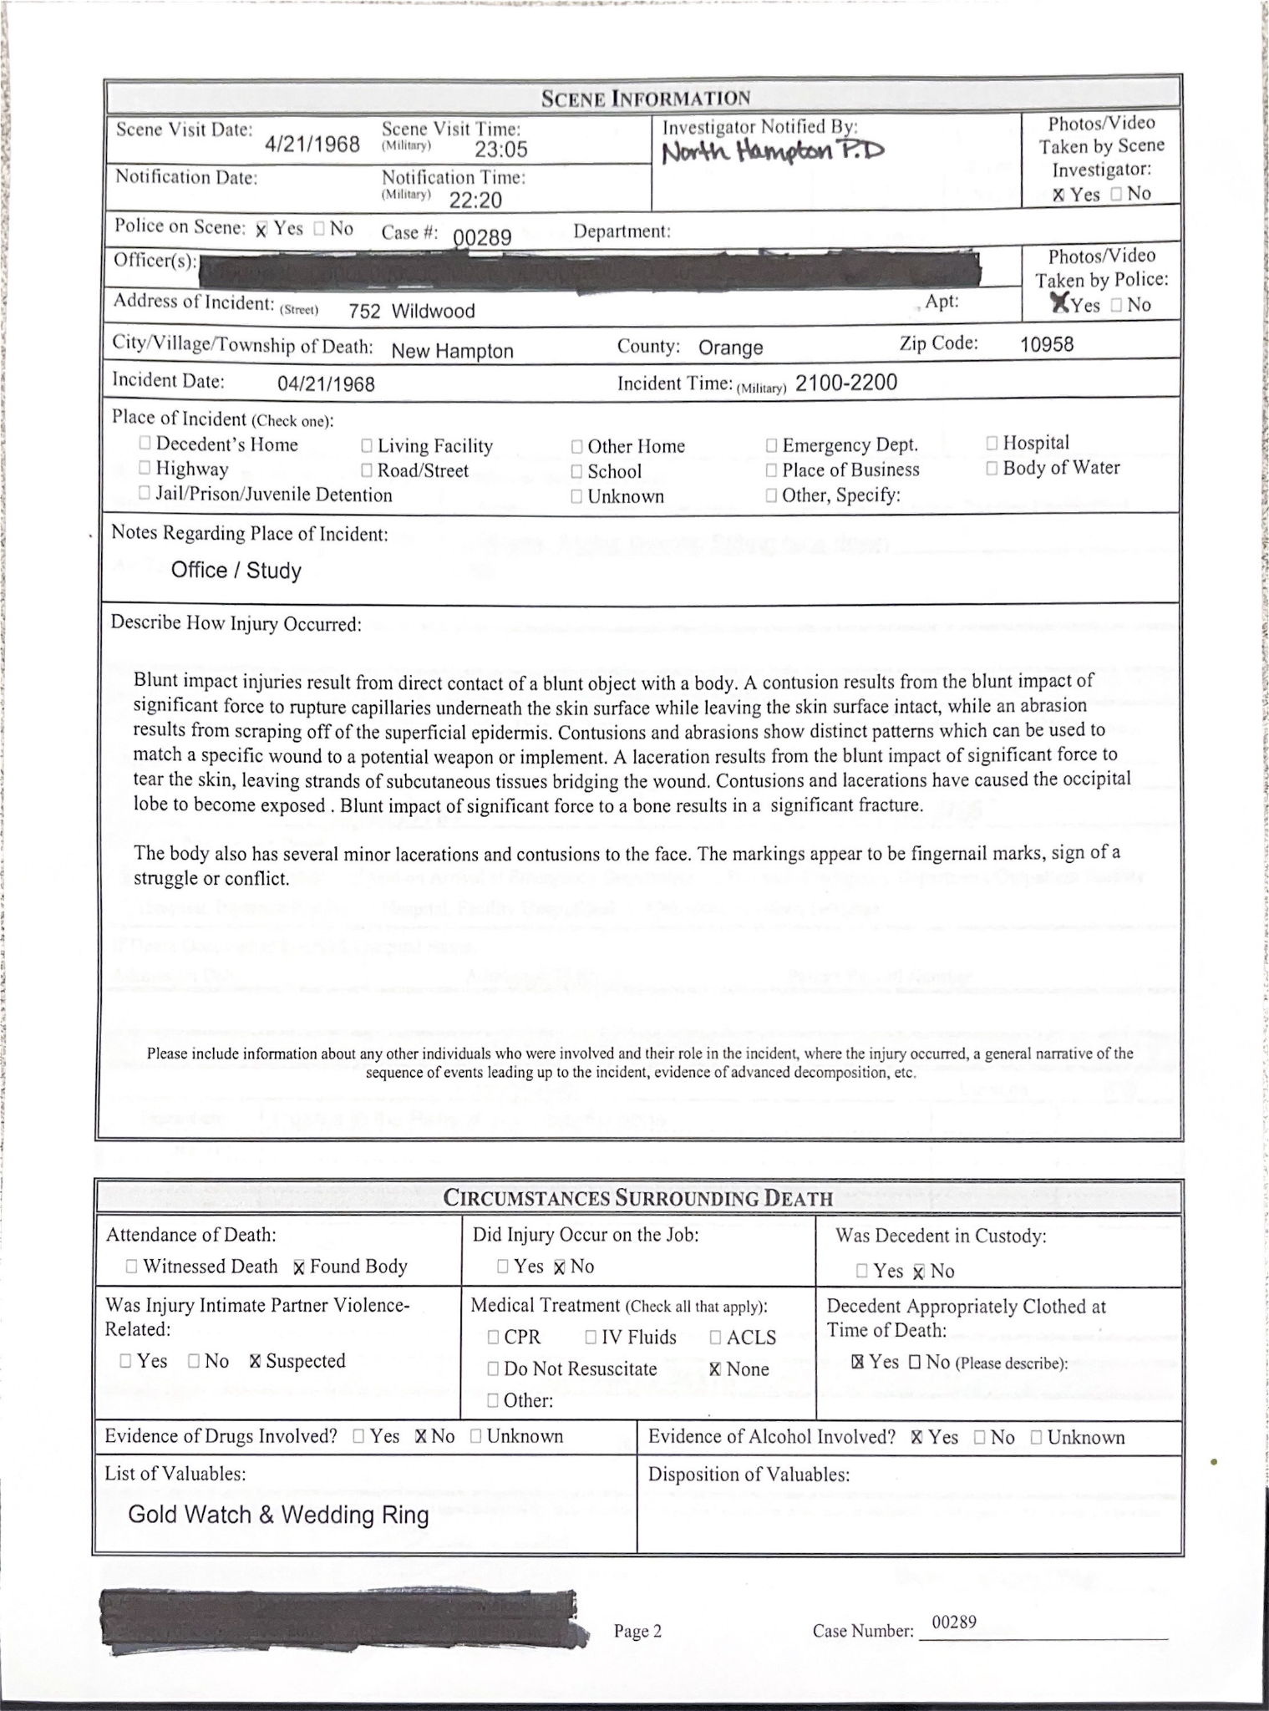

Clue Week
Students use Exponential Decay from their math, chemistry, or physics class to solve time of death for the Clue Week victim.

Slide 12

Clue Week
In ELA classes, students are studying The Great Gatsby and Julius Caesar.
The ELA department makes transcripts based on these plots.
They use familiar character traits, themes, diction, and motives so students can find parallels.
Notes:
Cugat, F. (2020). The Great Gatsby Cover 1925 Retouched. Wikimedia Commons. Retrieved January 20, 2023, from https://commons.wikimedia.org/wiki/File:The_Great_Gatsby_Cover_1925_Retouched.jpg.

Slide 13

Make Some Waves
In this lesson, students examine the physics behind synthesizers and use that knowledge to create unique sounds on a virtual synthesizer. This lesson explores both scientific and musical concepts, and can be used in both science and music classrooms.
Exploring Wave Interference with Synthesizers
  10th, 11th, 12th grades
  Performing Arts, Science, Physics, Music
  90 minutes
Standards Covered
  M.PR.3
  N.M.PR.3
  M.PR.5
  PH.PS4.3
  PH.PS4.3.DCI.1

Slide 14
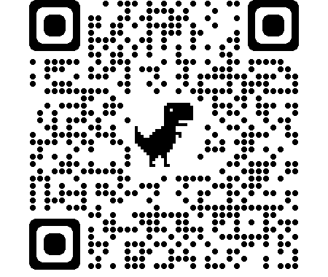




Music Lab Oscillator
Scan the QR code with the camera on your phone.
Spend a few minutes exploring the application.
Notes:
Chrome Music Lab. (n.d.). Retrieved September 29, 2022, from https://musiclab.chromeexperiments.com/Oscillators/

Slide 15
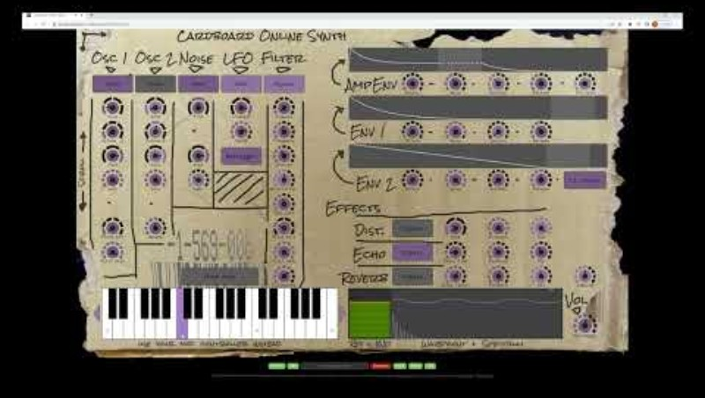
Cardboard Synthesizer Tutorial
Cardboard Synthesizer Tutorial
Notes:
YouTube. (2022). Cardboard Synthesizer Tutorial. YouTube. Retrieved September 29, 2022, from https://www.youtube.com/watch?v=L2g38xtag9Q.

Slide 16
Make Some Waves
Student Work Samples

Slide 17
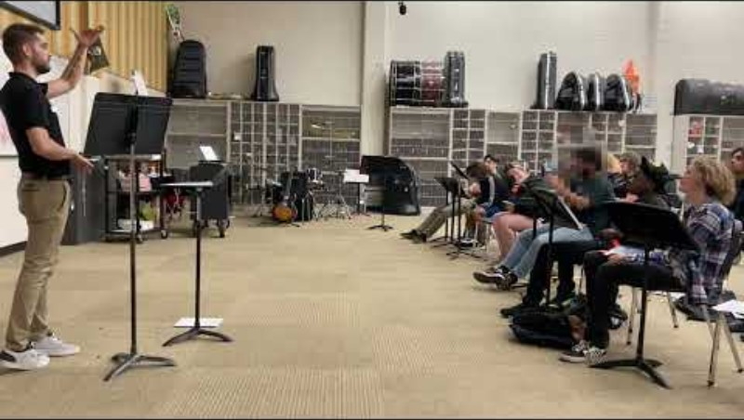
Make Some Waves
Make Some Waves
Notes:
YouTube. (2022). Make Some Waves Demo_YouTube. YouTube. Retrieved November 28, 2022, from https://www.youtube.com/watch?v=RydxVtBWwwM.

Slide 18
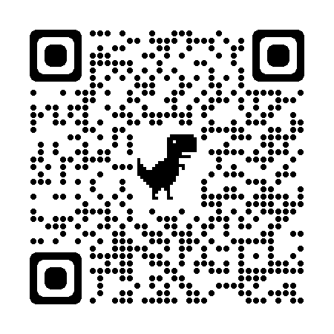
Make Some Waves
Take some time to review the lesson,
Make Some Waves.
Think back to the qualities of multidisciplinary learning that you generated in the collective brain dump. Does this lesson demonstrate the qualities you came up with?
Now that you’ve seen a few lessons, what are some other qualities of multidisciplinary learning?

Slide 19
Multidisciplinary Learning Defined
A “whole” or “comprehensive” method that covers an idea, topic, or text by integrating multiple knowledge domains. It is a very powerful method of teaching that crosses the boundaries of a discipline or curriculum in order to enhance the score and depth of learning.

Slide 20
Benefits of Multidisciplinary Instruction
Higher student engagement
Focus on Student-Centered Learning
Better retention of instruction

Slide 21

Commit and Toss
What has prevented you from developing a multidisciplinary lesson?
Notes:
K20 Center. (n.d.). Commit and toss. Strategies. https://learn.k20center.ou.edu/strategy/119

Slide 22
Different Perspectives
Science v. Music on filters.
Musician thinking about waveshape being altered.
Scientist thinking about resistor and capacitor modifying output.

Slide 23
Lesson Brainstorming
Core teachers group up by content area.
Electives teachers crash a content party of your choice.
Within your groups, use the brainstorming handout to develop an initial multidisciplinary lesson idea.
Focus on the lesson content and address the last two logistics questions if you still have time.
Notes:
Ask participants to group up with people in their content area. Have electives teachers crash the party of a content area of choice.
In their small groups, participants work together to develop an initial idea of a multidisciplinary lesson. Provide a brief overview of the Brainstorming handout. Encourage participants to focus their time on what the lesson would entail, leaving the logistic details for the end, if they have time.

Slide 24
Lesson Share Out
What do your barrier-free multidisciplinary lessons look like?
Notes:
Ask for a few volunteers to share their ideas with the whole group. Be sure they mention which content areas are involved and what content the lesson would cover.

Slide 25

What Am I Thinking? How Am I Feeling?
On a sticky note, respond to the following prompts:
What do I think about multidisciplinary lessons?
How am I feeling about creating and using multidisciplinary lessons?

