Slide 2
Break the Format
Using Brain Breaks as Formative Assessments

Slide 3
Snap, Clap, Pop
Walking Vote
Notes:
K20 Center. (n.d.). Snap, Clap, Pop. Strategies. https://learn.k20center.ou.edu/strategy/190

Slide 4
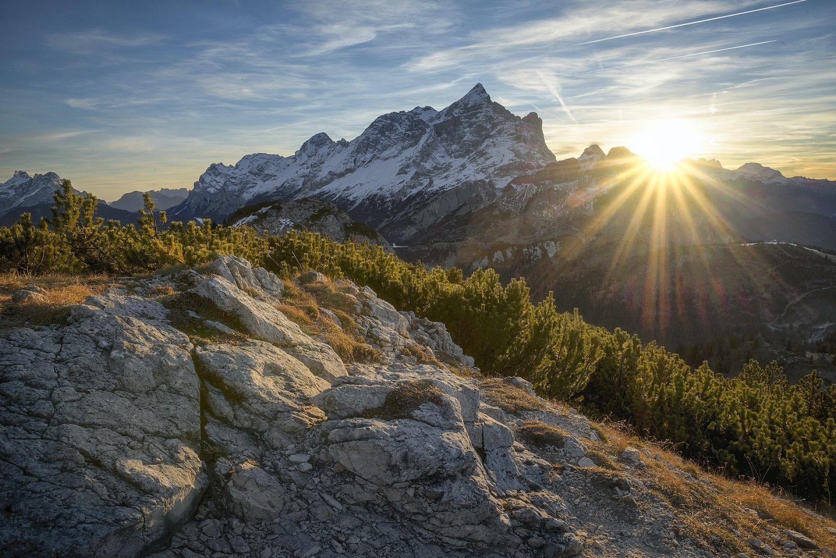
Beach or Mountains?
Beach
Mountains
Notes:
Andrea, S. (2017, November 8). Mountains [Photography]. Pexels. https://www.pexels.com/photo/snow-covered-mountain-during-sunrise-618833/
Ocean Waves. [Photography]. (2016, October 19). Pexels. https://pixabay.com/photos/beach-sea-sunset-sun-sunlight-1751455/

Slide 5
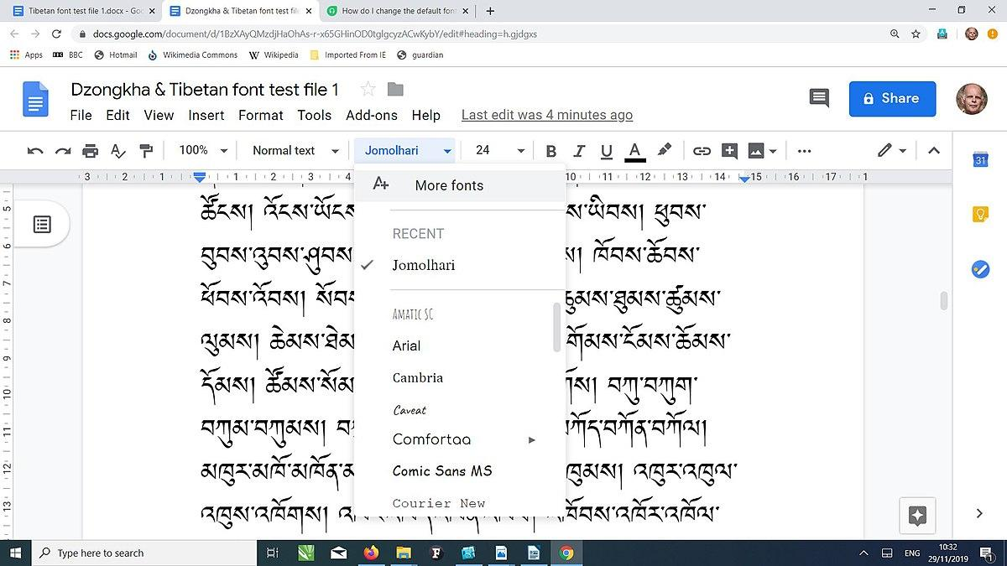
Paper or Digital Copies?
Paper Copies
Digital Copies
Notes:
Bondhus, J.J. (2011, July 11). Stack of Copy Paper [Photography]. Wikimedia. https://commons.wikimedia.org/wiki/File:Stack_of_Copy_Paper.jpg
Fynn., C.J. (2019, November 29). Example of Jomolhari font used in Google Docs [Screenshot]. Wikimedia. https://commons.wikimedia.org/wiki/File:Jomolhari_in_Google_Docs_(screen-shot).jpg

Slide 6
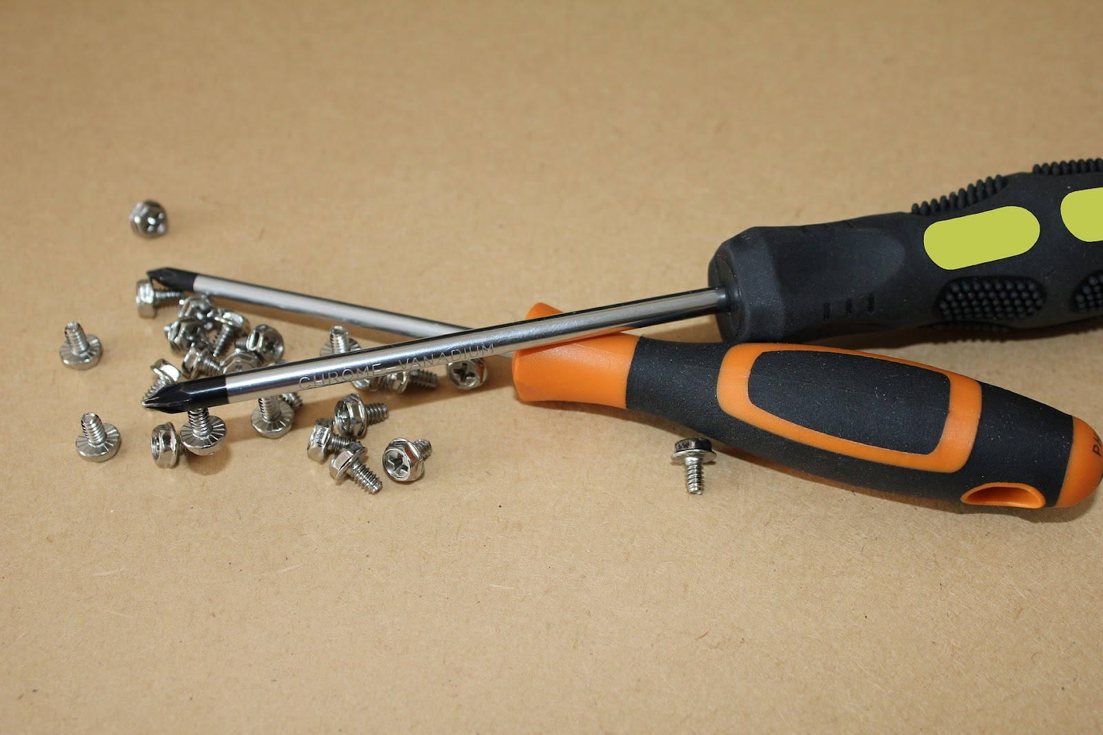
How Do You Begin?
Read Directions First
Dive Right In
Notes:
Athena. (2020, November 2). Assembly Instructions [Photography]. Pexels. https://www.pexels.com/photo/hammer-screwdrivers-and-furniture-assembly-instructions-5805494/
Bluebudgie. (2018, June 20). Screws, Screwdrivers [Photography]. Pixabay. https://pixabay.com/photos/screws-screwdriver-magnetic-point-3481339/

Slide 7
Snap, Clap, Pop
Walking Vote
Play a Musical Instrument: Mime
What is a Right Angle? Show Me
Visited K20 LEARN Website? Clap Twice
Notes:
K20 Center. (n.d.). Snap, Clap, Pop. Strategies. https://learn.k20center.ou.edu/strategy/190

Slide 8
Essential Question
How can brain breaks be used as formative assessments?

Slide 9
Learning Goals
Identify instructional strategies that promote active engagement.
Identify benefits of actively engaging students.
Examine ways to use student movement to assess classroom learning.

Slide 10
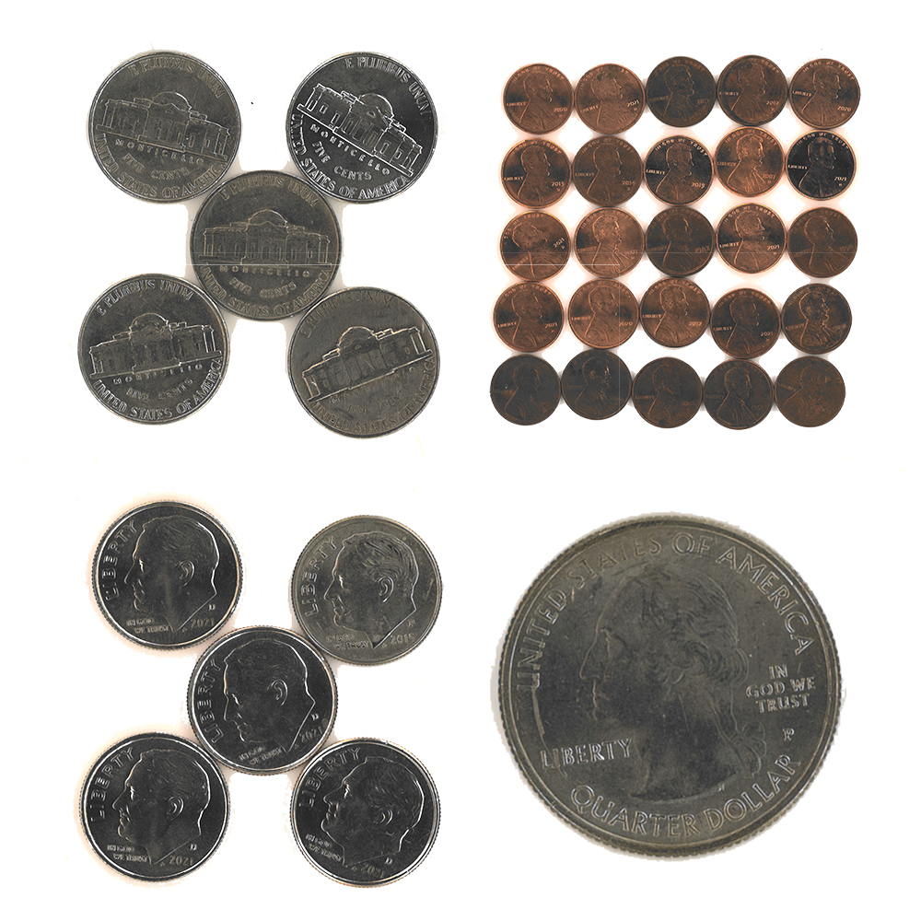
Four Corners
Go to the corner of the image that you think does not belong.
Discuss with your group why you chose that image.
Pick a spokesperson for your group to share out.
Notes:
K20 Center. (n.d.). Four Corners. Strategies. https://learn.k20center.ou.edu/strategy/138
Inspired by Bourassa, M. (2013). Which One Doesn't Belong? https://wodb.ca/

Slide 11
Jigsaw
In your group, read one of the selections from Movement Matters: The Importance of Incorporating Movement in the Classroom by Dana Kleinjan.
Become an expert on your assigned reading.
Pick a spokesperson for your group to share out.
Notes:
K20 Center. (n.d.). Jigsaw. Strategies. https://learn.k20center.ou.edu/strategy/179

Slide 12
Jigsaw Timer
10 Minute Timer

Slide 13
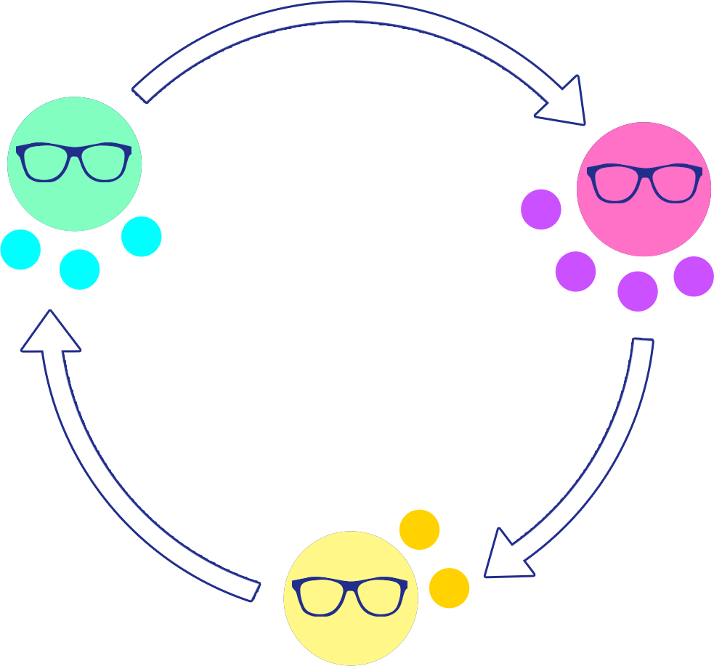
Expert Stay and Stray
In your group, read a selection from Movement Matters: The Importance of Incorporating Movement in the Classroom by Dana Kleinjan.
Become an expert on your assigned reading.
Experts stay; others rotate to the next group.

Slide 14
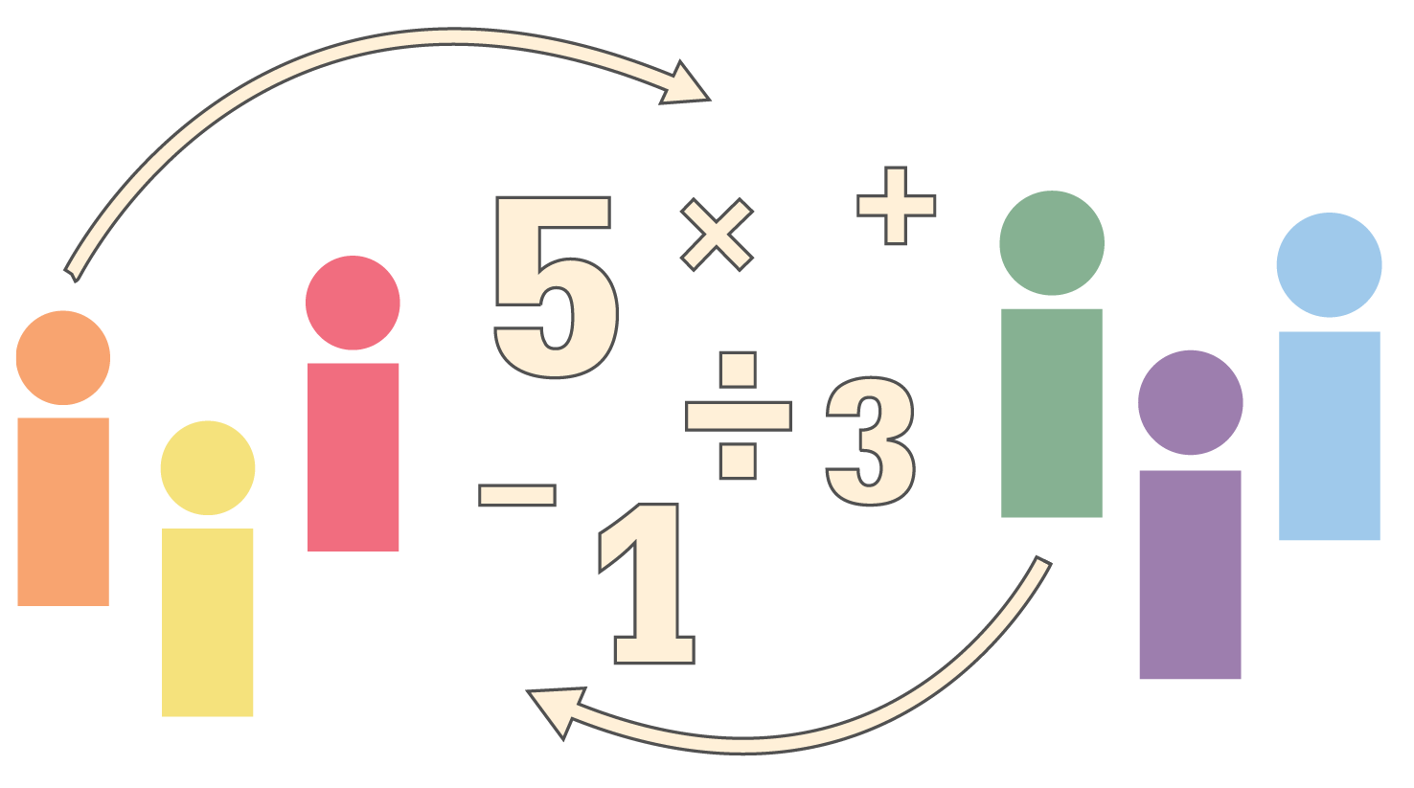
Mingling Questions
Everyone stand up and circle the room until the music stops playing.
When the music stops, use the prompt to determine your group size.
Once you find a group, discuss the displayed question.
Notes:
K20 Center. (n.d.). Mingle. Strategies. https://learn.k20center.ou.edu/strategy/53

Slide 15
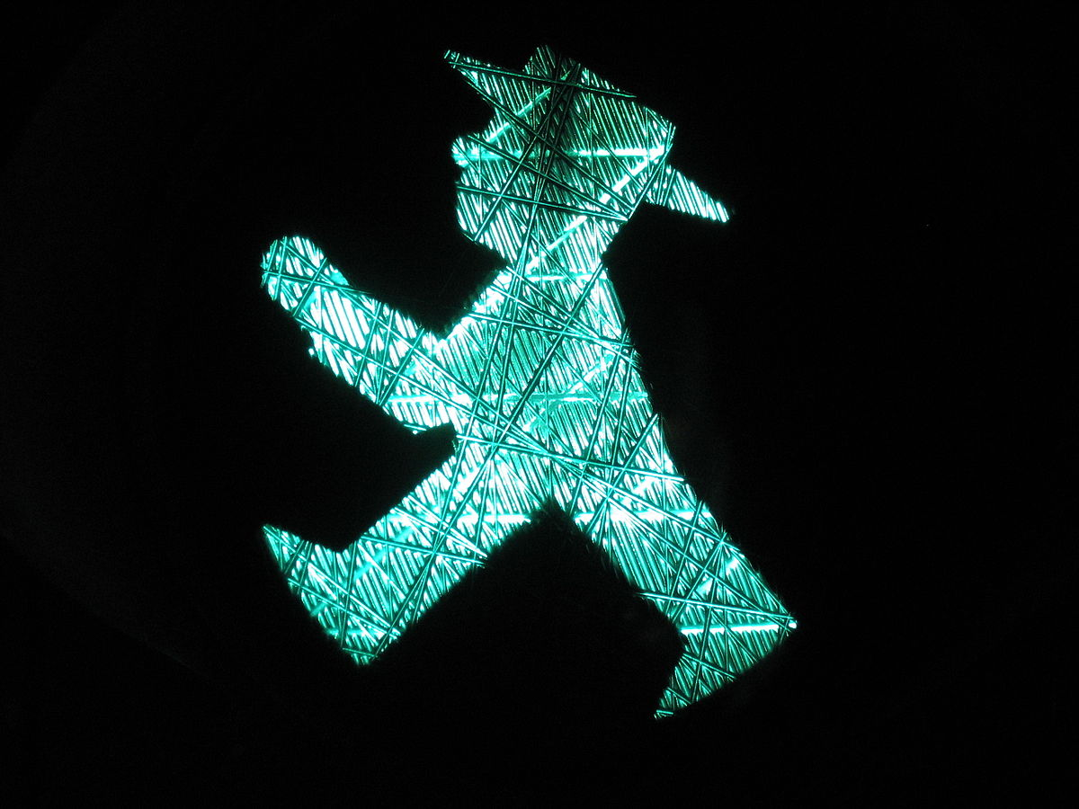
Mingle
Notes:
ANKAWÜ. (2007, March 29). Traffic Light, Go [Photography]. Wikimedia. https://commons.wikimedia.org/wiki/File:D-Ampelmaennchen-gehen-o.jpg

Slide 16
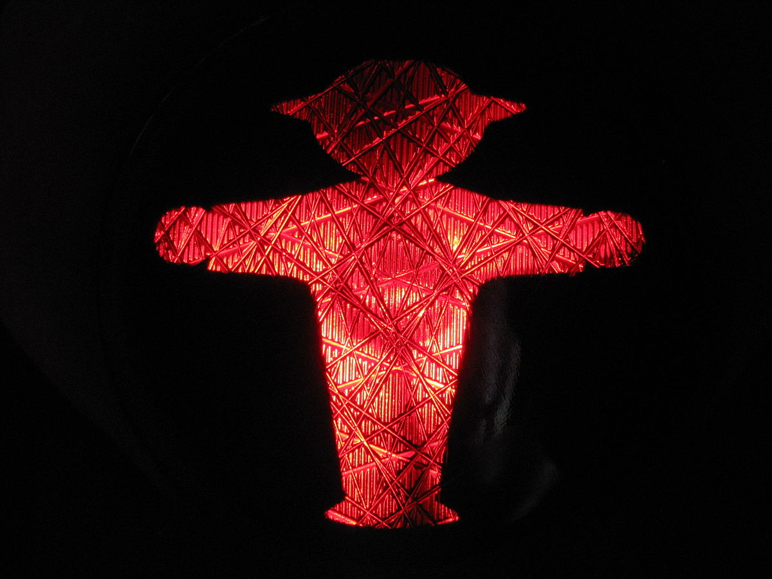
What is 20 ÷ 4?
Collaborate:
What movement and activities/games do you use in your classroom to actively engage students?
Notes:
ANKAWÜ. (2007, March 29). Traffic Light, Stop [Photography]. Wikimedia. https://commons.wikimedia.org/wiki/File:D-Ampelmaennchen-stehen-o.jpg

Slide 17
Mingle
Notes:
ANKAWÜ. (2007, March 29). Traffic Light, Go [Photography]. Wikimedia. https://commons.wikimedia.org/wiki/File:D-Ampelmaennchen-gehen-o.jpg

Slide 18
How many branches are there in the US Government?
Reflect:
How might this topic and activities explored today impact your teaching, student engagement, and overall class climate?
Notes:
ANKAWÜ. (2007, March 29). Traffic Light, Stop [Photography]. Wikimedia. https://commons.wikimedia.org/wiki/File:D-Ampelmaennchen-stehen-o.jpg

Slide 19
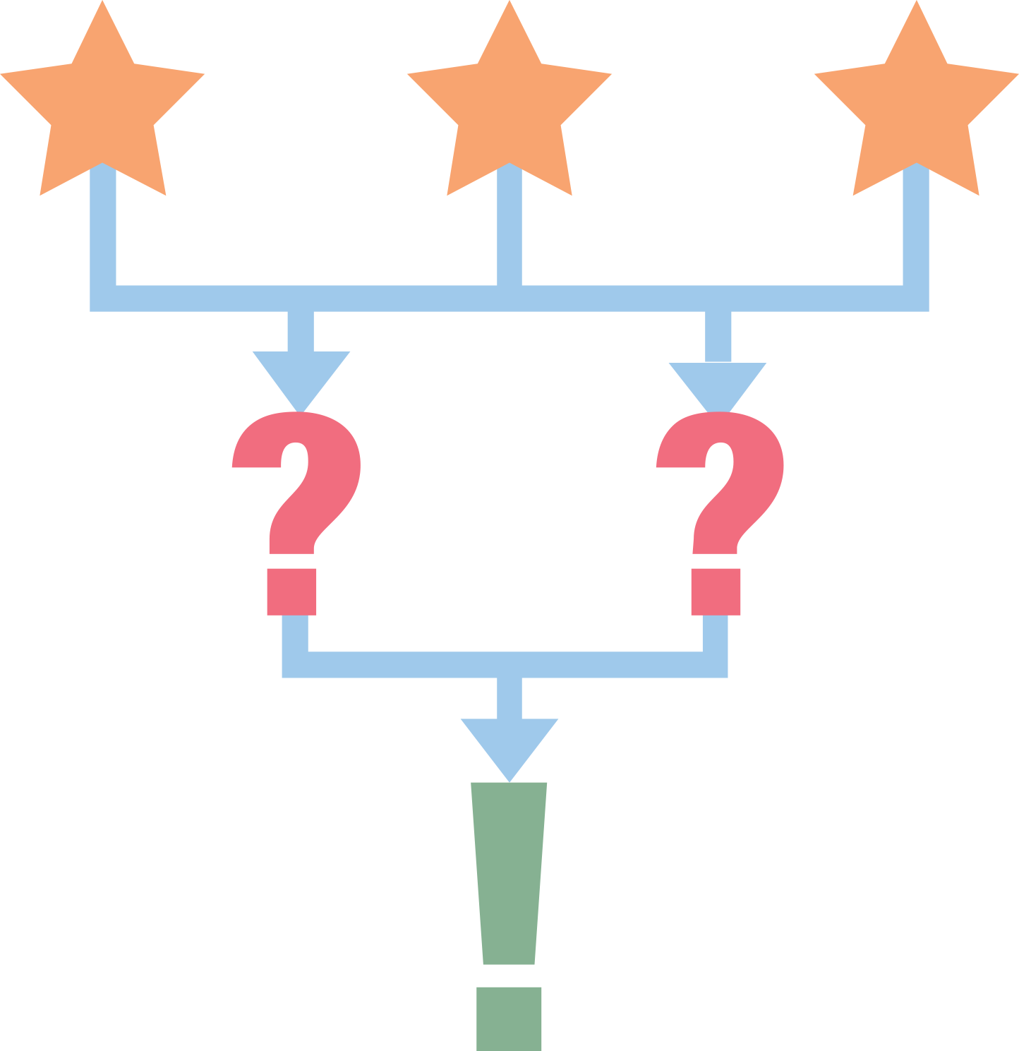
3-2-1 Follow Up
Please reflect and record the following on your handout. Be prepared to share your thoughts.
3 things that you are willing to try
2 people whom you are willing to collaborate with
1 fear or struggle you might have with implementation
Notes:
K20 Center. (n.d.). 3-2-1. Strategies. https://learn.k20center.ou.edu/strategy/117

