Slide 2
Magnetic Statements
Welcome!
Take a sticker.
Walk around and review each of the ISTE Standards hanging around the room.
Place your sticker on the standard that you find most challenging to teach.
Notes:
K20 Center. (n.d.). Magnetic statement. Strategies. https://learn.k20center.ou.edu/strategy/166

Slide 3
e-Learning
It’s Elementary, My Dear Watson

Slide 4
Essential Question
What is digital literacy?

Slide 5
Lesson Objectives
Investigate ISTE standards.
Deduce the meaning of Digital Literacy.
Draw conclusions to determine which tech tools promote digital literacy.

Slide 6
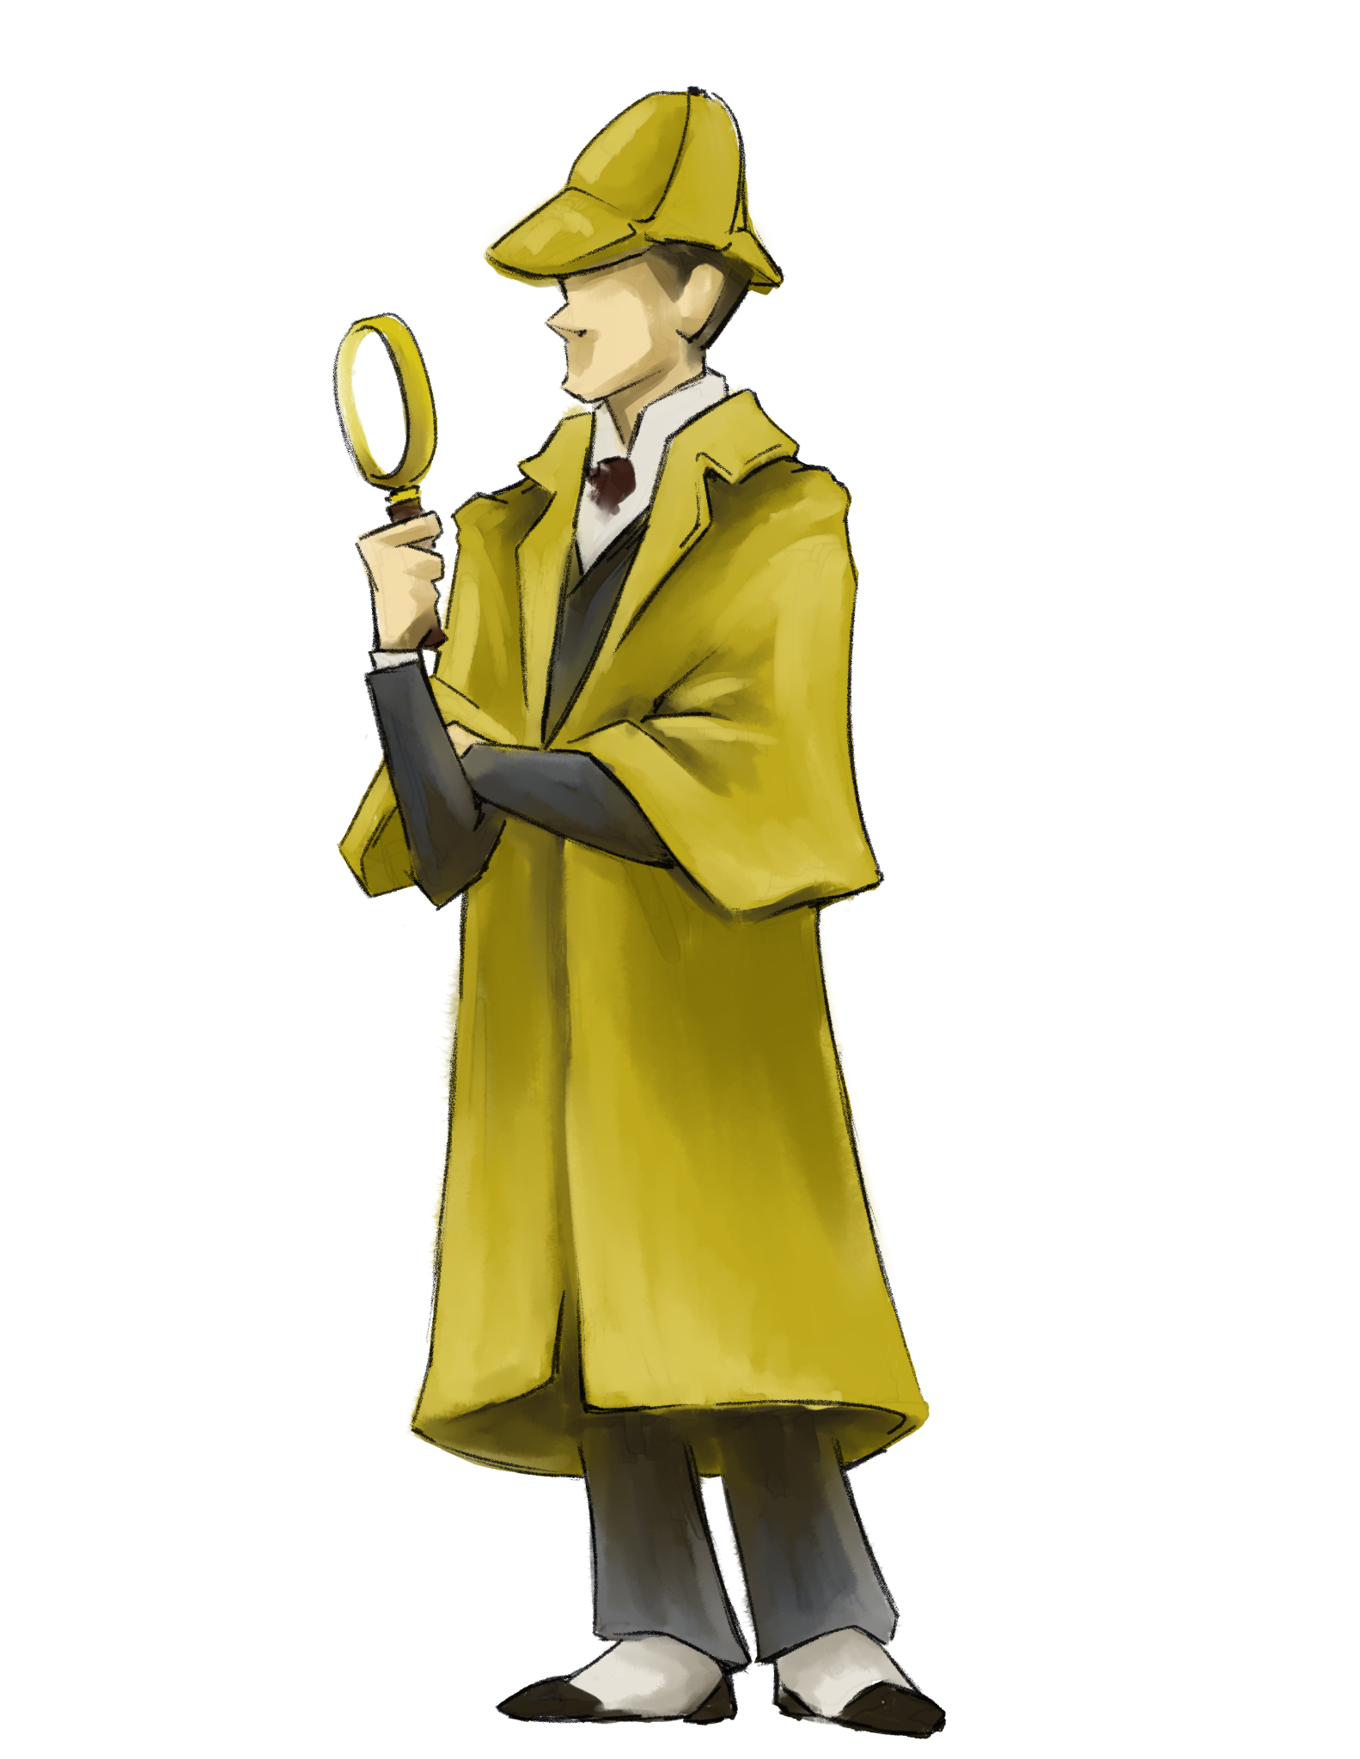
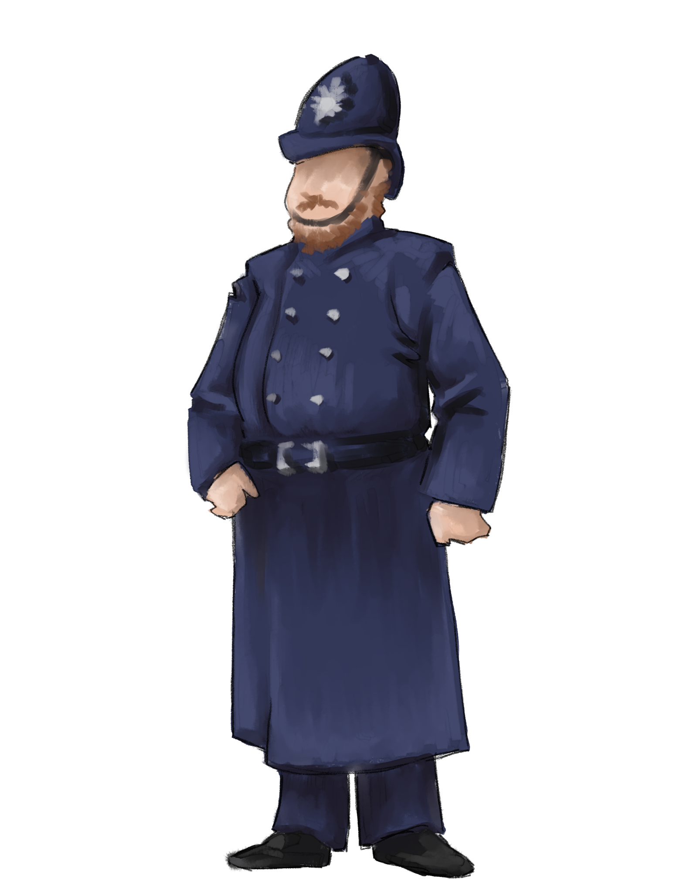
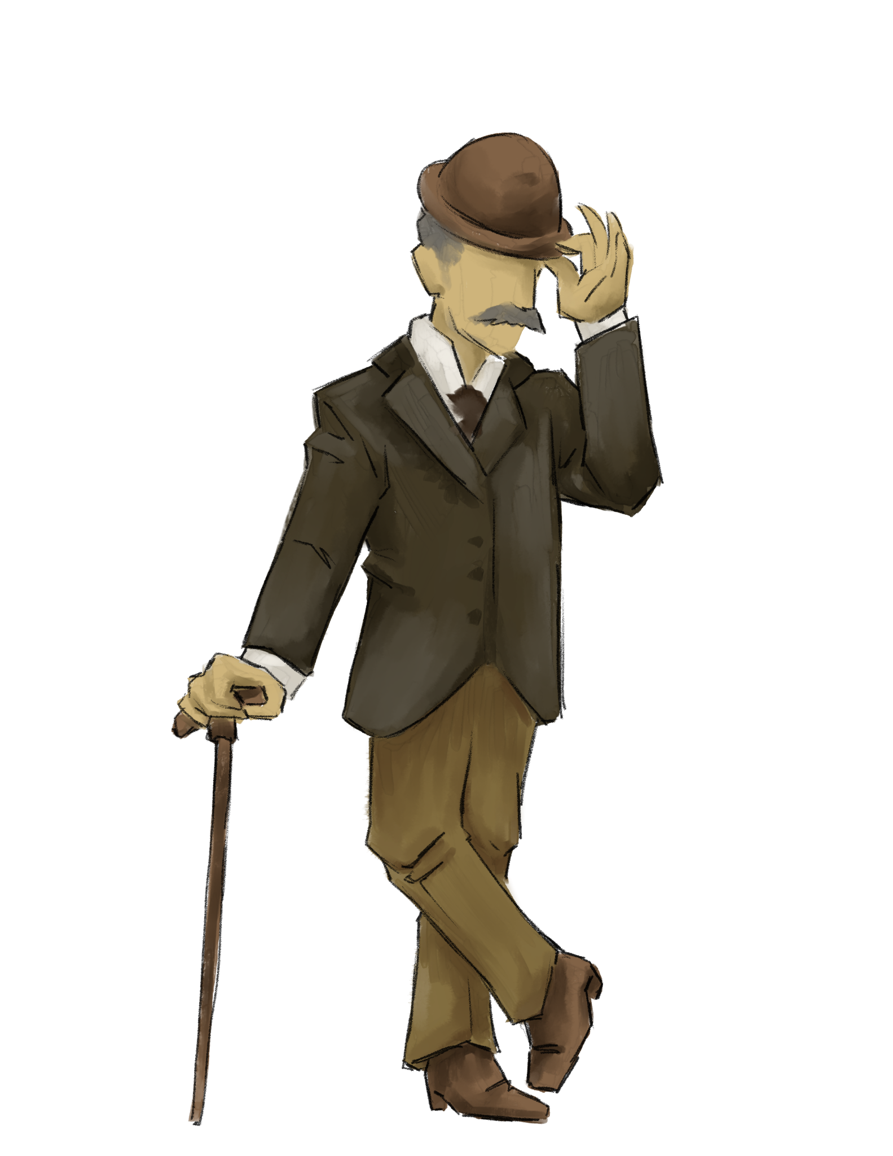
Notes:
K20 Center. (n.d.). Mentimeter. Strategies. https://learn.k20center.ou.edu/tech-tool/645

Slide 7
ISTE Standards
1.1 Empowered Learner
1.2 Digital Citizen
1.3 Knowledge Constructor
1.4 Innovative Designer
1.5 Computational Thinker
1.6 Creative Communicator
1.7 Global Collaborator

Slide 8
ISTE Standards
Take a moment to read each of the ISTE standards.
Choose an ISTE standard that you are most comfortable with teaching.
Insert link and QR code here
Notes:
Facilitator: insert QR code to link to the Canva presentation.

Slide 9
ISTE Standards
Add a sticky note with the questions you should ask yourself to determine which tech tool is the best to use when using that ISTE standard.
5-Minute Timer
Notes:
K20 Center. (2021, September 21). K20 Center 5 minute timer. YouTube. Retrieved January 12, 2023, from https://www.youtube.com/watch?v=EVS_yYQoLJg

Slide 10
ISTE Standards
1.1 Empowered Learner
1.2 Digital Citizen
1.3 Knowledge Constructor
1.4 Innovative Designer
1.5 Computational Thinker
1.6 Creative Communicator
1.7 Global Collaborator

Slide 11
Investigate ISTE Standards
What are the key components of this ISTE Standard?
How does this standard look in the classroom?
What tech tools support this standard?
How might you use this tech tool in the classroom?
10-Minute Timer
Notes:
K20 Center. (2021, September 21). K20 Center 10-minute timer. YouTube. Retrieved January 12, 2023, from https://www.youtube.com/watch?v=9gy-1Z2Sa-c

Slide 12
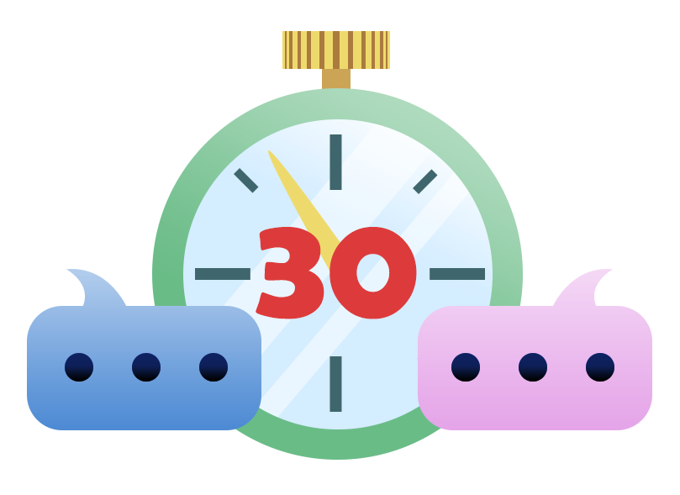
30-Second Expert
Choose one person at your table to give a brief statement about the most important aspects of your ISTE standard.
Notes:
K20 Center. (n.d.). 30-second expert. Strategies. https://learn.k20center.ou.edu/strategy/1048

Slide 13
Notes:
K20 Center. (n.d.). Mentimeter. Strategies. https://learn.k20center.ou.edu/tech-tool/645

Slide 14
What is Digital Literacy?
The American Library Association’s digital-literacy task force offers this definition: “Digital literacy is the ability to use information and communication technologies to find, evaluate, create, and communicate information, requiring both cognitive and technical skills.”
Notes:
Libguides: Digital Literacy: Welcome. Welcome - Digital Literacy - LibGuides at University of North Florida. (n.d.). Retrieved January 12, 2023, from https://libguides.unf.edu/digitalliteracy#:~:text=Subjects%3A%20Education-,What%20is%20Digital%20Literacy%3F

Slide 15
The 3 Buckets of Digital Literacy
Professor of literacy and technology at North Carolina State University, Hiller Spires views digital literacy as having three (3) buckets:
Finding and consuming digital content.
Creating digital content.
Communicating or sharing it.
Notes:
Loewus, L. (2020, December 9). What is Digital Literacy? Education Week. Retrieved January 12, 2023, from https://www.edweek.org/teaching-learning/what-is-digital-literacy/2016/11#:~:text=More%20simply%2C%20Hiller%20Spires%2C%20a,3

Slide 16
Notes:
K20 Center. (n.d.). Mentimeter. Strategies. https://learn.k20center.ou.edu/tech-tool/645

