Slide 2

Draw a Scientist Activity
Think back to your high school science teacher,
what did they look like?
On your handout, draw what comes to mind.
Take a picture with your device.
Scan the QR code and share your drawing on Padlet.
Notes:
K20 Center. (n.d.). Padlet. Tech Tools. https://learn.k20center.ou.edu/tech-tool/1077

Slide 3
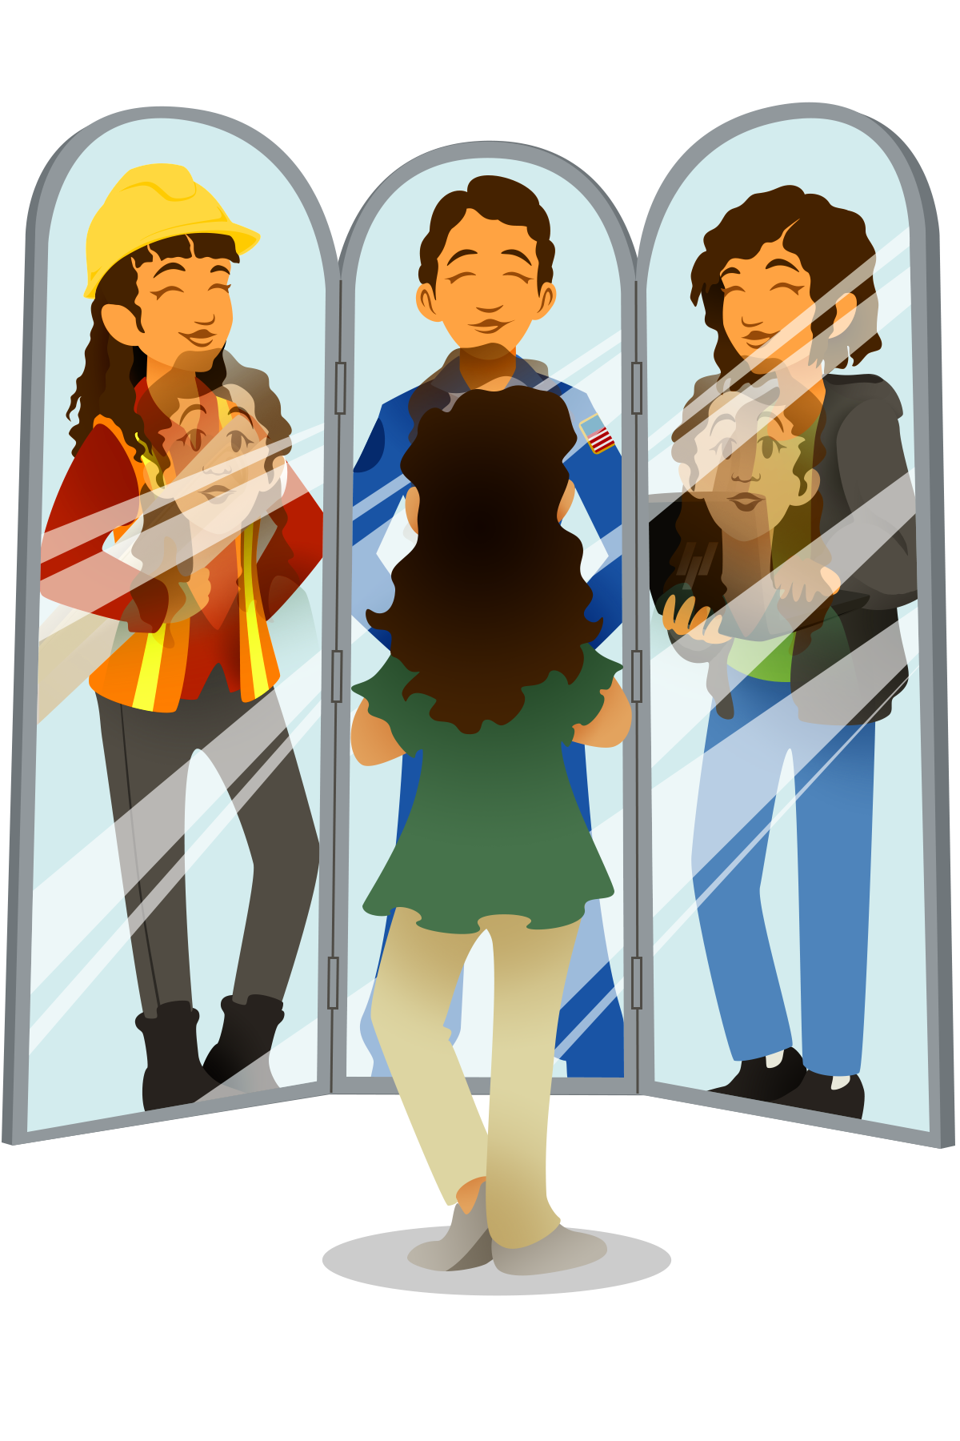
Girls Just Wanna Have Fun in STEM
Closing the Gender Gap

Slide 4
Essential Question
How can promoting women in STEM shape science for the future?

Slide 5
Session Objectives
Explore personal and professional STEM career misconceptions.
Analyze strategies and approaches to close the STEM gap in your schools and communities.

Slide 6
Draw a Scientist Activity
Think back to your high school science teacher,
what did they look like?
On your handout, draw what comes to mind.
Take a picture with your device.
Scan the QR code and share your drawing on Padlet.
Notes:
K20 Center. (n.d.). Padlet. Tech Tools. https://learn.k20center.ou.edu/tech-tool/1077

Slide 7
Show Us Your Scientists!
Access the Padlet to share your scientist with the group!
To do this:
Scan the QR code with your phone.
Click the plus sign (+) at the bottom-right of the Padlet.
Select the camera icon.
Take a photo of your drawing!
As others are adding their drawings,
take some time to view them.
Are there similarities?
Insert QR Code Here

Slide 8

S-I-T (Surprising, Interesting, Troubling)
S – What did you find Surprising?
I – What did you find Interesting?
T – What did you find Troubling?
Notes:
K20 Center. (n.d.). S-I-T (Surprising, Interesting, Troubling). Strategies. https://learn.k20center.ou.edu/strategy/926

Slide 9
Research
One meta-analysis collection of 5 decades of “DAST” results showed out of 20,860 drawings, only 11% were women.
- Cyril Ponnamperuma
Notes:
Miller, D. I., Nolla, K. M., Eagly, A. H., & Uttal, D. H. (2018). The development of children’s gender-science stereotypes: A meta-analysis of 5 decades of u.s. draw-a-scientist studies. Child Development, 89(6), 1943–1955. https://doi.org/10.1111/cdev.13039

Slide 10
Research
Scientists are human—they’re as biased as any other group. But they do have one great advantage in that science is a self-correcting process.
- Cyril Ponnamperuma

Slide 11

Magnetic Statements
Read each of the statements around the room.
Choose one (1) of the statements that most repels you.
Discuss your reasons with the others gathered around your statement.
Come up with one (1) way which this can be reversed, solved, or fixed.
  What is something we can do?
Notes:
K20 Center. (n.d.). Magnetic Statements. Strategies. https://learn.k20center.ou.edu/strategy/166

Slide 12
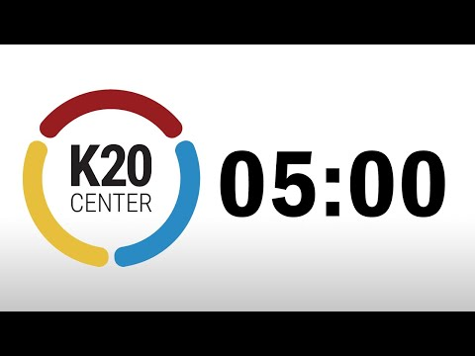
Magnetic Statements
Read each of the statements around the room.
Choose one of the statements that most repels you.
Notes:
K20 Center. (n.d.). Magnetic Statements. Strategies. https://learn.k20center.ou.edu/strategy/166

Slide 13
Magnetic Statements
With the others gathered around your statement, discuss:
  Why you chose the statement
  One (1) way it can be reversed, solved, or fixed
  What is something we can do?
Record any key information that you discussed on the chart paper.
Notes:
K20 Center. (n.d.). Magnetic Statements. Strategies. https://learn.k20center.ou.edu/strategy/166

Slide 14


Research
According to the United States Department of Commerce, “Although women fill close to half of all jobs in the U.S. economy, they hold less than 25 percent of STEM jobs. This has been the case throughout the past decade, even as college-educated women have increased their share of the overall workforce.”
- Draw-A-Scientist Studies
Notes:
Beede, D. N., Julian, T. A., Langdon, D., McKittrick, G., Khan, B., & Doms, M. E. (2011). Women in STEM: A gender gap to innovation. SSRN Electronic Journal. https://doi.org/10.2139/ssrn.1964782
K20 Center. (n.d.). Magnetic Statements. Strategies. https://learn.k20center.ou.edu/strategy/166

Slide 15
Magnetic Statements
Between 2008-2015, women earned 35.1% and 34.5% of undergraduate and Ph.D. STEM degrees, respectively.
- U.S. Department of Education
Notes:
U.S. Department of Education. (2016, October). Digest of Education Statistics, 2016. National Center for Education Statistics (NCES) Home Page, a part of the U.S. Department of Education. Retrieved December 8, 2022, from https://nces.ed.gov/programs/digest/d16/tables/dt16_318.45.asp
K20 Center. (n.d.). Magnetic Statements. Strategies. https://learn.k20center.ou.edu/strategy/166

Slide 16
Magnetic Statements
Women are 30% less likely to be called to interview for a job than an equally qualified male counterpart.
- The Role of Gender Stereotypes in Hiring
Notes:
González, M. J., Cortina, C., & Rodríguez, J. (2019). The role of gender stereotypes in hiring: A field experiment. European Sociological Review, 35(2), 187–204. https://doi.org/10.1093/esr/jcy055
K20 Center. (n.d.). Magnetic Statements. Strategies. https://learn.k20center.ou.edu/strategy/166

Slide 17
Magnetic Statements
Once hired, men are promoted at a 30% higher rate than women.
- Reducing Gender Bias in STEM
Notes:
Kong, S., Carroll, K., Lundberg, D., Omura, P., & Lepe, B. (2020). Reducing gender bias in STEM. MIT Science Policy Review, 1, 55–63. https://doi.org/10.38105/spr.11kp6lqr0a
K20 Center. (n.d.). Magnetic Statements. Strategies. https://learn.k20center.ou.edu/strategy/166

Slide 18
Magnetic Statements
Women experience less sense of belonging, positive attitudes, and aspirations in STEM careers.
- Gender Bias Produces Gender Gaps in STEM Engagement
Notes:
Moss-Racusin, C. A., Sanzari, C., Caluori, N., & Rabasco, H. (2018). Gender bias produces gender gaps in STEM engagement. Sex Roles, 79(11-12), 651–670. https://doi.org/10.1007/s11199-018-0902-z
K20 Center. (n.d.). Magnetic Statements. Strategies. https://learn.k20center.ou.edu/strategy/166

Slide 19
Magnetic Statements
Read each of the statements around the room.
Choose one of the statements that most attracts you.
Discuss your reasons with the others gathered around your statement.
Add on ways to incorporate this into your school.
  What are some new ideas that this sparks for you?
Notes:
K20 Center. (n.d.). Magnetic Statements. Strategies. https://learn.k20center.ou.edu/strategy/166

Slide 20
Magnetic Statements
Read each of the statements around the room.
Choose one of the statements that most attracts you.
Notes:
K20 Center. (n.d.). Magnetic Statements. Strategies. https://learn.k20center.ou.edu/strategy/166

Slide 21
Magnetic Statements
With the others gathered around your statement, discuss:
  Why did you choose the statement
  How could you incorporate this into your school.
  What are some new ideas that this sparks for you?
Record any key information that you discussed on the chart paper.
Notes:
K20 Center. (n.d.). Magnetic Statements. Strategies. https://learn.k20center.ou.edu/strategy/166

Slide 22

POMS
(Point of Most Significance)
As you watch the video, think about the most significant point that is made.
Notes:
K20 Center. (n.d.). Point of Most Significance (POMS). Strategies. https://learn.k20center.ou.edu/strategy/101

Slide 23
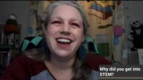
Girls Just Wanna Have Fun in STEM

Slide 24
POMS
(Point of Most Significance)
What did you find to be the most significant point in the video?
Notes:
K20 Center. (n.d.). Point of Most Significance (POMS). Strategies. https://learn.k20center.ou.edu/strategy/101

Slide 25
Magnetic Statements
Looking back at the research statement you chose, is there anything your group wants to add before sharing out?
Notes:
K20 Center. (n.d.). Magnetic Statements. Strategies. https://learn.k20center.ou.edu/strategy/166

Slide 26
Magnetic Statements
Women and girls need to see female role models in the workplace that look like them - over and over again.
- How to Recruit Women and Girls to the STEM Classroom
Notes:
Milgram, D. (2011). How to recruit women and girls to the science, technology, engineering, and math (STEM) classroom. Technology and Engineering Teacher, 71(3), 4-11.
K20 Center. (n.d.). Magnetic Statements. Strategies. https://learn.k20center.ou.edu/strategy/166

Slide 27
Magnetic Statements
They need to receive the message that women can work in STEM, be successful and fulfilled in their work life, while still have a personal life.
- How to Recruit Women and Girls to the STEM Classroom
Notes:
Milgram, D. (2011). How to recruit women and girls to the science, technology, engineering, and math (STEM) classroom. Technology and Engineering Teacher, 71(3), 4-11.
K20 Center. (n.d.). Magnetic Statements. Strategies. https://learn.k20center.ou.edu/strategy/166

Slide 28
Research
It is critical that biographies of female role models used in outreach materials emphasize not only the path these women took to arrive at their chosen careers, but also the joy they found in their work, as well as their personal interests and family stories.”
- How to Recruit Women and Girls to the STEM Classroom
Notes:
Milgram, D. (2011). How to recruit women and girls to the science, technology, engineering, and math (STEM) classroom. Technology and Engineering Teacher, 71(3), 4-11.
K20 Center. (n.d.). Magnetic Statements. Strategies. https://learn.k20center.ou.edu/strategy/166

Slide 29
Magnetic Statements
A recent study found that female 9th and 10th grade students performed better in science when the images in their textbooks included counter-stereotypical images of female scientists.
- The Journal of Social Psychology
Notes:
Good, J. J., Woodzicka, J. A., & Wingfield, L. C. (2010). The effects of gender stereotypic and counter-stereotypic textbook images on science performance. The Journal of Social Psychology, 150(2), 132–147. https://doi.org/10.1080/00224540903366552
K20 Center. (n.d.). Magnetic Statements. Strategies. https://learn.k20center.ou.edu/strategy/166

Slide 30
Magnetic Statements
Girls Who Code, an extracurricular program with a computer science focus for girls in programming, reports that interest reduces from 66% to merely 4% in girls between the ages of six to eighteen.
- Closing the Tech Gender Divide
Notes:
Ware, R. (2017). Closing the Tech Gender Divide. Connected, 2, 34–37. Retrieved 2022, from https://merchants.fiserv.com/content/dam/firstdata/us/en/documents/pdf/Connected-Magazine_Vol2_2017_online.pdf
K20 Center. (n.d.). Magnetic Statements. Strategies. https://learn.k20center.ou.edu/strategy/166

Slide 31
Magnetic Statements
By offering year-long clubs, after-school activities, and summer immersion programs, participants of Girls Who Code study computer science in college at “15 to 16 times the national average.”
- Girls Who Code
Notes:
Girls Who Code Annual Report 2019. Girls Who Code. (n.d.). Retrieved December 8, 2022, from https://girlswhocode.com/2019report/#numbers
K20 Center. (n.d.). Magnetic Statements. Strategies. https://learn.k20center.ou.edu/strategy/166

Slide 32
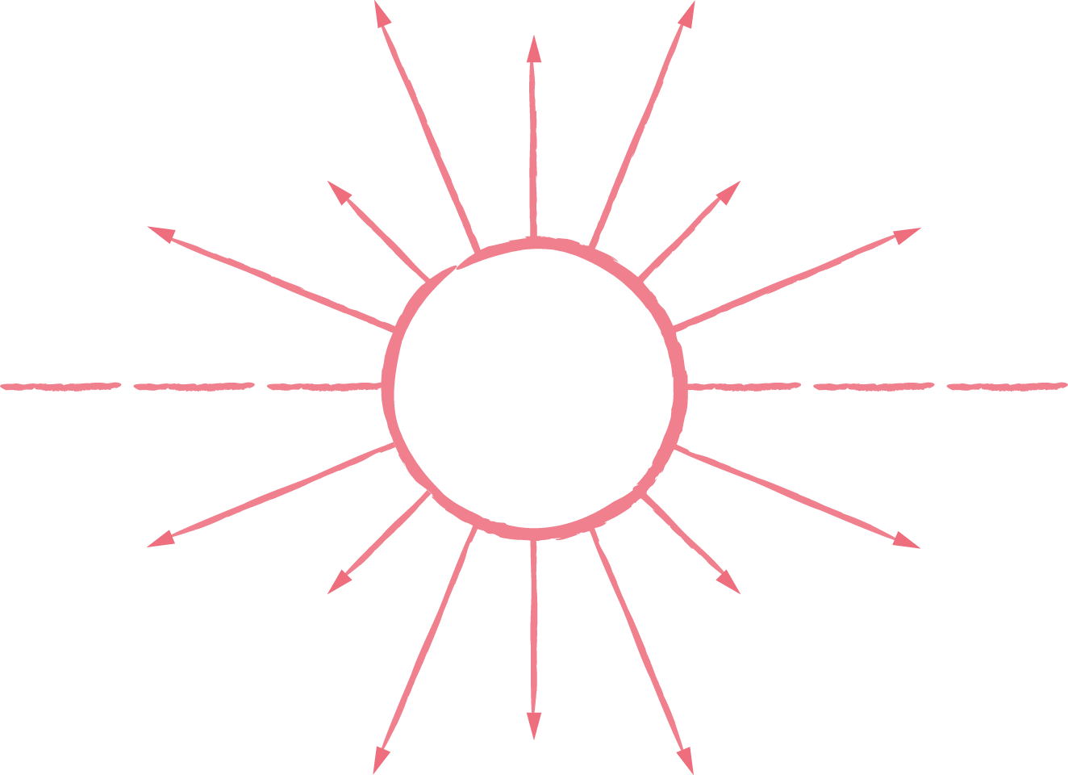
Identity Chart
Closing the Gender Gap
Tactics
Take a few minutes to consider some tactics or ideas for closing the gender gap in your school.
Ideas
Tactics
Ideas
Notes:
K20 Center. (n.d.). Identity Chart. Strategies. https://learn.k20center.ou.edu/strategy/2729

Slide 33
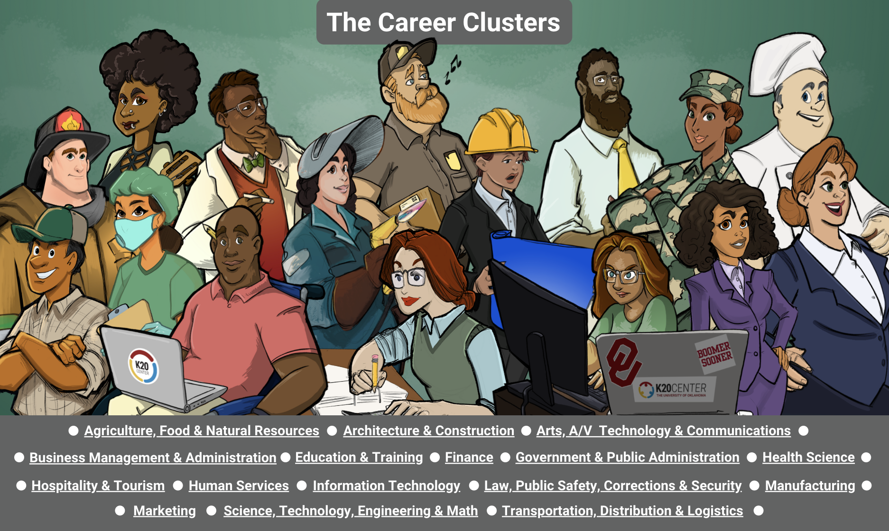
Notes:
Throughout the last 2 ½ years, as we developed more and more resources, we worked in tandem with our art department creating an interactive infogram that students could use and access everything.
https://infogram.com/k20center-careerclusters-1hdw2jp8e9n1x2l?live

Slide 34
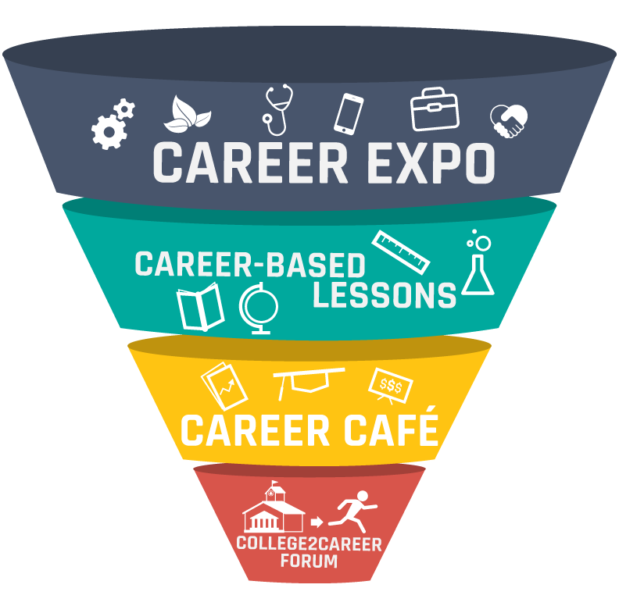
How is K20 working to Close the Gap?
Career Expo (CE)
Career Café (CC)
College2Career Forum (C2CF)
Student Resources
Woman Crush Wednesday (WCW) LEARN resources

Slide 35
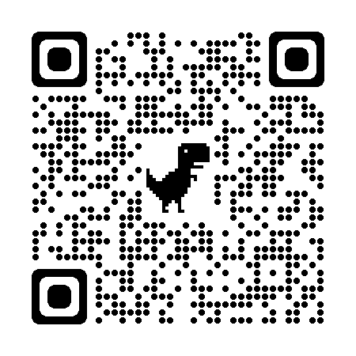
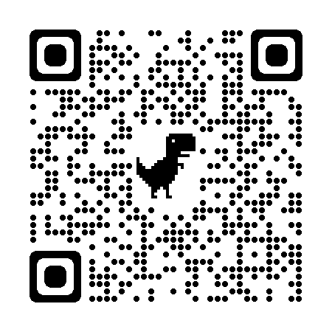
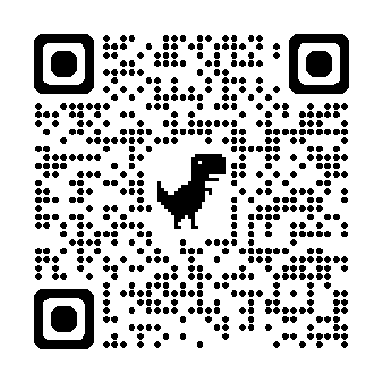
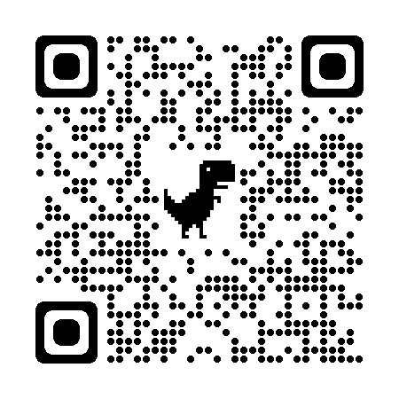
Closing the Gap
Woman Crush Wednesday
Zoom Into Your Career
Student Activities
Career Café
Notes:
Add infogram here too

Slide 36
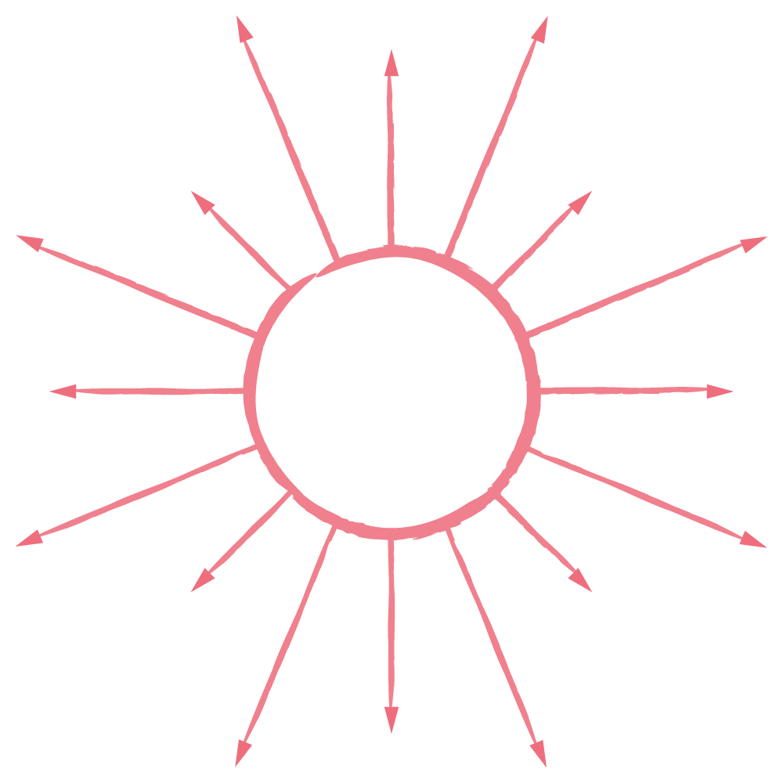
Identity Chart
Take a few minutes to consider some tactics for closing the gender gap in your school.
Complete your Identity Chart.
Notes:
K20 Center. (n.d.). Identity Chart. Strategies. https://learn.k20center.ou.edu/strategy/2729

Slide 37
S-I-T (Surprising, Interesting, Troubling)
S – What did you find Surprising?
I – What did you find Interesting?
T – What did you find Troubling?
Notes:
K20 Center. (n.d.). S-I-T (Surprising, Interesting, Troubling). Strategies. https://learn.k20center.ou.edu/strategy/926

