Slide 2
START: Students Taking Augmented Reality Tours

Slide 3
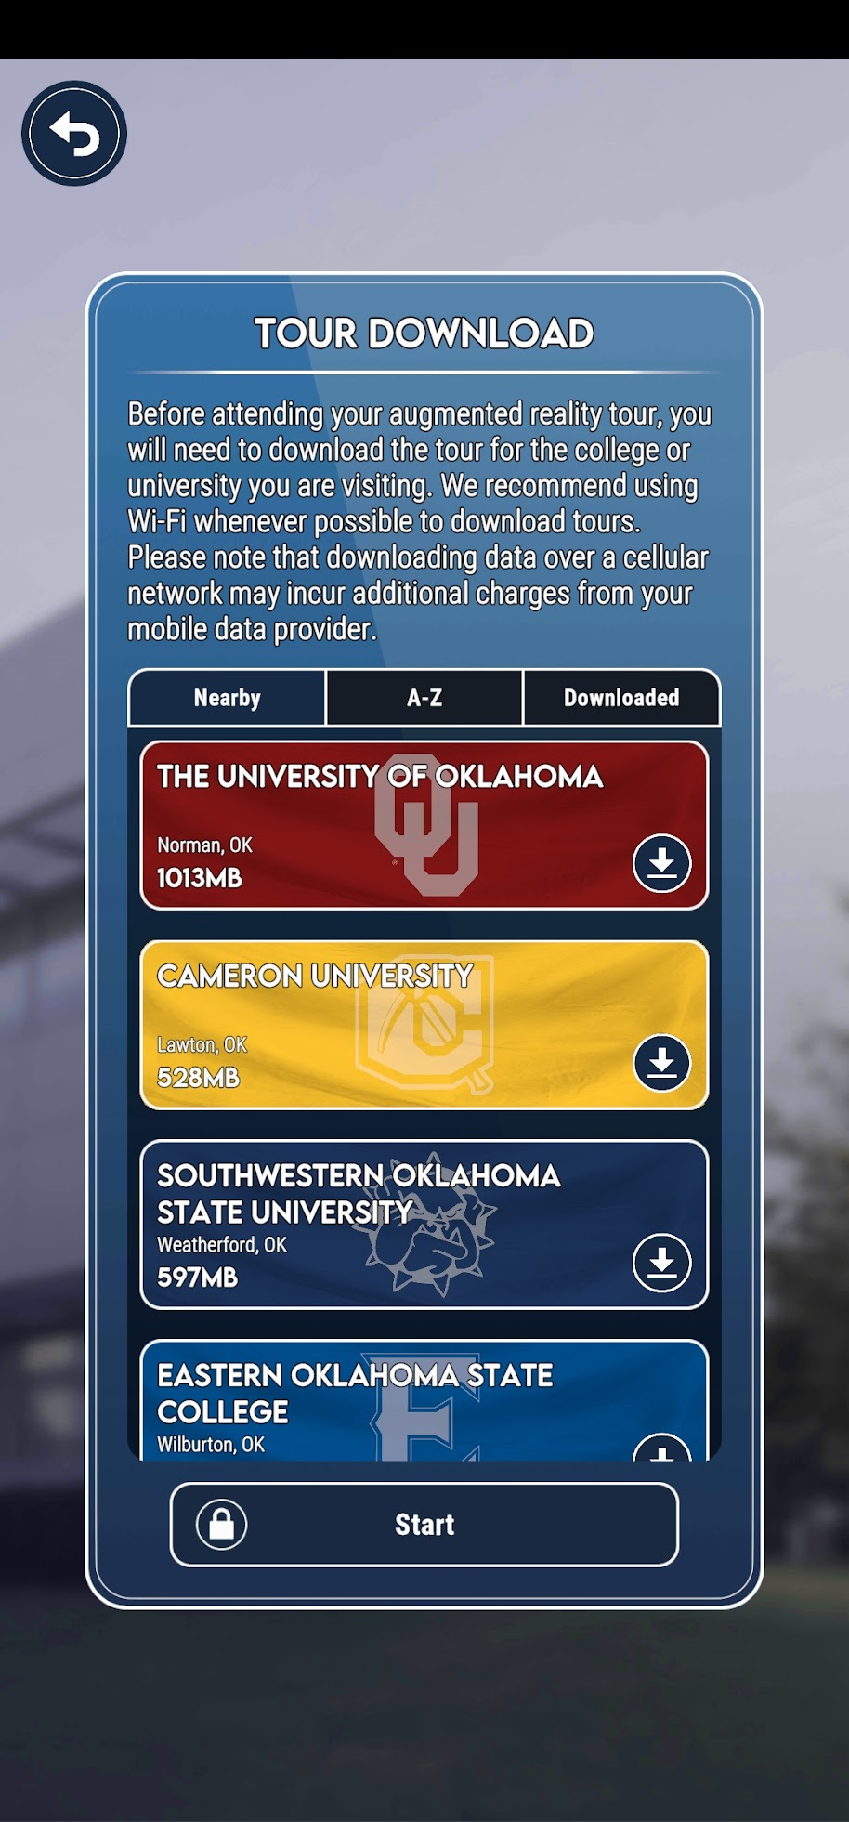
Before we begin, use the QR to download START on your device.
k20center.ou.edu/start
… then start downloading the OU Tour

Slide 4
Getting Students on College Campuses
Think about how you currently conduct college campus visits.
What is one thing that works well?
What is one thing you wish you could do?
Add your responses at menti.com by scanning the QR code or entering the code XXXX XXXX.

Slide 5
Session Objectives
Discuss the benefits of augmented reality for education and outreach.
Explore the START application.
Identify how you will use START.

Slide 6
What is Augmented Reality (AR)?
Technology that superimposes digital content over real-world environments. Example: Pokemon Go™​
Can be accessed using mobile devices such as smartphones and tablets.

Slide 7
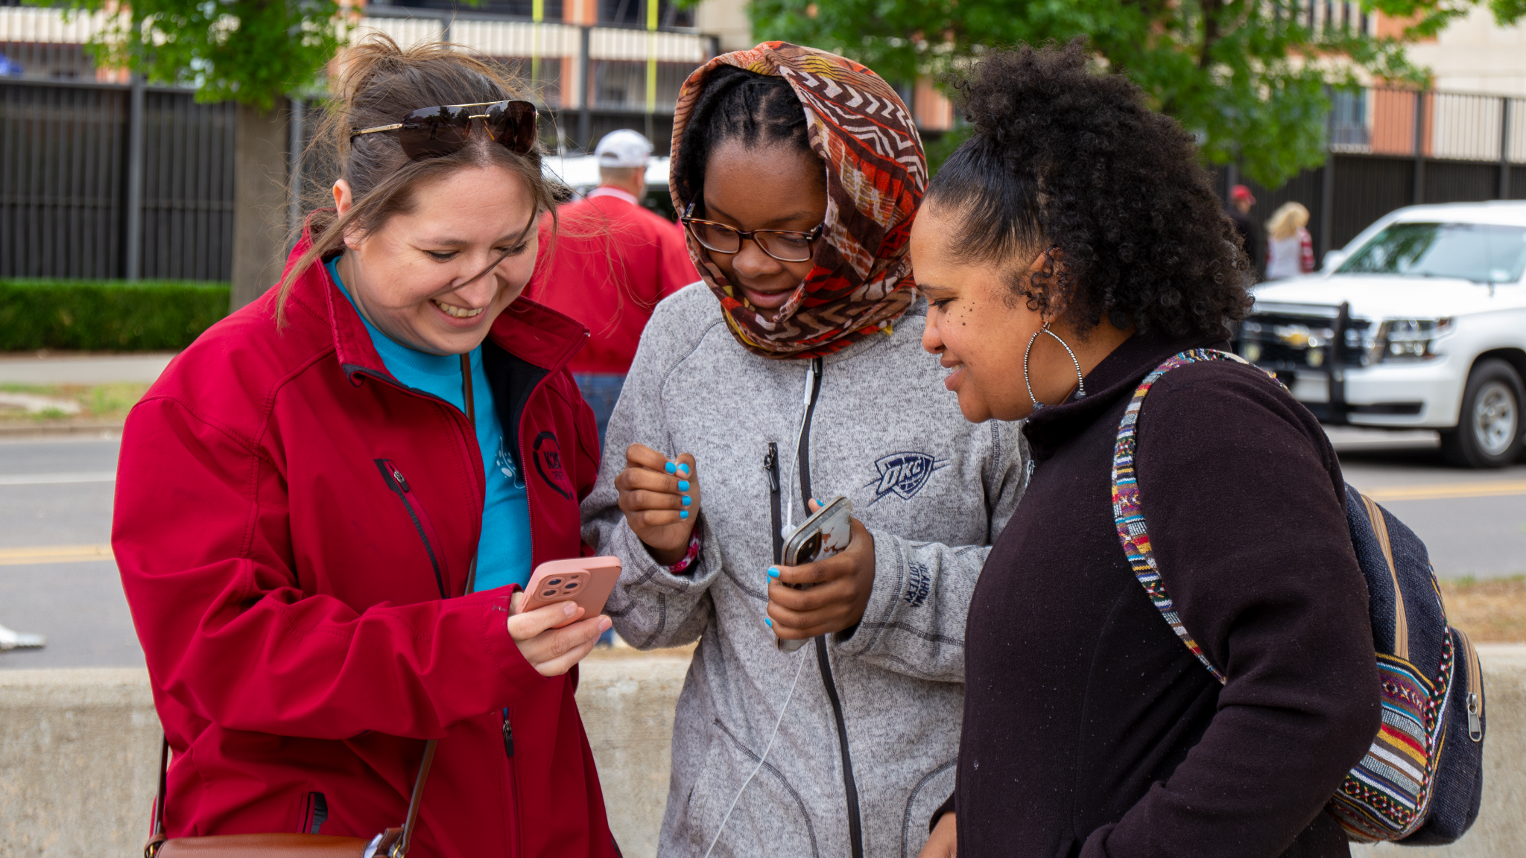
What is K20 START?
Interactive experience for prospective students.​
Self-guided, personalized experience​.
Gain valuable information on college departments, services, and student life.

Slide 8
What is K20 START?
https://www.youtube.com/watch?v=J1sMbyTyufk

Slide 9
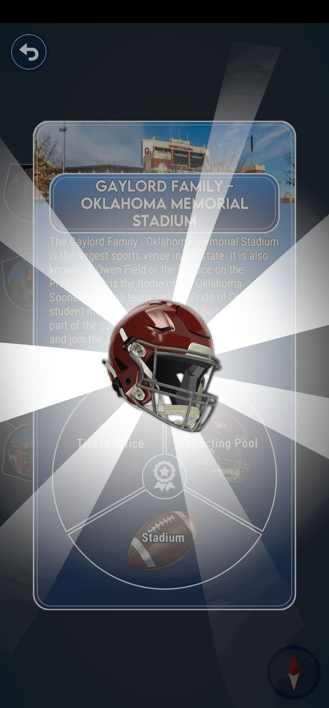
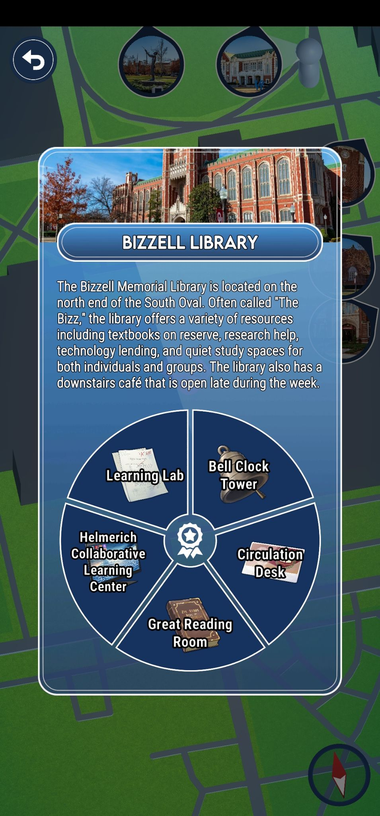
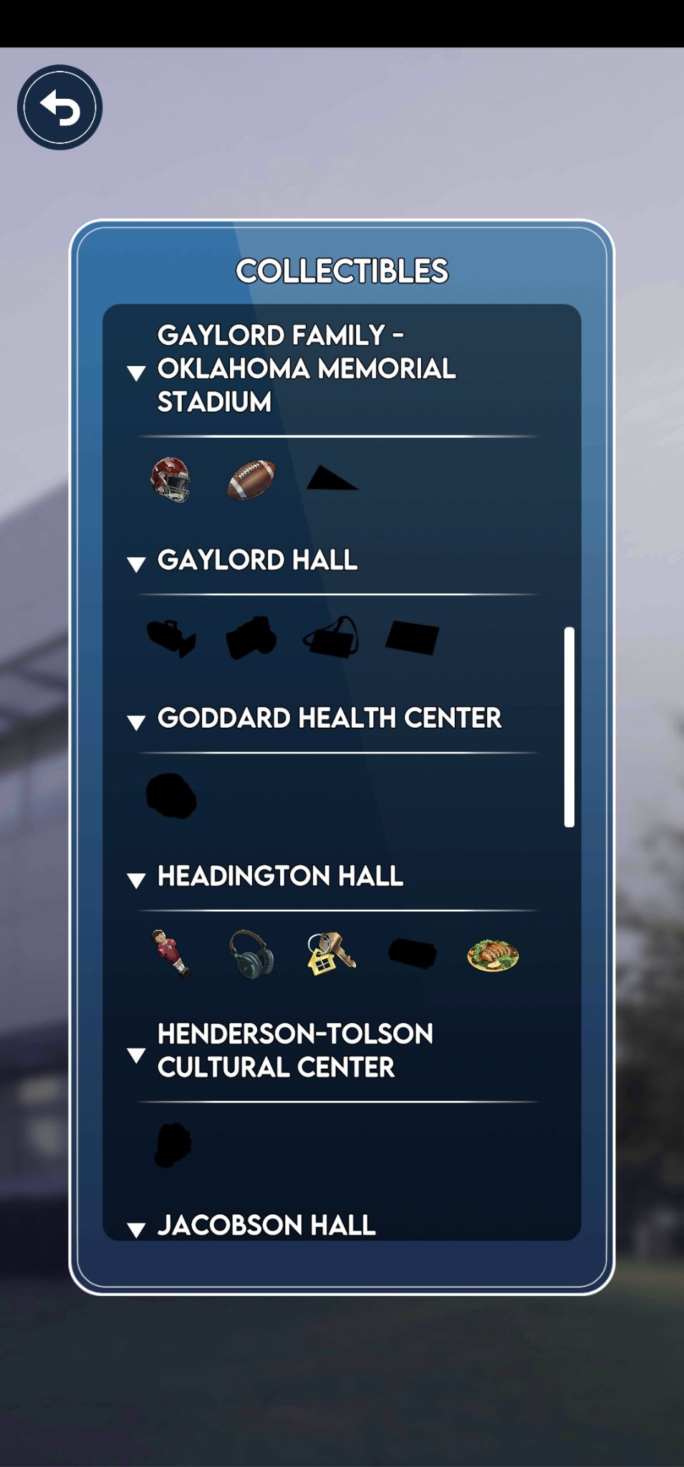
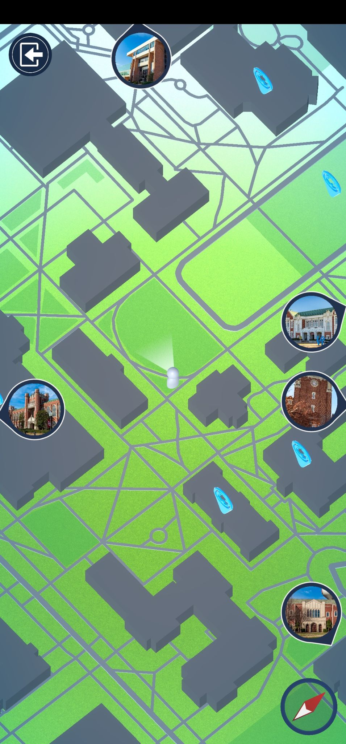
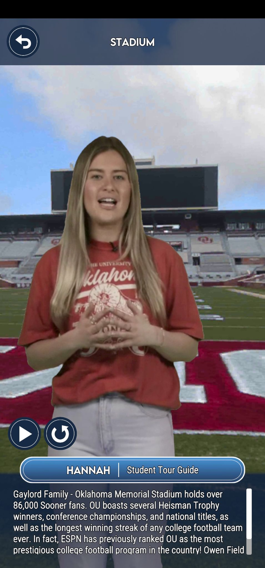
Using START
Take Home Information
Navigate Campus
Learn about Campus
Obtain Collectibles
Find Landmarks

Slide 10
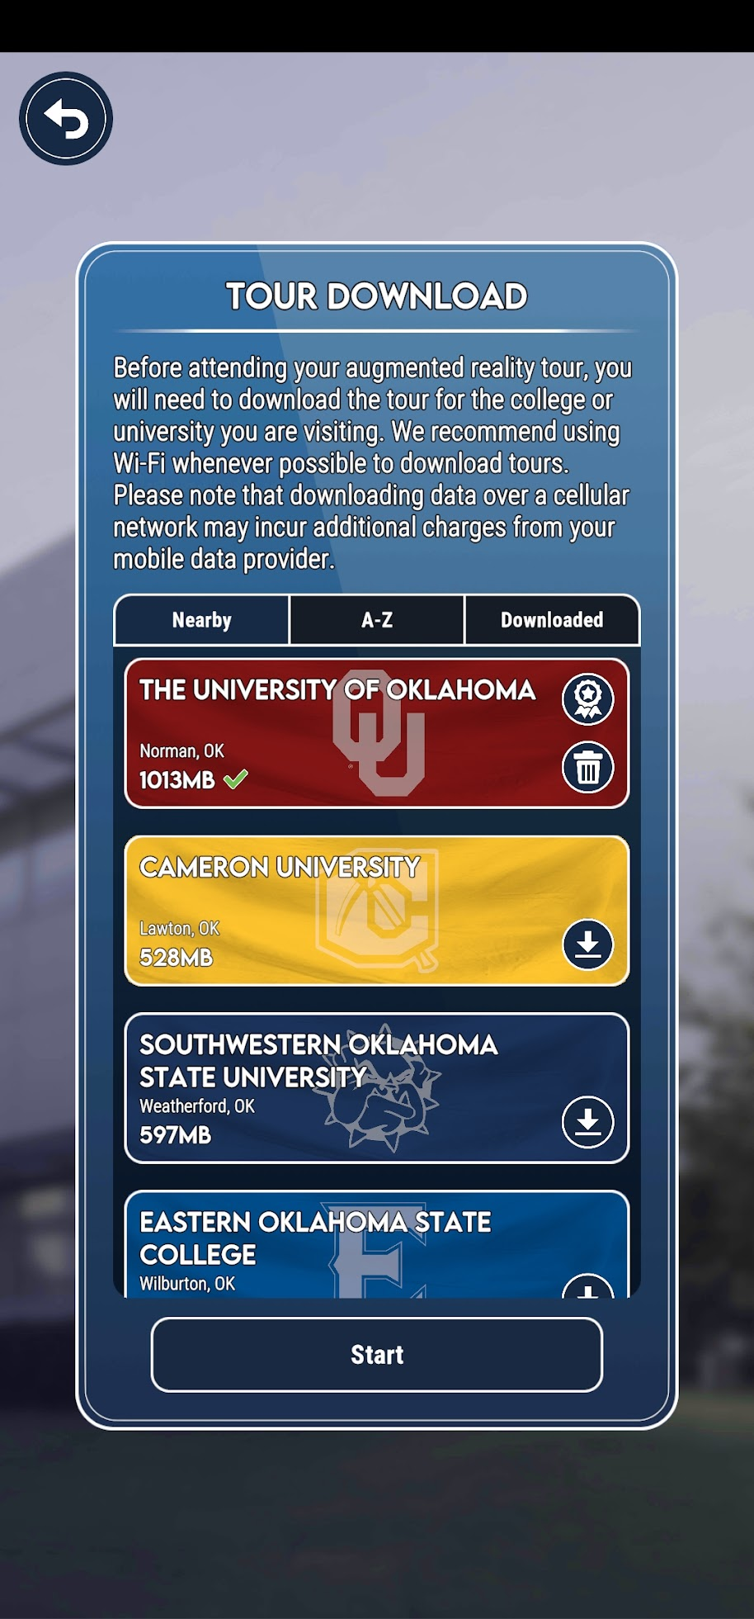
Experience START
Use the START app on the OU campus.

Slide 11
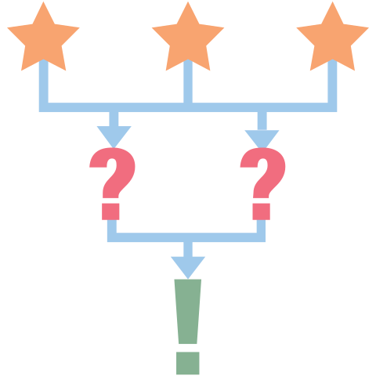
START 3-2-1 Reflection
Now that you have experienced START, what are:
3 things you learned about the app
2 questions you have
1 thing you found surprising
Notes:
https://is.k20center.ou.edu/strategies/3-2-1

Slide 12
START Strategies
Write down how you plan to use START with students.
Get three other ideas from participants and share your thoughts with one another.

Slide 13
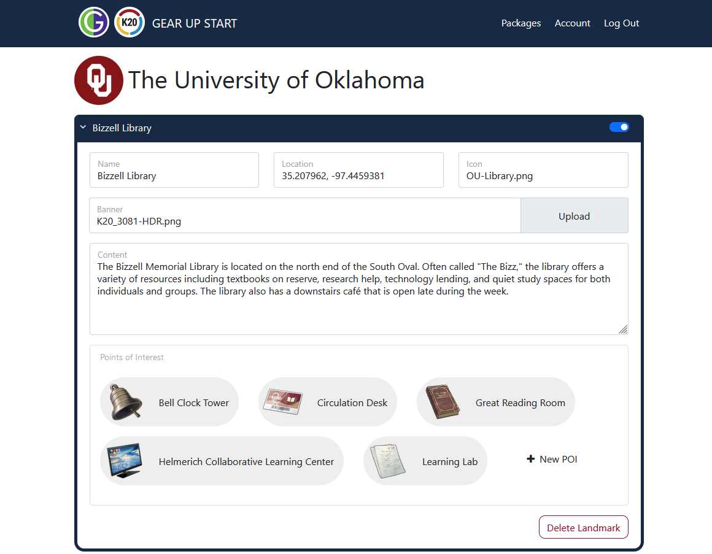
Creating New Tours
Meet with campus representatives and tour campus
Draft scripts
Stakeholders review, revise, and approve content
Take 360-degree photos on campus
Film videos in green-screen studio
Assemble all content into a tour
Stakeholders review and approve final product

Slide 14
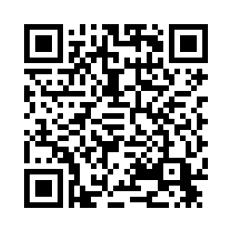
Adding START to Your Campus
Please take this survey so we can add your campus to START.

