Slide 2
Turning Mirrors Into Windows
Diversity, Equity, and Inclusion in Schools - Strategies and Approaches to Student-Centered Learning

Slide 3
Session Objectives
Participants will:
Reflect on what turning mirrors into windows is and how it is reflected in current practices.
Engage in dialogue with panelists to discuss integrating opportunities for students to explore concepts or ideas through multiple perspectives.

Slide 4
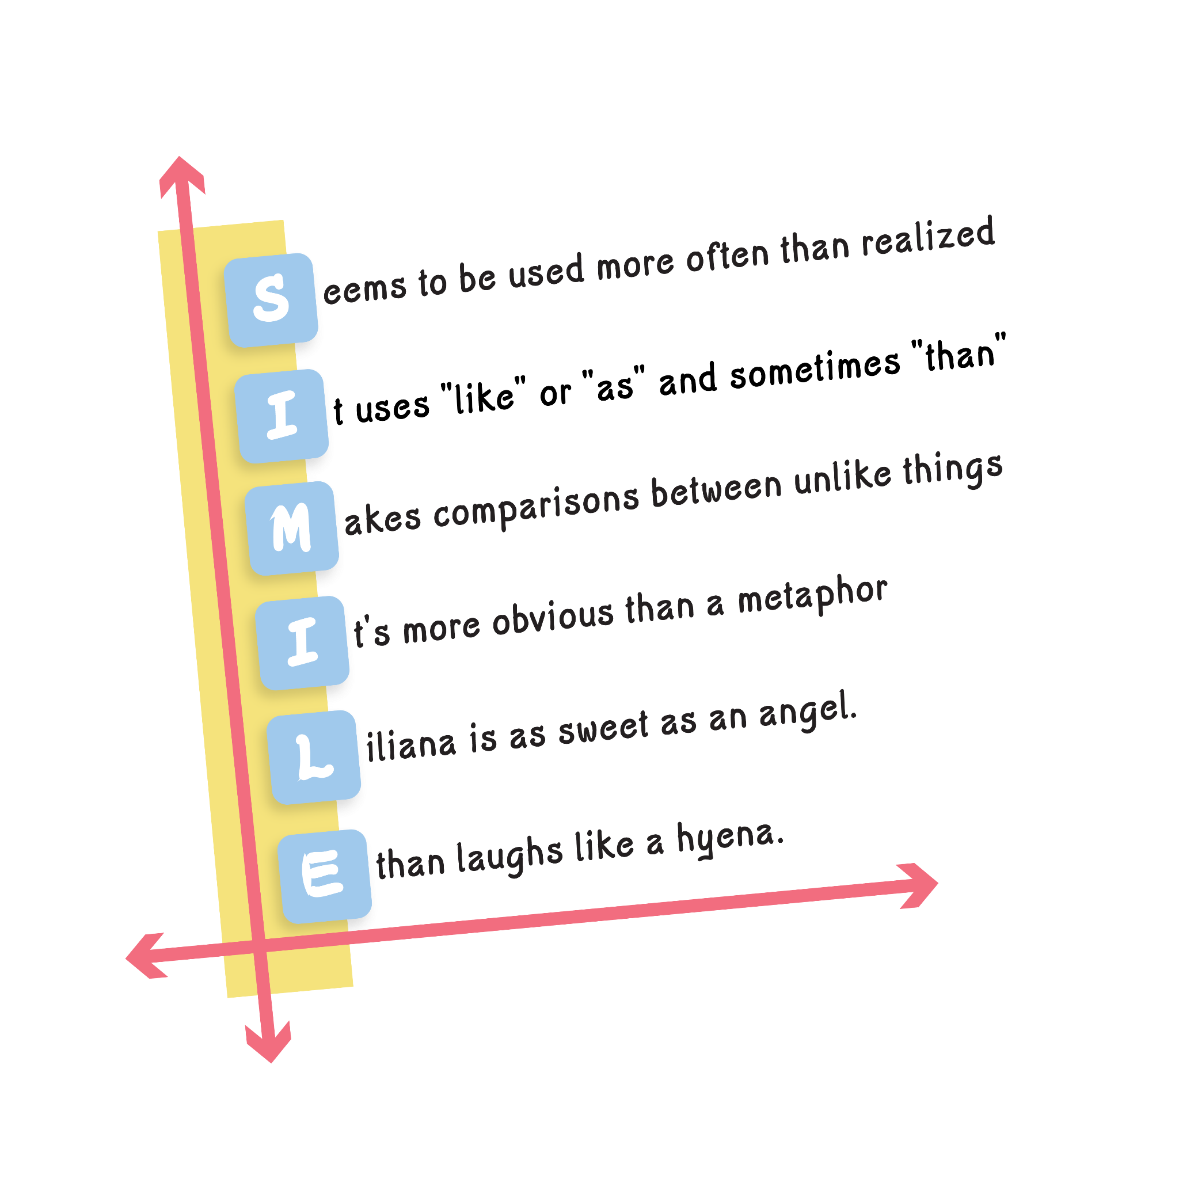
Vocabulary Acrostics
Every table has been assigned a term.
Use each letter of the word to describe it.
Please see example.
Example:
D - Dreams
O - Opportunities
O - Open
R - Restrictions

Slide 5
What words or phrases come to mind when you hear the words “mirror” and “window”?
Notes:
Have participants to ake a minute or two to discuss their responses in their groups and select a spokesperson who would be willing to share-out of what was your favorite word or phrase that your team came up with? 1 per group

Slide 6
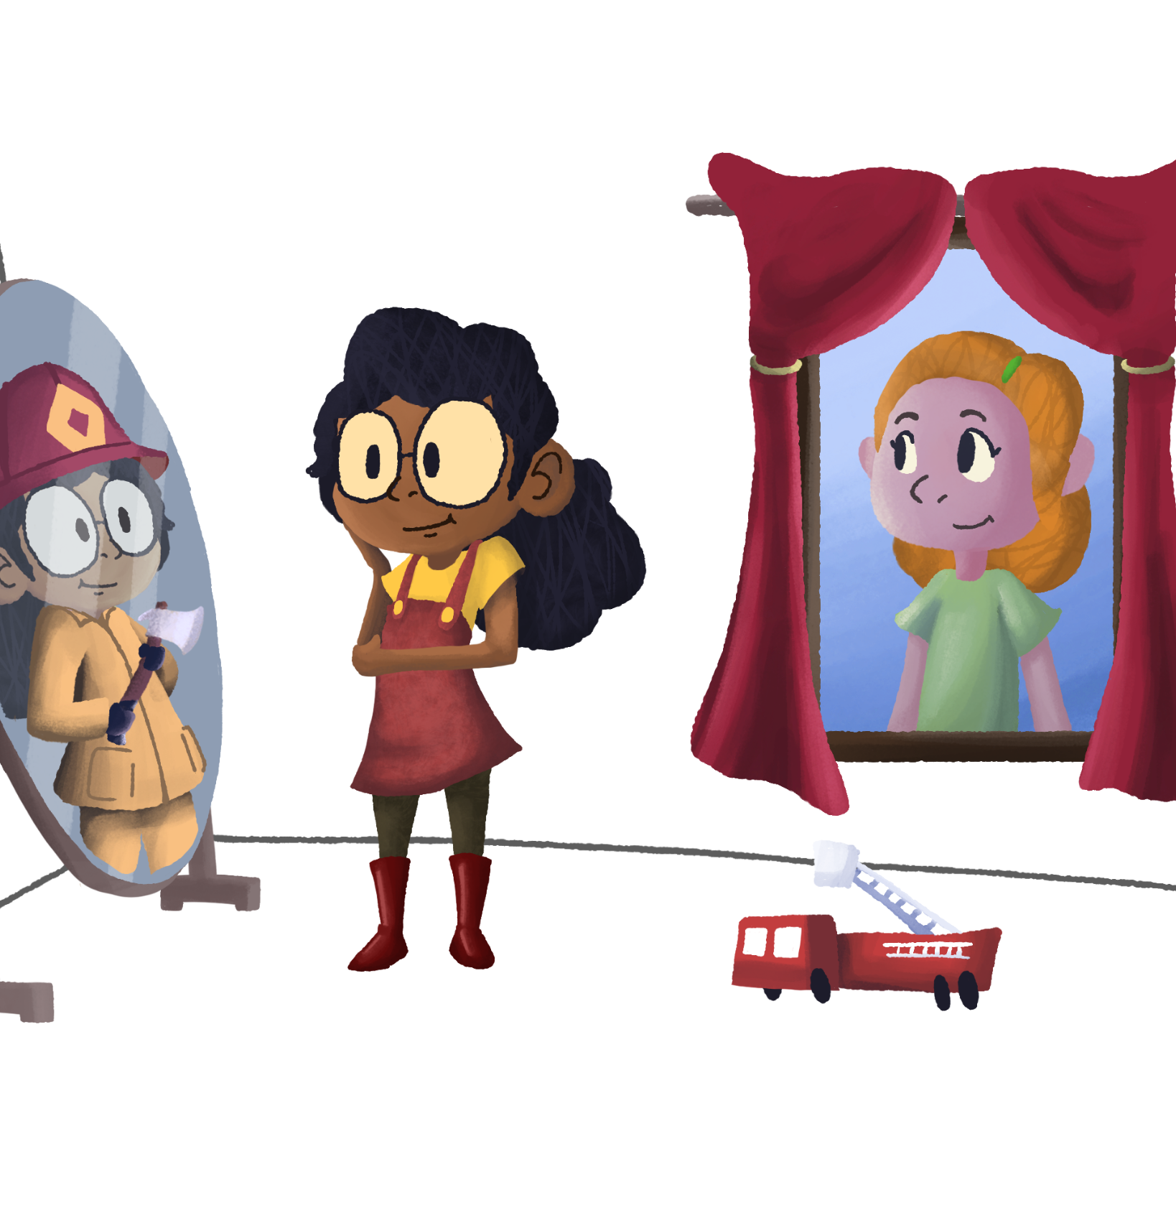
What are Mirrors & Windows
Mirror- Is your experiences and identities. It is a “mirror” of some aspects of your own life.
Window- Is seeing beyond your own experiences. It is a “window” into experiences and identities that are different from your own.

Slide 7
Mirrors & Windows
Using the “Turning Mirrors Into Windows Handout,” look at each question on the left hand side and fill in the Mirrors and Windows columns.
You’ll have 3 minutes to complete this task.

Slide 8


Slide 9

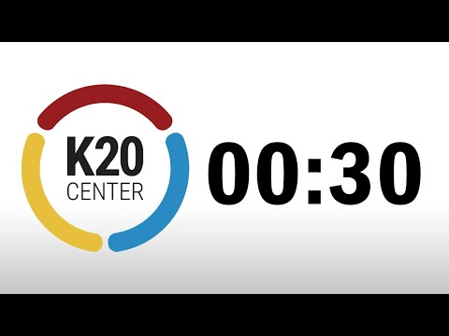
Roundabout Conversations
You will be split into two (2) equal groups, an inner circle (facing right) and an outer circle (facing left).
Both circles will move in the direction they are facing the number of paces that is called.
Once the number has been reached, you will turn toward your new partner.
Share your responses to the given prompt.

Slide 10
Roundabout Conversations
You will be split into two (2) equal groups, an inner circle (facing right) and an outer circle (facing left).
Music will play and you will walk in a circle.
When the music stops, you will turn toward your new partner.
Share your responses to the given prompt.

Slide 11
Mirrors & Windows Debrief
How did your/others windows change the trajectory of your mirrors?

Slide 12
Essential Question
How can I turn mirrors into windows in my classroom/school environment?

Slide 13
Research
Changing students’ perceptions (Chambers, 1983).
Connect coursework to future goal makes learning feel more personal and important(Bridgeland, Dilulio, & Morison, 2006; Rumberger et al., 2017)
Increase college-going culture and completion (Kronholz, 2012).
Recognize the strengths and assets your students possess and bring to the classroom already (Cummins, 2020; Deci & Ryan, 2015; Fortner et al., 2021; Howard & Rodriguez-Minkoff, 2017)

Slide 14
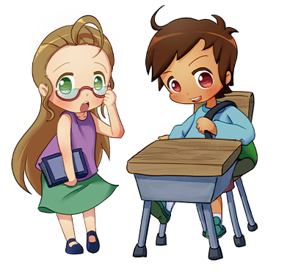
Stand Up, Sit Down
In your groups list in what ways you are turning mirrors into windows?
Choose the top 3 windows you’ve guys discussed to share.
Have a representative to stand up to share your points.
Cross off any points that you have that someone else has shared.
Take a seat once all 3 of your points have been shared.

Slide 15
Stand Up, Sit Down Share Outs

Slide 16
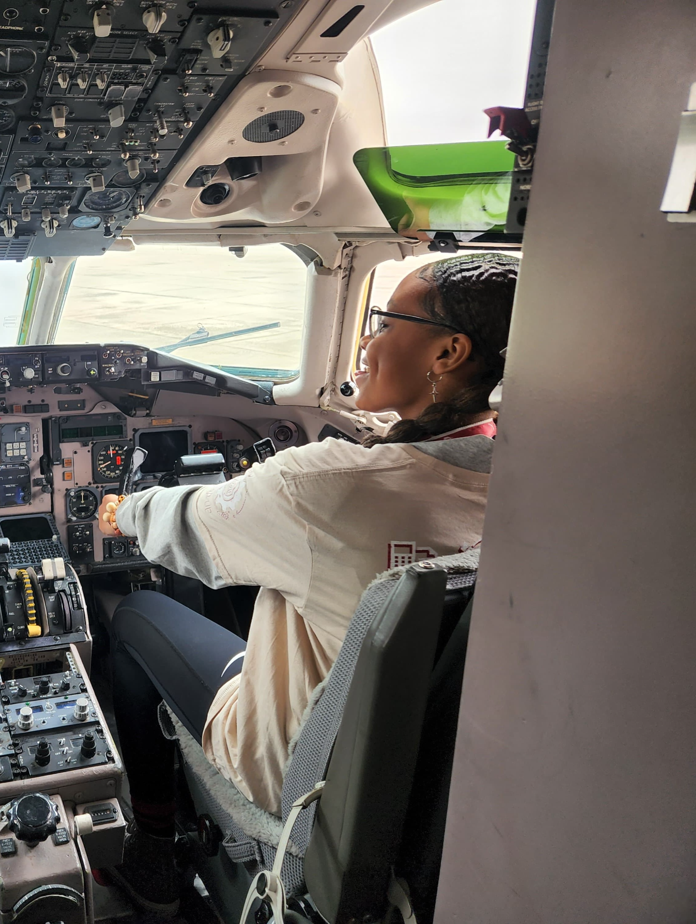
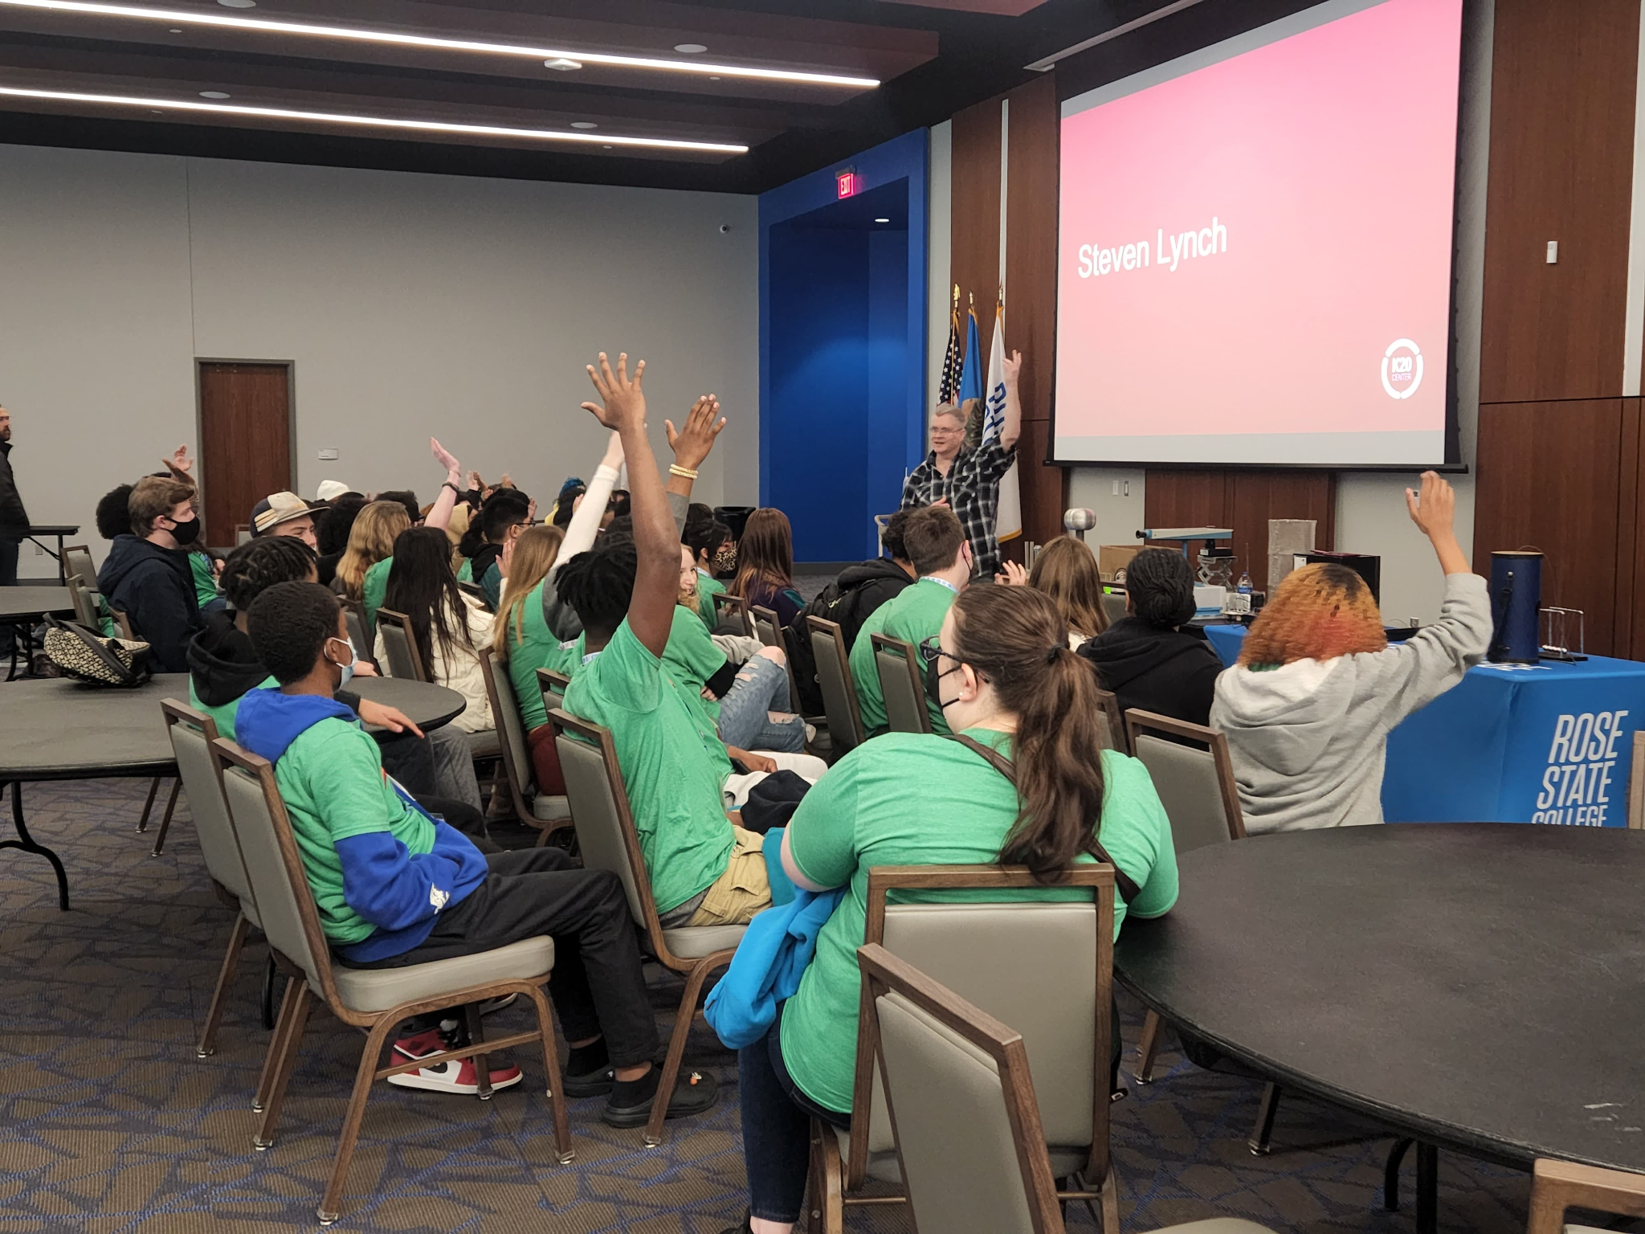
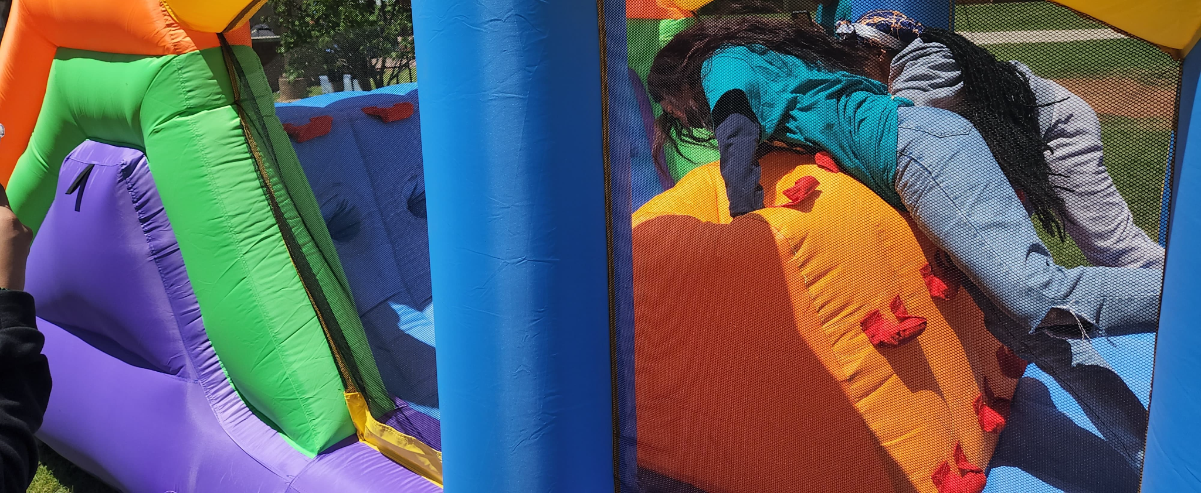
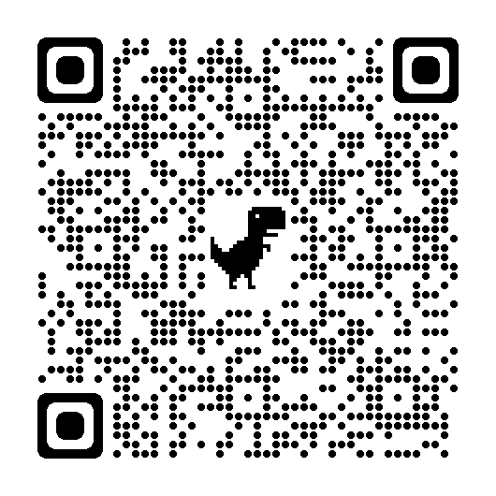
Campus Visits
College2Career Forum
Action Plan
Notes:
Everything we do at the research center is researched based, here are some ways in which K20 provides windows for our students

Slide 17
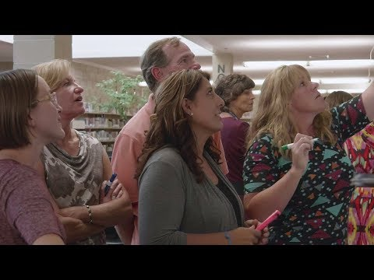
Making Sure Each Child Is Known
Notes:
We’re going to watch a short video that illustrates some of these ideas we’ve discussed so far.
Discussion Questions:
What methods did the teachers use to make students feel seen and valued?
How difficult would these be to implement in your classroom/building?
What are your major takeaways from this video and the research behind it?
Edutopia. (2017). Making Sure Each Child Is Known. YouTube. Retrieved February 10, 2023, from https://youtu.be/xjZx0VdmgkE.

Slide 18
Panel

Slide 19
Insert Panelist Video

Slide 20
Are my students at an advantage because I am their [educator]?”
Baruti Kafele

Slide 21
Reflection
What can you do in your role to provide more windows for your students within the next week?
Insert QR Code Here
Notes:
Provide diverse resources.
Explore what’s alike and what’s different.
Encourage student-led or student-inspired clubs.

