Slide 2
Better Together:
Relationships, Collaboration, and Outcomes
8 Aspects of Climate & Culture

Slide 3
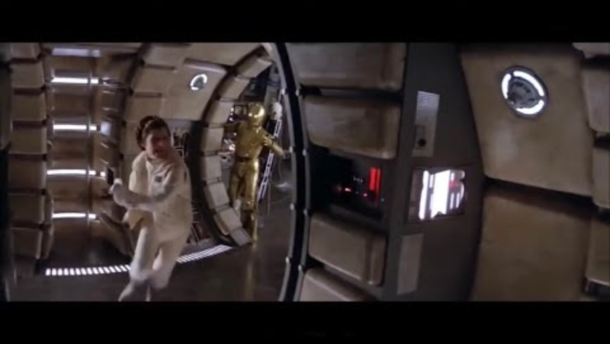
"No Time to Discuss This As a Committee!"
Notes:
Empire Fan Productions. (2021, April 8). “No time to discuss this as a committee!” [Video]. YouTube. https://www.youtube.com/watch?v=SmQjJ_hzz-4
1 min
LW
Most times collaboration is great (2 heads are better than one, etc.) But we respect that there are times when discussion may not be the best course of action.
Star Wars Video 13 seconds
Context: Imperial invasion aimed at destroying the Rebel Alliance's Echo Base hidden on the remote ice world Hoth. The base's location was compromised

Slide 4

Stoplight Statements: Collaboration
Choose and hold the color that best represents your position in the statements
on the following slides.
Green – Yes, let’s go!
Yellow – Sometimes depends on a few things.
Red – Nope, flying solo…
Notes:
K20 Center. (n.d.). Stoplight stickies. Strategies. https://learn.k20center.ou.edu/strategy/92
LH
Engage
10 minutes to get through all questions.
could use a color to hold up or could use menti…
*Formative Assessment Feedback: (Ryan’s clarifying question) How are we identifying collaboration? Me and one other person? Three to four people? Depends on your team and what is your normal work “norm?”

Slide 5
When generating new ideas, products, and/or processes.
Notes:
K20 Center. (n.d.). Stoplight stickies. Strategies. https://learn.k20center.ou.edu/strategy/92
LW
How do you feel about collaborating when…
Green - Yes, let’s go!
Yellow - Sometimes depends on a few things.
Red - Nope, flying solo…

Slide 6
Planning, coordinating, and carrying out complex work.
Notes:
K20 Center. (n.d.). Stoplight stickies. Strategies. https://learn.k20center.ou.edu/strategy/92
LW
How do you feel about collaborating when…
Green - Yes, let’s go!
Yellow - Sometimes depends on a few things.
Red - Nope, flying solo…

Slide 7
Speedy execution is important.
Notes:
K20 Center. (n.d.). Stoplight stickies. Strategies. https://learn.k20center.ou.edu/strategy/92
LW
How do you feel about collaborating when…
Green - Yes, let’s go!
Yellow - Sometimes depends on a few things.
Red - Nope, flying solo…

Slide 8
Gaining commitment and making decisions that affect many people.
Notes:
K20 Center. (n.d.). Stoplight stickies. Strategies. https://learn.k20center.ou.edu/strategy/92
LW
How do you feel about collaborating when…
Green - Yes, let’s go!
Yellow - Sometimes depends on a few things.
Red - Nope, flying solo…

Slide 9
Dealing with uncertain, complex, or risky problems.
Notes:
K20 Center. (n.d.). Stoplight stickies. Strategies. https://learn.k20center.ou.edu/strategy/92
LW
How do you feel about collaborating when…
Green - Yes, let’s go!
Yellow - Sometimes depends on a few things.
Red - Nope, flying solo…

Slide 10
You have enough information and resources to do the work well by yourself.
Notes:
K20 Center. (n.d.). Stoplight stickies. Strategies. https://learn.k20center.ou.edu/strategy/92
LW
How do you feel about collaborating when…
Green - Yes, let’s go!
Yellow - Sometimes depends on a few things.
Red - Nope, flying solo…

Slide 11
Learning new insights, perspectives, or methods.
Notes:
K20 Center. (n.d.). Stoplight stickies. Strategies. https://learn.k20center.ou.edu/strategy/92
LW
How do you feel about collaborating when…
Green - Yes, let’s go!
Yellow - Sometimes depends on a few things.
Red - Nope, flying solo…

Slide 12

Teamwork
Notes:
Igniter Media. (2018, August 10). Teamwork | Igniter Media | church video [Video]. YouTube. https://www.youtube.com/watch?v=J8Kz_poR55E
YouTube Video: https://youtu.be/wJuRrIf1FOw Starts: 00:04 and Ends: 02:15

Slide 13
Learning Objectives
Explore research-based characteristics of the research construct collaboration.
Analyze survey data in the context of your school.
Apply strategies to your role within your team and within the whole school.

Slide 14
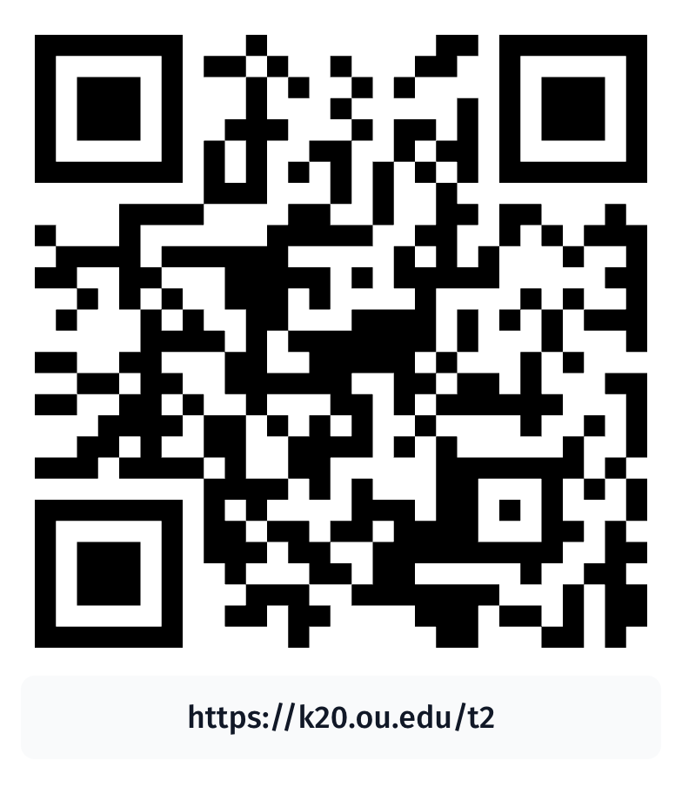
DISC Personality Assessment
Notes:
Buford, M. (n.d.). DISC personality assessment. Truity.com. Retrieved October 2, 2026, from https://www.truity.com/test/disc-personality-test

Slide 15
Personality Styles
Drive | Influence | Support | Clarity
What do you notice about these four styles in terms of projects and/or processes?
Notes:
LW
(1 min)
Keep you quiz results open through this session.
Note on Authority: This is kind of a corporate frame so some words they’ve chosen to describe things would be seen as assets in that domain and are off putting in the education world.
For example, they use the word authoritative which can be confused with authoritarian. Authoritarian style demands blind obedience, authoritative styles sets clear and reasonable boundaries/expectations.
Both words have the root word “Authority” or “Author” and I’d like to point out that despite most of us being slightly allergic to this word… it historically means a person of origination/inventor/creator of a plan or an idea. The person who causes something to happen.
Teachers are 100% authors of their own classroom, in truly beautiful ways. Quite a few of you could fall in this area and I’d like you to mentally modify this word to “authorship.”

Slide 16
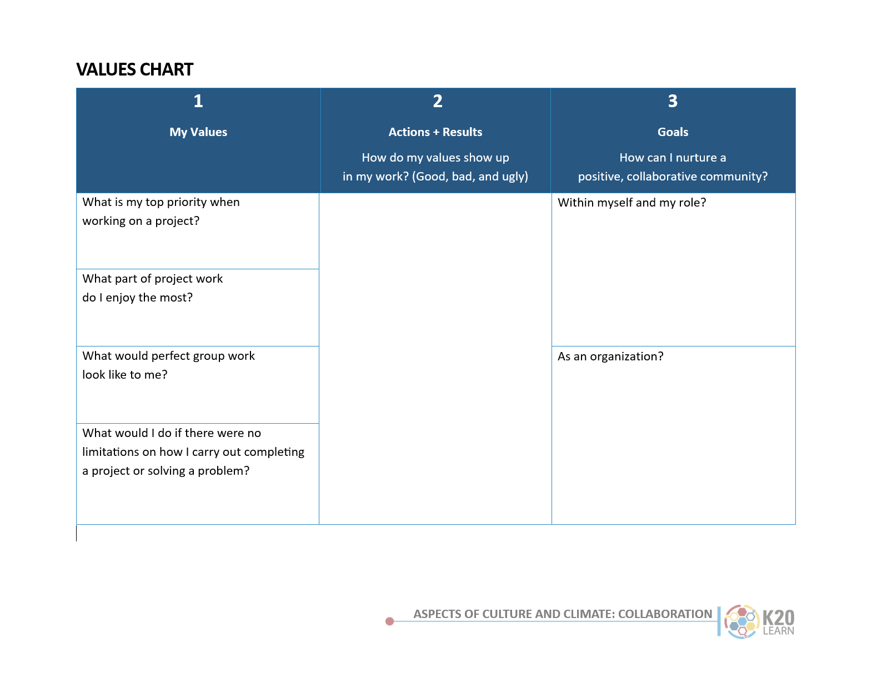
My Values
Answer the questions in the first column.
Notes:
LW
(4min)
pull up your Values chart: https://docs.google.com/document/d/1Yh6_rYsg9wmRmtdTJaEK9aFh5ZlQ2EL1Cz_7jiDMZQg/copy
Fill in the first column only. Note: If you’re struggling to answer the questions on the values chart. Look at your work preference style results to see if this helps you identify what it is you value when collaborating.

Slide 17
Better Together: Relationships, Collaboration, and Outcomes
Silently read the research brief.
Notes:
LH
(3 min)
No talking, please take three minutes to read this two page research brief. Facilitator will assess at the end of 3 mins how much more time is needed (show me one finger for one more min, two fingers for two more, etc.).
Needed 5 mins

Slide 18
DISC Personality Styles
Drive | Influence | Support | Clarity
Control Power Assertiveness Results-oriented | Relates to people Communication Networking Persuasion | Patience Thoughtful Harmony Organized | Structured Organized Detail-oriented Quality conscious
Notes:
Buford, M. (n.d.). DISC personality assessment. Truity.com. Retrieved October 2, 2026, from https://www.truity.com/test/disc-personality-test
LH
(4min)
Explain: Your assignment is based on the color highlighter you selected to use.
Choose a highlighter for the next activity:
Read the research brief and highlight concepts, words, or phrases that you feel speak to your assigned work preference style (based on the highlighter you chose).

Slide 19


Categorical Why-Lighting
Take turns at your table sharing what you highlighted and why you related that idea to the style you were assigned.
1-Minute Timer
Notes:
K20 Center. (n.d.). Categorical highlighting. Strategies. https://learn.k20center.ou.edu/strategy/192
LH
EXPLAIN
Use a timer that sets the rotation speed.
(5min)
https://docs.google.com/document/d/1SoeFuKASZphGE4GzFC1PcV01cGZlrlkBsxleUF-2jNI/copy
*Formative Assessment Feedback: Maybe we need to give the first person 90 seconds and then the other three people get up to 1 minute.

Slide 20
How does diversity in personality styles benefit collaboration?
Drive | Influence | Support | Clarity
Notes:
LH
(4 min)
Share from the tables and focus around this question.

Slide 21
Action + Results
Reflect on what actions you take during team projects.
List these in the second column of the values chart.
Notes:
LH
Reflect on what actions you take during team projects and fill in the second column of the values chart.
(3min)
Values chart: https://docs.google.com/document/d/1Yh6_rYsg9wmRmtdTJaEK9aFh5ZlQ2EL1Cz_7jiDMZQg/copy
Eg: If I value time on task then on the positive side I will schedule time on my calendar to work on a task. On the other side, I might get grumpy in meetings when they go off task.
Share out?

Slide 22
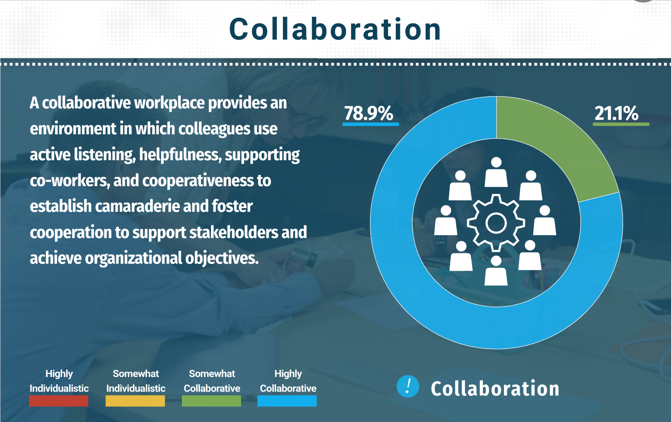
https://tinyurl.com/k20collaboration
Notes:
LW 2 min
Positive View - Facts/Data - What do you notice?
Objective view: Facts/Data - what are you seeing?
Top graph is all the data on collaboration together
The following three are subsets of data
Look at it and what to do you see? Write objective statements about
https://infogram.com/1pddk5x5rp69lwimvzl07weljksk2qyddnw?live (in the agenda or a link shortener on the slide).

Slide 23
What does the data say?
Write 2–4 objective statements about this data in the center square.
Notes:
K20 Center. (n.d.). Inside out. Strategies. https://learn.k20center.ou.edu/strategy/93
LW
4 min
Positive View - Facts/Data - What do you notice?
Objective view: Facts/Data - what are you seeing?
Top graph is all the data on collaboration together
The following three are subsets of data
Look at it and what to do you see? Write objective statements about
https://infogram.com/1pddk5x5rp69lwimvzl07weljksk2qyddnw?live (in the agenda or a link shortener on the slide).

Slide 24
Reflection and Interpretation
What are your feelings about the data?
What key insights do you take away from this data?
Notes:
K20 Center. (n.d.). Inside out. Strategies. https://learn.k20center.ou.edu/strategy/93
LW4min
As a group?

Slide 25
Decisions/Goals
What can we do as a result of this data?
Notes:
K20 Center. (n.d.). Inside out. Strategies. https://learn.k20center.ou.edu/strategy/93
LW
(4min)
Table, share out to whole group? Should we have a way to document this for leaders to view and make use of the suggestions?

Slide 26
Goals
Revisit your Values chart, column three:
How can we better foster a positive collaborative work community?
Notes:
LW
(3min)
Individual

