Slide 1
Access is Key: Information Adequacy and Flow
8 Aspects of Climate & Culture
Notes:
LH

Slide 2

What kinds of info do we exchange?
Look at or think about your last five
information exchanges…
(scheduling, ordering, lunch plans, etc.).
Individually, write the type of
information shared in each exchange on a
sticky note (you’ll each have five).
With your table, stack like types of info together.
Share your table’s info stacks out to the whole group.
Notes:
(15 Min)
Mariah/Trisha
Look at/ think on your past five messages/interactions…write each one on a sticky note. If you’re last five interactions have redundant types of info, then move to your 6th or 7th exchange. Should have five different things written down on your stickies.
Share with your small group and make a shared list, affinity process, group similar things together
Share out to whole room. Facilitators make a shared list on a dry erase board, don’t write down anything repeated…
Share your biggest pile
Next group can share the biggest pile they have that isn’t a repeat.
This is intended to get you to begin thinking about the kinds of info and how you share it across the center, take this frame into the following activities

Slide 3
Reflection
Look at these big information categories.
Reflect on the questions below:
Who all is involved in using this information?
What is your role in sharing this information?
Notes:
(4 Min)
Mariah/Trisha
Work through the shared list in a whole group discussion answering these two questions for a few of the items on the list. Transition to objectives
Timelines
New projects
Policy changes and implementations
Goals and vision
Data - APR,
Ordering
Scheduling
deadlines
Lunch plans
Jira tickets

Slide 4
Objectives
Explore research-based characteristics
of Information Access.
Analyze survey constructs and data in the
context of your organization.
Apply strategies to your role within
your team and organization.
Notes:
(1 Min)
Mariah/Trisha

Slide 5
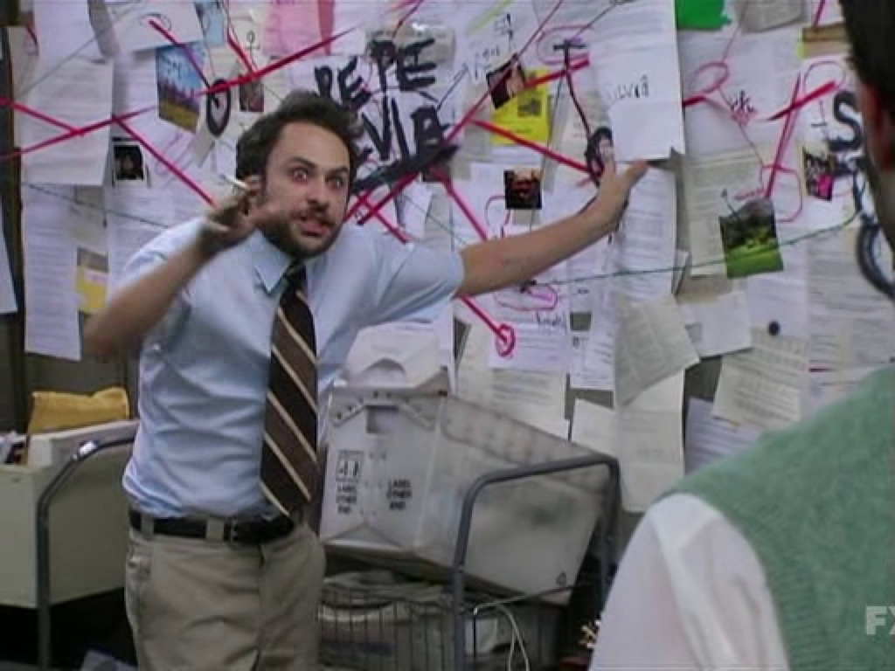

Put on your conspiracy theory hat.
Make a map of how all these ideas connect to one another.
Notes:
(10 Min)
LW/LH
Each table has a set of cards with research-based strategies and concepts from the research on information access. As a table create a map of how you see these concepts and ideas being related to one another.

Slide 6
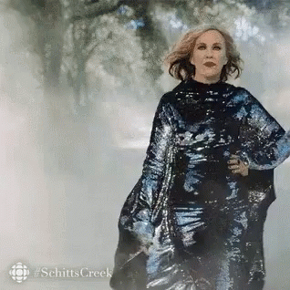
Scatter
Quickly walk around and take a look at at least one other group’s card map.
Briefly report back to your group differences you noticed.
Notes:
(2 Min)
LW
Walk around and look at at least one other group’s map and note how it is different from yours.
Return to your group and briefly share differences you noticed.

Slide 7

Access is Key:
Information Adequacy & Flow
Read the research brief.
After each paragraph, stop and jot down some notes on how it might inform your table’s card map.
Notes:
(5 mins)
LW/Trisha
Individually read
Research Brief (view only): https://docs.google.com/document/d/1JyIjm2VUMvLvFjCAUmOdFlZgt1E083pCLXiK_hILshM/edit?usp=sharing

Slide 8
Card Map Remix
Review your card map.
Discuss connections and
changes with your table group.
Move strategy cards based on the research.
Add additional strategies using provided sticky notes.
What changes or additions did you make?
Notes:
(10 mins)
LW/Trisha
Place a dot on the cards you moved. Share those cards and why.
Partners or square pairs?
Facilitators take a photo and put it in a folder for later review

Slide 9
Look at the Data
PLACE A SCREENSHOT
OF THE INFOGRAM
FOR YOUR SCHOOL’S DATA
IN THIS AREA HERE
[PASTE TINY URL HERE]
PLACE
QR CODE
TO INFOGRAM HERE
Notes:
(5 Min)
Before facilitating, take a screenshot of your survey results infogram and place it into this slide. Also, create a short url or QR code for easy participant access and add that to the slide.
Show data on large screens to share questions that were asked.

Slide 10
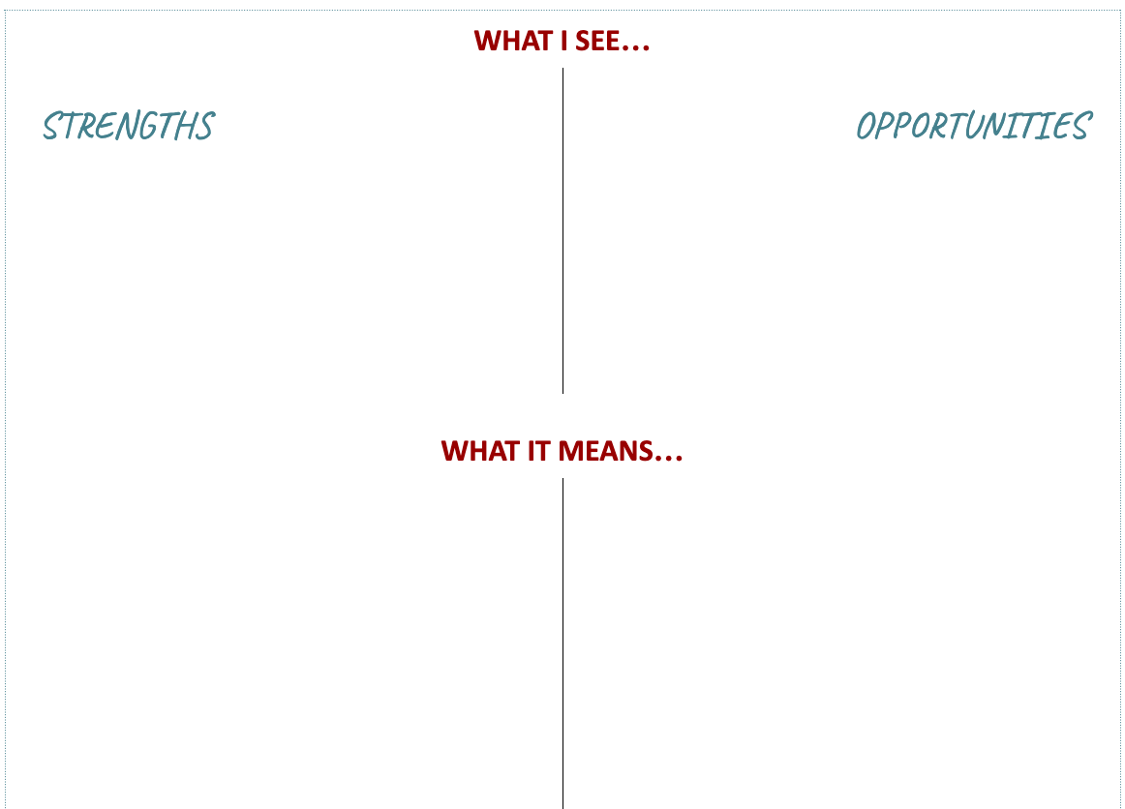
What I See…What Does it Mean?
Based on the data, what do you see?
Select appropriate strategies to list for strengths and opportunities.
What does it mean?
Explain or give examples of those strategies in your role.
Selecting appropriate concepts or strategies from your card map list these under the strengths and opportunities columns on your WIS/WIM posters. At least one strategy per quadrant to represent things we do well and things we could improve on.
Notes:
(20 Min)
Share out what is happening with collaboration charts we created last time. And that something similar will happen with these sheets of paper.
Have two people from each group look at one of the posters and fill in the columns. Feel free to write in ideas that are more specific/expand upon how this applies specifically to K20 (10mins)
Then have them trade to read one another’s work, add anything they would add (5mins)
After
Data for K20 Center: https://infogram.com/1p2ml2ep16j1kdu060jww0w22zurjnz0y7v?live

Slide 11
How can I leverage information access to improve organizational climate and culture?
Choose a strategy inspired by your card map that answers the question above.
Write down your strategy on two sticky notes.
Place one on bottom of the WIS/WIM poster under “WHAT I’LL DO…” and keep the second as a reminder.
Take a photo of your poster/s to talk about with your team at a later date.
Notes:
(5 Min)
Mariah/Trisha
Share out what is happening with collaboration charts we created last time with leaders/directors. And that something similar will happen with these sheets of paper.
Return to card sort and select one of the cards that answers the question above. You might also consider how this aspect of climate/culture is interdependent with collaboration (or any other aspect you’ve explored previously as a group)
Write down on a sticky what you will do to improve organizational climate and culture.
Place your sticky on the bottom of the WIS/WIM
Take a photo of both WIS/WIM posters with stickies and put in folder

