Slide 2
Getting to Know Your TI-Nspire™
Learn the essential mechanics of the calculator

Slide 3
Essential Question
Which mechanics of the TI-Nspire™are essential for me to know?

Slide 4
Learning Objectives
Explore the TI-Nspire™mechanics for calculations, graphs, geometric conceptual development, and data analysis.
Demonstrate the use of technology to enhance the learning of mathematics in the classroom.
Determine appropriate calculator-related activities for the classroom.

Slide 5
Magnetic Statements
When each statement displays, follow this three-step process:
Move to the side of the room that you agree with more.
Discuss your choice in your group.
Share why your group was attracted to the statement.
Notes:
K20 Center. (n.d.). Magnetic statements. Strategies. https://learn.k20center.ou.edu/strategy/166

Slide 6
I got my first calculator in
K-12
College

Slide 7
Calculators are best for
Graphing
Computing

Slide 8
Students need calculators
Always
Sometimes

Slide 9
Calculators support student understanding
Always
Sometimes

Slide 10
I am more comfortable using
TI-84 Plus
TI-Nspire™

Slide 11
TI-Nspire™ Scavenger Hunt
Complete the steps in the TI-Nspire™ scavenger hunt.
Choose the graphing calculator task card that aligns with your content area.
Pre-Algebra & Algebra 2
Geometry
Algebra II
Precalculus
Work through the task card to learn specific functions for your content.
If time allows, try another task card!

Slide 12
Say Something!
Share something about the TI-Nspire™
My favorite feature is…
I found these calculator commands are similar to a computer…
This is different than the TI-84 in that…
I think my students will need help with…
I was surprised by…
I wish I knew how to…
Notes:
K20 Center. (n.d.). Say something! Strategies. https://learn.k20center.ou.edu/strategy/778
Explain - Mechanics and info
NSPIRE is designed to be more streamlined
Can be updated
Intended to have less button pushed than the TI-84
This means that there are more menus
Has the same commands as computers
Ctrl v
Ctrl c
Ctrl x
Ect.
CX models can be used on the ACT (CAS models cannot)
Keyboard is not (like a computer keyboard) because ACT won’t allow that

Slide 13
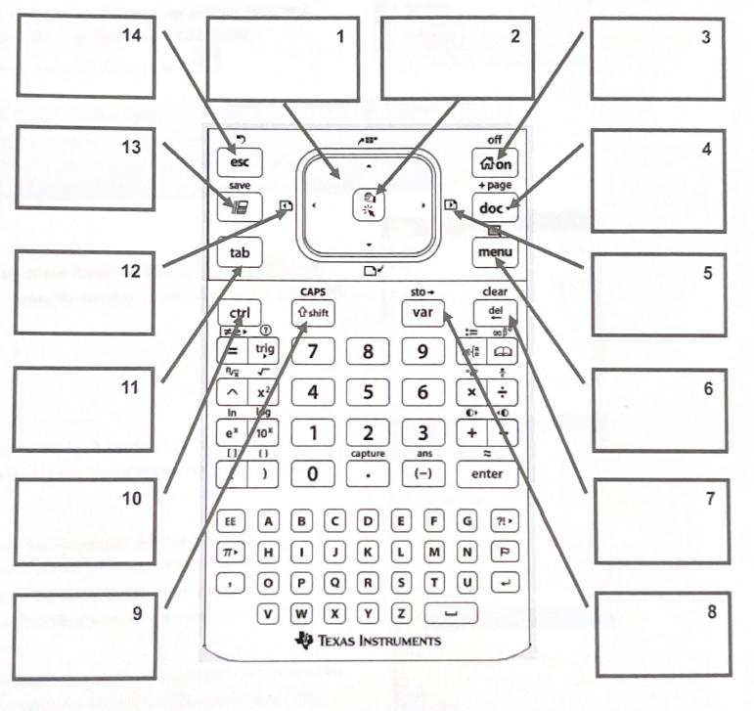

Slide 14
On Home
Escape
Touchpad
Left click
Scratch pad Quick calc
Stored
Docs
Previous Insert Point
Next Insert Point
Navigate between lines math quickly
Menu
Access blue controls
Backspace Delete
Define and store Variables
Capitalize letters

Slide 15
TI Teacher Software
Downloads to the computer at cost.
Builds applications for a deeper understanding of math.
TI has pre-built activities that are available on their website to download.

Slide 16
Explore Free Activities
Scan the QR code or use the short URL to access the TI Nspired website.
Find specific content area in the left-side menu.
Explore the free activities.
k20.ou.edu/nspired

Slide 17
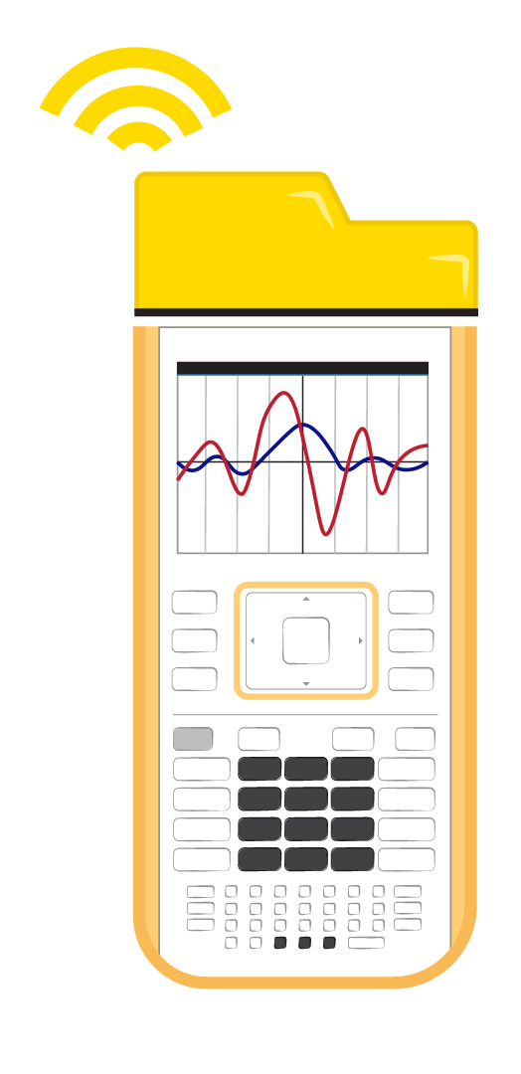
Connecting Calculators
TI Navigator System
Wirelessly connect up to 30 calculators at a time to the teacher device.
Teachers can send and collect all student activities at once.
Teachers can see student work in real time.
Teachers can spotlight student calculators during class.
USB Connectivity cord
Connects calculators and computers 1-to-1.
Teacher can send and collect to or from any calculator connected to the computer.

Slide 18
Say Something!
Share something about the Math Nspired activities
My favorite activity is…
I found this resource helpful because…
I didn’t know students could…
I think my students will…
I was surprised by…
I wish I knew…

Slide 19
BINGO: Find Someone Who Can…
Circle any spaces for each task you already know how to complete.
Collaborate with those around you to mark out un-circled spaces on the card.
Notes:
K20 Center. (n.d.). Muddiest point. Strategies. https://learn.k20center.ou.edu/strategy/109

Slide 20
Muddiest Point
What do you find most confusing or difficult about the TI-Nspire™?
Which tasks do you still need help with?

Slide 21
Commit and Toss
Write down
One thing you learned
One thing you still want to know
Toss your response in the container.
Notes:
K20 Center. (n.d.). Commit and toss. Strategies. https://learn.k20center.ou.edu/strategy/119

