Slide 2
Getting to Know the TI-84 Plus
Learn the essential mechanics of the calculator

Slide 3
Essential Question
Which mechanics of the TI-84 Plus are essential for me to know?

Slide 4
Learning Objectives
Explore the TI-84 Plus mechanics for calculations, graphs, geometric conceptual development, and data analysis.
Demonstrate the use of technology to enhance the learning of mathematics in the classroom.
Determine appropriate calculator-related activities for the classroom.

Slide 5
Magnetic Statements
When each statement displays the following, do as instructed:
Move to the side of the room that you agree with more.
Discuss your choice in your group.
Share why your group was attracted to the statement.
Notes:
K20 Center. (2020). Magnetic Statements. Strategies. https://learn.k20center.ou.edu/strategy/166.

Slide 6
I got my first calculator in
K-12
College

Slide 7
Calculators are best for
Graphing
Computing

Slide 8
Students need calculators
Always
Sometimes

Slide 9
Calculators support student understanding
Always
Sometimes

Slide 10
I am more comfortable using
TI-84 Plus
TI-Nspire™

Slide 11
TI-84 Plus Scavenger Hunt
Complete the steps in the TI-84 Plus scavenger hunt.
Choose the graphing calculator task card that aligns with your content area.
Pre-Algebra & Algebra I
Geometry
Algebra II
Pre-calculus
Work through the task card to learn specific functions for your content.
If time allows, try another task card!

Slide 12
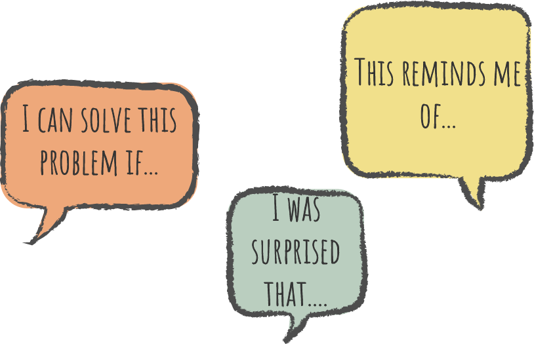
Say Something!
Share something about the TI-84 Plus
My favorite feature is…
I found these calculator commands are similar to a computer…
This is different than the TI-Nspire in that…
I think my students will need help with…
I was surprised by…
I wish I knew how to…
Notes:
K20 Center. (2021). Say something! Strategies. https://learn.k20center.ou.edu/strategy/778

Slide 13
8
7
1
6
2
5
4
3

Slide 14
8
Graphing controls
Access to Blue controls
7
1
Navigating arrows
Access to Green controls
6
2
Backspace Delete
Access to secondary menus
5
4
3
On/Off
Calculate

Slide 15
TI Teacher Software
Downloads to the computer at cost.
Builds applications for a deeper understanding of math.
TI has pre-built activities that are available on their website to download.

Slide 16
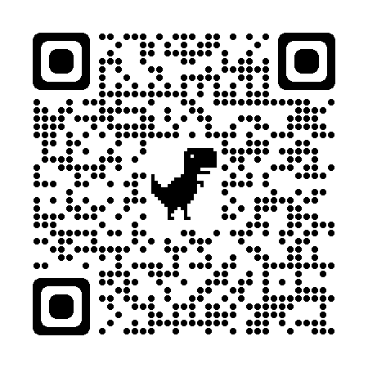
Explore Activities
Scan the QR code or use the short URL to access the 84 Activity Central website.
Find specific content area in the left-side menu.
Explore the free activities.
k20.ou.edu/84activity

Slide 17
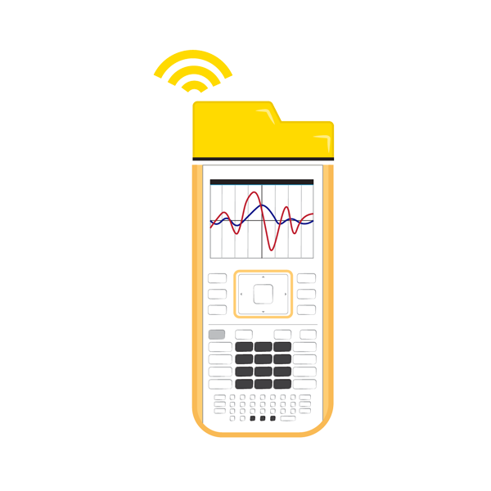
Connecting calculators
TI Navigator System
Wirelessly connect up to 30 calculators at a time to the teacher device.
Teachers can send and collect all student activities at once.
Teachers can see student work in real time.
Teachers can spotlight student calculators.
USB Connectivity cord
Connects calculators and computers 1-to-1.
Teacher can send and collect any calculator connected to the computer.

Slide 18
Say Something!
Share something about the 84 Activity Central activities
My favorite activity is…
I found this resource helpful because…
I didn’t know students could…
I think my students will…
I was surprised by…
I wish I knew…

Slide 19
BINGO: Find Someone Who Can…
Circle any spaces for each task you already know how to complete.
Collaborate with those around you to mark out un-circled spaces on the card.

Slide 20
Muddiest Point
What do you find most confusing or difficult about the TI-84 Plus?
Which tasks to you still need help with?
Notes:
K20 Center. (2020). Muddiest point. Strategies. https://learn.k20center.ou.edu/strategy/109

Slide 21
Commit and Toss
Write down the following:
One thing you learned
One thing you still want to know
Toss your responses in the container.
Notes:
K20 Center. (2020). Commit and toss. Strategies. https://learn.k20center.ou.edu/strategy/119

