Slide 2
QC2E
Question, Claim, Evidence, Explain

Slide 3
Essential Question
How does QC2E support higher-order thinking?

Slide 4
Chain Notes
Why is argumentation important to
college and career readiness?
Notes:
Participants get into groups of four and each individual will use the handout “Chain Notes” to answer the question “Why is argumentation important to college and career readiness?”
After a moment pass all papers to the right. Read the statement written and build on or extend the previous thoughts or ideas, agreeing or disagreeing with one another’s comments.

Slide 5
Why is
argumentation
important to college
and career
readiness???
Notes:
Share out the statements from the previous activity.

Slide 6
Session Objectives
Analyze how the QC2E strategy can be a useful tool to support argumentation and the use of text-based evidence.
Evaluate the QC2E strategy and its relevance to Authenticity.
Apply QC2E to your own content area.
Notes:
Briefly display the session objectives. Use LEARN to help guide your explanation.

Slide 7
QC2E Graphic Organizers
Question:
Claim | Evidence
Explanation
Make a claim about a question or problem
Provide evidence for the claim
Provide reasoning that links the evidence to the claim
Notes:
Begin Explore portion of LEARN: Participants will work in small groups (either by table or in pairs, depending on whole group size), completing one of the four following activities using slides 6–11.
Groups do not need to be based on content area. Mixed content areas are preferable because later on in PD session they will be grouped by content areas.

Slide 8
Social Studies
FDR’s Four Freedoms Speech
Which of the four freedoms are the most important to support in other countries?
Support your answer with evidence from the text.
Notes:
Participants will read FDR's "Four Freedoms" speech using Why-Lighting as a reading strategy to identify key parts of the speech. They will use the question "Which of the four freedoms are most important to support in other countries?" to make a claim. They will use evidence from the text and prior knowledge to support their claim. Lastly, they will write an explanation linking the claim and evidence together.
See also Sample Responses in presentation narrative.
Other options:
What does FDR's "Four Freedoms" speech reveal about the variety of different attitudes, priorities, and political philosophies encompassed by the word "freedom"?
Does the speech obligate the United States to defend the rights he names in other countries?
Roosevelt, F. D. (1941, January 6). Annual Message to Congress. Records of the United States Senate, SEN 77A-H1, Record Group 46, National Archives.

Slide 9
Why-Lighting
Read through just your section.
Highlight significant parts of the text.
Justify your choices in the margin.
Discuss with your group and come to
a consensus on the main idea.
Notes:
Just in case you want a reading strategy.

Slide 10
ELA
Four Skinny Trees by Sandra Cisneros
What do the trees represent?
Notes:
Participants will read an excerpt from "Four Skinny Trees" by Sandra Cisneros using Why-Lighting as a reading strategy to identify key components of the excerpt. They will use the question "What do the trees represent?" to make a claim. They will use evidence from the test and prior knowledge to support their claim. Lastly, they will write an explanation linking the claim and evidence together.
See also Sample Responses in presentation narrative.
Cisneros, S. (1984). Four skinny trees. In The House on Mango Street (pp. 74–75). Vintage Books.

Slide 11
Why-Lighting
Read through just your section.
Highlight significant parts of the text.
Justify your choices in the margin.
Discuss with your group and come to
a consensus on the main idea.
Notes:
Just in case you want a reading strategy.

Slide 12
Science
Use the available evidence to answer the following question:
Are any of the liquids in the data set
the same substance?
Support your answer with a scientific explanation.
Notes:
Participants will analyze the chart displaying four liquids. They will use the question "Are any of the liquids in the data set the same substance?" to make a claim. They will use evidence from the data set and knowledge about mass, density, melting point, and color to support their claim. Lastly, they will write a scientific explanation linking the claim and evidence together.
See also Sample Responses in presentation narrative.
Malone, L., De Lucchi, L., & Campbell, B. (2016). FOSS Next Generation Science Resources. Chemical Interactions. Delta Education.

Slide 13
Math
Can you model the height of a projectile flung from a
catapult over time with a function in the form of y = mx + b?
X | Y
0 | 7
2 | 12
6 | 16
8 | 15
Notes:
Participants will analyze the chart and graph provided to make a claim for the question, "Can you model the height of a projectile flung from a catapult over time with a function in the form y = mx + b?" They will use evidence from the chart, graph, and activity to support their claim. Lastly, they will write an explanation linking the claim and evidence together.
Math groups may use a plastic spoon and a small wadded-up piece of scratch paper to create a catapult and visually see the movement in action.
*See hidden slide for presenter help ☺
LEARN PD also has helpful info in sample responses.
Question: Can you model the height of a projectile flung from a catapult over time with a function in the form y = mx + b?

Slide 14
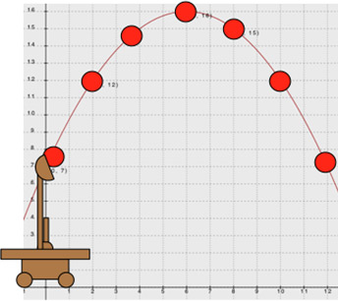
QC2E in Math
Question: Can you model the height of a projectile flung from a catapult over time with a function in the form y = mx + b?
Claim This data cannot be modeled using a function of the form y = mx + b. | Evidence
Explanation First, we imagined what the data might look like and decided the path of a projectile does not look like a line. Then, we collected our own data using a rubber-band catapult that we made to model this relationship and graphed it. You can see in the graph that this data should be modeled with a quadratic function of the form y = ax² + bx + c. The quadratic equation used to model this data is y = (−1/2)x² + 2x + 5.
X | Y
0 | 7
2 | 12
6 | 16
8 | 15
Notes:
LEARN PD also has help in sample responses.

Slide 15
Higher Order Thinking
Disciplined Inquiry
Authenticity
Value Beyond School
Implicit View of Students
Notes:
How does QC2E support higher-order thinking?
Other discussion questions can be found on LEARN PD.

Slide 16
How would I…
Notes:
Give participants a blank copy of the QC2E Graphic Organizer Template and let them discuss how to apply to their specific content area.

Slide 17
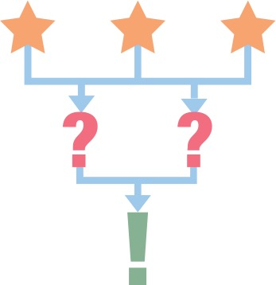
Notes:
At this point you may begin the 3-2-1 instructional strategy for wrapping up the session.
Three things they learned from today’s PD session
Two questions they still have about QC2E.
One way they can use this strategy in their classroom.
Also, remind participants to fill out the Instructional Strategy Note Sheet handout.
Slides beyond this slide are not to be shown to the participants.

Slide 18
Definitions
Claim: An assertion or conclusion that answers the original question or problem
Evidence: Scientific data that supports the students’ claim that must be appropriate and sufficient. Can come from investigation, observations, text, or existing data
Reasoning: Justification that links the claim and evidence. Shows why the data counts as evidence to support the claim using appropriate scientific principles.

Slide 19
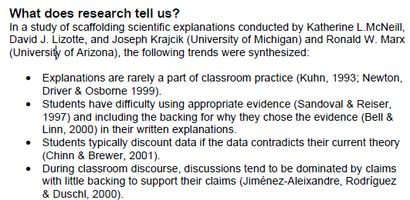
What Does Research Say?

Slide 20
Resources
Article "Fostering Argumentation Skills: Doing What Real Scientists Really Do" by Douglas Llewellyn and Hema Rajesh - http://www.gstboces.org/stem/docs/articles/STEMArticle-Fostering-Argumentation-Skills.pdf
Bell, P. (2000). Scientific arguments as learning artifacts: Designing for learning from the web with KIE. International Journal of Science Education, 22(8), 797-817.
Chain Notes instructional strategy: K20 Center. (n.d.). Why Lighting. Instructional Strategies. Retrieved from https://learn.k20center.ou.edu/strategy/d9908066f654727934df7bf4f50621a4
Chinn, C. A., & Brewer, W. F. (2001). Models of data: A theory of how people evaluate data. Cognition and Instruction, 19(3), 323-393.
Cisneros, S. (1984). “Four Skinny Trees.” The House on Mango Street. New York: Vintage Books, pp. 74-75.
Jimenez-Aleixandre, M. P., Rodriguez, A. B., & Duschl, R. A. (2000). " Doing the lesson" or" doing science": Argument in high school genetics. Science Education, 84(6), 757-792.
Kuhn, D. (1993). Science as argument: Implications for teaching and learning scientific thinking. Science education, 77(3), 319-337. • Linn, M. C. (2000). Designing the knowledge integration environment. International Journal of Science Education, 22(8), 781-796.
Llewellyn, D., & Rajesh, H. (2011). Fostering argumentation skills: doing what real scientists really do. Science Scope, 35(1), 22-28.
McNeill, K. L., Lizotte, D. J., Krajcik, J., & Marx, R. W. (2006). Supporting students' construction of scientific explanations by fading scaffolds in instructional materials. The Journal of the Learning Sciences, 15(2), 153-191.
Newton, P., Driver, R., & Osborne, J. (1999). The place of argumentation in the pedagogy of school science. International Journal of Science Education, 21(5), 553-576.
Roosevelt, F. (1941). Four freedoms.
Sandoval, W. A., & Reiser, B. J. (1997). Evolving Explanations in High School Biology.
Why Lighting instructional strategy: K20 Center. (n.d.). Why Lighting. Instructional Strategies. Retrieved from https://learn.k20center.ou.edu/strategy/d9908066f654727934df7bf4f50621a4

