Slide 2
Authentic Vocabulary Instruction
Shelby Blackwood, Professional Development Coordinator
Sandi Hebert, Professional Development Coordinator

Slide 3
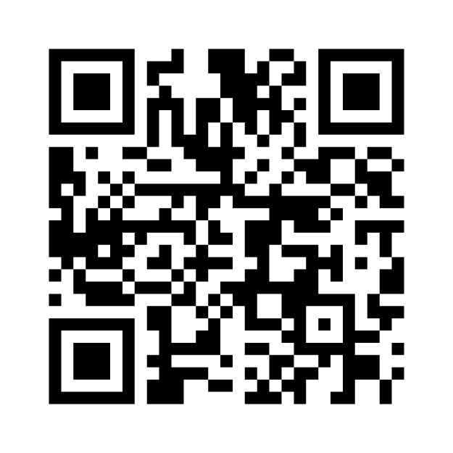
Collaborative Brain Dump
List words that surprise you that students don’t know.
Go to menti.com and enter:
3536 2592
OR
Scan this QR Code:
Notes:
K20 Center. (n.d.). Collective Brain Dump. Strategies. https://learn.k20center.ou.edu/strategy/111

Slide 4
Essential Question
How does the depth of one’s vocabulary contribute to the ability to read, write, and speak effectively?

Slide 5
Session Objectives
Explain the benefits of authentic vocabulary instruction.
Evaluate vocabulary words that students might encounter in college and career readiness programming.
Create a plan to implement one instructional strategy in your classroom.

Slide 6
GEAR UP Goals
Increase cohort academic performance and preparation for PSE.
Increase high school graduation and PSE participation.
Increase student educational expectations and increase student and family knowledge of PSE options, preparation, and financing.

Slide 7
Card Sort
Read the cards and consider how the words are related to one another.
Sort the cards into groups in the manner that makes sense to you.
Notes:
K20 Center. (n.d.). Card sort. Strategies. https://learn.k20center.ou.edu/strategy/147

Slide 8
What does the research say?
Write three important points from the research brief.
Write down anything that “squares” with your thinking.
Write down anything that is still “circling” in your mind.
Notes:
K20 Center. (n.d.). Triangle-Square-Circle. Strategies. https://learn.k20center.ou.edu/strategy/65

Slide 9
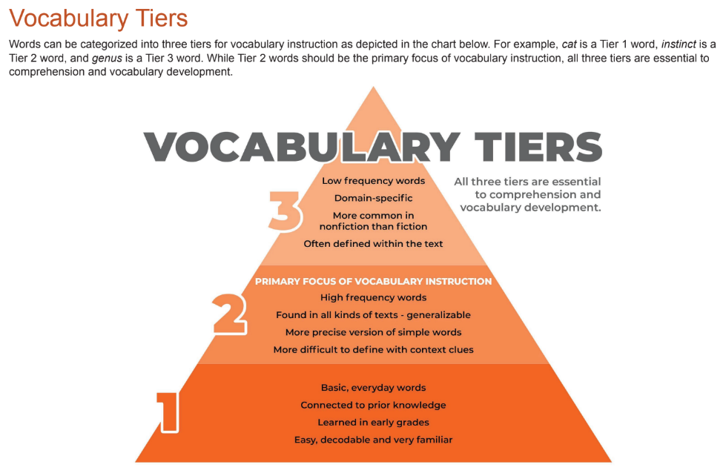
Notes:
https://sde.ok.gov/sites/default/files/documents/files/ELA%202021%20Appendix.pdf

Slide 10
Re-Card Sort
Can you re-group your cards into the three vocabulary tiers?

Slide 11
Symbol…Set…Go!
Circle – Tier 2 Words
Square – Tier 3 Words
Star – Words that could be in both Tiers

Slide 12
What’s Next?
Choose 3 Tier 2 vocabulary words.
Explore resources or strategies that support authentic vocabulary instruction.
Model the strategy and/or resource with your group.
Notes:
25 minutes
Demonstrate how to navigate to the LEARN website and the Strategies tab (learn.k20center.ou.edu) and then search for “vocabulary” in the search bar.
Participants will need devices to explore the LEARN site and other listed resources. Model how to get to the LEARN strategies.
Participants will then choose 3 Tier 2 vocabulary words and resources or strategies that would support authentic vocabulary instruction.
If time permits, ask participants to model their strategies for their small groups.
Debrief as a whole group.

Slide 13
Reflect
How does the depth of one’s vocabulary contribute to the ability to read, write, and speak effectively?

Slide 14
trek.k20center.ou.edu/oe/XXXXX
Google (School email)
(No Participant ID is required)
Notes:
2 minutes
***This slide MUST be edited with the correct TREK web address.***
Click on the link in the orange box to edit the numbers at the end and the QR code.

