Slide 2
We’re All in This Together
Climate, and Community

Slide 3
Beach Ball Toss
Notes:
Engage: Count off in groups of 6

Slide 4
O-Describe a time you felt really engaged in a project at work.
R-Describe a time when you bragged about your work.
B-Describe a time when you were working and lost track of time.
G-Describe a time when you were collaborating and your initial idea blossomed into something extraordinary.
W-Describe a time when you were recognized for your work.
Y-Describe a time you felt really connected to your coworker/s.
Notes:
Be sure that each person gets the ball at least once

Slide 5
Essential Question
How does employee engagement support organizational climate and community?

Slide 6
Objectives
Explore research-based characteristics of Climate and Community.
Analyze survey constructs and data in the context of their organization.
Apply strategies to their role within their team and organization.

Slide 7
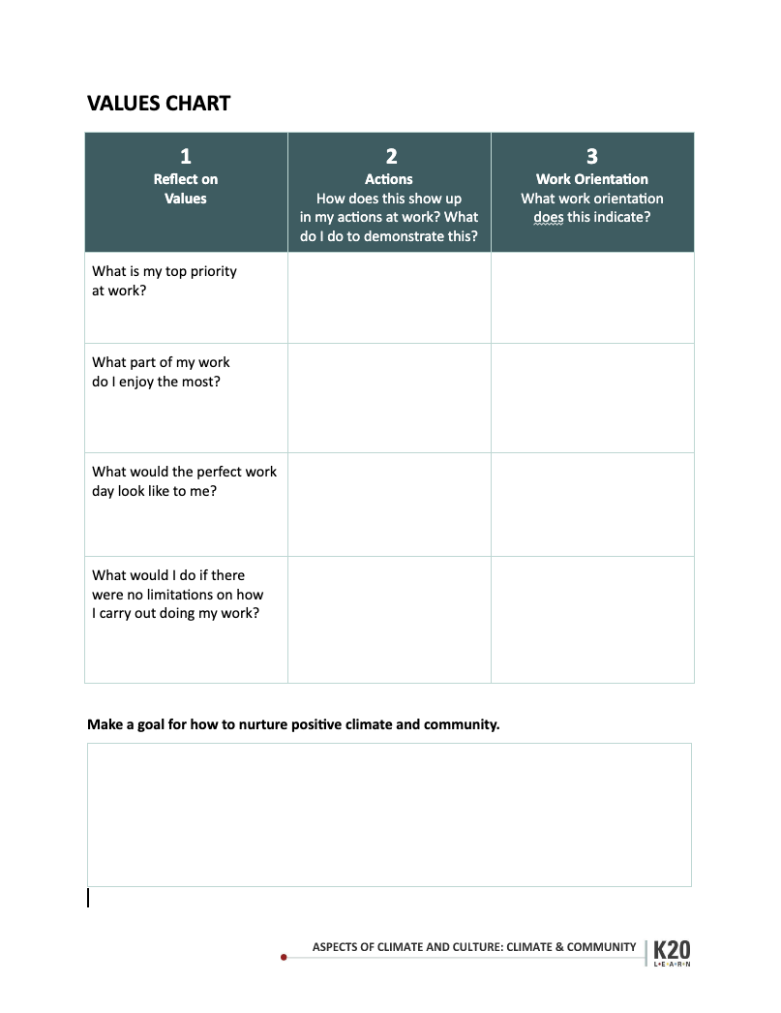
My Values
Answer the questions in the the first two columns.

Slide 8
We’re All in This Together: Climate and Community
Read the research brief.
After each paragraph, stop and jot some notes.
Notes:
(5 mins)
LW/Trisha
Individually read
Research Brief (view only): https://docs.google.com/document/d/1JyIjm2VUMvLvFjCAUmOdFlZgt1E083pCLXiK_hILshM/edit?usp=sharing

Slide 9
My Values
After reading the research brief, reflect on which of the work orientations in the reading is indicated by each of your values.
Notes:
LW
(4min)
pull up your Values chart: https://docs.google.com/document/d/1DkDzNlIG8gfwCDAVcyFwfiApRqZvijc2/copy
Fill in the first column only. Note: If you’re struggling to answer the questions on the values chart. Look at your work preference style results to see if this helps you identify what it is you value when collaborating.

Slide 10
Table Share Out
What did you learn about your work orientation?
Notes:
Leadership - Trisha
Inquiry - Jared
10 min

Slide 11
Goals
As a table group, generate a goal for how to nurture a positive organizational engagement climate and community.
Share out to larger group.
Notes:
LW
(4min)
pull up your Values chart: https://docs.google.com/document/d/1DkDzNlIG8gfwCDAVcyFwfiApRqZvijc2/copy
Fill in the first column only. Note: If you’re struggling to answer the questions on the values chart. Look at your work preference style results to see if this helps you identify what it is you value when collaborating.

Slide 12
Look at the Data
PLACE A SCREENSHOT
OF THE INFOGRAM
FOR YOUR SCHOOL’S DATA
IN THIS AREA HERE
[PASTE TINY URL HERE]
Notes:
Pull up the infographics, give just a couple of minutes (5 Min)
Before facilitating, take a screenshot of your survey results infogram and place it into this slide. Also, create a short url or QR code for easy participant access and add that to the slide.
Show data on large screens to share questions that were asked.

Slide 13
It says, I say, and So…
Example:
It says…
The porridge is 107 degrees hot.
The ideal temperature according to research is _____.
I say…
It’s too hot! It will burn my mouth if I eat it now.
And so…
I’ll go for a walk until it cools down.

Slide 14
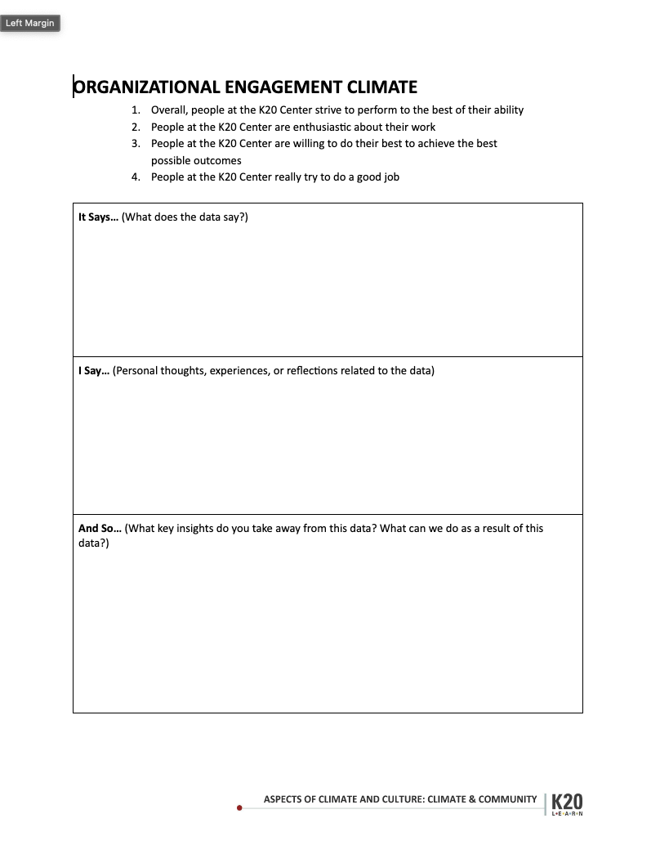
It says, I say, and So…
Write your answer to the first question on the handout.
It Says…
(What does the data say?)

Slide 15
It says, I say, and So…
Pass to the right. Write your answer to the second question on the handout.
I Say…
(Personal thoughts, experiences, or reflections related to the data.)

Slide 16
It says, I say, and So…
Pass to the right. Write your answer to the third question.
And So…
(What key insights do you take away from this data? What can we do as a result of this data?)

Slide 17
Share out
The last person holding each page reads to the whole table.
As a table, summarize takeaways to share to the whole group.

Slide 18
Rose, Bud, & Thorn
A Rose: Something that’s already blooming (well-supported in our culture/climate)
A thorn: Something you would like to see change
Bud: Something you need to support your future growth
INSERT
QR CODE
HERE
[paste short url link]
Notes:
10mins
Ask Each participant to make a post in each of the three columns.
Your input in these sessions is influencing our leaders. Every one of your analysis products goes to a leadership meeting and is processed and ideas come out of that group.
Before facilitating this session, make a copy of this padlet: https://k20center.padlet.org/shaynapond/remake-of-rose-bud-and-thorn-4x8tbbse0dbewwyz
Place the QR code and a short link on this slide.

