Slide 2
Generating Energy
Sense of Support

Slide 3
What fills you up?
Color, draw write, to represent your:
Motivation
Passion
Values
Aspirations, family, hobbies, etc
Notes:
15 mins total
5-9 minutes to make
2-5 minutes to share at table
Begin by handing out the “What fills you up?” coloring sheets. There are three options provided in this document, a heart, a bucket, and a battery. This is so the participants can choose which one they want to color in order to express the big ideas in their lives that keep them going. Again, this is to introduce the generating energy concept. Participants can draw pictures or write words on their coloring sheet. It may help them to provide some reflection questions on what sort of ideas they want to represent. It doesn’t have to all be grand philosophical ideas, if porch sitting is what you need to feel fully charged each day, that’s worth including.
What things are alive in your heart?
What drives you personally and professionally?

Slide 4
Essential Question
How do professional growth and a sense of support foster employee agency and energize engagement with work?
Notes:
2min
“Core of Motivation” is the generating energy idea for this session

Slide 5
Objectives
Explore research-based characteristics of Sense of Support.
Analyze survey constructs and data in the context of their organization.
Apply strategies to their roles within their team and organization.
Notes:
2mins

Slide 6
Job Demand-Resources Model
Motivation, Commitment, Well-being
Resources
Organizational Outcomes, Job Performance, & Job Satisfaction
Burnout, Stress, loss of health
Demands
Notes:
Facilitator’s choice on how much you want to bring this topic into this session:
The Job demands-resources model is a common framework for research on organizational climate/community. The basic concept is that job resources (emotional, organizational, social, etc) increase motivation and commitment where job demands in these same areas lead to burnout, stress, and reduced well-being. The overall sense of job satisfaction and improved organizational outcomes in terms of performance and culture are about the balance between these two things. Demands exist and will happen, but resources moderate and buffer the negative impact they have if the resources are adequate or outweigh the demands.
Resources can be provided, advocated for, and generated through awareness on the part of the employer and the employee together.

Slide 7
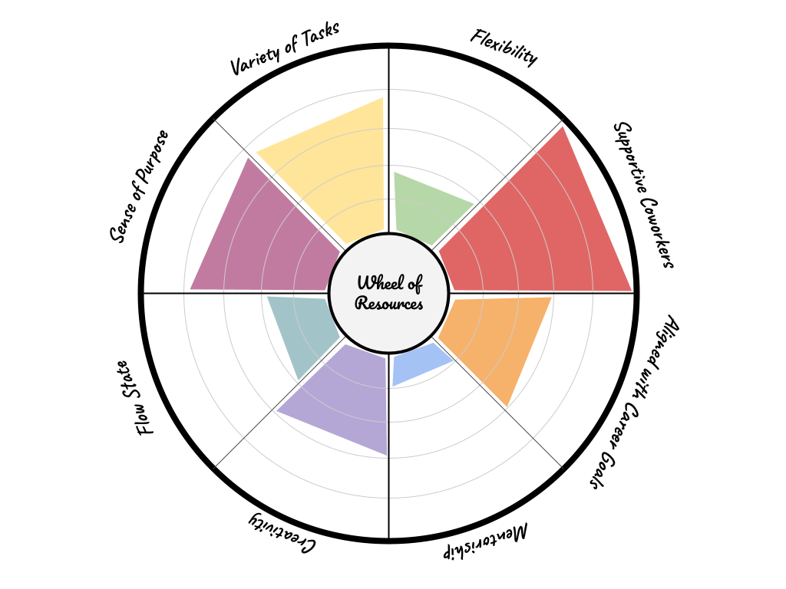
Wheel of Resources
Choose at least 4 ideas informed by your heart map that are important to you in your job.
Label slices on your wheel for each one.
Give each slice a score from 0-5 and color that section up to the line based on the score you gave that area.
Notes:
30 min
For example, if Family was the biggest thing on your heart map, what does that look like in terms of what you need from your job in order to feel like you are prioritizing what’s important to you. For me that might look like… predictable work hours, not having to take work home, flexibility when I need to take time off. Choose what of these items would be considered a need for you and label a slice of your wheel to represent that idea.
If creativity or creative time is something that fills you up, then you can label a slice for that on your wheel.
Chill beats while we work https://www.youtube.com/watch?v=5qap5aO4i9A
The reasoning behind this activity is to make the connections between personal motivators, job design, and resources in our work. The premise for this is based on the job-demands/resources model (an activity that goes more in-depth on this model can be found in “Directing Energy: Goals, Supports, and Structures”). There are organizational and personal resources that can be provided and/or supported by an organization's overall climate and culture.

Slide 8
Take a Break
Notes:
15 min
Fill your coffee, we’re going deep when we get back
Link to K20 Timer:https://timer.k20center.ou.edu/15m

Slide 9
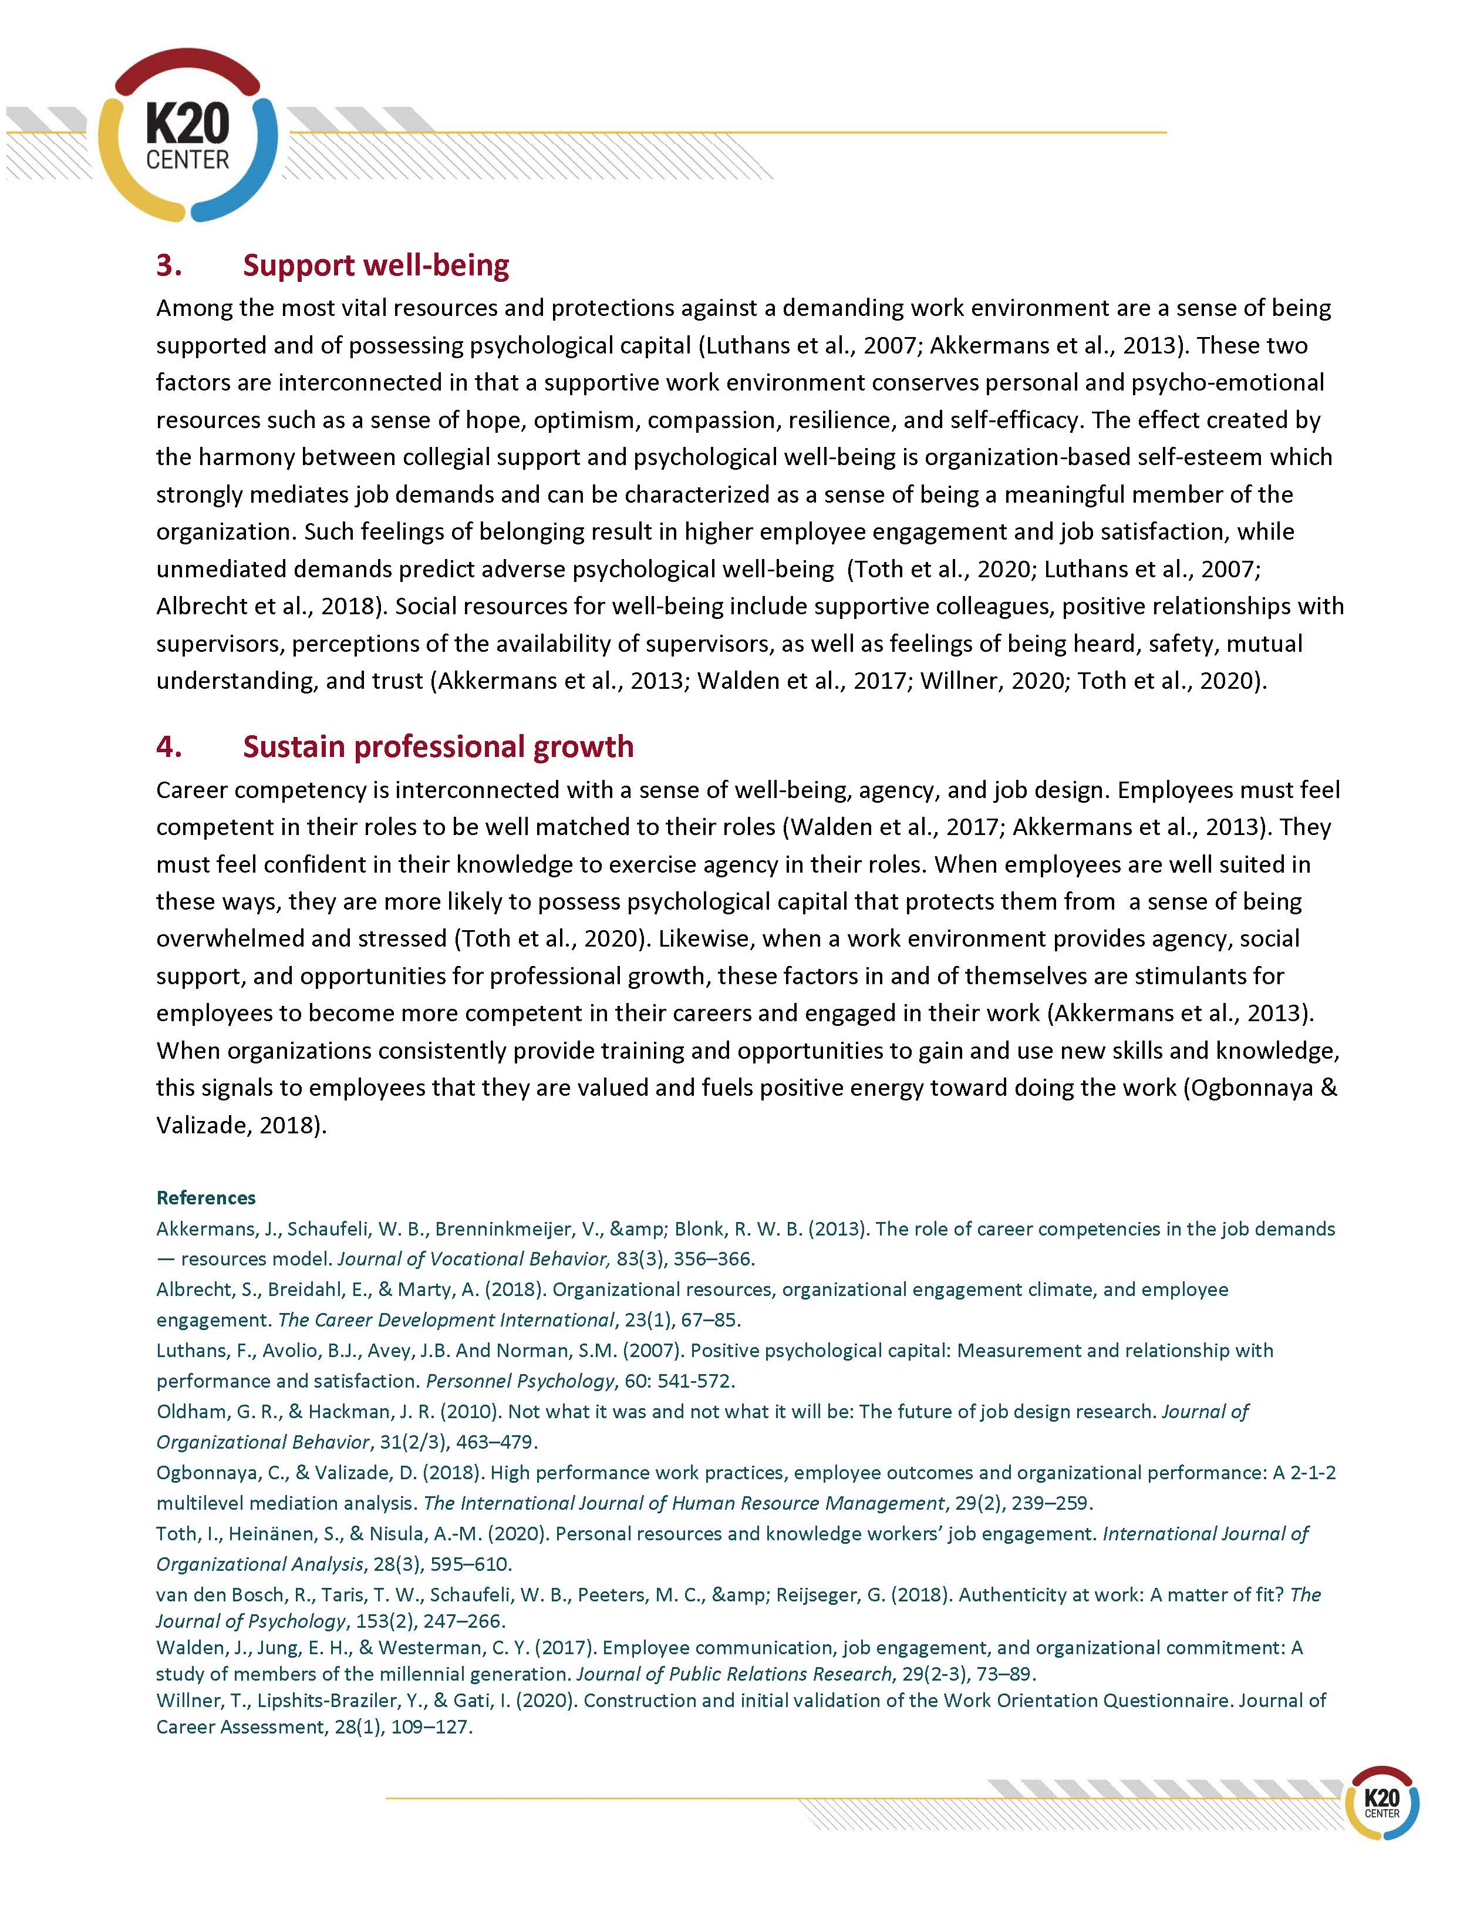
Generating Energy
Take a few moments to read the research brief.
Notes:
10 min
Hand out the research brief title Generating Energy: Professional Growth, Agency, and Job Satisfaction. Have participants spend about 10 minutes reading through the brief on their own.

Slide 10
Revisit and Label
Job Design
1) Label each slice from your wheel of resources according to the four areas in the research brief.
2) Do you have something in each category?
2.Agency
Notes:
10 min
No wrong answer, some of you may label the same resource into a different category.
Ask participants to look back at their Wheel of Resources and take note of how their labels might align what the research says. Do they have a slice to fit each category of the research?
Job Design
Agency
Well-being
Professional Growth
Have them label each slice of their wheel according to these categories. It’s okay if a slice can fit into more than one. Likewise, it’s okay if your elbow partner labels a slice with the same name as yours into a different category. For example, one person might feel that creativity fits into agency (because they feel they have agency when they can express creatively in their work), someone else may say job design (because they feel that it’s the design of their role that permits them to be creative) and another might even say it fits into well-being (especially if they feel emotionally depleted if they don’t have time or agency to be creative at work). These are all acceptable reasons and depend on individual processing of how their job provides them personal resources.
The goal for this activity is to provide personal connections that help us understand how the research constructs apply to us as individuals.

Slide 11
Look at the Data
PLACE A SCREENSHOT
OF THE INFOGRAM
FOR YOUR SCHOOL’S DATA
IN THIS AREA HERE
[PASTE TINY URL HERE]
PLACE
QR CODE
TO INFOGRAM HERE
Notes:
3 minutes
If you don’t have these links, you will need to request access to them prior to facilitating this session. Take a screenshot of the infographic page to paste into this slide. You will also want to create a QR code and short url to put on this slide for easy access.
Provide time for each participant to bring up the infographic data for your school. Also, begin to hand out a set of the chain notes handout for each table. In this case, the ideal group size will be 5 participants. Each participant’s page will have a different sub-construct heading at the top of the page along with the survey questions that align to that construct.

Slide 12
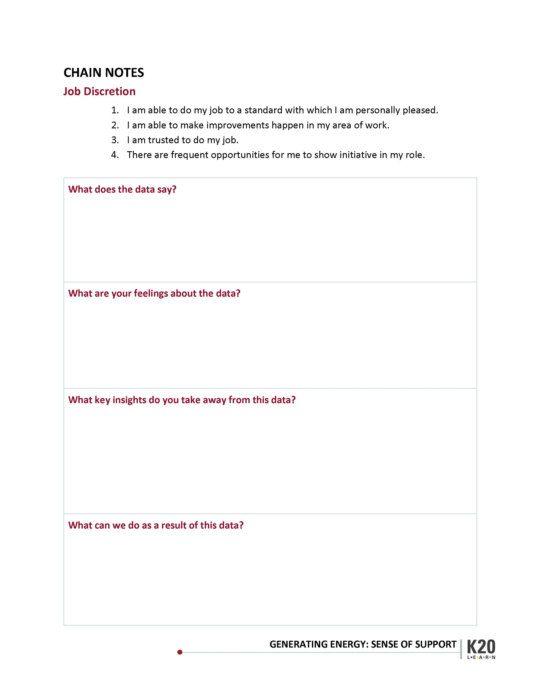
Chain notes
Write your answer to the first question on the page.
“What does the data say?”
Notes:
5 min
Be sure to state clearly that each participant will have about five minutes to fill in ONLY the FIRST BOX on their handout. After time is up, progress to slide 12, they will pass their sheet to the right. Then begin a timer for each participant to fill in the SECOND BOX ONLY. This rotation will happen four times (through slide 14) until all of the boxes are filled in on each page at their table.

Slide 13
Chain notes
Pass to the right. Write your answer to the second question on the page.
“What are your feelings about the data?”
Notes:
5 minutes

Slide 14
Chain notes
Pass to the right. Write your answer to the third question.
“What key insights do you take away from this data?”
Notes:
5 minutes

Slide 15
Chain notes
Pass to the right. Write your answer to the fourth question.
“What can we do as a result of this data?”
Notes:
5 minutes

Slide 16
Share out
The last person holding each page reads to the whole table.
As a table, summarize takeaways to share to the whole group
Notes:
10 mins
Once the rotations are done, have each person in the group read a summary of their page to the whole table. After all have shared at their table, the whole group should come up with a summary of takeaways to share with the whole group.

Slide 17
Rose, Bud, & Thorn
A Rose: Something that’s already blooming (well-supported in our culture/climate)
A thorn: Something you would like to see change
Bud: Something you need to support your future growth
INSERT
QR CODE
HERE
[paste short url link]
Notes:
10mins
Ask Each participant to make a post in each of the three columns.
Your input in these sessions is influencing our leaders. Every one of your analysis products goes to a leadership meeting and is processed and ideas come out of that group.
Before facilitating this session, make a copy of this padlet: https://k20center.padlet.org/shaynapond/remake-of-rose-bud-and-thorn-4x8tbbse0dbewwyz
Place the QR code and a short link on this slide.

