Slide 2
Paying for College 101
A Parent's Guide to Scholarships

Slide 3
Essential Questions
What are ways that will help pay for Postsecondary Education?
How do I access/find them?

Slide 4
Lesson Objectives
Participants will understand the benefits of scholarships.
Participants will identify potential scholarships for their student.
Participants will list scholarships that could be beneficial to their student.
Participants will review the requirements for the FAFSA.

Slide 5
Real or Fake?
Twins Days Festival Twins Scholarship
This scholarship is given to twins who will be attending an accredited university. The twins must have attended three out of the last five Twin Days Festival.
REAL
Notes:
Scholarships.com. (n.d.). Twins days festival twins scholarship. Scholarships for high school and college students 2023. https://www.scholarships.com/financial-aid/college-scholarships/scholarships-by-type/unusual-scholarships/twins-days-festival-twins-scholarship/

Slide 6
Real or Fake?
Paranormal Investigation Grant:
This grant is given to students interested in paranormal phenomena and conducting research or investigations into haunted location, supernatural occurrences, and unexplained mysteries.
FAKE

Slide 7
Real or Fake?
Emoji Interpretation Scholarship:
This scholarship is awarded to students who have demonstrated exceptional skills in deciphering the meaning and cultural significance of emojis in contemporary communication.
FAKE

Slide 8
Real or Fake?
Chick and Sophie Major Memorial Duck Calling Contest:
This contest awards the top four high school seniors who win the Duck Calling Competition. The award is meant to go toward a college or university.
REAL
Notes:
World duck calling scholarship contest. Wings over the Prairie Festival. (n.d.). https://www.stuttgartduckfest.com/scholarship-contest

Slide 9
Real or Fake?
Retro Gaming Preservation Grant:
This grant supports students passionate about preserving and documenting the history of retro video games, including their cultural impact and technological advancements.
FAKE

Slide 10
Real or Fake?
Vegetarian Resource Group College Scholarship:
This scholarship is awarded to high school students who promote vegetarianism in their high school and community. Applicants will be judged on having shown compassion, courage, and a strong commitment to promoting a peaceful world through a vegetarian lifestyle.
REAL
Notes:
Scholarships.com. (n.d.-b). Vegetarian Resource Group College scholarship. Scholarships for high school and college students 2023. https://www.scholarships.com/financial-aid/college-scholarships/scholarships-by-type/unusual-scholarships/vegetarian-resource-group-college-scholarship/

Slide 11
Parking Lot
Throughout the presentation if you have any questions, please feel free to add them to our Parking Lot.
Notes:
Add link or QR code to slide for a digital Parking Lot.
K20 Center. (n.d.). Parking lot. Strategies. Retrieved from https://learn.k20center.ou.edu/strategy/131

Slide 12
PSE Pathways
PSE stands for postsecondary education. This just means education after high school.
College
Two year community college or junior college
Four year college or university
Career Technology centers
Job Corps
Apprenticeship Programs
Military
Notes:
Students don’t have to choose just one pathway. These pathways can be combined to help students obtain the career they want.

Slide 13
Paying for PSE Pathways
Most PSE pathways cost money. There are many financial aid options to help manage these costs.
Scholarships
Work-studys
Loans
Notes:
May want to explain tuition/fee waiver and direct payments to the student

Slide 14
Grants = Free Money
Pell Grant
Apply by filling out the Free Application for Federal Student Aid (FAFSA)
The current maximum award is $______ per school year.
Oklahoma Tuition Aid Grant (OTAG)
Apply by filling out the FAFSA or an alternative application for undocumented students.
Funds are limited so apply as soon as the FAFSA application opens. Awards vary from $________ per school year.
Notes:
Use the sites below to help determine the maximum award for the current year.
Pell - https://studentaid.gov/understand-aid/types/grants/pell
OTAG - https://www.okhighered.org/admin-fac/finaidresources/otag.shtml

Slide 15
Scholarships = Free Money!
Scholarships can be in the form of a tuition waiver, fee waiver, or money paid directly to the PSE program or student.
Academic: based on grades and test scores
Financial need: based on family income
Leadership: based on extracurricular activities and community involvement
Athletic or activity related: based on participation in sports, performing arts, or other activities
Scholarships can also come from cultural or religious organizations, essay contests, businesses, banks, etc.
Notes:
You may want to explain tuition/fee waiver and direct payments to the student

Slide 16
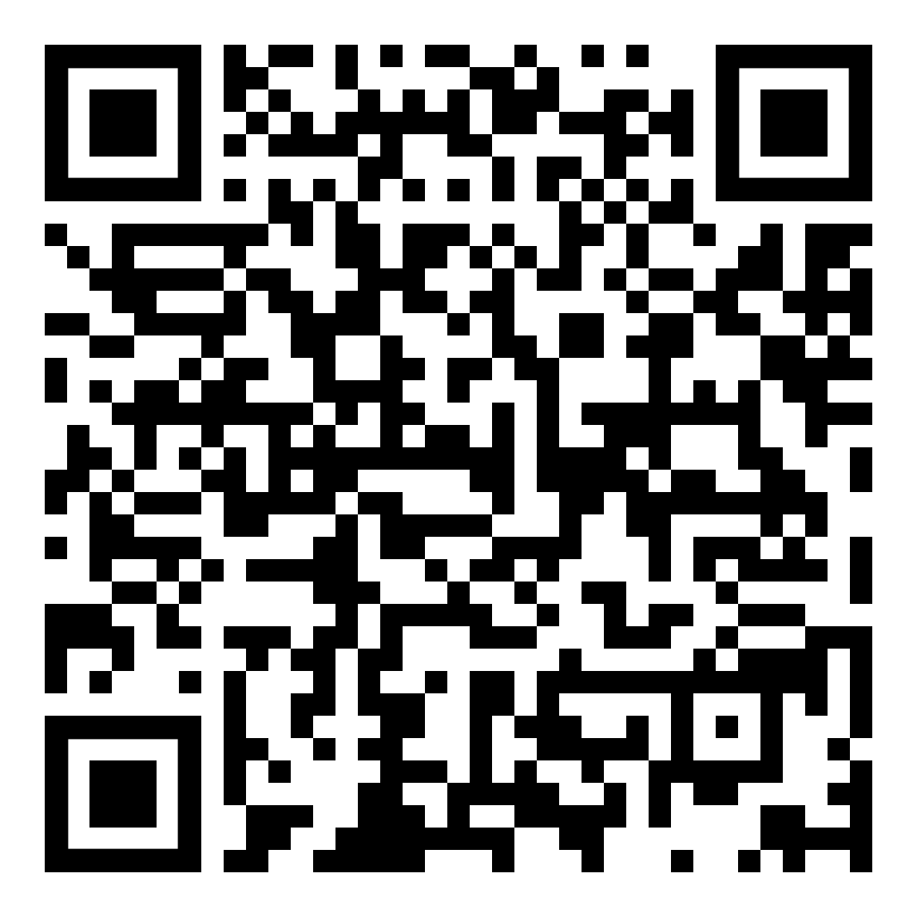
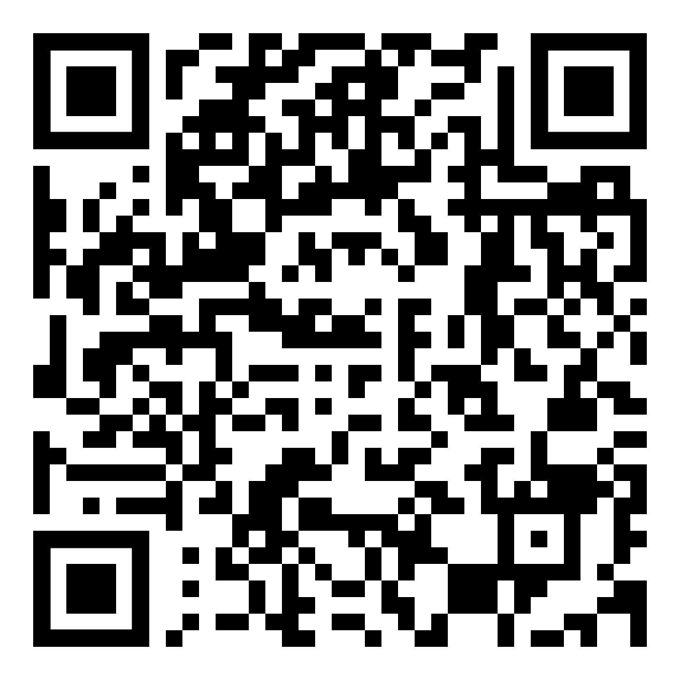
Digital Resources
Brag Sheet - English | Scholarship Tracking Sheet - English
Brag Sheet - Spanish | Scholarship Tracking Sheet - Spanish

Slide 17
I Notice, I Wonder
As you walk around the room use your phone to scan the QR codes on each poster.
Take a moment to look over the information about that specific scholarship website.
On the poster write something you noticed on the website that you thought was interesting and a question you are wondering about that scholarship.
Then, move to a new poster.
Notes:
YouTube. (2021, September 21). K20 Center 15 minute timer. YouTube. https://www.youtube.com/watch?v=m3zT2IxZQaw
K20 Center. (n.d.). I notice, I wonder. strategies. Retrieved from https://learn.k20center.ou.edu/strategy/180

Slide 18
I Notice, I Wonder
As you walk around the room look over the handout for each scholarship.
Take a moment to look over the information about that specific scholarship.
On the poster write something you noticed on the handout that you thought was interesting and a question you are wondering about that scholarship.
Then move to a new poster.
Notes:
YouTube. (2021, September 21). K20 Center 15 minute timer. YouTube. https://www.youtube.com/watch?v=m3zT2IxZQaw
K20 Center. (n.d.). I notice, I wonder. strategies. Retrieved from https://learn.k20center.ou.edu/strategy/180

Slide 19
PSE Pathway
https://oklahoma.gov/careertech.html
Notes:
https://oklahoma.gov/careertech/about.html
Does not cover fees, books, housing, or meals.
Students must begin their first CareerTech program before their 24th birthday.
Students who are undocumented can receive the Next Step scholarship, but it’s important for them to check with an academic advisor to make sure they are eligible for certification within specific program fields.
CareerTech. (n.d.). https://oklahoma.gov/careertech.html

Slide 20
PSE Pathway
https://www.jobcorps.gov/
Notes:
https://www.jobcorps.gov/
Students can learn and earn money at the same time. Job Corps programs provide housing, meals, medical care, and a living allowance for students while they train for a career.
Students aged 16-24 are eligible to attend Job Corps.
Training programs are available in welding, computer technology, health care, carpentry, and many other career fields.
Oklahoma has 3 Job Corps locations: Guthrie, Tahlequah, and Tulsa. There are also Job Corps all over the country.
Students can go to jobcorps.gov to learn more information and apply.
Job Corps: Careers Begin here. Job Corps | Careers Begin Here. (n.d.). https://www.jobcorps.gov/

Slide 21
PSE Pathway
https://www.apprenticeship.gov/
Notes:
https://www.apprenticeship.gov/
Students can earn while they learn. Apprenticeships provide paid on-the-job training along with some classroom instruction.
Registered apprenticeships are available in a wide variety of industries from employers who partner with the government to provide paid training, usually for students aged 16–24.
Registered apprenticeships are available in construction, plumbing, pharmacy technology, truck driving, and many other career fields.
Students can go to apprenticeship.gov to search for registered apprenticeships.
Apprenticeship, O. of. (2023, May 12). Apprenticeship.gov. https://www.apprenticeship.gov/

Slide 22
PSE Pathway
Notes:
https://www.defense.gov/About/our-forces/
Students who serve in the Army, Navy, Air Force, Coast Guard, Marine Corps, or Space Force can receive tuition assistance to help them pay for college.
Many colleges have ROTC programs with scholarships available to students who plan to serve in the military after they graduate.
Students may choose to join the reserves to serve on a part-time basis while going to college.
Students may be eligible to receive financial benefits for college based on their parents’ military service.
Students can be deployed while still in college.
Our forces. U.S. Department of Defense. (n.d.). https://www.defense.gov/About/our-forces/

Slide 23
PSE Scholarship
https://www.okhighered.org/okpromise/
Notes:
https://www.okhighered.org/okpromise/
This scholarship provides a full tuition waiver at public colleges and many CareerTech centers in Oklahoma. It provides partial tuition at private colleges and some career training programs. It does not cover fees, books, housing, or meals.
Students must apply while in 8th–11th grade.
Students must have a 2.5 GPA overall AND in the courses required for OK Promise when they graduate high school.
Annual income guidelines apply:
$60,000 OR LESS with 1 or 2 dependent children.
$70,000 OR LESS with 3 or 4 dependent children.
$80,000 OR LESS with 5 or more dependent children.
What is Oklahoma’s promise? Oklahoma’s Promise. (n.d.). https://www.okhighered.org/okpromise/

Slide 24
PSE Scholarship
https://www.smartscholarship.org/smart
Notes:
https://www.smartscholarship.org/smart
Scholarship-for Service is a combined educational and workforce development opportunity for STEM students that pays full tuition and education related expenses.
The purpose of the scholarship is to allow students to focus on complex research to further the Department of Defense's mission and create a lasting impact.
For every year of degree funding the student commits to working for a year with the DoD as a civilian employee.
Full tuition and education related expenses (meal plans, housing, and parking not included)
Stipend paid depends on degree level
There is a required summer research internships ranging from 8 to 12 weeks
Health insurance allowance provided.
Employment placement at a Department of Defense facility upon completion of their degree.
Smart scholarship-for-service program. DoD STEM Scholarships & Grants - SMART Scholarship. (n.d.-a). https://www.smartscholarship.org/smart

Slide 25
Local Scholarship
Add information
Notes:
Add information about local scholarships and unhide the slide for the presentation.

Slide 26
Local Scholarship
Add information
Notes:
Add information about local scholarships and unhide the slide for the presentation.

Slide 27
Local Scholarship
Add information
Notes:
Add information about local scholarships and unhide the slide for the presentation.

Slide 28
Scholarship Tips
Look for scholarship pages specific to colleges/degree programs
Start early, apply for scholarships throughout high school
Be mindful of requirements and deadlines, apply early
Store scholarship documents in cloud storage (Google Drive, Dropbox, etc)
Notes:
Each PSE program a student is interested in will likely have a scholarship page on its website that lists scholarships available specifically for that college/program.
Start early as the student can apply for many scholarships throughout high school, not just in their senior year. There is no limit to how many they can apply for, so just apply.
Pay attention to requirements and deadlines. Apply to PSE programs early to meet their early scholarship deadlines.
Store all of your student’s scholarship-related documents in a cloud-based storage platform, like Google Drive or Dropbox.

Slide 29
Scholarship Tips
Get a professional-sounding email for college communication
Adapt one essay for multiple scholarships
Track awards and community service hours
Create a student resume
Notes:
Make sure the student has a personal, professional-sounding email account to use for communicating with colleges. Their school email and Google Drive will not work after they graduate.
One essay can be used or tweaked to apply for multiple scholarships, but carefully read the instructions for each scholarship to make sure the requirements are being met.
Keep a record of awards and community service hours for the scholarship applications. Develop a resume that provides a brief summary of the students activities and accomplishments.

Slide 30
Scholarship Tips
Seek recommendations from teachers, counselors, supervisors, or leaders
Share student resume with them
Instruct them on submission method
Notes:
Many scholarships require a letter of recommendation from teachers, counselors, principals, or coaches. The student might also ask a supervisor from a job or a leader from a community organization or a place of worship.
Provide recommenders with the student’s resume of activities and accomplishments. Teachers and counselors work with a lot of students, so this will help them remember the details about the student.
Make sure to let them know how to submit the letter of recommendation. Sometimes these have to be completed online or mailed.

Slide 31
Scholarship Tips
Most colleges offer President’s Leadership scholarships based on involvement
Dress professionally for scholarship interviews
Assist student with interview practice
Notes:
Most colleges offer a President’s Leadership scholarship that is based on the student’s involvement in their high school and community. These scholarships usually require interviews.
If the student has a scholarship interview, make sure they dress professionally. If they need help with clothing for interviews, ask a counselor at the school.
Help the student practice for scholarship interviews.

Slide 32
Scholarship Databases
Watch out for scams! Check out the following trusted sites for scholarship opportunities:
occf.org/scholarships
Scholarships for students in Oklahoma
ucango2.org/scholarships.html
okcollegestart.org
fastweb.com
k20.ou.edu/scholarships
https://www.scholarships.com/
Notes:
Remind the participants that they should not have to pay to apply for a scholarship. If a participant has a question about a scholarship they should reach out to a counselor or their child’s school.

Slide 33
Other Forms of Financial Aid
Work-study: money you earn
Work part-time on campus.
Your student earnings go toward any outstanding tuition, fees, or room and board.

Slide 34
Other Forms of Financial Aid
Loans: Money you pay back with interest
Federal student loans: Apply by filling out the FAFSA. No credit check is needed.
Private loans: Appy through banks. Credit checks are used to qualify. Fewer than 10% of students need private loans, so this is a last resort.

Slide 35
Additional Tips for Managing PSE Costs
Two-year colleges cost less than four-year colleges. Students can transfer to a four-year college to complete a bachelor’s degree.
Most PSE programs offer monthly payment plans.
Students who live on a college campus can apply to be Resident Advisors (RAs) after their first year. Many colleges pay for RA’s housing and meal plans.

Slide 36
Additional Tips for Managing PSE Costs
Renting or buying used textbooks is usually cheaper than buying new ones.
College libraries often offer textbooks for borrowing.
Many PSE programs provide food pantries, clothing closets, and other resources.

Slide 37
Find a Scholarship or Two
Take some time to look over the Scholarship handout or visit the Wakelet at http://k20.ou.edu/paying4college.
Find 1-2 scholarships that could apply to your student.
At the bottom of the Note Catcher write down the scholarships that you found.
Notes:
K20 Center. (n.d.). Wakelet. Tech tools. https://learn.k20center.ou.edu/tech-tool/2180
YouTube. (2021a, September 21). K20 Center 5 minute timer. YouTube. https://www.youtube.com/watch?v=EVS_yYQoLJg

Slide 38
What is the FAFSA?
FAFSA stands for Free Application for Federal Student Aid. This is NOT financial aid itself.
FAFSA needs to be completed in order to apply for federal student aid (federal grants, work-study funds, and loans)
FAFSA is free and gives you access to the largest source of aid to help pay for college or career school.
FAFSA also helps determine your eligibility for state and school aid. Even some private aid providers will use your FAFSA information.

Slide 39
What information is needed for the FAFSA?
Social Security number (student and parent(s)) | Tax Returns | Driver’s License Number
Alien Registration number (if not a U.S. citizen) | W-2s | A list of all schools your student is interested in attending
Assets: How much money is in your checking and savings accounts, stocks, and bonds | FSA ID (for parent(s) and student)
Notes:
Inform participants that FAFSA can access their federal tax information using the IRS Data Retrieval Tool.

Slide 40
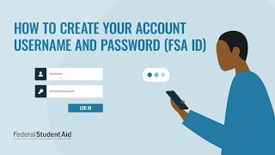
Notes:
YouTube. (2022a, July 15). How to create an account and username (FSA ID) for studentaid.gov. YouTube. https://www.youtube.com/watch?v=iTb7hMVtzco&t=2s

Slide 41
FSA ID
FSA ID is the username and password that allows parents and students to identify themselves electronically to access U.S. Department of Education systems, including the FAFSA. Each student and parent will create their own FSA ID.
Create an FSA ID tonight before you leave!
It only takes a few minutes!
You will need your social security number.
Could take up to 3 days to receive your
information.

Slide 42
What? So What? Now What?
On your Paying for College 101: Part One Note Catcher answer the three questions below:
What did you learn?
So what are some scholarships your student might apply for?
Now what are your next steps?
Notes:
K20 Center. (n.d.). What? So what? Now what?. Strategies. Retrieved from https://learn.k20center.ou.edu/strategy/b30762a7557ba0b391f207f4c6002113

Slide 43
Paying for College: Part Two
Date:
Time:
Place:
Notes:
Add time and date for

