Slide 2
Educating with Indigenous Perspectives:
Integrating Native Culture into the Curriculum

Slide 3
How Am I Feeling? What Am I Thinking?
Reflect on a time you felt represented
in something you read, watched,
or learned about.
How did it make you feel?
What did you learn from that experience?
Notes:
K20 Center. (n.d.). How am I feeling? What am I thinking?. Strategies. https://learn.k20center.ou.edu/strategy/187
Ask participants to first reflect individually, then share at their table group, highlighting the positive impact it had on their sense of identity and belonging. Then have one representative from each table give a summary of the benefits of diverse representation.

Slide 4
Essential Question
What are the benefits of acknowledging students’ cultural frameworks in classroom learning?

Slide 5
Objectives
Recognize the benefits of acknowledging students' cultural backgrounds.
Explore lessons that are culturally inclusive.
Create a personal action plan to include students' cultural backgrounds in your classroom.

Slide 6
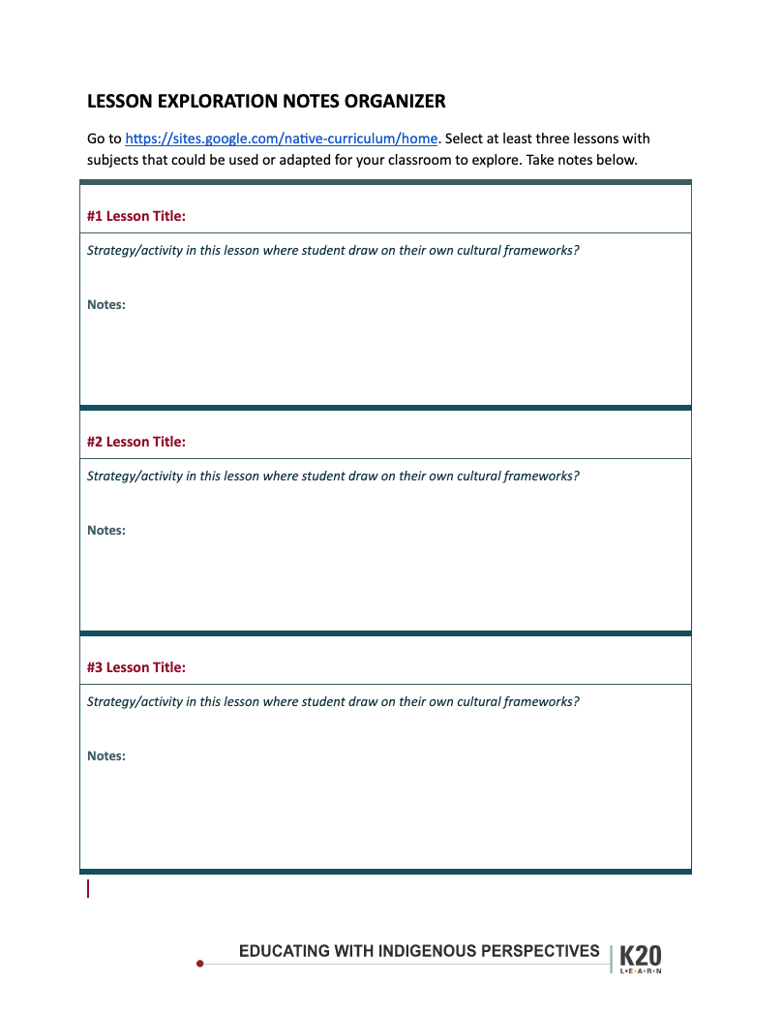
Explore Lessons
Go to http://k20.ou.edu/native-lessons
Select at least three lessons with subjects that could be used or adapted for your classroom to explore.
Take notes on the provided organizer.
Notes:
Emphasize: What Strategy/activity(ies) used in this lesson where student draw on their own cultural frameworks?
Share one strategy they found at their table.

Slide 7
CUS and Discuss
As you read the brief:
Circle concepts and words that are new to you.
Underline details that support the main ideas.
Star main ideas.
Notes:
K20 Center. (n.d.). CUS and discuss. Strategies. https://learn.k20center.ou.edu/strategy/162

Slide 8
Discuss: True for Who?
“
Integrating students’ cultural frameworks into the design of learning experiences leverages a deep well of prior knowledge, motivation, and relevance.
What is at stake in this claim for students of the dominant culture?
What is at stake for students of indigenous or minoritized cultures?
What is at stake for teachers of both these students?
“
Notes:
This quote represents one of the main ideas from the reading. Discuss at your table ideas you marked that support this idea and talk about the reflection questions on the slide.

Slide 9
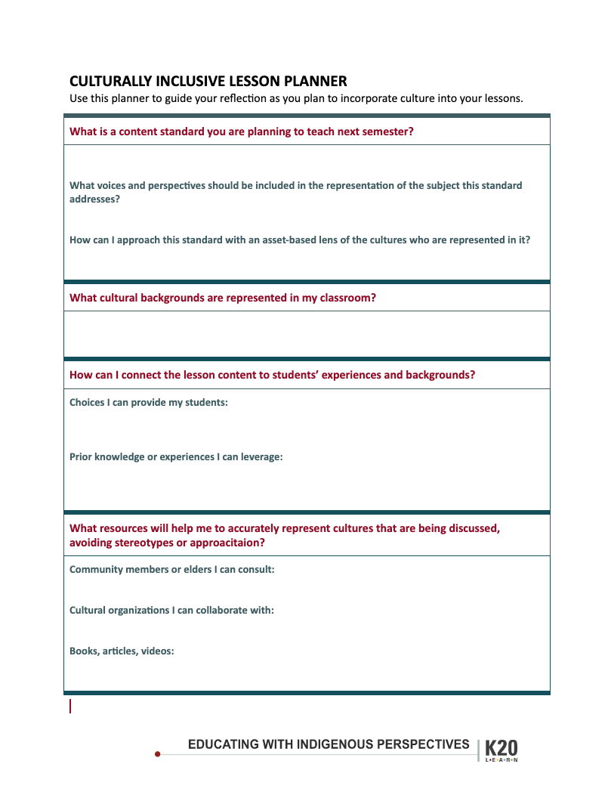
Plan a Lesson
Reflect on a content standard that you will teach in the near future.
Use the questions on the lesson planning guide to help you consider how to make your lesson culturally inclusive.

Slide 10
Chalk Talk/Two Stars and a Wish
Pass your lesson guide to the right.
Read your neighbor’s guide.
Stars: Draw a star by two things you think are important ideas.
Wish: Write one note in the margins as an additional idea for them to consider in their plan.
Pass to the right and provide feedback again 2x.
Pass left three time to return guides to original authors.
Notes:
K20 Center. (n.d.) Chalk talk. Strategies. https://learn.k20center.ou.edu/strategy/197
K20 Center. (n.d.). Two stars and a wish. Strategies. https://learn.k20center.ou.edu/strategy/83

