Slide 2
Ring That Bell!!!
Supporting Literacy with Bell Ringers

Slide 3
INSTRUCTIONAL
STRATEGIES

Slide 4
Essential Questions
How can literacy be used to engage students?
In what ways can bell ringers support authentic learning?

Slide 5
Objectives
Explore Bell Ringers as a way to engage students at the beginning of class.
Identify levels of scaffolding to support higher levels of literacy.
Apply instructional strategies that encourage authentic learning.

Slide 6
CHAIN NOTES
Bell ringers are . . .

Slide 7
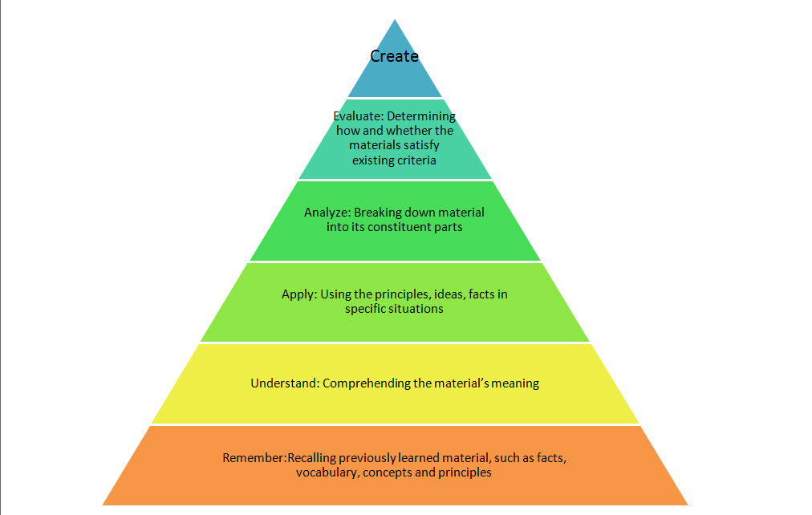
Notes:
Image from Morgan, P. J. (2012, February 26). Games as instructional technology II: Bloom’s Taxonomy [Web log]. Thoughts on Libraries and Library Related Stuff. https://pamelajmorgan.org/2012/02/26/games-as-instructional-technology-ii-blooms-taxonomy/

Slide 8
Thinking Notes
“Myanmar Sidecars”
Main Idea – Central to the author’s purpose
I Love This Part! – Great writing or idea
Raises a Question – Possible discussion point for
class
Unclear or Confusing – I need to ask about this in
class
!
?
??
DAY 1

Slide 9
COMMIT & TOSS
???????????????????????????????
Share your questions from Thinking Notes.
Choose one and write it on your paper.
DAY 2

Slide 10
C.E.R. (Claim, Evidence, Reasoning)
CLAIM
DAY 3
EVIDENCE
REASONING

Slide 11
I THINK WE THINK
Which component of the evidence was the most significant/influential?
Write a statement supporting your decision.
DAY 4

Slide 12
CREATE!
GENRES:
Narrative: Write a brief narrative about someone you know who has been brave enough to defy something they felt was wrong.
Persuasive: Do you agree with the stance of the writer? Defend their stance or argue against it.
Expository: Explain which search terms you would use to conduct more research to understand some of the topics in their article better? Explain what you would hope to learn and why you want to learn about that topic.
DAY 5

Slide 13
INSTRUCTIONAL
STRATEGIES

Slide 14
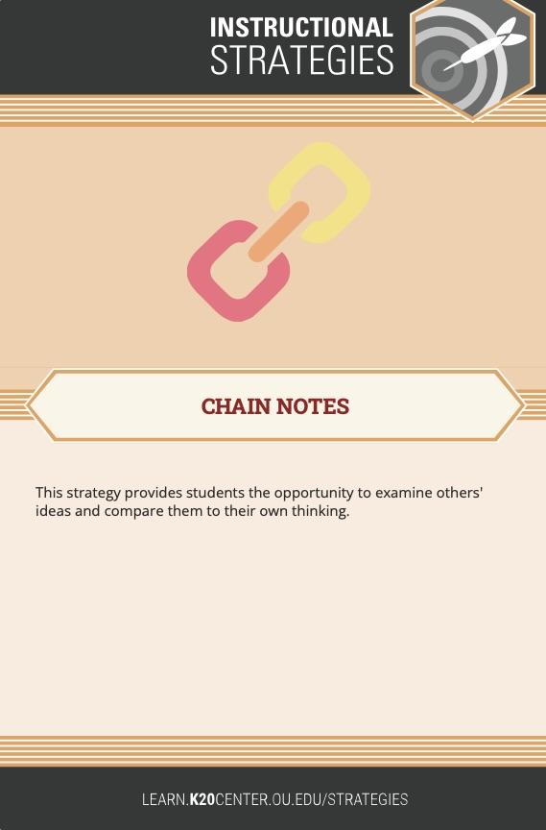
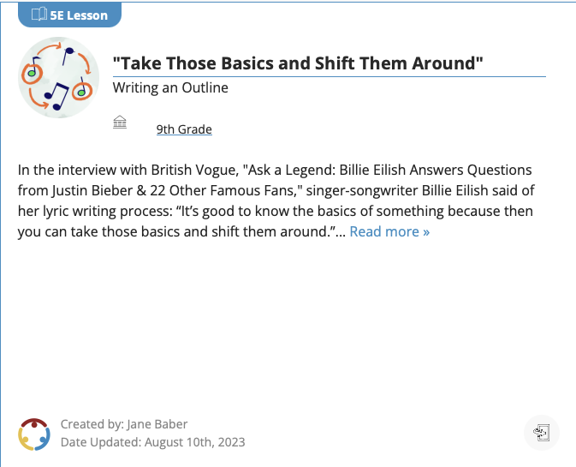
K20 RESOURCES
Lessons
Instructional
Strategies
https://learn.k20center.ou.edu

