Slide 2
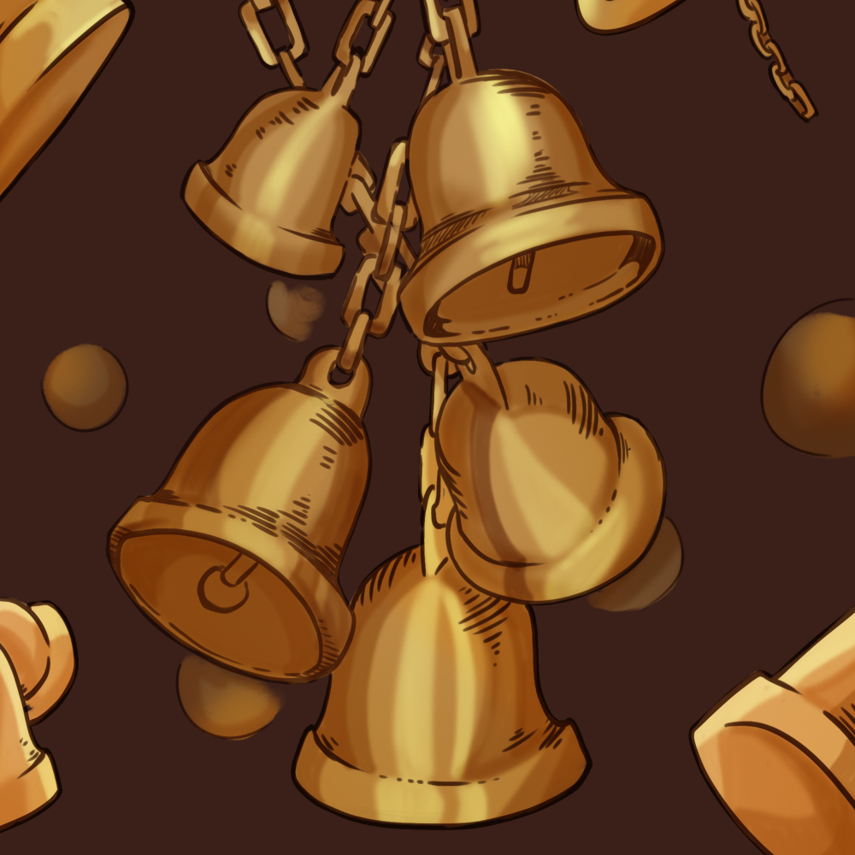
Ring that Bell!
Supporting Literacy with Bell Ringers

Slide 3


Chain Notes
In groups of four:
Take turns completing the following statement on your handout:
  A bell ringer is . . . .
Pass the paper to your right for the next person.
Do not repeat what has already been written.
Notes:
K20 Center. (2021a, September 21). K20 Center 1 minute timer [Video]. YouTube. https://www.youtube.com/watch?v=6ilD555O_RE

Slide 4
Essential Questions
How can literacy be used to engage students?
In what ways can Bell Ringers support authentic learning?

Slide 5
Session Objectives
Explore Bell Ringers as a way to engage students at the beginning of class.
Identify levels of scaffolding to support higher levels of literacy.
Apply instructional strategies that encourage authentic learning.

Slide 6

Day 1 - Thinking Notes
Read “The Sit-in Movement” article.
Main Idea – Central to the author’s purpose.
I Love This Part! - Great writing or idea.
Raises a Question - Possible discussion for class.
Unclear or Confusing - I need to ask about this in class.
!
?
??
Notes:
K20 Center. (n.d.). Thinking Notes. Strategies. https://learn.k20center.ou.edu/strategy/178

Slide 7

Day 2 - Commit and Toss
Use your Thinking Notes from the previous activity.
Write one question you have on the colored paper in front of you.
Crumple your paper when you have finished writing and wait for the signal to throw it.
Find a paper that is not the color you threw and read the question.
Find a partner and discuss the question with your partner and be ready to share out your answers.
Notes:
K20 Center. (n.d.). Commit & toss. Strategies. https://learn.k20center.ou.edu/strategy/52

Slide 8

Day 3 - C.E.R. (Claim, Evidence, Reasoning)
With your partner, discuss the main claim of the article.
Record two points of evidence.
Write a sentence or two that connects the evidence to the claim with reasoning.
Notes:
K20 Center. (n.d.). Claim, evidence, reasoning (CER). Strategies. https://learn.k20center.ou.edu/strategy/156

Slide 9

Day 4 - I Think, We Think
Looking back at your C.E.R. from yesterday, think about the following question:
Which component of the evidence
was the most significant/influential?
Write a statement supporting your decision in the I Think column.
Notes:
K20 Center. (n.d.). I think/we think. Strategies. https://learn.k20center.ou.edu/strategy/141

Slide 10
Day 4 (cont’d) - I Think, We Think
Create a group of three or four.
Share your I Think statement with your group.
Work as a group to synthesize your answers and record it under the We Think column.
Notes:
K20 Center. (n.d.). I think/we think. Strategies. https://learn.k20center.ou.edu/strategy/141

Slide 11
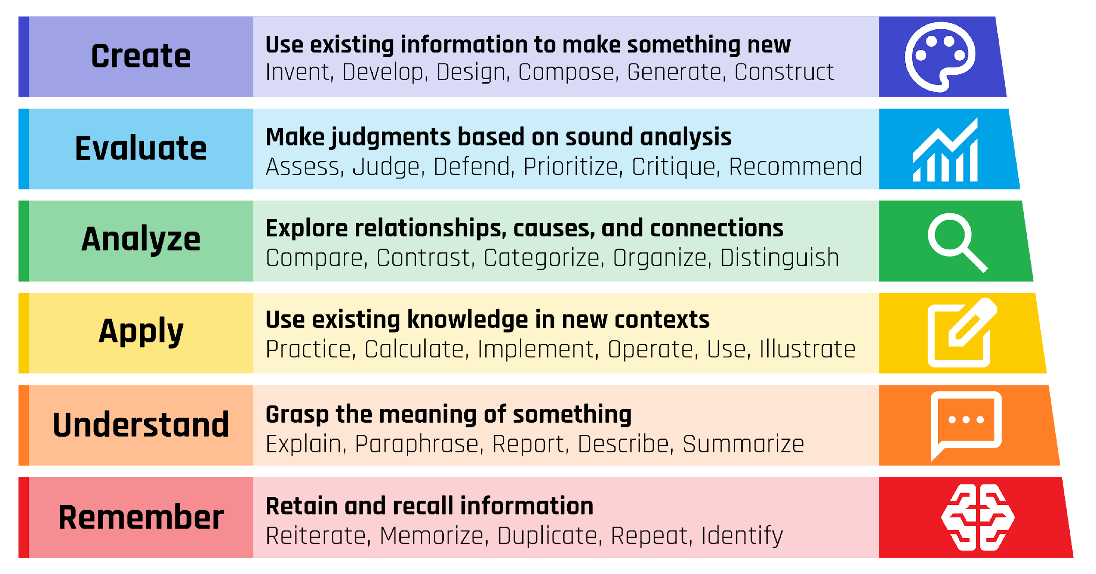
Bloom’s Taxonomy
Notes:
Share the following information with the participants
“Benjamin Bloom’s system for classifying types of learning, developed in the 1950s, remains a popular tool among educators for outlining and illustrating students’ learning objectives. It categorizes cognitive skills into three tiers: basic comprehension (“remember” and “understand”), practical application (“apply” and “analyze”), and higher-order thinking (“evaluate” and “create”). The classic pyramid model places foundational learning at the base and positions “create” at the apex—suggesting it’s both more advanced and less frequently incorporated into instruction. However, the Stearns Center argues that all levels are essential for learners in the 21st century; although recalling information is foundational, it’s insufficient preparation for professional success beyond academia.”
Stearns Center for Teaching and Learning. (n.d.). Bloom’s taxonomy. George Mason University. https://stearnscenter.gmu.edu/knowledge-center/course-and-curriculum-redesign/blooms-taxonomy/

Slide 12
Bloom’s Taxonomy and Bell Ringers
Think back to the Bell Ringers we completed earlier. Where would each of those Bell Ringers fit on this chart?

Slide 13
Day 5 - Create!
GENRES
Narrative: Write a brief narrative about someone you know who has been brave enough to defy something they felt was wrong.
Persuasive: Do you agree with the stance of the writer? Defend their stance or argue against it.
Expository: Explain which search terms you would use to conduct more research to understand some of the topics in the article better? Explain what you would hope to learn and why you want to learn about that topic.

Slide 14
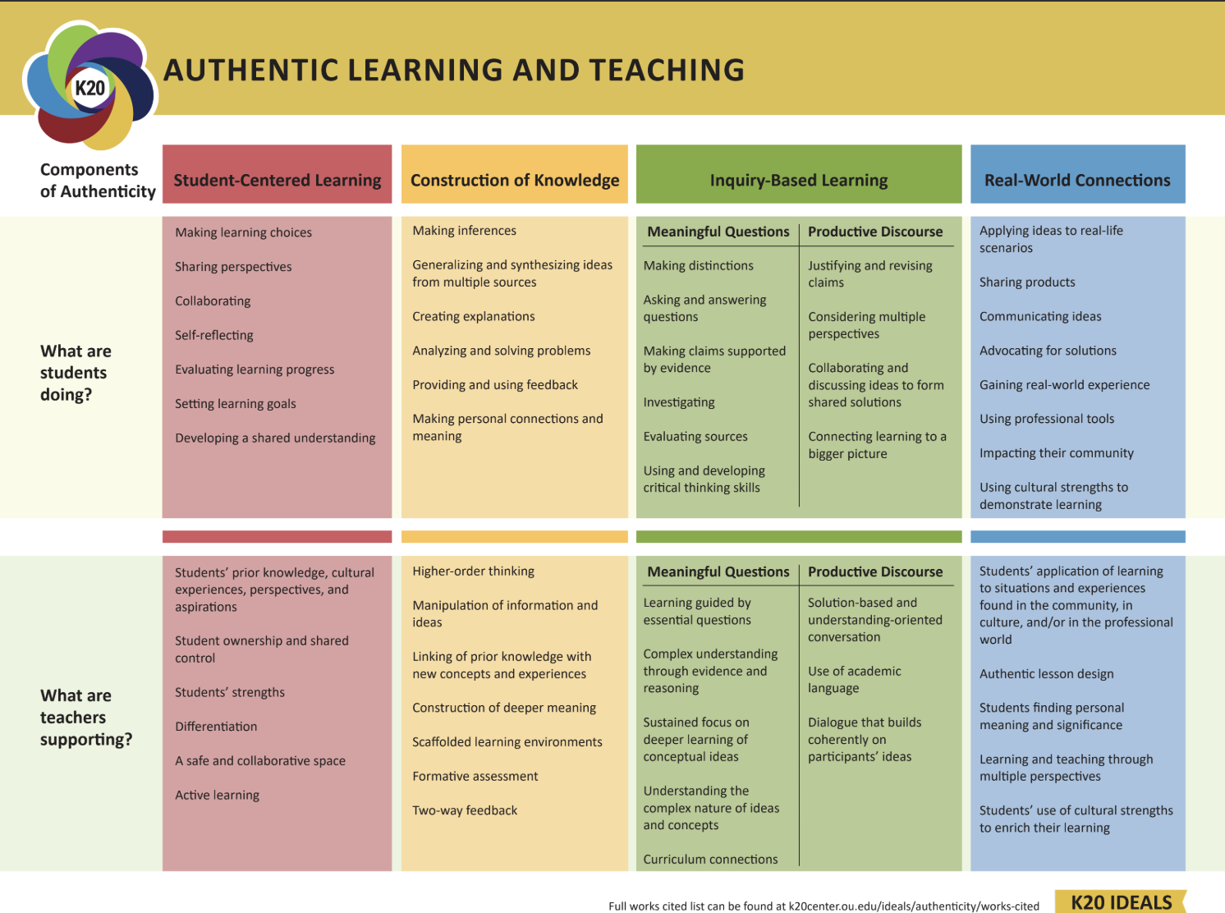

Slide 15


Instructional Strategy Note Sheet
Chain Notes
Thinking Notes
Commit and Toss
C.E.R. (Claim, Evidence, Reasoning)
I Think, We Think

Slide 16

LEARN Instructional Strategies
learn.k20center.ou.edu

