Slide 1
Authenticity: Transforming Your Teaching Approach With the Authentic Learning Framework

Slide 2
Meaningful Learning
Think of one of the most meaningful learning experiences you’ve had in your lifetime.
Share it with your table.
As a group, create a list of 3-5 common characteristics across your shared learning experiences.

Slide 3
Stand Up/Sit Down
Have a representative from each group stand up.
Read one item from their list.
Others mark this item off their own list if it’s too similar to something they already have.
Sit down if all of the characteristics you’ve listed have been stated.
Notes:
Write each word/characteristic on a large piece of chart paper, white, board or other place that is visible for the whole room which will serve as an Anchor Chart.
Explain that this will be revisited at a later time in this activity in order to construct a shared definition for authentic learning.

Slide 4
Session Objectives
Experience a shortened version of a model lesson featuring multiple components of the authentic learning framework.
Identify and explain how the activities in the lesson demonstrate each component of authenticity.
Be able to describe how the lesson supports authentic learning.
Notes:
Emphasize that we are moving shortly into a model lesson where they will experience a learning activity designed using the authentic learning framework as if they are the students.
They may put on a student hat as they participate, but also keep their teacher eye in the back of their mind to observe some of the strategies and take note of how this approach may be different from others they’ve experienced or tried out themselves.

Slide 5
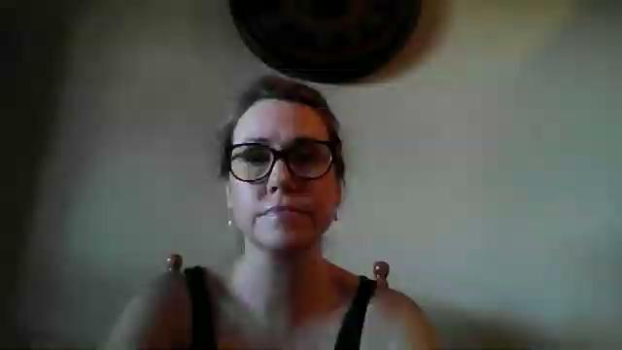
Testimonial
Notes:
This is a short video compilation of testimonials from other teachers who have attended our three day professional learning program ARA and how using the Authentic Learning Framework has affected them, their teaching, their classroom.

Slide 6
Testimonial
What did you hear about in this testimony that is on our common characteristics chart?
Notes:
Call on participants to share the common characteristics and the facilitators will put the stars on the chart.

Slide 7


Notes:
Remember that the topic of the lesson is not important here. We are modeling what an authentic lesson looks like and you are experiencing it as a student might. We would like to pay attention to the approach for teaching this topic.
Many of us have had a part in making this lesson and it’s a large part of all of our work to create many awesome learning experiences like these.

Slide 8

Essential Question
How do authors use similar tropes but come up with different variations of the same character?

Slide 9


Learning Objectives
Analyze the extent to which historical, cultural, and/or global perspectives affect an author's stylistic choices.
Evaluate how authors writing on the same issue reached different conclusions because of differences in assumptions, evidence, reasoning, and viewpoints.

Slide 10

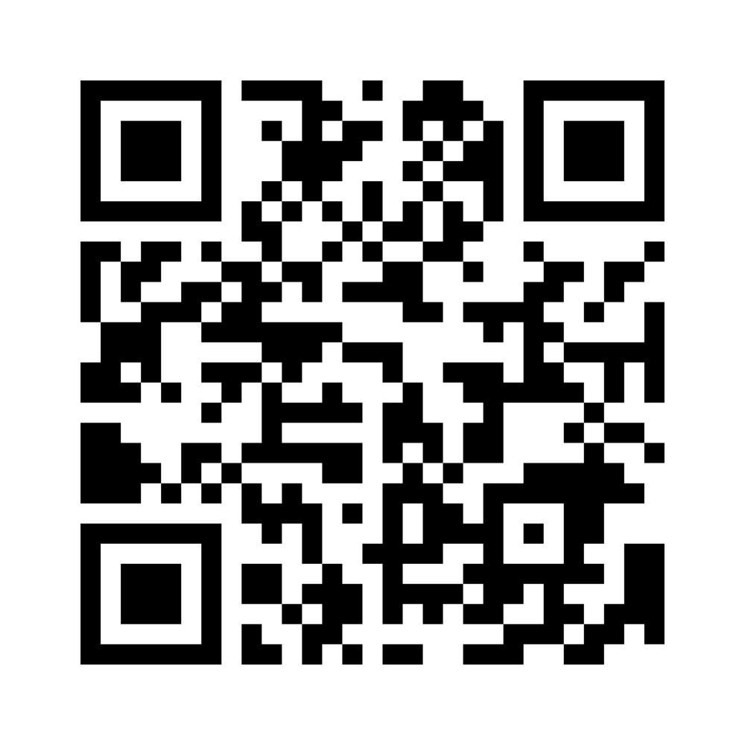
Always, Sometimes, or Never True
Read each of the statements and decide whether it is:
    always true
    sometimes true
    never true
Go to Menti to respond:
www.menti.com/bl7qtioure19
Enter code: 9977 4529
Notes:
This is going to be a menti instead of the slides.
Results:
https://www.mentimeter.com/app/presentation/blwf5upvbuanuo53ssujpkma16ofd1oa
Edit Presentation: https://www.mentimeter.com/app/presentation/blwf5upvbuanuo53ssujpkma16ofd1oa/4va6yzdfwhx8/edit

Slide 11

Trope
[trohp]
noun
A recurring theme or motif, as in literature or art:
The heroic trope
A convention or device that establishes a predictable or stereotypical representation of a character, setting, or scenario in a creative work:
From her introduction in the movie, the character is nothing but a Damsel in Distress trope.
Notes:
Discussion of what is a trope.

Slide 12


Affinity Process
What are some common vampire tropes?
Answer this question on your sticky notes.
Each separate answer should have its own sticky note.
Notes:
Everyone does this separately not in a group.

Slide 13
Affinity Process
With your partner:
Read through your sticky notes.
Group any sticky notes that are similar together into a category.
Label that category.
Notes:
This is done with partners first. On the next slide they group with their whole table group

Slide 14

Affinity Process
With your group:
Read through your sticky notes.
Group any sticky notes that are similar together into a category. Label that category.
Choose a favorite label for each category.

Slide 15
Affinity Process
Whole Room
Share out the group’s categories.
Keep these in mind for the next activity.

Slide 16
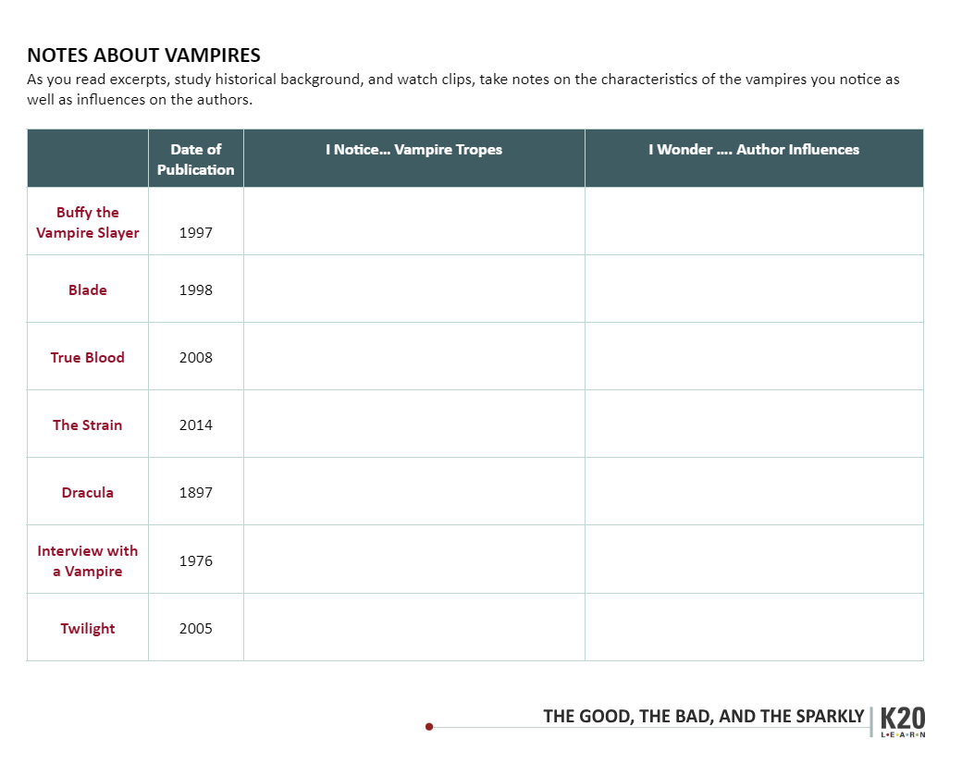
Intro Graphic Organizer
How do you see the tropes that were identified through the affinity process in the following vampire media?
Notes:
The graphic organizer is handed out now. On the back of the graphic organizer is the author’s influencer chart.

Slide 17
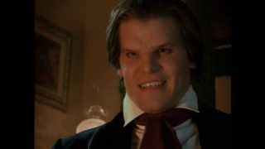
Buffy the Vampire Slayer
Notes:
Show this first clip and work through the graphic organizer as a group. ( modeling)
YouTube. (2013). Angel - Introducing Angel Featurette (Season 1). YouTube. Retrieved October 3, 2022, from https://www.youtube.com/watch?v=G19HhL9H4JI

Slide 18
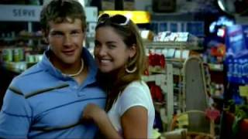
True Blood
Notes:
YouTube. (2009). True Blood Pilot Opening Sequence. YouTube. Retrieved October 3, 2022, from https://www.youtube.com/watch?v=7vmuHzhHEdI

Slide 19

The Strain
Notes:
After media videos: have a short discussion using these questions. What kind of tropes did you see? How did the creator convey those tropes?
YouTube. (2016). The Strain | Trailer | iflix. YouTube. Retrieved October 3, 2022, from https://www.youtube.com/watch?v=j-Y8B700lNA

Slide 20
Read Author Influences Handout
Consider how the author may have been influenced in creating their vampire.
Take notes on your organizer.

Slide 21

Reading Instructions
In groups of three, you will jigsaw the readings.
As you read your excerpts and the historical background on vampires, take notes on the characteristics you notice as well as possible influences on the authors.
Notes:
Continue using the graphic organizer from before
We are going to read some excerpts that will help us reach a better understanding of the Essential Question:How do authors use similar tropes but come up with different variations of the same character?

Slide 22

Timeline Card Sort
Arrange title covers by date they were published.
  Publication dates are on the organizer
Place vampire tropes under the title cover it matches with.
  Some tropes may be used more than once.

Slide 23
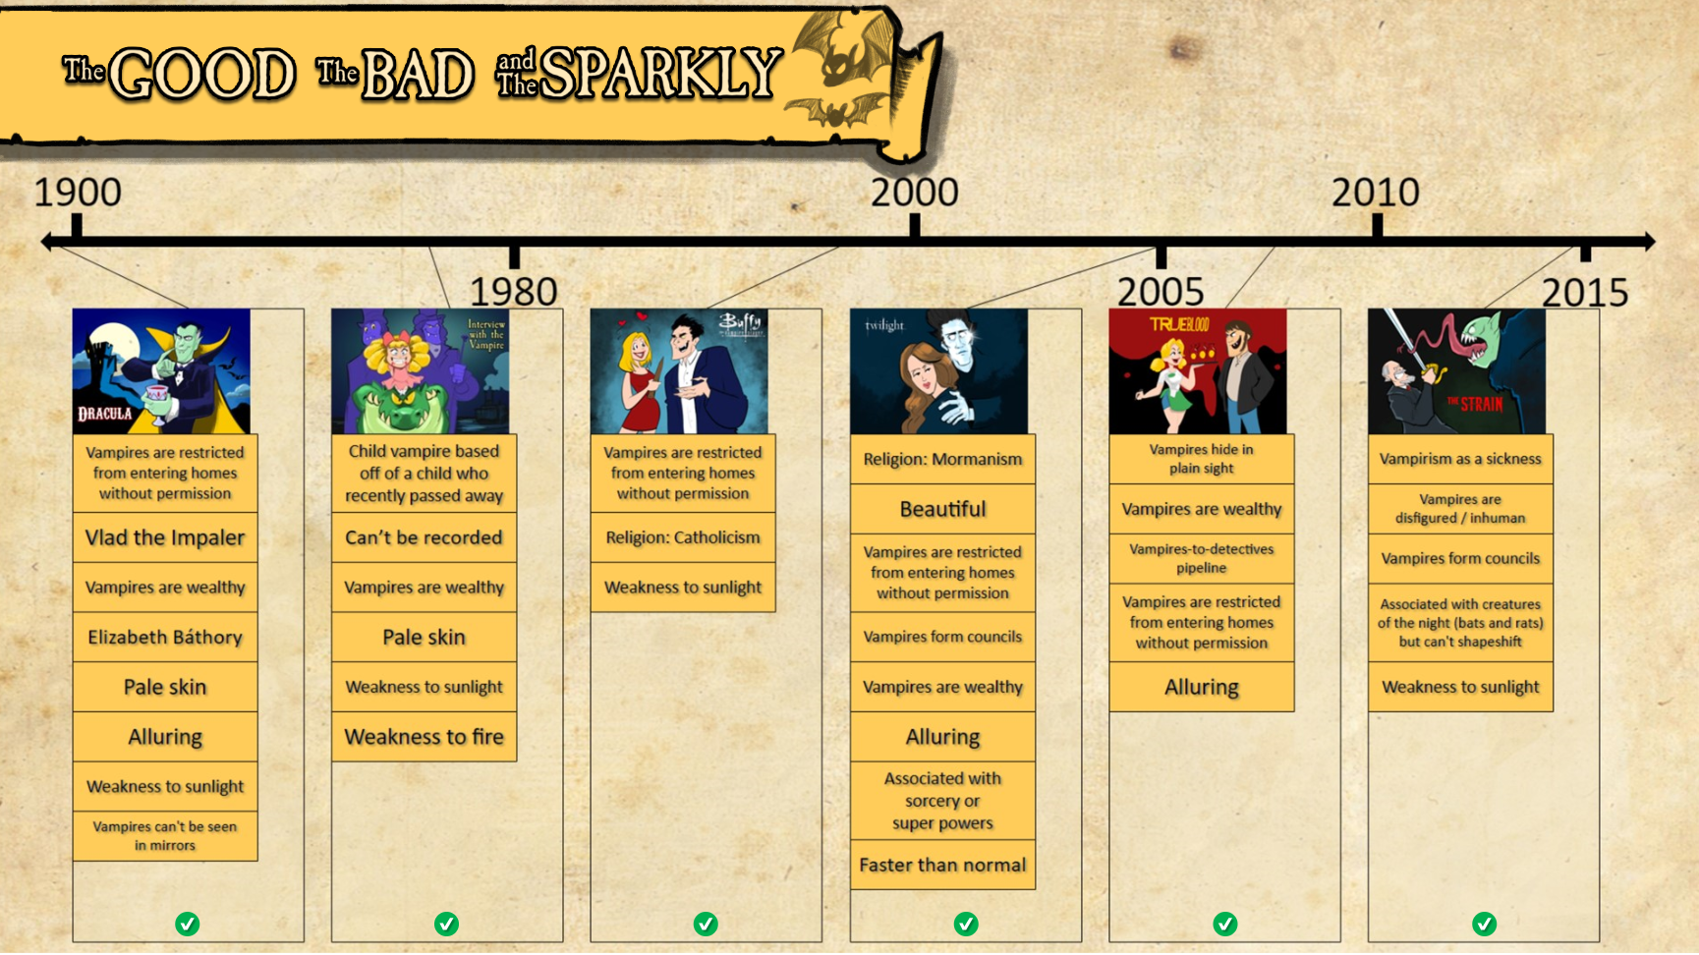

Slide 24

One-Pager
Create a One-Pager to answer the following questions:
  How do these authors address the same topic?
  How did these authors reach different conclusions due to the time period in which they wrote?
Make sure to include the following:
  Title
  Border around the page that includes the theme of the lesson
  Image that represents the subject
  A paragraph that answers each of the questions
Notes:
See student examples or talk through this part...

Slide 25
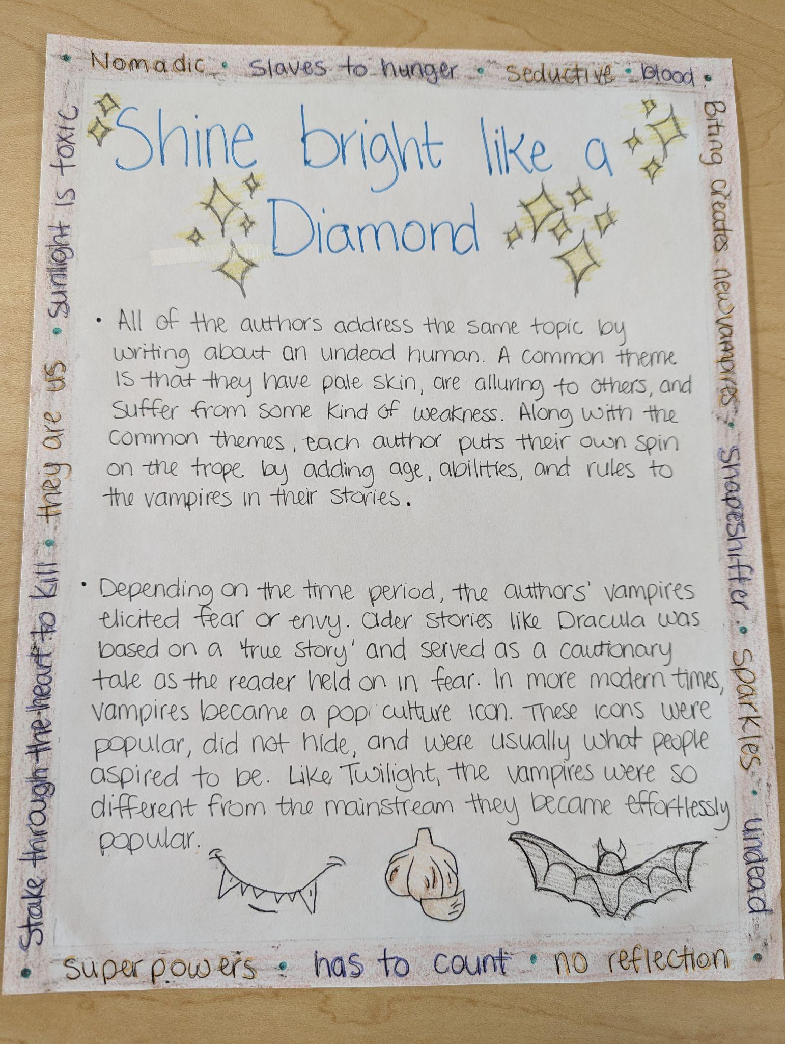
One Pager example 1
Notes:
Show this first. ( modeling)
YouTube. (2013). Angel - Introducing Angel Featurette (Season 1). YouTube. Retrieved October 3, 2022, from https://www.youtube.com/watch?v=G19HhL9H4JI

Slide 26
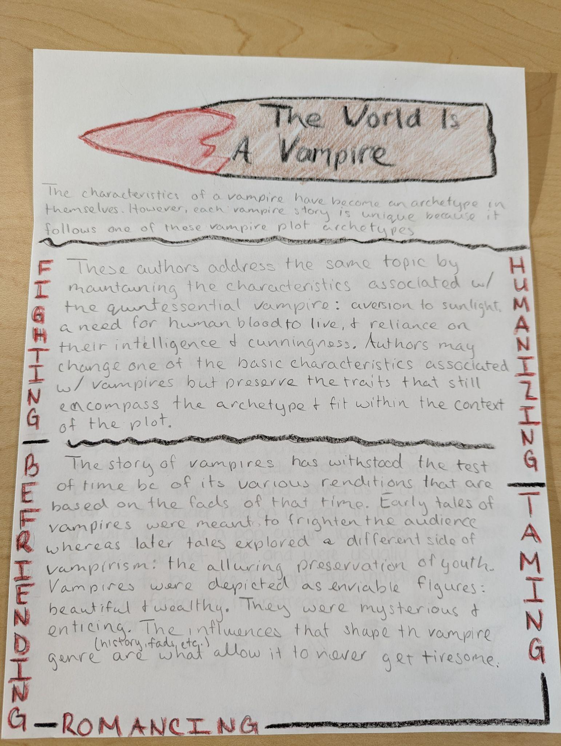
One Pager example 2
Notes:
Show this first. ( modeling)
YouTube. (2013). Angel - Introducing Angel Featurette (Season 1). YouTube. Retrieved October 3, 2022, from https://www.youtube.com/watch?v=G19HhL9H4JI

Slide 27
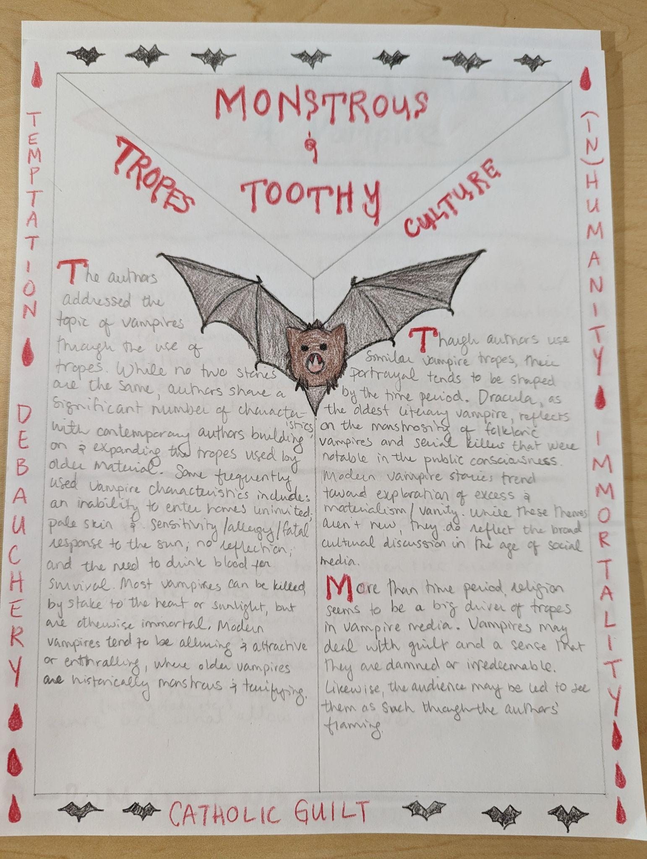
One Pager example 3
Notes:
Show this first. ( modeling)
YouTube. (2013). Angel - Introducing Angel Featurette (Season 1). YouTube. Retrieved October 3, 2022, from https://www.youtube.com/watch?v=G19HhL9H4JI

Slide 28
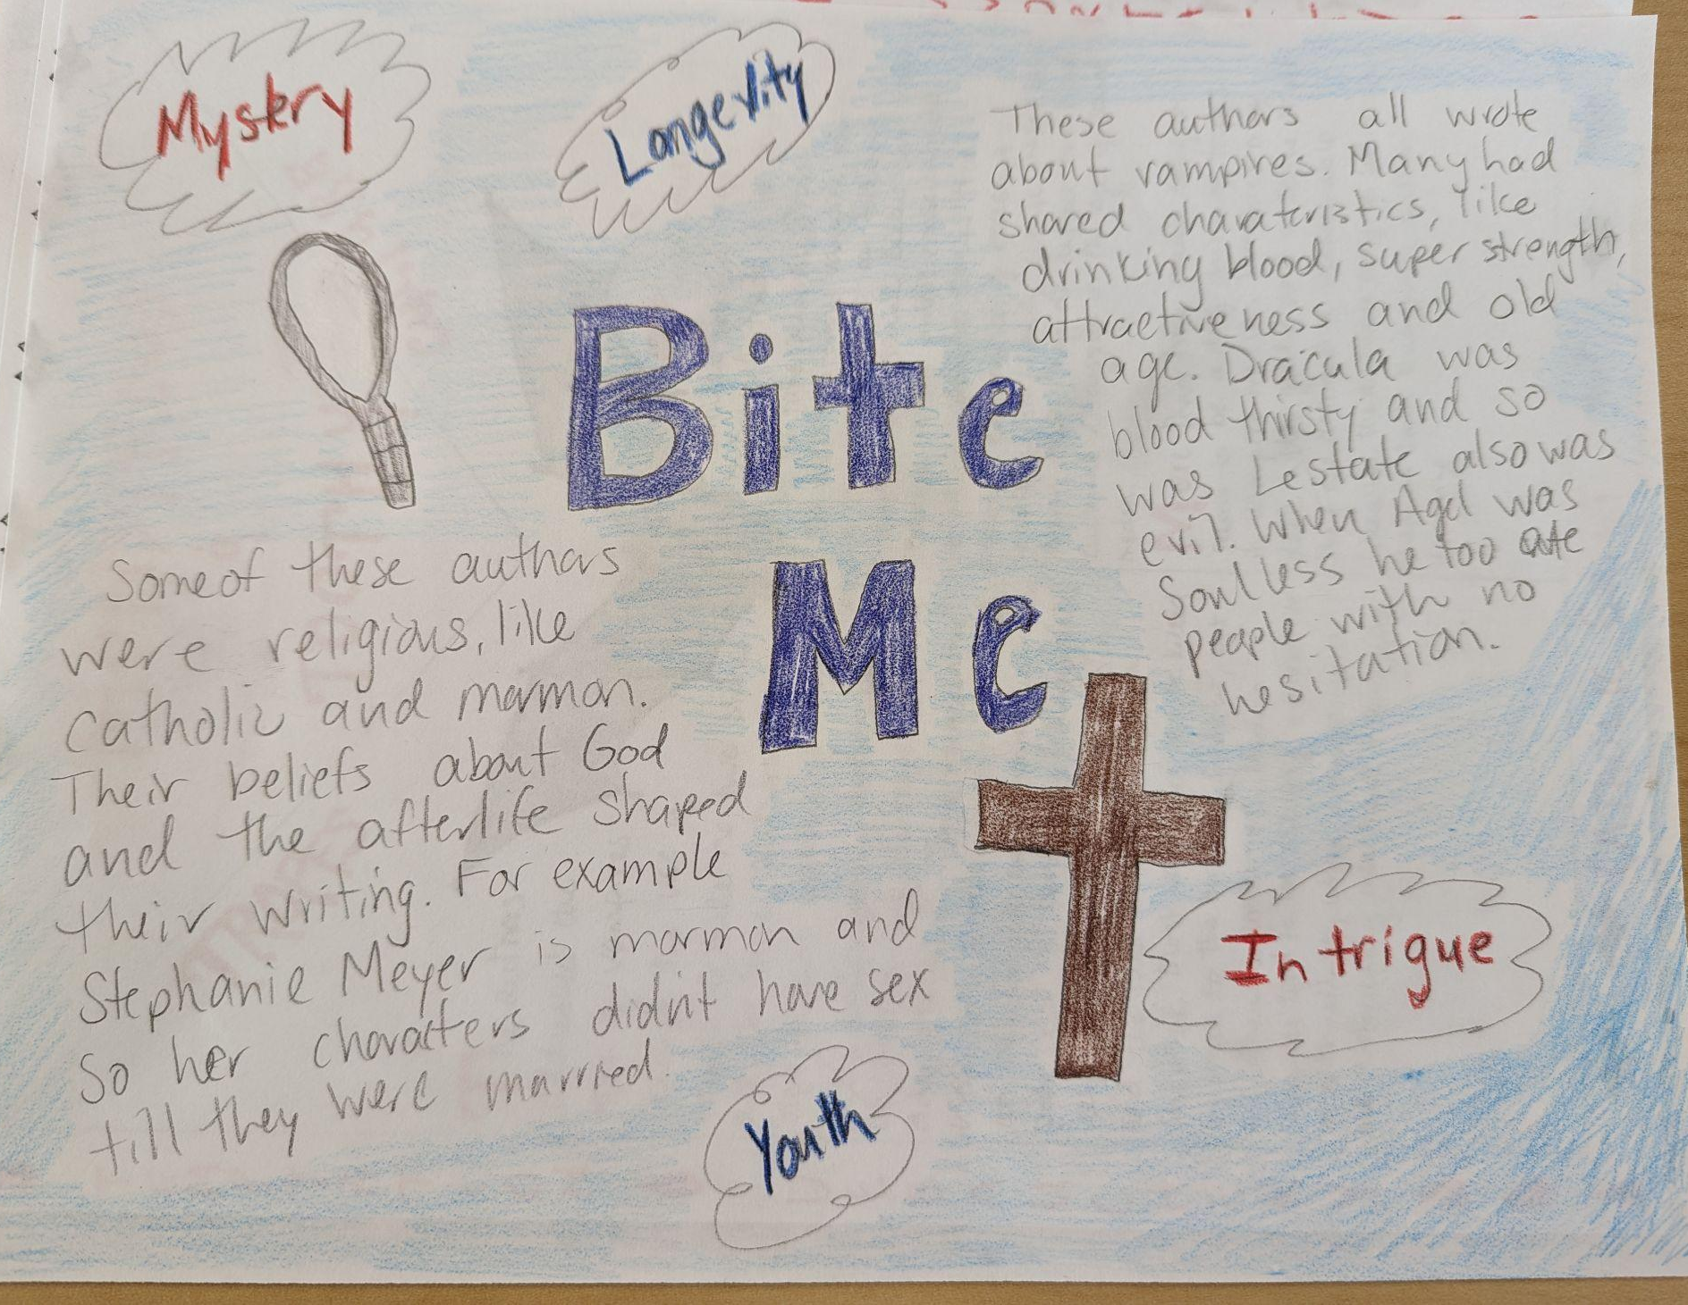
One Pager example 4
Notes:
Show this first. ( modeling)
YouTube. (2013). Angel - Introducing Angel Featurette (Season 1). YouTube. Retrieved October 3, 2022, from https://www.youtube.com/watch?v=G19HhL9H4JI

Slide 29
Exit Ticket (2-minute paper)
Choose one of the vampire creators.
Describe how their influences (culture, time, personal history) show up in their use of the vampire trope.

Slide 30

Storyline
https://k20center.ou.edu/e-learning/good-bad-sparkly/
Notes:
We did this activity with paper resources but there is an awesome digital version of the reading and timeline portions here with cool illustrations from our art team!

Slide 31
BREAK

Slide 32
Model Lesson Standard
Oklahoma Academic Standards: English Language Arts (Grade 9)
9.3.R.1: Analyze the extent to which historical, cultural, and/or global perspectives affect authors' stylistic choices in grade-level literary and informational texts.

Slide 33
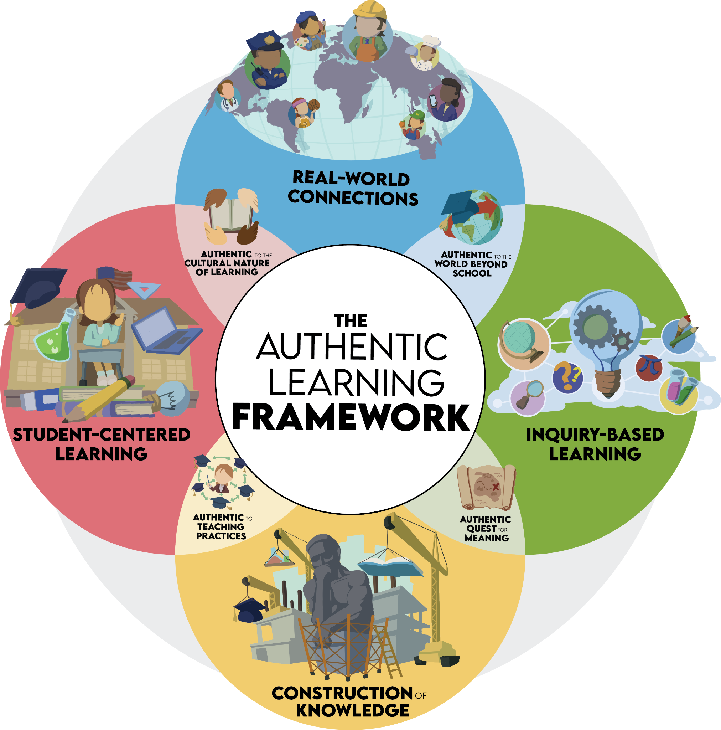
Components
Student-centered
Learning
Construction of
Knowledge
Inquiry-based
Learning
Real-world
Connections
Notes:
Introduce the framework first then
Pass out components packet second

Slide 34
More on the
Components of Authenticity
Read about the component assigned to your group.
Write a Definition for the component.
List the main Characteristics.
Represent Visually.
Describe: “How did you see this component in the lesson we experienced?”
Define List
Visual Reflect
COMPONENT
Notes:
provide each group with a piece of chart paper and marker/s. Each group will make a poster demonstrating their component through four main segments of information:
Definition: Write their own definition for the component
Main characteristics: list 3-5 characterisiics that are essential to this component
Draw a picture: Sketch a scene or symbol that represents their component
Describe an example from the model lesson where they saw this component represented.

Slide 35
Gallery Walk
Groups will walk around the room and find another group with the same component as your group.
  Compare and revise your posters to incorporate each other’s ideas.
Hang posters together.
Walk the room to view all other group posters.
Notes:
Group like components together for groups to collaborate
Gallery walk as a component group to other components

Slide 36
Revisit Meaningful Learning
Review each group’s Frayer Model on the components of authenticity as a whole group.
Star elements on the Meaningful Learning list that are affirmed by the components of authenticity
Add anything that’s missing to the Meaningful Learning list.
Mark off anything that doesn’t seem to fit.
Notes:
After each group presents their poster, revisit the Meaningful Learning Experiences List from the beginning of this session and star ideas that are reinforced. Strike out any that don’t seem to fit anymore. Using the themes represented, generate a rough draft definition of Meaningful Learning.

Slide 37
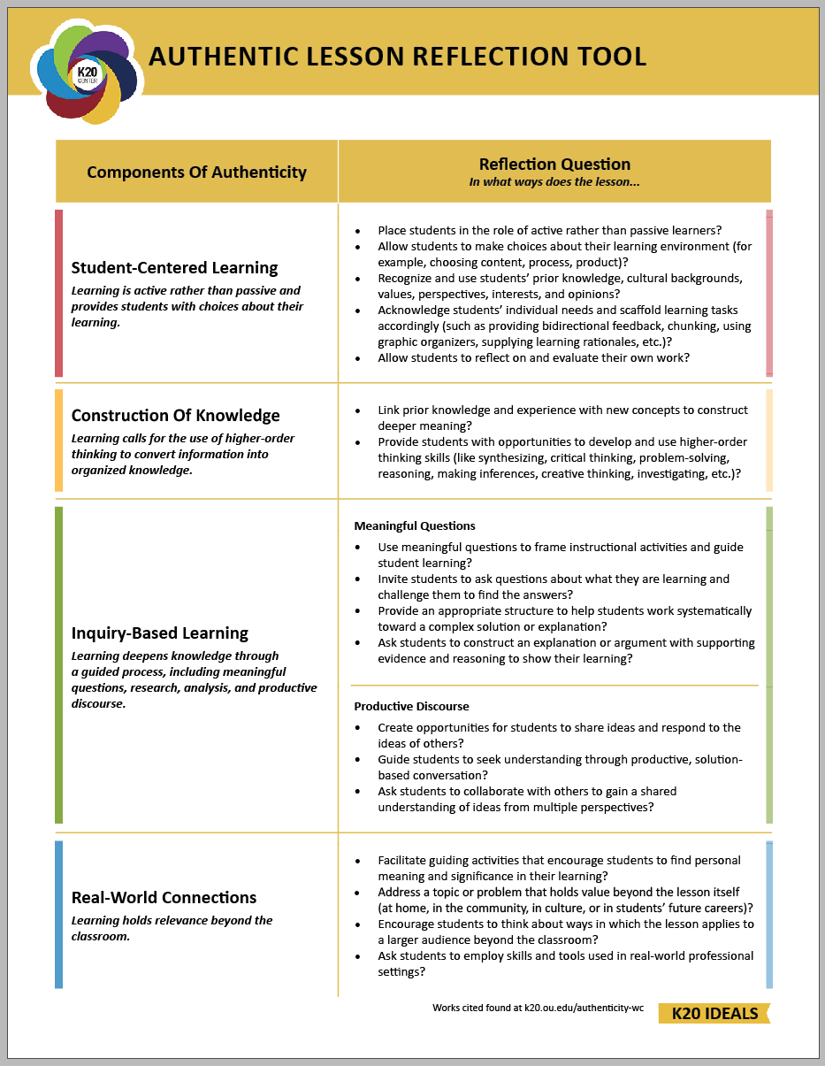
Lesson Reflection
Share out the reflect segment of each group’s poster.

Slide 38

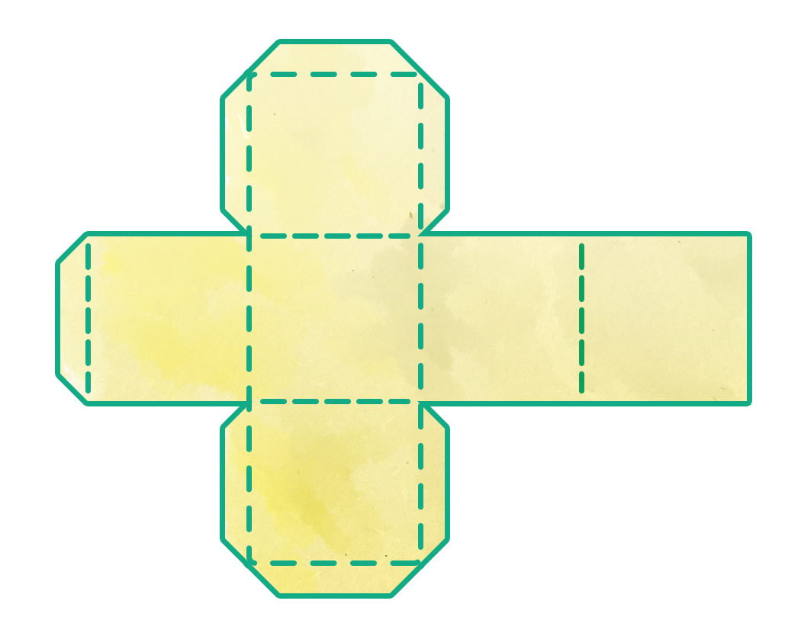
Critical Thinking Cube
In small groups,
There are 6 topics on your cube.
Roll the cube, and respond to the face-up prompt.
You will have 4 minutes to answer each prompt.
Be prepared to share out at the end.
Notes:
No more than 2 people from the same job type in a group
Each prompt has max 4 minutes to respond. Gauge the room to determine if groups need more or less time to respond. Based on time, choose how many rolls you want the participants to do.
“These are written for teachers and schools; think of how you can apply it in your job.”

Slide 39
Purpose of Today
K20 Center has refreshed our foundational beliefs, the IDEALS. Everything we do should be based in these IDEALS. These all-staff PDs should help you expand your understanding of our core-beliefs.
In addition, each of these PDs will be published on LEARN as well as facilitated with our school partners. This session is serving as a vetting of the PD sessions. Therefore, any feedback should focus on changes to make this best for further partnerships.
Notes:
This will be deleted for LEARN

Slide 40

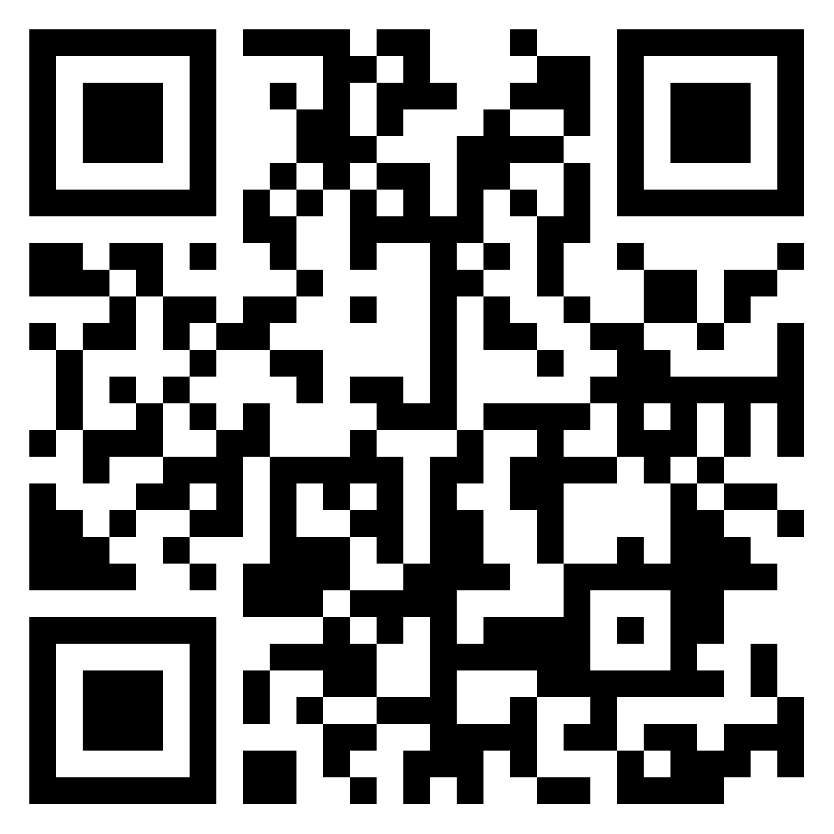
Mirror, Microscope, Binoculars
Go to the padlet and make a post for the prompts in each of the three columns.
https://shorturl.at/gzFTZ
Notes:
padlet?

