Slide 2

Authenticity
Transforming Your Teaching Approach with the Authentic Learning Framework

Slide 3

Meaningful Learning
Think of one of the most meaningful learning experiences you’ve had in your lifetime.
Share it with your table.
As a group, create a list of 3-5 common characteristics across your shared learning experiences.
K20 Two-Minute Timer
Notes:
K20 Center. (2021, September 21). K20 Center 2-minute timer. [Video]. YouTube. https://youtu.be/HcEEAnwOt2c?si=DoVAyQWMg914g3SO

Slide 4
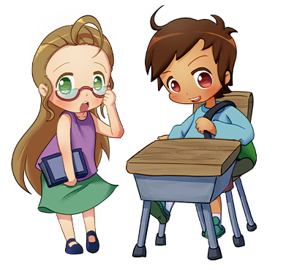
Stand Up/Sit Down
Have a representative from each group stand up.
Read one item from their list.
Others mark this item off their own list if it’s too similar to something they already have.
Sit down if all of the characteristics you’ve listed have been stated.
Notes:
K20 Center. (n.d.). Stand up, sit down. Strategies. https://learn.k20center.ou.edu/strategy/1771

Slide 5
Learning Objectives
Experience a shortened version of a model lesson featuring multiple components of the authentic learning framework.
Identify and explain how the activities in the lesson demonstrate each component authenticity.
Be able to describe how the lesson supports authentic learning.

Slide 6
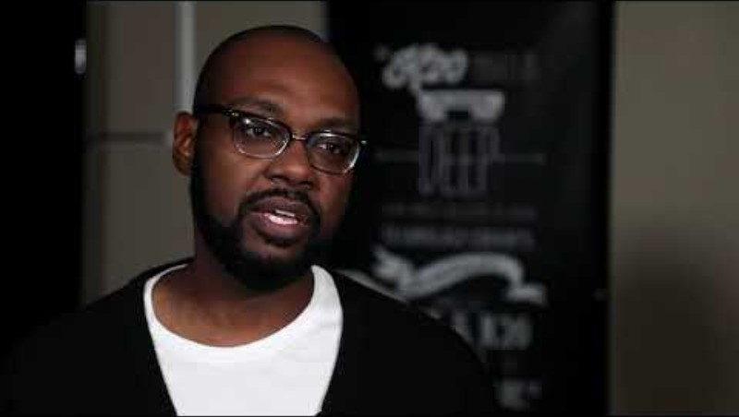
Testimonial
Milton Bowens on Authenticity
Notes:
K20 Center. (2019, May 21). ILI2019-Milton Bowens on Authenticity. YouTube. https://www.youtube.com/watch?v=-x-t3MCR1Yo

Slide 7

Testimonial
What did you hear about in this testimony that is on our common characteristics chart?
Notes:
K20 Center. (n.d.). Anchor charts. Strategies. https://learn.k20center.ou.edu/strategy/58

Slide 8


Notes:
Monster Monday: The Good, the Bad and the Sparkly: Vampire Tropes Throughout History. Lesson. https://learn.k20center.ou.edu/lesson/2613

Slide 9
Essential Question
How do authors use similar tropes but come up with different variations of the same character?

Slide 10
Learning Objectives
Analyze the extent to which historical, cultural, and/or global perspectives affect an author’s stylistic choices.
Evaluate how authors writing on the same issue reach different conclusions because of differences in assumptions, evidence, reasoning, and viewpoints.

Slide 11

Always, Sometimes, or Never True
Read each of the statements and decide whether it is:
  Always true
  Sometimes true
  Never true
Go to Menti to respond:
[insert url]
Enter code:
9977 4529
[insert QR code]
Notes:
K20 Center. (n.d.). Always, sometimes, or never true. Strategies. https://learn.k20center.ou.edu/strategy/145
K20 Center. (n.d.). Mentimeter. Tech Tools. https://learn.k20center.ou.edu/tech-tool/645

Slide 12

Always, Sometimes, or Never True?
Vampires have a reflection.
Notes:
K20 Center. (n.d.). Always, sometimes, or never true. Strategies. https://learn.k20center.ou.edu/strategy/145

Slide 13
Always, Sometimes, or Never True?
To kill a vampire, you need to stake them in the heart.
Notes:
K20 Center. (n.d.). Always, sometimes, or never true. Strategies. https://learn.k20center.ou.edu/strategy/145

Slide 14
Always, Sometimes, or Never True?
Vampires can’t enter a home without permission.
Notes:
K20 Center. (n.d.). Always, sometimes, or never true. Strategies. https://learn.k20center.ou.edu/strategy/145

Slide 15
Always, Sometimes, or Never True?
Vampires can’t go out during the day.
Notes:
K20 Center. (n.d.). Always, sometimes, or never true. Strategies. https://learn.k20center.ou.edu/strategy/145

Slide 16
Always, Sometimes, or Never True?
Vampires are compelled to count everything.
Notes:
K20 Center. (n.d.). Always, sometimes, or never true. Strategies. https://learn.k20center.ou.edu/strategy/145

Slide 17

Trope
[troph]
noun
A recurring theme or motif, as in literature or art: The heroic trope
A convention or device that establishes a predictable or stereotypical representation of a character, setting, or scenario in a creative work: From her introduction in the movie, the character is nothing but a Damsel in Distress trope.

Slide 18


Affinity Process
What are some common vampire tropes?
Answer this question on your sticky notes.
Each separate answer should have its own sticky note.
K20 3-Minute Timer
Notes:
K20 Center. (n.d.). Affinity process. Strategies. https://learn.k20center.ou.edu/strategy/87
K20 Center. (2021, September 21). K20 Center 3-minute timer. [Video]. YouTube. https://youtu.be/iISP02KPau0?si=f2FqNUF8Miocuk66

Slide 19
Affinity Process
With your partner:
Read through your sticky notes.
Group any sticky notes that are similar together into a category.
Label that category.
K20 3-Minute Timer
Notes:
K20 Center. (n.d.). Affinity process. Strategies. https://learn.k20center.ou.edu/strategy/87
K20 Center. (2021, September 21). K20 Center 3-minute timer. [Video]. YouTube. https://youtu.be/iISP02KPau0?si=f2FqNUF8Miocuk66

Slide 20

Affinity Process
With your group:
Read through your sticky notes.
Group any sticky notes that are similar together into a category. Label that category.
Choose a favorite label for each category.
K20 5-Minute Timer
Notes:
K20 Center. (n.d.). Affinity process. Strategies. https://learn.k20center.ou.edu/strategy/87
K20 Center. (2021, September 21). K20 Center 5-minute timer. [Video]. YouTube. https://www.youtube.com/watch?v=EVS_yYQoLJg

Slide 21
Affinity Process
Whole Room
Share out the group’s categories.
Keep these in mind for the next activity.
Notes:
K20 Center. (n.d.). Affinity process. Strategies. https://learn.k20center.ou.edu/strategy/87

Slide 22

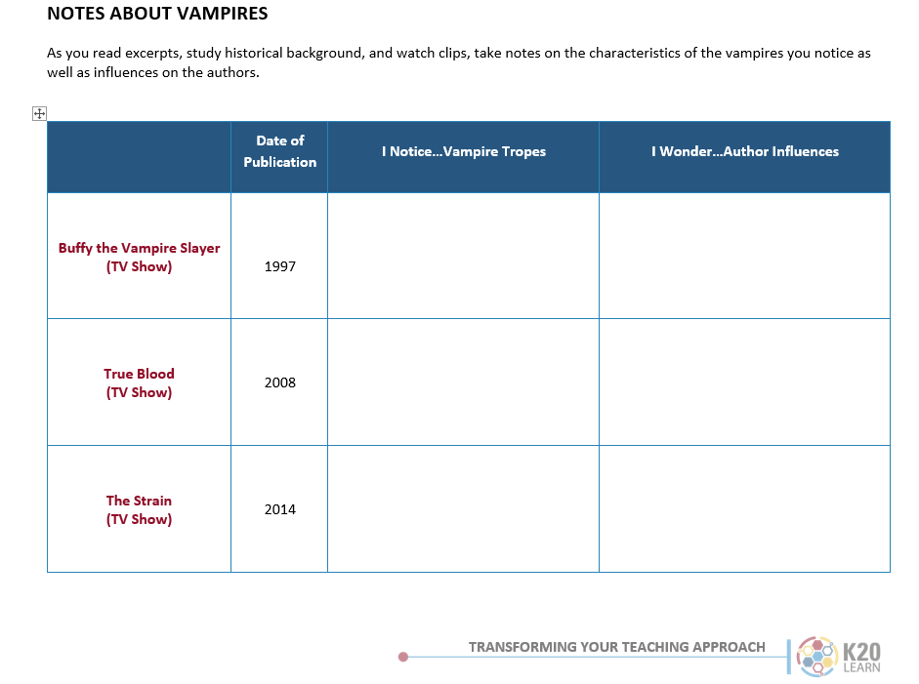
Introduction to Graphic Organizer
Think about the tropes that were identified through the affinity process.
What do you notice about tropes in the following video clips?
Notes:
K20 Center. (n.d.). I notice, I wonder. https://learn.k20center.ou.edu/strategy/180

Slide 23
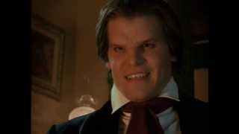
Buffy the Vampire Slayer
Introducing Angel
Notes:
YouTube. (2013). Angel - Introducing Angel Featurette (Season 1). YouTube. Retrieved October 3, 2022, from https://www.youtube.com/watch?v=G19HhL9H4JI

Slide 24
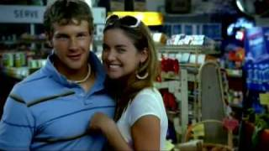
True Blood
True Blood Pilot
Notes:
YouTube. (2009). True Blood Pilot Opening Sequence. YouTube. Retrieved October 3, 2022, from https://www.youtube.com/watch?v=7vmuHzhHEdI

Slide 25

The Strain
The Strain Trailer
Notes:
YouTube. (2016). The Strain | Trailer | iflix. YouTube. Retrieved October 3, 2022, from https://www.youtube.com/watch?v=j-Y8B700lNA

Slide 26
Read Author Influences Handout
What do you wonder about how the author may have been influenced in creating their vampire?
Notes:
K20 Center. (n.d.). I notice, I wonder. https://learn.k20center.ou.edu/strategy/180

Slide 27


Reading Instructions
In groups of three, you will jigsaw the readings.
As you read your excerpts and the historical background on vampires, take notes on the characteristics you notice as well as possible influences on the authors.
Notes:
K20 Center. (n.d.). Jigsaw. Strategies. https://learn.k20center.ou.edu/strategy/179

Slide 28

Timeline Card Sort
Arrange title covers by date they were published.
  Publication dates are on the organizer.
Place vampire tropes under the title cover that it matches.
  Some tropes may be used more than once.
Notes:
K20 Center. (n.d.). Card matching. Strategies. https://learn.k20center.ou.edu/strategy/1837

Slide 29
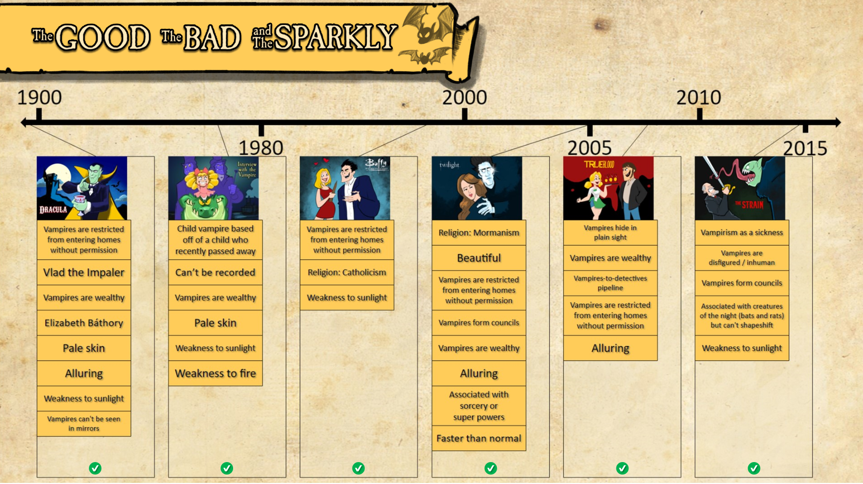

Slide 30

One-Pager
Create a One-Pager to answer the following questions:
  How do these authors address the same topic?
  How did these authors reach different conclusions, given the era in which they wrote?
Make sure to include the following:
  Title
  Border around the page that includes the themes of the lesson
  Image that represents the subject
  A paragraph that answers each of the questions
Notes:
K20 Center. (n.d.). One-pager. Strategies. https://learn.k20center.ou.edu/strategy/72

Slide 31
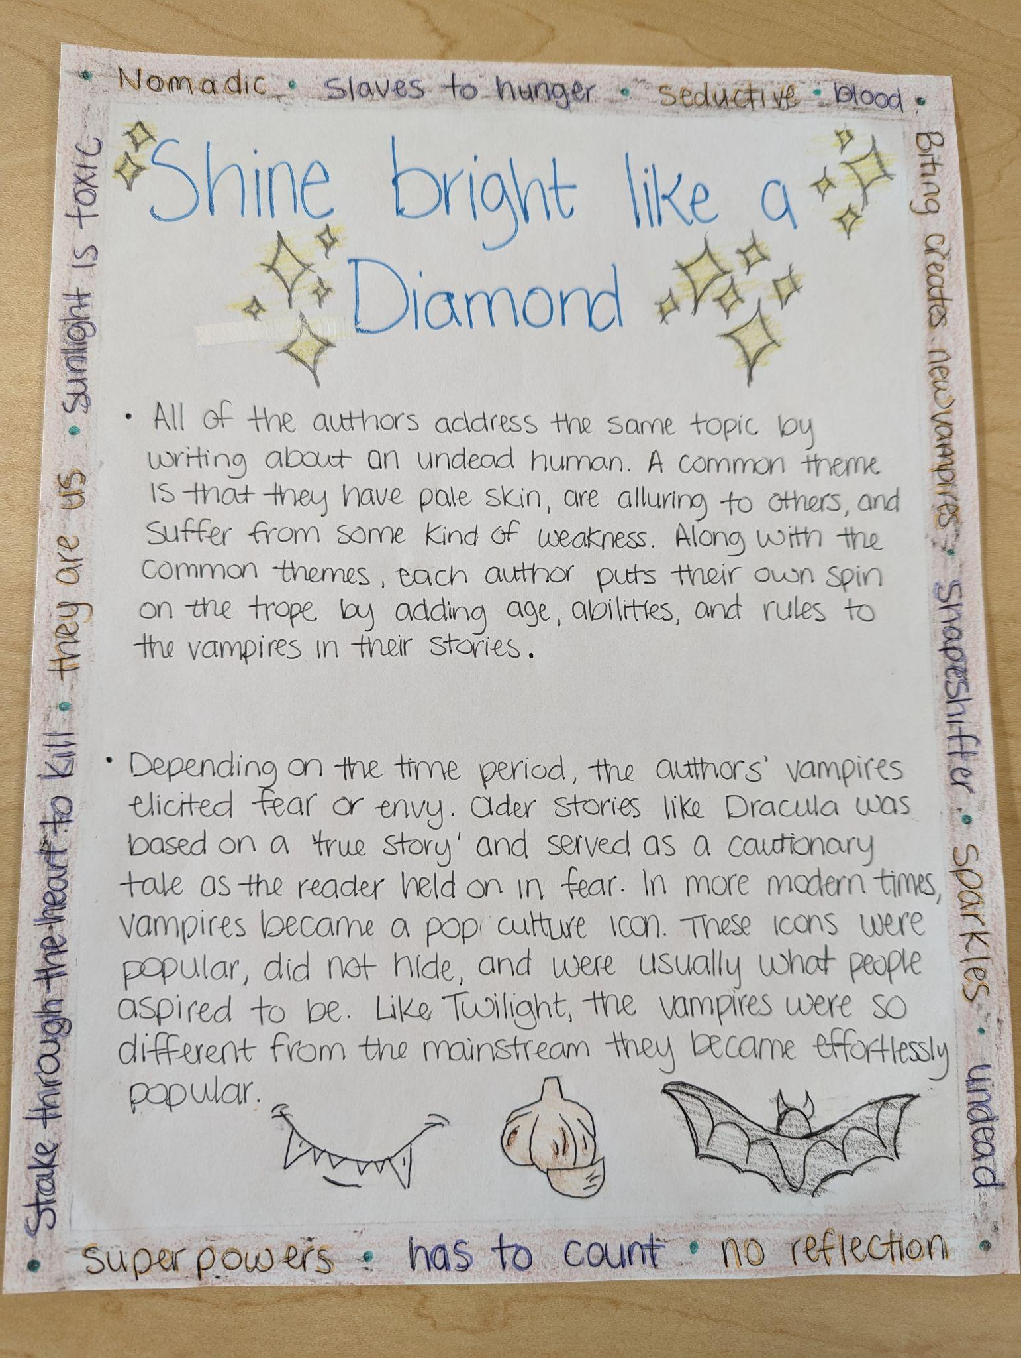
One-Pager – Example 1

Slide 32
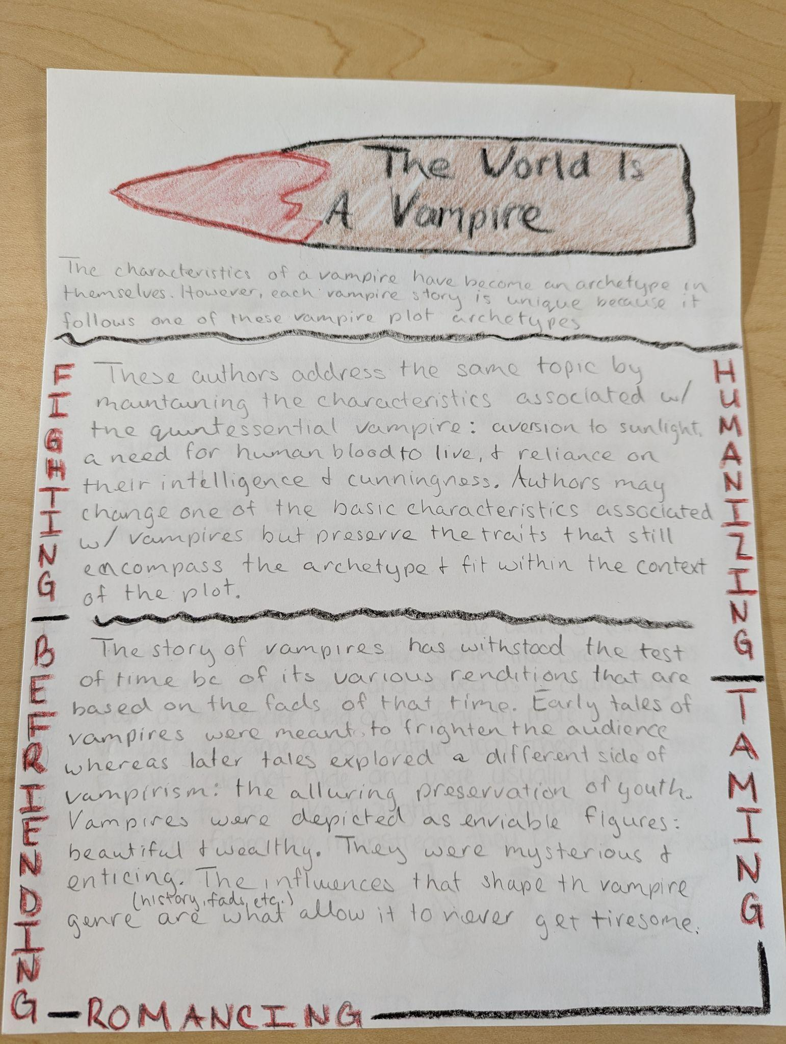
One-Pager – Example 2

Slide 33
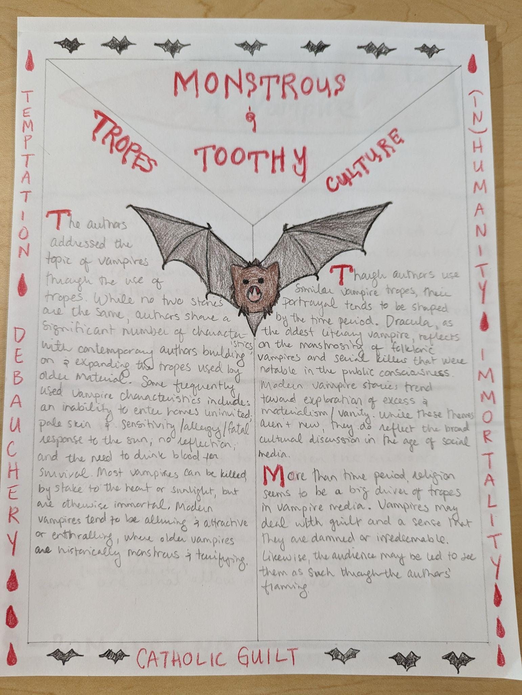
One-Pager – Example 3

Slide 34
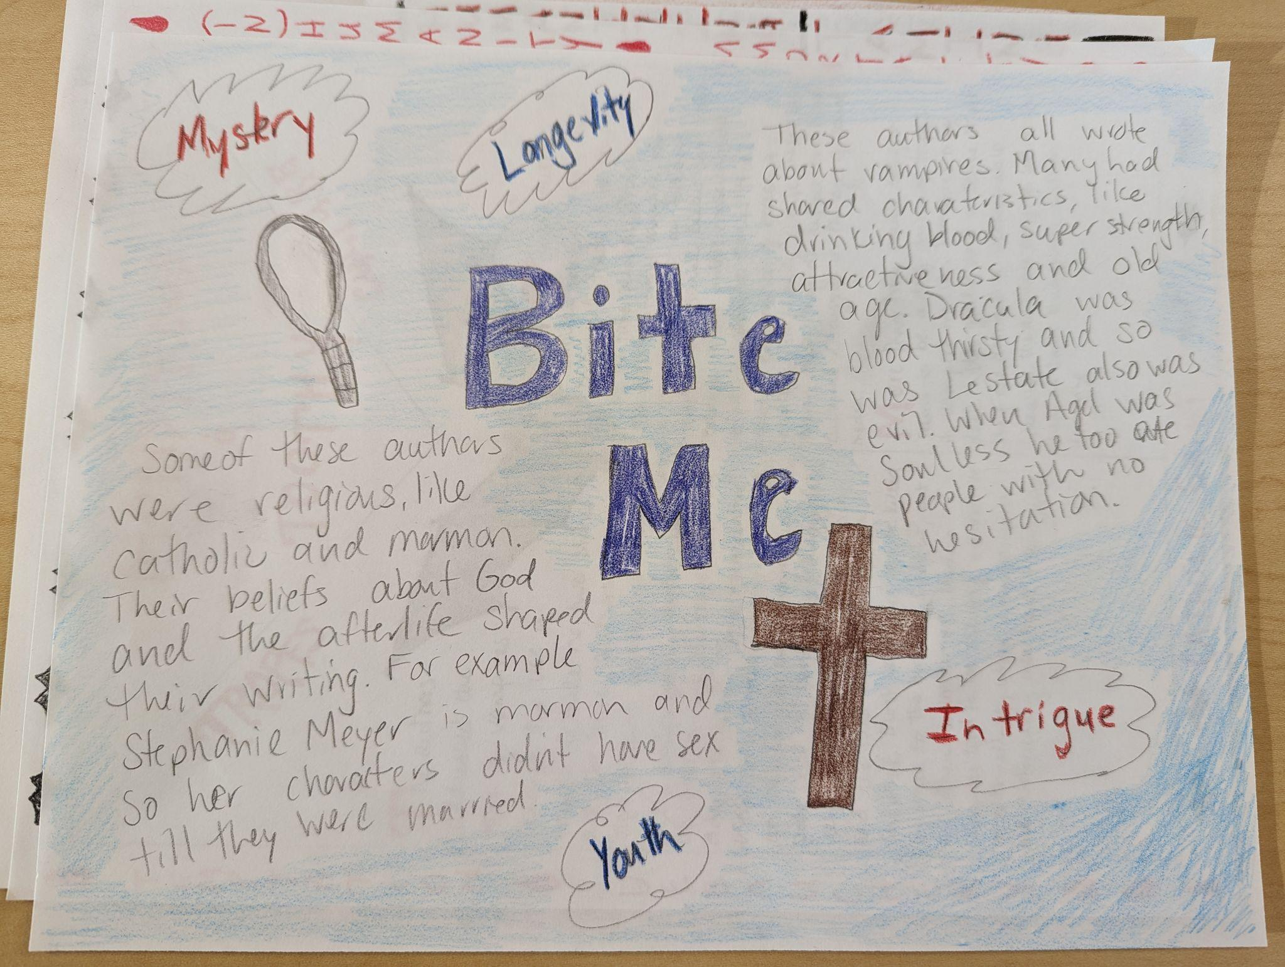
One-Pager – Example 4

Slide 35

Exit Ticket (2-minute Paper)
Choose one of the vampire creators.
Describe how their influences (culture, time, personal history) show up in their use of the vampire trope.
Notes:
K20 Center. (n.d.). Bell ringers and exit tickets. Strategies. https://learn.k20center.ou.edu/strategy/125

Slide 36

Storyline
Access the digital version of these activities here:
https://k20center.ou.edu/e-learning/good-bad-sparkly/

Slide 37
Model Lesson Standard
Oklahoma Academic Standards: English Language Arts (Grade 9)
9.3.R.1: Analyze the extent to which historical, cultural, and/or global perspectives affect authors' stylistic choices in grade-level literary and informational texts.

Slide 38
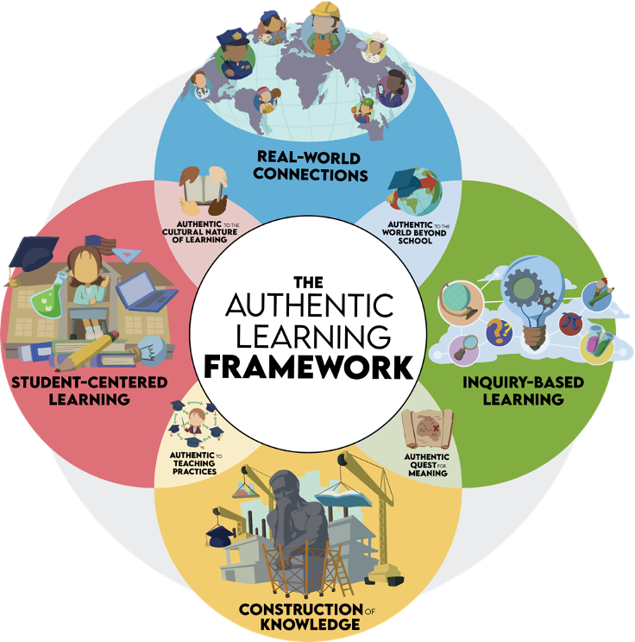
Components
Student-Centered Learning
Construction of Knowledge
Inquiry-Based Learning
Real-World Connections

Slide 39
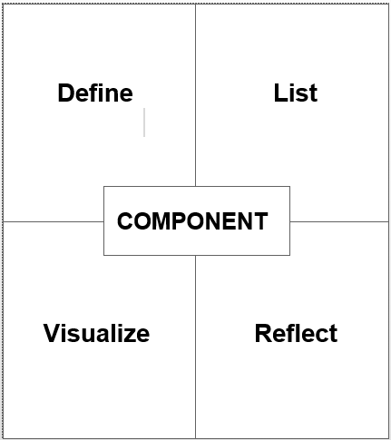
More on the Components of Authenticity
Read about the component assigned to your group.
Write a definition for the component.
List the main characteristics.
Represent visually.
Describe: “How did you see this component in the lesson we experienced?”

Slide 40


Gallery Walk
Groups will walk around the room and find another group with the same component as your group.
  Compare and revise your posters to incorporate each other’s ideas.
  Groups note 1 thing that stood out and 1 question.
Hang posters together.
Walk the room to view all other group posters.
Notes:
K20 Center. (n.d.). Gallery walk/Carousel. Strategies. https://learn.k20center.ou.edu/strategy/118
K20 Center. (n.d.). Exclaim and question. Strategies. https://learn.k20center.ou.edu/strategy/94

Slide 41
Revisit Meaningful Learning
Review each group’s Frayer Model on the components of authenticity as a whole group.
Star elements on the Meaningful Learning list that are affirmed by the components of authenticity.
Add anything that’s missing to the Meaningful Learning list.
Mark off anything that doesn’t seem to fit.

Slide 42
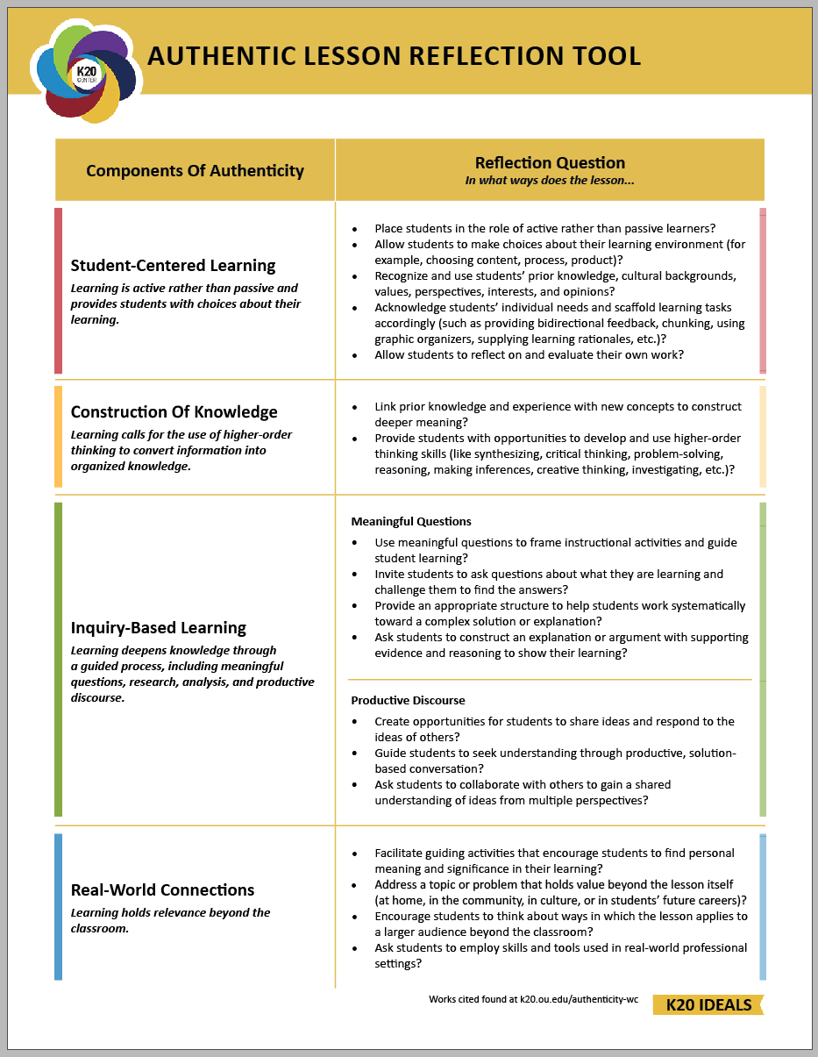
Lesson Reflection
Share out the “reflect” segment of each group’s poster.

Slide 43
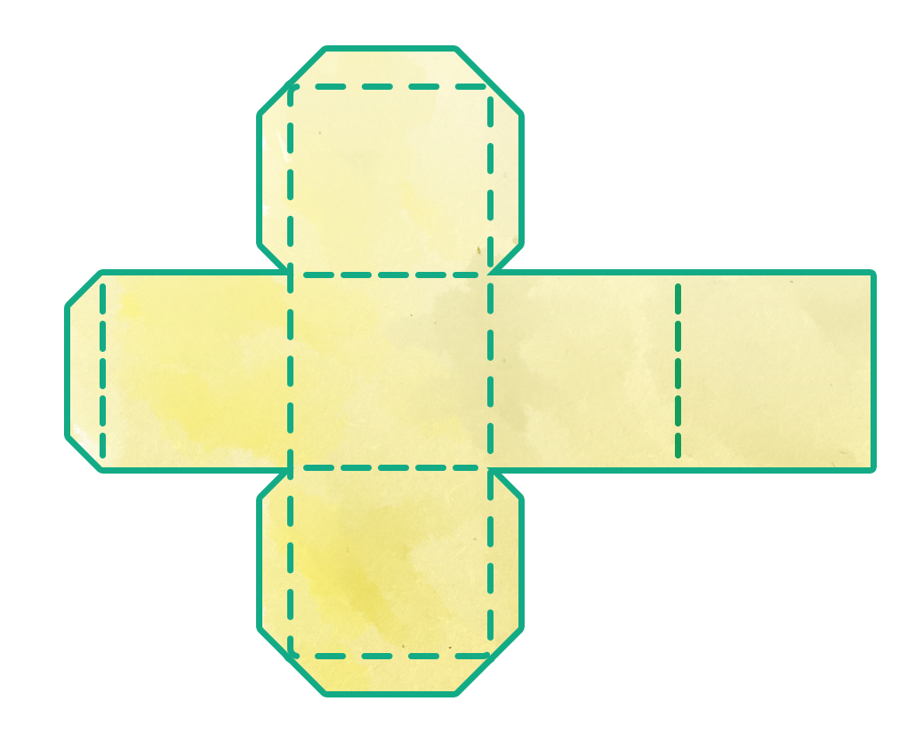

Critical Thinking Cube
In small groups:
  Note the 6 topics on your cube.
  Roll the cube and respond to the face-up prompt.
  You will have 4 minutes to answer each prompt.
  Be prepared to share out at the end.
K20 4-Minute Timer
Notes:
K20 Center. (n.d.). Critical thinking cube. Strategies. https://learn.k20center.ou.edu/strategy/1583
K20 Center. (2021, September 21). K20 Center 4-minute timer. [Video]. YouTube. https://youtu.be/kpCsfuvzQeY?si=8sPluFptBbYlaC0q

Slide 44

Mirror, Microscope, Binoculars
Go to Padlet and make a post for the prompts in each of the three columns.
INSERT QR CODE HERE
Notes:
K20 Center. (n.d.). Mirror, microscope, binoculars. Strategies. https://learn.k20center.ou.edu/strategy/3020

