Slide 2
From Awareness to Action
Nurturing Equity

Slide 3
Magnetic Statements
Read the listed statements and move to the one that most attracts you.
At your statement, discuss your choice with the other participants gathered around that statement.
Why were you attracted to the statement?
Is there anything in particular that stands out to you?
Notes:
K20 Center. (n.d.). Magnetic statements. Strategies. https://learn.k20center.ou.edu/strategy/166

Slide 4
Magnetic Statements
Equity is:
Setting universally high expectations
Promoting positive school leadership
Culturally responsive teaching
Accessible learning
Differentiated instruction
Student-centered learning
Reflection on practices
Building partnerships with schools, families, and communities
Notes:
K20 Center. (n.d.). Magnetic statements. Strategies. https://learn.k20center.ou.edu/strategy/166

Slide 5
Magnetic Statements
Equity is:
Setting universally high expectations & promoting positive school leadership
Culturally responsive teaching & student-centered learning
Differentiated instruction & accessible learning
Reflection on practices & building partnerships with schools, families, and communities
Notes:
K20 Center. (n.d.). Magnetic statements. Strategies. https://learn.k20center.ou.edu/strategy/166

Slide 6
Essential Question
How can equity be promoted for all stakeholders?

Slide 7
Learning Objectives
Identify the research-based elements of equity.
Apply concepts from research to case studies and conversations.
Generate goals to foster equity in your professional community.

Slide 8
GramIt
In your group, create an image that represents the group’s idea of equity.
Add a caption and hashtag to the image to help explain how the image conveys equity.
Notes:
K20 Center. (n.d.). GramIt. Strategies. https://learn.k20center.ou.edu/strategy/2554

Slide 9
Gallery Walk
With your group, move around the room to view at least three other images.
Respond to images by discussing in your group, writing comments on sticky notes, and placing them on the images.
Notes:
K20 Center. (n.d.). Gallery walk / carousel. Strategies. https://learn.k20center.ou.edu/strategy/118

Slide 10
Categorical Highlighting
Read and highlight the Equity Research Brief. Use the following color key:
Blue: Something you are doing well at your site.
Yellow: Something you have seen at your site, but it’s not happening consistently.
Pink: Something you wish were happening at your site, but it’s not currently in practice.
Notes:
K20 Center. (n.d.). Categorical highlighting. Strategies. https://learn.k20center.ou.edu/strategy/192
Highlight the categories with the colors you have on site.

Slide 11
Discussion
Within your small group, share out some of the key aspects you highlighted for each color.
Focus on categories 2 and 3.
What might be some ways to improve the yellow highlights?
What are ways to improve pink highlights?
Prepare one key takeaway from your group to share out.

Slide 12
Share Out

Slide 13
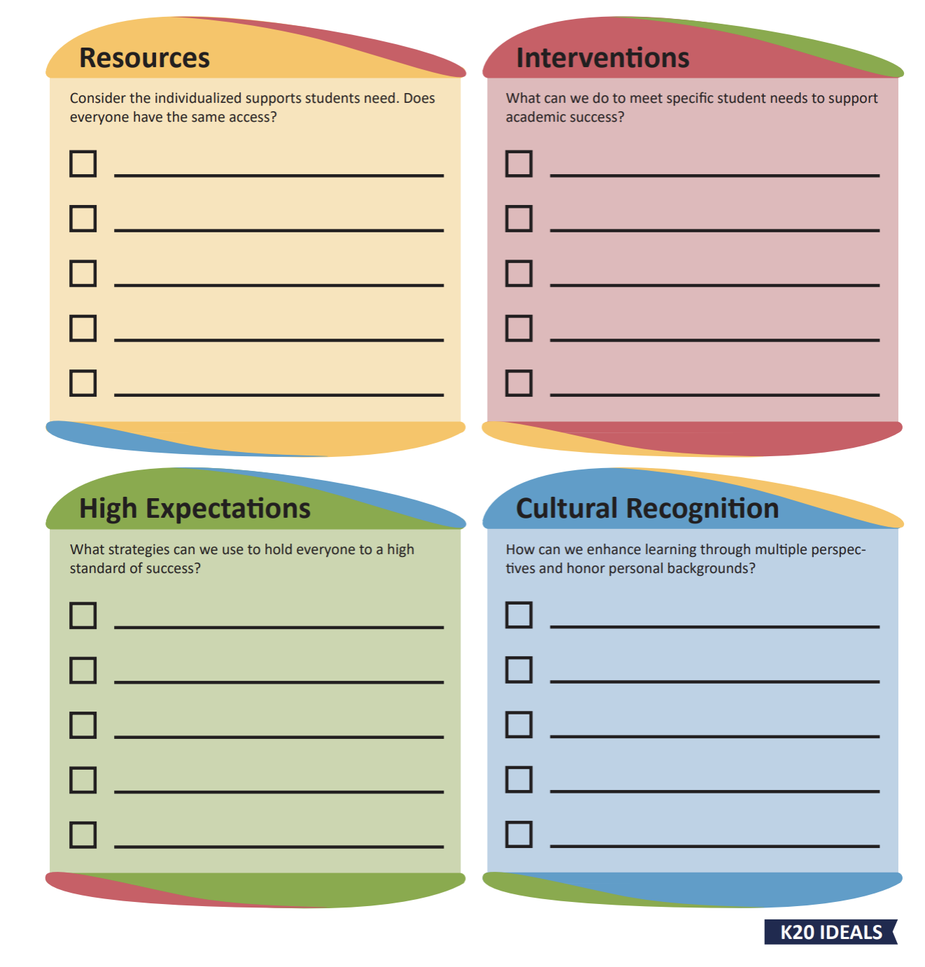
Equity in Practice
Read over the Equity in Practice brief.
As you read, make connections between what you read and the Planning for Equity handout.
Discuss in your table groups the four goal areas. Come up with an example for each.

Slide 14
Case Study
With your group, read over your case study.
As a group, use the Planning for Equity handout for the following:
Identify equity-related challenges.
Discuss ways you or your site could help with the challenges identified.
Choose a spokesperson for your group to share one item you identified from each goal area on your handout.

Slide 15
GramIt Remix
Review your image.
Discuss connections and changes you might make with your table group.
Make changes to your image or leave a comment on a sticky note to explain what you would change.
Share one change your group made or would make.
Notes:
K20 Center. (n.d.). GramIt. Strategies. https://learn.k20center.ou.edu/strategy/2554

Slide 16
Extending to Your Own Site
Read the Equity in Practice Research Brief.
Review your Categorical Highlighting.
Discuss what you would like to implement at your site using the Planning for Equity handout.
What are your next steps?

