Slide 1
Ctrl + Alt + Teach:
Unlocking Authentic Learning with Technology

Slide 2

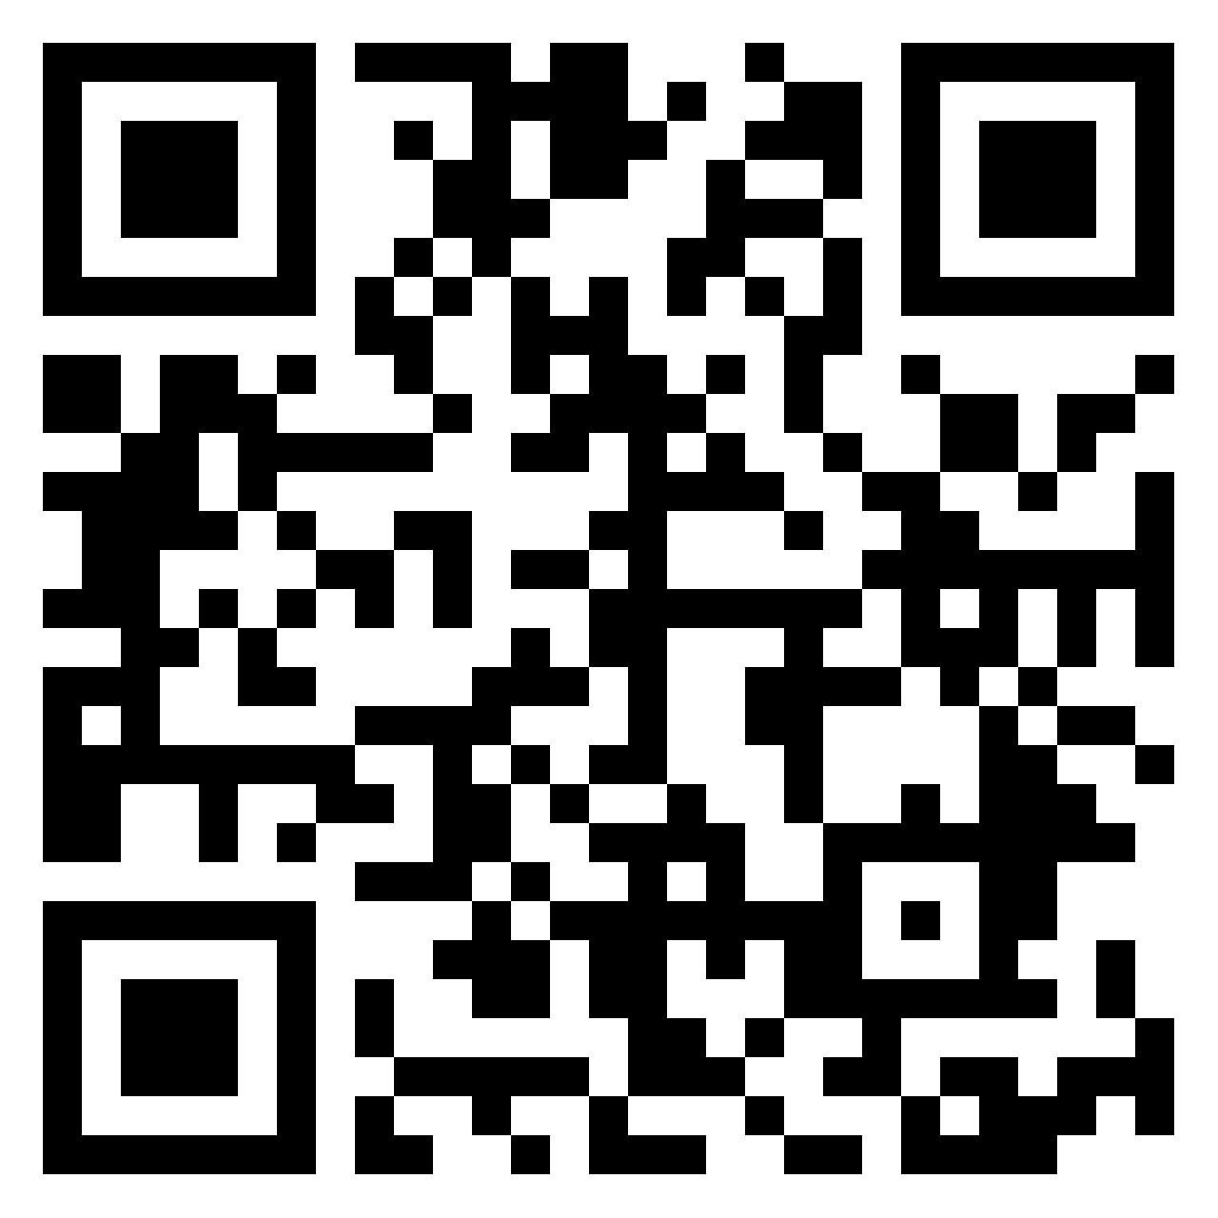
3-2-1
Add the following to the Padlet:
  The 3 technologies you use most often
  Your 2 favorite technologies
  1 example of your students’ favorite technology
bit.ly/321ele
Notes:
K20 Center. (n.d.). 3-2-1. Strategies. https:/te/learn.k20center.ou.edu/strategy/117
K20 Center. (n.d.). Padlet. Tech Tools. https://learn.k20center.ou.edu/tech-tool/1077

Slide 3

Airplane Landing
Choose one of your technologies, and explain how it is currently used in your classroom.
Give your answer in your assigned “landing order,” even if a very similar answer has already been given.
Notes:
K20 Center. (n.d.). Airplane landing. Strategies. https://learn.k20center.ou.edu/strategy/78

Slide 4
How can technology be used to support authentic learning?
Notes:
This is the essential question for the session. Pose it and briefly allow participants to discuss with their table how they have possibly used tech to create student-centered learning experiences. Some may summarize what was shared among their table group.

Slide 5

Honeycomb Harvest
Sort the honeycomb cards based on how you and your partner(s) feel they make sense.
Items that connect should touch.
You can use multiple honeycombs or one large honeycomb.
Notes:
https://docs.google.com/document/d/1ariKCUe16g00bJrv44JFa421_ltZ8F9sS9c13mUCv9c/edit?usp=sharing
K20 Center. (n.d.). Honeycomb harvest. Strategies. https://learn.k20center.ou.edu/strategy/61

Slide 6
Authentic Use of Technology Handout
Compare the handout to your honeycomb harvest.
How does the handout organization compare to your honeycomb(s)?
What action(s) stood out to you? Why?
Notes:
K20 Center. (n.d.). Honeycomb harvest. Strategies. https://learn.k20center.ou.edu/strategy/61

Slide 7

Group Reflection
Think back to the technologies you shared in the 3-2-1 activity.
Which Component(s) of Authenticity do they promote?
  Student-Centered Learning
  Construction of Knowledge
  Inquiry-Based Learning
  Real-World Connections
Notes:
K20 Center. (n.d.). Padlet. Tech Tools. https://learn.k20center.ou.edu/tech-tool/1077

Slide 8

Three Corners
Choose a corner that best matches your comfort level with using technology in the classroom:
  Tech Wizard
  Computer Comfort-Zoner
  AV-Avoidant
Notes:
K20 Center. (n.d.). Four corners. Strategies. https://learn.k20center.ou.edu/strategy/138

Slide 9
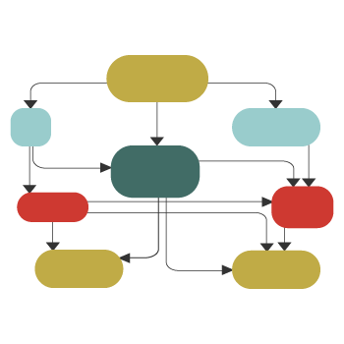
Standard Operating Procedure (SOP)
In your group, create a Standard Operating Procedure for choosing technology that supports Authenticity.
An SOP can be modeled as a flow chart, series of steps, or question-answer-flow model.
You can create a guide to specific technology or a technology-agnostic guide.
Reference the Authentic Use of Technology handout as you build your SOP.
Notes:
K20 Center. (n.d.). Standard operating procedure (SOP). Strategies. https://learn.k20center.ou.edu/strategy/89

Slide 10

What? So What? Now What?
Add to Menti:
  What is an idea that really stood out to you in this session?
  So what will you be looking for when choosing tech tools moving forward?
  Now what do you want to look into more? (e.g., tech tool, concept, etc.)
Notes:
K20 Center. (n.d.). What? So what? Now what? Strategies. https://learn.k20center.ou.edu/strategy/95
K20 Center. (n.d.). Mentimeter. Tech tools. https://learn.k20center.ou.edu/tech-tool/645

