Slide 2
Student-Centered Learning Climate (SCLC)
Engage to Excel

Slide 3
Essential Question
What is Student-Centered Learning Climate (SCLC)?
How can SCLC positively impact a school’s environment?

Slide 4
Session Objectives
Identify the themes of a SCLC
Understand key stakeholders in creating a SCLC
Explain the importance/impact of SCLC

Slide 5

What do you remember?
Navigate to: menti.com
Enter the join code: Insert join code here
Think about a time when you were a student.
Describe an experience that felt student-centered.
Notes:
K20 Center. (n.d.). Collective Braindump. Strategies. Retrieved from https://learn.k20center.ou.edu/strategy/111
K20 Center. (n.d.). Mentimeter. Tech Tool. https://learn.k20center.ou.edu/tech-tool/645

Slide 6

Themes of SCLC
With your partner, take a look at your card sort.
Sort the cards under the heading of leaders and teachers based on who you think is responsible for that action.
Notes:
K20 Center. (n.d.). Card sort. Strategies. https://learn.k20center.ou.edu/strategy/147

Slide 7
Themes of SCLC
Rotate to the next theme in your group.
Review how the cards are sorted and make changes as needed.
Put a sticky note with an explanation next to each change you make.
Repeat for the last theme.
Notes:
K20 Center. (n.d.). Card sort. Strategies. https://learn.k20center.ou.edu/strategy/147

Slide 8

Think About it
As you read the infogram, mark the following information:
Draw a star next to the main idea(s).
Write an exclamation point by your favorite part(s).
Write a question mark where you are unsure about something.
Draw a heart where you see information about the importance of SCLC.
Notes:
K20 Center. (n.d.). Thinking notes. Strategies. Retrieved from https://learn.k20center.ou.edu/strategy/178

Slide 9
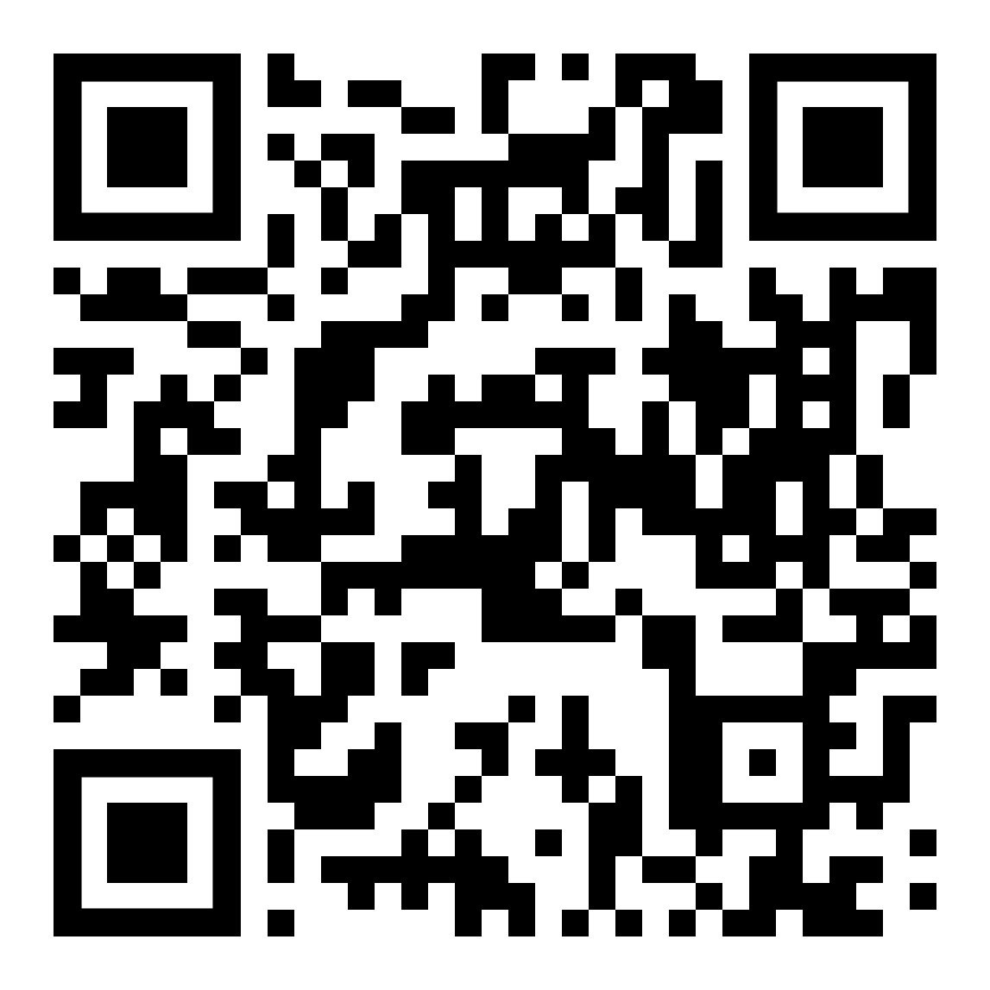
Themes of SCLC
Now take a look at the card sort in front of you.
Is there anything you would change?
Make adjustments based on what you have learned.
Share with your group the final version of your card sort.
Notes:
K20 Center. (n.d.). Card sort. Strategies. https://learn.k20center.ou.edu/strategy/147
SCLC Infographic: https://infogram.com/1pzd0glyly0g12a29jyrzgerp2t1kgjz3zm?live

Slide 10

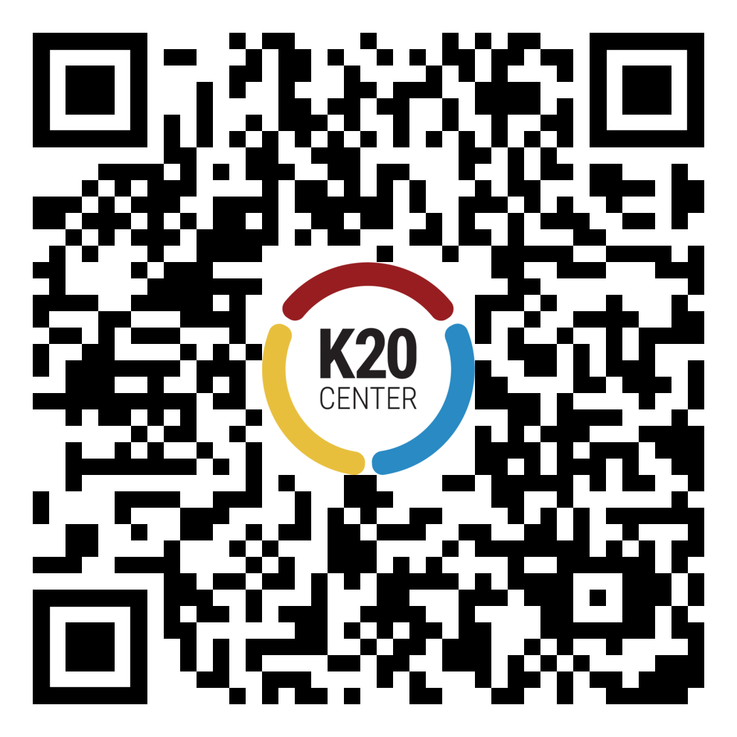
Two Stars and a Wish
Write down the two SCLC themes that you know the most about now.
Write down one SCLC theme that you want to learn more about.
Notes:
K20 Center. (n.d.). Two stars and a wish. Strategies. Retrieved from https://learn.k20center.ou.edu/strategy/83

