Slide 1
Welcome! While waiting…
Identified strategies on your anchor chart (Pre-work).
Write each strategy on a sticky note and place it on the bottom part of the poster that best reflects its purpose within the Authenticity Framework.
At your table, complete the Name Tent Activity.
Directions on the whiteboard
Notes:
Posters around the room.

Slide 2
School
Content/ Grade
Name
Fictional character that represents you
Fun fact about you

Slide 3
LEAD
Leading Educators in Authentic Development
Shelby Blackwood, GEAR UP for MY SUCCESS
Bailie Cobble, GEAR UP for MY SUCCESS
Amber Hale, GEAR UP for MY SUCCESS
Patricia McDaniels-Gomez, GEAR UP O+K=C
Mariah Warren, GEAR UP for the FUTURE Jared Whaley, GEAR UP for the FUTURE
Evalyne Tracy, GEAR UP for the FUTURE
Notes:
5 mins
Name, title, grant, subject, location of teaching (city/state)

Slide 4
Introductions
OKC
FUTURE
GUMS
Notes:
10 min
(name + grant)

Slide 5
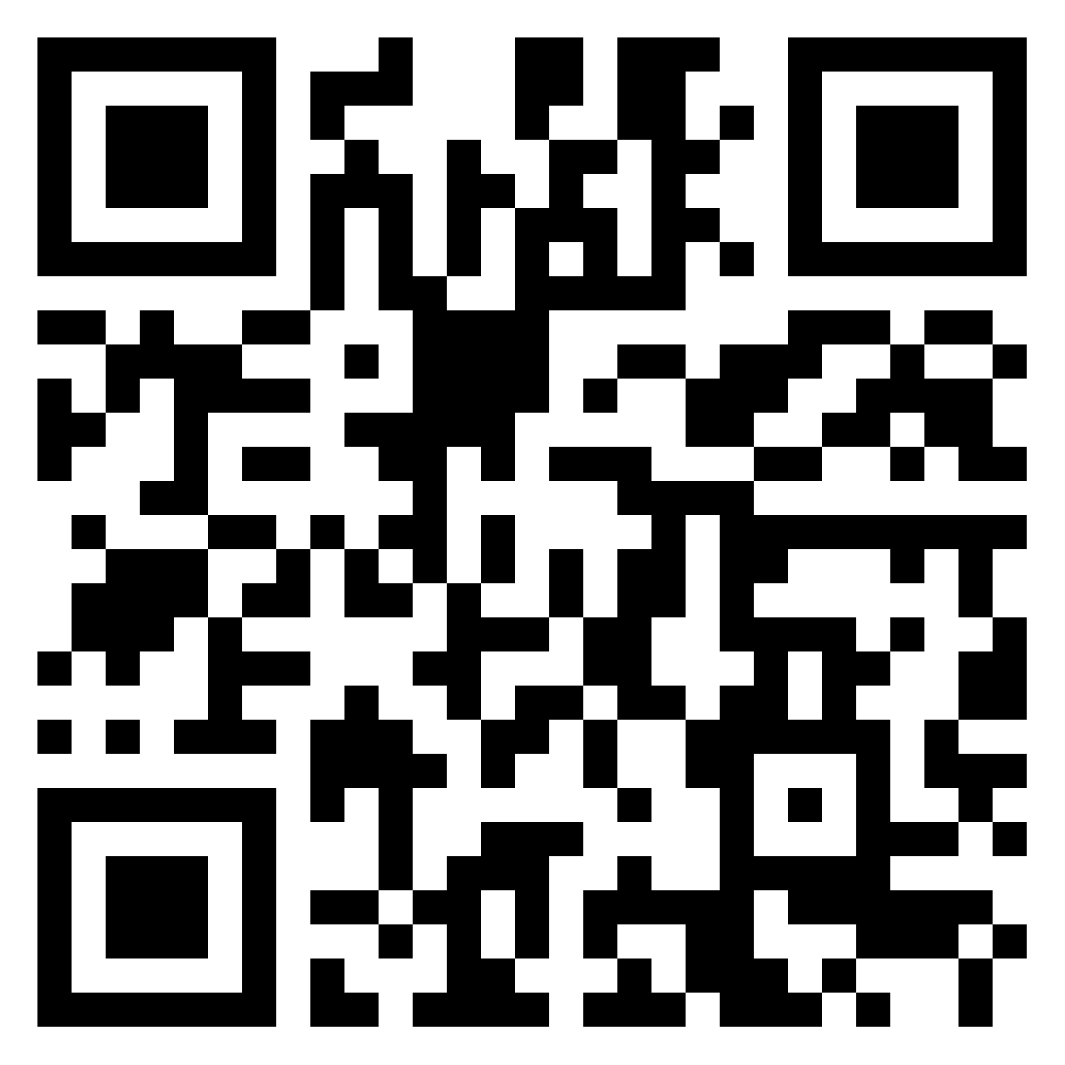
Pick - a - Pic
Find a photo/image that reflects how you are feeling today or something you would like to share.
Post the image on the Padlet and be ready to share out!
k20.ou.edu/pickapiclead
Notes:
Shelby
10 - 15 mins
Participants introduce themselves, school, returner, subject, etc.
https://k20center.padlet.org/lhawkins/pictures

Slide 6
Paperwork
Memorandum of Understanding
Talent Release
Supplier Form- Payment can take up to 12 weeks
Lunch
Notes:
Shelby
We will do mileage on Day 2
5 min

Slide 7
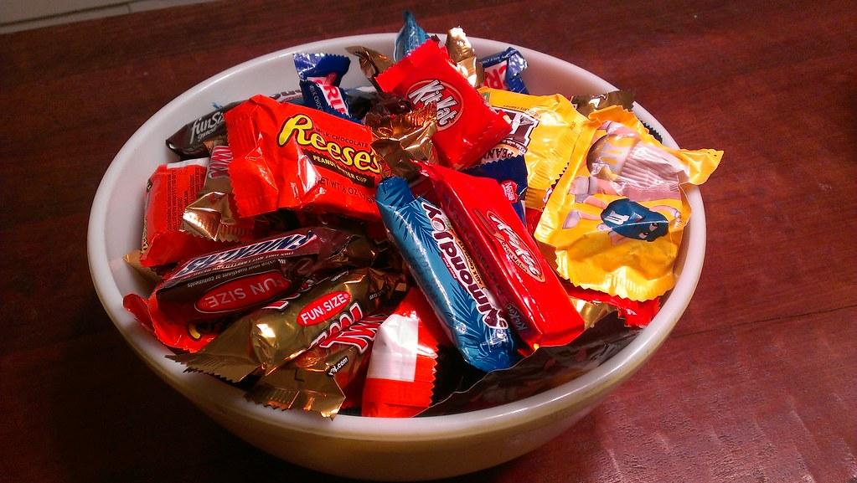
Sweet Talk
Choose one piece of candy.
Notes:
Bailie
(3min)
get a piece of candy
find someone you don’t know that has the same piece of candy (round 1)
discuss the question your candy is tied to
find someone you don’t know that has a different candy than you (round 2)
discuss both questions in pairs

Slide 8
Share the answers that correspond to your candy selection.
Laffy Taffy - What is the best professional development you have received that made an impact on your teaching?
Twix - What teacher or teachers helped you be successful? How did they help you?
Kit Kats - What do you believe are the biggest challenges your students face in the future?
Notes:
Bailie
(12min)
3 mins round 1 - same candy partners, discuss the question
5 mins round 2 - different candy partners, discuss both questions
(15 mins total)

Slide 9
GEAR UP for the FUTURE & for MY SUCCESS
Goal 1: Increase the percentage of students who are academically prepared for postsecondary education upon graduation from GEAR UP schools.
Goal 2: Increase the high school graduation rate and postsecondary education enrollment rates of GEAR UP schools.
Goal 3: Increase GEAR UP students’ and families’ knowledge of postsecondary education options, preparation, and financing.
GEAR UP for O+K=C
Goal 1: Increase percent of students who report they are engaged in learning.
Goal 2: Increase GEAR UP OKC students academic preparation for PSE upon graduation.
Goal 3: Increase GEAR UP OKC schools’ high school graduation rates and PSE enrollment.
Goal 4: Increase GEAR UP OKC students’ and families’ of PSE options, preparation, and financing.
Notes:
Jared (2 mins)

Slide 10
Why LEAD?
Shared Leadership
In the school environment, shared leadership can extend beyond definite limits to be shared with all staff as long as the focus remains on student achievement (Cobanoglu, 2020; Torres et al., 2020).
This type of leadership builds capacity for change and improvement through cultivating leadership at all levels of the school to empower others to also take on decision-making (Grice, 2019).
Notes:
Jared 8 mins
LEAD teachers share out a few opportunities that LEAD
What is shared Leadership?
Why do we do shared leadership in LEAD?
Source of research:
Dampson, D. G., Havor, F., Laryea, P. (2018) Distributed leadership an instrument for school improvement: the study of public senior high schools in Ghana. Journal of Education and e-learning research, 5(2) 79-85. Retrieved from: https://eric.ed.gov/?id=EJ1173265
Lambert, L. (2002). A framework for shared leadership. Educational Leadership, 59(8) 37-40. Retrieved from: http://www.ascd.org/publications/educational-leadership/may02/vol59/num08/A-Framework-for-Shared-Leadership.aspx

Slide 11
Today we will:
examine the role of authenticity in student learning and post-secondary readiness.
develop and practice the presentation skills of effective professional development for adult learners.
Notes:
1 min
Mariah

Slide 12
Authenticity
Think-Pair-Share
Using your pre-work,
Summarize authenticity in your own words.
Discuss how authenticity supports student learning.
Notes:
Mariah
9 mins
get papers/pre-work out
partner up
discuss topic

Slide 13
Authenticity
Choose one component from your anchor chart.
Move to that poster.
Max 6 per poster
Discuss the importance of this component.
Four Corners
Notes:
Mariah
7 mins
Take reading and anchor chart with you.
No more than 5 in a group so have a second or third in mind
Discuss that all participants have completed the pre-work and have some knowledge of authentic instruction

Slide 14
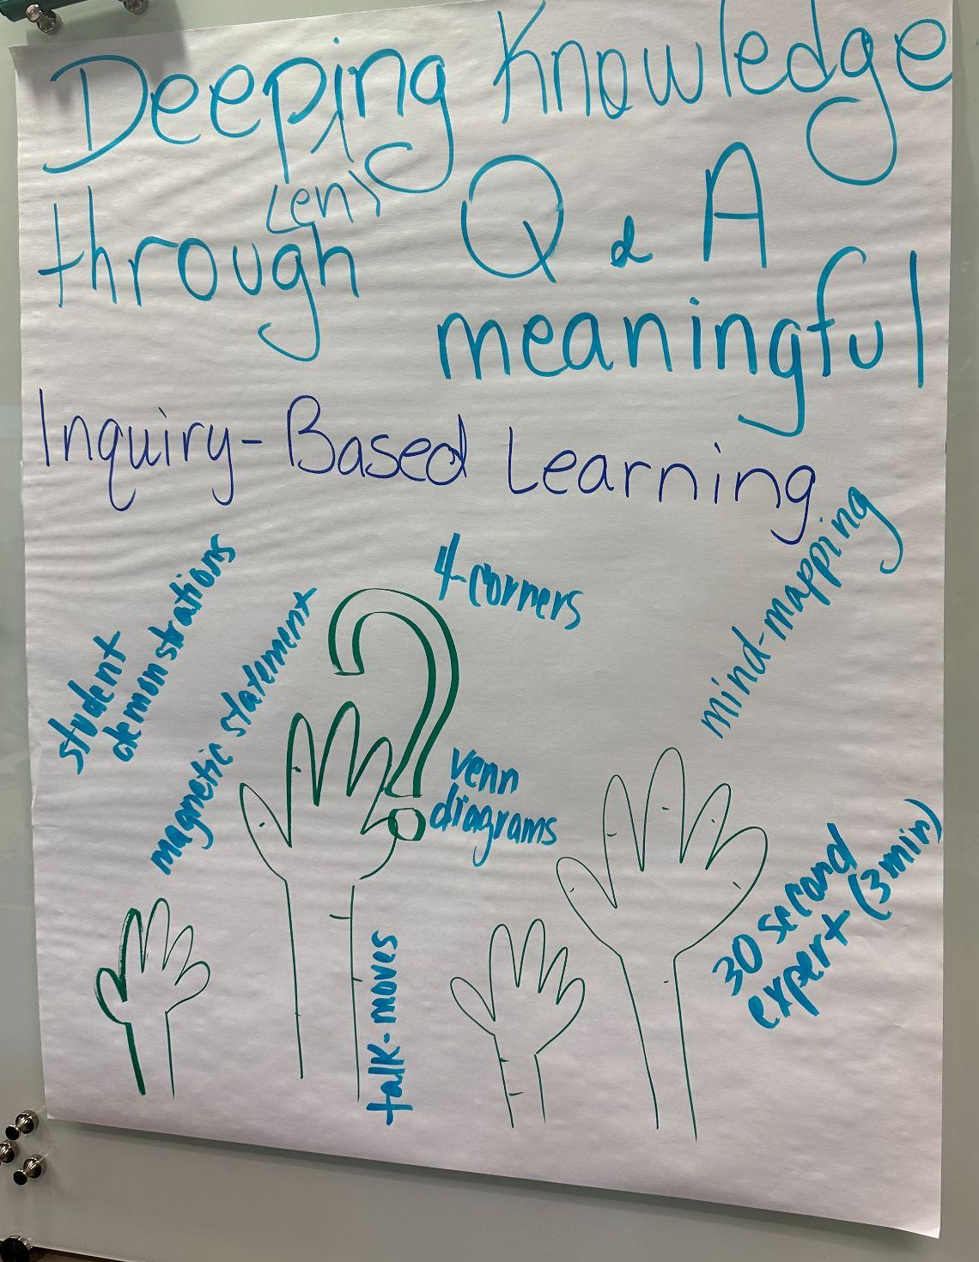
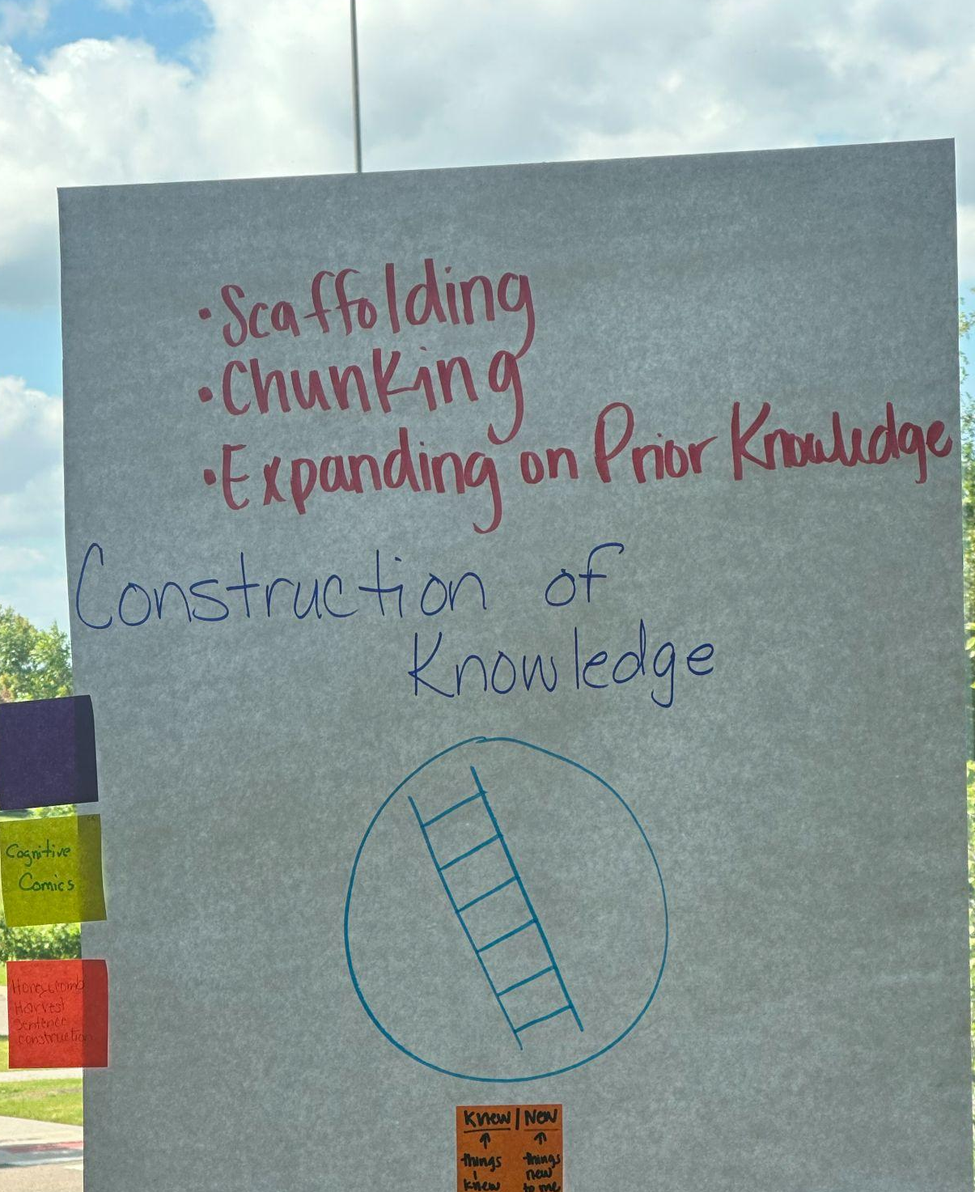
Authenticity
CSI
Above the title: With your group, summarize the component of authenticity and how it supports student learning.
Below the title: Choose a color, create a symbol, and draw an image.
Bottom: Select an example strategy that reflects this element. (Use the sticky notes as possible examples.)
Notes:
Amber
13 mins
Have groups share out their CSI
Activity examples

Slide 15
LEARN Strategy & Tech Reflection
Padlet
Think-Pair-Share
Four Corners
CSI
Notes:
Amber
10 mins
Go through as a group the strategies and help participants write down what is and how they might apply it in your classroom. Quickly discuss each strategy individually. Share out something you heard from another participant that you thought was a great idea of how to implement.
Padlet – Padlet is a web app that works like a digital bulletin board. Students and teachers may use Padlet to share ideas and collaborate by posting notes, text, and images to the board.
Think-Pair-Share – In this activity, students collaborate with a partner to brainstorm and share ideas. This strategy can be used in a variety of ways to get participants thinking, communicating, and collaborating.
Four Corners – This strategy groups students by their level of agreement with a prompt so they can discuss their views with people of like mind before debating them with groups that hold different views.
CSI – This instructional strategy allows participants to explore a new concept without using written words or oral language.

Slide 16
Break time!
Notes:
timer.k20center.ou.edu/15m
15 min? https://timer.k20center.ou.edu/15m

Slide 17
College or Career Success
With your table, think about the skills that students need to be successful in a career or college.
Brainstorm as many skills as possible in four minutes.
Collective Brain Dump
Notes:
Trisha
5 mins
Use blank paper to record your answers.
We are doing this for kids and their future. It goes back to the WHY and the GEAR UP Goals.

Slide 18
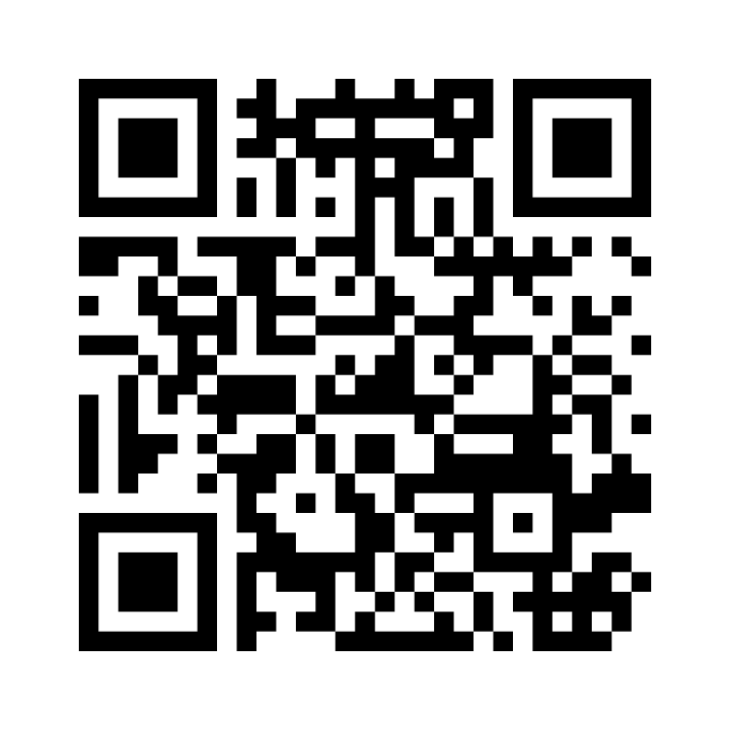
Mentimeter
Go to menti.com
Use this code: 9221 9958
Write four or five phrases from your list.
*Mentimeter is a free interactive software for polls, brainstorming, and presentations.
Notes:
Trisha
8 mins
https://www.mentimeter.com/app/presentation/bl4s5hdwk4hdignfrb5u6yfy2mutfbsh
Each table adds their list to a mentimeter (flowing grid or speech bubbles) We can create a wordle on Mentimeter

Slide 19
Table Talk
Compare the skills generated on Mentimeter with the elements of authenticity to address this question.
How can implementing the components of authenticity help teachers prepare students for pursuing post-secondary opportunities?
Notes:
Shelby
5 mins - 10mins

Slide 20
Elevator Speech
Choose one component of authenticity.
Think about what you want to say.
Jot down some important ideas.
Create a 60 second speech, describing an element of authentic instruction and how it can support a student’s college and career readiness.
Notes:
Jared & Bailie
10 mins
Tables divide up into partners. Partners stand up and find a quieter place in the room. One person starts while facilitators time it. Then the partner gives feedback on content. Second partner elevator speech. Use protocol of a star and a wish. Change partners.
https://timer.k20center.ou.edu/10m

Slide 21
Elevator Speech Reflection
Two Stars and a Wish
Present your elevator speech to a partner.
After the speech, reflect upon the content using Two Stars and a Wish:
“I like that I _______and _______.
I wish I had done this__________.”
Partner then shares their speech and reflects in the same manner.
Notes:
Bailie & Jared
7 mins
Tables divide up into partners. Partners stand up and find a quieter place in the room. One person starts while facilitators time it. Then the person that presented the elevator speech reflects and says what they liked and what they wish they had done. The person listening my give a Star also, but will not give a wish. Second partner shares their elevator speech and then also reflects on their own speech.

Slide 22
LEARN Strategy & Tech Reflection
Collective Brain Dump
Mentimeter
Table Talk
Elevator Speech
Two Stars and a Wish
Notes:
Mariah
10 mins
Go through as a group the strategies and help participants write down what is and how they might apply it in your classroom. Quickly discuss each strategy individually. Share out something you heard from another participant that you thought was a great idea of how to implement.
Collective Brain Dump – Students access previous knowledge by first working independently and then with a group to brainstorm list that defines a given topic before creating a whole-class list together.
Mentimeter/Wordle – Mentimeter enables you, while teaching, to visualize your students' opinions with real-time graphs and charts. Get input from in-person or online students with live polls, quizzes, word clouds, Q&As, and more. This allows for live interaction between you and your students with the web-based mobile polling app, ensuring that everyone is a part of the presentation.
Elevator Speech – This strategy encourages students to prepare and deliver short persuasive speeches using a version of the "elevator speech" concept. Students hone their public speaking skills as they persuade their peers to consider the validity of a topic.
Two Stars and a Wish – Two Stars and a Wish is a reflection strategy designed to provide student feedback via peer- and self-assessment. Students consider a recent activity, lesson, event, etc., and respond with two positive (stars) and one hopeful (wish) reflection.

Slide 23
LUNCH!
Notes:
around 11 - 12:30PM

Slide 24
Quiz, Quiz, Trade - Oklahoma Facts
Grab a card!
Hold the question side outward and the answer side (italicized) toward you.
With other hand, put it in the air.
Find a partner who also has a hand in the air. Fist bump or high five.
Introduce yourself
Quiz each other. Switch cards.
Put hand in the air and find another partner who has a hand in the air.
Keep Going!
Notes:
Amber and Trisha
15 mins
Ppl Bingo
back to school stories
Oklahoma questions
https://www.theteachertoolkit.com/

Slide 25
Adult Learning: Review Relay
To review the needs of the adult learner:
Line up as a team.
Each team member will select a word and place the word in a sentence that makes the most sense.
Teams will compare answers
Notes:
Shelby
15 mins

Slide 26
Categorical Highlighting
What are the characteristics of effective PD?
What do adult learners need for professional development?
Categorical Highlighting
Notes:
Bailie & Amber
15 mins
Read and highlight with both colors looking for both effective PD and adult Learners need. There might be some overlap (green)
Divide Group in half. Some underlining what are the characteristics of professional development and the other half, what do adult learners need.
Pass out handout after the relay. Discuss what knowles mean.
Malcolm Knowles (considered the father of adult learning theory)
move from dependent learners as children to self-directed learners as adults
adults learn because they want to
adults have had bad PD experiences in the past; informal learning is best (active engagement/learning can be informal)
wants to apply knowledge immediately; relevancy
motivation to learn is internal
adult learning should be process centered instead of content oriented
Ask participants to share after research.
Pass out handout after the relay. Discuss what knowles mean.
https://docs.google.com/document/d/18HnbHTaych1K2W8qZw49OMI6icr5b0gW/copy

Slide 27
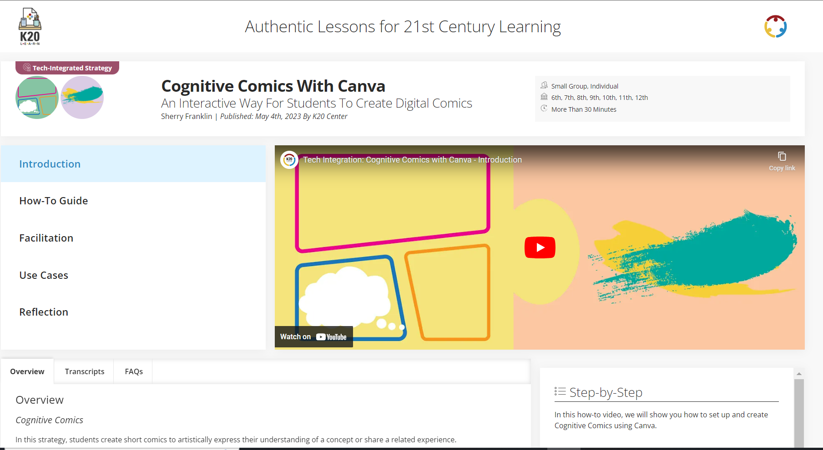
bit.ly/K20CCC
Notes:
Jared

Slide 28
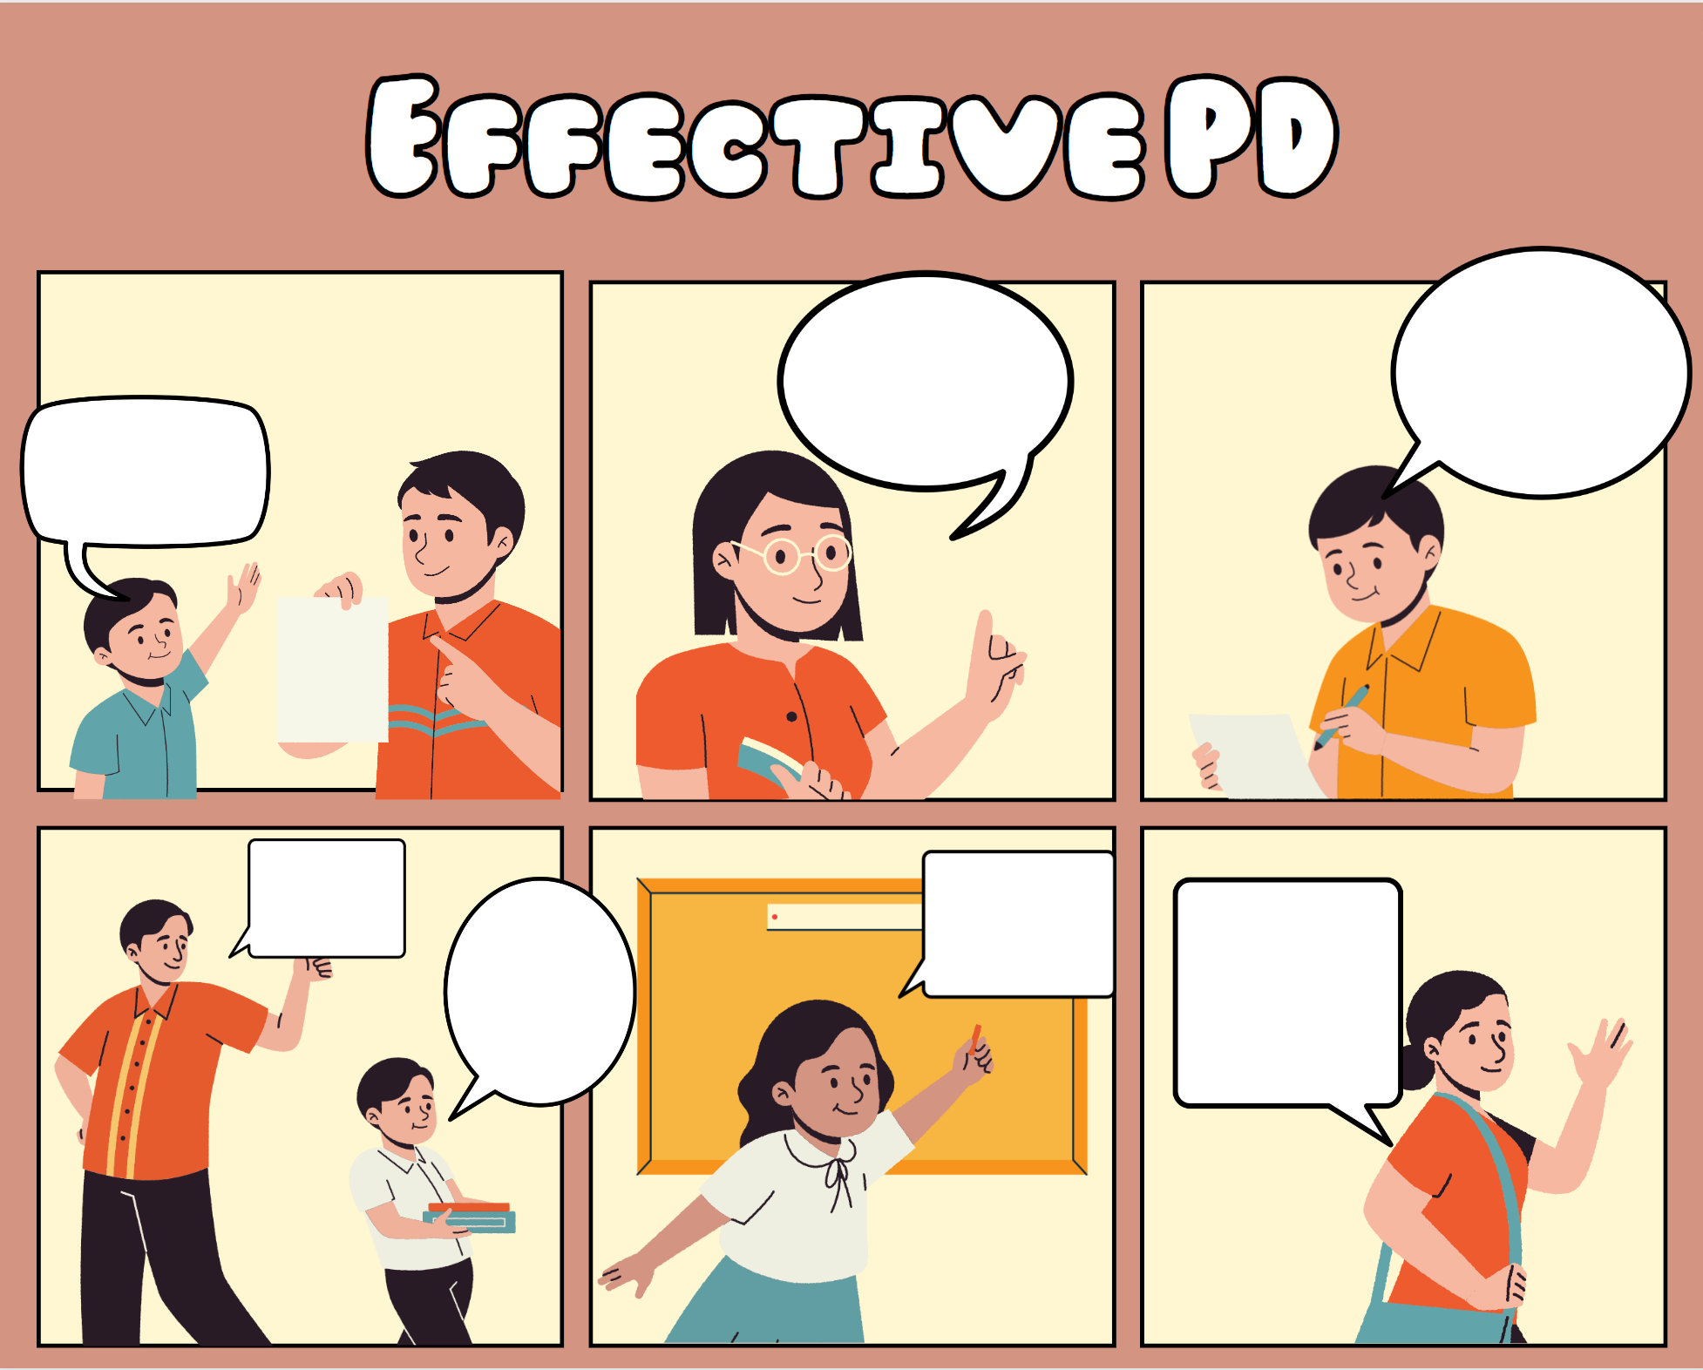
Cognitive Comics
Use your categorical highlighting to create an effective PD scenario using one of the provided comic templates.
When finished, click “share” and download as a PNG file.
Post your PD Comic on Padlet.
k20.ou.edu/cogcom
Notes:
Jared

Slide 29
LEARN Strategy & Tech Reflection
Quiz, Quiz, Trade
Categorical Highlighting
Cognitive Comics
Tech Integration with Canva
Notes:
10 min - Trisha
Go through as a group the strategies and help participants write down what is and how they might apply it in your classroom. Quickly discuss each strategy individually. Share out something you heard from another participant that you thought was a great idea.
Quiz Quiz Trade –This strategy allows participants to review information together by asking and answering questions with a partner. This collaboration fosters active engagement and discussion.
Categorical Highlighting – This strategy actively engages readers in a text as they look for and annotate information that fits in predetermined categories of interest or importance.
Cognitive Comics – This strategy allows participants to artistically express their understanding of a concept or related experience.

Slide 30
Break time!
Notes:
timer.k20center.ou.edu/15m
15 min? https://timer.k20center.ou.edu/15m

Slide 31
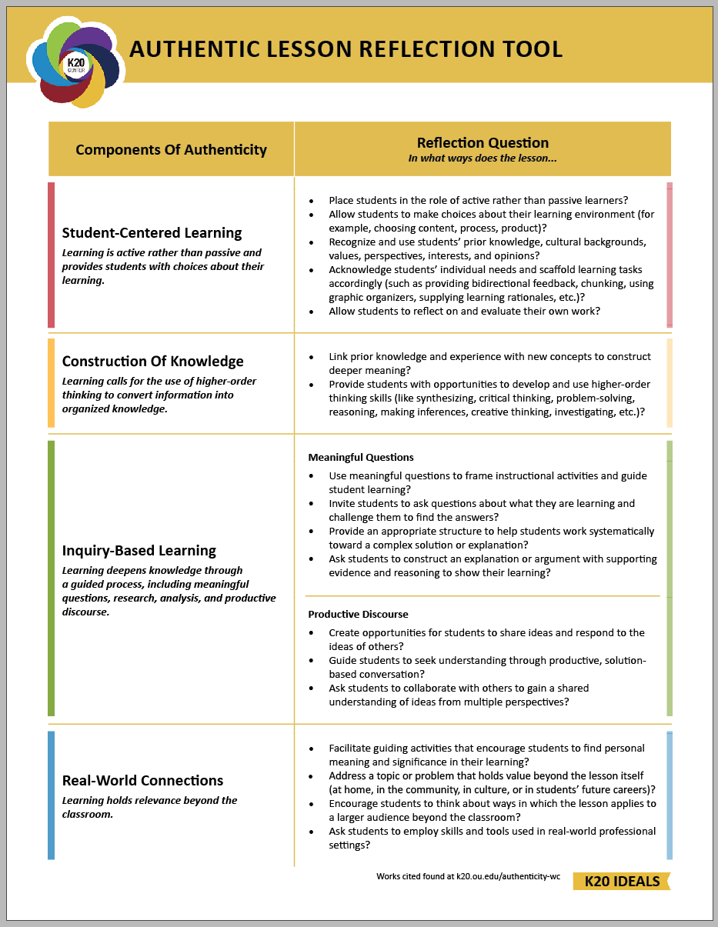
Reflect on Authentic Teaching and Learning
Notes:
Mariah
15 mins
Individually, Think about the activities from today… using these questions identify activities/tasks that have addressed these questions. Be prepared to share out.

Slide 32
Owning the Learning
Owning the Learning: Intentional Student Choice
Read through the professional development.
While reading, use the authenticity reflection sheet to identify components of authenticity within the PD.
Notes:
Trisha
45 mins
PD from the LEARN repository
30 mins to first read and identify
5 mins to share a few
10 mins to finish what they can of the PD read through

Slide 33
Wrapping Up Day 1
8:30AM tomorrow!
Bring your charged laptop/Chromebook
Leave your folder, name tag, pens, etc.
Turn in paperwork you may still have in your folder.
Don’t leave anything valuable in the room.
Notes:
Mariah
20 mins

Slide 34
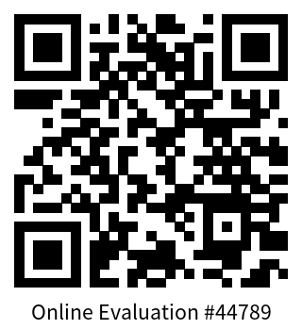
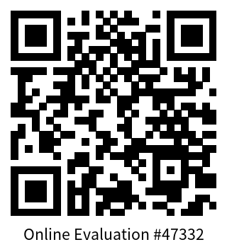
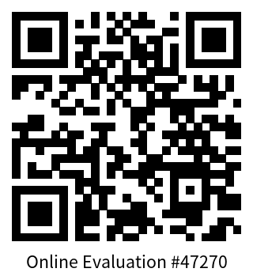
GUMS
OKC
GUF
Notes:
Mariah
5 min
This slide can be removed before publishing

Slide 35
Returners Stay!
Pam
Tonia
Jacqueline
Nivian
David
Tammy
Notes:
divide and practice fold the line and yes because

Slide 36
Paperwork
Mileage- Beginning and ending mileage address should be home or school site, whichever is closest to the K20 Center
Notes:
Shelby
5 min

Slide 37
LEAD
Day 2
Tonia Fairbanks, GEAR UP O+K=C, Douglass HS
Pam Higle, GEAR UP for MY SUCCESS, Marietta HS
Jacqueline Smith, GEAR UP for the FUTURE, El Reno HS
Nivian Rozumialski, GEAR UP for the FUTURE, MacArthur HS
David Rowden, GEAR UP for the FUTURE, Noble HS
Tammy Cooper, GEAR UP for the FUTURE, Shawnee HS

Slide 38
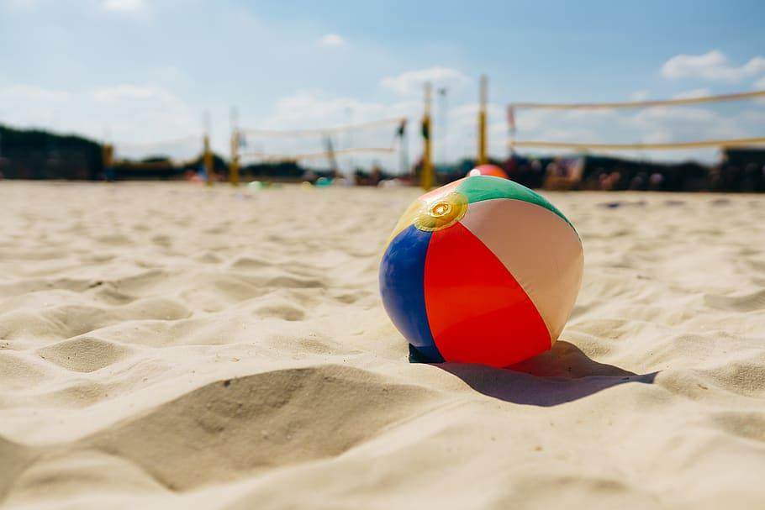
Beachball Buzz
When you catch the ball, answer the question your left thumb lands on.
Notes:
Tonia & Trisha
20 mins

Slide 39
Blue - Ever met anyone famous? Tell us more!
Orange - Most beautiful/treasured possession
Yellow - If I could travel anywhere . . .
White - The last time I worked incredibly hard
Red - A talent I wish I had
Green - I most admire . . .

Slide 40
5E Card Sort
With a partner,
Arrange the cards to best reflect a 5E model you would facilitate
Notes:
Pam & Shelby
10 mins

Slide 41
The 5E Model
Triangle Square Circle
Record 3 key points or main ideas.
What squared with your beliefs or teaching practices?
What is something you are still circling or thinking about?
Notes:
Pam & Shelby
15 mins
Read the 5E research
Use triangle square circle as the structure for reviewing and discussing.

Slide 42
5E Card Sort
Rearrange cards into a sequence that aligns with the research.
Did you change anything from your original sort?
Notes:
Pam & Shelby
10 mins

Slide 43
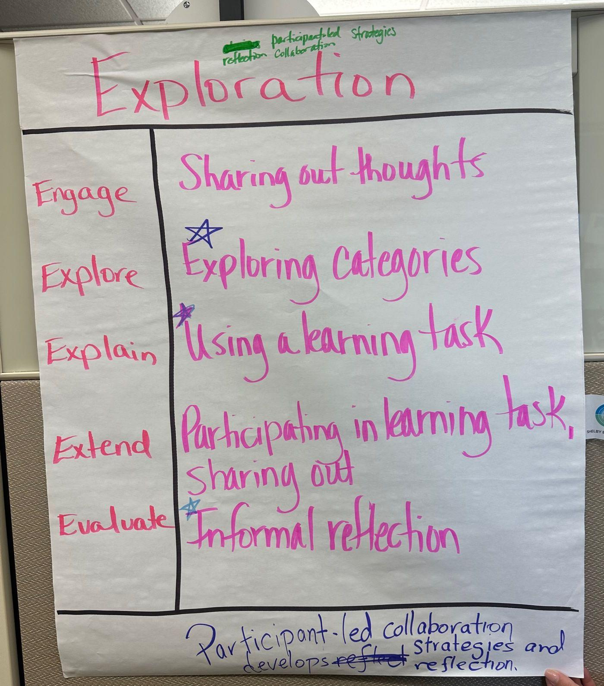
Owning the Learning: 5E Focus
Cornell
Notes
In your small group,
Analyze the PD narrative using the 5E document looking for your element.
On the chart paper, record examples and evidence of the assigned element.
Notes:
Jacqueline & Mariah
30 mins
Count off 1 - 5. Engage, Explore, Explain, Extend, Evaluate.
Use the 5E vetting tool and review the PD again, but focus on the elements of the 5E.
Look through the whole PD and focus on the questions for your part.
Jigsaw the 5Es into five groups and then Share out to the whole group taking turns with each E.
After teachers share out their E, ask them to consider how this PD could benefit their staff. BECAUSE As a LEAD teacher, you will be responsible for taking PDs like this one back to your site and facilitating them to your coworkers
Activity example photo link: BEFORE
Activity example photo link: AFTER

Slide 44
Six Word Memoir
How does this 5E PD support
authentic teaching and
learning for adults?
Answer this question using only six words.
Notes:
Jacqueline & Mariah (1

Slide 45
LEARN Strategy & Tech Reflection
Beachball Buzz
Card Sort
Triangle Square Circle
Cornell Notes
Six Word Memoir
Notes:
Tonia & Trisha
10 mins
Go through as a group the strategies and help participants write down what is and how they might apply it in your classroom. Quickly discuss each strategy individually. Share out something you heard from another participant that you thought was a great idea.
Quiz, Quiz, Trade – This cooperative-learning technique has students review information with other students by asking and answering questions. Working with peers in a nonthreatening manner builds confidence, encourages greater participation, and results in more thoughtful discussions.
Card Sort – This strategy is used in a variety of ways to organize prior knowledge about a concept or topic and has students practice argumentative communication by debating their answers with a group or partner.
Triangle Square Circle – This reflective strategy requires students to reflect and choose important pieces of information and question anything they don’t completely understand.
Jigsaw – This strategy breaks up complex readings into equal parts to be shared between multiple students. Doing so encourages students to share responsibility for each other's learning while developing group communication skills and practicing close reading.
Tweet UP – This strategy is used to help students synthesize and summarize information in a clear and concise manner.

Slide 46
Break time!
Notes:
15 min?

Slide 47
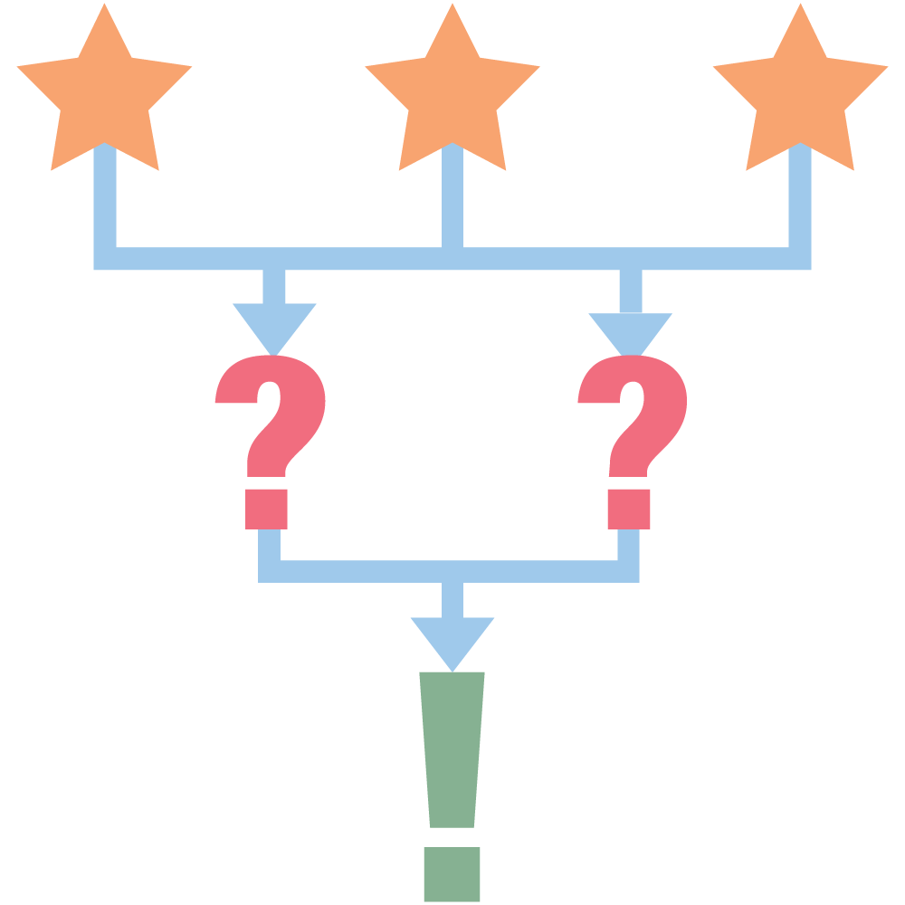
Tell Us About Your Own Site…
3 - What are three things your school is great at doing/implementing?
2 - What are two areas of need that could help your school grow?
3-2-1
Notes:
David & Jared 15 mins
Jot your thoughts on a post-it note.
3 things your site/school is doing well
2 things your site could improve on
1 PD that could support your needs.

Slide 48
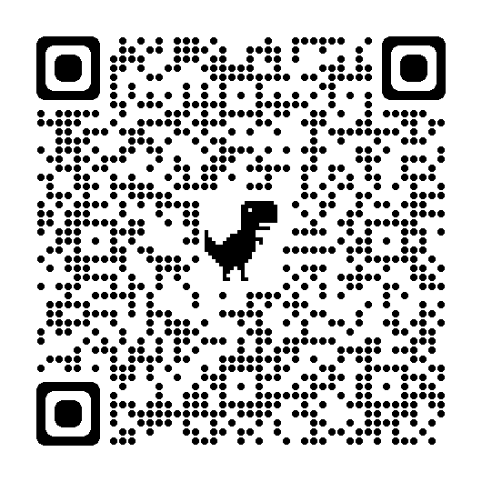
Extending To Your Own Site
1 - Find one K20 LEARN PD that addresses at least one of the needs you listed.
Submit your PD selection on the Google Form. bit.ly/pdsite22
Notes:
David & Jared 30 min.
3-2-1
1 - find one PD that addresses at least one of the needs you listed.
Submit your selected PD https://docs.google.com/forms/d/e/1FAIpQLSdXJlbM7Tq7H25iW4NplS6pH-57YiNSdA9lFGJM_uQaFDktew/viewform

Slide 49
LUNCH!
Notes:
around 12:00 - 1:45PM

Slide 50
PD Review
Review your PD (printed).
Answer the following questions:
How does the 5E narrative support authentic teaching and learning?
What makes these PDs good choices for your staff?
What E would be the most engaging, and why?
What E would be the most challenging, and why?
Notes:
Tammy & Mariah
20 minutes
Read through the PD you selected. As you read through it, reflect on the how the 5E Model narrative supports authentic teaching and learning.

Slide 51
What LEARN activity did you find for your site?
Move to the table that best represents your PD topic:
Academic Preparedness
Technology Integration
College and Career Awareness and Readiness
Student Engagement
Climate and Culture
Notes:
Tammy & Mariah
5 min.
Before lunch we asked you to browse the K20 LEARN site to find a professional learning experience that you believe would benefit the staff at your school. All of the professional learning experiences should fall into one of the following four categories: Student Engagement, Academic Rigor and Engagement, Technology Integration, or College and Career Awareness and Readiness.
Thinking back on the learning experience you chose, which category would it fall under? Change your Zoom name to one of those categories, Academic, Tech, or CCGC along with your name. This will help us put you into breakout groups.

Slide 52
What LEARN activity did you find for your site?
Share a brief description of the PD you chose.
In your small group, discuss the following:
How does the 5E narrative support authentic teaching and learning?
What makes these PDs good choices for your staff?
One E that would be the most engaging, and why?
One E that would be the most challenging, and why?
Notes:
Tammy & Mariah25 min.
in your small groups, share the following. Ask each other questions about the PDs selected if there is still time remaining.

Slide 53
How Nervous are you about presenting a PD?
1 I get the sweats just thinking about it!
3 Worried about some things, but feel okay about providing PD.
5 I’m a Rockstar and they’re lucky to have me provide PD!
Fold the Line
Notes:
Nivian, Jared, Amber, Bailie - 15 mins
Person #1:
Ask the whole group to thinking about the question, “How nervous are you about presenting PD?”
Review the three reference points on the slide (click three times to bring up all three).
Person #2:
Now that you have thought about where you might fall using these reference points, everyone is going to make a single line. So in a minute, you are going to line up in order 1 to 5. Ones will be on this side of the room and fives will be on the other (choose your location based on space available). Okay go now.
Person #3:
(Check that they are lined up) Now that you are lined up, we are going to fold the line in half. So, it’s like follow the leader. The last person (five at the end) will walk down here to stand in front of the first person (one at the start of the line). This will be your partner for our next activity.

Slide 54
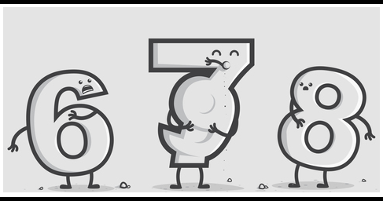
Combating Nervousness
Is six afraid of seven?… Yes, because...
Adapted from: Association for Talent Development. (2016). Understanding how adults learn best. ATD training skills. p. 2-16 – 2-18.
Notes:
Nivian, Jared, Amber, Bailie
20 min.
Person #1:
We are going to now talk about Combating Nervousness. Sometimes nervousness can also be fear and some of you might be a little afraid of facilitating PD at your site.
(Set up the Joke) [Name of Person #2] Is 6 afraid of Seven?...
Person #2
Yes, because seven, “eight” nine! (laughter hopefully). We have just modeled the Yes, Because strategy that we are going to use for exploring combating nervousness.
[Name of Person #1] is handing out the paper we will be using for this activity. You all are in two rows. Row 1 (pick a side) will read the statement on the paper and the partner standing on the other side will respond to the statement with “Yes, because…” and give a reason to support the statement. [Name of Person #3 and #4 are going to model the first one for you and then we will work our way down the line. Once we reach the end of the line we will finish by switching which row reads and which on responds.
https://k20.ekadence.com/faculty-portal/activities/147692/view?fromStateRouteName=classActivities

Slide 55
LEARN Strategy & Tech Reflection
3-2-1
Fold the Line
Yes, Because
Notes:
Tonia & Trisha
10 mins
Go through as a group the strategies and help participants write down what is and how they might apply it in your classroom. Quickly discuss each strategy individually. Share out something you heard from another participant that you thought was a great idea.
3-2-1 – This writing activity enables students to summarize their understanding of material, to evaluate understanding for gaps in knowledge, and to communicate this to their teacher.
Fold the Line – This strategy pairs students of opposing views or opposite levels of understanding together so they can discuss a prompt.
Yes, Because – This strategy reinforces speaking and listening skills, allowing students to add to peers' statements through summarizing, contributing, making connections, or affirming what others are saying. Students practice skills while engaged in conversation with others.

Slide 56
Break time!
Notes:
Jared
15 min?

Slide 57
PD Checklist
Notes:
Shelby
5 mins

Slide 58
Notes:
Mariah
10 min https://k20center.instructure.com/courses/65/files/3895/download?wrap=1
Engage/Explore
Review the PD cycle and why it is important to reflect on what you have accomplished and how you have supported continual learning at your site.
You are a support structure for growth. Think about your action plans, school objectives, and how to move forward to the next school year.
You can follow-up with teachers to help foster continual learning.
Don’t forget to invite teachers in to watch “new” strategies or technology you are using with your students. Offer modeling and co-teaching opportunities, as you have embraced taking on a LEAD role within your schools. This is a heavy lift, but you all are very compassionate about creating successful educational experiences and engaging learners with authentic teaching practices.

Slide 59
Upcoming Events!

Slide 60
LEAD Upcoming Events!
Quarter 1 Meeting
Tues August 29 @ 4:00pm-5:00pm
Fall Collaboration Day
Sat October 28 @ 8:00-5:00
Quarter 2 Meeting
Tues November 28 @ 4:00 PM- 5:00

Slide 61
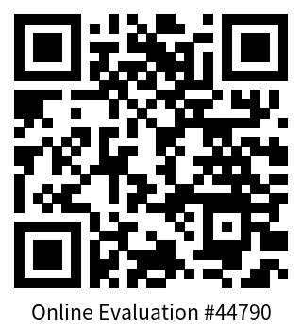
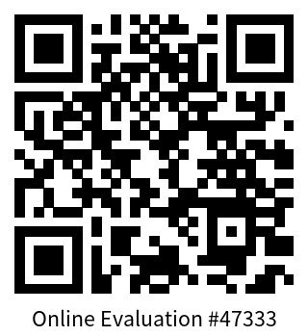
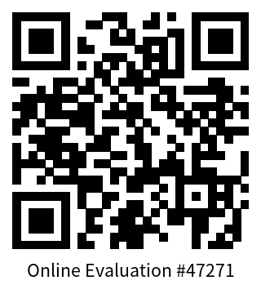
GUMS
OKC
GUF
Notes:
Mariah
Complete eval then divide into grant
5 min
This slide can be removed before publishing

Slide 62
Next Steps
Look for more communication from your PD Coordinator
PD 1 observation and debrief (may be the GEAR UP Overview)
Co-facilitate PD 2.
Identify cohort (11th- and 12th-grade) teachers you will support this semester. *Student attendance is required once a quarter - MOU
Questions?
Notes:
Trisha
5 min
What you have available and your situation will allow (use some ideas to help us drive summer lead opportunities)
Discuss the next steps teachers will take between now and the next LEAD session.
Each site will be different depending upon the PD plan and timeline. Follow up by reaching out to each participant and discussing their next steps.

