Slide 2
Discourse: Teacher Talk
K20 Center

Slide 3
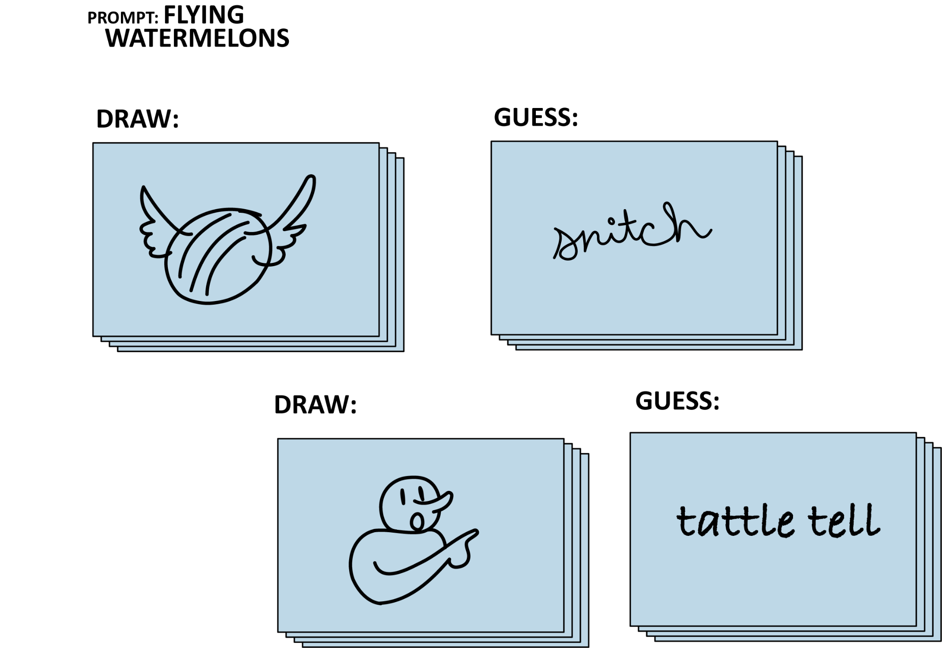
Notes:
It might help to explain that this is like the old-school telephone game except with drawing added to the mix. Or if they’ve played the party game Telestrations, this activity is a version of that. Then begin to hand out the stacks of note cards and prompts (folded to keep secret) and instruct each person to make sure they are the only person at their table who can read their prompt.

Slide 4


Paper Telephone
How to Play
Get into groups of 4-5 at your table.
Each player take a stack of cards.
Each player draws a topic for their first illustration based on the provided prompts.
Pass the stack to the next player who will view the card on top, move it to the back of the stack and then write their guess for the illustration topic.
Pass the stack again for the next player. View top card, move to back, then create a new drawing to represent what your read.
Repeat until the stack returns to the original player.
Share the interpretations.
Notes:
K20 Center. (n.d.). Paper telephone. Strategies. https://learn.k20center.ou.edu/strategy/3477
12 minutes

Slide 5

Characteristics of Healthy Discourse
Based on your experience with the Paper Telegphone game, what are some of the important conditions to set in order to have good communication?
Notes:
This game may not have been an example of “good” communication. So think for a moment about what conditions need to be in place in order to set the stage for good communication or healthy discourse.
Based on what people say, we will compile a list on poster paper or a white board.
How might the preceding activity been different if we has established these conditions beforehand?

Slide 6
Essential Question
How does effective discourse improve schools and student learning?
Notes:
1 min
This is our essential question for the day. As you participate in the activities, reflect on how the strategies model healthy discourse and how they could be used to improve discourse and thus student learning in the classroom.

Slide 7
Session Objectives
Identify the research-based elements of
effective discourse.
Apply concepts from research to a conversation.
Generate personal goals to foster discourse in their professional community.
Notes:
1 min

Slide 8

Chalk Talk: A silent debate
Participants silently walk around, reflecting on each topic or quote.
Write arguments on the poster paper.
Walk, read, and silently respond on other posters.
Notes:
Provide each table group a poster with a provided debate topic from the list written in the center:
Social media has ruined modern discourse
Cross-curricular discourse is always beneficial
Email v. Meeting
Gifs v. Emojis
Calling v. Texting
Grammar police v. grammar rebels
Participant can write down their contributions to each debate topic in pen or pencil on the chart paper in the space around the provided topic. They should read what their table members write and respond to each other, only by writing. There is no talking during this part of the activity, but there will be time to discuss later. Before beginning, ask to see if anyone has questions about the directions before you start a timer and silence is expected. Allow about 15 minutes for the silent part of this activity.
Next, set the timer to 15 minutes again and this time all participants can walk around the room to view other table’s papers and write in responses to the contributions already made for each topic.
After this timer participants can have time at their table to discuss their topics or any of the topics they’ve seen. During this time they should arrive at their table with an elevator pitch summary on the characteristics and values of productive discourse.
Have each table share their summary to the whole room.

Slide 9
Chalk Talk: A silent debate
Social media has ruined modern discourse.
Cross-curricular discourse is always beneficial.
Email is preferable to face-to-face meeting.
Gifs, which can convey motion and animation, are more effective than emojis.
Telephoning has been replaced by texting because texting is more efficient.
With the expansion of electronic communication, grammar is losing its importance.
Notes:
12 mins
Provide each table group a poster with a provided debate topic from the list written in the center:
Social media has ruined modern discourse
Cross-curricular discourse is always beneficial
Email v. Meeting
Gifs v. Emojis
Calling v. Texting
Grammar police v. grammar rebels
Participant can write down their contributions to each debate topic in pen or pencil on the chart paper in the space around the provided topic. They should read what their table members write and respond to each other, only by writing. There is no talking during this part of the activity, but there will be time to discuss later. Before beginning, ask to see if anyone has questions about the directions before you start a timer and silence is expected. Allow about 15 minutes for the silent part of this activity.
Next, set the timer to 15 minutes again and this time all participants can walk around the room to view other table’s papers and write in responses to the contributions already made for each topic.
After this timer participants can have time at their table to discuss their topics or any of the topics they’ve seen. During this time they should arrive at their table with an elevator pitch summary on the characteristics and values of productive discourse.
Have each table share their summary to the whole room.

Slide 10
Characteristics of Healthy Discourse
What would you change, add, or take away from our list?
Notes:
5 mins

Slide 11
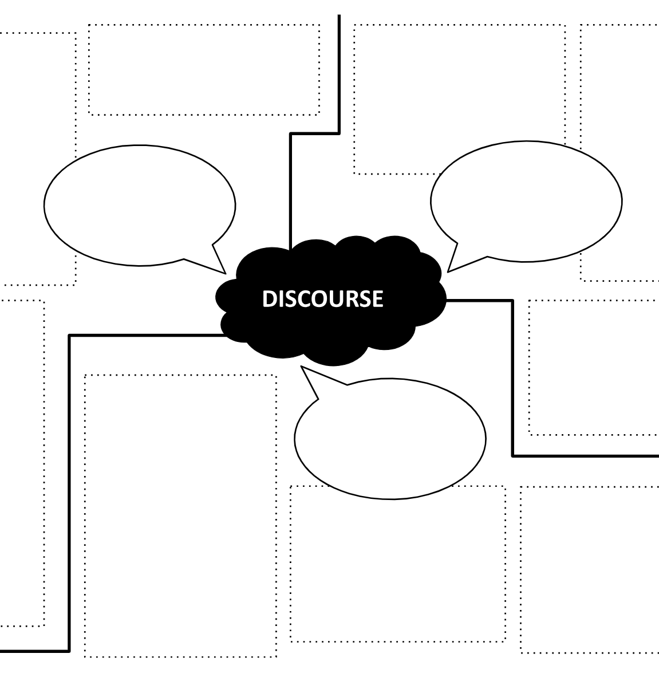
Research Brief
Read the “Teacher Talk” handout and/or access the practitioner brief at bit.ly/DiscourseBrief.
Demonstrate your understanding of the characteristics and values
of productive discourse on the Concept Map handout.
Notes:
Pass out the Practitioner Brief, Teacher Talk, and Concept map handouts. 10 mins
Look at one or both of these resources and use them to inform a concept map. Your map should demonstrate how you see the characteristics and values of productive discourse relating to one another. And I’m going to give away the next part. You will be sharing your map with a partner at your table, so consider how you’d structure these relationships in order to explain how you see the relationships to someone else.

Slide 12
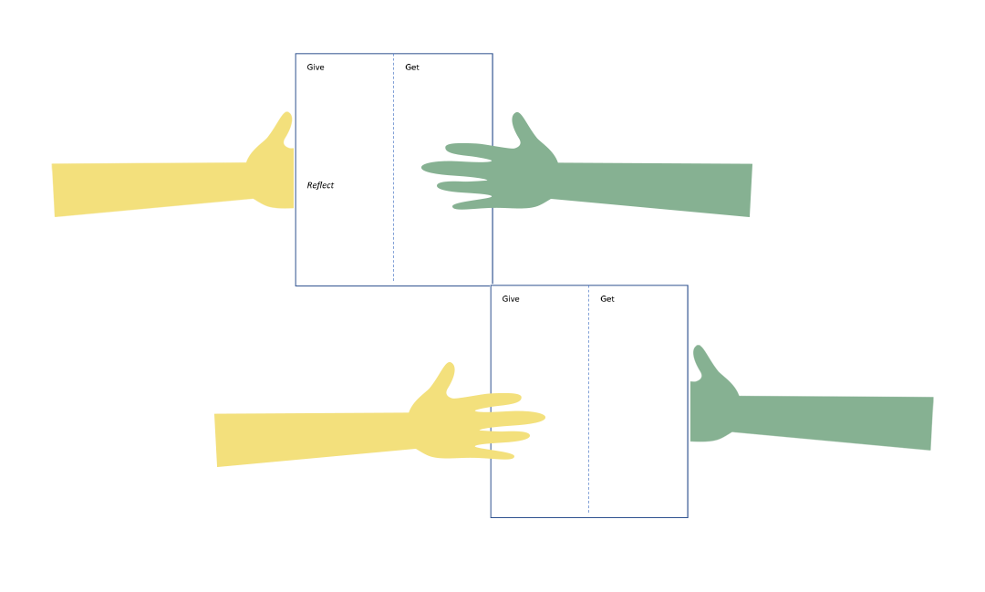
Give, Get, Reflect
Exchange concept maps with an elbow partner.
Discuss the similarities and differences between the concept maps.
Notes:
5 mins

Slide 13
Characteristics of Healthy Discourse
After reading the research and discussing with your partner:
Do you see anything on our list that needs revision or clarification?
Any that need to go?
Notes:
5 mins
We’ve revisited this list twice before, but this time you not only have your experiences in the activities to guide you, but also you’ve read the research, talked about the research with your table partners. So with that in your pocket, do you see anything on this list that needs revision, clarification.

Slide 14

Strike Out!
Write three goals for improving discourse on your Strike Out hand out.
Pass your paper to the person next to you. Mark out one goal from your neighbor’s paper you feel is the least important goal.
Repeat previous step.
Return handouts to original owner with only one goal remaining.
Narrow down to a single shared goal through discussion at your table.
Notes:
Make three goals for improving student learning or your school through discourse?

Slide 15
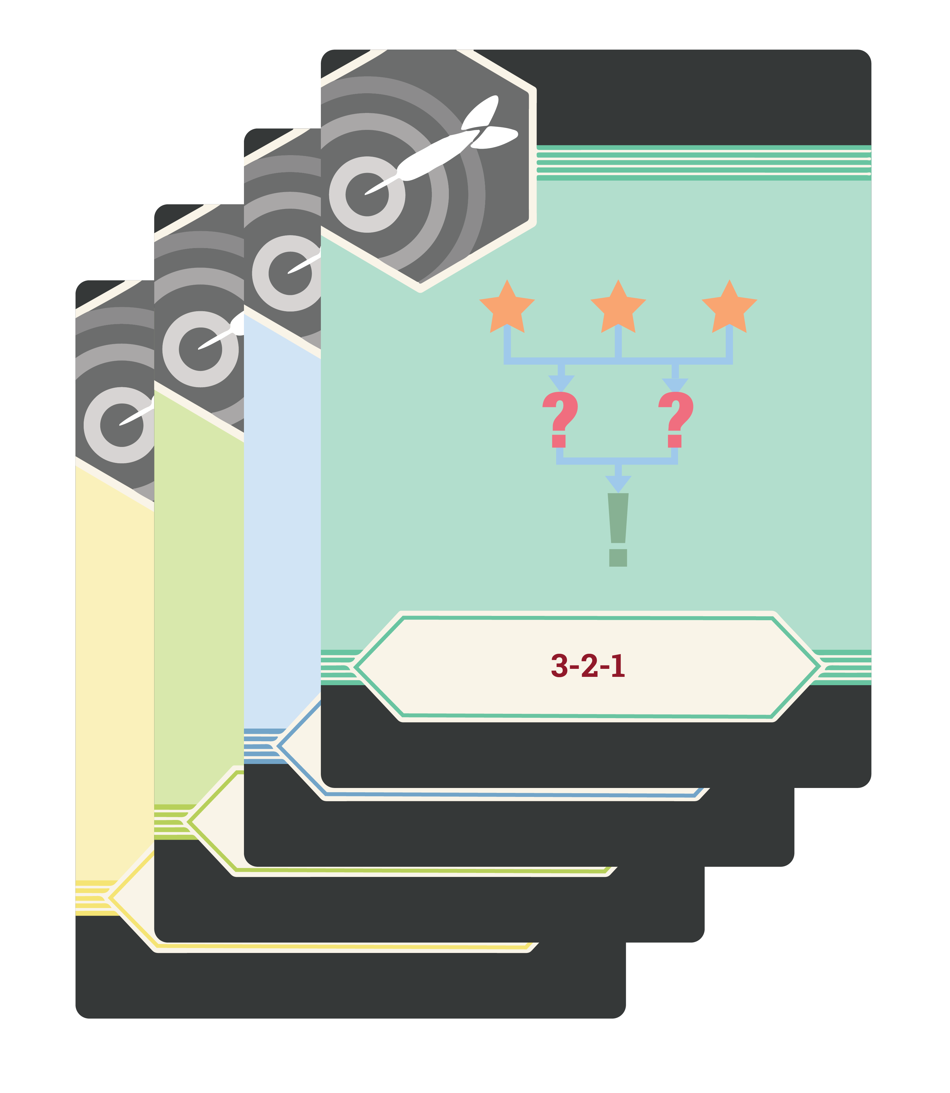
LEARN Strategy Reflection
Chalk Talk
Give, Get, Reflect
Strike Out!
Notes:
Talk about how the strategies covered during session model discourse
-

