Slide 2
Math in Action

Slide 3
Essential Question
How can math concepts be supported in all content areas?

Slide 4
AGREEMENT CIRCLES
IT IS EASY TO SUPPORT MATH CONTENT IN ANY SUBJECT AREA.

Slide 5
Learning Objectives
Identify parallels between problem solving and logical reasoning in math and in other content areas.
Learn about math strategies that can reinforce math objectives in your subject area.

Slide 6
AUTHENTICITY
VALUE
BEYOND SCHOOL
Connection is made between the lesson topic and actual situations or experiences and is explored in a way that allows students to create personal meaning and significance.
STUDENT-CENTERED LEARNING
Instruction provides student ownership of the learning environment focused on personal experience and prior knowledge with teacher and student sharing control of the learning.

Slide 7
STATS are FUN!
Find an elbow partner.
During this activity, you will construct a viable argument to address the essential question.
You will utilize the statistics given to support your argument.
Notes:
Read directions to participants. Allow them time to find an elbow partner, then move to next slide and present the question.

Slide 8
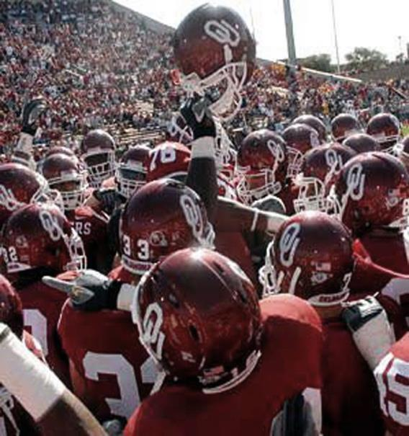
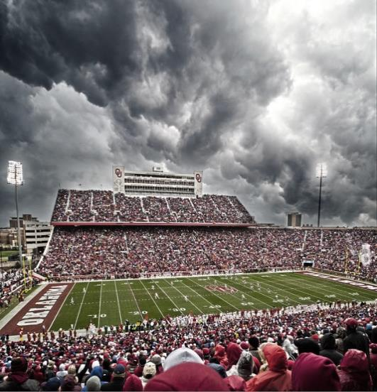
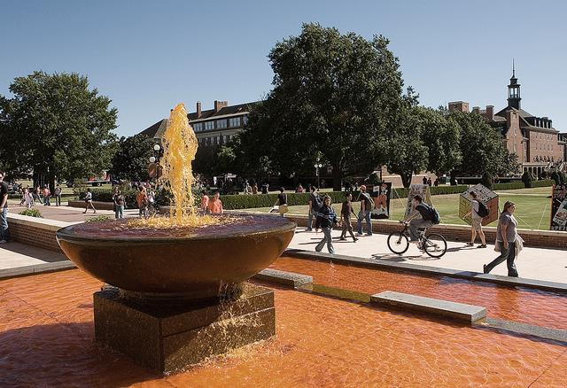
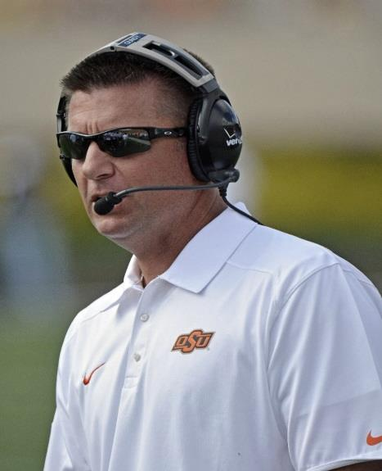
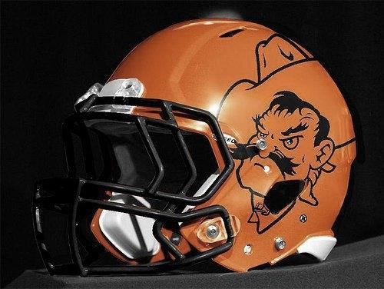
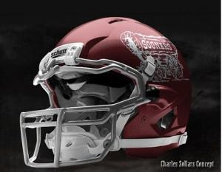
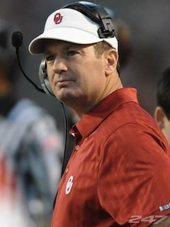
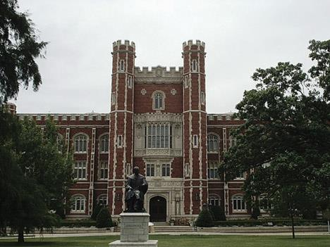
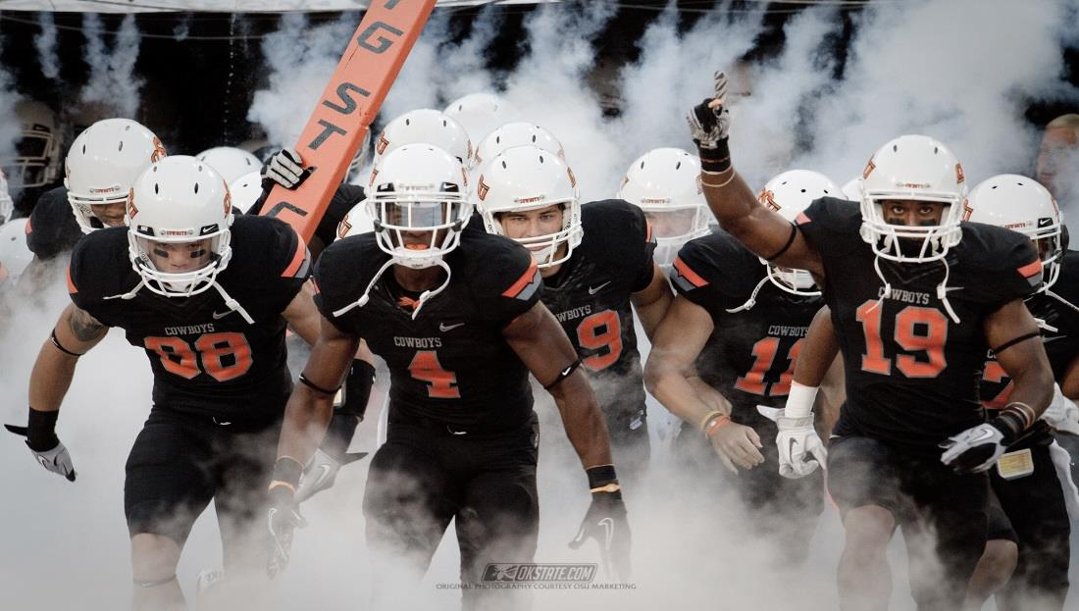
WHO IS THE
BETTER TEAM?

Slide 9
VS. STATISTICS
87, 405, 301, 165 | Rushing yards | 85, 183, 154, 200
150, 118, 171, 193 | Passing Yards | 274, 197, 440, 200
2(0), 0(2), 1(2), 1(2) | Turnovers | 0(1), 1(3), 0(3), 2(1)
12, 48, 41, 33 | Total Points | 42, 38, 49, 24
Notes:
Stats from:
Sports Reference LLC. (2000-2016). 2013 Oklahoma State Cowboys. http://www.sports-reference.com/cfb/schools/oklahoma-state/2013-schedule.html
Sports Reference LLC. (2000-2016). 2013 Oklahoma Sooners. http://www.sports-reference.com/cfb/schools/oklahoma/2013-schedule.html

Slide 10
OPPONENTS
Baylor
Iowa State
Kansas State
Bedlam
Kansas
Texas
Baylor
Bedlam
Notes:
Information from:
Sports Reference LLC. (2000-2016). 2013 Oklahoma State Cowboys. http://www.sports-reference.com/cfb/schools/oklahoma-state/2013-schedule.html
Sports Reference LLC. (2000-2016). 2013 Oklahoma Sooners. http://www.sports-reference.com/cfb/schools/oklahoma/2013-schedule.html

Slide 11
SHARE OUT
Who did your team decide was the best team, based on the information that you looked at?

Slide 12
CONTENT STANDARDS
Math––Construct viable arguments and critique the reasoning of others.
Science––Develop a logical relationship between evidence and explanation to form and communicate a valid conclusion, and suggest an alternative explanation.
Social Studies––Support claims with logical reasoning and relevant, accurate data and evidence that demonstrate an understanding of the topic or text, using critical sources.
English––Write arguments to support claims in an analysis of substantive topics or texts, using valid reasoning and relevant, sufficient evidence.

Slide 13
REFLECTION
How could this practice of constructing a viable argument be used in other content areas? (e.g., English, science, and history)
Why would this math practice be important in all areas?

Slide 14
AUTHENTICITY CONNECTION:
How does this lesson demonstrate the use of the
components of authenticity?

Slide 15
EVERYDAY IDEAS
Students compute their own percentages for grades in class
Breaking down math vocabulary in word problems to determine appropriate action steps
Using data wall information to create graphs and track progress.
Students use individual assessment data to track their own progress.
Turn to page “7 x 8” or “66 - 10”, etc., instead of saying the page number.
Math teachers: Any other ideas?
Notes:
7 x 8 is read 7 times 8, and 66 - 10 is read 66 minus 10.

Slide 16
DIY
NUMBER SENSE
Estimating
Percentage and decimals
Rounding
Measurement (e.g., act of measuring, choice of units)
SOCIAL STUDIES––Lewis and Clark, industrial revolution
SCIENCE––weights and measurements, cells
ELA––haiku, iambic pentameter
How do you DIY?

Slide 17
I USED TO THINK, BUT NOW I KNOW . . .
How have your ideas about supporting math in all content areas changed (or become more detailed)?

Slide 18
K20 LEARN
https://learn.k20center.ou.edu
INSTRUCTIONAL STRATEGIES
https://learn.k20center.ou.edu/search?type=strategies

Slide 19
REFLECTION
Instructional Strategy Note Sheet
These are the strategies we used today. Please take a moment to reflect on how they were used in this session, and how you could modify them to use in your own classroom.

