Slide 2
Power Up ACT Prep

Slide 3
Fiction in the Facts
Colleges prefer the SAT over ACT (or vice versa).
The ACT covers 215 questions in 2 hours and 55 minutes.
Oklahoma’s composite average is almost 2 points lower than the national average.
ACT skills are only important and applicable for college-bound students.
Notes:
K20 Center. (n.d.). Fiction in the Facts. Strategies. https://learn.k20center.ou.edu/strategy/60
Fiction: The Princeton Review. (n.d.). 4 biggest act myths. The Princeton Review. Retrieved from https://www.princetonreview.com/college-advice/4-act-myths
Fact: Kaplan Test Prep. (n.d.). What is the act®?. Kaplan Test Prep. Retrieved from https://www.kaptest.com/act/what-is-the-act
Fact: ACT (2022) Average act scores by state: class of 2022. ACT. Retrieved from https://www.act.org/content/dam/act/unsecured/documents/2022/2022-Average-ACT-Scores-by-State.pdf
Fiction: ACT. (n.d.). ACT college and career readiness standards. ACT. Retrieved from https://www.act.org/content/act/en/college-and-career-readiness/standards.html

Slide 4
LEARN Strategy Reflection
Fiction in the Facts
Notes:
K20 Center. (n.d.). Fiction in the Facts. Strategies. https://learn.k20center.ou.edu/strategy/60

Slide 5
Essential Question
What strategies and resources can educators use to effectively prepare students for success on the ACT exam?

Slide 6
Session Goals
Assess prior knowledge of the ACT.
Explore a “Power Up ACT” Lesson.
Analyze how the “Power Up ACT” curriculum can be implemented within existing classes or school structures.

Slide 8
Power Up: Reading ACT Prep, Week 2
Finding Main Ideas and Supporting Details
Notes:
K20 Center. (n.d.). Power up: reading ACT prep, Week 2. Educator Resource. https://learn.k20center.ou.edu/educator-resource/3139

Slide 9
Essential Question
How can I increase my ACT score?

Slide 10
Learning Objectives
Identify the genre, type, and purpose of a reading passage.
Identify the main idea, supporting details, and evidence of a text.

Slide 11
Reading Test Always, Sometimes, or Never True

Slide 12
Always, Sometimes, or Never True
The ACT reading test is divided into four passages.

Slide 13
Always True
There will always be four reading passages.
The test is 35 minutes.
There are 40 questions.

Slide 14
Always, Sometimes, or Never True
The reading portion of the ACT asks questions about the reading passage as a whole.

Slide 15
Sometimes True
Questions on the reading section will be about the passage as a whole and specific portions of the passage.

Slide 16
Always, Sometimes, or Never True
Before each passage, the ACT will give you the author’s name, the source of the passage, and important details about the passage.

Slide 17
Sometimes True
The ACT always gives the author’s name and the source, but only sometimes gives important information about the passage.
Make sure to always read this information, just in case there is helpful information for answering the questions.

Slide 18
Reading Test:
Strategies and Skills

Slide 19
Great Depression Reading: Genres
Review the information provided at the top of the passage.
Is the passage:
Fiction
Nonfiction
Notes:
K20 Center. (n.d.). Fist to Five. Strategies. https://learn.k20center.ou.edu/strategy/68

Slide 20
Great Depression Reading: Types of Passages
Literary Narrative
Social Science
Humanities
Natural Science

Slide 21
Great Depression Reading: Purpose
Persuade
Inform
Entertain

Slide 22
Great Depression Reading: Identifying
Read the passage and highlight in different colors:
The main idea of the passage
Supporting details of the passage
Evidence that supports the details
Notes:
K20 Center. (n.d.) Categorical Highlighting. Strategies. https://learn.k20center.ou.edu/strategy/192

Slide 23
Great Depression Reading: Questions
Answer the ACT-style questions about the passage.
Refer back to the reading passage to answer the questions.

Slide 24
Great Depression Reading: Answers
B
E
C
G
A

Slide 25
You Powered Up!!
Side Quest: Before next time, practice reading and looking for the main idea.
Sneak Peek: Next time we will be reviewing how to paraphrase a text.

Slide 26
How Am I Feeling/What Am I Thinking?
How do you feel about using the Power UP curriculum based on what you saw in this model activity?
What do you think might be a practical way to work this curriculum into your class?
Notes:
K20 Center. (n.d.). How Am I Feeling?. Strategies. https://learn.k20center.ou.edu/strategy/187

Slide 27
Quick Notes
10 lessons, designed for 1 per week per test section in core subjects
Social Studies = Reading, aligned to 11th grade Social Studies topics & skills
35 minutes/lesson
Builds up to 10 questions/section over several weeks
Each week focuses on different skills
Stamina-building weeks include timers
Gives time to explore TestNav

Slide 28
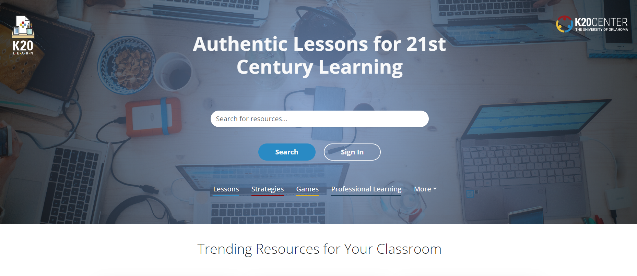
Curriculum on K20 LEARN

Slide 29
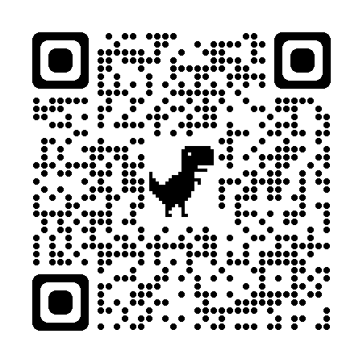
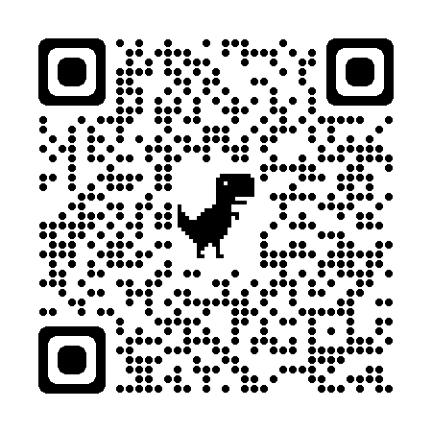
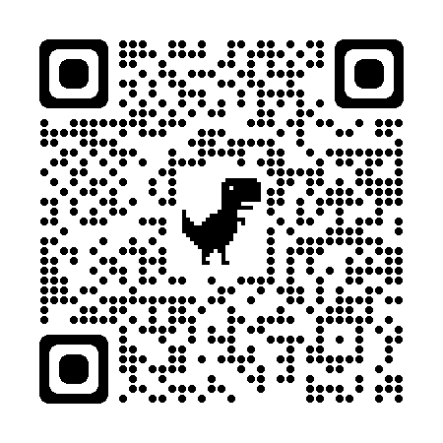
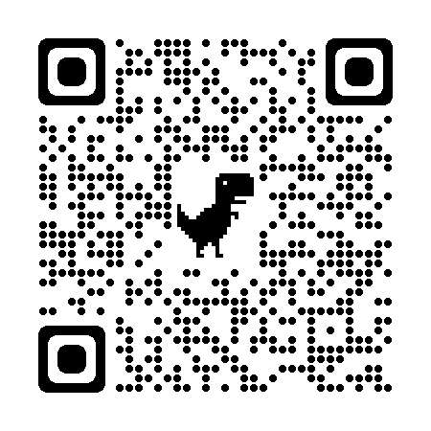
Find Your ACT Activities (by Subject)
Notes:
English ACT Collection: https://learn.k20center.ou.edu/collection/3094 OR k20.ou.edu/ACTenglish
Math ACT Collection: https://learn.k20center.ou.edu/collection/3212 OR k20.ou.edu/ACTmath
Reading ACT Collection:https://learn.k20center.ou.edu/collection/3214 OR k20.ou.edu/ACTreading
Science ACT Collection: https://learn.k20center.ou.edu/collection/3213 OR k20.ou.edu/ACTscience

Slide 30
What, So What, Now What
What does authentic ACT prep look like?
So What? Why is it important to prepare students to take the ACT?
Now, what will you do to support students in preparing for the ACT?
Notes:
K20 Center. (n.d.) What, So What, Now What. Strategies. https://learn.k20center.ou.edu/strategy/95

Slide 31
LEARN Strategy Reflection
Always, Sometimes, Never True
Fist to Five
Categorical Highlighting
How are you feeling? What are you thinking?
Scavenger Hunt Notes
What? So What? Now What?

Slide 32
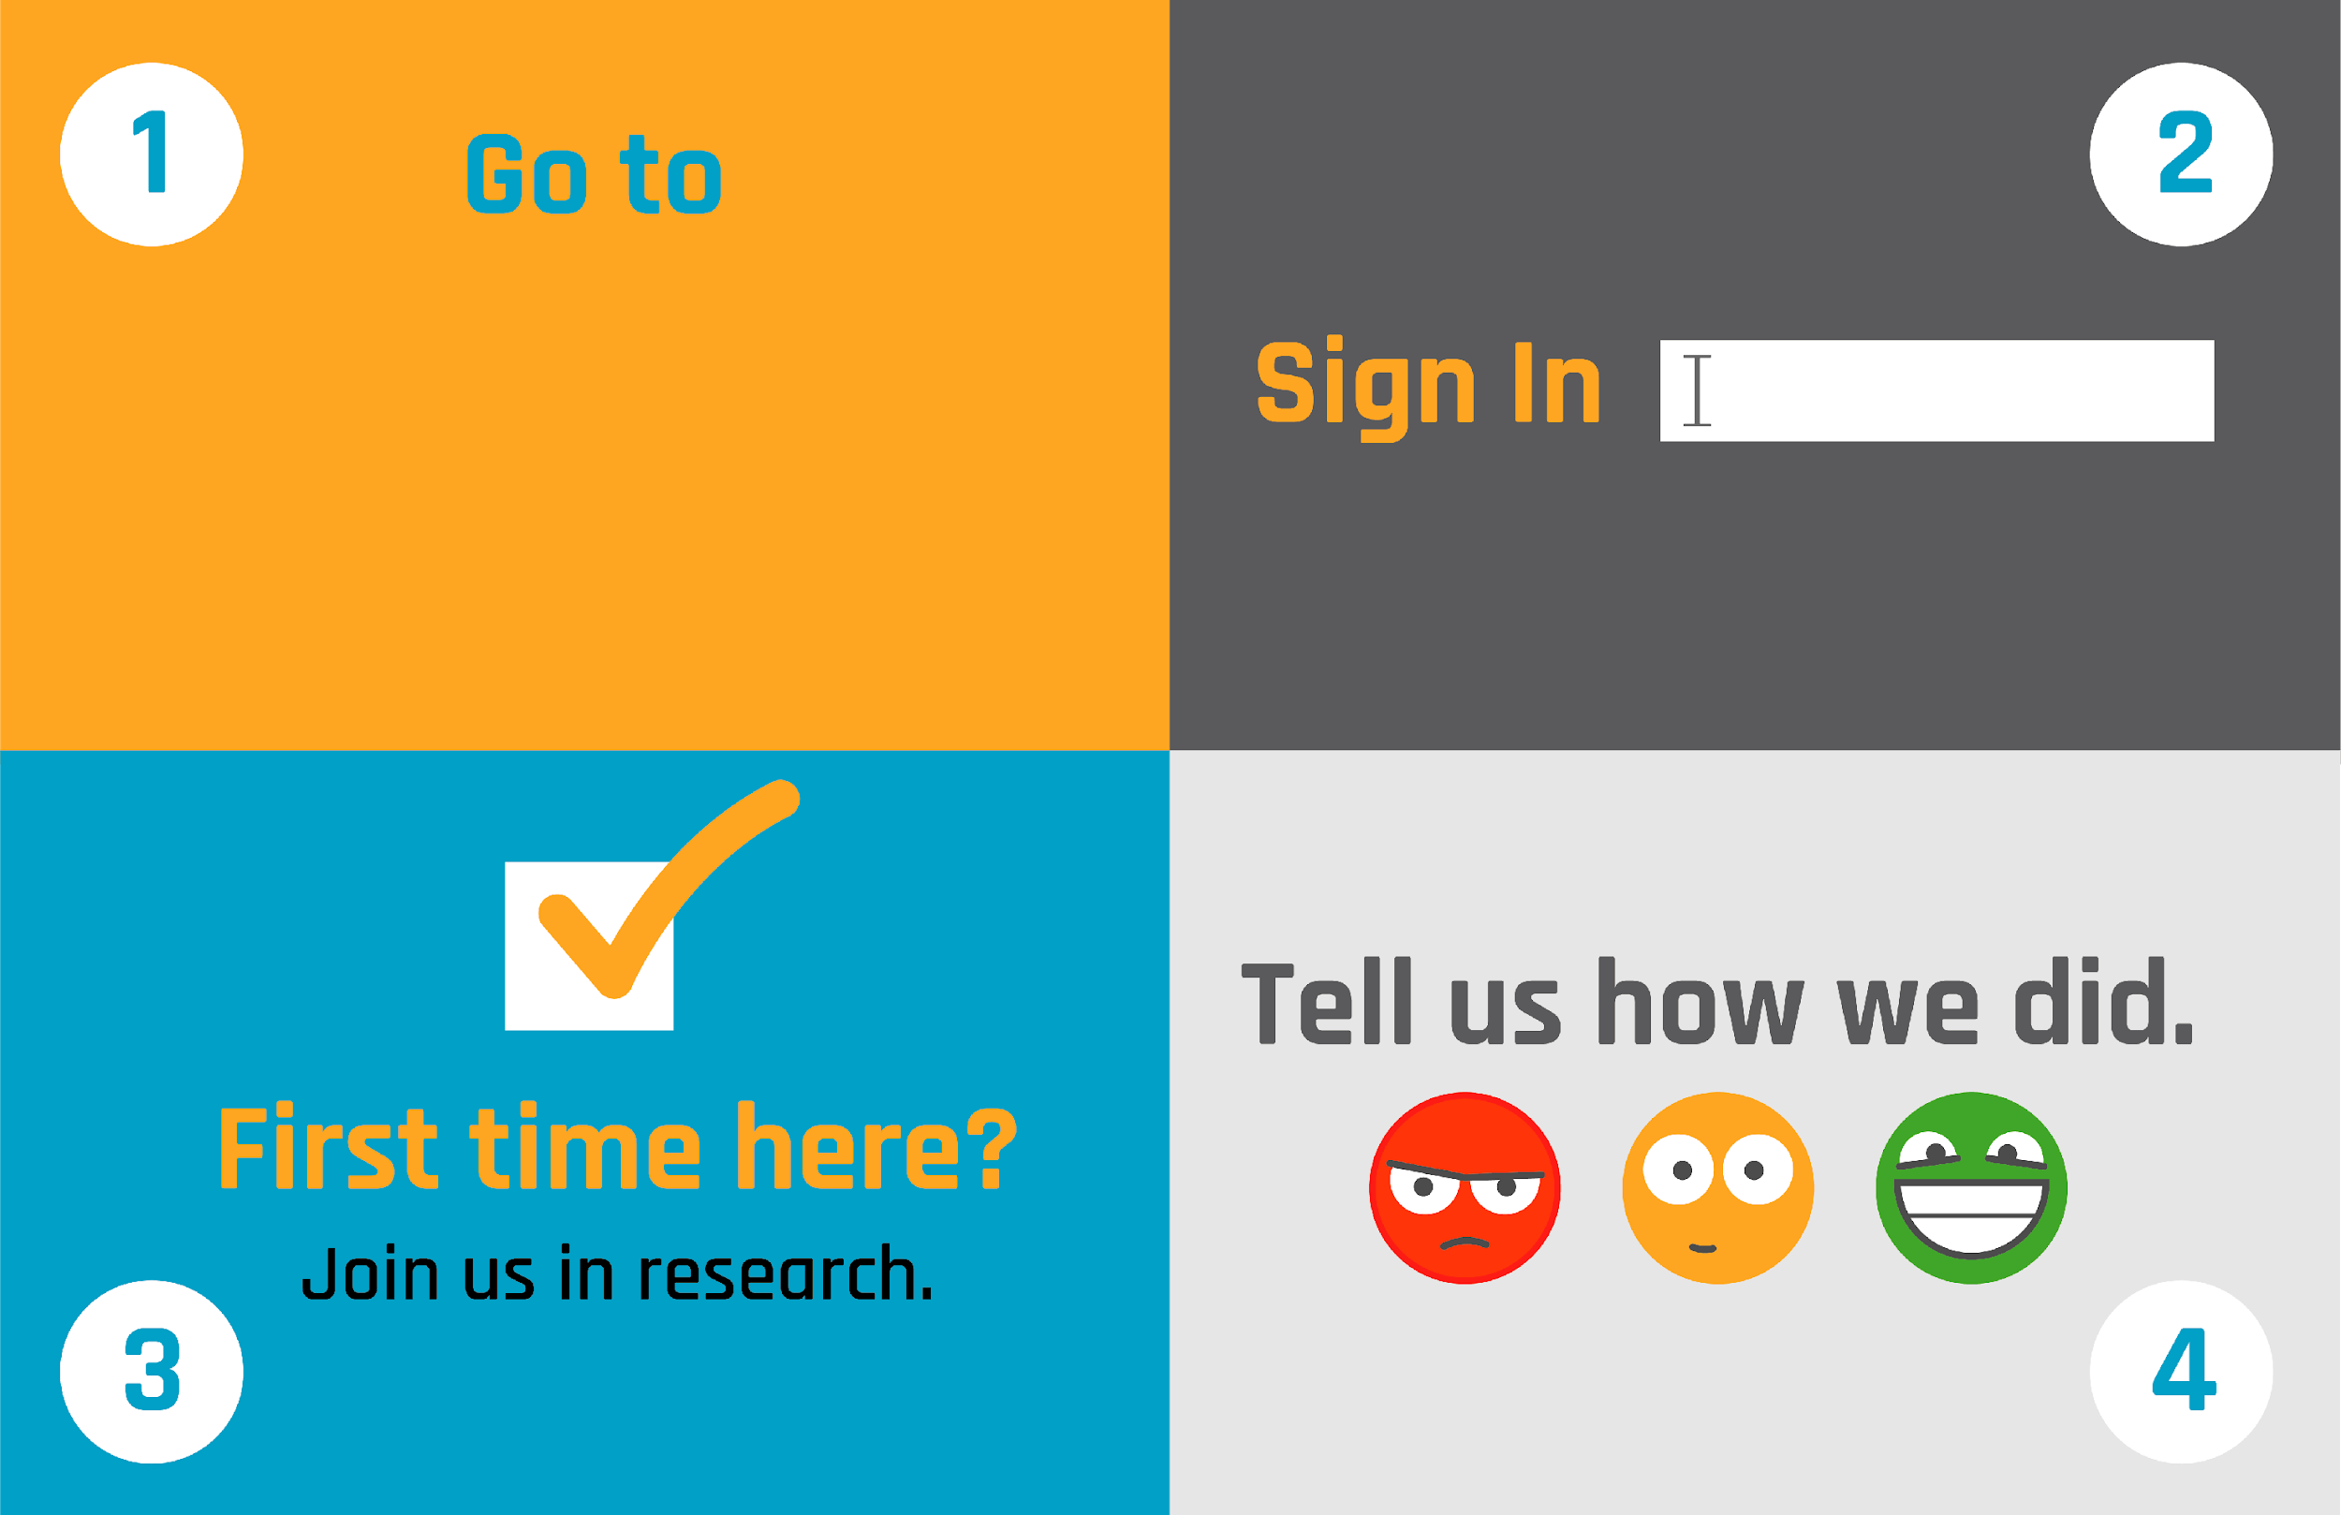
School email
(No Participant ID is required.)
Notes:
***This slide MUST be edited with the correct TREK web address.***
Click on the link in the orange box to edit the numbers at the end and the QR code.

