Slide 2
GEAR UP for LIFE Staff Overview
Notes:
Add presenters’ names and titles

Slide 3
Snap, Clap, Pop
If… Stand up and...
You’ve attended a K20 event or PD before…
You think quality PD should model strategies…
You teach social studies or ELA…
You teach science or math…
You teach another subject…
You think learning should be engaging and relevant…
You were a first-generation college student…
You participated in GEAR UP as a student…
You’ve participated in GEAR UP in another capacity…
You KNOW Bigfoot is real…
Give a wave!
Say, “Here, here!”
Pose like you’re writing an essay or story.
Pose like you’re pondering on a problem.
Act out your subject.
Say, “I do!”
Say, “Cheers!”
Clap your hands.
Shout out your position.
Do your best holler!
Notes:
K20 Center. (n.d.). Snap, clap, pop. Strategies. https://learn.k20center.ou.edu/strategy/190

Slide 4
Objectives
Identify characteristics and generate questions about K20 and its research-based professional development approaches.
Identify characteristics and generate questions about goals, benefits, and expectations of participation in the GEAR UP for LIFE grant.
Apply your understanding of the benefits of going to college to create an image depicting the effects that going to college could have on an individual student that you know.
Learn about upcoming grant events you can sign up for.
Notes:
///
Choose and sign up for more information on the following K20 events: Counselor Academy, ADEPT, OETT, and Leadership.

Slide 5
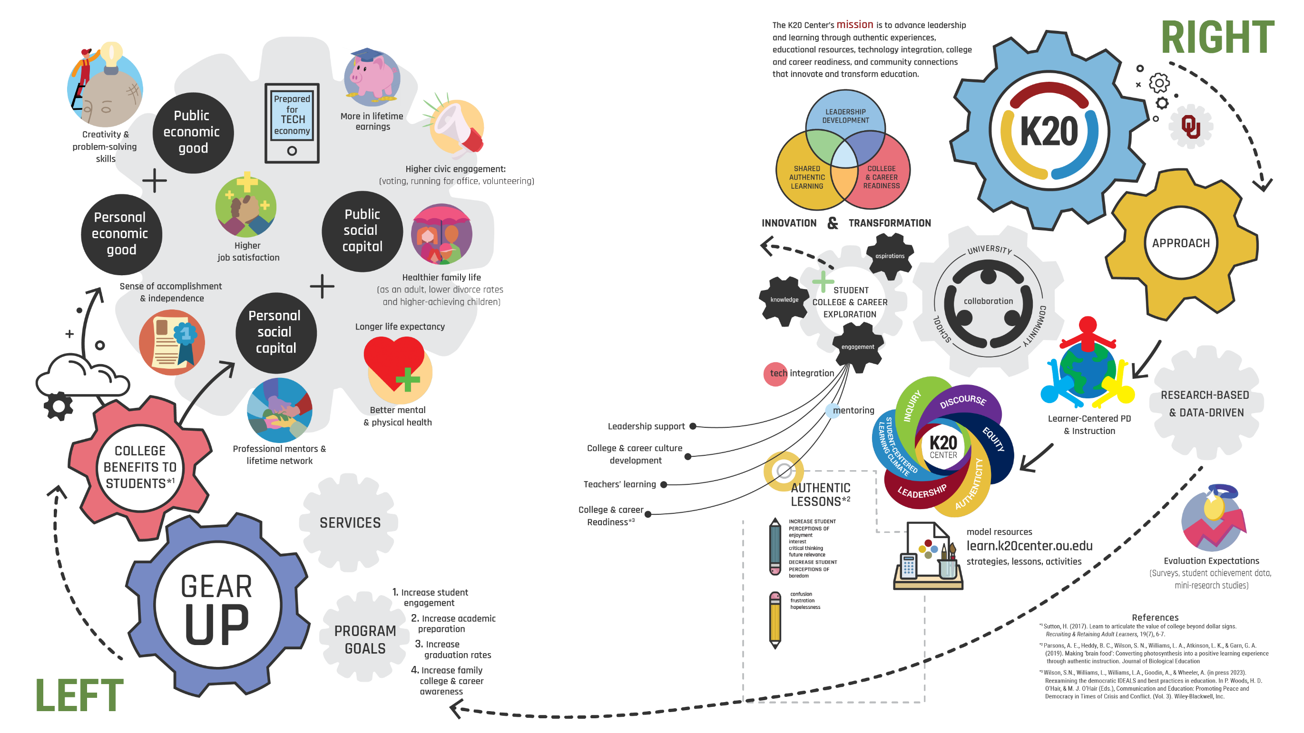
I Notice, I Wonder
Notes:
K20 Center. (n.d.). I notice, I wonder. Strategies. https://learn.k20center.ou.edu/strategy/180
3-minute timer: timer.k20center.ou.edu/3m
K20 Center. (n.d.). Timer. https://timer.k20center.ou.edu/3m

Slide 6
I Notice, I Wonder
As a group:
Choose ONE notice and ONE wonder statement.
Write each statement on a different colored sticky note.
I Notice – Yellow
I Wonder – Blue
Place each sticky note on the larger poster in your assigned area.
Notes:
K20 Center. (n.d.). I notice, I wonder. Strategies. https://learn.k20center.ou.edu/strategy/180

Slide 7
What did you notice and wonder about…
The K20 Center?

Slide 8
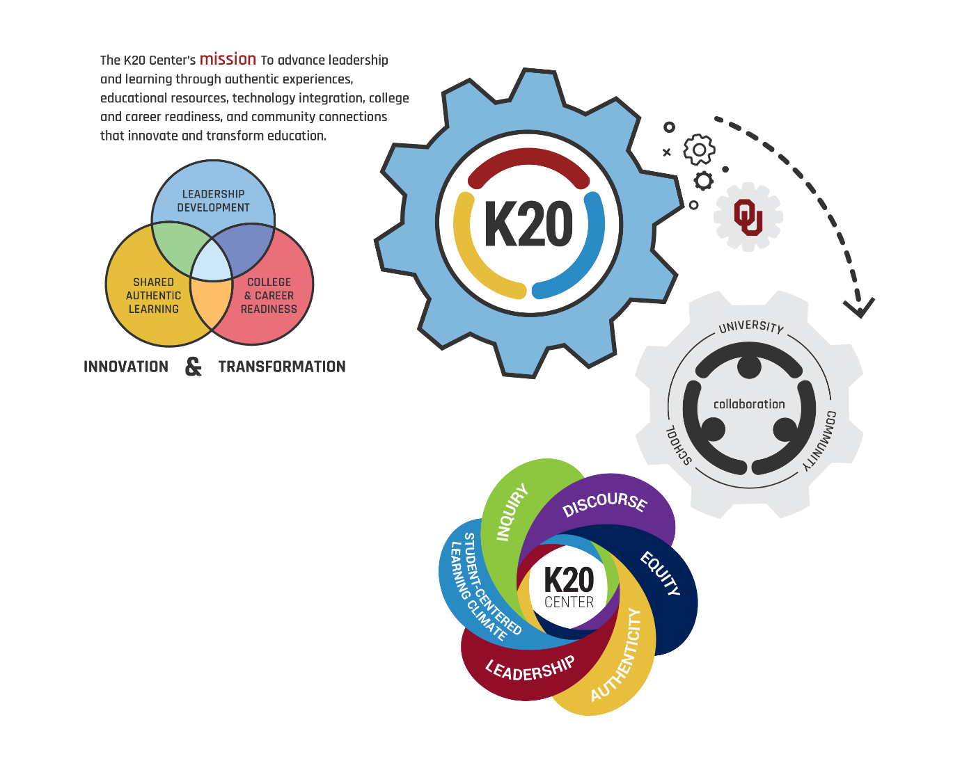
K20 Center
Statewide education research and development center
Provides professional development to educators across the state

Slide 9
What did you notice and wonder about…
GEAR UP for LIFE?

Slide 10
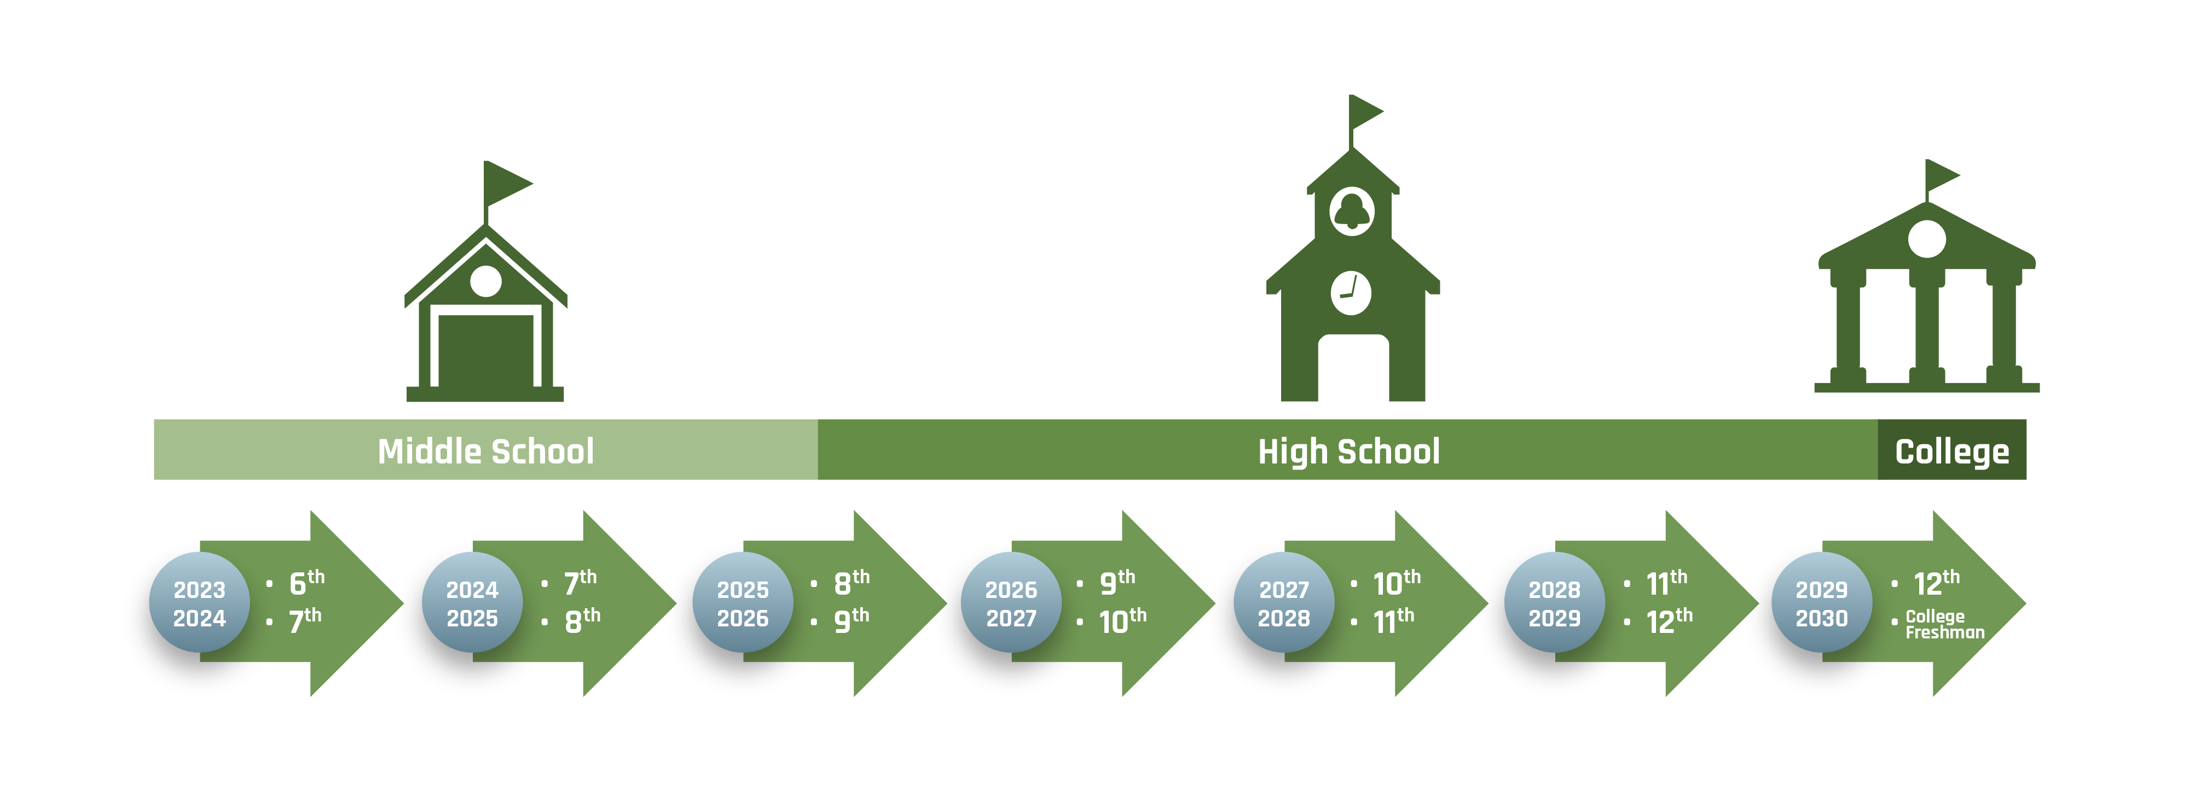
GEAR UP Model: Gaining Early Awareness and Readiness for Undergraduate Programs

Slide 12
What did you notice and wonder about…
College benefits to students?

Slide 13
College Benefits to Students
Sutton, H. (2017). Learn to articulate the value of college beyond dollar signs. Recruiting & Retaining Adult Learners, 19(7), 6-7.

Slide 14
What did you notice and wonder about…
Research-based approaches?

Slide 15
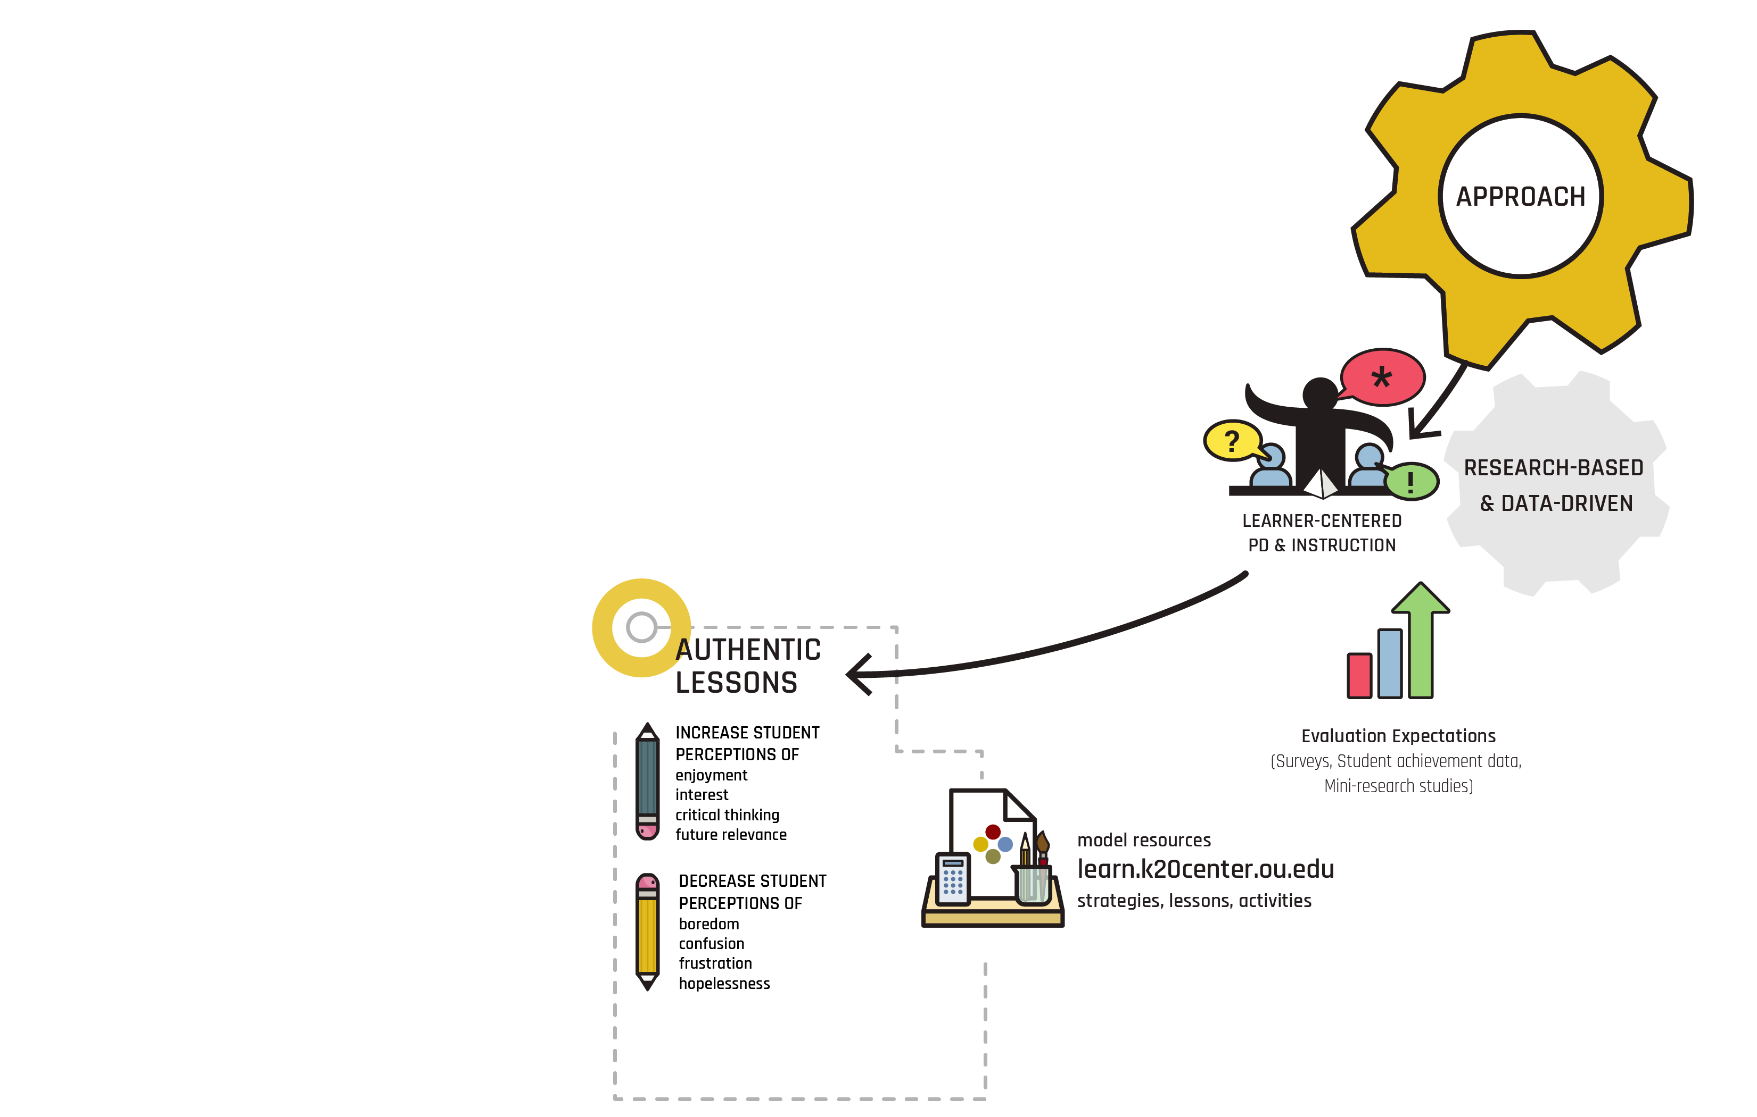
Research-Based Approaches

Slide 16
3-2-1
Record 3 student benefits of postsecondary opportunities or college.
Identify 2 benefits LIFE will have for my school.
Think of 1 student or group of students you envision this grant affecting (write a pseudonym or description).
Notes:
K20 Center. (n.d.). 3-2-1. Strategies. https://learn.k20center.ou.edu/strategy/117
5-minute timer: timer.k20center.ou.edu/tm
K20 Center. (n.d.). Timer. https://timer.k20center.ou.edu/5m

Slide 17
GEAR UP Overview
Notes:
K20 Center. (n.d.). GEAR UP overview. [Video]. https://www.youtube.com/watch?v=MaDO99ncRrk

Slide 18
Your ONE Student
Again, picture that ONE student (or group of students).
While you listen to this story think deeply about…
How will this partnership make a difference for your student(s)?
What does that difference look like in your mind’s eye?
Notes:
*

Slide 19
Who do you envision?
What will the effects of this partnership look like for your student(s)?
Notes:
5-minute timer: timer.k20center.ou.edu/tm
K20 Center. (n.d.). Timer. https://timer.k20center.ou.edu/5m

Slide 20
ADEPT Live
(Authenticity and Discourse for Engagement using Pedagogy and Technology)
Two teacher leaders from each school will be selected.
Work quarterly with an instructional coach.
Attend an in-person summer institute.
Receive an honorarium for their participation.
Mark your calendar for the week of July 8th!

Slide 21
Counselor Academy
Counselor Academy aims to equip counselors with skills to build partnerships, provide valuable information, and facilitate college readiness for students and families.
Mark your calendars for the week of June 17th!

Slide 22
The mission of the Oklahoma Educational Technology Trust is to equip Oklahoma school and CareerTech students with the technology and skills necessary to compete in the global marketplace. The Trust provides up to $40,000 for computer and telecommunications equipment, infrastructure, leadership, and professional development to implement and advance integration of technology into classroom instruction.
Grant cycle begins early November and continues through early February.

Slide 23
OETT/OK-ACTS Phase 1: Leadership
The first step to an OETT Grant is for administrators to attend Phase 1: Leadership.
Date(s) | Return Date
January 31–February 1, 2024 | February 28, 2024
March 6–7, 2024 | June 11, 2024
k20center.ou.edu/leadershipreg/

Slide 24
Interested?
Sign up to receive more information:
k20.ou.edu/lifeevents

Slide 25
LEARN Strategies
Fill in the Instructional Strategy Note Sheet in the back of your booklet.
Snap, Clap, Pop
I Notice, I Wonder
3-2-1
Cognitive Comics

Slide 26
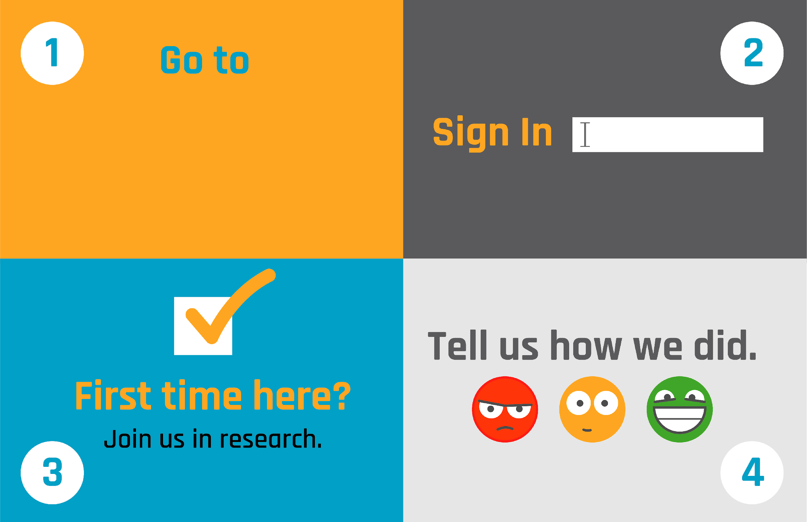
School email
(No Participant ID is required.)

