Slide 3
Essential Question
How can I support students applying to college?

Slide 4
Lesson Objectives
Understand the variety of resources available in the CAN DO kit.
Brainstorm an implementation plan of college application support in your school.

Slide 5
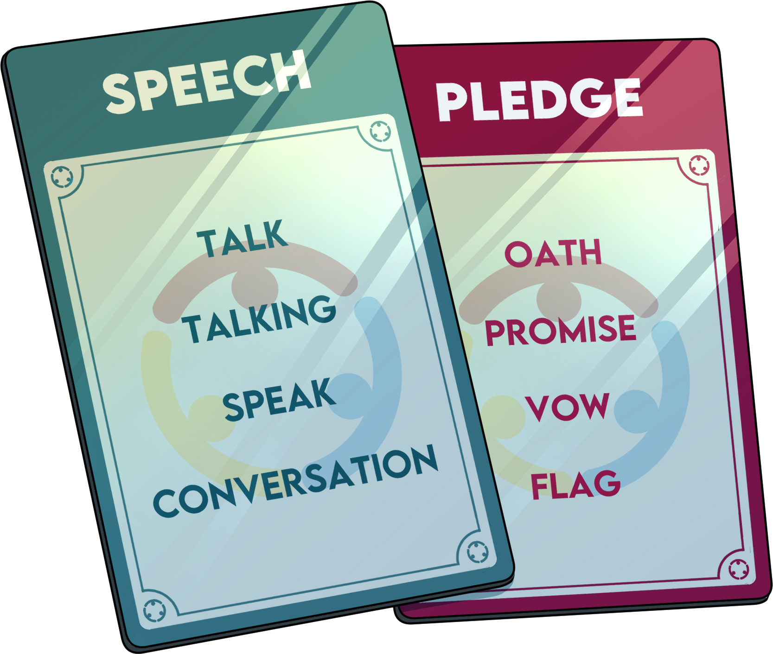
Forbidden Phrases
In this activity, participants partner up to guess the words. One person is the guesser and one person is the clue giver.
The clue giver cannot say the clue or the words listed on the card.

Slide 6
Forbidden Phrases
Activity timer: timer.k20center.ou.edu/6m00s

Slide 7
Double Sticky Bars
Use the number line to answer both questions.
1 = strongly disagree
8 = strongly agree
Answer the first question by placing your sticky note above the number line.
Answer the second question by placing your sticky note below the number line.
1-2-3-4-5-6-7-8

Slide 8
Double Sticky Bars
Answer above the line: I am prepared to help students apply to college.
Answer below the line:
Students have dedicated time at school to apply to college.
1-2-3-4-5-6-7-8

Slide 9
College Application Reflection
Reflect on your college application experience
How much help did you have?
What aspects of applying to college were difficult for you?

Slide 10
Jigsaw
In groups of four, have each participant take a handout.
Read through your handout and think of how you might use this with a student.
Also consider any questions you have about the handout.

Slide 11
I Notice, I Wonder
On a sticky note, write one thing that you found interesting about the handout.
On a different sticky note, write one question you had about the handout.

Slide 12
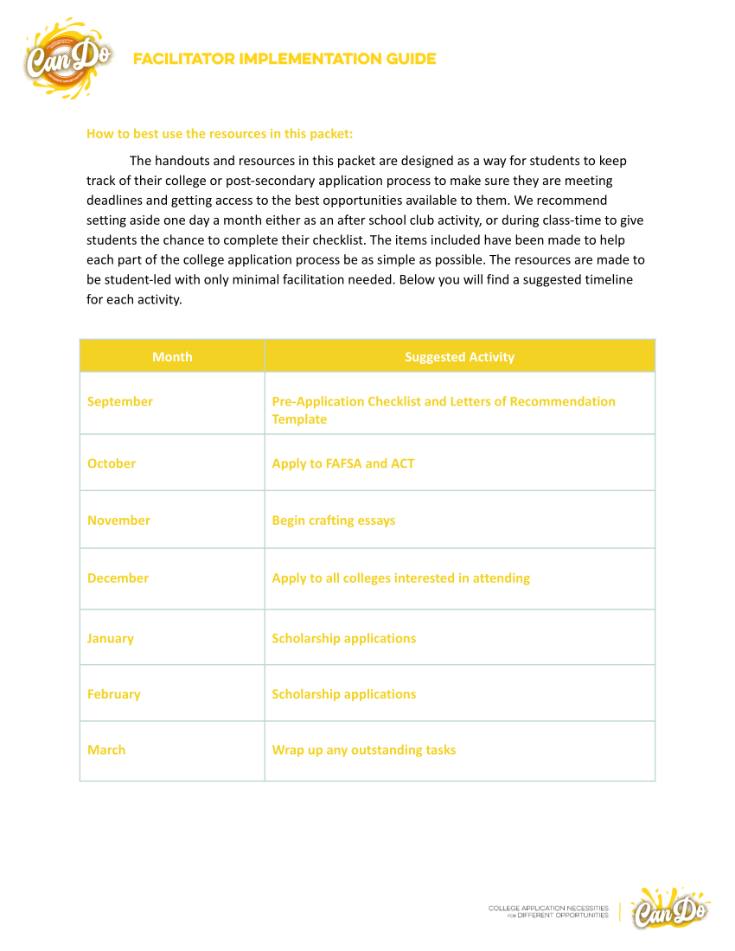
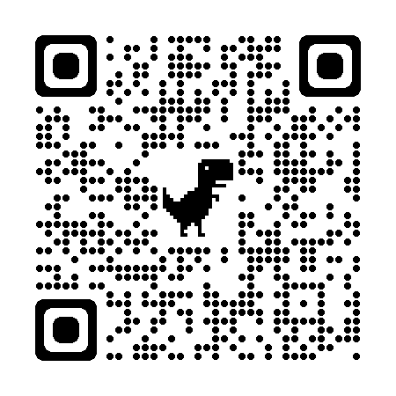
Facilitator Implementation Guide
The Facilitator Implementation Guide breaks down the sequence of activities.
CAN DO Web Resources

Slide 13
What can CAN DO do for you?
What questions do you have at this time?
What changes do you foresee making to best fit the needs of your students and school?

Slide 14
Mirror, Microscope, Binoculars
This reflection strategy is a way for students to look at their learning through three different lenses: self-reflection, learning reflection, and social/global reflection. This strategy is best used at the end of a unit or activity.

Slide 15
Mirror, Microscope, Binoculars
How has this experience changed my thinking?
How can these resources be utilized?
What can be done to improve our school’s postsecondary education culture?

Slide 16
Strategy Option 1

Slide 17
Layout Examples
The slides that follow are meant to illustrate the use of various slide layouts available in the LEARN template.

